Slide 1
Pattern Recognition
Final Project Announcement
Lastest update: 2023.05.03 12:00
Notes:
‹#›

Slide 2
Final Project
Deadline: June. 7, Wed. at 23:59
Code assignment (60%)
Participate in a competition and put forth your best effort to achieve a strong performance.
Report (40%)
Include a detailed description of your research process and implementation in the report.
Competition: Link

Slide 3
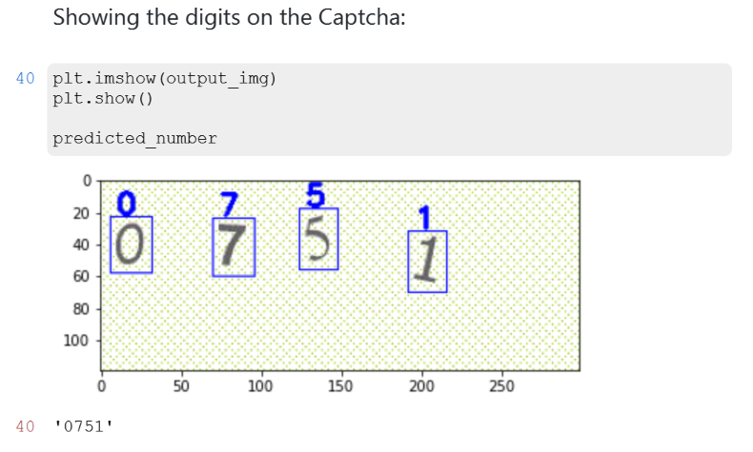
Captcha Recognition
Train a model to predict all the digits in the image.
Task 1: Single character in the image.
Task 2: Two characters in the image (order matters).
Task 3: Four characters in the image (order matters).

Slide 4
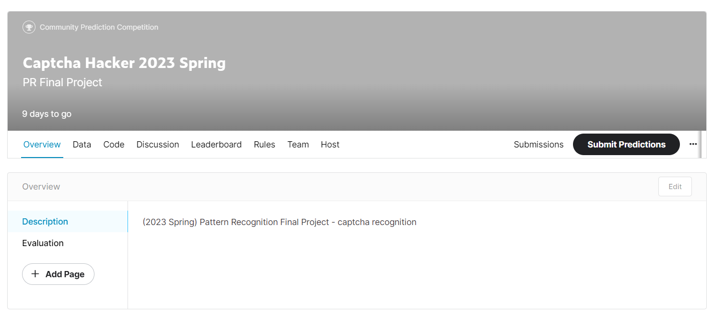
Join the Competition [HERE]

Slide 5
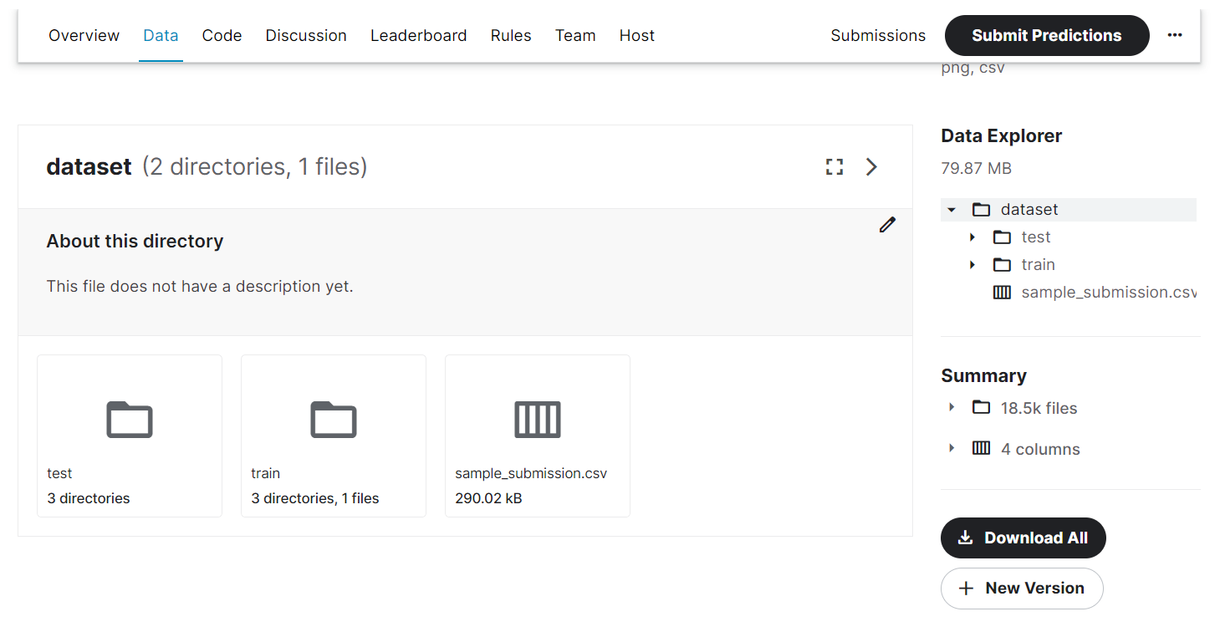
Download the Dataset

Slide 6
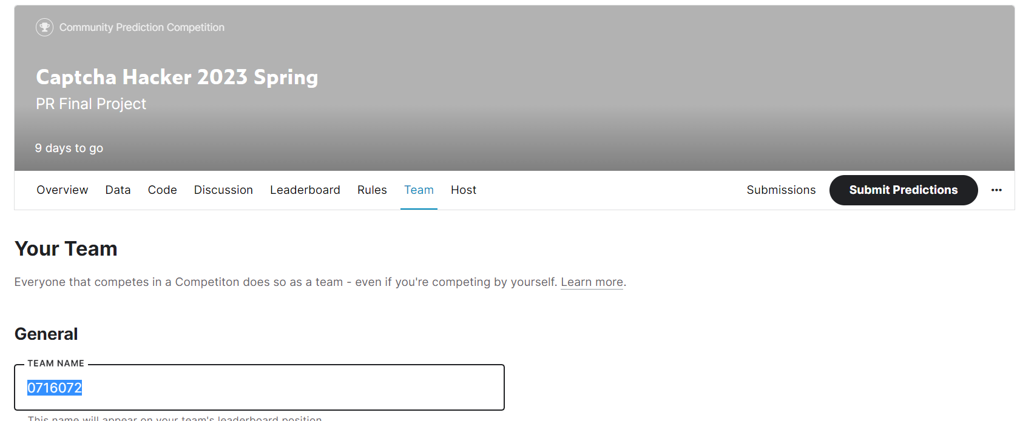
Kaggle Team Name
You MUST set the team name as your Student_ID.

Slide 7
Competition
Can we used the pre-trained weights, e.g., ImageNet?
Pre-trained weights are available. Please indicate their usage in your reports.
How can I get better performance?
Data pre-processing and augmentation.
Hyperparameter searching for model structure and optimizer (learning rate, …).
Find some techniques from SoTA paper in the paper with codes.
Reasonable resources and techniques are permitted for use but you need to state in the report.
If you are unsure whether certain techniques are allowed, please ask in the discussion forum first.

Slide 8
Grading
Report: (40 points)
Performance score (50 points): accuracy on the private set.
Weak Baseline: 60% (30 points)
Strong Baseline: 85% (20 points)
Engage in competition with your peers (10 points):
The final 10 points will be awarded based on how you perform in comparison to your peers.
Partial credit will be given if you are unable to meet the baselines.
score:
0
30
50
60
accuracy:
0
0.6
0.85
Best accuracy
among peers.
Linear
interpolation
Linear
interpolation
Linear
interpolation

Slide 9
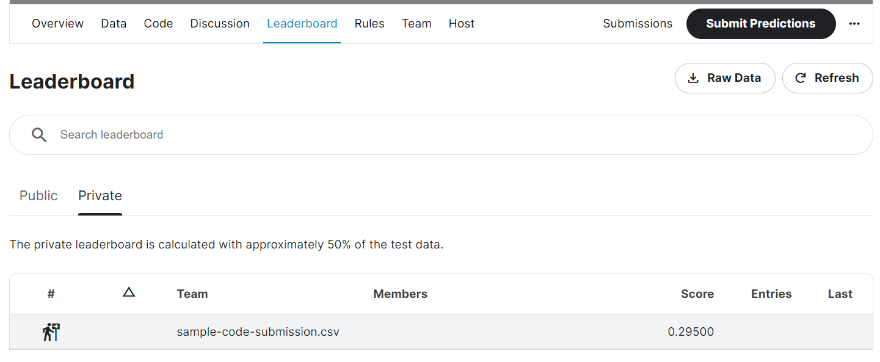
Kaggle Submission (60%)
Take a screenshot of your results on the public leaderboard and paste it on the report.
Your score will be determined by the private leaderboard, but we will verify if your results match.
The maximum number of entries allowed per day is 5.

Slide 10
Report (40%)
Environment details
Python version
… (the more complete, the better)
Implementation details
Model architecture
Hyperparameters
A detailed description of your experimental design, including the methodology and procedures employed in your study.
Compare with different method, ablation study, result analysis, …
… (the more complete, the better)
No environment or implementation details may result in additional penalties.
Note that you must provide a comprehensive and detailed explanation to receive a higher score (35 ~ 40 points).

Slide 11
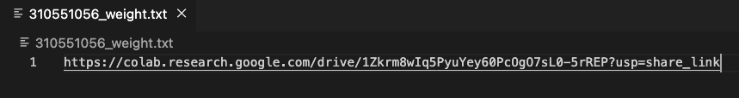
Submission
<STUDENT ID>_final.zip
Training code
Place all of your training code in the ./training/ directory.
Inference code
<STUDENT_ID>_inference.ipynb/.py
Report
<STUDENT_ID>_report.pdf
Model weight
<STUDENT ID>_weight.txt
Provide a Google Drive link to your weights & ensure access permissions are granted.
Environmental setting
If you implement your code using .py files, please also include a requirements.txt file.
For your reference. Provide your model weight’s link here!

Slide 12
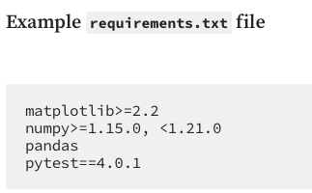
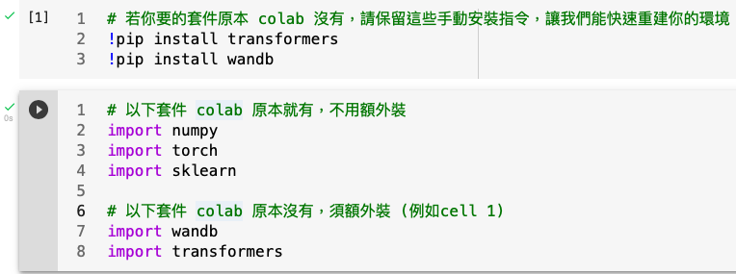
Environment Setup
For python file (.py)
It will be checked in our lab’s servers. (Nvidia 2080Ti, cuda 11.3)
Providing a requirements.txt file can help us quickly rebuild your environment and accurately reproduce your results. (see tutorial)
For jupyter notebook file (.ipynb)
It will be checked in google colab.
Please include the necessary pip install instructions in the first cell.

Slide 13
Test inference.py on our lab’s server.
We will take the following steps to reproduce your result. (You can check it by yourself before submission)
Build the virtual environment (tutorial) via
$ virtualenv -p <python version that you provided in report> myenv $ source ./myenv/bin/activate $ pip install -r requirements.txt
Download the <pre-trained weight that you provided in txt file>
Modify the necessary path in inference code (testing data, model weight, and so on…)
The code should be able to run successfully after modifications (Otherwise, no points will be given)
Check the results we reproduced and the Kaggle leaderboard.

Slide 14
Test inference.ipynb file on google colab
We will take the following steps to reproduce your result. (You can check it by yourself before submission)
Download the <pre-trained weight that you provided in txt file>
Modify the necessary path in inference code (colab mount, testing data, model weight, and so on…)
Restart and run all, the code should be able to run successfully after modifications (Otherwise, no points will be given)
Check the results we reproduced and the Kaggle leaderboard.

Slide 15
Note
Plagiarism
No points will be awarded if any plagiarism is discovered.
Late policy
There is no late submission policy for the final project.
For students who are new to deep learning
You may start with this sample code first

Slide 16
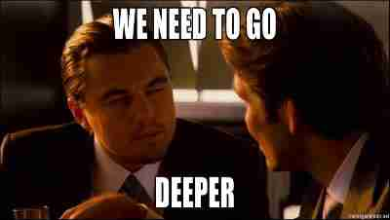
Have fun!

