Slide 1
Introduction to Natural Language Processing
HW2
TA : WEI-LING HSU
weiling.hsu.cs11@nycu.edu.tw

Slide 2
Task introduction
Sentiment analysis with neural network
For example : “This movie is so funny !”
You can use any external package you want, e.g. Pytorch, Keras…
Tips: Use RNN with word embedding and attention to build your model
You can only use RNN or CNN, other advanced model (e.g. BERT) is not allowed in hw2.
Requirement:
1.Submit a report and your source code to E3
2.Upload your submission to Kaggle
model
happy

Slide 3
Dataset
https://drive.google.com/drive/folders/1PD38uQGZwQfIeHIw-t9d2YKcW21KYAPI?usp=share_link
You can get the dataset from the link or E3,
it contains : < train_HW2dataset.csv >
< dev_ HW2dataset.csv >
< test_ HW2dataset.csv >
You can use < train_ HW2dataset > and < dev_ HW2dataset > to tune your model,
then predict the emotion of Utterances in < test_ HW2dataset >

Slide 4
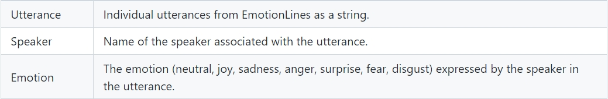
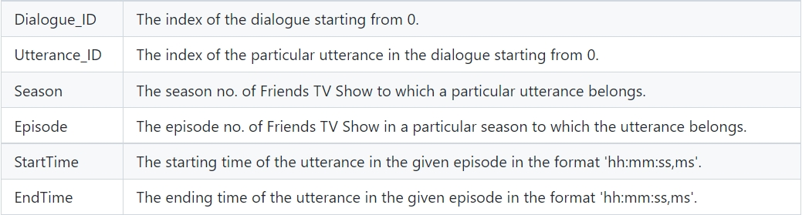
Column Specification

Slide 5
Output
Your model need to predict which type of emotion is for Utterance in < test _HW2dataset.csv >
We have 7 types of emotion at all, please map them into 0~6.
neutral -> 0, anger -> 1, joy -> 2
surprise -> 3, sadness -> 4, disgust -> 5, fear -> 6
For example:
Input Utterance “Good morning, John.”, model output 0.
Input Utterance “This movie is so funny!”, model output 2.

Slide 6
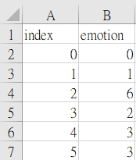
Kaggle submission(50%)
Kaggle link: https://www.kaggle.com/t/964d464205694362a12061ddc60b1e47
Display team name:<student ID>
Submission format:
A 3401 X 2 .csv file, first row is for the column name and the last 3400 rows for your result.
Column name should be index and emotion.
Result should be the index and emotion(0~6),please make sure the order of your result is wright!
There will be two bassline(strong and simple).
I will provide hints about simple baseline on 11/29 14:00.
Get bonus if you achieve the simple baseline before that time.

Slide 7
Kaggle submission(50%)
You can submit at most 5 times each day.
You can choose 2 of the submissions to be considered for the private leaderboard, or will otherwise default to the best public scoring submissions.
The scoring metric will be macro F1, not accuracy!

Slide 8
Report Submission(50%)
Submit a report contains 4 questions:
1. Describe how you build your model ? How did you do to preprocess your data from dataset ? The distribution of the emotion is unbalance, what did you do to improve the accuracy on those emotion which are in small scale?(30%)
2. Have you tried pretrain word embedding?( e.g. Glove or Word2vec).What is the influence of the result after you using them?(30%)
3. Have you tried attention on your model? What is the influence of the result after you using them? Which text your model attention on when it predict the emotion?(30%)
4.Have you used other information form dataset to improve your model performance?(e.g. Speaker) What is the influence of the result after you using them?(10%)
Please answer the questions in detailed!

Slide 9
E3 Submission
- Deadline:
- Submit Zip to E3 before 12/8 11:59PM
- No Late Submission!
- Format:
- Source code : Hw2_<student ID>.py
- Report file : Hw2_<student ID>.pdf
- Zip file : Hw2_<Student ID>.zip

Slide 10
Grading policy
Kaggle(50%):
- Basic score (according to the public leaderboard):
under simple baseline: 40
over simple baseline: 60 *1.2 If you achieve before TAs provide hints(10/25 14:00)
over strong baseline: 80
Ex:
。If you achieve simple baseline after 11/29 but you don’t achieve strong baseline in the end, your basic score will be 60.
。If you achieve simple baseline before 11/29 but you don’t achieve strong baseline in the end, your basic score will be 72.
。If you achieve simple baseline before 11/29 and you achieve strong baseline in the end, your basic score will be 80.
- Ranking score (according to the private leaderboard) :
score= 20-(20/N)*(ranking-1), N=number of people
Source code and Report(50%):
- the more detail you make, the higher score you get

Slide 11
Timeline
TA provide hints
Deadline
Hw2 release
11/29
14:00
12/8
23:59
11/10
Simple baseline score: 60*1.2=72
Strong baseline score: 80
Simple baseline score: 60
Strong baseline score: 80
If you have any question about HW2, please feel free to contact with TA: WEI-LING HSU,
through email weiling.hsu.cs11@nycu.edu.tw

