Slide 2
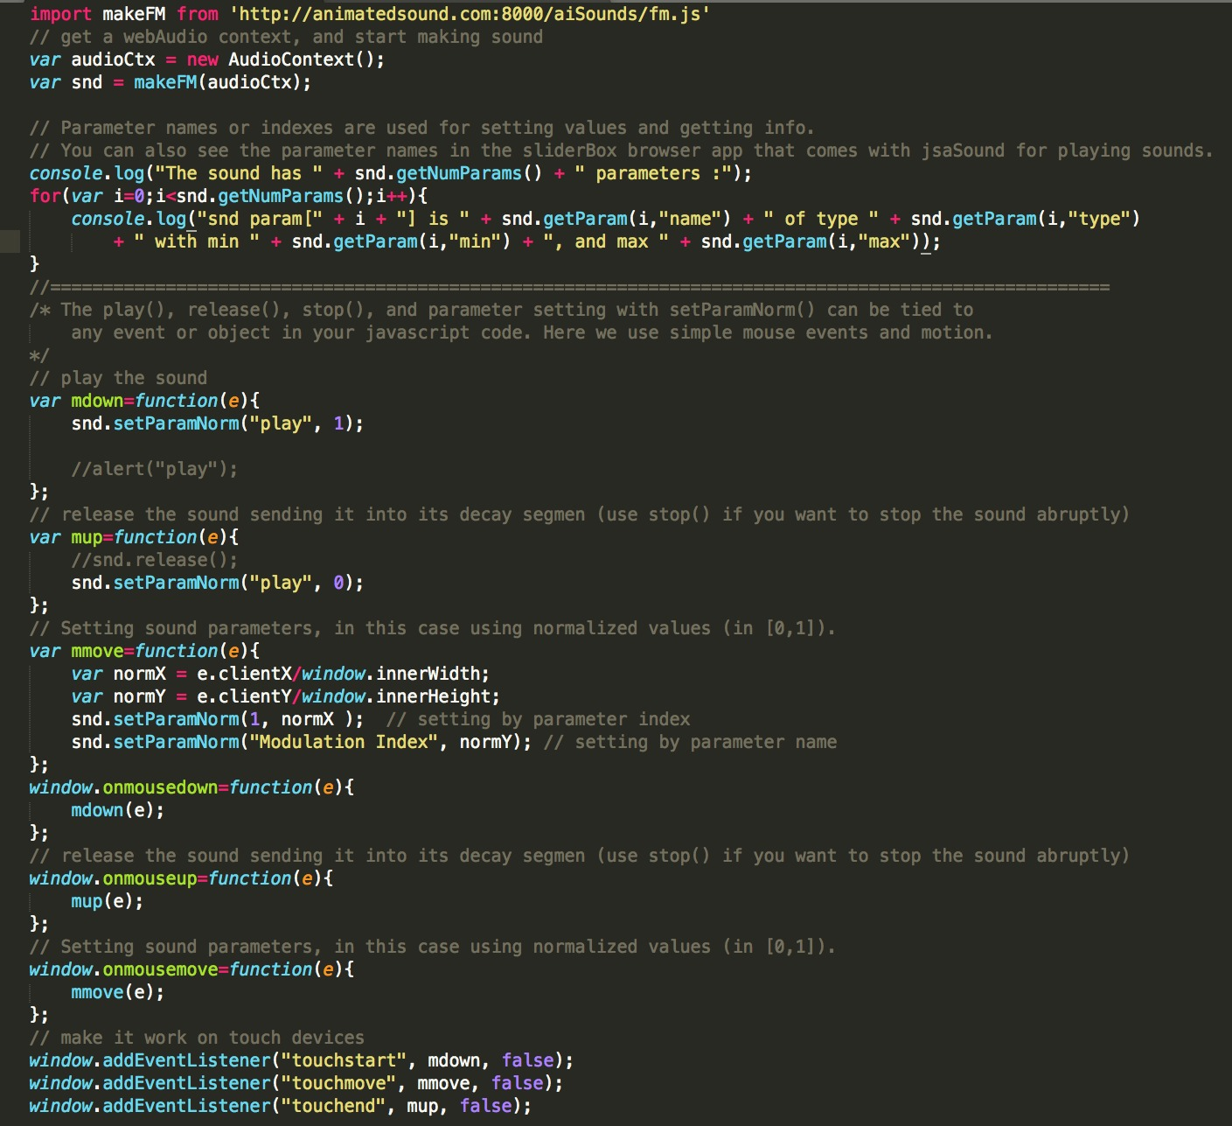
Sound factory
create the sound
Optional info
play
stop
interact

Slide 3
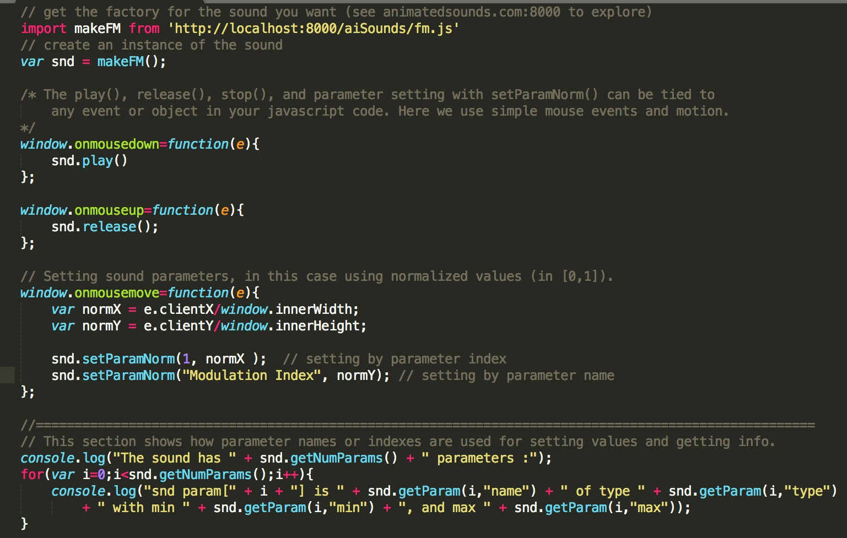
Sound factory
Create
play
stop
interact

