Slide 1
510k Bridge
FDA 510(k) Pathway Management for Medical Device Companies
Pilot Software LLC dba 510k Bridge · Oregon, USA

Slide 2
The Challenge
Why medical device companies need a dedicated 510(k) partner
🏛
Complex Regulation
The FDA 510(k) process involves 17+ review criteria, 100+ guidance documents, and strict timeline requirements.
🌏
Cross-Border Complexity
International companies must navigate US entity formation, FDA registration, US Agent requirements, and labeling compliance.
⏱
Timeline Pressure
Average 510(k) review takes 130+ days. Delays in Pre-Sub, RTA screening, or AI/SI questions can add months.

Slide 3
How It Works
Three steps from first call to FDA clearance
1
2
3
→
→
Schedule a Call
Launch Control Tower
Submit & Clear 510(k)
Free 30-minute consultation to assess your device, predicate strategy, and timeline.
We set up your tri-lingual dashboard, map milestones, and kick off the dual-track plan.
We manage every gate, document, and FDA interaction through to clearance.

Slide 4
Services & Pricing
📊 Control Tower SaaS
From $500/mo
Dedicated dashboard, tri-lingual wizard, dual-track tracking, document control, real-time messaging, risk & budget monitoring.
🏗️ QMS-Lite
$200–500/mo
Lightweight QMS aligned to 21 CFR 820 & ISO 13485. Document control, CAPA, training, supplier qualification.
🔍 Predicate Finder
Included
AI-powered openFDA search for predicate devices, substantial equivalence analysis, comparison reports.
⭐ Professional PM
$10–25K/mo
Dedicated PMP manager, FDA Communications Center, US Agent, gate reviews, regulatory submission oversight.
🏛 Entity Setup Tracker
$1K–5K
Delaware C-Corp, Oregon registration, EIN, bank account, FDA establishment, US Agent compliance.
🚀 Enterprise
Project-based
Full service: regulatory strategy, 17-item RTA self-check, SE flowchart, US entity formation, end-to-end 510(k).

Slide 5
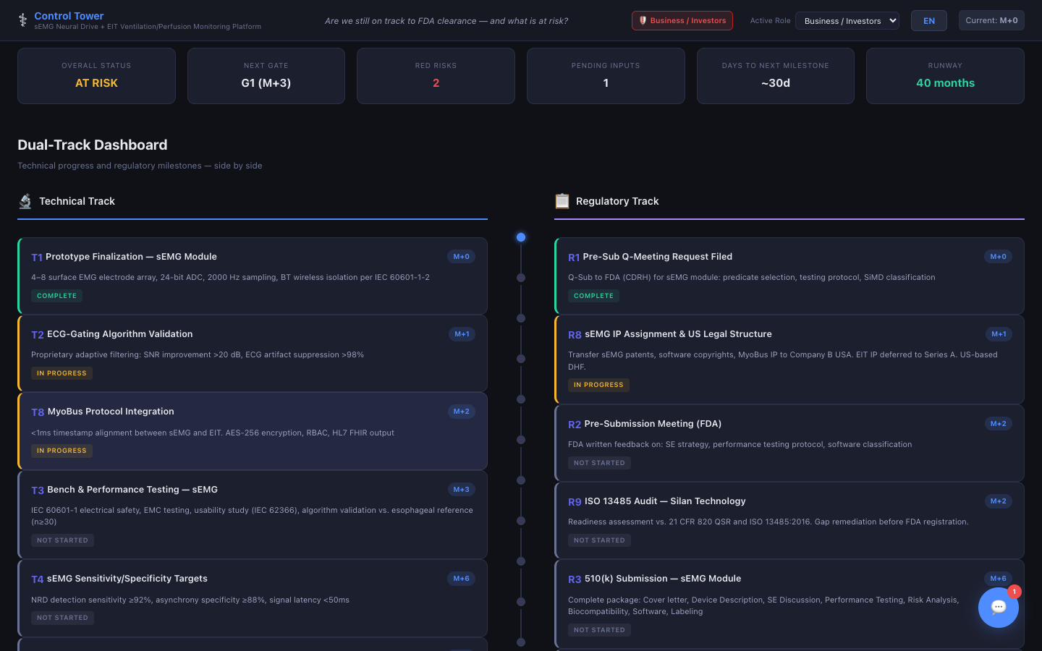
Inside the Control Tower
16-tab dashboard managing every aspect of your FDA journey

Slide 6
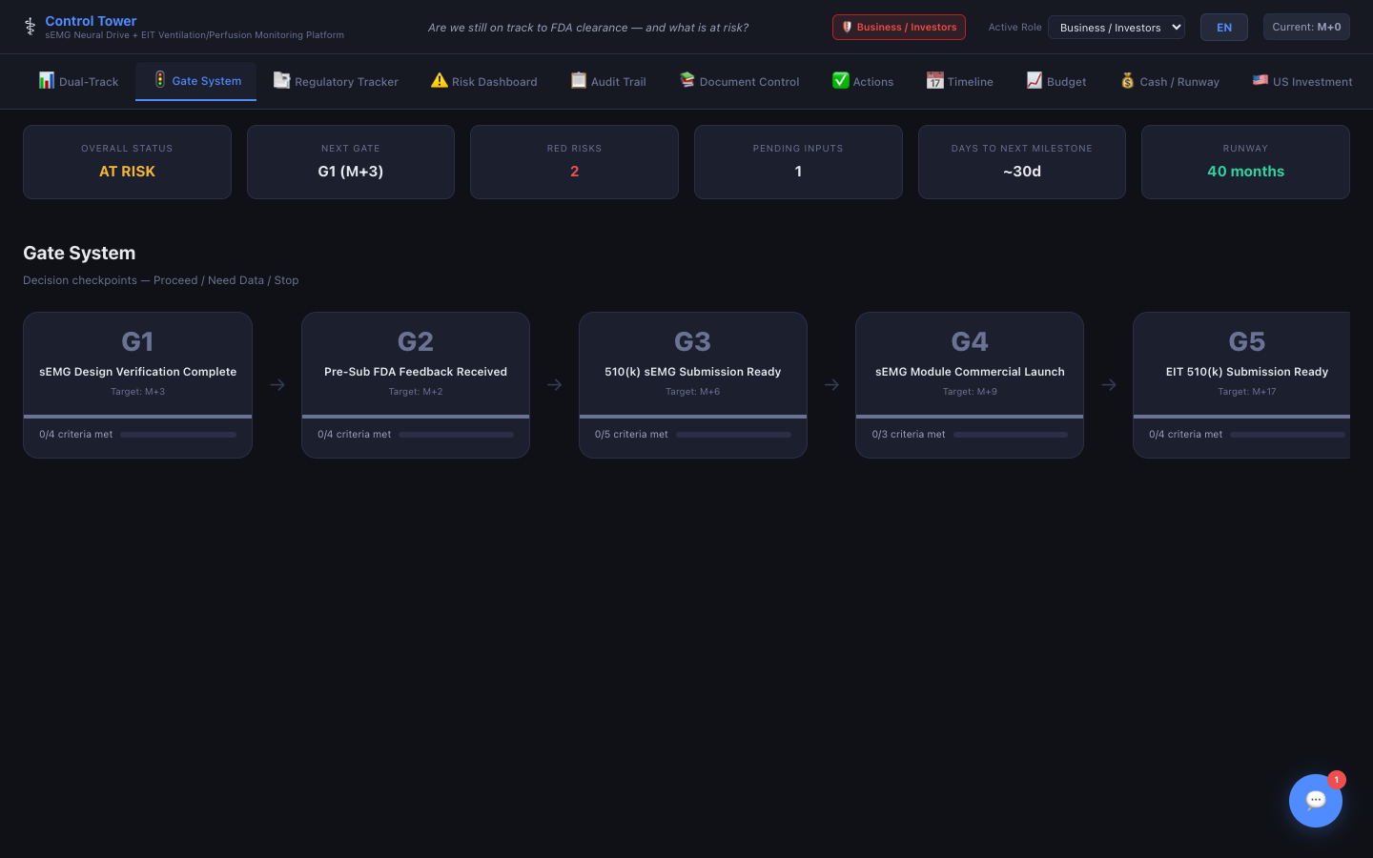
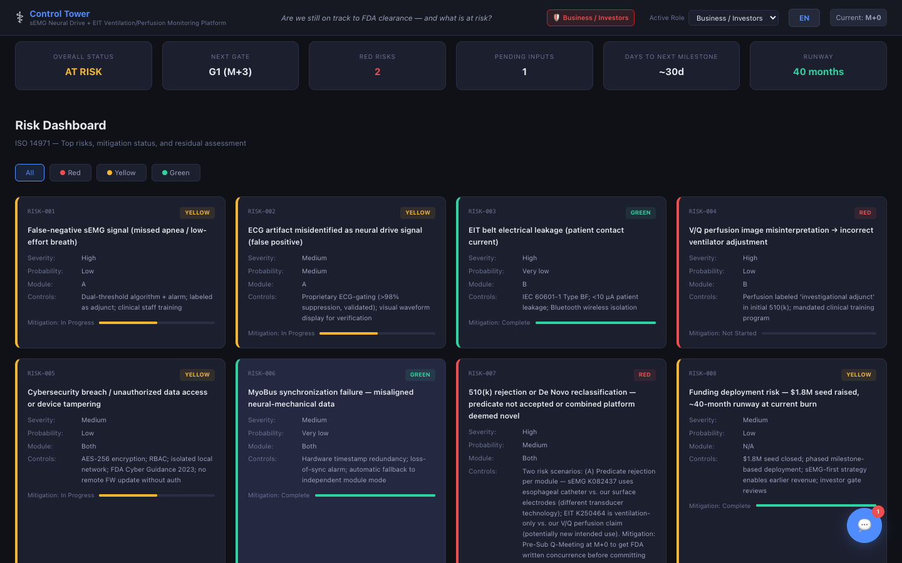
Inside the Control Tower — Core Tracking
Dual-Track Dashboard
Gate System
Risk Dashboard
Technical and regulatory milestones tracked side by side.
Phase-gate reviews with Go/No-Go decisions and stakeholder inputs.
ISO 14971 risk matrix with severity, probability, and color-coded levels.

Slide 7
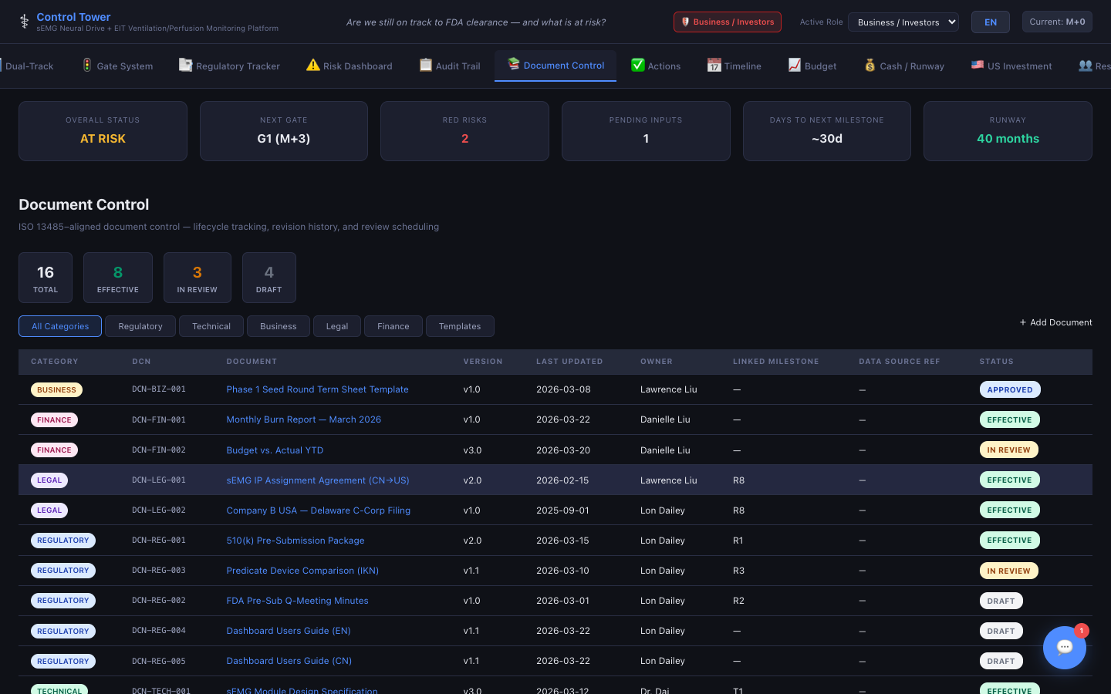
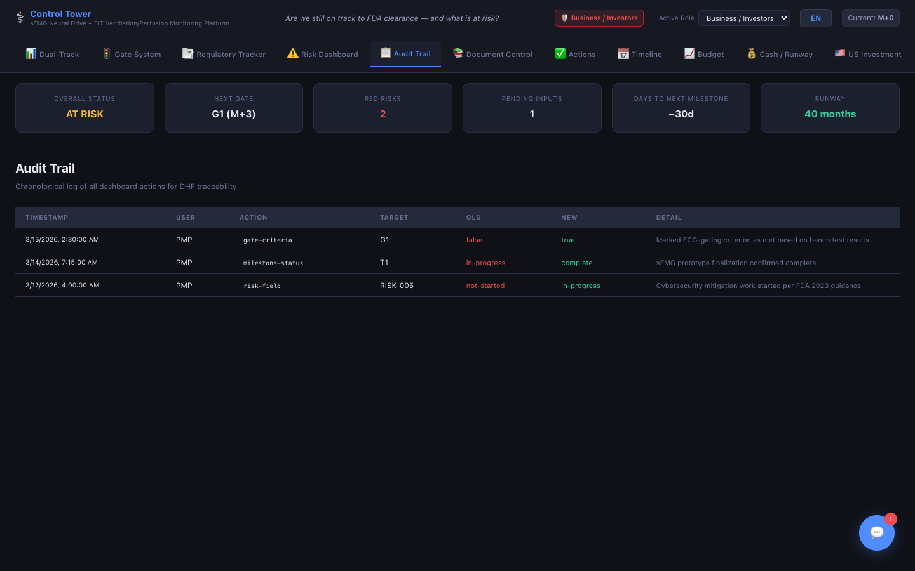
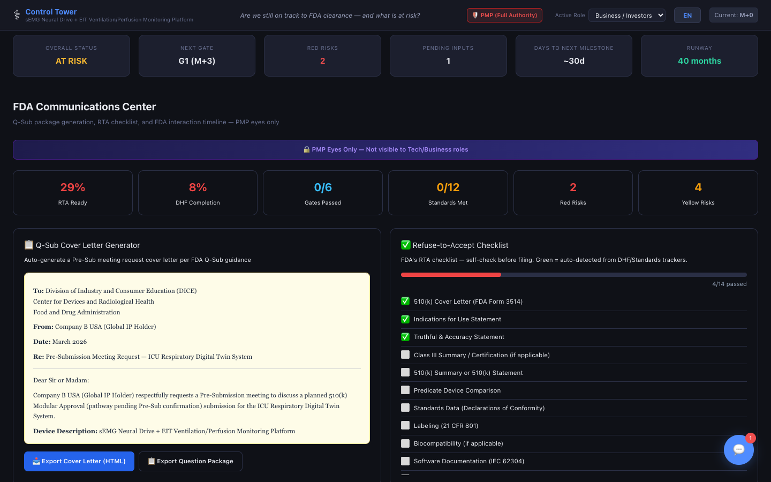
Inside the Control Tower — Documents & Compliance
Document Control
Audit Trail
FDA Communications
ISO 13485-aligned lifecycle tracking with version history and audit trail.
21 CFR Part 11 compliant — every change timestamped with full detail.
Q-Sub cover letters, 17-item RTA self-check, MDUFA timeline, SE flowchart.

Slide 8
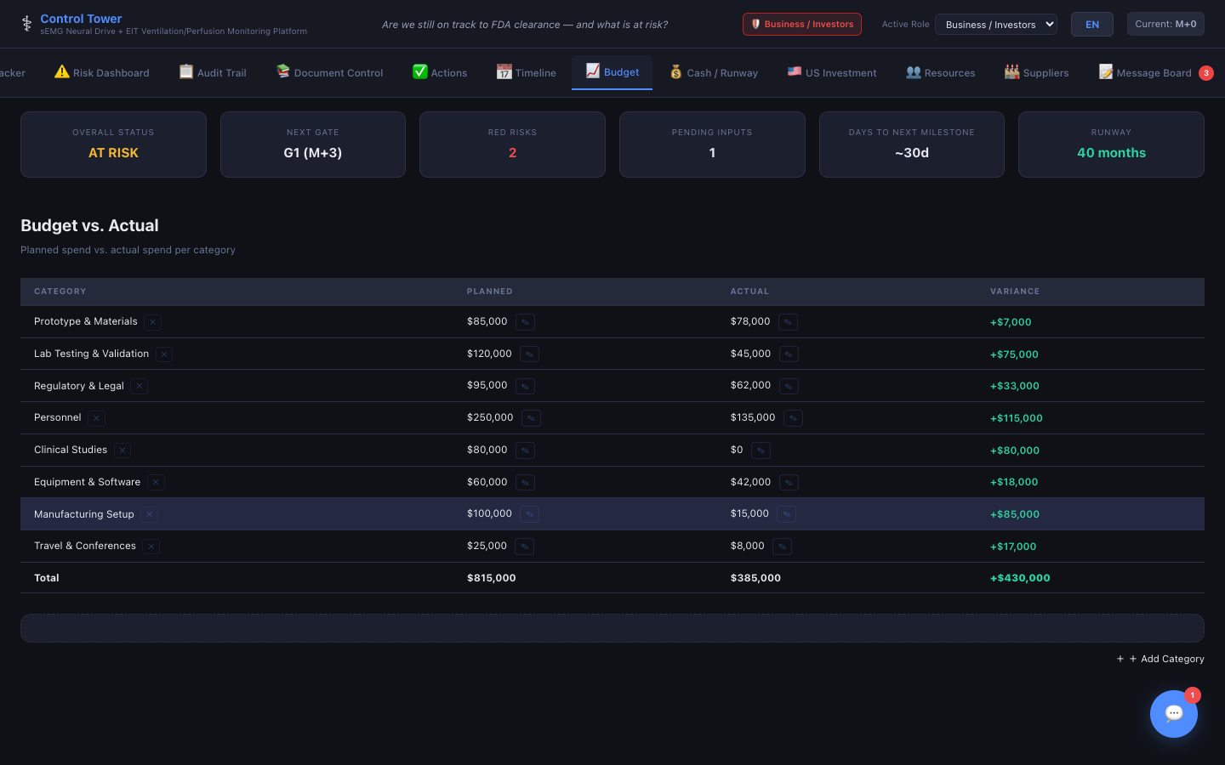
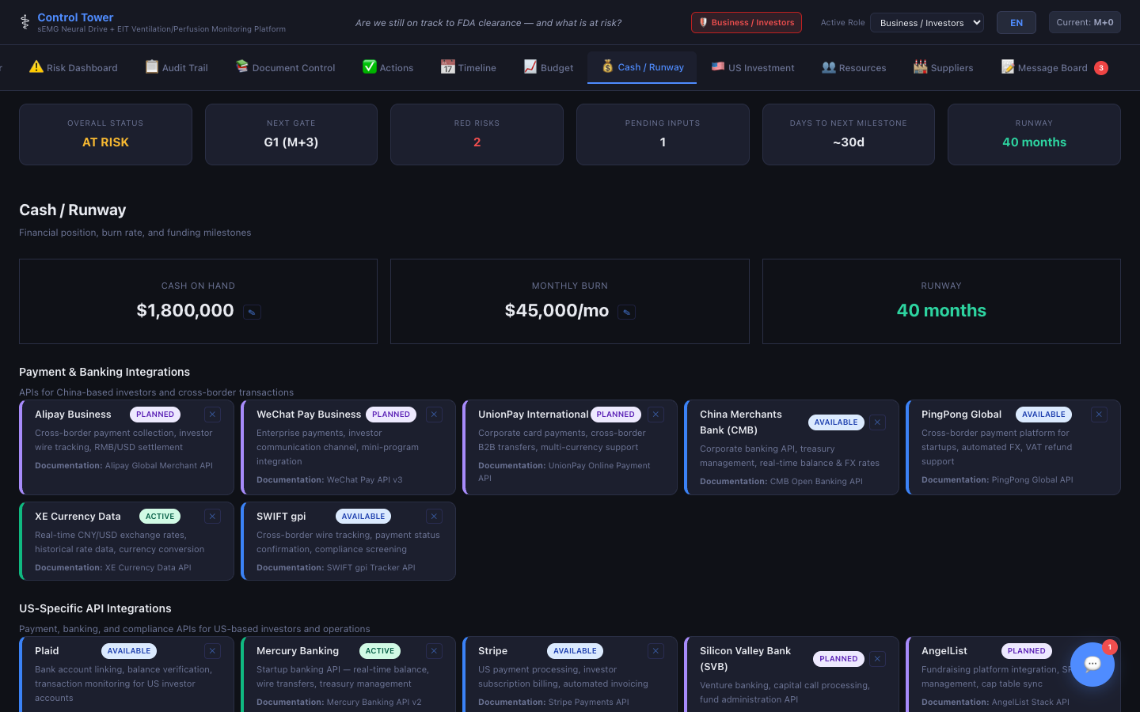
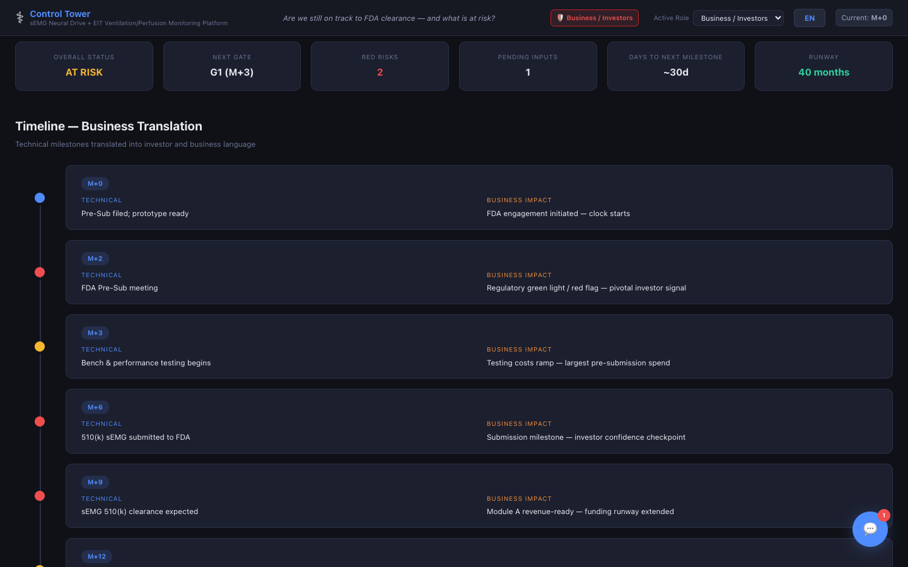
Inside the Control Tower — Operations & Finance
Budget Tracking
Cash / Runway
Timeline
Planned vs. actual spend by category with automatic variance calculation.
Burn rate analysis, runway projections, and funding milestone tracking.
Gantt-style project timeline with milestones and critical path.

Slide 9
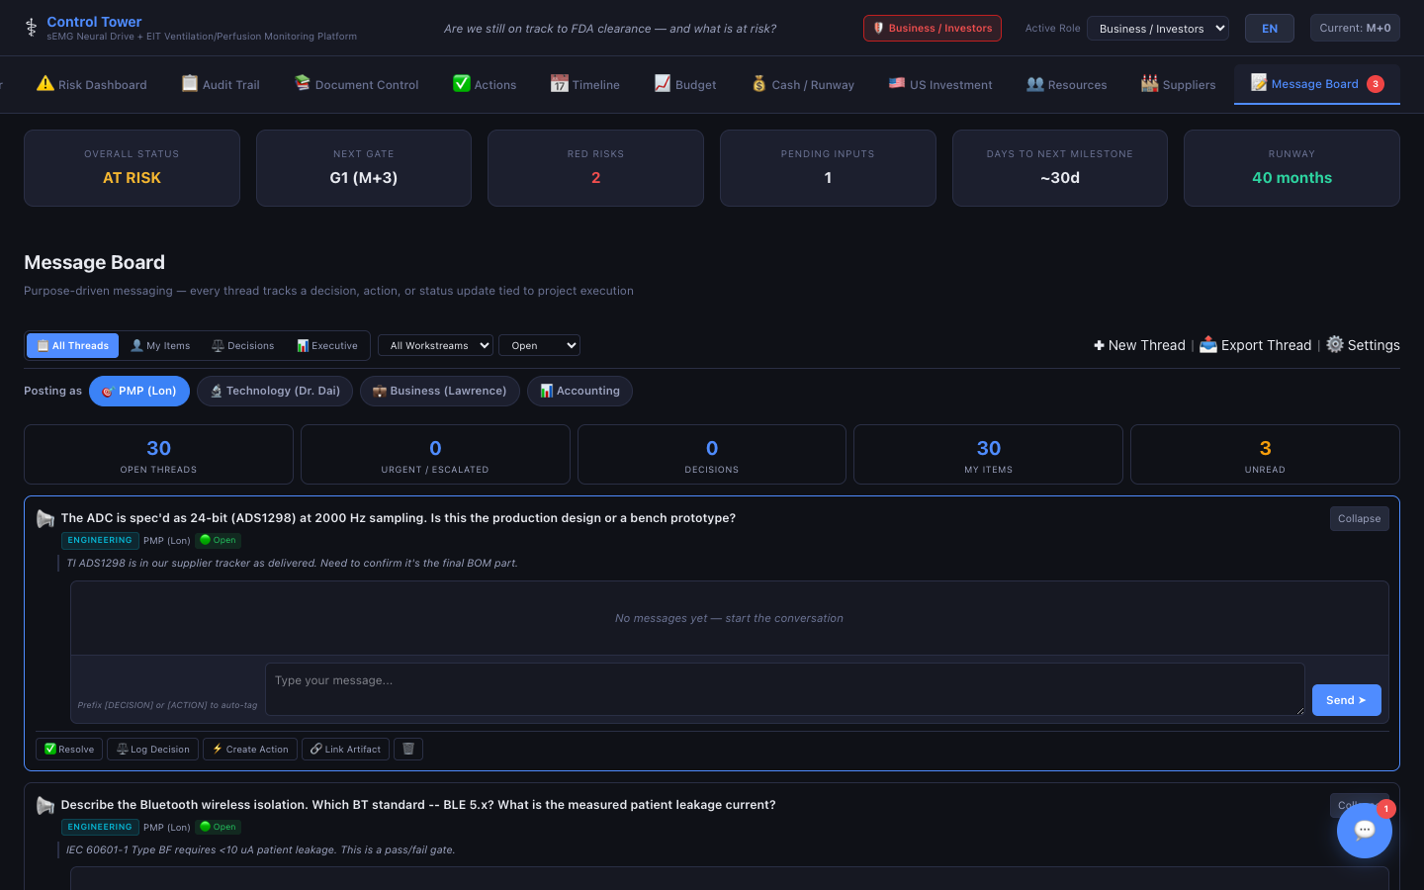
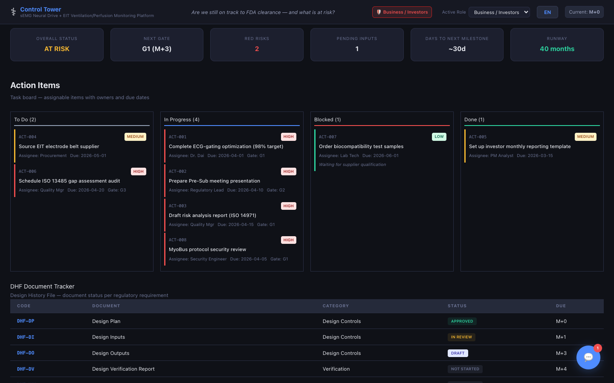
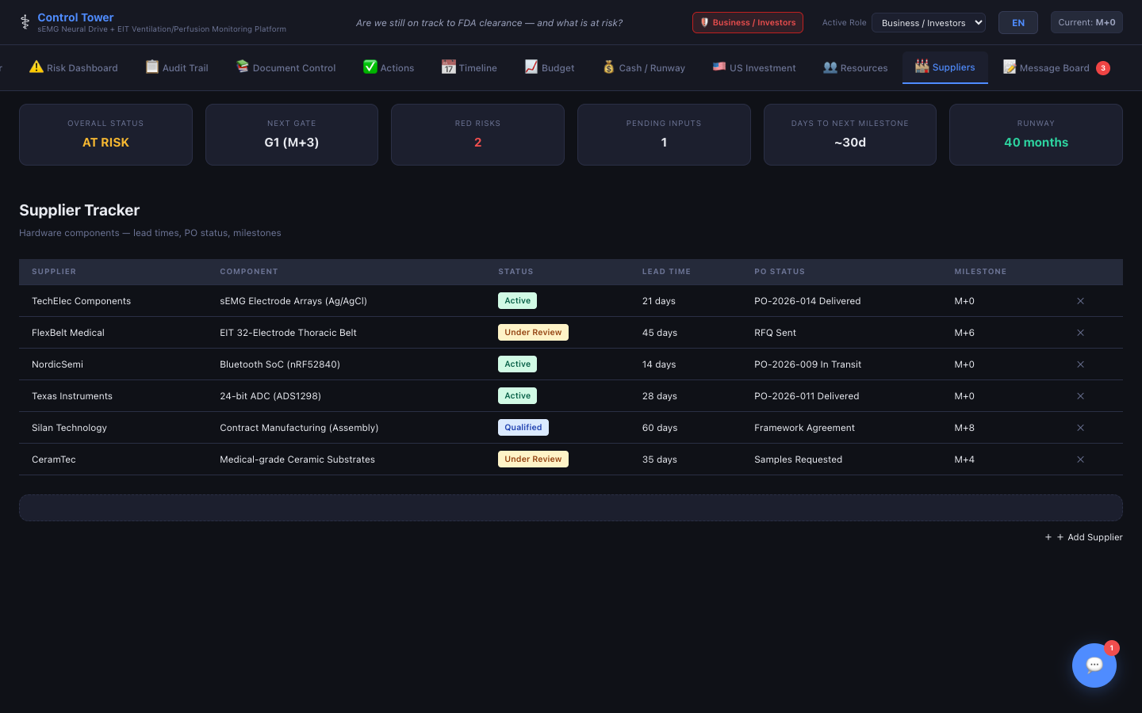
Inside the Control Tower — Team & Collaboration
Message Board
Actions / DHF / CAPA
Suppliers
Purpose-driven messaging tied to decisions, actions, and status updates.
Task board, Design History File tracker, and Corrective Action log.
Supplier qualification, evaluation scoring, and document tracking.

Slide 10
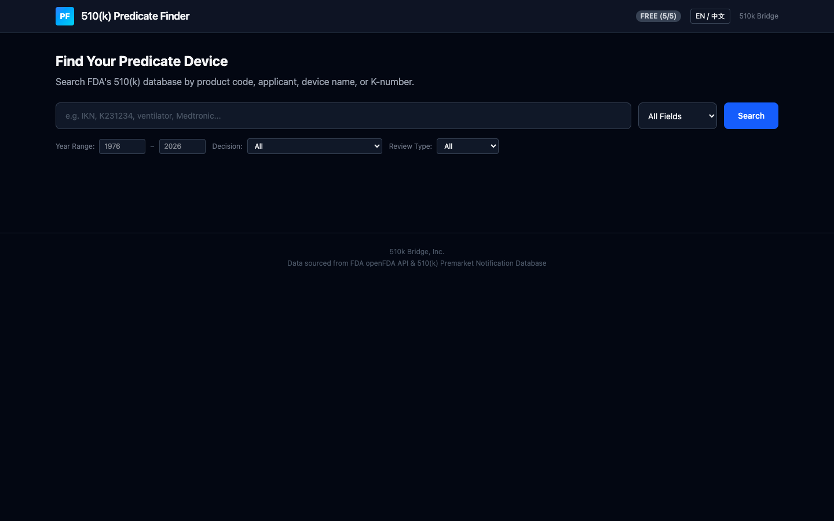
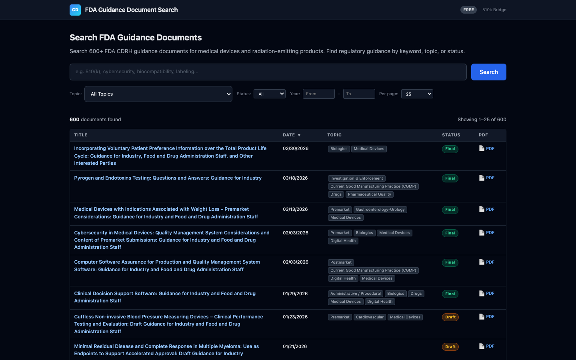
Standalone Tools
Powerful research tools included with every engagement
510(k) Predicate Finder
FDA Guidance Search
QMS-Lite
Search FDA's openFDA database by product code, applicant, or K-number. AI-powered substantial equivalence analysis.
Search 600+ CDRH guidance documents — filter by topic, status, year. Direct links to official PDFs.
Lightweight QMS aligned to 21 CFR 820 and ISO 13485 — document control, CAPA, training, supplier qualification.

Slide 11
Platform Highlights
🧙
Tri-lingual Wizard
9-step wizard pre-populates your entire project in EN, 中文, or 한국어.
🏛️
FDA Comms Center
Q-Sub automation, RTA self-check, MDUFA tracking, SE flowchart — one tab.
📋
RTA & DHF Readiness
Real-time readiness scoring from your DHF and Standards trackers.
🌐
Entity Setup
Step-by-step US market entry — Delaware C-Corp, EIN, bank, FDA registration.

Slide 12
Free Resources
📘
FDA 510(k) Pathway Guide
Step-by-step US market entry guide
📋
Service Overview Fact Sheet
One-page platform & capabilities summary
🎓
PMP Course
Free project management course
💰
Investment Guide
Term sheets, funding rounds, 510(k) Bridge strategy

Slide 13
Let's Talk
Schedule a free 30-minute consultation about your FDA pathway.
📧 info@510kbridge.com
🌐 510kbridge.com
📍 Oregon, USA — Serving clients in US, China, and Korea
Schedule a Consultation →

