Slide 1
510(k) Bridge Control Tower
The First Purpose-Built FDA 510(k) Project Management Platform
18 integrated tabs • Trilingual (EN / 中文 / 한국어) • Role-based access 21 CFR Part 11 audit trail • ISO 14971 risk management • FDA Q-Sub automation Real-time cloud sync • 7 pre-configured device templates • 3 subscription tiers
510(k) Bridge • Gresham, Oregon • www.510kbridge.com

Slide 2
The Problem: No FDA-Specific Project Management Platform Exists
Why the Industry Needs Control Tower
▸ Medical device companies use generic PM tools (Jira, Asana, Monday.com) that have zero FDA awareness
▸ Regulatory consultants rely on spreadsheets, email threads, and tribal knowledge
▸ No existing platform connects technical milestones to FDA regulatory gates
▸ 510(k) submissions average 6-9 months of rework due to disorganized documentation (DHF/DMR gaps)
▸ Companies send 2-3 FDA Q-Sub requests before getting accepted — each cycle costs $10K-$25K in delays
▸ ISO 14971 risk management is tracked in standalone documents, disconnected from project decisions
▸ International teams (US-China, US-Korea corridors) lack a unified multilingual workspace
Competitive Landscape Gaps
▸ Greenlight Guru — QMS-focused, not project management; no milestone/gate tracking; $$$
▸ MasterControl — Enterprise QMS; complex, expensive ($50K+/yr); no 510(k) workflow
▸ Jama Connect — Requirements management only; no budget, risk matrix, or FDA comms
▸ Arena Solutions (PTC) — PLM/BOM-focused; no regulatory submission tools
▸ Qualio — Document-centric QMS; no dual-track milestones, no gate system
▸ Monday.com / Asana — Generic PM; zero FDA vocabulary or compliance features
None of these platforms provide an integrated 510(k) project lifecycle from Pre-Sub through clearance with built-in FDA automation, trilingual support, and role-based governance.

Slide 3
Platform Architecture: 17 Integrated Tabs in 5 Groups
PROGRAM MGMT
REGULATORY
DOCUMENTS
FINANCE
OPERATIONS
1. Dual-Track Milestones
2. Gate System
3. Timeline
4. Actions Panel
5. Regulatory Tracker
6. Risk Dashboard
7. FDA Comms Center
17. Predicate Finder
18. Guidance Docs
8. Document Control
9. Audit Trail
10. Budget
11. Cash / Runway
12. US Investment
13. Resources
14. Suppliers
15. Message Board
Cross-Cutting Platform Capabilities
Trilingual (EN/中文/한국어) • Role-Based Access (PMP / Tech / Business / Accounting) • 3 Subscription Tiers ($500–$2,000/mo) • 7 Device Templates • Supabase Cloud + Offline • 21 CFR Part 11 Audit Trail • Setup Wizard • Real-Time Collaboration

Slide 4
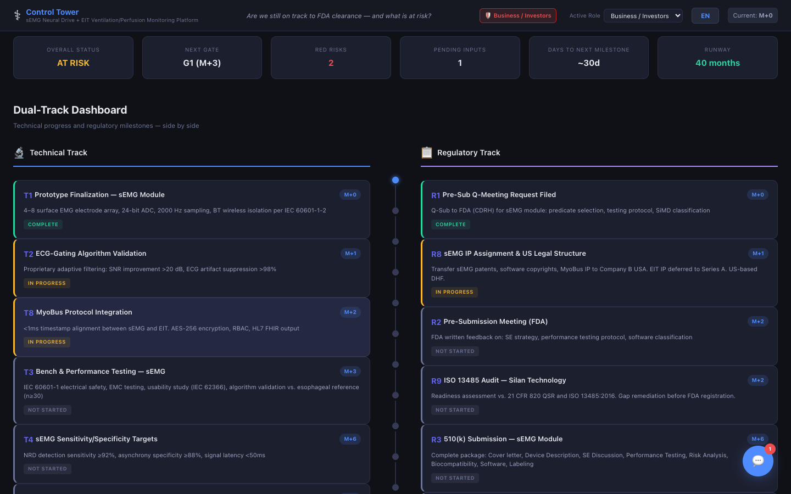
PROGRAM MANAGEMENT
510(k) Bridge
Tab 1: Dual-Track Milestones
Control Tower
Value Proposition
▸ Parallel technical & regulatory milestone tracking — the ONLY platform that visualizes both tracks side-by-side
▸ Technical track: Design freeze → Prototype → Bench verification → V&V → Design transfer
▸ Regulatory track: Pre-Sub Q-Meeting → 510(k) prep → Submission → Expected clearance
▸ Auto-populated timelines based on project duration (18-23 months typical)
▸ Status cycling (Not Started → In Progress → Complete / Blocked) with full audit logging
▸ Owner assignment per milestone (Tech, Regulatory, or Business) ensures accountability
Competitor Gap Analysis
Jira/Asana have task boards but no concept of synchronized technical + regulatory tracks. Greenlight Guru tracks QMS documents but not engineering milestones. No competitor links a prototype testing schedule to an FDA submission timeline.

Slide 5
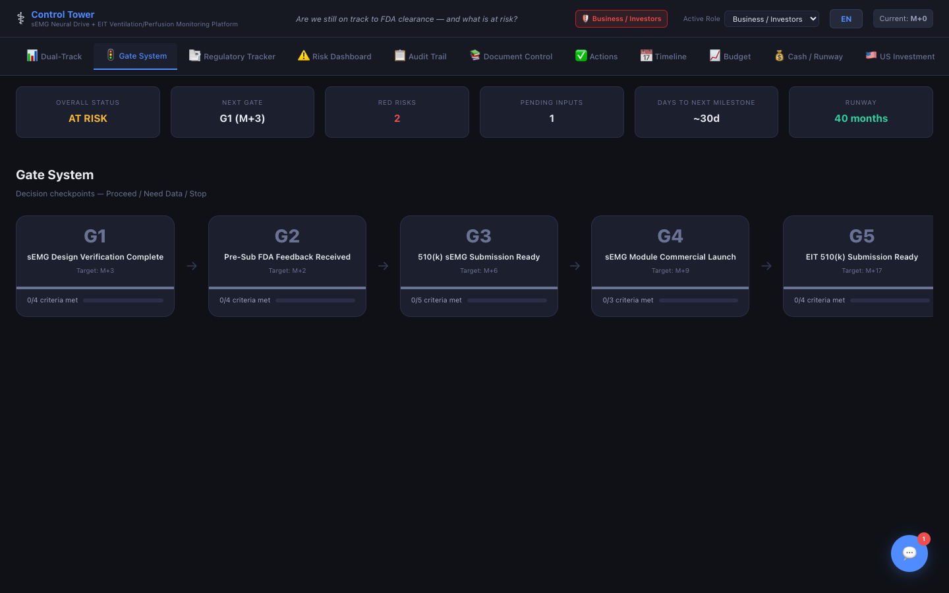
PROGRAM MANAGEMENT
510(k) Bridge
Tab 2: Gate System
Control Tower
Value Proposition
▸ Phase-gate governance with digital review — checklist-based criteria per gate
▸ 2-6 gates auto-generated based on project length
▸ Gate decisions: Proceed / No-Go / Conditional — PMP records with timestamp attribution
▸ Stakeholder inputs from Tech and Business teams feed into each gate decision
▸ Gate notes capture discussion points, conditions, and commitments
▸ Gate status auto-updates (Not Started → Pending Review → Approved → Blocked) as criteria complete
Competitor Gap Analysis
Stage-Gate® is a well-known methodology, but no SaaS tool implements it for medical devices. Generic PM tools require manual spreadsheet gates. Control Tower's gate system directly references 510(k) deliverables — e.g., 'DHF complete?' as an actual gate criterion linked to the DHF tracker.

Slide 6
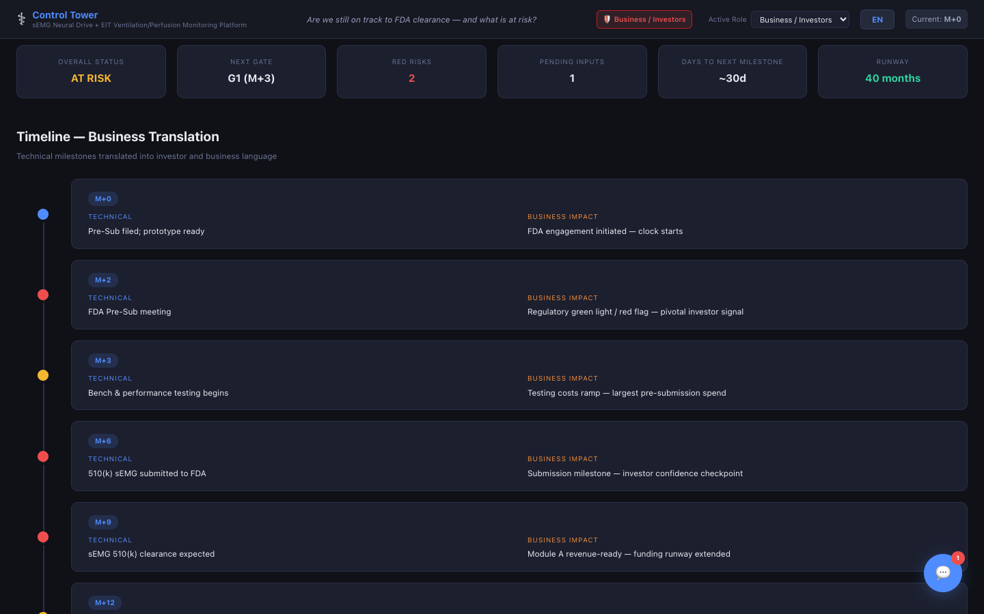
PROGRAM MANAGEMENT
510(k) Bridge
Tab 3: Timeline
Control Tower
Value Proposition
▸ Month-by-month consolidated project view showing technical + business activities
▸ Impact indicators: Neutral (|), Warning (⚠), Critical (🔴) for schedule risk
▸ Auto-generated from device template or wizard inputs — instant project skeleton
▸ Editable events with team-modifiable text and impact levels
▸ Events linked to Dual-Track milestones for full traceability
▸ Gives executives a single-page view of the entire 510(k) program lifecycle
Competitor Gap Analysis
Gantt charts in MS Project or Monday.com are generic bars — they don't know an FDA milestone from a marketing campaign. Control Tower's timeline is purpose-built for 510(k) programs with built-in FDA terminology and impact-flagging.

Slide 7
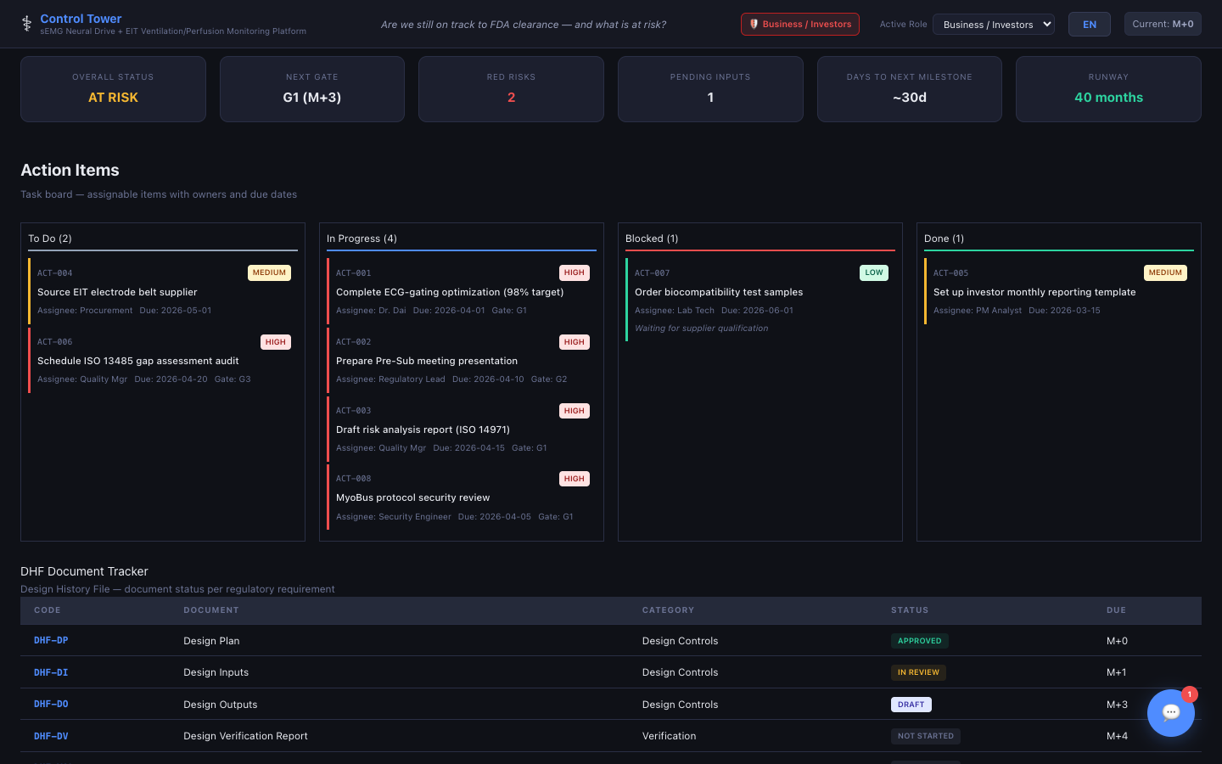
PROGRAM MANAGEMENT
510(k) Bridge
Tab 4: Actions Panel
Control Tower
Value Proposition
▸ Full task board: title, assignee, priority (H/M/L), status (Todo/In Progress/Done/Blocked), due date
▸ Gate-linked actions — each task can reference a specific gate (G1, G2, etc.)
▸ DHF Document Tracker — 21 CFR 820.30 Design History File document checklist
▸ DMR Document Tracker — 21 CFR 820.181 Device Master Record (12 document types)
▸ CAPA Log — Corrective & Preventive Actions with risk linkage from Risk Dashboard
▸ Four integrated sub-sections in one tab: Tasks + DHF + DMR + CAPA
Competitor Gap Analysis
Greenlight Guru has DHF tracking but it's siloed from project management tasks. Jira has task boards but no DHF/DMR/CAPA awareness. Control Tower uniquely combines task management with FDA documentation checklists and links CAPAs directly to risks identified in the Risk Dashboard.

Slide 8
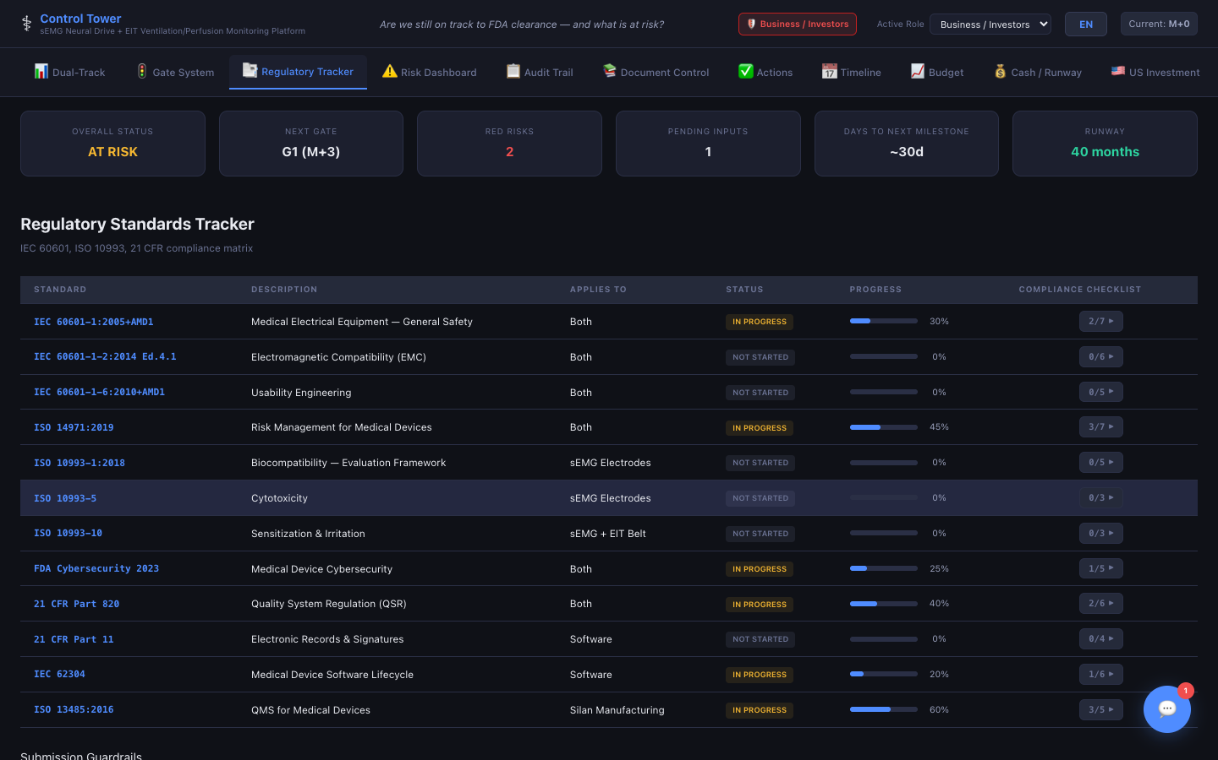
REGULATORY
510(k) Bridge
Tab 5: Regulatory Tracker
Control Tower
Value Proposition
▸ Standards compliance dashboard auto-populated from device template
▸ Tracks IEC 60601-1, IEC 60601-1-2, ISO 10993, ISO 14971, IEC 62304, 21 CFR 820, ISO 13485
▸ Clause-level tracking — drill down to individual sub-clauses (e.g., ISO 10993-5, -10)
▸ 0-100% progress bar per standard with status cycling
▸ Evidence linking — attach document references to each clause
▸ Instantly shows which standards are behind schedule, focusing team effort
Competitor Gap Analysis
Qualio and MasterControl track document compliance but not standard-by-standard progress. No competitor auto-populates applicable standards based on device type. Teams currently maintain compliance matrices in Excel — Control Tower eliminates that spreadsheet and makes it live.

Slide 9
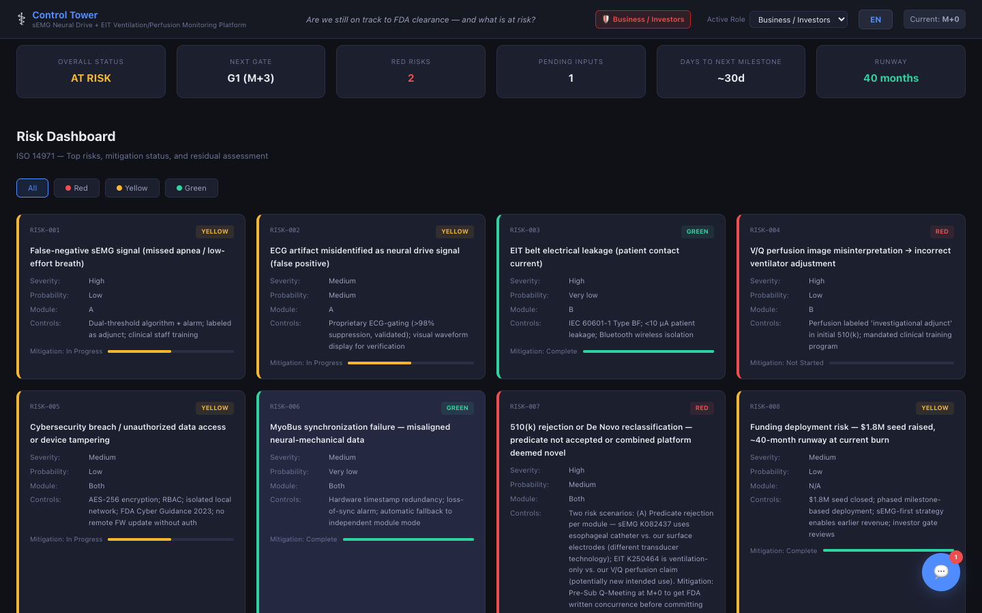
REGULATORY
510(k) Bridge
Tab 6: Risk Dashboard
Control Tower
Value Proposition
▸ Full ISO 14971 risk management visualization with severity × probability matrix
▸ Color-coded risk levels: Green (Acceptable) → Yellow (ALARP) → Red (Unacceptable)
▸ Per-risk fields: severity, probability, controls, residual risk, mitigation status, module, standard
▸ Red-risk alerts automatically trigger warnings in the FDA Comms tab
▸ Template-pre-populated risks (5-8 per device category — e.g., respiratory gets EMG-specific risks)
▸ Click risk ID to open detailed editor — all changes audit-logged
Competitor Gap Analysis
Most companies track risks in Word documents or standalone Excel matrices. Greenlight Guru has risk management but decoupled from project timelines. Control Tower's Risk Dashboard connects risks to CAPAs, gate criteria, and FDA Pre-Sub questions — a closed-loop risk system.

Slide 10
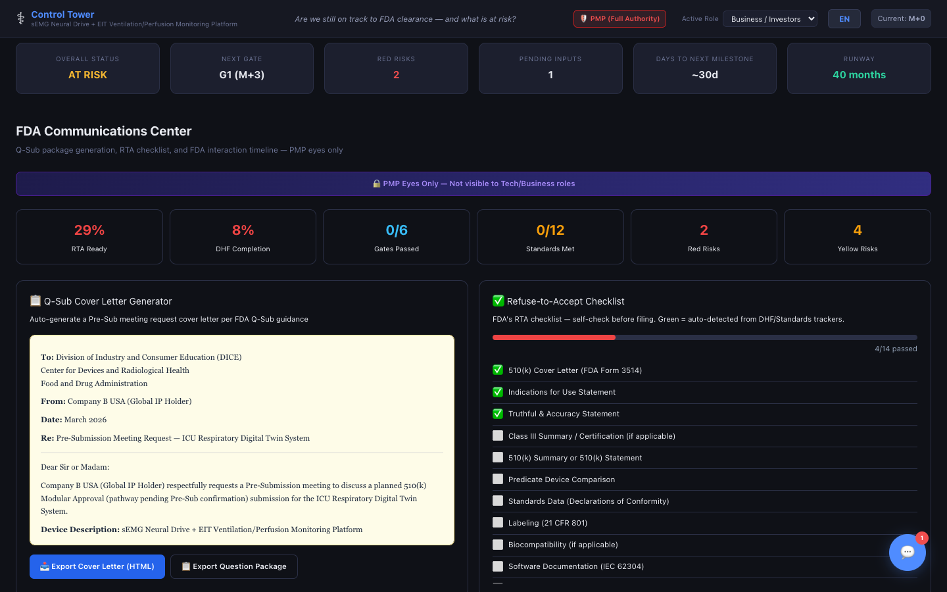
REGULATORY
510(k) Bridge
Tab 7: FDA Communications Center
Control Tower
Value Proposition
▸ PMP-exclusive tab — the nerve center for FDA interactions
▸ Q-Sub Cover Letter Generator — 5 types (Pre-Sub Meeting, Written Questions, Controlled Correspondence, etc.)
▸ Export Question Package — pulls Pre-Sub question threads from Message Board into formatted FDA package
▸ Refuse-to-Accept (RTA) Checklist — 17-item self-validation against FDA acceptance criteria
▸ MDUFA Review Timeline — Day 1 through Day 90 milestone tracking for standard 510(k) review
▸ Substantial Equivalence Decision Flowchart — FDA's SE determination logic visualized
Competitor Gap Analysis
NO COMPETITOR HAS THIS. No existing platform generates FDA Q-Sub cover letters, exports Pre-Sub question packages, or provides an RTA pre-check. This is Control Tower's single strongest differentiator — it automates the most time-consuming and error-prone regulatory communication workflows.

Slide 11
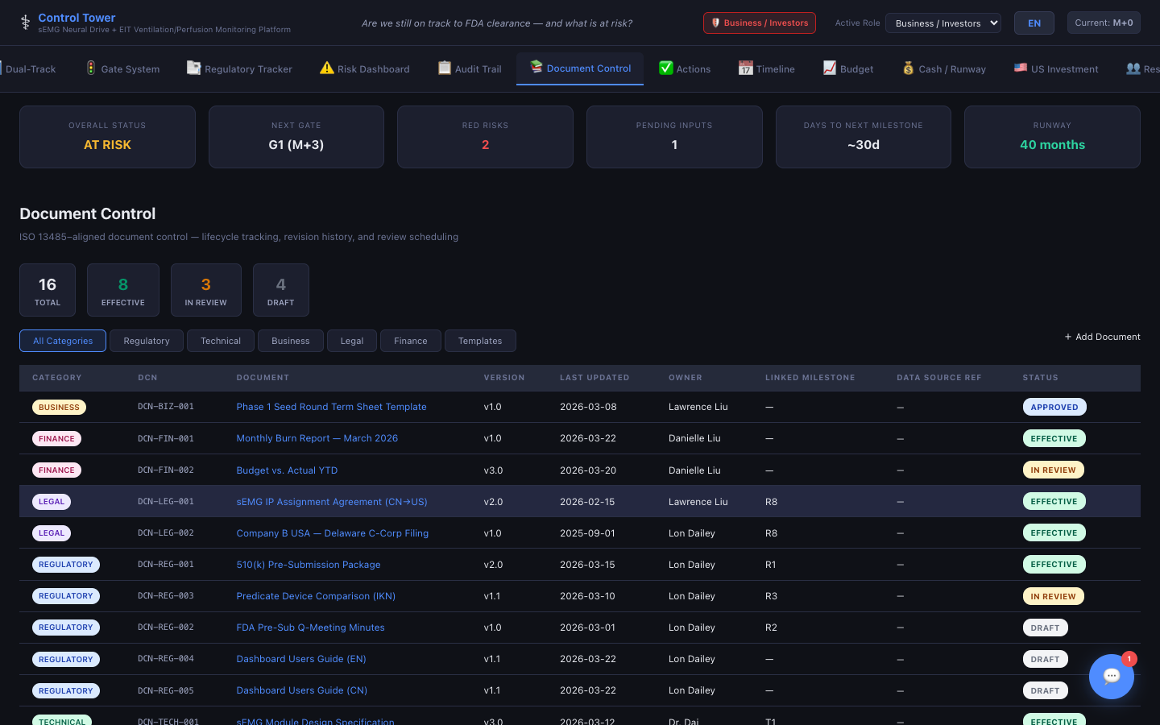
DOCUMENTS
510(k) Bridge
Tab 8: Document Control
Control Tower
Value Proposition
▸ ISO 13485-aligned document lifecycle: Draft → In Review → Approved → Effective → Obsolete
▸ Auto-generated Document Control Numbers (DCN-REG-001, etc.)
▸ Categories: Regulatory, Technical, Business, Legal, Finance, Templates
▸ Browser localStorage for IP protection + optional server sync for approved docs
▸ Source reference linking (GitHub commit, SVN revision, etc.)
▸ Milestone linkage — e.g., R8 milestone triggers DHF document readiness check
Competitor Gap Analysis
MasterControl and Qualio are full QMS platforms costing $50K+/yr. Control Tower provides 80% of critical document control features at a fraction of the cost, tightly integrated with project milestones rather than existing as a standalone system.

Slide 12
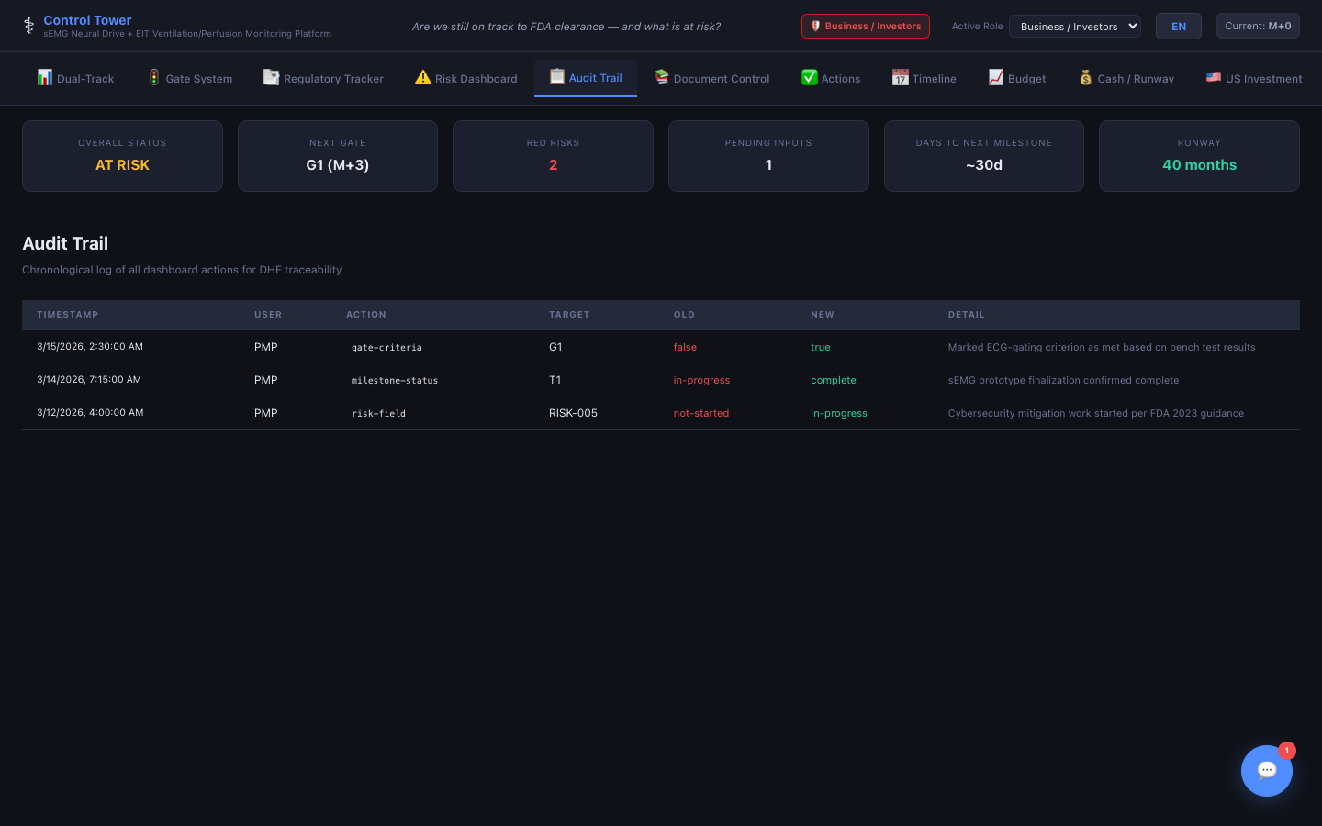
DOCUMENTS
510(k) Bridge
Tab 9: Audit Trail
Control Tower
Value Proposition
▸ 21 CFR Part 11-compliant immutable activity log
▸ Every change captured: timestamp, user role, action type, target, old value → new value
▸ 100+ action types (milestone-status, risk-field, gate-decision, doc-status, budget-entry, etc.)
▸ Keyword search and action-type filtering
▸ Export complete history as CSV/JSON for regulatory submissions
▸ Auto-synced to Supabase backend; queues locally if offline — zero data loss
Competitor Gap Analysis
This is table-stakes for regulated industries but missing from generic PM tools. Jira's audit log is IT-focused, not regulatory. Control Tower's audit trail is designed specifically for FDA investigators and notified body auditors, capturing the exact fields and formatting they expect.

Slide 13
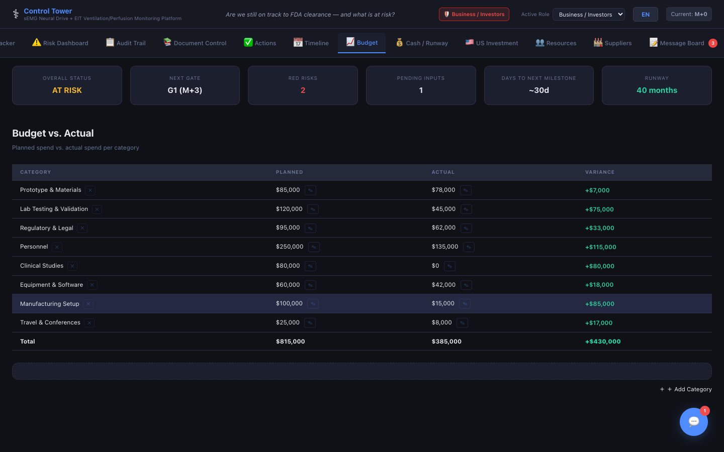
FINANCE
510(k) Bridge
Tab 10: Budget
Control Tower
Value Proposition
▸ Budget vs. actual tracking by category — pre-populated from device template
▸ Categories: Prototype & Materials, Testing, Regulatory & Legal, Personnel, etc.
▸ Per-category fields: planned amount, actual amount, variance (auto-calculated), notes
▸ Dual currency support: USD/CNY auto-toggle (7.25× conversion rate)
▸ Add/edit/delete categories as project evolves
▸ All budget changes captured in Audit Trail for financial accountability
Competitor Gap Analysis
Generic PM tools either lack budgeting entirely (Jira) or provide basic spend tracking without medical-device-specific cost categories. Control Tower pre-populates budget categories that match 510(k) development phases — testing lab fees, regulatory counsel, biocompatibility studies, etc.

Slide 14
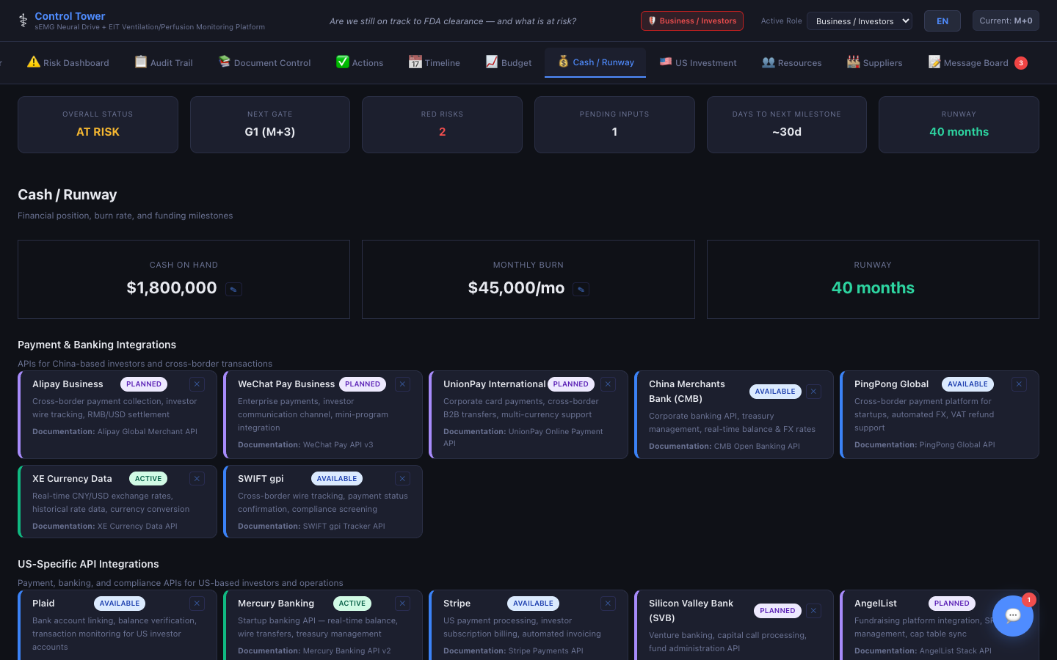
FINANCE
510(k) Bridge
Tab 11: Cash / Runway
Control Tower
Value Proposition
▸ Real-time financial health dashboard: Cash on Hand, Monthly Burn Rate, Runway (months)
▸ Runway color coding: Green (>12 mo), Yellow (6-12 mo), Red (<6 mo) — instant visibility
▸ Funding round tracking: Pipeline → Committed → Received with amounts and dates
▸ Month-by-month burn history: actual vs. planned expenditure
▸ Visual burn history charts for board presentations
▸ Critical for startups — answers 'do we have enough cash to reach FDA clearance?'
Competitor Gap Analysis
Financial planning tools (QuickBooks, Xero) don't tie cash runway to regulatory milestones. Startup dashboards (Carta, Visible) track burn but know nothing about FDA timelines. Control Tower uniquely answers the question every med-device founder asks: 'Will my money last until 510(k) clearance?'

Slide 15
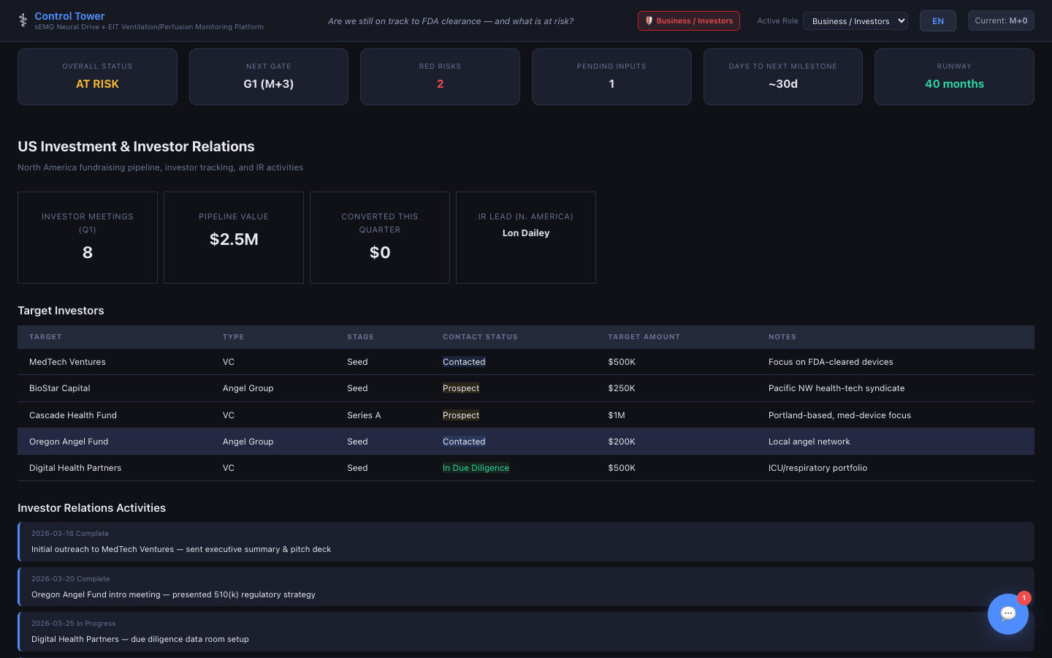
FINANCE
510(k) Bridge
Tab 12: US Investment
Control Tower
Value Proposition
▸ Investor relations pipeline: Prospect → Contacted → In Discussions → Term Sheet → Committed
▸ Investor profiles: type (VC, Angel, Strategic, PE, Government), stage fit, committed amounts
▸ IR activity logging: meetings, presentations, due diligence sessions, term negotiations
▸ Activity metrics and conversion rates for fundraising effectiveness
▸ Purpose-built for international med-device companies entering the US market
▸ Consolidates investor tracking that otherwise lives in scattered spreadsheets and CRMs
Competitor Gap Analysis
CRM tools (HubSpot, Salesforce) track investor contacts but have no medical-device context. Control Tower provides a specialized investor pipeline that sits alongside the 510(k) program — so founders can show investors exactly where they are in the regulatory process.

Slide 16
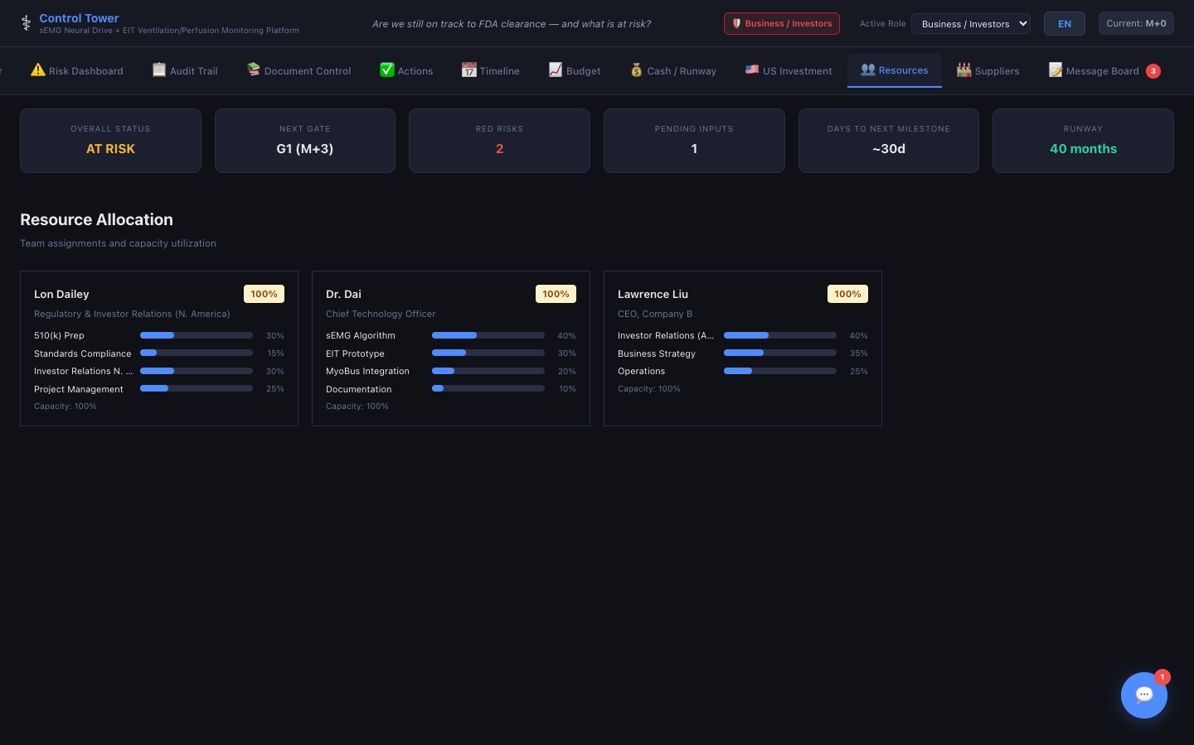
OPERATIONS
510(k) Bridge
Tab 13: Resources
Control Tower
Value Proposition
▸ Team allocation and utilization monitoring across workstreams
▸ Workstream allocation: % across Technical, Regulatory, Business, Finance (+ custom)
▸ Utilization gauge: Green (<85%), Yellow (85-100%), Red (>100%) — prevents burnout
▸ Team member profiles: name, role, email, bio
▸ Inline editing — click percentage to adjust allocations in real time
▸ Audit-logged allocation changes for workforce planning transparency
Competitor Gap Analysis
Resource management in Jira or Monday.com is task-hour based, not workstream-% based. Med-device teams often have dual-hatted engineers (tech + regulatory). Control Tower's allocation model matches how small device teams actually work — showing at a glance if your V&V engineer is also overloaded on regulatory documentation.

Slide 17
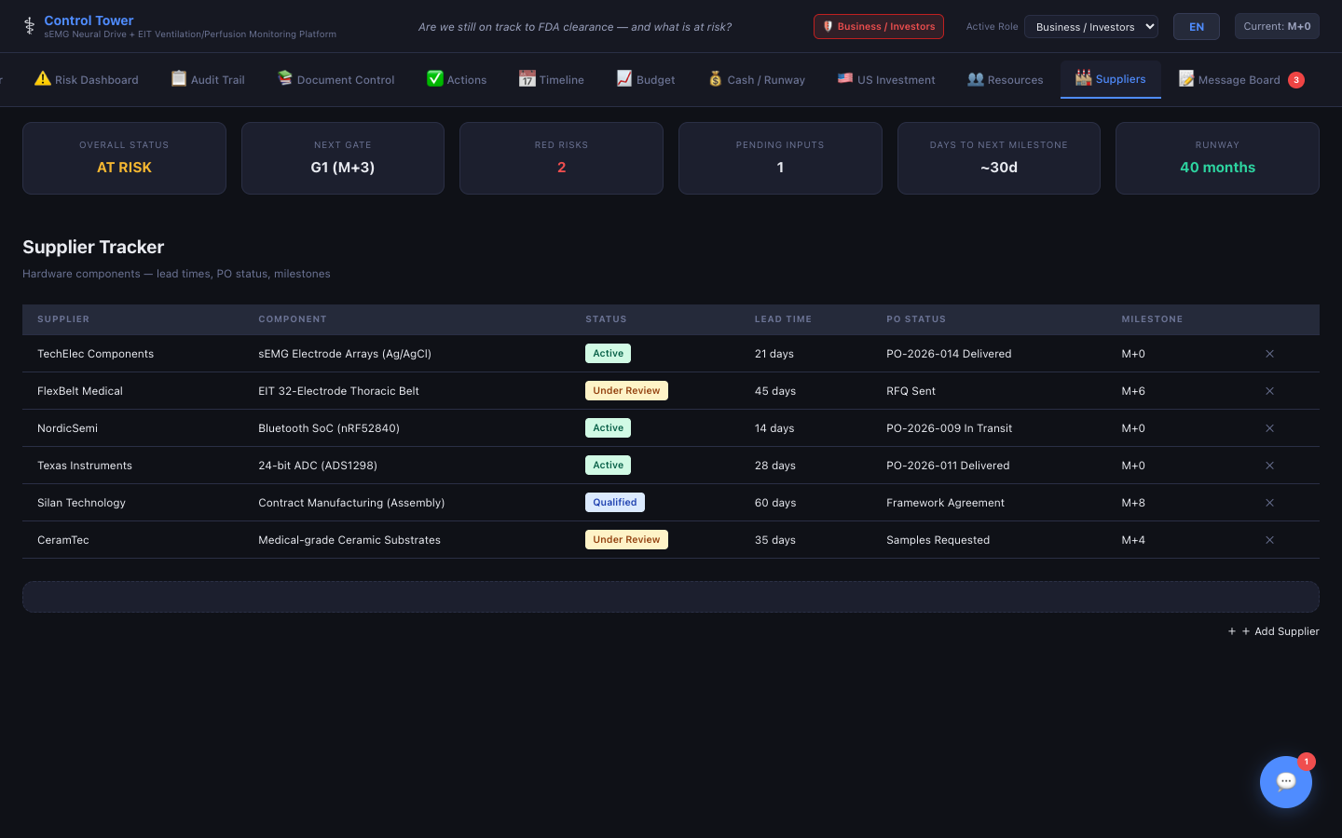
OPERATIONS
510(k) Bridge
Tab 14: Suppliers
Control Tower
Value Proposition
▸ Supplier qualification and PO tracking — aligned with 21 CFR 820 supplier controls
▸ Status lifecycle: Under Review → Qualified → Active → On Hold → Rejected
▸ Fields: component/part, lead time (days), PO status, contract mfg milestones
▸ Qualification criteria: ISO 13485/9001 certs, test reports, business continuity plans
▸ Critical for 510(k) — FDA expects documented supplier qualification in your QMS
▸ Linked to project milestones — knows when a component's lead time threatens a gate review
Competitor Gap Analysis
Arena Solutions (PTC) is a full PLM with BOM management but costs $1,000+/seat/yr. Control Tower provides the supplier qualification tracking FDA expects without the complexity of a full PLM — perfect for startups building their first device with 5-15 suppliers.

Slide 18
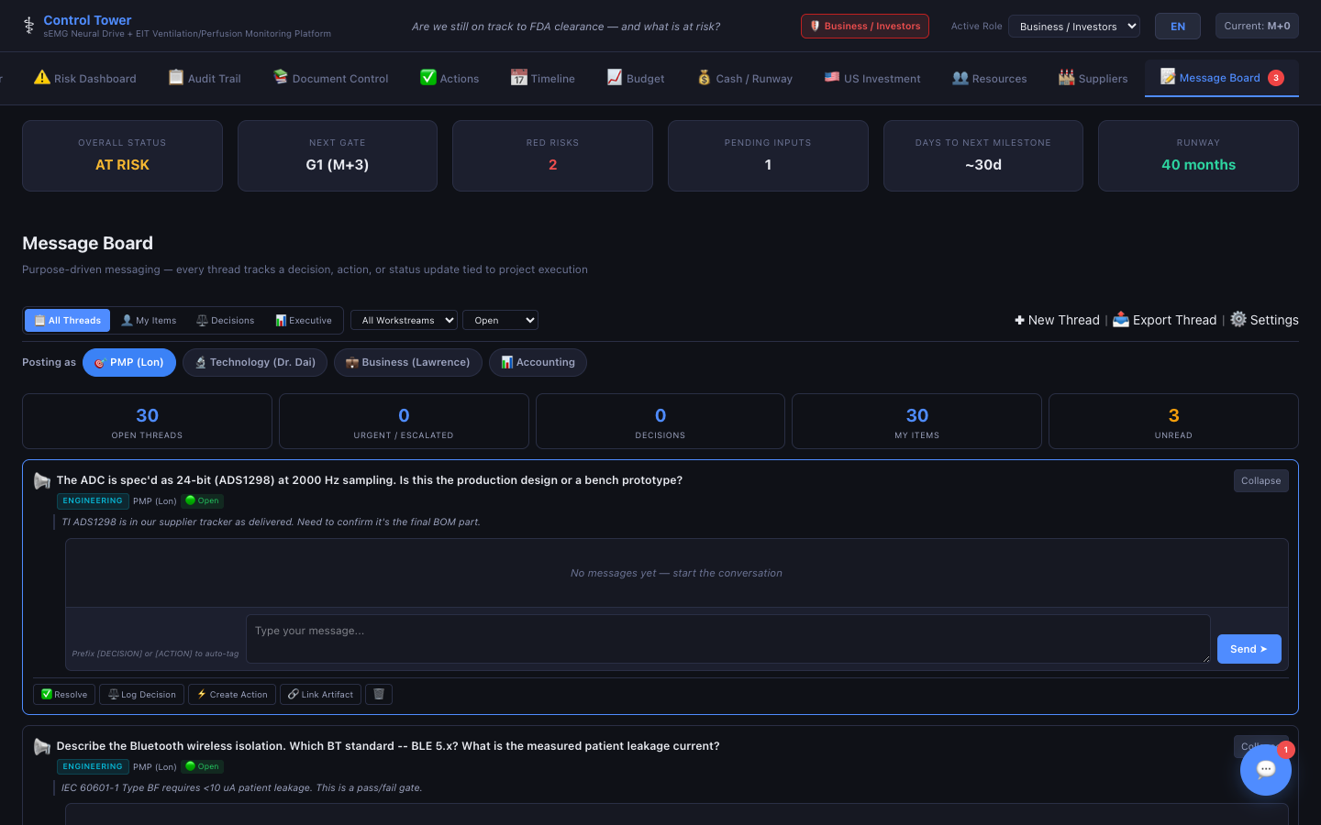
COMMUNICATIONS
510(k) Bridge
Tab 15: Message Board
Control Tower
Value Proposition
▸ Cross-functional threaded discussions with decision & action tracking
▸ Workstreams: Technical, Regulatory, Business, Finance, Pre-Sub Questions, Other
▸ Intent tags: Discuss, Decide, Inform, Escalate — every conversation has purpose
▸ [DECISION] and [ACTION] message prefixes for traceability
▸ Pre-Sub Questions workstream: collaboratively author FDA questions → export to FDA Comms
▸ Views: All Threads, My Items, Decisions, Executive — filter by lifecycle (Open/Resolved)
Competitor Gap Analysis
Slack, Teams, and email are where medical device decisions die — critical regulatory decisions buried in chat streams with no traceability. Control Tower's Message Board captures every decision with role attribution, timestamps, and the ability to spawn action items — then exports Pre-Sub questions directly to the FDA Communications Center.

Slide 19
REGULATORY
510(k) Bridge
Tab 16: Predicate Finder
Control Tower
Value Proposition
▸ Standalone SaaS tool powered by openFDA — search 200K+ cleared 510(k) devices
▸ Search by product code, applicant, device name, or K-number
▸ Real-time FDA database queries — always current data, no stale exports
▸ One-click predicate selection — feeds directly into your 510(k) project
▸ Decision number, clearance date, product code, and statement links for every result
▸ Free tier access — available even without a Control Tower subscription
Competitor Gap Analysis
Regulatory teams currently search FDA's 510(k) database manually via clunky FDA.gov search. No competitor integrates predicate device search directly into the 510(k) workflow. Control Tower's Predicate Finder automates the most critical first step in a 510(k) — identifying your predicate device — and links it directly into your project.

Slide 20
REGULATORY
510(k) Bridge
Tab 17: FDA Guidance Document Search
Control Tower
Value Proposition
▸ Searchable database of FDA guidance documents relevant to 510(k) submissions
▸ Filter by device type, topic area, publication date, and draft/final status
▸ Quick-reference summaries — understand guidance applicability without reading 100-page PDFs
▸ Links to official FDA.gov source documents for citation in submissions
▸ Guidance bookmarks — save frequently referenced documents for easy access
▸ Auto-suggestions based on your device template and applicable standards
Competitor Gap Analysis
Regulatory professionals spend hours searching FDA.gov for relevant guidance documents. No competitor platform indexes or surfaces FDA guidance within the project context. Control Tower puts guidance discovery inside the workflow where it's needed — eliminating the tab-switching and manual searching that slows regulatory strategy.

Slide 21
CROSS-CUTTING FEATURES
510(k) Bridge
Stakeholder Inputs & Change Requests
Stakeholder Inputs
▸ Floating 📥 button on every Gate System page — opens a side panel
▸ Tech & Business stakeholders submit structured input per gate
▸ Fields: gate selection, input type (Technical/Business/Risk/Resource/Other), free-text notes
▸ PMP sees all submissions in the gate detail view — organized by contributor
▸ Inputs feed directly into gate decisions — no more hunting through email/Slack
▸ Ensures cross-functional voices are captured before gate reviews
Change Request Workflow
▸ Non-PMP team members can request changes via structured Change Request form
▸ Covers: milestone dates, budget adjustments, risk re-assessments, resource reallocations
▸ PMP reviews and approves/rejects with timestamp, rationale, and audit trail
▸ Prevents unauthorized changes while preserving team agility
▸ Every request and decision captured in 21 CFR Part 11 audit trail
▸ Balances governance with speed — critical for regulated product development
Why This Matters
No competitor has structured stakeholder inputs tied to phase-gate decisions. In generic PM tools, stakeholder feedback is scattered across comments, emails, and meetings with no traceability. Control Tower ensures every voice is heard, every change is governed, and every decision is audit-logged.

Slide 22
CROSS-CUTTING FEATURES
510(k) Bridge
QMS-Lite for Startups
Document Control (ISO 13485 §4.2.4)
→ Tab 8: Document Control
Risk Management (ISO 14971)
→ Tab 6: Risk Dashboard
Design & Dev Controls (21 CFR 820.30)
→ Tabs 1-4: Milestones + Actions + DHF/DMR
CAPA (21 CFR 820.198)
→ Tab 4: Actions Panel — CAPA Log
Supplier Controls (21 CFR 820.50)
→ Tab 15: Suppliers
Audit Trail (21 CFR Part 11)
→ Tab 9: Audit Trail
Management Review
→ Tab 2: Gate System — gate decisions
Training Records
→ Tab 14: Resources — team qualifications
Regulatory Submissions
→ Tab 7: FDA Comms Center
80% QMS Coverage at Startup-Friendly Pricing
Startups don't need Greenlight Guru ($30K+/yr) or MasterControl ($50K+/yr) to demonstrate QMS readiness. Control Tower maps 9 core QMS requirements to existing tabs — giving startups an 80% QMS solution at a fraction of the cost. Perfect for seed-stage companies preparing for their first FDA submission.

Slide 23
CROSS-CUTTING FEATURES
510(k) Bridge
Notifications, Alerts & Executive Report
Smart Notifications & Alerts
▸ Notification bar with 5 alert types: overdue milestones, gate reviews due, high-priority actions, budget variances, and red-risk alerts
▸ Badge count on the notification bell — unread alerts at a glance
▸ Click-to-navigate: each alert links directly to the relevant tab and record
▸ Configurable notification preferences per user role
▸ Proactive alerting prevents missed deadlines and gate delays
Export Report & Readiness Guardrails
▸ One-click Executive Report — comprehensive HTML export of entire project status
▸ Covers: milestone progress, gate status, risk summary, budget variance, team utilization
▸ Professional formatting ready for board presentations or investor updates
▸ Includes Regulatory Readiness Guardrails: 3-panel system with 11 automated checks
▸ Checks: SE argument strength, Performance Data completeness, Biocompatibility status, Software Documentation (IEC 62304), 21 CFR 820 Design Controls, and more
▸ Auto-generated guardrail score gives teams a pre-submission confidence rating
Why This Matters
Generic PM tools have basic notifications but zero regulatory awareness. Control Tower's alerts are FDA-context-aware — they know when a gate review is overdue, when a red risk lacks mitigation, or when a Pre-Sub deadline is approaching. The Export Report replaces the manual PowerPoint status decks that consume 4-8 hours per month.

Slide 24
Setup Wizard & 7 Pre-Configured Device Templates
🫁 Respiratory
❤️ Cardiovascular
🦴 Orthopedic
🧪 IVD
Ventilators, CPAP, nebulizers Product codes: BZD, CBK, BTT, FRA
ECG monitors, BP devices, stents Product codes: DRX, DXH, MHX
Joint implants, instruments, fixation devices
In-vitro diagnostics, assays, analyzers
Includes: • Pre-seeded risks & standards • Budget categories • Timeline & milestones
Includes: • Pre-seeded risks & standards • Budget categories • Timeline & milestones
Includes: • Pre-seeded risks & standards • Budget categories • Timeline & milestones
Includes: • Pre-seeded risks & standards • Budget categories • Timeline & milestones
📷 Imaging
♿ Rehabilitation
💻 SaMD
X-ray, ultrasound, MRI accessories
Therapy devices, mobility aids
Software as a Medical Device (IEC 62304 lifecycle)
Includes: • Pre-seeded risks & standards • Budget categories • Timeline & milestones
Includes: • Pre-seeded risks & standards • Budget categories • Timeline & milestones
Includes: • Pre-seeded risks & standards • Budget categories • Timeline & milestones
Each template auto-populates risks, standards, budget categories, milestones, and timelines — teams are productive within minutes of project creation, not weeks.

Slide 25
Role-Based Access & Subscription Tiers
PMP (Project Manager)
Full access to all 17 tabs; FDA Comms exclusive
Technology
Technical/Regulatory tabs, Risks, Docs, Actions, Resources, Message Board
Business
Business milestones, Budget, Investment, Message Board
Accounting
Budget, Cash/Runway (limited editing)
Subscription Tiers
Starter — $500/mo
2 seats
Dual-Track, Gates, Timeline, Budget
Growth — $1,000/mo
5 seats
All except FDA Comms, US Investment
Scale — $2,000/mo
10 seats
All 17 tabs including FDA Comms + Predicate Finder

Slide 26
Competitive Comparison: Control Tower vs. Alternatives
Feature
Control Tower
Greenlight Guru
Master Control
Jama Connect
Qualio
Monday.com / Asana
Dual-Track Milestones
✅
❌
❌
❌
❌
❌
Phase-Gate System
✅
❌
❌
❌
❌
❌
FDA Q-Sub Generator
✅
❌
❌
❌
❌
❌
RTA Pre-Check
✅
❌
❌
❌
❌
❌
Predicate Finder (openFDA)
✅
❌
❌
❌
❌
❌
FDA Guidance Doc Search
✅
❌
❌
❌
❌
❌
ISO 14971 Risk Dashboard
✅
✅
✅
❌
❌
❌
DHF/DMR Tracking
✅
✅
✅
❌
✅
❌
CAPA Management
✅
✅
✅
❌
✅
❌
Stakeholder Gate Inputs
✅
❌
❌
❌
❌
❌
Budget & Cash Runway
✅
❌
❌
❌
❌
❌
Investor Pipeline
✅
❌
❌
❌
❌
❌
QMS-Lite (9 requirements)
✅
✅
✅
❌
✅
❌
Trilingual (EN/CN/KO)
✅
❌
❌
❌
❌
❌
21 CFR Part 11 Audit Trail
✅
✅
✅
⚠️
✅
❌
Starting Price
$500/mo
~$1K/mo
~$4K/mo
~$3K/mo
~$1K/mo
$10/seat

Slide 27
Why Control Tower?
The only platform purpose-built for FDA 510(k) medical device development. ✓ Replaces 6+ standalone tools (PM, QMS, risk, finance, investor, comms) ✓ 18 integrated tabs including Predicate Finder & FDA Guidance Doc Search ✓ Automates FDA Q-Sub generation, RTA pre-checks, and MDUFA timeline tracking ✓ Stakeholder Inputs, Change Requests & Regulatory Readiness Guardrails ✓ QMS-Lite maps 9 core quality requirements — 80% QMS at startup pricing ✓ Trilingual for US-China and US-Korea market corridors ✓ 21 CFR Part 11 audit trail from Day 1 • 7 device templates ✓ Starting at $500/month — 10× cheaper than enterprise QMS platforms From Pre-Submission to FDA Clearance — one platform, one team, one source of truth.
510(k) Bridge • Gresham, Oregon • www.510kbridge.com Schedule a Demo • info@510kbridge.com

