Slide 1
The Smart Salary Chain
Blockchain-powered, certified payroll processing
Notes:
So, welcome to the Smart Salary Chain presentation!

Slide 2


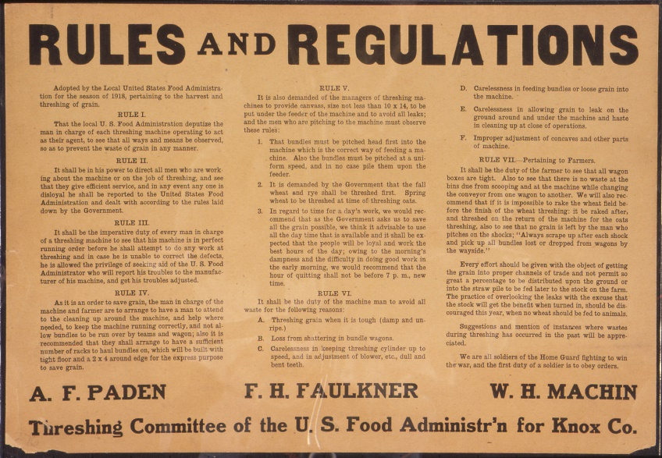


Current issues with salary administration:
Notes:
Paying for a services is a complicate process

Slide 3



Headache for big businesses, small businesses…
Notes:
It is difficult for all businesses

Slide 4









…let alone for the emerging P2P and sharing economies…
Notes:
And a often legal nightmare for startups

Slide 5









What is it all about?
Public Institutions
Employer
Employee
Private Institutions
Notes:
If you want to pay bob, you should also pay for insurances and institutions
And there are contracts involved
Plenty of contracts

Slide 6

How can we simplify this?
Public Institutions
Employer
Employee
Private Institutions
Notes:
How can we simplify this?

Slide 7




Smart Contracts to the rescue!
SECURE
APPROVED
CERTIFIED
LEGAL
COMPLIANT
AUDITABLE
TRANSPARENT
Public Institutions
Employer
Employee
Private Institutions
Notes:
Here is where the Blockchain and Smart Contracts can halp.
The rules can be embedded in the system, which means that you just have to pay for Bob’s services.
All the heavy regulative work is resolved by the system, and you’re sure to be compliant with the law.

Slide 8




Stop for a second…

Slide 9





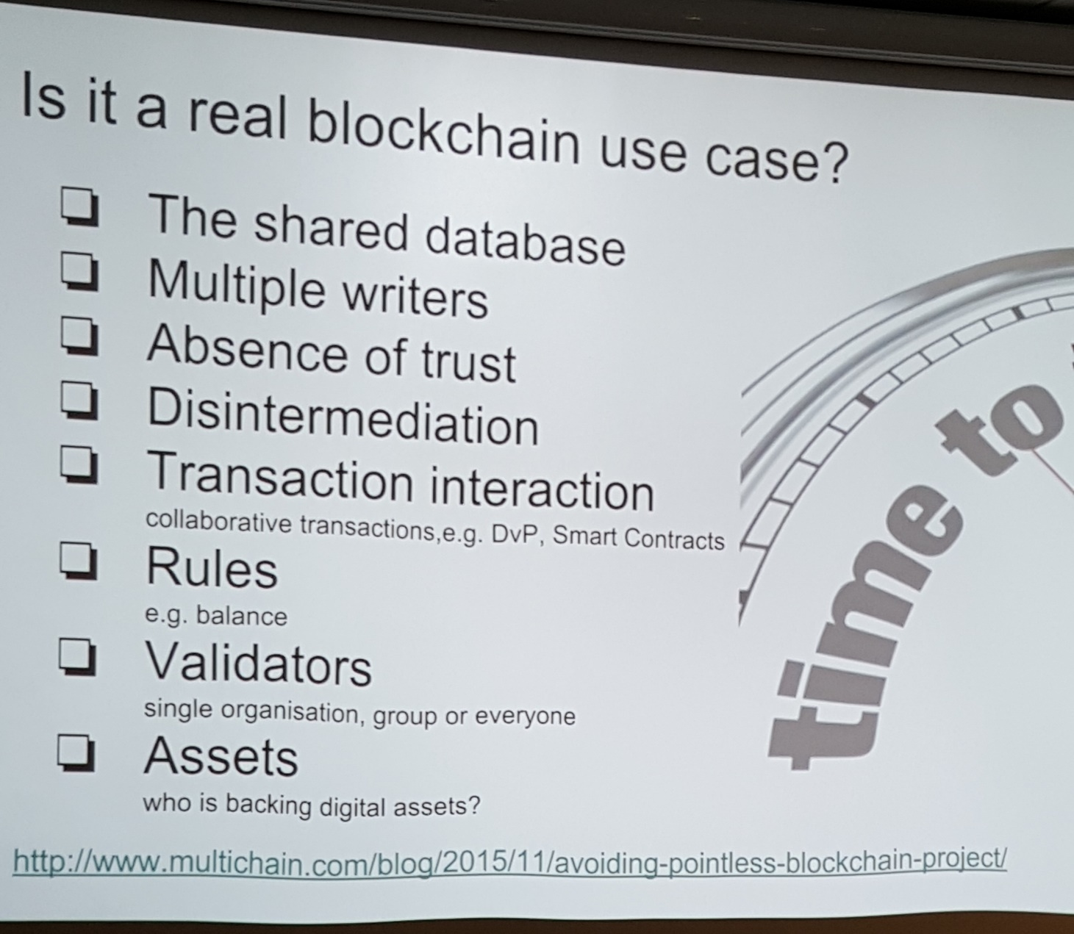






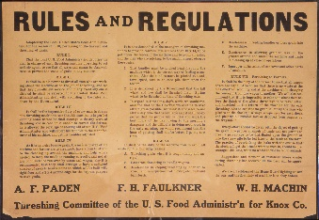


We heard the rules:

Slide 10

DEMO
Notes:
Here is how it works, and it’s implemented on the blockchain
We do a simple payment, say 100 CHF for a service., and here’s what happens.
Time is up, so vote for us if you want to know more.

Slide 11


THANKS !

