Slide 1
The Smart Salary Chain
Blockchain-powered, certified payroll processing

Slide 2


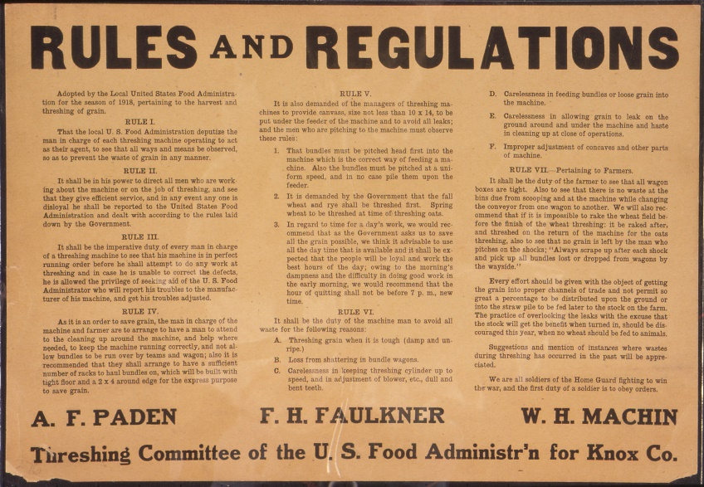


Current issues with salary administration and regulations:

Slide 3



Headache for big businesses, small businesses…

Slide 4








…let alone for the emerging P2P and sharing economies…

Slide 5









What is it all about?
Public Institutions
Employer
Employee
Private Institutions

Slide 6


How can we simplify this?
Public Institutions
Employer
Employee
Private Institutions

Slide 7



Smart Contracts to the rescue!
Public Institutions
Employer
Employee
Private Institutions

Slide 8




Stop for a second…

Slide 9





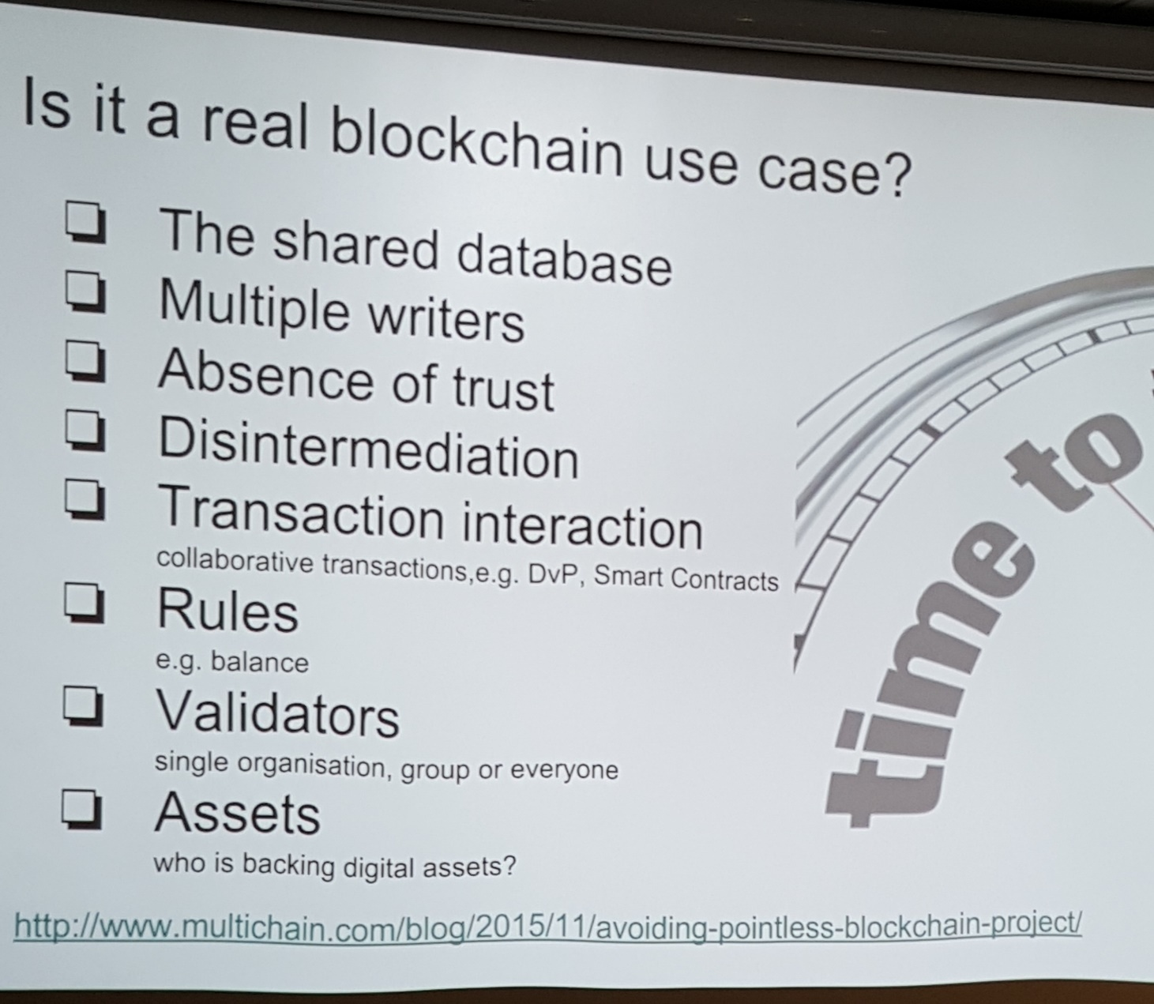






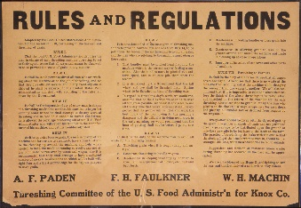


We heard the rules:

Slide 10

12 seconds DEMO time

Slide 11


THANKS !

