Slide 1
The Smart Salary Chain
Blockchain-powered, certified payroll processing
Notes:
So, welcome to the Smart Salary Chain presentation!

Slide 2


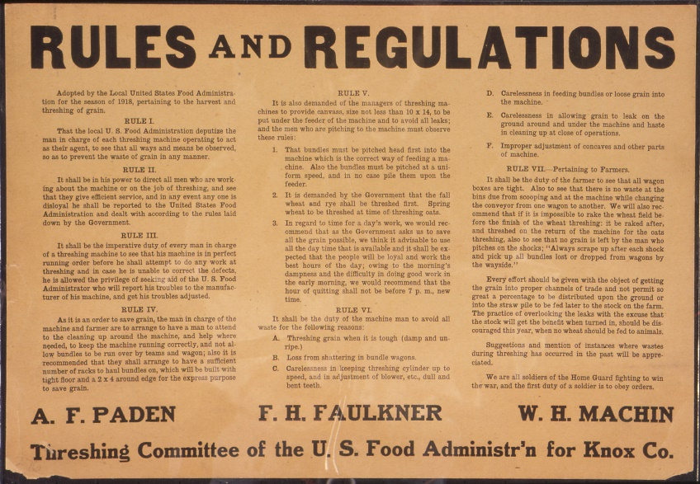

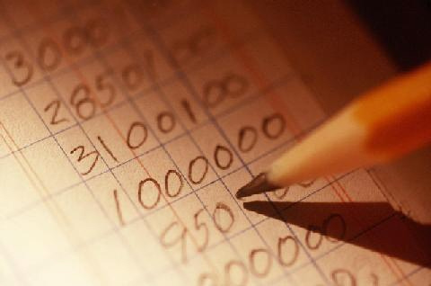
Current issues with salary administration:
Notes:
Paying for a services is a complicate process

Slide 3


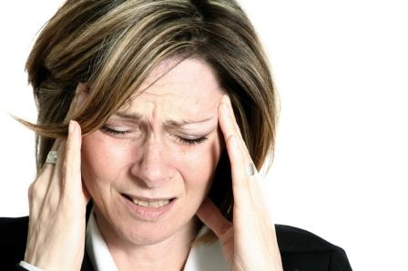
Headache for big businesses, small businesses…
Notes:
Businesses of all sizes have been struggling to follow for decades.

Slide 4









…let alone for the emerging P2P and sharing economies…
Notes:
It is so difficult to do it properly that most startups of the new P2P and sharing economy find themselves on the edge of legality, with a looming hammer of sanctions and investigations over their heads

Slide 5









What is it all about?
Public Institutions
Employer
Employee
Private Institutions
Notes:
But if what is all this complication about?
Well, if an employer wants to pay an employee
He should not forget to pay the public and private institutions of the nation’s the social security and insurances system
The same goes for on the receiving end
And all these transactions are subject to complicated contracts and paperwork
And if with the life evolving, more paperwork and complications
and if you do business with several employees, it’s inferno

Slide 6

How can we simplify this?
Public Institutions
Employer
Employee
Private Institutions
Notes:
How can we simplify this?

Slide 7




Smart Contracts to the rescue!
Public Institutions
Employer
Employee
Private Institutions
Notes:
There is a new technology in town, and it’s called the Blockchain and its smart contracts, It’s set to radically change how things work
The rules get embedded in the system, which means that you just have to pay for Bob’s services.
All the heavy regulative work is performed by the system, and you’re always legal and compliant.

Slide 8

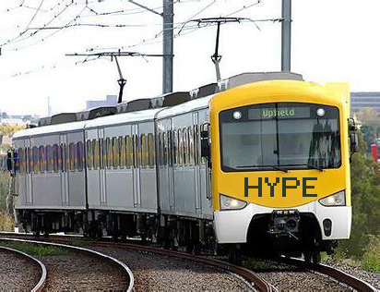
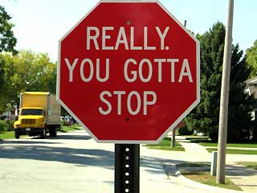
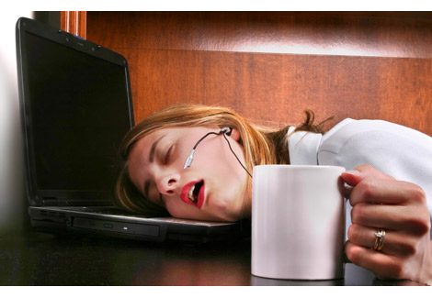
Stop for a second…

Slide 9





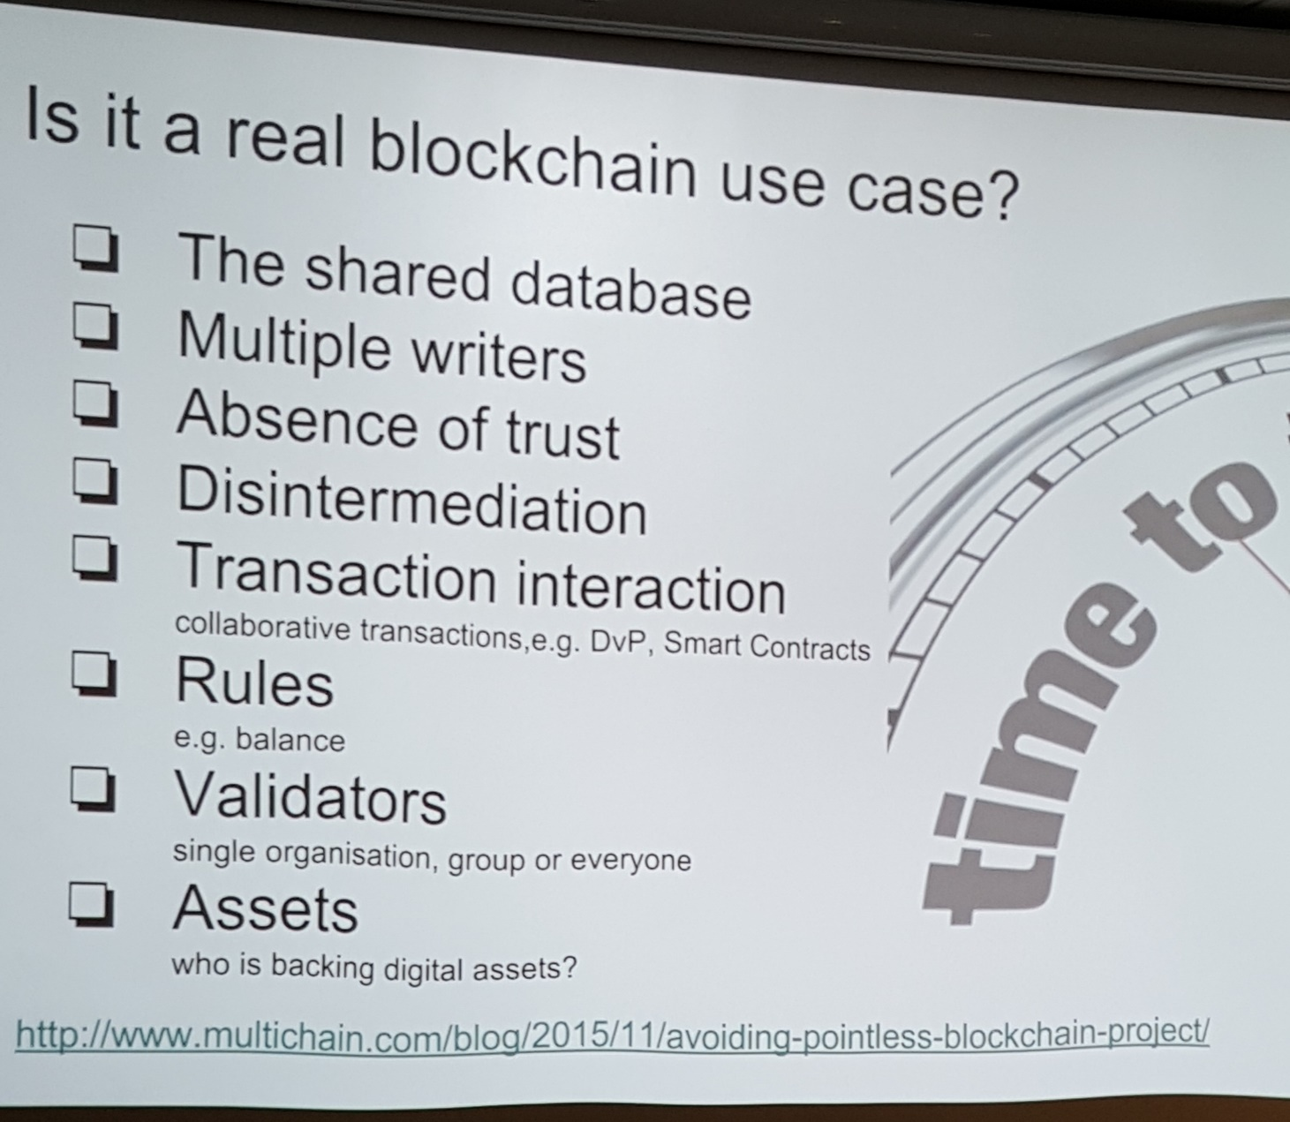




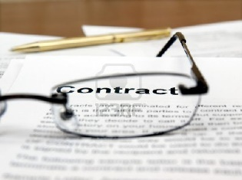

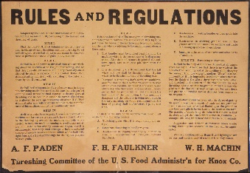


We heard the rules:

Slide 10

12 seconds DEMO time
Notes:
Here is how it works, and it’s implemented on the blockchain
We do a simple payment, say 100 CHF for a service., and here’s what happens.
Time is up, so vote for us if you want to know more.

Slide 11


THANKS !

