Slide 1


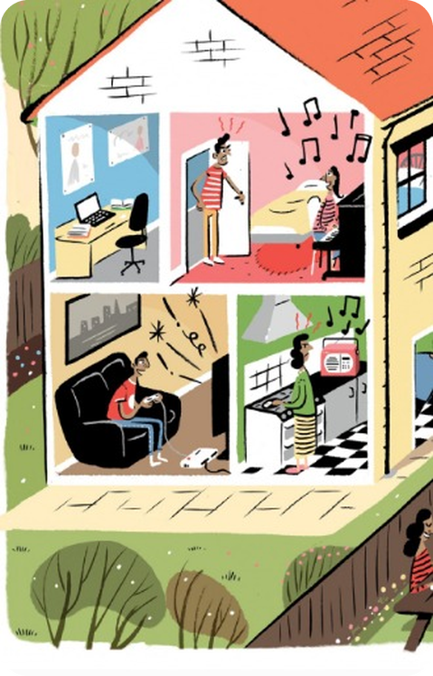


English File Elementary · SB pp.40–41
💡 THINK · PENSA
5B
A quiet life?
Present continuous · noise
🎯
Today you're going to…
🔊 talk about noise: bark, cry, argue, make a noise
🎬 say what's happening now: She's playing the piano
🔤 say /ŋ/: singing, going, young
🎧 listen to a noisy family and noisy neighbours
🕵️ guess what people are doing
Is your family noisy? Are your neighbours noisy?
EXAMPLE Yes! My neighbours have a dog and it barks all night.
Notes:
1. OPENING (2 min)
OPENING (2 min). TG lead-in: make a noise (music, bang the desk) – elicit noise, make a noise, noisy, neighbours /ˈneɪbəz/.

Slide 2

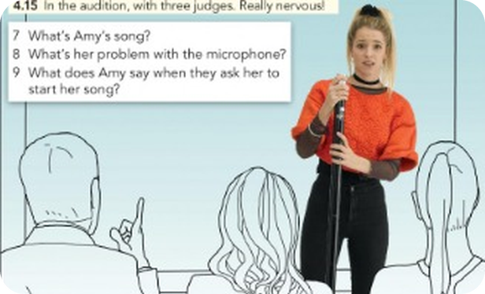
2
Remember last lesson?
💡 THINK → 💬 TALK
⏱ 3 min 👥 pairs
🎯 Revision · Retrieval
Can you remember? Say it – then use it in a sentence!
Ti ricordi? Dillo – poi usalo in una frase!
🔤 Can you remember these words? What do they mean?
call a taxi
look for your keys
wait for a bus
tell somebody a secret
send a text message
find a parking space
hear a noise
run a race
⭐ What does it mean?
⭐⭐ Use it in a sentence.
⭐⭐⭐ Make it negative or a question!
📅
Last lesson…
5A: Vote for me!
can / can't · verb phrases
Your turn: can / can't
I can sing. /kən/
She can't dance. /kɑːnt/
Can you swim? – Yes, I can.
5B · Revision · last lesson
Notes:
2. Revision · last lesson (3 min)
ACTIVE RECAP (3 min). Pairs: 3 things you can do well, 1 you can't do at all.
HOW TO RUN IT (active recap): pairs. Words: A points at a word, B says what it means (⭐); then a sentence with it (⭐⭐); strong students make it negative or a question (⭐⭐⭐). Grammar: pairs make their own example for each use (offer, plan…) BEFORE you click – then click to show the model answers.

Slide 3

3
Noisy family? Noisy neighbours?
👀 READ → 🎧 LISTEN
⏱ 5 min 👥 pairs
🎯 Vocabulary · Controlled practice
Read the forum. Guess the meaning of the highlighted verbs. Then listen and number the sounds 1–8.
Leggi il forum. Indovina i verbi evidenziati. Poi ascolta e numera i suoni 1–8.
⭐
Example
1
Sound 1
The couple next door argue a lot.
Do you have a problem with noise? Tell us about your problems.
2
Sound 2
The neighbours' dog barks all day – and all night!
3
Sound 3
The baby in the flat upstairs cries all the time.
4
Sound 4
The old people next door have the TV on very loud.
5
Sound 5
The people next door have builders who make a lot of noise.
6
Sound 6
The people next door often have noisy parties until 3.00 a.m.
7
Sound 7
My sister practises the piano for hours.
🎧 5.9
8
Sound 8
My son plays loud music in his room – awful music, too.
5B · Vocabulary · noise · 📖 SB p.40 · 1a, 1b · audio 5.9 (TG key)
Notes:
3. Vocabulary · noise (5 min)
NOISE (5 min). 1a: questions 1–4 with a partner first (how many family members, are they noisy, neighbours upstairs / downstairs / next door). 1b key (TG). play loud music = put music on (not play an instrument).

Slide 4

4
Are you noisy?
💬 TALK · PARLA
⏱ 3 min 👥 pairs
🎯 Speaking · Communicative
Answer the questions with a partner.
Rispondi con un compagno.
1
What noises do your family or neighbours make? Are the noises a problem for you?
e.g. My brother plays loud music. It's a problem when I study.
2
Are you noisy? Do you do any of the things in the forum?
e.g. Yes – I have noisy parties!
3
Are people in your country noisy? Is this a problem?
e.g. Yes, very! In Bagheria people talk very loud.
💬
Useful phrases
My neighbours upstairs / downstairs / next door…
It's a problem because…
I play loud music!
Italians are quite noisy!
5B · Speaking · noise · 📖 SB p.40 · 1c
Notes:
4. Speaking · noise (3 min)
NOISE TALK (3 min). Students interview you first (TG), then each other.

Slide 5

5
It's impossible to work!
🎧 LISTEN → ✏️ FILL THE GAPS
⏱ 6 min 👤 alone
🎯 Grammar · Listening → grammar
Why are Max and his mother unhappy? Listen. Then complete the conversations with verbs from the list.
Perché Max e sua madre sono infelici? Ascolta. Poi completa con i verbi.
1 · Max and Lucy
MAX Hey, Lucy. I'm (1) ________ to study, and you're (2) ________ an awful noise.
LUCY It isn't a noise, it's Beethoven. I'm (3) ________ – I have a school concert tomorrow. You can study downstairs.
MAX I can't, Jake's (4) ________ a video game. LUCY What about the kitchen?
MAX No, Mum's (5) ________ dinner, and she's (6) ________ to the radio. It's impossible to work in this house!
🏠
Why are they unhappy?
1 · Max and Lucy
MAX Hey, Lucy. I'm (1) trying to study, and you're (2) ________ an awful noise.
LUCY It isn't a noise, it's Beethoven. I'm (3) ________ – I have a school concert tomorrow. You can study downstairs.
MAX I can't, Jake's (4) ________ a video game. LUCY What about the kitchen?
MAX No, Mum's (5) ________ dinner, and she's (6) ________ to the radio. It's impossible to work in this house!
1 · Max and Lucy
MAX Hey, Lucy. I'm (1) trying to study, and you're (2) making an awful noise.
LUCY It isn't a noise, it's Beethoven. I'm (3) ________ – I have a school concert tomorrow. You can study downstairs.
MAX I can't, Jake's (4) ________ a video game. LUCY What about the kitchen?
MAX No, Mum's (5) ________ dinner, and she's (6) ________ to the radio. It's impossible to work in this house!
1 · Max and Lucy
MAX Hey, Lucy. I'm (1) trying to study, and you're (2) making an awful noise.
LUCY It isn't a noise, it's Beethoven. I'm (3) practising – I have a school concert tomorrow. You can study downstairs.
MAX I can't, Jake's (4) ________ a video game. LUCY What about the kitchen?
MAX No, Mum's (5) ________ dinner, and she's (6) ________ to the radio. It's impossible to work in this house!
1 · Max and Lucy
MAX Hey, Lucy. I'm (1) trying to study, and you're (2) making an awful noise.
LUCY It isn't a noise, it's Beethoven. I'm (3) practising – I have a school concert tomorrow. You can study downstairs.
MAX I can't, Jake's (4) playing a video game. LUCY What about the kitchen?
MAX No, Mum's (5) ________ dinner, and she's (6) ________ to the radio. It's impossible to work in this house!
1 · Max and Lucy
MAX Hey, Lucy. I'm (1) trying to study, and you're (2) making an awful noise.
LUCY It isn't a noise, it's Beethoven. I'm (3) practising – I have a school concert tomorrow. You can study downstairs.
MAX I can't, Jake's (4) playing a video game. LUCY What about the kitchen?
MAX No, Mum's (5) cooking dinner, and she's (6) ________ to the radio. It's impossible to work in this house!
1 · Max and Lucy
MAX Hey, Lucy. I'm (1) trying to study, and you're (2) making an awful noise.
LUCY It isn't a noise, it's Beethoven. I'm (3) practising – I have a school concert tomorrow. You can study downstairs.
MAX I can't, Jake's (4) playing a video game. LUCY What about the kitchen?
MAX No, Mum's (5) cooking dinner, and she's (6) listening to the radio. It's impossible to work in this house!
2 · Isabel and Paul
ISABEL Paul! Come here. PAUL Yes, dear? What's the matter?
ISABEL What's (7) ________ next door? Why's their dog (8) ________ ? I can't hear the radio.
PAUL They're (9) ________ a party in the garden.
ISABEL Not again! Can you go and talk to them? PAUL Yes, good idea. It's their second party in three weeks!
2 · Isabel and Paul
ISABEL Paul! Come here. PAUL Yes, dear? What's the matter?
ISABEL What's (7) happening next door? Why's their dog (8) ________ ? I can't hear the radio.
PAUL They're (9) ________ a party in the garden.
ISABEL Not again! Can you go and talk to them? PAUL Yes, good idea. It's their second party in three weeks!
2 · Isabel and Paul
ISABEL Paul! Come here. PAUL Yes, dear? What's the matter?
ISABEL What's (7) happening next door? Why's their dog (8) barking ? I can't hear the radio.
PAUL They're (9) ________ a party in the garden.
ISABEL Not again! Can you go and talk to them? PAUL Yes, good idea. It's their second party in three weeks!
2 · Isabel and Paul
ISABEL Paul! Come here. PAUL Yes, dear? What's the matter?
ISABEL What's (7) happening next door? Why's their dog (8) barking ? I can't hear the radio.
PAUL They're (9) having a party in the garden.
ISABEL Not again! Can you go and talk to them? PAUL Yes, good idea. It's their second party in three weeks!
barking · cooking · happening · having · listening
making · playing · practising · trying
Max can't study – his family are making a lot of noise. His mum: the neighbours' party and dog.
5B · Grammar · present continuous · 📖 SB p.41 · 2a, 2b · audio 5.10 (TG key)
Notes:
5. Grammar · present continuous (6 min)
MAX'S FAMILY (6 min). Cover the text, play 5.10: why are they unhappy? (click side answer). Then play again – one click per gap. TG key: 1 trying 2 making 3 practising 4 playing 5 cooking 6 listening 7 happening 8 barking 9 having. EXTRA: pairs read the conversations aloud.

Slide 6
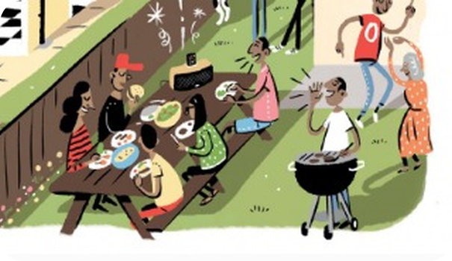
6
Paul goes next door
🎧 LISTEN → ✅ CHECK
⏱ 3 min 👤 alone
🎯 Listening · Controlled practice
Listen. What happens when Paul goes next door?
Ascolta. Cosa succede quando Paul va dai vicini?
⭐
Example
1
Why are they having a party?
It's the woman's birthday.
Guess first! Does Paul stop the party?
2
What does Paul want to talk about?
The noise.
3
What happens?
They invite him to the party and offer him a drink – he has a beer!
4
What's the last question?
'Do you want to dance, Paul?'
🎧 5.11
5B · Listening · next door · 📖 SB p.41 · 2c · audio 5.11 (TG key + script p.119)
Notes:
6. Listening · next door (3 min)
NEXT DOOR (3 min). Elicit ideas, play 5.11. TG key: the neighbours invite him to the party and offer him a drink. What does Isabel think now?!

Slide 7

7
be + verb + -ing
👀 LOOK · GUARDA
⏱ 4 min 🙋 whole class
🎯 Grammar · Guided discovery
Complete with be. Then click!
Completa con be. Poi clicca!
+ / − / ?
Use + spelling
+ They're having a party next door.
? Are they playing music?
− No, they aren't playing music. They're talking.
NOW: We're having a class. I'm talking, you're listening.
play → playing · study → studying (no change!)
have → having (−e) · sit → sitting (double)
be (am / is / are) + verbo + -ing
adesso, in questo momento (= sto facendo)
⚠ ✗ Hello! What do you do here? → ✓ What are you doing here? · ✗ studing → ✓ studying · see → seeing (-ee: keep it)
5B · Grammar Bank 5B · the rule · 📖 SB p.41 · 2d, 2e · Grammar Bank 5B p.132 · audio 5.12 (TG notes)
Notes:
7. Grammar Bank 5B · the rule (4 min)
RULE (4 min). 2d key (TG): They're / are having · Are they playing · aren't playing. 2e: now. TG notes: the typical mistake is the present simple for now (What do you do here?). -ing spelling: y stays, drop e (but be, see, agree).

Slide 8
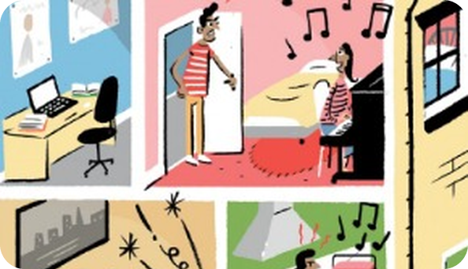
8
Grammar Bank practice
✍️ WRITE → ✅ CHECK
⏱ 4 min 👥 pairs
🎯 Grammar · TPRS · reading
Grammar Bank 5B a: What are they doing?
Grammar Bank 5B a: Cosa stanno facendo?
Ask and answer
1 she / cry → (1) ________
1 she / cry → What's she doing? She's crying.
2 they / watch TV → (2) ________
2 they / watch TV → What are they doing? They're watching TV.
3 he / play basketball → (3) ________
3 he / play basketball → What's he doing? He's playing basketball.
4 they / sing → (4) ________
4 they / sing → What are they doing? They're singing.
💡
Remember
5 it / eat → (5) ________
5 it / eat → What's it doing? It's eating.
What's he / she doing?
5B · Grammar Bank 5B p.133 · a · 📖 Grammar Bank 5B p.133 · a (TG key)
Notes:
8. Grammar Bank 5B p.133 · a (4 min)
GRAMMAR BANK a (4 min). Prompts made from the TG answers. b key (TG): 1 'm staying 2 are…doing 3 'm looking for 4 'm looking 5 Are…living 6 's…doing 7 Is…studying 8 's working 9 isn't enjoying 10 's looking for.

Slide 9
9
What's happening?
🎧 LISTEN → 🔊 SAY IT
⏱ 4 min 👥 pairs
🎯 Grammar · Controlled practice
Books closed! Listen to the sounds. What's happening? Say a full sentence.
Libri chiusi! Ascolta i suoni. Cosa succede? Di' una frase intera.
⭐
Example
1
Sound 2
Somebody's sending messages / texting.
1 Somebody's cooking. (Somebody = a man or a woman)
2
Sound 3
Somebody's having a shower and singing.
3
Sound 4
It's raining.
4
Sound 5
Somebody's eating spaghetti.
5
Sound 6
Somebody's making a coffee.
6
Sound 7
Somebody's crying.
🎧 5.13
7
Sound 8
Somebody's doing the housework.
5B · Grammar · listen to the sounds · 📖 SB p.41 · 2g · audio 5.13 (TG key)
Notes:
9. Grammar · listen to the sounds (4 min)
SOUNDS (4 min). Play once, then again pausing – pairs write full sentences. Accept any good answer. No audio yet? Do it live: mime or make the sounds yourself!

Slide 10
10
singer /ŋ/
🎧 LISTEN → 🔊 SAY IT
⏱ 3 min 🙋 whole class
🎯 Pronunciation · Guided discovery
Listen and repeat /ŋ/. Then: /ŋ/ or /ŋk/?
Ascolta e ripeti /ŋ/. Poi: /ŋ/ o /ŋk/?
🏷️
The sound
singing
🎤 singer /ŋ/
going
🎤 singer /ŋ/
🎤 singer /ŋ/
🏦 + k: /ŋk/
doing
🎤 singer /ŋ/
studying
🎤 singer /ŋ/
language
🎤 singer /ŋ/
wrong
🎤 singer /ŋ/
🎧 5.14
young
🎤 singer /ŋ/
think
🏦 + k: /ŋk/
bank
🏦 + k: /ŋk/
pink
🏦 + k: /ŋk/
thanks
🏦 + k: /ŋk/
5B · Pronunciation · /ŋ/ · 📖 SB p.41 · 3a · audio 5.14
Notes:
10. Pronunciation · /ŋ/ (3 min)
/ŋ/ (3 min). No hard g at the end: singing, not 'singin-g'! Back of the tongue up. Sound Bank video on the Teacher's Resource Centre (TG).

Slide 11
11
What's she doing?
💬 TALK · PARLA
⏱ 4 min 👥 pairs
🎯 Speaking · Communicative
Point at the picture of the houses. Ask and answer: What's she doing?
Indica la figura delle case. Chiedi e rispondi: What's she doing?
1
The girl upstairs?
e.g. She's playing the piano.
2
The boy in the living room?
e.g. He's playing a video game.
3
The woman in the kitchen?
e.g. She's cooking and listening to the radio.
💬
Useful phrases
4
The people in the garden?
e.g. They're having a party.
She's playing the piano.
What are they doing?
They're having a party.
The dog is barking.
5
What's your mum doing now? Your best friend?
e.g. I think she's probably having lunch.
5B · Speaking · the houses · 📖 SB p.41 · 3b · TG extra idea
Notes:
11. Speaking · the houses (4 min)
THE HOUSES (4 min). Then TG extra idea: write 5 friends / family on the board – What's your mother doing at the moment? – I think she's probably having lunch. Spot the differences (Communication A p.105, B p.110 – TG key) if you have the books.

Slide 12
12
What are they doing?
🎧 LISTEN → ✅ CHECK
⏱ 6 min 👤 alone
🎯 Listening · Controlled practice
Listen to 6 short conversations. What are the people doing?
Ascolta 6 conversazioni. Cosa stanno facendo?
⭐
Example
1
The woman (5.15)
She's checking in at a hotel. – reservation, two nights, sign here, key card, room 212
Which words help you? Write two for each.
2
1
He's buying a coffee. – latte, regular or large, take away, £3.40
3
2
He's looking for his car keys. – I can't find them, Look in the living room
4
3
They're waiting for a train. – waiting room, platform, slow train
5
4
She's taking a photo. – stand together, Are you ready?, Say cheese!
6
5
He's having a job interview. – the hours, overtime, the contract
🎧 5.16
5B · Listening · working out the situation · 📖 SB p.41 · 4a–4d · audio 5.15, 5.16 (TG key + scripts pp.119–120)
Notes:
12. Listening · working out the situation (6 min)
WHAT ARE THEY DOING? (6 min). 5.15 first (She's checking in…), then 5.16 – pause after each. Key + clue words (TG).

Slide 13
13
Guess what I'm doing!
🎲 PLAY → 💬 TALK
⏱ 6 min 🏆 teams
🎯 Speaking · Communicative game
Guess what I'm doing! Mime an action. The others guess with the present continuous.
Indovina cosa sto facendo! Mima un'azione. Gli altri indovinano.
🎲
How to play
Are you playing the guitar?
→ Yes, I am!
1
One student mimes an action (no talking!).
The team guesses: Are you swimming? – No, I'm not!
Correct guess in 30 seconds = 1 point. Use verb phrases from 5A too!
Are you looking for your keys?
→ No, I'm not. I'm…
2
Is she taking a photo?
→ Yes, she is!
3
Are they arguing?
→ No – they're dancing the tango!
4
TEAM A ☆☆☆☆☆
TEAM B ☆☆☆☆☆
5B · Game · mime it! · 📖 Communicative photocopiable Guess what I'm doing! p.227 – zero-prep version
Notes:
13. Game · mime it! (6 min)
MIME (5 min). Short answers: Yes, I am. / No, I'm not.

Slide 14
14
3 · 2 · 1
⏱ 2 min 👥 pairs
🎯 Revision · Retrieval
Books closed! Tell your partner…
Libri chiusi! Di' al compagno…
3
Tell me 3 noisy things neighbours do.
📝
Homework · Compiti
Workbook 5B pp.34–35
2
Tell me 2 things people are doing in this room now.
Next lesson: 5C A city for all seasons – present simple or continuous? (SB p.42)
1
Tell me what happens when Paul goes next door.
5B · Exit · what can you remember?
Notes:
14. Exit · what can you remember? (2 min)
EXIT (2 min). Pairs, books closed.

Slide 15
15
Today you…
💡 THINK · PENSA
⏱ 1 min 🙋 whole class
🎯 Revision · Reflection
Can you do it now? Thumbs up or thumbs down!
Ora sai farlo? Pollice su o pollice giù!
🔊
Talked about noise: bark, cry, argue, make a noise
✅
👍 👌 👎
Can you do it now?
Ora sai farlo?
🎬
Said what's happening now: She's playing the piano
✅
🔤
Said /ŋ/: singing, going, young
✅
🎧
Listened to a noisy family and noisy neighbours
✅
🕵️
Guessed what people are doing
✅
5B · Review · what did you do today?
Notes:
15. Review · what did you do today? (1 min)
TODAY YOU… (1 min). Read each line (one per click: the tick appears). Students show thumbs up / middle / down: can they do it now? Note any thumbs down for the next lesson's recap.

