Slide 1


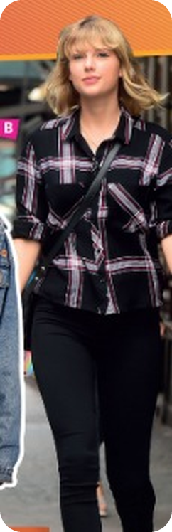


Prepare · Unit 2 · SB pp.14–15
💡 THINK · PENSA
2A
In fashion
Clothes adjectives · Fashion and music
🎯
Today you're going to…
👕 describe clothes with 10 new adjectives
📸 say what famous people are wearing
📖 read 'Fashion and music'
🎸 match the fashions to the decades
🗣️ say why young people dress like music stars
What are you wearing today? What fashions do you like? Which colours or clothes look good on you?
EXAMPLE Today I'm wearing jeans and a black hoodie. I like 90s fashion. I think blue looks good on me.
Notes:
1. OPENING (3 min)
ABOUT YOU (3 min). SB p.14 – the video is online only, so start with the questions. Model (TB): 'Today I'm wearing trousers and a shirt. I like fashions from the 1960s. I look good in bright colours.' Pairs ask and answer; 3 students report their partner ('She's wearing…' – 3rd person -s!).

Slide 2

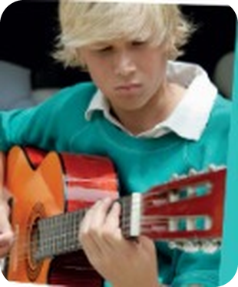
2
Remember last lesson?
💡 THINK → 💬 TALK
⏱ 3 min 👥 pairs
🎯 Revision · Retrieval
Can you remember? Say it – then use it in a sentence!
Ti ricordi? Dillo – poi usalo in una frase!
🔤 Can you remember these words? What do they mean?
impatient
unfair
incorrect
unwell
impolite
invisible
quite
a bit
⭐ What does it mean?
⭐⭐ Use it in a sentence.
⭐⭐⭐ Make it negative or a question!
📅
Last lesson…
Your turn: present simple
Your turn: present continuous
1B: All about me (2)
present simple / continuous · un-, in-, im-
Make a habit · a fact · a no -ing verb
Make a now · a temporary · a plan
I practise every day.
She doesn't like cold weather.
Right now I'm living in the USA.
I'm going to the cinema tonight.
2A · Revision · last lesson
Notes:
2. Revision · last lesson (3 min)
ACTIVE RECAP (3 min). Words: ⭐ meaning ⭐⭐ sentence ⭐⭐⭐ negative or question. Grammar: students make their OWN example for each card first, then click for the models. Check homework: who wrote their online profile? 2 students read theirs.
HOW TO RUN IT (active recap): pairs. Words: A points at a word, B says what it means (⭐); then a sentence with it (⭐⭐); strong students make it negative or a question (⭐⭐⭐). Grammar: pairs make their own example for each use (offer, plan…) BEFORE you click – then click to show the model answers.

Slide 3

3
Clothes race
🎲 PLAY · GIOCA
⏱ 4 min 🏆 teams
🎯 Revision · Communicative game
Teams: 60 seconds! Write clothes words.
Squadre: 60 secondi! Scrivete parole di vestiti.
🎲
How to play
Clothes for your top half
→ shirt, T-shirt, jacket, top, blouse, hoodie, jumper
e.g.
60 seconds per round. Write as many clothes words as you can.
Correct spelling = 1 point.
Someone in the class is wearing it = 1 more point!
Clothes for your legs
→ jeans, trousers, skirt, shorts, tights, tracksuit
1
On your feet
→ trainers, boots, sandals, shoes
2
Accessories
→ bag, handbag, cap, tie, necklace, sunglasses
3
TEAM A ☆☆☆☆☆
TEAM B ☆☆☆☆☆
2A · Warmer · clothes · 📖 TB p.25 · warmer
Notes:
3. Warmer · clothes (4 min)
WARMER (4 min) – TB warmer as a team race. Round 1 is the example (click to show). Teams write; read lists; bonus point if someone in the room is wearing it. TB key words: bag, blouse, boots, cap, handbag, jacket, jeans, necklace, shirt, sleeve, suit, T-shirt, tie, top, tracksuit, trainers, trousers.

Slide 4
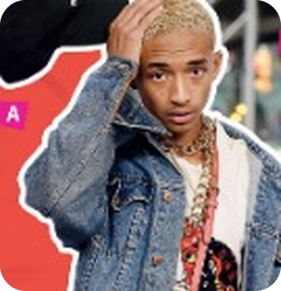
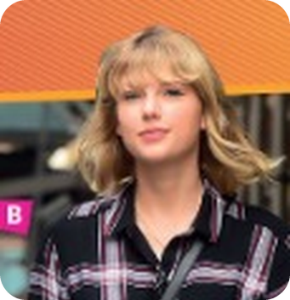
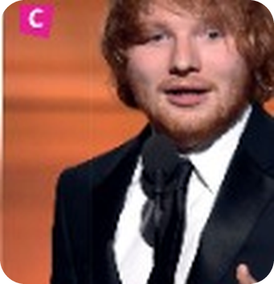
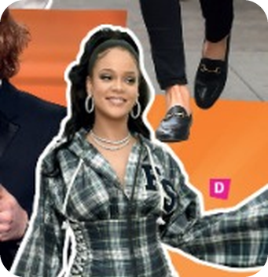
4
Who's wearing what?
👀 LOOK → 💬 TALK
⏱ 4 min 👥 pairs
🎯 Vocabulary · Controlled practice
Who are the people? What are they wearing?
Chi sono? Cosa indossano?
A
B
C
e.g. A
Jaden Smith (singer, actor): denim jacket, white T-shirt, white trousers, black cap (bag, necklaces)
B
Taylor Swift (singer, actor): black shirt, black trousers (handbag)
C
Ed Sheeran (singer): black suit, white shirt, black tie
D
D
Rihanna (singer): trainers, trousers, black and white blouse
2A · Vocabulary · describe the photos · 📖 SB p.14 · Vocabulary 1
Notes:
4. Vocabulary · describe the photos (4 min)
PHOTOS (4 min). SB Vocabulary ex.1 – no audio, so check with the slide. A is the example. Pairs name each person and list their clothes; click once per photo. Key (TB p.25). Accept any correct description ('He's wearing a red bag').

Slide 5

5
Comfortable or smart?
✅ CHECK · CONTROLLA
⏱ 4 min 🙋 whole class
🎯 Vocabulary · TPRS · meaning
Explain it in English (harder) – or say it in Italian (easier). Click.
Spiegalo in inglese (più difficile) – o dillo in italiano (più facile). Clicca.
🛋️
comfortable
📏
skinny
🏷️
brand new
👔
smart
gives a pleasant feeling
narrow and fitting closely to the body
completely new
clean, tidy and stylish
comodo
attillato, skinny
nuovo di zecca
elegante
🔥
trendy
⭐
well-dressed
👖
loose-fitting
♻️
second-hand
popular at a particular time
wearing attractive, good-quality clothes
large and comfortable to wear
owned by someone before you
alla moda
ben vestito
largo, comodo
di seconda mano, usato
⚠ Watch out! smart = elegante (not 'intelligente' here!) · comfortable /ˈkʌmftəbl/ – 3 syllables
2A · Vocabulary · clothes adjectives · 📖 SB p.14 · Vocabulary 3, 4 · WB p.8 ex.2 meanings
Notes:
5. Vocabulary · clothes adjectives (4 min)
KEY WORDS (4 min). The adjectives from SB ex.3 and ex.4 (the interview is online only). Meanings = Workbook p.8 ex.2. Point at clothes in the room: 'Are Luca's trainers brand new?' Drill comfortable /ˈkʌmftəbl/ and dressed /drest/ (TB).

Slide 6
6
Opposites
🔗 MATCH · ABBINA
⏱ 3 min 👥 pairs
🎯 Vocabulary · Controlled practice
Match each adjective to its OPPOSITE.
Abbina ogni aggettivo al suo CONTRARIO.
⭐
Example
1
casual
smart
badly-dressed → well-dressed
2
loose-fitting
skinny
3
second-hand
brand new
4
uncomfortable
comfortable
5
unfashionable
trendy
2A · Vocabulary · opposites · 📖 SB p.14 · Vocabulary 4
Notes:
6. Vocabulary · opposites (3 min)
OPPOSITES (3 min). SB Vocabulary ex.4 – the example is from the book. Pairs match; click once per line. Key (TB p.25): badly-dressed – well-dressed · casual – smart · loose-fitting – skinny · second-hand – brand new · uncomfortable – comfortable · unfashionable – trendy. Drill casual /ˈkæʒuəl/, uncomfortable /ʌnˈkʌmftəbl/.

Slide 7
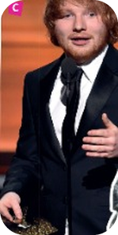
7
Which photo?
👀 LOOK → 💬 TALK
⏱ 3 min 👥 pairs
🎯 Speaking · Communicative
Describe a photo with 3 adjectives. Your partner guesses which one!
Descrivi una foto con 3 aggettivi. Il compagno indovina quale!
1
Describe one photo (A–D) with 3 adjectives from today.
e.g. She's wearing loose-fitting trousers – they look comfortable. It's quite trendy. – Is it D?
2
Swap! How many adjectives can you use for ONE photo?
e.g. C: smart, well-dressed, brand new…
3
Challenge: describe someone in the class. Don't say the name!
e.g. He's wearing comfortable trainers and a casual jacket.
💬
Useful phrases
He's / She's wearing…
a smart suit / skinny jeans
He looks really well-dressed.
I think it's casual / trendy.
Is it photo…?
2A · Speaking · describe and guess · 📖 SB p.14 · Vocabulary 4 (second part) · TB fast finishers
Notes:
7. Speaking · describe and guess (3 min)
DESCRIBE AND GUESS (3 min). SB ex.4 part 2 ('How many adjectives can you match to each photo?') + TB fast finishers. Model line 1 yourself. Keep the class challenge kind.

Slide 8
8
You and your clothes
💬 TALK · PARLA
⏱ 4 min 👥 pairs
🎯 Speaking · Communicative
Discuss the questions. Give reasons!
Discuti le domande. Dai motivi!
💬
Useful phrases
1
What do you like wearing? What types of clothing do you never wear? Why?
e.g. I like wearing hoodies. I never wear skirts – they're uncomfortable.
I like wearing… because…
I'd never wear…
I prefer casual / smart clothes.
For me, it's (not) very important to…
2
Do you generally prefer smart or casual clothes? Why?
e.g. Casual – I want to be comfortable.
3
How important is it for you to wear trendy clothes?
e.g. Not very important. I like second-hand clothes.
2A · Speaking · about you · 📖 SB p.14 · Vocabulary 5
Notes:
8. Speaking · about you (4 min)
DISCUSS (4 min). SB Vocabulary ex.5. Ask stronger students first, then pairs. Join in; 3 students tell the class about their partner. Board any new words.

Slide 9
9
Stars of the past
💡 THINK → 🎲 PLAY
⏱ 3 min 🏆 teams
🎯 Reading · Communicative game
Teams: 1 minute! Name bands and singers from the last century.
Squadre: 1 minuto! Nominate band e cantanti del secolo scorso.
🎲
How to play
e.g. 1950s
→ Elvis Presley, Buddy Holly, The Supremes
e.g.
Read the article quickly (next slide).
1 point for every name that is in the article!
1960s–70s
→ The Rolling Stones, The Beatles, Dusty Springfield, Joni Mitchell
1
Late 70s – 80s
→ The Clash, Debbie Harry, Patti Smith, Michael Jackson, Madonna, U2
2
TEAM A ☆☆☆☆☆
TEAM B ☆☆☆☆☆
1990s
→ Britney Spears, the Backstreet Boys, the Spice Girls
3
2A · Reading · prediction · 📖 SB p.15 · Reading 1
Notes:
9. Reading · prediction (3 min)
PREDICTION (3 min). SB Reading ex.1. Teams write names (1 min). Then they read the article QUICKLY (next 2 slides, 2 min) and score a point for each name in it. Click: the names in the article by decade.

Slide 10
10
Fashion and music (1)
👀 READ · LEGGI
⏱ 5 min 👤 alone
🎯 Reading · for detail
Read part 1. Choose A or B for questions 1–3.
Leggi la parte 1. Scegli A o B per le domande 1–3.
1 Before the 1950s, teenagers… A didn't listen to music very much. B listened to the same music as adults.
Fashion and music
Before the mid-1950s, there was no such thing as 'youth culture'. Most young people wore the same fashions as their parents, and they listened to the same kind of music. But that all changed with the arrival of rock 'n' roll.
It started with the 1954 song Rock Around the Clock by Bill Haley and the Comets. Although the older generation didn't understand rock 'n' roll, teenagers fell in love with it straight away. It was a new sound – lively and exciting – and with it came new fashions in clothing. Young men wore smart suits with skinny ties, like the popular singers Buddy Holly and Elvis Presley. Young women liked groups such as The Supremes, and they wore loose-fitting skirts which looked great when they danced.
In the 1960s, rock bands like The Rolling Stones became symbols of the growing youth culture. Young women wore very short 'mini skirts' – the older generation was shocked! The mid-1960s to the mid-70s was the hippie era. Young hippies were interested in peace and love, and they listened to The Beatles, Dusty Springfield and Joni Mitchell. Men and women alike had long hair and wore flowery clothing and sandals.
Fashion and music
Before the mid-1950s, there was no such thing as 'youth culture'. Most young people wore the same fashions as their parents, and they listened to the same kind of music. But that all changed with the arrival of rock 'n' roll.
It started with the 1954 song Rock Around the Clock by Bill Haley and the Comets. Although the older generation didn't understand rock 'n' roll, teenagers fell in love with it straight away. It was a new sound – lively and exciting – and with it came new fashions in clothing. Young men wore smart suits with skinny ties, like the popular singers Buddy Holly and Elvis Presley. Young women liked groups such as The Supremes, and they wore loose-fitting skirts which looked great when they danced.
In the 1960s, rock bands like The Rolling Stones became symbols of the growing youth culture. Young women wore very short 'mini skirts' – the older generation was shocked! The mid-1960s to the mid-70s was the hippie era. Young hippies were interested in peace and love, and they listened to The Beatles, Dusty Springfield and Joni Mitchell. Men and women alike had long hair and wore flowery clothing and sandals.
1
B – 'they listened to the same kind of music'
2 In the 1950s, teenage boys… A joined rock 'n' roll bands. B wore clothes similar to the pop stars.
2
B – 'smart suits with skinny ties, like the popular singers'
3 In the 1960s, A fashions shocked some people. B hippies wore mini skirts.
3
A – 'mini skirts – the older generation was shocked!'
2A · Reading · detail (1) · 📖 SB p.15 · Reading 2 (the text is on the slide)
Notes:
10. Reading · detail (1) (5 min)
DETAIL 1 (5 min). SB Reading ex.2, questions 1–3, next to the text. TB: find the key words in the question first (Q1 = the introduction, Q2 = paragraph 1). Click once per answer; the first click lights up the proof in the text. Key (TB p.27): 1B 2B 3A. Q3: hippies wore flowery clothing, not mini skirts.

Slide 11
11
Fashion and music (2)
👀 READ · LEGGI
⏱ 5 min 👤 alone
🎯 Reading · for detail
Read part 2. Choose A or B for questions 4–6.
Leggi la parte 2. Scegli A o B per le domande 4–6.
4 Punks in the late 70s… A wore colourful clothing. B didn't wear brand new clothes.
Fashion and music
The punk music of the late 70s was loud and angry, and the trends matched the music. Punks wanted to shock people. They dressed in second-hand clothes, which they often tore to look more individual, and their hairstyles were colourful and messy. Teenagers were into bands like The Clash and singers like Debbie Harry and Patti Smith. In the 1980s, long curly hair and bright colours were trendy, and people listened to Michael Jackson, Madonna and U2.
By the 1990s, teens were in love with the look and sound of singers like Britney Spears. It was also the decade of 'boy bands' and 'girl bands' – the Backstreet Boys and the Spice Girls were 'top of the pops'. Black American music called hip hop became popular internationally. Hip hop stars wore tracksuits, gold rings and necklaces, and they sang about having money and driving expensive cars.
Today, people are interested in the styles of their favourite YouTubers and tunes by superstar DJs like Calvin Harris. Hollywood actors or bestselling singers such as Taylor Swift and Ed Sheeran are also popular. There are dozens of genres of rock and dance music and, thanks to the internet, music and clothing fashions are here today and gone tomorrow.
Fashion and music
The punk music of the late 70s was loud and angry, and the trends matched the music. Punks wanted to shock people. They dressed in second-hand clothes, which they often tore to look more individual, and their hairstyles were colourful and messy. Teenagers were into bands like The Clash and singers like Debbie Harry and Patti Smith. In the 1980s, long curly hair and bright colours were trendy, and people listened to Michael Jackson, Madonna and U2.
By the 1990s, teens were in love with the look and sound of singers like Britney Spears. It was also the decade of 'boy bands' and 'girl bands' – the Backstreet Boys and the Spice Girls were 'top of the pops'. Black American music called hip hop became popular internationally. Hip hop stars wore tracksuits, gold rings and necklaces, and they sang about having money and driving expensive cars.
Today, people are interested in the styles of their favourite YouTubers and tunes by superstar DJs like Calvin Harris. Hollywood actors or bestselling singers such as Taylor Swift and Ed Sheeran are also popular. There are dozens of genres of rock and dance music and, thanks to the internet, music and clothing fashions are here today and gone tomorrow.
1
B – 'They dressed in second-hand clothes'
5 Hip hop singers of the 1990s liked… A wearing jewellery. B wearing smart suits.
2
A – 'gold rings and necklaces'
6 Nowadays, people… A get their fashion ideas from YouTubers. B wear similar clothing to Taylor Swift and Ed Sheeran.
3
A – 'the styles of their favourite YouTubers'
2A · Reading · detail (2) · 📖 SB p.15 · Reading 2 (the text is on the slide)
Notes:
11. Reading · detail (2) (5 min)
DETAIL 2 (5 min). Questions 4–6. Key (TB p.27): 4B 5A 6A. Q4: the HAIR was colourful, not the clothes. Q6: Taylor Swift and Ed Sheeran are popular, but the text doesn't say people dress like them.

Slide 12
12
Find the word
🔍 FIND · TROVA
⏱ 3 min 👥 pairs
🎯 Vocabulary · Guided discovery
Find the highlighted words in the article. Say the full sentence.
Trova le parole evidenziate nell'articolo. Di' la frase intera.
1
fashions or styles
'the trends matched the music.'
2
pulled something in order to break it
'second-hand clothes, which they often tore' (tear – tore)
3
untidy or dirty
'their hairstyles were colourful and messy.'
4
young people in general
'there was no such thing as youth culture.'
5
someone's appearance
'teens were in love with the look and sound of singers'
6
what people wear in general
'new fashions in clothing.'
2A · Vocabulary · words from the text · 📖 SB p.15 · Reading 3
Notes:
12. Vocabulary · words from the text (3 min)
WORDS (3 min). SB Reading ex.3. Key (TB p.27): 1 trends 2 tear (tore in the text) 3 messy 4 youth 5 look 6 clothing. TB also: straight away = immediately, lively = full of energy, alike = both men and women, be into = like, genre /ˈʒɒnrə/ = type.

Slide 13
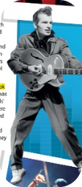
13
Which decade?
🎲 PLAY · GIOCA
⏱ 3 min 🏆 teams
🎯 Speaking · Communicative game
Teams: which decade? Then say it in a sentence!
Squadre: quale decennio? Poi dillo in una frase!
🎲
How to play
e.g.
smart suits and skinny ties
→ 1950s – 'Young men wore smart suits.'
Teacher reads the clue.
Say the decade = 1 point.
Past simple sentence = 1 more point!
mini skirts
→ 1960s – 'Young women wore very short skirts.'
1
2
long hair, flowery clothing and sandals
→ mid-60s to mid-70s (hippies)
3
torn second-hand clothes, messy hair
→ late 70s (punks)
4
long curly hair and bright colours
→ 1980s
5
tracksuits, gold rings and necklaces
→ 1990s (hip hop)
2A · Game · fashion through time · 📖 SB p.15 · recycles the article
Notes:
13. Game · fashion through time (3 min)
WHICH DECADE? (3 min). Teams answer from memory (books closed!); the first item is the example. Bonus point for a sentence with wore / listened / had – a preview of next lesson's past simple.

Slide 14
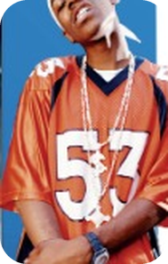
14
Talking points
💬 TALK · PARLA
⏱ 4 min 👨‍👩‍👧 groups
🎯 Speaking · Communicative
Discuss in groups. Agree or disagree – and say why!
Discutete in gruppi. D'accordo o no – e perché!
1
Why do young people like to dress differently from their parents and grandparents?
e.g. Because they want to look individual.
2
Why do you think people choose to dress like music stars?
e.g. Because they want to be like them – and it's trendy.
💬
Useful phrases
I think young people want to…
Because they want to look like…
I agree / I don't agree because…
My parents would never wear…
2A · Speaking · talking points · 📖 SB p.15 · Talking points
Notes:
14. Speaking · talking points (4 min)
TALKING POINTS (4 min). TB: 5 minutes of notes in groups, then share; other students agree/disagree. Weaker students: use the adjectives from p.14 and answer with 'Because…'.

Slide 15
15
3 · 2 · 1
⏱ 2 min 👥 pairs
🎯 Revision · Retrieval
Books closed! Tell your partner…
Libri chiusi! Di' al compagno…
3
Tell me 3 clothes adjectives and their opposites.
📝
Homework · Compiti
Workbook p.8: exercises 1–4 (clothes adjectives)
Workbook p.9: read 'What do you think about shoes?', exercises 1–4
2
Tell me 2 fashions from the article and their decades.
Next lesson: past simple · adverbs (SB p.16)
1
Tell me 1 thing you're wearing today – with an adjective.
2A · Exit · what can you remember?
Notes:
15. Exit · what can you remember? (2 min)
EXIT (2 min). Pairs, books closed. Homework is in the students' app.

Slide 16
16
Today you…
💡 THINK · PENSA
⏱ 1 min 🙋 whole class
🎯 Revision · Reflection
Can you do it now? Thumbs up or thumbs down!
Ora sai farlo? Pollice su o pollice giù!
👕
Described clothes with 10 new adjectives
✅
👍 👌 👎
Can you do it now?
Ora sai farlo?
📸
Said what famous people are wearing
✅
📖
Read 'Fashion and music'
✅
🎸
Practised match the fashions to the decades
✅
🗣️
Said why young people dress like music stars
✅
2A · Review · what did you do today?
Notes:
16. Review · what did you do today? (1 min)
TODAY YOU… (1 min). Read each line (one per click: the tick appears). Students show thumbs up / middle / down: can they do it now? Note any thumbs down for the next lesson's recap.

Slide 17
⭐
Optional extensions
Only if there's time – the lesson is finished. · Solo se c'è tempo – la lezione è finita.
Notes:
17. OPTIONAL EXTENSIONS
The lesson ended on the previous slide ("Today you…"). Use the next slides only if there is time left, or keep them for a quick start next lesson.

Slide 18
18
Who is it?
✍️ WRITE → 🎲 PLAY
⏱ 4 min 🙋 whole class
🎯 Speaking · Communicative game
Write a description of a classmate's clothes. The class guesses who it is!
Descrivi i vestiti di un compagno. La classe indovina chi è!
🎲
How to play
This person is wearing…
→ This person is wearing skinny black jeans and brand new trainers.
e.g.
Write 2 sentences about a classmate's clothes – no name!
Use 2 adjectives from today.
Swap papers. Read one out. Guess who!
Their jacket looks…
→ Their jacket looks really comfortable.
1
I think their style is…
→ I think their style is casual and trendy.
2
⭐ OPTIONAL EXTENSION · only if there's time
2A · Cooler · who is it? · 📖 TB p.27 · cooler
Notes:
18. Cooler · who is it? (4 min)
COOLER (4 min) – TB cooler. Students write a short description (no name, no 'he/she'), swap, volunteers read out, the class guesses.

