Slide 1


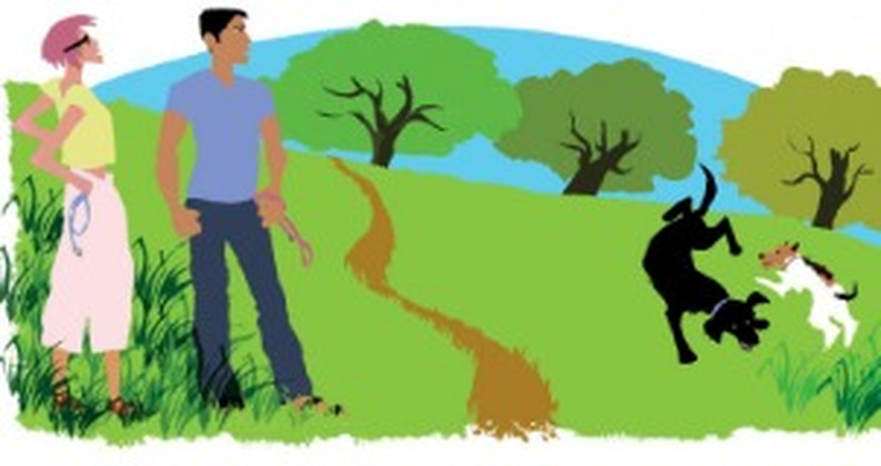


English File Elementary · SB pp.26–27 · Writing p.113
💡 THINK · PENSA
3C
Love me, love my dog
Word order in questions · question words
🎯
Today you're going to…
❓ put questions in the right order: What kind of music do you like?
🔤 use question words: who, which, why…
🎵 say questions with the right rhythm
🎧 listen to Becca and Dave meet in the park
✍️ write a personal profile
Do you have a dog? What kind of dog is it?
EXAMPLE Yes, I do. She's a Labrador. Her name's Luna.
Notes:
1. OPENING (2 min)
OPENING (2 min). TG lead-in: who has a dog? What kind of dog? Who usually takes it for a walk?

Slide 2


2
Remember last lesson?
💡 THINK → 💬 TALK
⏱ 3 min 👥 pairs
🎯 Revision · Retrieval
Can you remember? Say it – then use it in a sentence!
Ti ricordi? Dillo – poi usalo in una frase!
🔤 Can you remember these words? What do they mean?
a nurse
an engineer
a lawyer
a vet
a hairdresser
a builder
a flight attendant
an accountant
⭐ What does it mean?
⭐⭐ Use it in a sentence.
⭐⭐⭐ Make it negative or a question!
📅
Last lesson…
3B: 9 to 5
present simple ? · jobs
Your turn: Do or does?
Make a Yes, I do. / No, he doesn't.
Do you work at night?
Does he have free weekends?
3C · Revision · last lesson
Notes:
2. Revision · last lesson (3 min)
ACTIVE RECAP (3 min). Words: a or an? Then each student asks a partner 2 questions about a friend's job (Does he / she…?) before you click.
HOW TO RUN IT (active recap): pairs. Words: A points at a word, B says what it means (⭐); then a sentence with it (⭐⭐); strong students make it negative or a question (⭐⭐⭐). Grammar: pairs make their own example for each use (offer, plan…) BEFORE you click – then click to show the model answers.

Slide 3
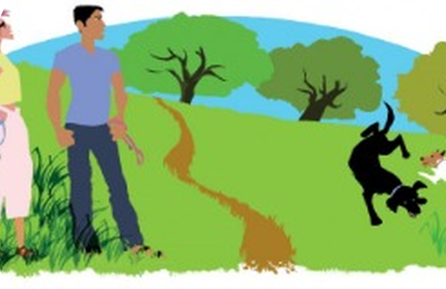

3
Who's who?
🎧 LISTEN → 🔗 MATCH
⏱ 4 min 👤 alone
🎯 Listening · for detail
Listen. A man and a woman meet in the park. Match the names to the people or the dogs.
Ascolta. Un uomo e una donna si incontrano al parco. Abbina i nomi.
🎧 3.17 · play twice
Becca
the woman (example)
Barry
her dog
Dave
the man
Dolly
his dog
What kind of dog is Barry?
a Labrador – he's two
💡
Then: what do you find out about the dogs?
What kind of dog is Dolly?
a fox terrier – the same age
▶ normal
🐢 slower
3C · Listening · identifying who's who · 📖 SB p.26 · 1a · audio 3.17 (script p.119 · TG key)
Notes:
3. Listening · identifying who's who (4 min)
WHO'S WHO (4 min). TG key: Barry is her dog, Dave is the man, Dolly is his dog. Dogs: Barry = Labrador, two years old; Dolly = fox terrier, two years old (Dave hesitates – remember that for later!).

Slide 4

4
At the café
🎧 LISTEN → ✏️ FILL THE GAPS
⏱ 4 min 👤 alone
🎯 Listening · → grammar
Listen. What happens in the end? Then listen again and complete the questions.
Ascolta. Cosa succede alla fine? Poi ascolta di nuovo e completa le domande.
Becca and Dave at the café
D It's really hot. Would you (1) like a drink? Or an ice cream?
B Yes, why not? Let's go to the café.
D (2) ________ kind of ice cream do you (2) ________ ✓
B Er, a Magnum if they have it. … Thanks, Dave.
D (3) ________ do you (3) ________ ✓
B Very near here, in Park Road. And you?
D I live quite near, in Queen's Road. (4) ________ do you (4) ________ , Becca?
B I'm a journalist.
🍦
What happens in the end?
Becca and Dave at the café
D It's really hot. Would you (1) like a drink? Or an ice cream?
B Yes, why not? Let's go to the café.
D (2) What kind of ice cream do you (2) want ✓
B Er, a Magnum if they have it. … Thanks, Dave.
D (3) ________ do you (3) ________ ✓
B Very near here, in Park Road. And you?
D I live quite near, in Queen's Road. (4) ________ do you (4) ________ , Becca?
B I'm a journalist.
Becca and Dave at the café
D It's really hot. Would you (1) like a drink? Or an ice cream?
B Yes, why not? Let's go to the café.
D (2) What kind of ice cream do you (2) want ✓
B Er, a Magnum if they have it. … Thanks, Dave.
D (3) ________ do you (3) ________ ✓
B Very near here, in Park Road. And you?
D I live quite near, in Queen's Road. (4) ________ do you (4) ________ , Becca?
B I'm a journalist.
Becca and Dave at the café
D It's really hot. Would you (1) like a drink? Or an ice cream?
B Yes, why not? Let's go to the café.
D (2) What kind of ice cream do you (2) want ✓
B Er, a Magnum if they have it. … Thanks, Dave.
D (3) Where do you (3) live ✓
B Very near here, in Park Road. And you?
D I live quite near, in Queen's Road. (4) ________ do you (4) ________ , Becca?
B I'm a journalist.
Becca and Dave at the café
D It's really hot. Would you (1) like a drink? Or an ice cream?
B Yes, why not? Let's go to the café.
D (2) What kind of ice cream do you (2) want ✓
B Er, a Magnum if they have it. … Thanks, Dave.
D (3) Where do you (3) live ✓
B Very near here, in Park Road. And you?
D I live quite near, in Queen's Road. (4) ________ do you (4) ________ , Becca?
B I'm a journalist.
Becca and Dave at the café
D It's really hot. Would you (1) like a drink? Or an ice cream?
B Yes, why not? Let's go to the café.
D (2) What kind of ice cream do you (2) want ✓
B Er, a Magnum if they have it. … Thanks, Dave.
D (3) Where do you (3) live ✓
B Very near here, in Park Road. And you?
D I live quite near, in Queen's Road. (4) What do you (4) do , Becca?
B I'm a journalist.
Becca and Dave at the café
D It's really hot. Would you (1) like a drink? Or an ice cream?
B Yes, why not? Let's go to the café.
D (2) What kind of ice cream do you (2) want ✓
B Er, a Magnum if they have it. … Thanks, Dave.
D (3) Where do you (3) live ✓
B Very near here, in Park Road. And you?
D I live quite near, in Queen's Road. (4) What do you (4) do , Becca?
B I'm a journalist.
Listen once – books closed.
Dave invites Becca to lunch on Saturday.
3C · Listening · at the café · 📖 SB p.26 · 1b, 1c · audio 3.18 (TG key)
Notes:
4. Listening · at the café (4 min)
CAFÉ part 1 (3 min). 1b: cover the text, play 3.18 once – what happens in the end? (click: Dave invites Becca to lunch). 1c: play again; one click per gap. TG key: 2 What…want? 3 Where…live? 4 What…do 5 work 6 What 7 want. EXTRA CHALLENGE: pairs guess the words before they listen.

Slide 5
5
At the café (2)
🎧 LISTEN → ✏️ FILL THE GAPS
⏱ 3 min 👤 alone
🎯 Listening · → grammar
Listen. Complete the questions 5–7.
Ascolta. Cosa succede alla fine? Completa le domande 5–7.
Becca and Dave at the café
D Really? How interesting! Do you (5) ________ for a newspaper?
B No, for TV. (6) ________ about you?
D I'm a teacher. I'm on holiday now.
B Me too. Oh! My ice cream.
D Dolly! Bad dog! I'm really sorry. Do you (7) ________ another ice cream?
B No, thanks.
D Are you sure? I'm really sorry. Look, let's have lunch one day. Are you free on Saturday?
B Oh, well, OK, then. Yes. Thanks very much.
🍦
What happens in the end?
Becca and Dave at the café
D Really? How interesting! Do you (5) work for a newspaper?
B No, for TV. (6) ________ about you?
D I'm a teacher. I'm on holiday now.
B Me too. Oh! My ice cream.
D Dolly! Bad dog! I'm really sorry. Do you (7) ________ another ice cream?
B No, thanks.
D Are you sure? I'm really sorry. Look, let's have lunch one day. Are you free on Saturday?
B Oh, well, OK, then. Yes. Thanks very much.
Becca and Dave at the café
D Really? How interesting! Do you (5) work for a newspaper?
B No, for TV. (6) What about you?
D I'm a teacher. I'm on holiday now.
B Me too. Oh! My ice cream.
D Dolly! Bad dog! I'm really sorry. Do you (7) ________ another ice cream?
B No, thanks.
D Are you sure? I'm really sorry. Look, let's have lunch one day. Are you free on Saturday?
B Oh, well, OK, then. Yes. Thanks very much.
Becca and Dave at the café
D Really? How interesting! Do you (5) work for a newspaper?
B No, for TV. (6) What about you?
D I'm a teacher. I'm on holiday now.
B Me too. Oh! My ice cream.
D Dolly! Bad dog! I'm really sorry. Do you (7) want another ice cream?
B No, thanks.
D Are you sure? I'm really sorry. Look, let's have lunch one day. Are you free on Saturday?
B Oh, well, OK, then. Yes. Thanks very much.
Listen once – books closed.
Then listen again and fill the gaps.
Dave invites Becca to lunch on Saturday.
3C · Listening · at the café · 📖 SB p.26 · 1b, 1c · audio 3.18 (TG key)
Notes:
5. Listening · at the café (3 min)
CAFÉ part 2 (3 min). 1b: cover the text, play 3.18 once – what happens in the end? (click: Dave invites Becca to lunch). 1c: play again; one click per gap. TG key: 2 What…want? 3 Where…live? 4 What…do 5 work 6 What 7 want. EXTRA CHALLENGE: pairs guess the words before they listen.

Slide 6
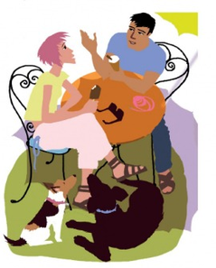
6
Really? How interesting!
🎧 LISTEN → 🔊 SAY IT
⏱ 4 min 👥 pairs
🎯 Speaking · Communicative
Listen and repeat the phrases for showing interest. Then practise the conversation.
Ascolta e ripeti le frasi per mostrare interesse. Poi esercitati con il dialogo.
1
I'm a journalist.
e.g. Really? How interesting!
2
Do you work for a newspaper? – No, for TV.
e.g. What about you?
3
I'm on holiday now.
e.g. Me too.
💬
Useful phrases
4
Now read the café conversation with a partner. Then swap roles!
e.g. A = Dave · B = Becca
Really?
How interesting!
What about you?
Me too.
And you?
3C · Showing interest · 📖 SB p.26 · 1d, 1e · audio 3.19 (Showing interest box)
Notes:
6. Showing interest (4 min)
SHOWING INTEREST (4 min). Play 3.19: students repeat only the interest phrases – copy the intonation (big voice range on How interesting!). Then 1e: pairs read the conversation, swap roles. They use these phrases again in Speaking.

Slide 7
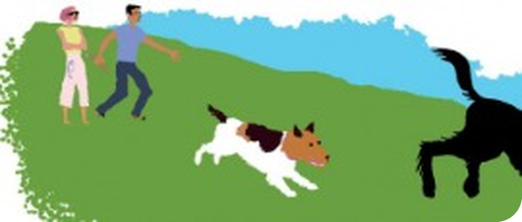
7
Lunch at Dave's
🎧 LISTEN → ✅ CHECK
⏱ 5 min 👤 alone
🎯 Listening · for detail
Becca goes to Dave's flat. Listen. Becca (B) or Dave (D)?
Becca va a casa di Dave. Ascolta. Becca (B) o Dave (D)?
🎧 3.20 · play twice
___ lives on the first floor.
D – Dave
___ likes the flat.
B – Becca
___ doesn't really like dogs.
D – Dave
___ doesn't have a big flat.
D – Dave
___ has two cats.
B – Becca
___ makes pasta and ice cream for lunch.
D – Dave
💡
Then: is the lunch a success?
Is the lunch a success? Why?
Yes! Neither dog is theirs – and they both love cats.
▶ normal
🐢 slower
3C · Listening · lunch at Dave's flat · 📖 SB p.26 · 1f, 1g · audio 3.20 (script p.119 · TG key)
Notes:
7. Listening · lunch at Dave's flat (5 min)
DAVE'S FLAT (5 min). TG key 1 D 2 B 3 D 4 D 5 B 6 D. The twist: Dolly is his friend's dog and Barry is Becca's sister's dog! 1g: whole class – is the lunch a success? Do you prefer cats or dogs?

Slide 8
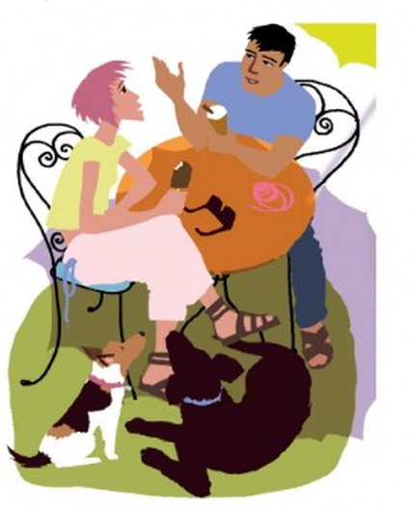
8
Retell it!
💬 TALK · PARLA
⏱ 3 min 👥 pairs
🎯 Speaking · TPRS · retell
Retell the story to your partner. Use the prompts!
Racconta di nuovo la storia al compagno. Usa gli spunti!
1
park · Becca · Barry (Labrador)
💬 Becca is in the park with…
2
Dave · Dolly (fox terrier)
💬 Dave has a…
3
café · Magnum · journalist · teacher
💬 They go to…
4
ice cream · bad dog · lunch on Saturday
💬 Dolly eats…
5
Dave's flat · not his dog · sister's dog
💬 At the flat, Dave says…
6
two cats · spaghetti carbonara
💬 In the end…
7
Change 2 things in the story!
💬 In my story…
3C · Speaking · retell
Notes:
8. Speaking · retell (3 min)
RETELL (3 min). A tells lines 1–3, B the rest, then swap. Prompts only – no reading. Listen for questions: Where do you live? What do you do?

Slide 9
9
QuASI!
👀 LOOK → 🔊 SAY IT
⏱ 4 min 🙋 whole class
🎯 Grammar · Communicative
Put the words in order. Say the question, then click!
Metti le parole in ordine. Di' la domanda, poi clicca!
Barry is old how
Qu + be
?
How old is Barry?
his name what's
Qu + 's
?
What's his name?
like do it you
A S I
?
Do you like it?
about feel do cats you how
Qu A S I
?
How do you feel about cats?
work you where do
Qu A S I
?
Where do you work?
music kind of do like what you
Qu A S I
?
What kind of music do you like?
3C · Grammar · word order in questions · 📖 SB p.27 · 2a, 2b · audio 3.21 · Grammar Bank 3C p.128 (3.22, 3.23 · TG notes)
Notes:
9. Grammar · word order in questions (4 min)
WORD ORDER (4 min). 2a: students say the question first, click to check (3.21 for 1–4). TG grammar notes: ASI (auxiliary, subject, infinitive) and QuASI (question word, auxiliary, subject, infinitive) – use them as a quick reminder when students make mistakes. Play 3.22 / 3.23 for listen and repeat.

Slide 10
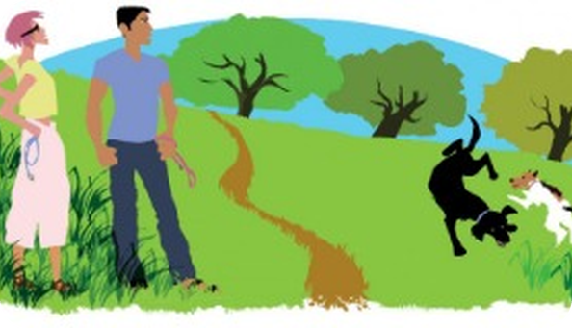
10
Grammar Bank practice
✍️ WRITE → ✅ CHECK
⏱ 5 min 👤 alone
🎯 Grammar · TPRS · reading
Grammar Bank 3C a: put the words in order.
Grammar Bank 3C a: metti le parole in ordine.
Make the question
1 children / have / how many / you / do → (1) ________
1 children / have / how many / you / do → How many children do you have?
2 job / is / interesting / your → (2) ________
2 job / is / interesting / your → Is your job interesting?
3 car / colour / is / what / his → (3) ________
3 car / colour / is / what / his → What colour is his car?
4 work / your brother / does / where → (4) ________
4 work / your brother / does / where → Where does your brother work?
5 computers / work / you / do / with → (5) ________
5 computers / work / you / do / with → Do you work with computers?
6 magazines / you / what kind of / read / do → (6) ________
6 magazines / you / what kind of / read / do → What kind of magazines do you read?
7 at the weekend / he / does / do / what → (7) ________
7 at the weekend / he / does / do / what → What does he do at the weekend?
8 in your job / you / are / stressed → (8) ________
8 in your job / you / are / stressed → Are you stressed in your job?
💡
Remember
9 live / your sister / where / does → (9) ________
9 live / your sister / where / does → Where does your sister live?
Qu + A + S + I
be: Qu + be + S
10 in English / say / do / how / you / that → (10) ________
10 in English / say / do / how / you / that → How do you say that in English?
3C · Grammar Bank 3C p.129 · a · 📖 Grammar Bank 3C p.129 · a (TG key)
Notes:
10. Grammar Bank 3C p.129 · a (5 min)
GRAMMAR BANK a (5 min). Jumbled prompts made from the TG answers. Alone, then click once per question. Fast finishers: Grammar Bank b (key: 1 does…do 2 does she work 3 Does…like 4 does…do 5 Is he 6 Does…do 7 do you do).

Slide 11
11
Question words
💡 THINK → 🎧 LISTEN
⏱ 5 min 👥 pairs
🎯 Vocabulary · Controlled practice
Complete the questions with a question word. Then listen and check.
Completa le domande con una parola interrogativa. Poi ascolta.
⭐
Example
1
___ phone do you have? – I have a Samsung.
What (example)
How many · What · What kind of · When · Where · Which · Who · Why
2
___ brothers and sisters do you have? – I have two sisters.
How many
3
___ do you prefer, cats or dogs? – Cats, I think.
Which
4
___ do you work? – In a restaurant in the city centre.
Where
5
___ do you have language classes? – On Mondays and Wednesdays.
When
6
___ music do you like? – I like pop and reggae.
What kind of
7
___'s your favourite actor? – Benedict Cumberbatch.
Who
🎧 3.24
8
___ do you like him? – Because he's a fantastic actor.
Why
▶ normal
🐢 slower
3C · Vocabulary · question words · 📖 SB p.27 · 3a, 3b · audio 3.24 (TG key)
Notes:
11. Vocabulary · question words (5 min)
QUESTION WORDS (5 min). Then 3b (TG): 1 Who – wh = /h/ 2 the others – wh = /w/ 3 What…? = many possibilities; Which…? = a small number, often two. Pairs ask each other the 8 questions.

Slide 12
12
Copy the rhythm
🎧 LISTEN → 🔊 SAY IT
⏱ 3 min 👥 pairs
🎯 Pronunciation · Controlled practice
Listen. Copy the rhythm. Then A asks, B answers – swap!
Ascolta. Copia il ritmo. Poi A chiede, B risponde – scambiatevi!
⭐
Example
1
1
WHERE do you WORK?
BIG words = stressed (nouns, verbs, adjectives) · small words = quick (do, you, your)
2
2
WHAT PHONE do you HAVE?
3
3
WHAT KIND of MUSIC do you LIKE?
4
4
WHO'S your FAVOURITE ACTOR?
🎧 3.25
▶ normal
🐢 slower
3C · Pronunciation · sentence stress · 📖 SB p.27 · 4a, 4b · audio 3.25
Notes:
12. Pronunciation · sentence stress (3 min)
STRESS (3 min). TG notes: stressed = information words; unstressed = pronouns, articles, prepositions, auxiliaries – that gives English its rhythm. Play 3.25: listen, then repeat. 4b: A asks, B answers (work → study if needed). EXTRA CHALLENGE: B closes the book, A asks in a different order.

Slide 13
13
Get to know you
💡 THINK → 💬 TALK
⏱ 8 min 👥 pairs
🎯 Speaking · Communicative
Make the questions. Then interview a partner – show interest!
Fai le domande. Poi intervista un compagno – mostra interesse!
1
What words are missing? Where ___ live?
e.g. Where do you live? – add do you
2
Who / What ___ your favourite…?
e.g. Who's your favourite actress? – add is / 's
3
A: Where do you live? B: In the centre of town, near the station.
e.g. A: Really? Me too.
💬
Useful phrases
4
Ask an extra question!
e.g. What colour is it? Do you like it?
Where do you live / work / study?
What kind of films / food do you like?
What sports / music do you play?
What car do you have?
Who's your favourite singer?
Really? How interesting! Me too.
5
What do you have in common?
e.g. We both like pizza and we both play tennis!
3C · Speaking · interview · 📖 SB p.27 · 5a, 5b
Notes:
13. Speaking · interview (8 min)
INTERVIEW (8 min). 5a (TG): groups 1–3 add do you; group 4 add is / 's after Who / What. Elicit a few questions. 5b: pairs, preferably someone they don't usually work with. Model with a strong student. Extra questions + extra information. Feedback: what do you have in common?

Slide 14
14
3 · 2 · 1
⏱ 2 min 👥 pairs
🎯 Revision · Retrieval
Books closed! Tell your partner…
Libri chiusi! Di' al compagno…
3
Tell me 3 question words.
📝
Homework · Compiti
Workbook 3C pp.22–23
Writing p.113: a personal profile
2
Ask me 2 questions: one with do you, one with does he / she.
Next lesson: Practical English 2 – Coffee to take away: telling the time (SB p.28)
1
Tell me 1 thing about Becca or Dave.
3C · Exit · what can you remember?
Notes:
14. Exit · what can you remember? (2 min)
EXIT (2 min). Pairs, books closed. Show the writing model (Fiona's profile, p.113) before they leave: occupation, interests, and / but / or.

Slide 15
15
Today you…
💡 THINK · PENSA
⏱ 1 min 🙋 whole class
🎯 Revision · Reflection
Can you do it now? Thumbs up or thumbs down!
Ora sai farlo? Pollice su o pollice giù!
❓
Practised put questions in the right order: What kind of music do you like?
✅
👍 👌 👎
Can you do it now?
Ora sai farlo?
🔤
Used question words: who, which, why…
✅
🎵
Said questions with the right rhythm
✅
🎧
Listened to Becca and Dave meet in the park
✅
✍️
Wrote a personal profile
✅
3C · Review · what did you do today?
Notes:
15. Review · what did you do today? (1 min)
TODAY YOU… (1 min). Read each line (one per click: the tick appears). Students show thumbs up / middle / down: can they do it now? Note any thumbs down for the next lesson's recap.

Slide 16
⭐
Optional extensions
Only if there's time – the lesson is finished. · Solo se c'è tempo – la lezione è finita.
Notes:
16. OPTIONAL EXTENSIONS
The lesson ended on the previous slide ("Today you…"). Use the next slides only if there is time left, or keep them for a quick start next lesson.

Slide 17

17
Who are you?
🎲 PLAY → 💬 TALK
⏱ 6 min 👨‍👩‍👧 groups
🎯 Speaking · Communicative game
Famous people! One student is a famous person. The others ask questions – correct word order!
Personaggi famosi! Uno è un personaggio famoso. Gli altri fanno domande!
🎲
How to play
Where are you from? · Where do you live?
→ I'm from Italy. I live in Rome.
1
Groups of 4. One student secretly chooses a famous person.
The group asks real questions: Where do you live? What do you do?
Guess in 10 questions! A wrong word order = no answer.
What do you do? · Do you work in a team?
→ Are you a footballer?
2
How old are you? · Are you married?
→ Do you have children?
3
What kind of music do you like?
→ Who's your favourite…?
4
⭐ OPTIONAL EXTENSION · only if there's time
3C · Game · famous interview · 📖 Communicative photocopiable Famous people p.222 (TG p.206) – optional
Notes:
17. Game · famous interview (6 min)
GAME (6 min). Zero-prep version of the TG communicative 'Famous people'. Rule: if the word order is wrong, the 'famous person' says 'Sorry?' and doesn't answer – fun QuASI correction.

Slide 18

18
A personal profile
✍️ WRITE · SCRIVI
⏱ 10 min 👤 alone
🎯 Writing · TPRS · reading
Write your personal profile. Use and, but, or.
Scrivi il tuo profilo personale. Usa and, but, or.
Model
Name: (1) ________
Name: your name
From: (2) ________
From: town, country
Occupation: I'm a… / I work in… (3) ________
Occupation: I'm a… / I work in… I'm a nurse and I work in Bagheria.
Languages: I speak… (4) ________
Languages: I speak… I speak Italian and a little English.
Interests: I like… but I don't like… (5) ________
Interests: I like… but I don't like… I like music, but I don't like football.
💡
Remember
Favourite food / music / films: (6) ________
Favourite food / music / films: pizza or pasta, pop music…
and = + more
but = a contrast
or = ? / − choice
⭐ OPTIONAL EXTENSION · only if there's time
3C · Writing · p.113 (extra) · 📖 Writing p.113 · a, b, c
Notes:
18. Writing · p.113 (extra) (10 min)
WRITING (extra or homework). Fiona's profile on p.113 is the model. Check: capital letters (I, names, nationalities, languages) and and / but / or.

