Slide 1


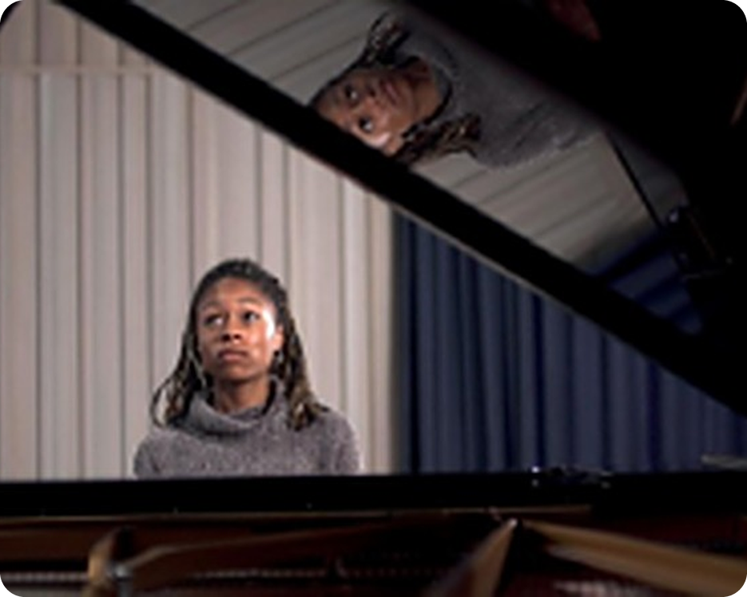


English File Upper-intermediate · SB pp.60–61
💡 THINK · PENSA
6B-1
Music to my ears
Music, emotions, -ing or to?
🎯
Today you're going to…
🎧 listen to a talk: why do we listen to music?
✏️ -ing or to? remember, try, stop
🎻 music words – and Italian traps!
🔊 say cello, concerto the English way
📖 listen to a class story and answer questions
💬 tell a partner your music memories
Can music change the way you feel?
EXAMPLE Yes! When I'm stressed, a calm song helps me – but a sad song makes me even sadder!
Notes:
1. OPENING (2 min)
Show the photo (a young pianist). Ask the THINK question; take 3–4 answers – push for a reason: 'How? Give me an example.' Click: the example answer. Read 'Today you're going to…' together. Don't correct gerunds/infinitives yet – just note errors like 'I like listen' for later.

Slide 2

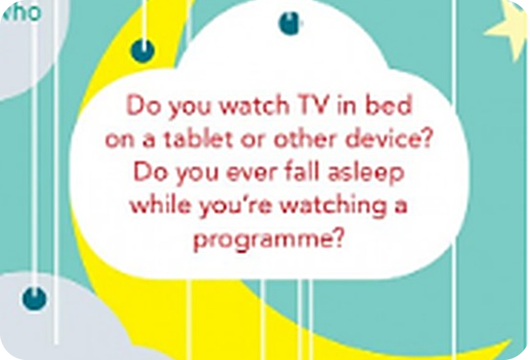
2
Remember last lesson?
💡 THINK PENSA
⏱ 2 min 🙋 whole class
Read the examples. Then say one about you.
Revision · Retrieval
Leggi gli esempi. Poi dinne uno su di te.
used to · be used to · get used to
Sleep words
I used to sleep with the light on.
Nurses are used to working at night.
I'm getting used to waking up at 6.30.
→ used to + verb · be / get used to + -ing
I overslept and missed the bus.
My dad snores like a train!
I'm a light sleeper – I wake up easily.
→ nap · pillow · duvet · fall asleep
📅
Last lesson…
6A Night night (2 Oct)
used to / be used to / get used to · sleep words
🔤 KEY WORDS
snore
nap
oversleep
light sleeper
fall asleep
set the alarm
insomnia
sleepwalk
6B-1 · Revision · last lesson (6A)
Notes:
2. Revision · last lesson (6A) (2 min)
REVISION (2 min). Read the examples together. Ask 2 students: 'What did you use to do before bed when you were small?' 'Is there anything you can't get used to?' Point out the key contrast again: used to + VERB (past habit) vs be/get used to + -ING (to = preposition). This prepares today: TODAY's grammar is also about -ing vs to. Then the warmer game uses exactly these sleep words.

Slide 3

3
Describe it – with used to!
🎲 PLAY GIOCA
⏱ 3 min 👥 pairs
A explains the word. B guesses. Then swap.
Revision · Communicative game
A spiega la parola. B indovina. Poi scambiatevi.
🎲
How to play
A explains
B explains
A looks at the screen. B looks away.
A guarda lo schermo. B si gira.
A explains the word in English. Don't say it!
A spiega la parola in inglese. Non dirla!
Bonus: use used to / be used to. e.g. 'My grandad used to do it at night – a loud noise!' → snore
Bonus: usa used to / be used to.
snore
sleepwalk
nap
insomnia
pillow
duvet
TEAM A ☆☆☆☆☆
TEAM B ☆☆☆☆☆
oversleep
set the alarm
6B-1 · Warmer · 6A sleep words · 📖 Recycles 6A (2 Oct)
Notes:
3. Warmer · 6A sleep words (3 min)
RETRIEVAL WARMER (3 min). Variation of 'Describe it!' (last lesson's warmer was 'Here's the answer – what's the question?'). Demo first with a strong student: 'I'm not used to sleeping in the afternoon, but in Spain they often have one after lunch' → a nap. Click once per word (A sees it, B faces away). After round 1, partners swap seats/roles. Bonus point when the description uses used to / be used to / get used to correctly (I'm used to + -ing!). ICQ: 'Can you say the word?' (no) · 'Italian?' (no, English only).

Slide 4
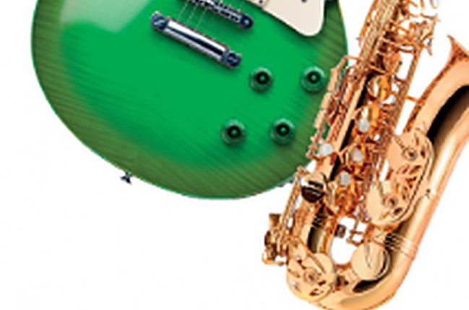
4
Music in your day
💬 TALK PARLA
⏱ 3 min 👥 pairs
Answer each question. Then ask: And you?
Speaking · Communicative
Rispondi a ogni domanda. Poi chiedi: E tu?
1
On a typical day, when and where do you listen to music?
e.g. On the bus to school and when I do my homework.
2
How do you listen? (phone, speaker, headphones…)
e.g. On Spotify, with my wireless headphones.
3
Do you listen to different kinds of music at different times of day?
e.g. Yes – rap in the morning, chill music at night.
4
What makes you choose one kind of music over another?
e.g. My mood! If I'm stressed, I want something calm.
💬
Useful phrases
I usually listen to… when I…
It depends on my mood.
If I'm…, I put on…
And you? · Really? Me too!
5
Extension: what's the WORST music for a dentist's waiting room? Why?
e.g. Heavy metal – you'd be terrified before you sit down!
6B-1 · Speaking · music in your day · 📖 SB p.60 · 1a
Notes:
4. Speaking · music in your day (3 min)
LEAD-IN (3 min). SB 1a. Questions appear ONE per click (about 30 seconds each). Model Q1 with your own answer. Push beyond the first answer: 'Why?', 'Always?'. Q5 = extension (negative/absurd questions get teens talking). Note good answers about MOOD – they lead straight into John Sloboda's talk.

Slide 5

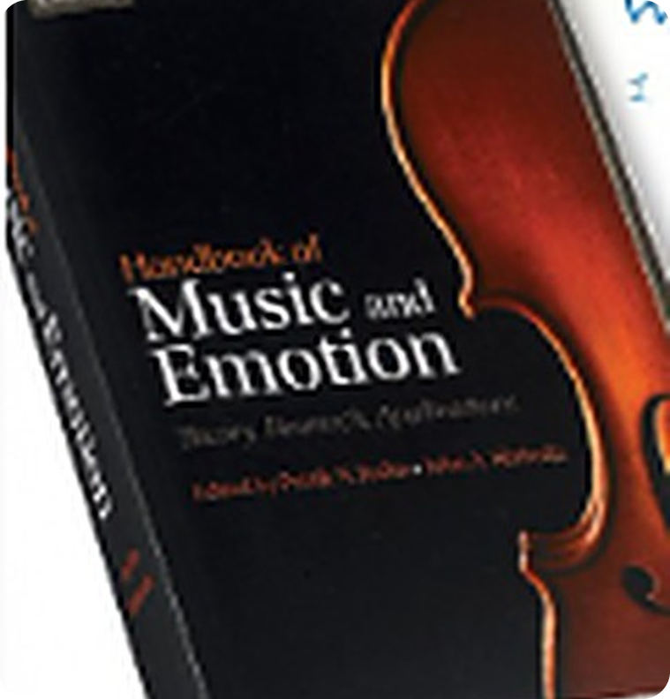
5
Why do we listen to music?
👀 READ LEGGI
🤔 GUESS INDOVINA
Guess John's 3 reasons from the 6 words.
⏱ 2 min 👥 pairs
Leggi. Indovina i 3 motivi di John dalle 6 parole.
Listening · Prediction
John Sloboda's talk
John Sloboda is a music psychologist. He edited the 'Handbook of Music and Emotion'. In Part 1 of his talk, he gives three reasons why we listen to music.
➡ NEXT Next slide: listen to Part 1. Complete John's 3 reasons + an example for each.
🔤 6 WORDS FROM HIS EXAMPLES · guess the 3 reasons!
film
night
work
sad
angry
date
6B-1 · Listening · prediction · 📖 SB p.60 · 1b (before listening)
Notes:
5. Listening · prediction (2 min)
PREDICTION (2 min). Read the introduction. Pairs use the 6 words to guess John's three reasons: 'I think one reason is to relax after work…' Take 2–3 guesses and write them on the board – DON'T confirm. ICQ: 'Are we listening yet?' (no – guessing first). The words come from his examples (film = Casablanca, night = going out in the evening, work = relaxing after work, sad / angry / date (a romantic dinner) = intensifying emotions).

Slide 6
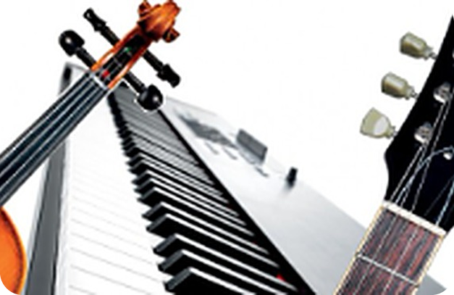

6
John's 3 reasons
🎧 LISTEN ASCOLTA
✍️ WRITE SCRIVI
Listen. Write key words for reasons 1–3.
⏱ 5 min 👤 alone
Ascolta. Scrivi parole chiave per i motivi 1–3.
Listening · Listening for detail
🎧 6.10 · play twice
1 to make us ___
remember important moments in the past
e.g. ___
when we met someone for the first time
2 to help us to ___
change activities
e.g. ___
prepare to go out in the evening · relax after work
3 to intensify ___
the emotion we're feeling
💡
Guess first, then listen!
e.g. ___
sad → sadder · romantic dinner → more romantic
▶ normal · 🐢 slower
6B-1 · Listening · John Sloboda, Part 1 · 📖 SB p.60 · 1b, 1c · audio 6.10
Notes:
6. Listening · John Sloboda, Part 1 (5 min)
LISTENING FOR KEY IDEAS (5 min). Worked example: show row 1 – 'to make us ___' needs a verb + what (e.g. 'remember…'). Play 6.10 once (1 min 40). Pairs compare and try to remember more (SB 1c). Play again (🐢 slower copy for weaker students). Click once per row. ANSWERS (SB key 1c): 1 to make us remember important moments in the past, e.g. when we met someone for the first time (like Humphrey Bogart in Casablanca saying 'Darling, they're playing our song'). 2 to help us to change activities, e.g. to prepare us to go out in the evening, to relax us when we get home from work. 3 to intensify the emotion that we're feeling, e.g. if we're feeling sad, we want to get sadder; if we're angry, we want to intensify the anger; at a romantic dinner, music makes it more romantic. Compare with the class predictions from the board. SB 1d (30 sec, pairs): 'When do YOU listen to music for one of these reasons? What kind?' AUDIO SCRIPT: not in our files – see the Student's Book audioscript (Listening 6.10).

Slide 7
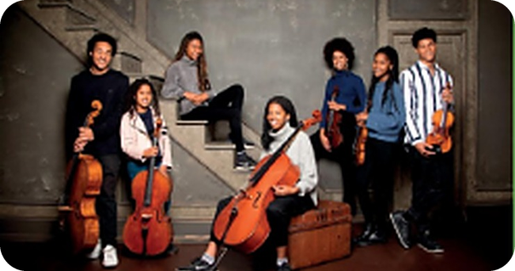
7
How do they make you feel?
🎧 LISTEN ASCOLTA
✍️ WRITE SCRIVI
Listen. Write one adjective for each piece.
⏱ 3 min 👤 alone
Ascolta 4 brani. Scrivi un aggettivo per ognuno.
Listening · Controlled practice
⭐
Example
1
1 Beethoven: Seventh Symphony (1st movement)
e.g. joyful, energetic, triumphant
0 It sounds calm. / It makes me feel relaxed.
2
2 Holst: Mars, from The Planets
e.g. threatening, aggressive, tense
3
3 Albinoni: Adagio for Strings
e.g. melancholy, moving, heartbreaking
4
4 The music from Hitchcock's film Psycho
e.g. terrifying, creepy, nerve-racking
5
5 Which piece did you like most? Why?
e.g. Mars – it sounds like a battle in a film!
🎧 6.11 · play once
▶ normal · 🐢 slower
6B-1 · Listening · four pieces of music · 📖 SB p.60 · 1e · audio 6.11
Notes:
7. Listening · four pieces of music (3 min)
PERSONAL RESPONSE (3 min). SB 1e: there is no 'right' answer – students write their own adjective for each extract. Play 6.11 once (1 min 30, four extracts – pause briefly after each). B2 PRECISION challenge: no 'happy', 'sad', 'nice' – choose a more precise word. Then click: the chips are only suggestions to extend vocabulary (not book answers). Q5 = quick pair talk. In Part 2 (next slide) John says which emotion HE links to each piece.

Slide 8
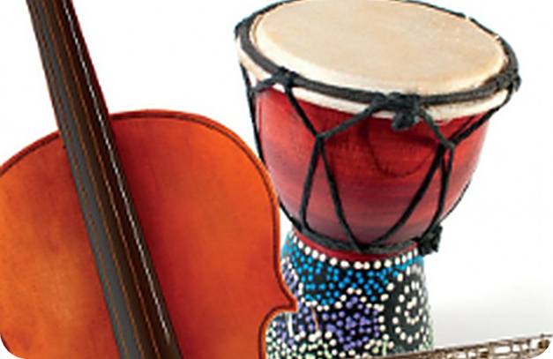
8
Music copies the human voice
🎧 LISTEN ASCOLTA
✏️ FILL THE GAPS COMPLETA
Listen to Part 2. Complete the notes.
⏱ 5 min 👤 alone
Ascolta la parte 2. Completa gli appunti.
Listening · Listening for detail
🎧 6.12 · play once
Voice · happy: people speak ___ , the voice is ___
faster · higher
Voice · sad: people speak ___ , the voice is ___
more slowly · lower
Voice · angry: people ___ their voices or ___
raise · shout
Music 1: ___ , ___ -pitched music sounds happy
faster · high (-pitched)
Music 2: ___ music with ___ pitches sounds sad
slow · falling
💡
Guess first, then listen!
Music 3: ___ music with ___ rhythms sounds angry
loud · irregular
▶ normal · 🐢 slower
6B-1 · Listening · John Sloboda, Part 2 · 📖 SB p.60 · 1f · audio 6.12
Notes:
8. Listening · John Sloboda, Part 2 (5 min)
LISTENING FOR DETAIL (5 min). Give 30 seconds to read and GUESS (e.g. 'happy people speak… faster?'). Play 6.12 (3 min 15 – the longest track; pause after the human voice part if needed, or use the 🐢 slower copy for a second listening). Pairs compare. Click once per row. ANSWERS (SB key 1f): human voice: happy = people speak faster, the voice is higher · sad = people speak more slowly, the voice is lower · angry = people raise their voice or shout. Music copies the voice: 1 faster, high-pitched music sounds happy · 2 slow music with falling pitches sounds sad · 3 loud music with irregular rhythms sounds angry. Next slide: the emotions John gives each piece. AUDIO SCRIPT: not in our files (SB audioscript 6.12).

Slide 9
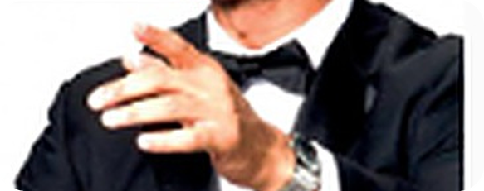
9
Which emotion?
🔗 MATCH ABBINA
⏱ 1 min 👥 pairs
Which emotion does John give each piece?
Listening · Guided discovery
Quale emozione dà John a ogni brano?
🏷️
John's emotions
1 Beethoven: Seventh Symphony
happy
happy
angry
2 Holst: Mars
angry
sad
terrified
3 Albinoni: Adagio for Strings
sad
4 Psycho (film music)
terrified
6B-1 · Listening · John's emotions · 📖 SB p.60 · 1f · audio 6.12
Notes:
9. Listening · John's emotions (1 min)
CHECK (1 min). From memory (they heard it in 6.12); replay the end of 6.12 if they're unsure. Click once per piece. ANSWERS (SB key 1f): 1 happy = the Beethoven · 2 angry = the Holst · 3 sad = the Albinoni · 4 terrified = the film music from Psycho. Quick question: 'Did John's emotions match YOUR adjectives?'

Slide 10
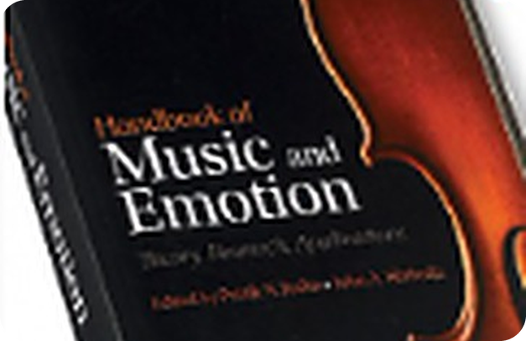
10
Remember hearing it?
✏️ FILL THE GAPS COMPLETA
🎧 LISTEN ASCOLTA
Write the verb: -ing, to + verb or verb?
⏱ 3 min 👥 pairs
Scrivi il verbo: -ing, to + verbo o verbo?
Grammar · Listening for detail
🎧 6.13 · listen and check
0 We listen to music to relax. (relax)
example: to relax (= purpose)
1 We listen to music to make us ___ important moments. (remember)
remember (make + verb)
2 We remember ___ it for the first time. (hear)
hearing
3a If we want ___ from one activity to another… (go)
to go
3b …we use music to help us ___ the change. (make)
make (help + verb / to)
💡
Guess first, then listen!
▶ normal · 🐢 slower
6B-1 · Grammar · from the talk · 📖 SB p.61 · 2a, 2b · audio 6.13
Notes:
10. Grammar · from the talk (3 min)
NOTICING (3 min). Row 0 = worked example (click 1 shows it). The sentences come from John's talk (SB 2a). Pairs write the verbs (1 min), then play 6.13 to check; click once per answer. ANSWERS (SB key 2b): 1 remember · 2 hearing · 3 to go, make. Ask: 'Why make us REMEMBER without to?' (make + object + verb) · 'help us (to) make' – both are possible. Point at 2: 'remember HEARING' – did he hear it before or after remembering? (before → a memory). That's the next slide.

Slide 11
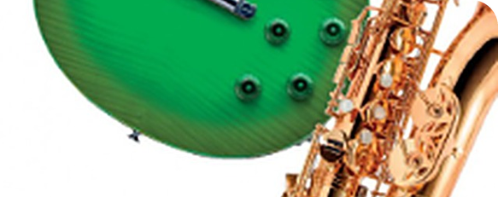
11
Same verb, different meaning
🔗 MATCH ABBINA
⏱ 4 min 👥 pairs
Read each sentence. What does the verb mean?
Grammar · Guided discovery
Leggi ogni frase. Cosa significa il verbo?
🏷️
Choose the meaning
1 I remember meeting him for the first time.
B memory
2 Please remember to meet him at the station.
A task (later)
A task (later)
B memory
3 Did you remember to lock the door?
A task (later)
effort (hard)
experiment
finish
pause to do
4 I'll never forget hearing that song live.
B memory
5 I tried to open the window, but it was stuck.
effort (hard)
6 Can't sleep? Try listening to calm music.
experiment
7 He stopped playing the drums at midnight.
finish
8 We stopped to listen to a street musician.
pause to do
6B-1 · Grammar · meaning changes · 📖 SB p.61 · 2c (1–2) + more examples
Notes:
11. Grammar · meaning changes (4 min)
GUIDED DISCOVERY (4 min). Worked example: do 1 together – 'Did I meet him before I remember? Yes → a MEMORY (B).' Pairs decide 2–8, click once per sentence. ANSWERS SB 2c: 1 B (to have or keep an image in your memory of something you did) · 2 A (to not forget to do something; to do what you have to do). 3–8 are our extra examples for forget / try / stop: 3 task · 4 memory · 5 effort (it was difficult, maybe impossible) · 6 experiment (do it and see if it helps) · 7 finish (he doesn't play now) · 8 pause/stop in order to do something else. CCQ: 'I stopped smoking / I stopped to smoke – who is a smoker now?' (the second!). Italian: ricordarsi DI fare (task) vs ricordare DI AVER fatto (memory) – Italian uses 'di' for both, so Italians mix them up.

Slide 12
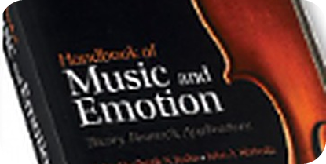
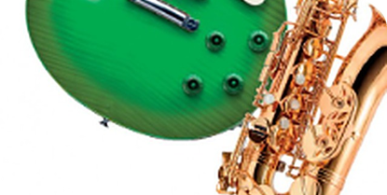
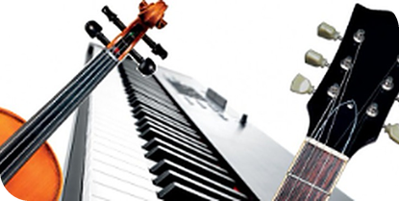
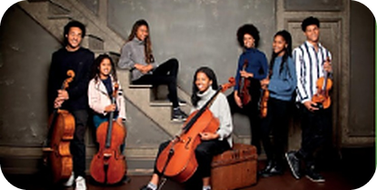
12
-ing or to? Meaning!
👀 LOOK GUARDA
⏱ 4 min 🙋 whole class
Read the rule. Then click for examples.
Grammar · Guided discovery
Leggi la regola. Poi clicca per gli esempi.
remember / forget
try
stop
other verbs
+ to = a task · + -ing = a memory
+ to = effort · + -ing = experiment
+ -ing = finish · + to = in order to
-ing · to · verb (no to)
Remember to buy the tickets!
I'll never forget seeing them live.
I tried to reach the high note.
Try singing it lower!
Stop playing – it's midnight!
We stopped to buy a coffee.
I can't stand waiting.
We managed to get tickets.
Mum made me practise.
ricordarsi di ≠ ricordare di aver fatto
cercare di ≠ provare a (per vedere)
smettere di ≠ fermarsi per
make / let + verbo senza to
⚠ need + -ing = passive meaning: My guitar needs tuning (= needs to be tuned). ✗ suggest to do → ✓ suggest doing
6B-1 · Grammar · gerunds and infinitives · 📖 Grammar Bank 6B p.143
Notes:
12. Grammar · gerunds and infinitives (4 min)
CLARIFY (4 min). Elicit each rule from the previous slide BEFORE clicking the examples (one click per column, then the ⚠ line). CCQs: 'Try singing it lower – is it difficult or an idea to test?' (an idea) · 'I tried to reach the note – did I succeed?' (probably not – it was hard). Column 4 = Grammar Bank 6B verbs: + -ing after enjoy, mind, can't stand, suggest, feel like, imagine, avoid, give up · + to after want, manage, offer, threaten, would prefer, decide · verb without to after make, let, had better, would rather, modal verbs. like / love / hate / prefer: -ing or to with little difference. Italian traps: ✗ suggest to take → suggest taking · ✗ made me to tidy → made me tidy · ✗ I'm looking forward to see → to seeing. Need + -ing appears in the speaking task ('a job that needs doing').

Slide 13
13
Luca's worst gig ever
🎧 LISTEN ASCOLTA
💬 TALK PARLA
Listen to the story. Answer the questions!
⏱ 4 min 🙋 whole class
Ascolta la storia. Rispondi alle domande!
Speaking · TPRS · story
🔑
Story phrases
1
Luca remembered to buy tickets for a big concert in Palermo – a miracle!
❓ Did Luca remember or forget to buy tickets? · Where was the concert?
remember to + verb
ricordarsi di (un compito)
forget to + verb
dimenticarsi di
try to · try -ing
cercare di · provare a
stop to · stop -ing
fermarsi per · smettere di
let / make + verb
lasciar fare · far fare
never forget -ing
non dimenticare mai (ricordo)
But he forgot to charge his phone – and the tickets were on it.
❓ Did he remember to charge it? · What did he forget to do?
2
3
He tried to explain, but the security guard wouldn't let him go in.
❓ Did he try to explain? · Did the guard let him go in? · Why not?
4
He stopped to think, then tried climbing over the back fence. Bad idea!
❓ Did he stop to think or stop thinking? · What did he try doing?
5
Security made him sit outside, so he started singing – really loudly.
❓ Did they let him stay or make him sit outside? · What did he start doing?
6
The band stopped playing and called him on stage! He'll never forget singing there.
❓ Why did the band stop? · And you – what concert will you never forget?
6B-1 · Speaking · class story (TPRS)
Notes:
13. Speaking · class story (TPRS) (4 min)
TPRS CLASS STORY (4 min) – straight after the rule (meaning is clear) and before the controlled practice, the key word race and 'Tell your partner about…', so the class hears remember / forget / try / stop + -ing or to (and let / make + verb) many times in one context. Click once per line. For each line: 1) say it, 2) ask the questions in grey round the class (yes/no → either/or → who/what/why), 3) let the CLASS change details: 'Was the concert in Palermo? No? Where was it? Which band?' – accept their idea and use it in later lines. Students answer with one word or a short phrase – that's fine; at B2 push for the contrast in the answer ('He stopped TO think – he paused; he didn't stop thinking!'). Line 4 and 6 are the key meaning contrasts: stop to think (pause in order to) vs stopped playing (finished); tried climbing (experiment) vs tried to explain (effort). Finish: 'What happens next?' – one or two ideas, then move on.

Slide 14
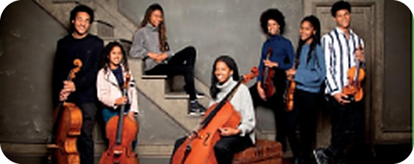
14
-ing, to or no to?
🔗 MATCH ABBINA
⏱ 4 min 👥 pairs
-ing, to or no to? Say the full sentence.
Grammar · Guided discovery
Quale forma dopo il verbo? Di' la risposta completa.
🏷️
e.g. I enjoy ___ (sing) → singing
1 I suggest ___ a taxi to the airport tomorrow. (take)
+ -ing
2 In the snow, we managed ___ to the shop. (drive)
+ to + verb
+ -ing
+ to + verb
3 We'd better ___ some shopping. (do)
verb (no to)
verb (no to)
4 I'm very impatient. I can't stand ___ in queues. (wait)
+ -ing
5 A young man kindly offered ___ my bags. (carry)
+ to + verb
6 My parents used to make me ___ my room. (tidy)
verb (no to)
7 Do you feel like ___ to the gym with me? (come)
+ -ing
8 I'd prefer ___ out, not get a takeaway. (eat)
+ to + verb
6B-1 · Grammar · Grammar Bank 6B practice · 📖 Grammar Bank 6B p.143 · a (adapted)
Notes:
14. Grammar · Grammar Bank 6B practice (4 min)
CONTROLLED PRACTICE (4 min). Worked example in the colour card: I enjoy ___ (sing) → singing (+ -ing). Pairs say each sentence aloud with the right form, then click: the colour shows the pattern; a student says the full answer. ANSWERS (SB key, Grammar Bank 6B a): 1 I suggest taking · 2 we managed to drive · 3 We'd better do · 4 I can't stand waiting · 5 offered to carry · 6 make me tidy · 7 feel like coming · 8 I'd prefer to eat. (GB a also has: 9 We threatened to call the police if the boys didn't stop throwing stones · 10 I don't mind working late tonight.) NOTE: sentences adapted from the key – check the exact Grammar Bank wording in the book (we don't have p.143). Grammar Bank 6B b (key: 1 seeing · 2 to call · 3 taking · 4 locking · 5 to turn · 6 painting · 7 to send · 8 to reach) – do it in the book if there's time, or set it as homework.

Slide 15
15
Key word race!
🎲 PLAY GIOCA
⏱ 4 min 🏆 teams
Use the KEY WORD. Write 2–5 words.
Speaking · Communicative game
Completa la frase 2 con 2–5 parole. Usa la PAROLA CHIAVE.
🎲
How to play
1
Don't forget to call Grandma.
REMEMBER → ___ Grandma.
→ Remember to call
Read sentence 1 and the KEY WORD.
Leggi la frase 1 e la parola chiave.
Write 2–5 words. Don't change the key word!
Scrivi 2–5 parole. Non cambiare la parola chiave!
e.g. Don't forget the tickets! REMEMBER → Remember to bring the tickets!
Corretta = 1 punto.
The jar was too hard to open.
TRIED → I ___ the jar, but I couldn't.
→ tried to open
2
3
Why not turn it off and on again?
TRY → ___ it off and on again.
→ Try turning
4
I saw them live – amazing!
FORGET → I'll never ___ them live.
→ forget seeing
TEAM A ☆☆☆☆☆
TEAM B ☆☆☆☆☆
Mum didn't allow me to go to the gig.
LET → Mum ___ go to the gig.
→ didn't let me
5
6B-1 · Game · Cambridge B2 First Part 4 · 📖 Cambridge B2 First · Reading & Use of English Part 4 style
Notes:
15. Game · Cambridge B2 First Part 4 (4 min)
EXAM GAME (4 min). Teams of 2–3. One sentence at a time: 45 seconds per item, teams write on mini-whiteboards/paper, then click. Point for a correct answer of 2–5 words with the key word UNCHANGED; contractions count as 2 words (didn't = did not). B2 First Part 4 facts (tell them): 6 items, 2 marks each (1 mark for each half), meaning must stay the same. Answers (our items): 1 Remember to call · 2 tried to open · 3 Try turning · 4 forget seeing · 5 didn't let me (3 words – contractions count as 2). The worked example is in the 'How to play' card. Common errors to reward/penalise: 'Remember calling' (wrong meaning), 'let me to go' (✗).

Slide 16
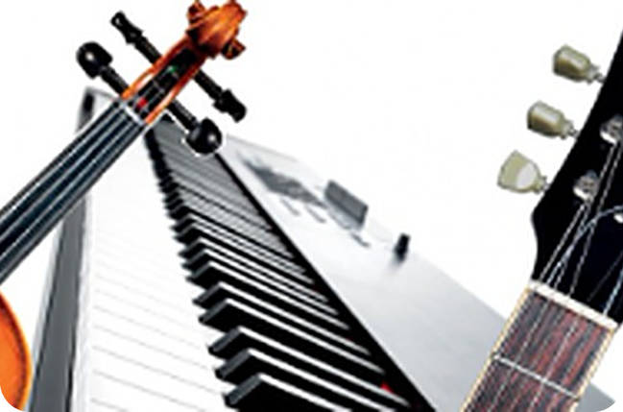
16
Tell your partner about…
💬 TALK PARLA
⏱ 5 min 👥 pairs
Choose 3 topics. Tell your partner.
Speaking · Communicative
Scegli 3 argomenti. Parla al compagno. Fai 1 domanda.
1
a piece of music you'll never forget hearing for the first time
e.g. I'll never forget hearing my dad's favourite song at a wedding – I was about seven.
2
something you sometimes forget to do before you leave the house
e.g. I often forget to charge my phone, so it dies at lunchtime!
3
something you remember doing before you were five
e.g. I remember playing on the beach at Aspra with my grandad.
4
a skill you tried to learn but couldn't
e.g. I tried to learn the guitar, but my fingers hurt too much!
💬
Useful phrases
5
something you've tried doing when you can't sleep at night
e.g. I've tried listening to rain sounds – it actually works.
Memory: I'll never forget… -ing · I remember… -ing
Trying: I tried to… · I've tried… -ing
Follow up: When was that? Did it work?
React: No way! · Me too! · Really?
6
Extension: which song will you choose in 20 years to remember this year? Why?
e.g. This summer's hit – it'll remind me of my friends and the beach.
6B-1 · Speaking · tell your partner about… · 📖 SB p.61 · 2e
Notes:
16. Speaking · tell your partner about… (5 min)
FREER PRACTICE (5 min). Prompts appear one per click – show them all, then pairs CHOOSE 3 (+ the extension if they finish early). Model one with your own true story. Worked example: A tells, B asks one follow-up question ('How old were you?'), then swap. Monitor: remember/forget/try + the right form. Other SB 2e prompts you can add: something you must remember to do today or this week · a job that needs doing in your house (e.g. the kitchen ceiling needs repainting) · something you need to do this evening. Delayed correction (1 min): 3 errors on the board, pairs correct them.

Slide 17
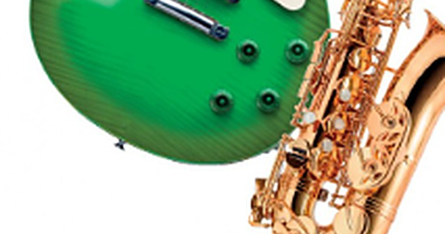
17
Name the instrument!
✍️ WRITE SCRIVI
🎧 LISTEN ASCOLTA
Read the clue. Write the instrument.
⏱ 3 min 👥 pairs
Leggi l'indizio. Scrivi lo strumento. Poi ascolta.
Vocabulary · Controlled practice
⭐
Example
1
🎸 4 strings, very low notes
a bass guitar – bass = /beɪs/ (like base!)
0 🎻 small, under your chin → a violin /vaɪəˈlɪn/
2
🥁 you hit them with sticks
drums (✗ battery!)
3
🎹 an electric piano
a keyboard /ˈkiːbɔːd/
4
🎻 big – you sit to play it
a cello /ˈtʃeləʊ/
5
🎶 silver – you blow across it
a flute /fluːt/
6
🎷 jazz – gold – you blow into it
a saxophone /ˈsæksəfəʊn/
🎧 6.16 + 6.17
▶ normal · 🐢 slower
6B-1 · Vocabulary · instruments · 📖 SB p.61 · 3a, 3b · audio 6.16, 6.17
Notes:
17. Vocabulary · instruments (3 min)
ELICIT FIRST (3 min). Pairs write the instrument for each clue (row 0 = example). Click once per row. Then play 6.16 (2 min 45 – sounds of instruments and musicians): students SAY which word they hear (no written key for the order in our files – just check orally). 6.17 = listen and check the words + stress: guiTAR, KEYboard, vioLIN, CELlo, SAXophone, conDUCtor, ORchestra, soPRAno. Musicians (choir, orchestra, conductor, soprano) are on the next slide. 3b: 'Can you play any of these instruments? Add more words: trumpet, harp, recorder, clarinet, drummer, pianist, lead singer…' (SB key 3b suggestions).

Slide 18
18
Careful, Italians!
✅ CHECK CONTROLLA
⏱ 2 min 🙋 whole class
Explain it in English. Then click.
Vocabulary · TPRS · meaning
Spiegalo in inglese. Poi clicca per l'italiano.
🤵
a conductor
🎼
an ORchestra
👥
a choir /ˈkwaɪə/
🔁
a chorus /ˈkɔːrəs/
leads an orchestra
a big classical group
people who sing together
the repeated part of a song
direttore d'orchestra
orchestra
coro
ritornello
🎫
a concert
🎻
a concerto
🎤
a soprano
✍️
a composer
a live music show
for soloist + orchestra
the highest female voice
writes music (Beethoven)
un concerto
concerto (per solista)
soprano
compositore
🎸
a band
📝
lyrics
🥁
drums
🎹
a keyboard
a pop or rock group
the words of a song
you hit them with sticks
an electric piano
gruppo / band
il testo (di una canzone)
batteria
tastiera
⚠ Watch out! conductor ≠ conduttore (TV = presenter) · concert = concerto (show) · chorus = ritornello · ORchestra, not orCHEStra · ✗ battery
6B-1 · Vocabulary · musicians + Italian traps · 📖 SB p.61 · 3a musicians
Notes:
18. Vocabulary · musicians + Italian traps (2 min)
CONSOLIDATION (2 min, rule 5). Students explain each word in simple English first; click 1 shows the English meaning, click 2 the Italian and the ⚠ line. FALSE FRIENDS for Italians: a conductor = direttore d'orchestra (a TV conduttore = a presenter / host; a bus conductor = bigliettaio) · a concert = un concerto (show) but a concerto = a piece for a soloist and orchestra · a chorus = ritornello (or a large choir) · lyrics = il testo (not 'la lirica' = opera) · drums = la batteria (✗ battery) · a band = a pop/rock group (banda = brass band). PRONUNCIATION: concerto /kənˈtʃɜːtəʊ/, soprano /səˈprɑːnəʊ/. STRESS: ORchestra /ˈɔːkɪstrə/ (Italian orCHEStra), soPRAno, conDUCtor, CHOIR = one syllable-ish /ˈkwaɪə/.

Slide 19
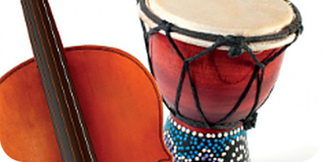
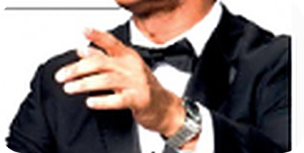
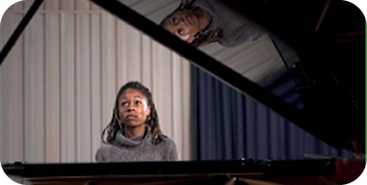
19
Borrowed words
🔊 SAY IT PRONUNCIA
⏱ 3 min 🙋 whole class
Read the rule. Click. Say the words aloud.
Pronunciation · Guided discovery
🎧 6.18 + 6.19
Leggi la regola. Clicca. Di' le parole.
Italian c + e / i
Italian zz
Greek ch · rh · ph
French
c = /tʃ/
zz = /ts/
ch = /k/ · rh = /r/ · ph = /f/
French sounds
concerto /kənˈtʃɜːtəʊ/
cello · ciao
mezzo-soprano
/ˌmetsəʊ səˈprɑːnəʊ/
chorus · orchestra
rhythm /ˈrɪðəm/
symphony /ˈsɪmfəni/
ballet /ˈbæleɪ/
encore /ˈɒŋkɔː/
genre /ˈʒɒnrə/
come in italiano!
come in pizza
ch NON è /tʃ/!
t finale muta
▶ normal · 🐢 slower
6B-1 · Pronunciation · words from other languages · 📖 SB p.61 · 3c, 3d · audio 6.18 (+ 6.19 for 3e/f)
Notes:
19. Pronunciation · words from other languages (3 min)
PRONUNCIATION – RULE, THEN PRACTISE (3 min). Read the SB box 'Foreign words that are used in English': the English pronunciation is often similar to the original language – c before i and e in words from Italian is /tʃ/ (cello, ciao), ch in words from Greek is /k/ (choir, orchestra). 3c: pairs try to say concerto, mezzo-soprano, chorus, rhythm, symphony, ballet, encore, genre and underline the stress. Then click one column at a time and play 6.18 (23 sec) – students repeat. ANSWERS (SB key 3d): the second c in concerto = /tʃ/ · zz in mezzo = /ts/ · ch in chorus = /k/ · rhy in rhythm = /rɪ/ · ph in symphony = /f/ · et in ballet = /eɪ/ · en in encore = /ɒŋ/ · g in genre = /ʒ/. Stress (SB 3c phonemics): conCERto, mezzo-soPRAno, CHOrus, RHYthm, SYMphony, BALlet, ENcore, GENre. THE ITALIAN TRAP: Italians say these words perfectly – in Italian! In English vowels change: cappuccino /ˌkæpʊˈtʃiːnəʊ/, paparazzi /ˌpæpəˈrætsi/ (/æ/), barista /bəˈriːstə/ (weak /ə/). SPEAKERS (bottom right): 1 = 6.18 · 2 = 6.19 (for 3e/f, extra slide 22) · 3–4 = slower copies.

Slide 20
20
Today you…
💡 THINK PENSA
⏱ 1 min 🙋 whole class
Can you do it now? Thumbs up or thumbs down!
Revision · Reflection
Ora sai farlo? Pollice su o pollice giù!
🎧
Listened to a talk: why do we listen to music?
✅
👍 👌 👎
Can you do it now?
Ora sai farlo?
✏️
Practised -ing or to? remember, try, stop
✅
🎻
Practised music words – and Italian traps!
✅
🔊
Said cello, concerto the English way
✅
📖
Listened to a class story and answered questions
✅
💬
Told a partner your music memories
✅
6B-1 · Review · what did you do today?
Notes:
20. Review · what did you do today? (1 min)
TODAY YOU… (1 min). Read each line (one per click: the tick appears). Students show thumbs up / middle / down: can they do it now? Note any thumbs down for the next lesson's recap.

Slide 21
21
3 · 2 · 1
⏱ 2 min 👥 pairs
Revision · Retrieval
Books closed! What can you remember?
Libri chiusi! Cosa ricordi?
3
verbs + -ing or to (e.g. enjoy…)
📝
Homework · Compiti
Workbook 6B: 1a, 1b, 1c, 1d (gerunds and infinitives)
Workbook 6B: 2a, 2b, 2c, 2e (music · borrowed words)
Workbook 6B: 2d, 2f, 2g, 2h with the Workbook audio
2
music words Italians get wrong
1
true sentence: I'll never forget …-ing
Next lesson: 6B part 2 · Music while you work · reading + speaking
6B-1 · Exit · what can you remember?
Notes:
21. Exit · what can you remember? (2 min)
RETRIEVAL EXIT (2 min). Books closed. Pairs: 3 verbs with their pattern (enjoy + -ing, manage + to, make + verb…), 2 music words with a trap (conductor, concerto, chorus, orchestra…), 1 true 'I'll never forget …-ing' sentence – 3 students read theirs. Set homework: Workbook 6B pp.43–45: Grammar 1a–d; Vocabulary & Pronunciation 2a–h (2d, 2f–h need the Workbook audio 6.3–6.5).

Slide 22
22
Where's it from?
🤔 GUESS INDOVINA
🎧 LISTEN ASCOLTA
Italian, Greek or French? Then listen.
⏱ 4 min 👥 pairs
Italiano, greco o francese? Poi ascolta.
Pronunciation · Guided discovery
🏷️
Where does it come from?
barista
I Italian
I Italian
G Greek
chauffeur
F French
F French
psychologist
G Greek
paparazzi
I Italian
croissant
F French
6B-1 · Pronunciation · borrowed words · 📖 SB p.61 · 3e, 3f · audio 6.19 is on slide 19
EXTRA · if there's time
Notes:
22. Pronunciation · borrowed words (4 min)
EXTRA (4 min). SB 3e: 18 words – the slide shows 5; do the others in the book. Pairs write I, G or F, then click; play 6.19 from slide 19 (second speaker) to check and repeat (the audio is there so its icon doesn't cover the EXTRA label here). ⚠ The SB key has NO answers for 3e – these are the usual origins; CHECK with audio 6.19: Italian: barista, cappuccino, graffiti, macchiato, paparazzi, villa · French: bouquet, chauffeur, chef, chic, croissant, fiancé · Greek: architecture, hypochondriac, microphone, philosophy, psychic, psychologist (architecture: Greek root, via Latin/French – confirm with the audio). Pronunciation: Greek ps- = /s/ (psychologist /saɪˈkɒlədʒɪst/), ch = /k/ (architecture /ˈɑːkɪtektʃə/); French ch = /ʃ/ (chauffeur, chef, chic). 3g: 'Which English words does Italian borrow? (weekend, smartphone, il manager…) Do Italians say them the English way?'

Slide 23
23
Describe it – music!
🎲 PLAY GIOCA
⏱ 4 min 👥 pairs
A explains the word. B guesses. Then swap.
Speaking · Communicative game
A spiega la parola. B indovina. Poi scambiatevi.
🎲
How to play
A explains
B explains
A looks at the screen. B looks away.
A guarda lo schermo. B si gira.
A explains in English. Don't say the word!
A spiega in inglese. Non dire la parola!
e.g. 'He leads the orchestra with a stick.' → a conductor
Pronuncia all'inglese!
a choir
an orchestra
drums
a chorus
a concerto
a keyboard
TEAM A ☆☆☆☆☆
TEAM B ☆☆☆☆☆
lyrics
a soprano
6B-1 · Game · music words
EXTRA · if there's time
Notes:
23. Game · music words (4 min)
EXTRA GAME (4 min). Same 'Describe it!' format. Point only if B says the word with ENGLISH pronunciation and stress (ORchestra, /ˈkwaɪə/, conCERto). Click once per word.

Slide 24
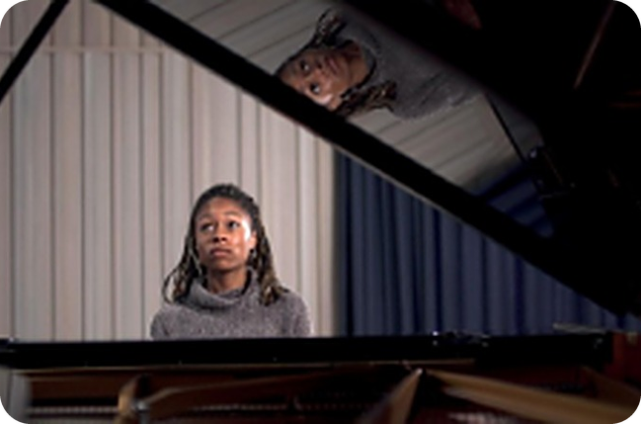
24
What music would you play…?
💬 TALK PARLA
⏱ 5 min 👥 pairs
Choose music. Give a reason.
Speaking · Communicative
Scegli la musica per ogni situazione. Spiega perché.
1
…if you were preparing to go out and feeling happy and excited about it?
e.g. I'd play something loud and fast – it gets me in the mood!
2
…if you wanted to create a romantic atmosphere?
e.g. Something slow and soft – maybe an old Italian song.
3
…if you were feeling furious about something or somebody?
e.g. Heavy metal! It makes me even angrier – but then I feel better.
4
…if you were feeling stressed or nervous?
e.g. Piano music, really quiet. It slows me down.
💬
Useful phrases
If I was…, I'd play… because…
It reminds me of… · It makes me feel…
Really? I'd choose…
5
…if you were feeling depressed?
e.g. If I was feeling depressed, I'd play Someone Like You by Adele, because it makes me cry. (SB)
6B-1 · Speaking · what music would you play? · 📖 SB p.60 · 1g
EXTRA · if there's time
Notes:
24. Speaking · what music would you play? (5 min)
EXTRA (5 min). SB 1g. Questions one per click. Connect to John's ideas: do they choose music to CHANGE their mood or to INTENSIFY it (reason 3)? The last example is the one printed in the Student's Book.

