Slide 1


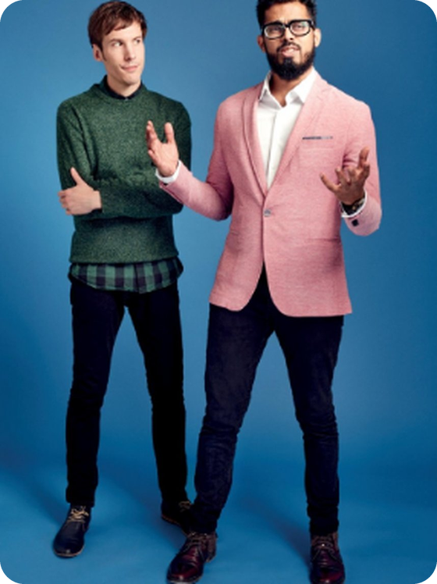


English File B1 · SB pp.62–63
💡 THINK · PENSA
6B-2
Every picture tells a story
The body · body language · charisma
🎯
Today you're going to…
🖐️ learn parts of the body and body verbs
🔊 say 'two sounds in one': bike, train, phone…
📖 read and listen: can you LEARN charisma?
📖 listen to a class story and answer questions
🎭 play a body-language mime game
Who is the most charismatic person you know? Why?
EXAMPLE My uncle! He smiles all the time and everybody listens to him.
Notes:
1. OPENING (2 min)
OPENING (2 min). Show the photo (Colin Drury and Danish Sheikh, SB p.63). Ask the THINK question; take 3–4 answers. Click: the example. If they don't know 'charismatic': 'a person people like and want to listen to' – the full definition comes later. Read 'Today you're going to…'.

Slide 2

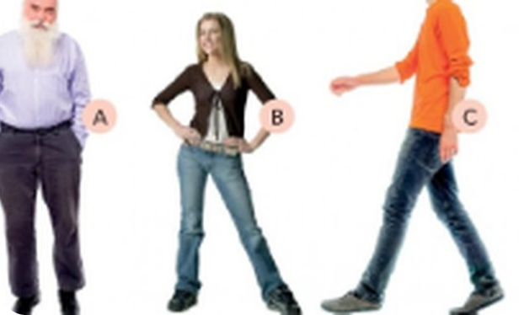
2
Remember last lesson?
💡 THINK → 💬 TALK
⏱ 2 min 👥 pairs
🎯 Revision · Retrieval
Can you remember? Say it – then use it in a sentence!
Ti ricordi? Dillo – poi usalo in una frase!
🔤 Can you remember these words? What do they mean?
must + infinitive
might
may
could
can't
no 'to'!
⭐ What does it mean?
⭐⭐ Use it in a sentence.
⭐⭐⭐ Make it negative or a question!
📅
Last lesson…
Your turn: Sure it's true ✓
Your turn: Maybe / Sure it's NOT
6B part 1: Every picture tells a story
Deduction: must · might · can't
She must be tired. (I'm sure.)
He must love animals.
He might / may / could be Spanish.
It can't be true! (✗ mustn't)
6B-2 · Revision · last lesson
Notes:
2. Revision · last lesson (2 min)
REVISION (2 min). Read the two cards; highlight: must / might / can't + infinitive WITHOUT to, and can't (NOT mustn't) for 'I'm sure it isn't true'. Point at the three people on the slide: 'How old must he be? What might she do?' – quick answers, then the error game.
HOW TO RUN IT (active recap): pairs. Words: A points at a word, B says what it means (⭐); then a sentence with it (⭐⭐); strong students make it negative or a question (⭐⭐⭐). Grammar: pairs make their own example for each use (offer, plan…) BEFORE you click – then click to show the model answers.

Slide 3

3
Spot the error!
🎲 PLAY · GIOCA
⏱ 3 min 🏆 teams
🎯 Revision · Communicative game
Find the mistake. Careful: ONE sentence is correct!
Trova l'errore. Attenzione: UNA frase è giusta!
🎲
How to play
e.g.
Is that really Jack's wife? It mustn't be true!
→ It can't be true!
Read the sentence.
Leggi la frase.
Teams write the correct sentence.
Le squadre scrivono la frase corretta.
Correct = 1 point. 'Correct' a correct sentence = –1!
Giusta = 1 punto. 'Correggere' una frase giusta = –1!
He's speaking Spanish, so he can be from Spain or Mexico.
→ he might / may / could be
1
2
She's been working all day. She must to be tired.
→ She must be tired.
3
Her profile photo is her cat. She must love animals.
→ ✓ Correct!
4
Nobody's answering. They might are on holiday.
→ They might be on holiday.
TEAM A ☆☆☆☆☆
TEAM B ☆☆☆☆☆
5
Where's Tom? – I'm not sure. He might working.
→ He might be working.
6B-2 · Warmer · last lesson · 📖 Recycles 6B part 1 · Grammar Bank 6B p.143
Notes:
3. Warmer · last lesson (3 min)
RETRIEVAL WARMER (4 min). Two teams, 30 seconds per sentence; click to show the correction. Sentence 4 is the trap (correct). Typical Italian errors (TG): mustn't for impossible, can for possibility, must/might + to, missing be.

Slide 4


4
Point to your…!
🎧 LISTEN → ✅ CHECK
⏱ 5 min 🙋 whole class
🎯 Vocabulary · TPRS · meaning
Listen and point to the part of your body. Then click!
Ascolta e indica la parte del corpo. Poi clicca!
🙂
chin
🤷
shoulders
👅
tongue /tʌŋ/
👍
thumb /θʌm/
the bottom part of your face, under your mouth
where your arms join your body
it's in your mouth – you taste with it
the short, thick finger
mento
spalle
lingua
pollice
🦵
knees (silent k!)
🍽️
stomach /ˈstʌmək/
🦶
toes
👄
lips
the middle of your legs – they bend
food goes here after you eat
the 'fingers' on your feet
the edges of your mouth
ginocchia
stomaco / pancia
dita dei piedi
labbra
⚠ Watch out! fingers (hands) ≠ toes (feet) – Italian says 'dita' for both! · I've hurt MY knee (✗ the knee)
🎧 6.14
▶ normal
🐢 slower
6B-2 · Vocabulary · the body · 8 new words · 📖 SB p.62 · 3b · Vocabulary Bank The body p.160 · audio 6.14
Notes:
4. Vocabulary · the body · 8 new words (5 min)
ESTABLISH MEANING (5 min). Play 6.14 (all 22 body words, Vocabulary Bank p.160) – students point to each part of their own body as they hear it. Then the 8 words on the slide are the ones B1 students usually DON'T know: say the word, everybody points; click 1 = English definition, click 2 = Italian. Drill tongue /tʌŋ/, thumb (silent b), knees (silent k), stomach /ˈstʌmək/. Possessive: in English we say MY knee, YOUR hands (Italian uses the article). Full key VB p.160 in the key.

Slide 5
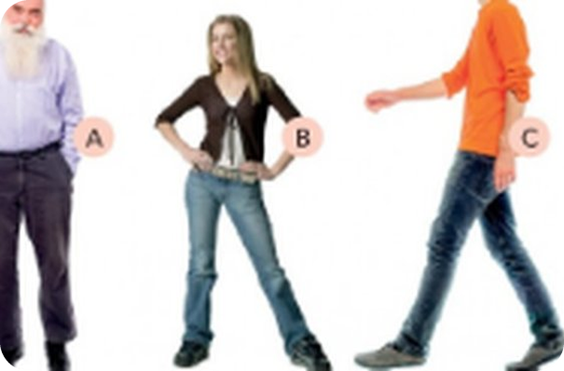
5
What do you use to…?
💡 THINK · PENSA
⏱ 4 min 👥 pairs
🎯 Vocabulary · Controlled practice
Which part of the body do you use? Tell your partner.
Quale parte del corpo usi? Dillo al compagno.
⭐
Example
1
clap
your hands – applaudire
bite → your teeth (mordere)
2
kick
your feet – calciare
3
nod
your head – annuire
4
point
your finger – indicare
5
smell
your nose – annusare
6
stare
your eyes – fissare
7
whistle (silent t!)
your lips – fischiare
🎧 6.15
8
taste
your tongue / mouth – assaggiare
▶ normal
🐢 slower
6B-2 · Vocabulary · body verbs · 📖 Vocabulary Bank p.160 · 2 Verbs · audio 6.15
Notes:
5. Vocabulary · body verbs (4 min)
BODY VERBS (5 min). First Vocabulary Bank p.160 ex. 2: complete sentences 1–11, play 6.15 to check (1 bite · 2 kicked · 3 smells · 4 stared · 5 taste · 6 whistle · 7 touch · 8 clapped · 9 pointed · 10 smiles · 11 nodded). Then this slide: pairs say the body part; click once per line. DO each verb as you check it (TPR). bite is irregular: bite – bit – bitten.

Slide 6
6
Teacher says…
🎧 LISTEN → 🎲 PLAY
⏱ 3 min 🙋 whole class
🎯 Speaking · Communicative game
Stand up! Listen and DO it. Don't speak!
In piedi! Ascolta e FALLO. Non parlare!
🎲
How to play
e.g.
Teacher says: clap your hands!
→ 👏
Listen to the audio and DO the action.
Ascolta l'audio e fai l'azione.
Then: 'Teacher says…' – only move if you hear 'Teacher says'!
Poi: muoviti solo se senti 'Teacher says'!
Wrong move? Sit down. The last person standing wins!
Sbagli? Siediti. Vince l'ultimo in piedi!
Teacher says: nod your head!
→ 🙂↕️
1
2
Point at the board!
→ ✗ no 'Teacher says' – sit down!
3
Teacher says: touch your knees!
→ 🦵
4
Teacher says: stare at your partner!
→ 👀
🎧 6.16
5
Whistle a song!
→ ✗ sit down!
▶ normal
🐢 slower
6B-2 · Game · Teacher says! · 📖 SB p.62 · 3c · audio 6.16
Notes:
6. Game · Teacher says! (3 min)
TPR GAME (4 min). Everyone stands. Play 6.16 – students follow the instructions (clap, stare at the person next to you, point at the board, nod, whistle, touch your chair, smile). Then play 'Teacher says' (Simon says): say commands fast, sometimes WITHOUT 'Teacher says' – anyone who moves sits down. Click to show the examples. Then let a student lead. Energy change – keep it fast.

Slide 7
7
Two sounds in one ①
🎧 LISTEN → 🔊 SAY IT
⏱ 3 min 👥 pairs
🎯 Pronunciation · Guided discovery
Say the word. Which sound is it?
Di' la parola. Quale suono è?
🏷️
5 sounds
bite
/aɪ/ bike
/aɪ/ bike
/eɪ/ train
face
/eɪ/ train
/əʊ/ phone
/aʊ/ owl
nose
/əʊ/ phone
/eə/ chair
mouth
/aʊ/ owl
hair
/eə/ chair
🎧 6.17 + 6.18
eyes
/aɪ/ bike
▶ normal
🐢 slower
6B-2 · Pronunciation · diphthongs (two sounds in one) · 📖 SB p.62 · 4a–4c · audio 6.17, 6.18
Notes:
7. Pronunciation · diphthongs (two sounds in one) (3 min)
PRONUNCIATION (3 + 2 min). A diphthong = two short vowel sounds joined (Italians often make it too short or say only one sound). Play 6.17: repeat bike, train, phone, owl, chair. Pairs say each word aloud and decide; click once per word. 6.18 checks all 12 words (both slides). Answers (script): /aɪ/ bite, eyes, smile · /eɪ/ face, taste · /əʊ/ nose, shoulders, throw, toes · /aʊ/ mouth · /eə/ hair, stare.

Slide 8
8
Two sounds in one ②
🔊 SAY IT → 🎧 LISTEN
⏱ 2 min 👥 pairs
🎯 Pronunciation · Guided discovery
Now these words. Then listen and check!
Ora queste parole. Poi ascolta e controlla!
🏷️
5 sounds
taste
/eɪ/ train
/aɪ/ bike
/eɪ/ train
shoulders
/əʊ/ phone
/əʊ/ phone
/aʊ/ owl
smile
/aɪ/ bike
/eə/ chair
stare
/eə/ chair
throw
/əʊ/ phone
🎧 6.18
toes
/əʊ/ phone
▶ normal
🐢 slower
6B-2 · Pronunciation · diphthongs · 📖 SB p.62 · 4b, 4c · audio 6.18
Notes:
8. Pronunciation · diphthongs (2 min)
Play 6.18 to check both slides; repeat. Then 4c phrases: fair hair · narrow shoulders · a wide mouth · brown eyes · a Roman nose (= with a bump) · a round face – pairs say them to each other.

Slide 9
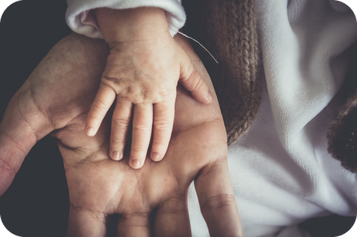
9
What does your body say?
💬 TALK · PARLA
⏱ 3 min 👥 pairs
🎯 Speaking · Communicative
Ask and answer with a partner. Use the phrases!
Fai domande e rispondi con un compagno. Usa le frasi!
1
Do you smile a lot when you meet new people?
e.g. Yes, but only when I'm not nervous.
2
When do you cross your arms?
e.g. When I'm cold – or bored!
3
Do you look people in the eye when you talk to a teacher?
e.g. Not really, I usually look down.
💬
Useful phrases
4
What do YOU do with your hands when you're nervous?
e.g. I touch my hair all the time.
When I'm nervous, I usually…
I (don't) make eye contact when…
I think … has charisma because…
Me too! / Really? I don't.
6B-2 · Speaking · body language and you · 📖 Personalisation before reading (PQA)
Notes:
9. Speaking · body language and you (3 min)
PQA – PERSONAL QUESTIONS (4 min). Ask 2–3 students question 1 yourself first and circle the answer ('Marco smiles a lot. Does Marco smile a lot? Yes! Who smiles more – Marco or Giulia?'). Then pairs ask all 4 questions using the phrases. Click once per question. Feedback: 'Who in your pair has the best body language?'

Slide 10
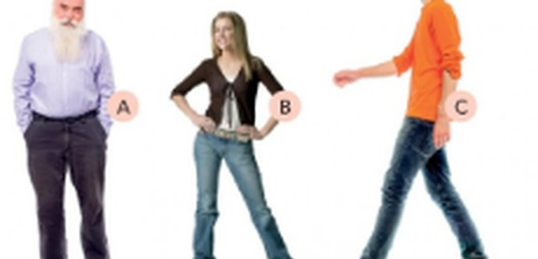
10
Dario's big solo
👀 READ → 💬 TALK
⏱ 4 min 🙋 whole class
🎯 Speaking · TPRS · story
Listen to the story. Answer the questions!
Ascolta la storia. Rispondi alle domande!
1
Dario has a trumpet solo at the school concert. He's so nervous he bites his nails.
❓ Is Dario nervous or relaxed? · What does he bite?
2
His knees shake and his stomach hurts. He can't feel his toes!
❓ Do his knees shake? · What hurts – his head or his stomach?
3
On stage, he can't play a note. So he whistles the song with his lips!
❓ Does he play or whistle? · What does he whistle with?
🔑
Story phrases
4
A boy in the front row stares at him and points at his trousers.
❓ Does the boy stare or smile? · What does he point at?
bite (your nails) – mangiarsi (le unghie)
knees · stomach · toes – ginocchia · stomaco · dita dei piedi
whistle · lips – fischiare · labbra
stare at · point at – fissare · indicare
clap · nod – applaudire · annuire
chin · shoulders – mento · spalle
5
Oh no! Dario's trousers are on back to front! But everybody claps.
❓ Are his trousers OK? · Does everybody clap or laugh?
6
Dario lifts his chin, moves his shoulders back and nods: 'Thank you!'
❓ Is Dario sad or proud? · And you – what do you do when you're nervous?
6B-2 · Speaking · class story (TPRS)
Notes:
10. Speaking · class story (TPRS) (4 min)
TPRS CLASS STORY (4 min) – the story step of the TPRS staging: meaning was established with the body (TPR + 'Teacher says…'), then personal questions (PQA); now the body words and body verbs are heard many times in a story BEFORE the charisma article and the mime game. Click once per line. For each line: 1) say it (and DO the action – bite, whistle, stare, point, clap, nod: students copy), 2) ask the questions in grey round the class (yes/no → either/or → who/what), 3) let the CLASS change details: 'Is it a trumpet solo? No? What does Dario play?' – accept their idea and use it in later lines. Students answer with one word or a short phrase – that's fine. Finish: 'What happens next?' – one or two ideas, then move on. Line 6 = confident body language → leads into 'Can you learn charisma?'. Recycles: bite, knees, stomach, toes, whistle, lips, stare at, point at, clap, chin, shoulders, nod.

Slide 11
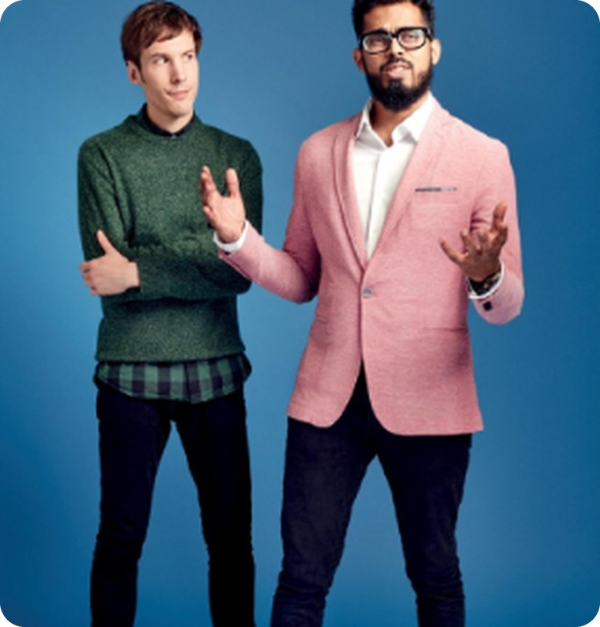
11
Can you learn charisma?
💡 THINK · PENSA
⏱ 2 min 👥 pairs
🎯 Reading · Prediction
Guess! What do the numbers mean?
Indovina! Cosa significano i numeri?
Charisma
charisma /ˈkærɪzmə/ = the powerful personal quality that some people have which attracts and impresses other people
➡ NEXT One man is a journalist, one is a charisma coach. Who's who? Why?
🔢 NUMBER BANK · guess what they mean!
£150
2
3
6B-2 · Reading · prediction · 📖 SB p.62 · 5a, 5b
Notes:
11. Reading · prediction (2 min)
PREDICTION (2 min). Read the definition (book wording); drill charisma /kəˈrɪzmə/ and charismatic. 5b: who's the journalist and who's the coach? Why? (Colin Drury = journalist, left; Danish Sheikh = coach, right.) Numbers: pairs guess – £150 = what he charges an hour · 2 = two days as his student · 3 = companies he's worked with (Microsoft, Yahoo, BBC). Don't confirm – they read to check.

Slide 12

12
Can you learn charisma? · the article
👀 READ · LEGGI
⏱ 4 min 👤 alone
🎯 Reading · TPRS · reading
Read. Check your guesses. Who's the coach?
Leggi. Controlla. Chi è il coach?
Colin Drury and Danish Sheikh
In the 21st century, charisma is the quality that people in all fields of life would most like to have. But can you learn it?
The man I have just met thinks so. His name is Danish Sheikh, and he is a charisma coach.
He has worked with Microsoft, Yahoo, and the BBC, and he thinks he can turn anyone into George Clooney.
He charges £150 an hour, and plenty of people are paying. And for two days, I'm going to be his student.
Yesterday, he followed me everywhere and watched how I behaved with people – in shops, at the hairdresser's, and in work meetings.
His impressions of me are not good: I can't make conversation, I have negative body language, and I don't smile enough. I also seem bored.
💡
Remember
fix = correct / repair
plenty of = a lot of
'But don't worry!' Sheikh says, cheerfully. 'We're going to fix all this.'
6B-2 · Reading · the journalist's article · 📖 SB p.63 · 5c
Notes:
12. Reading · the journalist's article (4 min)
READ THE CLASS TEXT (5 min). Students read alone (3 min) and check the prediction + the numbers. Then read it aloud with the class and CIRCLE: 'Is Danish a journalist? No! Is he a coach? Yes! How much does he charge? £150 a day? No – an hour!' Next slide: the book's questions.

Slide 13

13
Check: what did you understand?
👀 READ → 💬 TALK
⏱ 3 min 👥 pairs
🎯 Reading · Controlled practice
Answer with a partner. The article is on the last slide.
Rispondi con un compagno. L'articolo è nella slide precedente.
⭐
Example
1
What experience does Danish Sheikh have?
Microsoft, Yahoo and the BBC
Who's the coach? → Danish Sheikh
2
Is he successful?
Yes – £150 an hour, and plenty of people pay
3
What did he do yesterday? Why?
followed Colin everywhere – to watch how he behaves with people (Colin is going to be his student)
4
What problems does Colin have?
can't make conversation · negative body language · doesn't smile enough · seems bored
6B-2 · Reading · comprehension · 📖 SB p.62 · 5c
Notes:
13. Reading · comprehension (3 min)
COMPREHENSION (3 min). Pairs answer, then click once per answer (TG key). Ask: 'Do YOU know anyone with negative body language? (no names!)'.

Slide 14
14
A person with charisma…
💡 THINK → 🎧 LISTEN
⏱ 5 min 👥 pairs
🎯 Listening · Guided discovery
Tick ✓ or cross ✗ with a partner. THEN listen and check.
Segna ✓ o ✗ con un compagno. POI ascolta e controlla.
🏷️
Does it?
1 shows people what he / she is like
✓ yes
2 makes other people feel important
✓ yes
✓ yes
✗ no
3 talks a lot about himself / herself
✗ no
4 never says anything about himself / herself
✗ no
5 is self-confident
✓ yes
🎧 6.19
6 stands with feet apart and arms wide
✓ yes
7 makes eye contact, but doesn't stare
✓ yes
8 uses a lot of hand gestures
✗ no
9 speaks very slowly
✗ no
10 listens to people carefully
✓ yes
▶ normal
🐢 slower
6B-2 · Listening · audio 6.19 · 📖 SB p.63 · 5d, 5e · audio 6.19
Notes:
14. Listening · audio 6.19 (5 min)
PREDICT THEN LISTEN (5 min). 5d: pairs decide ✓/✗ for all 10 BEFORE listening (2 min). 5e: play 6.19 (use 🐢 slower if needed). Click once per line. Answers (TG): ✓ 1, 2, 5, 6, 7, 10. From the script: talk about yourself enough, but not too much · 'stand like a gorilla' = feet apart, arms wide · eye contact max. four seconds · don't use hand gestures too much · vary your speed · listening carefully is the most important thing of all.

Slide 15

15
What does Colin say about…?
🎧 LISTEN · ASCOLTA
⏱ 4 min 👤 alone
🎯 Listening · for detail
Read the 4 questions. Listen again and answer.
Leggi le 4 domande. Ascolta di nuovo e rispondi.
🎧 6.19 · play 2× · 🐢 = slower
1 talking about yourself
enough – but not too much
2 remembering a past success
it helps you feel more confident
3 how to enter a room
chin up, shoulders back
4 if you aren't really listening
the other person notices very quickly
💡
Guess first, then listen!
▶ normal
🐢 slower
6B-2 · Listening · detail · audio 6.19 · 📖 SB p.63 · 5f · audio 6.19
Notes:
15. Listening · detail · audio 6.19 (4 min)
DETAIL (4 min). Read the 4 prompts together first. Play 6.19 again; students write notes; compare; click once per answer (TG). Then everybody stands 'like a gorilla' for 3 seconds – feet apart, chin up, shoulders back!

Slide 16
16
Colin's test
💡 THINK → 🎧 LISTEN
⏱ 3 min 👤 alone
🎯 Listening · for detail
Guess first. Then listen and complete.
Indovina prima. Poi ascolta e completa.
🎧 6.20 · play 1–2× · 🐢 = slower
1 In the pub, Colin has to…
talk to strangers
2 Sheikh helps him by…
giving advice: make eye contact, don't cross your arms
3 In the end, Colin thinks charisma is about…
understanding who you really are
💡
Guess first, then listen!
▶ normal
🐢 slower
6B-2 · Listening · the practical test · audio 6.20 · 📖 SB p.63 · 5g · audio 6.20
Notes:
16. Listening · the practical test · audio 6.20 (3 min)
LISTENING (4 min). Pairs guess the endings (1 min) – accept any idea. Play 6.20; click once per answer (TG). Ask: 'Would YOU talk to strangers in a café in Bagheria to practise?'

Slide 17
17
Mime it!
🎲 PLAY · GIOCA
⏱ 5 min 🏆 teams
🎯 Speaking · Communicative game
Mime the action. Your team says the FULL phrase!
Mima l'azione. La tua squadra dice la frase COMPLETA!
🎲
How to play
e.g.
SHAKE HANDS
→ You're shaking hands!
The mimer looks at the screen – the team does NOT.
Il mimo guarda lo schermo – la squadra NO.
Mime it: no words, no sounds!
Mima: niente parole, niente suoni!
Team: 'You're shaking hands!' Full phrase = 1 point.
Squadra: frase completa = 1 punto.
CROSS YOUR ARMS
→ You're crossing your arms!
1
2
GIVE A THUMBS UP
→ You're giving a thumbs up!
3
STAND WITH YOUR FEET APART
→ You're standing with your feet apart!
4
CHIN UP, SHOULDERS BACK
→ You've got your chin up and your shoulders back!
TEAM A ☆☆☆☆☆
TEAM B ☆☆☆☆☆
5
MAKE EYE CONTACT
→ You're making eye contact!
6B-2 · Game · body-language mime · 📖 SB p.63 · 5h
Notes:
17. Game · body-language mime (5 min)
GAME (6 min). The phrases come from 5h (the body phrases in 6.19/6.20). Two teams; one mimer each turn stands facing the screen, everybody else turns round. Click → the phrase appears; mimer mimes; team must say the whole phrase in the present continuous ('hands!' = 0). Click again shows the model sentence. Energy + language upgrade.

Slide 18

18
Can you really learn charisma?
💬 TALK · PARLA
⏱ 3 min 👨‍👩‍👧 groups
🎯 Speaking · Communicative
Discuss in groups of 3. Give reasons!
Discuti in gruppi di 3. Spiega perché!
1
Is it possible to teach people to have charisma?
e.g. I think you can learn some things, like eye contact.
2
Would you ever do a course like this? Why (not)?
e.g. Maybe before a job interview.
3
Is £150 an hour worth it?
e.g. No way – I can watch videos online!
💬
Useful phrases
4
Which tip will YOU try this week?
e.g. I'm going to make more eye contact.
I think you can / can't learn it because…
It depends on…
I'd never pay £150 an hour!
I agree / I'm not so sure…
6B-2 · Speaking · discussion · 📖 SB p.63 · 5i
Notes:
18. Speaking · discussion (3 min)
DISCUSSION (4 min). Groups of 3, 3 minutes. Click once per question. Forced choice for Q1: yes or no, no 'maybe'. Feedback: one person per group reports their group's answer to Q4.

Slide 19
19
3 · 2 · 1
⏱ 2 min 👥 pairs
🎯 Revision · Retrieval
Books closed! What can you remember?
Libri chiusi! Cosa ricordi?
3
Tell me 3 body verbs and the part of the body you use (clap → hands).
📝
Homework · Compiti
Workbook 6B: 2a, 2b, 2c, 2d, 3a
Vocabulary Bank p.160: test yourself
Homework sheet in the LLS app
2
Tell me 2 tips from the charisma coach.
1
Tell me 1 word with two sounds in one (like bike, train, phone).
Next lesson: Revise and Check 5 & 6
6B-2 · Exit · what can you remember?
Notes:
19. Exit · what can you remember? (2 min)
RETRIEVAL EXIT (2 min). Books closed. Set homework. Extension slides follow (video, describe-and-draw) – use if there is time or start the next lesson with one.

Slide 20
20
Today you…
💡 THINK · PENSA
⏱ 1 min 🙋 whole class
🎯 Revision · Reflection
Can you do it now? Thumbs up or thumbs down!
Ora sai farlo? Pollice su o pollice giù!
🖐️
Learnt parts of the body and body verbs
✅
👍 👌 👎
Can you do it now?
Ora sai farlo?
🔊
Said 'two sounds in one': bike, train, phone…
✅
📖
Read and listened: can you LEARN charisma?
✅
📖
Listened to a class story and answered questions
✅
🎭
Played a body-language mime game
✅
6B-2 · Review · what did you do today?
Notes:
20. Review · what did you do today? (1 min)
TODAY YOU… (1 min). Read each line (one per click: the tick appears). Students show thumbs up / middle / down: can they do it now? Note any thumbs down for the next lesson's recap.

Slide 21
⭐
Optional extensions
Only if there's time – the lesson is finished. · Solo se c'è tempo – la lezione è finita.
Notes:
21. OPTIONAL EXTENSIONS
The lesson ended on the previous slide ("Today you…"). Use the next slides only if there is time left, or keep them for a quick start next lesson.

Slide 22
22
A day with a personal stylist
🎬 WATCH · GUARDA IL VIDEO
⏱ 7 min 🙋 whole class
🎯 Listening · Authentic video
Watch Part 1. Answer the questions.
Guarda la Parte 1. Rispondi alle domande.
What's Sam's job?
an actor
Why did he want a stylist?
his wardrobe was boring – he wanted a new opinion
Which outfit did Sam like best?
2 – quite bold; he felt very smart
First thing he did?
filled in a questionnaire
💬
After watching
Which of Sam's outfits do YOU like best? Why?
⭐ OPTIONAL EXTENSION · only if there's time
6B-2 · Extension · video listening · Part 1 · 📖 SB p.63 · 6a–6c · video Part 1 (4'42")
Notes:
22. Extension · video listening · Part 1 (7 min)
EXTENSION VIDEO (7 min). Teach personal stylist and outfit. Read the questions first. Play Part 1; PAUSE when the narrator asks which outfit Sam likes best – class votes. Play on. Click once per answer (video script). 6c order: 1 fills in a questionnaire · 2 meets Elin at the Fashion Lounge · 3 Elin asks about his lifestyle · 4 they go shopping · 5 he tries on four outfits.

Slide 23
23
Elin's golden rules
💡 THINK → 🎬 WATCH
⏱ 4 min 🙋 whole class
🎯 Listening · Authentic video
Guess the missing words. Then watch Part 2.
Indovina le parole mancanti. Poi guarda la Parte 2.
1 Look at ___ before you go shopping.
your own wardrobe
2 Stay ___ when you go shopping.
true to yourself
3 It doesn't matter ___ you've got.
how much money
4 Everyone should have ___.
a good pair of jeans
💬
After watching
Do you agree with Elin's rules?
⭐ OPTIONAL EXTENSION · only if there's time
6B-2 · Extension · video listening · Part 2 · 📖 SB p.63 · 6d, 6e · video Part 2 (1'27")
Notes:
23. Extension · video listening · Part 2 (4 min)
EXTENSION VIDEO (4 min). Pairs guess the gaps first, then play Part 2; click once per answer (TG / video script). Did Sam enjoy the day? 'It exceeded my expectations.'

Slide 24
24
Draw the alien!
🎲 PLAY · GIOCA
⏱ 7 min 👥 pairs
🎯 Speaking · Communicative game
A describes an alien. B draws it. No looking!
A descrive un alieno. B lo disegna. Senza guardare!
🎲
How to play
Describe the head
→ It's got three eyes and a very long tongue.
e.g.
A secretly draws a funny alien. Don't show it!
A disegna un alieno buffo. Non mostrarlo!
A describes it. B draws and asks questions.
A lo descrive. B disegna e fa domande.
Compare. Most similar pair wins! Then swap.
Confrontate. Vince la coppia più simile! Poi scambiate.
Describe the body
→ It's got four arms and six thumbs on each hand.
1
Ask a question
→ How many toes has it got? Where are its knees?
2
⭐ OPTIONAL EXTENSION · only if there's time
6B-2 · Extension · describe and draw · 📖 Extension · body vocabulary
Notes:
24. Extension · describe and draw (7 min)
EXTENSION (7 min). Information gap + humour. Practises body words, its / his / her, have got, and plurals (feet, teeth). Click to show model sentences.

