Slide 1


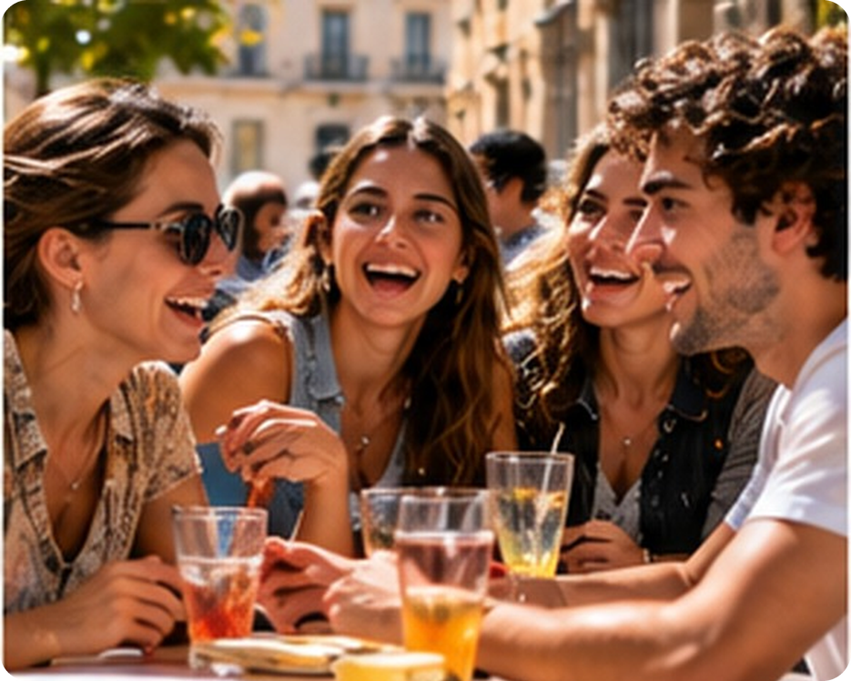


B1.1 Young · LLS course · LLS original lesson · no book needed
💡 THINK · PENSA
Y1
Weekend plans
Free time, plans and arrangements
🎯
Today you're going to…
🎮 learn 12 free-time words
📱 read a group chat about the weekend
📖 listen to a class story and answer questions
🗓 talk about plans: I'm going to… / I'm meeting…
💬 find a friend for your weekend
It's Friday afternoon. What are you going to do this weekend?
EXAMPLE I'm going to sleep a lot and play football on Sunday!
Notes:
1. OPENING (2 min)
OPENING (2 min). Show the photo: Friday, friends, the weekend starts! Ask the THINK question; take 4–5 answers in any form (don't correct the grammar yet). Write two good answers on the board – you'll come back to them at the rule slide. Read the 'Today you're going to…' list together.

Slide 2

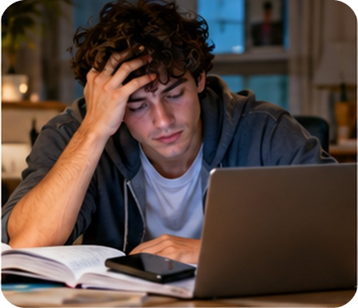
2
Remember last lessons?
💡 THINK → 💬 TALK
⏱ 3 min 👥 pairs
🎯 Revision · Retrieval
Can you remember? Say it – then use it in a sentence!
Ti ricordi? Dillo – poi usalo in una frase!
🔤 Can you remember these words? What do they mean?
do
does
am
is
are
going to
⭐ What does it mean?
⭐⭐ Use it in a sentence.
⭐⭐⭐ Make it negative or a question!
Your turn: Do or Be?
Your turn: Plans
📅
Last lesson…
Do you like football? – Yes, I do.
Are you tired? – No, I'm not.
Is your brother at school? – Yes, he is.
I'm going to study tonight.
My cousin is going to visit us.
Are you going to watch the match?
12 Oct: Do or Be in questions
7 Oct: family + plans with going to
Y1 · Revision · last lessons
Notes:
2. Revision · last lessons (3 min)
REVISION (3 min). Read the examples. Quick check: ask 4 students a Do or Be question (Are you hungry? Do you have a dog? Is it cold today? Do you play an instrument?). Pairs make one more example for each column. Today: plans for the weekend.
HOW TO RUN IT (active recap): pairs. Words: A points at a word, B says what it means (⭐); then a sentence with it (⭐⭐); strong students make it negative or a question (⭐⭐⭐). Grammar: pairs make their own example for each use (offer, plan…) BEFORE you click – then click to show the model answers.

Slide 3

3
Weekend words
✅ CHECK · CONTROLLA
⏱ 3 min 🙋 whole class
🎯 Vocabulary · TPRS · meaning
Say it in English. Then click for the Italian.
Dillo in inglese. Poi clicca per l'italiano.
⚽
play football
🎮
play video games
🛍️
go shopping
🍕
go out for a pizza
giocare a calcio
giocare ai videogiochi
fare shopping
uscire a mangiare una pizza
🎬
go to the cinema
🏖️
go to the beach
👵
visit my grandparents
😴
have a lie-in
andare al cinema
andare al mare
andare dai nonni
dormire fino a tardi
📚
do my homework
🎂
go to a party
🏋️
go to the gym
🧹
tidy my room
fare i compiti
andare a una festa
andare in palestra
riordinare la camera
⚠ Watch out! go shopping / go swimming (no to!) · have a lie-in = stay in bed late · do homework (not make)
Y1 · Vocabulary · free time
Notes:
3. Vocabulary · free time (3 min)
VOCABULARY (3 min). Click once per tile: the Italian appears. Before clicking, mime the activity and let the class say it in English. Point at the 'Watch out' line: go shopping (not go to shopping), do homework (not make). Choral drill 4–5 of the phrases.

Slide 4

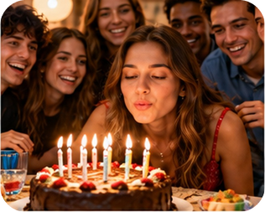
4
Mime it!
🎲 PLAY · GIOCA
⏱ 3 min 🏆 teams
🎯 Vocabulary · Communicative game
Mime an activity. Your team guesses!
Mima un'attività. La tua squadra indovina!
🎲
How to play
Team A
Team B
One student looks at the word.
Uno studente guarda la parola.
Mime it. No talking!
Mimala. Non parlare!
Team guesses in English = 1 point.
La squadra indovina in inglese = 1 punto.
have a lie-in
play video games
go shopping
go out for a pizza
tidy my room
visit my grandparents
go to the gym
go to a party
Y1 · Vocabulary game
Notes:
4. Vocabulary game (3 min)
GAME 1 (3 min). Two teams. A student from team A faces the screen; the rest of team A faces the class. Click to show each word: 30 seconds to mime it. Full phrase in English = 1 point (just 'shopping' = half point). Then team B.

Slide 5
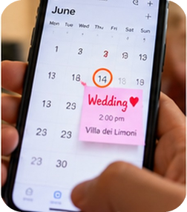
5
Marco's busy Saturday
👀 READ → 💬 TALK
⏱ 4 min 🙋 whole class
🎯 Speaking · TPRS · story
Listen to the story. Answer the questions!
Ascolta la storia. Rispondi alle domande!
1
It's Friday. Marco is going to have a lie-in on Saturday. That's his big plan!
❓ Is it Friday or Saturday? · What's Marco's plan?
2
But his mum says: 'We're visiting Nonna at 10 o'clock. It's in the diary!'
❓ Is Marco happy? · Who are they visiting? · What time?
3
Then his friend Sara texts: 'We're meeting at the cinema at 4. Are you coming?'
❓ Who texts Marco? · Where are they meeting? · What time?
🔑
Story phrases
4
Marco says: 'Yes! And after the cinema I'm going to eat a big pizza!'
❓ Is Marco going to eat a pizza or a burger? · When?
is going to (play) – ha intenzione di (giocare)
is meeting (at 4 o'clock) – si incontra (già organizzato)
has a lie-in – dorme fino a tardi
Are you coming? – Vieni?
What are you doing on Saturday? – Cosa fai sabato?
5
Saturday morning: Nonna makes cannoli. Marco eats five! He isn't hungry for pizza…
❓ How many cannoli? · Is he going to eat the pizza now?
6
Sara asks: 'What are you doing on Sunday?' Marco: 'I'm going to have a lie-in… finally!'
❓ And you – what are you doing on Sunday?
Y1 · Speaking · class story (TPRS)
Notes:
5. Speaking · class story (TPRS) (4 min)
TPRS CLASS STORY (4 min). Click once per line. For each line: 1) say it with drama, 2) ask the grey questions round the class (yes/no → either/or → open), 3) let students change details ('Is Marco visiting Nonna? No? Who is he visiting?') and use their ideas in the next lines. Students hear 'going to' (plans) and present continuous with a time (arrangements) 15+ times BEFORE the rule. Last question: personalise.

Slide 6
6
Saturday? 📱
👀 READ → ✏️ FILL THE GAPS
⏱ 4 min 👥 pairs
🎯 Reading · TPRS · reading
Read the group chat. Complete 1–5 with the words in the box.
Leggi la chat. Completa 1–5 con le parole del riquadro.
💬 Group chat: 'SATURDAY!!!'
🧺 Word box · 2 words don't fit!
Giulia: Hi guys! What (1) ________ on Saturday? 🤔
are you doing
do
Giulia: Hi guys! What are you doing on Saturday? 🤔
going to
'm going
Luca: I (2) ________ to the gym in the morning. Then nothing! 😎
Luca: I'm going to the gym in the morning. Then nothing! 😎
'm having
're meeting
Sofia: Me and Anna (3) ________ at the beach at 3. Come! 🏖️
went
Sofia: Me and Anna 're meeting at the beach at 3. Come! 🏖️
Giulia: Sorry, I (4) ________ lunch at my nonna's. But I'm free after 5!
Giulia: Sorry, I'm having lunch at my nonna's. But I'm free after 5!
Luca: OK! Let's get a pizza at 7? I'm (5) ________ book a table. 🍕
💡
Remember
Luca: OK! Let's get a pizza at 7? I'm going to book a table. 🍕
book a table = prenotare un tavolo
free = libero
Sofia: Yesss! See you at 7! 🎉
Y1 · Reading · the group chat (on this slide)
Notes:
6. Reading · the group chat (on this slide) (4 min)
READING + GAPS (4 min). The text is ON THE SLIDE. Gist first (30 seconds): 'What are they going to do on Saturday evening?' (a pizza at 7). Then pairs complete 1–5 with the box – 2 words don't fit (went = past, do). Click once per gap: the answer appears in the text. Answers: 1 are you doing · 2 'm going · 3 're meeting · 4 'm having · 5 going to.

Slide 7
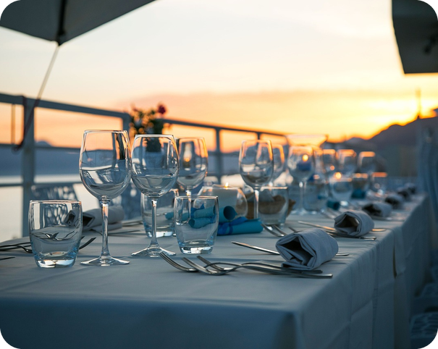
7
Who's doing what?
💬 TALK · PARLA
⏱ 3 min 👥 pairs
🎯 Reading · Controlled practice
Answer the questions about the chat.
Rispondi alle domande sulla chat.
⭐
Example
1
Who is going to the beach?
Sofia and Anna
Where is Luca going in the morning? → To the gym.
2
What time are they meeting?
at 3 o'clock
3
Why can't Giulia go to the beach?
She's having lunch at her nonna's.
4
When is Giulia free?
after 5
5
What is Luca going to do?
book a table for pizza
6
What time is the pizza?
at 7
Y1 · Reading · detail
Notes:
7. Reading · detail (3 min)
DETAIL (3 min). Pairs answer from the chat on the last slide (they can go back). Click once per answer. Short answers are fine.

Slide 8
8
Plan or arrangement?
🔗 MATCH · ABBINA
⏱ 3 min 👥 pairs
🎯 Grammar · Guided discovery
Is it a plan or an arrangement? Match the colour.
È un piano o un appuntamento? Abbina il colore.
🏷️
The colours
a Marco is going to have a lie-in.
plan (my idea)
plan (my idea)
arrangement (in the diary)
b We're visiting Nonna at 10 o'clock.
arrangement (in the diary)
c We're meeting at the cinema at 4.
arrangement (in the diary)
d I'm going to eat a big pizza!
plan (my idea)
e I'm having lunch at my nonna's.
arrangement (in the diary)
f I'm going to book a table.
plan (my idea)
Y1 · Grammar · noticing
Notes:
8. Grammar · noticing (3 min)
GUIDED DISCOVERY (3 min) before the rule. Pairs decide: is it just an idea (plan) or organised with a time / other people (arrangement)? Click once per sentence. Then ask: which verb form do the pink ones use? (going to) And the green ones? (am/is/are + -ing).

Slide 9
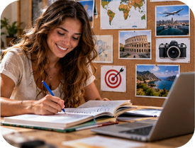

9
Plans or arrangements?
👀 LOOK · GUARDA
⏱ 4 min 🙋 whole class
🎯 Grammar · Guided discovery
Look at the examples. Which one is in the diary?
Guarda gli esempi. Quale è già in agenda?
be going to
present continuous + time
a PLAN: I decided, but no time or place yet
an ARRANGEMENT: day, time, people – it's in the diary
I'm going to have a lie-in.
Luca is going to book a table.
Are you going to watch the match?
We're meeting at the beach at 3.
I'm having lunch at my nonna's on Saturday.
What are you doing on Sunday?
intenzione (ho deciso)
già organizzato (in agenda)
⚠ Italian present ≠ English: ✗ Saturday I go to the beach → ✓ On Saturday I'm going to the beach. ✗ What do you do on Saturday? (habit) → ✓ What are you doing on Saturday? (plan)
Y1 · Grammar · plans and arrangements
Notes:
9. Grammar · plans and arrangements (4 min)
RULE (4 min), built from the story and the chat. Click once per column. CCQs: 'We're meeting at 3 – do Sofia and Anna know the time?' (yes) 'Is it organised?' (yes) → present continuous. 'I'm going to have a lie-in – is there a time?' (no) 'Did Marco decide?' (yes) → going to. Tell them: both are correct in many sentences – the important thing is NOT to use the Italian present simple.

Slide 10
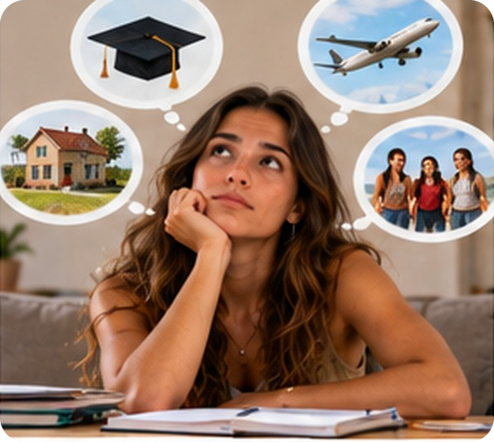
10
Plans and arrangements
✏️ FILL THE GAPS · COMPLETA
⏱ 4 min 👥 pairs
🎯 Grammar · Controlled practice
Complete with going to or the present continuous.
Completa con going to o il present continuous.
a I ___ (play) football with my cousins on Sunday at 10.
'm playing
b One day I ___ (learn) to play the guitar.
'm going to learn
c ___ you ___ (do) anything on Saturday night?
Are you doing
d My sister ___ (have) a party on Friday at 8.
's having
e I'm tired. I ___ (go) to bed early tonight.
'm going to go
💡
Try first, then check!
f We ___ (not / go) to the beach – it's raining!
aren't going to go
Y1 · Grammar · practice
Notes:
10. Grammar · practice (4 min)
CONTROLLED PRACTICE (4 min). Pairs write the answers, then click once per sentence. Accept both forms where both are natural (e.g. c 'Are you going to do'). Ask for each: is it a plan or an arrangement? Clue words: a time or a day + other people = arrangement.

Slide 11
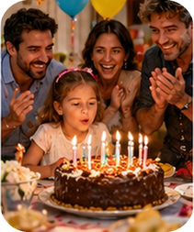
11
Say it like a Brit!
🎧 LISTEN → 🔊 SAY IT
⏱ 4 min 👥 pairs
🎯 Pronunciation · Drilling
Listen to the teacher. Write only the BIG words.
Ascolta l'insegnante. Scrivi solo le parole forti.
🗣
The teacher reads it twice
1
going
PARty
SATurday
I'm going to a party on Saturday.
🔊
Big words = STRESSED
2
WHAT
DOing
WEEKend
nouns, verbs, adjectives are strong
to, a, the, of are weak and fast
What are you doing at the weekend?
3
MEETing
FRIENDS
FOUR
We're meeting our friends at four.
4
GOing
BUY
TRAINers
I'm going to buy some new trainers.
Y1 · Pronunciation · going to /ɡəʊɪŋ tə/
Notes:
11. Pronunciation · going to /ɡəʊɪŋ tə/ (4 min)
PRONUNCIATION (4 min). No recording: YOU read each sentence twice at natural speed. Students write only the stressed words, then rebuild the sentence. Click 1 = big words, click 2 = full sentence. Drill: 'going to' is fast and weak /ɡəʊɪŋ tə/; 'to' is /tə/, not /tu:/. Italian speakers stress every word – exaggerate the big ones, whisper the small ones.

Slide 12
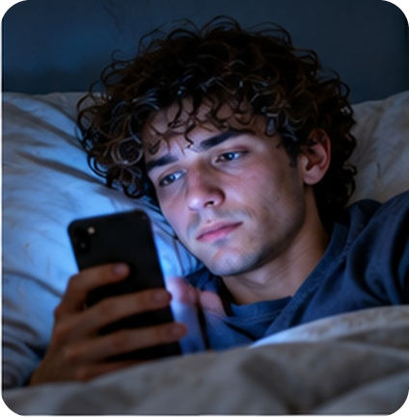
12
Your reply 📱
✍️ WRITE · SCRIVI
⏱ 4 min 👤 alone
🎯 Writing · Controlled practice
Write a reply to the group chat. Then read it to your partner.
Scrivi una risposta nella chat. Poi leggila al compagno.
⭐
Example
1
What are you doing on Saturday morning?
I'm… / I'm going to…
Hi! I'm playing football on Saturday at 10, but I'm free after 6. I'm going to come to the pizza! 🍕
2
Are you free in the afternoon?
Yes, I'm free! / Sorry, I'm…
3
Are you coming to the pizza at 7?
Yes! / I can't, because…
4
One question for your friends
What are you doing on Sunday?
Y1 · Writing · reply to the chat
Notes:
12. Writing · reply to the chat (4 min)
WRITING (4 min). Each student writes a 3–4 line reply to the group chat from slide 6, answering the 4 prompts (click once per prompt to show sentence starters). Then read it to a partner. Fast finishers: write Sunday's plans too. Collect 2–3 replies and read them out (good for error correction).

Slide 13
13
Diary race!
🎲 PLAY · GIOCA
⏱ 3 min 🏆 teams
🎯 Grammar · Communicative game
Read the situation. Say the sentence!
Leggi la situazione. Di' la frase!
🎲
How to play
e.g.
📅 Sat 4 pm · cinema with Sara
→ I'm going to the cinema with Sara on Saturday at 4.
Read the diary note.
Leggi l'appunto in agenda.
Teams: say a full sentence in 10 seconds.
Squadre: dite una frase completa in 10 secondi.
Correct sentence = 1 point.
Frase corretta = 1 punto.
💭 idea: buy new trainers
→ I'm going to buy new trainers.
1
2
📅 Sun 1 pm · lunch at Nonna's
→ We're having lunch at Nonna's on Sunday.
3
💭 idea: start the gym
→ I'm going to start the gym.
4
📅 Fri 6 pm · football training
→ I'm playing football on Friday at 6.
TEAM A ☆☆☆☆☆
TEAM B ☆☆☆☆☆
5
❓ ask Luca: Saturday night?
→ What are you doing on Saturday night?
Y1 · Grammar game
Notes:
13. Grammar game (3 min)
GAME 2 (3 min). 📅 = in the diary (arrangement → present continuous). 💭 = an idea (plan → going to). ❓ = make a question. Click to show a model answer after each round. Point for a correct full sentence.

Slide 14
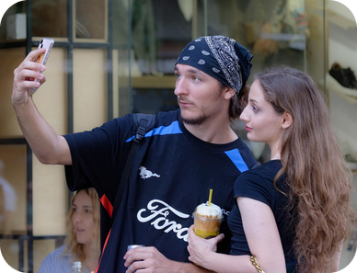
14
Are you free on Saturday?
💬 TALK · PARLA
⏱ 5 min 🚶 mingle
🎯 Speaking · Communicative
Fill your diary. Then find a friend for your weekend!
Compila l'agenda. Poi trova un amico per il weekend!
1
What are you doing on Saturday morning?
e.g. I'm having a lie-in!
2
Are you doing anything on Saturday afternoon?
e.g. Yes, I'm meeting my friends at 4.
3
What are you going to do on Sunday?
e.g. I'm going to visit my grandparents.
💬
Useful phrases
4
Are you free on Sunday evening?
e.g. Yes! Let's go out for a pizza.
Sorry, I'm busy. I'm… · I'm free! · Let's… · Shall we…?
Y1 · Speaking · my weekend
Notes:
14. Speaking · my weekend (5 min)
FREER PRACTICE (5 min). First, each student writes 3 things in a mini-diary on paper (Sat morning / Sat afternoon / Sun…), leaving at least one slot free. Questions appear one per click as models. Mingle: find someone free at the same time and make an arrangement ('Let's go to the cinema at 5!'). Feedback: 3 students tell the class their new arrangement. Note 4–5 errors for correction on the board.

Slide 15
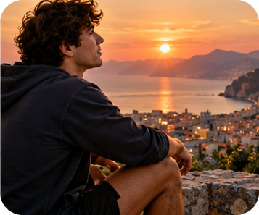
15
Tell me about…
💬 TALK · PARLA
⏱ 5 min 👥 pairs
🎯 Speaking · Communicative
Talk in pairs. Give one extra detail!
Parlate in coppia. Aggiungete un dettaglio!
1
What are you going to do after school today?
e.g. I'm going to do my homework, then I'm going to play video games.
2
What are you doing next weekend?
e.g. I'm going to a party on Saturday – it's my friend's birthday.
3
Where are you going to go in the summer?
e.g. I'm going to the beach every day, because it's hot!
💬
Useful phrases
4
What are you going to do when you're 18?
e.g. Maybe I'm going to learn to drive.
because… · with… · I think… · maybe…
Y1 · Speaking · B1 Preliminary style
Notes:
15. Speaking · B1 Preliminary style (5 min)
EXAM-STYLE SPEAKING (5 min). Like B1 Preliminary Part 1: short answers + one extra detail. Questions appear one per click; about 1 minute each. Model the first one with a strong student. Push for 'because…' and 'with…'.

Slide 16
16
3 · 2 · 1
⏱ 2 min 👥 pairs
🎯 Revision · Retrieval
Books closed! What can you remember?
Libri chiusi! Cosa ricordi?
3
Tell me 3 weekend words (no looking!)
📝
Homework · Compiti
Write your weekend diary: 5 sentences (going to + present continuous)
Learn the 12 weekend words
Easier homework in the LLS app
2
Tell me 2 sentences: one plan (going to), one arrangement (+ time)
1
Tell me 1 question to ask a friend about Saturday
Next lesson: what did you do at the weekend? (past simple)
Y1 · Exit · what can you remember?
Notes:
16. Exit · what can you remember? (2 min)
RETRIEVAL EXIT (2 min). Books closed. Pairs: 3 words, 2 sentences, 1 question. Share a few. Set homework from the portal (B1.1 Young easier homework).

Slide 17
17
Today you…
💡 THINK · PENSA
⏱ 1 min 🙋 whole class
🎯 Revision · Reflection
Can you do it now? Thumbs up or thumbs down!
Ora sai farlo? Pollice su o pollice giù!
🎮
Learnt 12 free-time words
✅
👍 👌 👎
Can you do it now?
Ora sai farlo?
📱
Read a group chat about the weekend
✅
📖
Listened to a class story and answered questions
✅
🗓
Talked about plans: I'm going to… / I'm meeting…
✅
💬
Found a friend for your weekend
✅
Y1 · Review · what did you do today?
Notes:
17. Review · what did you do today? (1 min)
TODAY YOU… (1 min). Read each line (one per click: the tick appears). Students show thumbs up / middle / down: can they do it now? Note any thumbs down for the next lesson's recap.

Slide 18
⭐
Optional extensions
Only if there's time – the lesson is finished. · Solo se c'è tempo – la lezione è finita.
Notes:
18. OPTIONAL EXTENSIONS
The lesson ended on the previous slide ("Today you…"). Use the next slides only if there is time left, or keep them for a quick start next lesson.

Slide 19
19
Guess my weekend!
🎲 PLAY · GIOCA
⏱ 4 min 🏆 teams
🎯 Speaking · Communicative game
Ask yes/no questions. Guess the plan!
Fai domande sì/no. Indovina il piano!
🎲
How to play
Are you going to play a sport?
→ Yes, I am. / No, I'm not.
e.g.
One student thinks of a weekend plan.
Uno studente pensa a un piano per il weekend.
The class asks yes/no questions: Are you going to…? Are you meeting…?
La classe fa domande sì/no.
Guess in 10 questions = 1 point.
Indovinate in 10 domande = 1 punto.
Are you meeting friends?
→ Yes, I am.
1
Is it in the evening?
→ No, it isn't.
2
Are you going to the beach?
→ Yes! 🏖️
3
TEAM A ☆☆☆☆☆
TEAM B ☆☆☆☆☆
⭐ OPTIONAL EXTENSION · only if there's time
Y1 · Extra game
Notes:
19. Extra game (4 min)
EXTRA (if there's time). Model first: think of 'going to the beach with my cousins on Sunday'. Students ask Are you going to…? / Are you meeting…? / Is it on Saturday? Click to show model questions.

