Slide 1


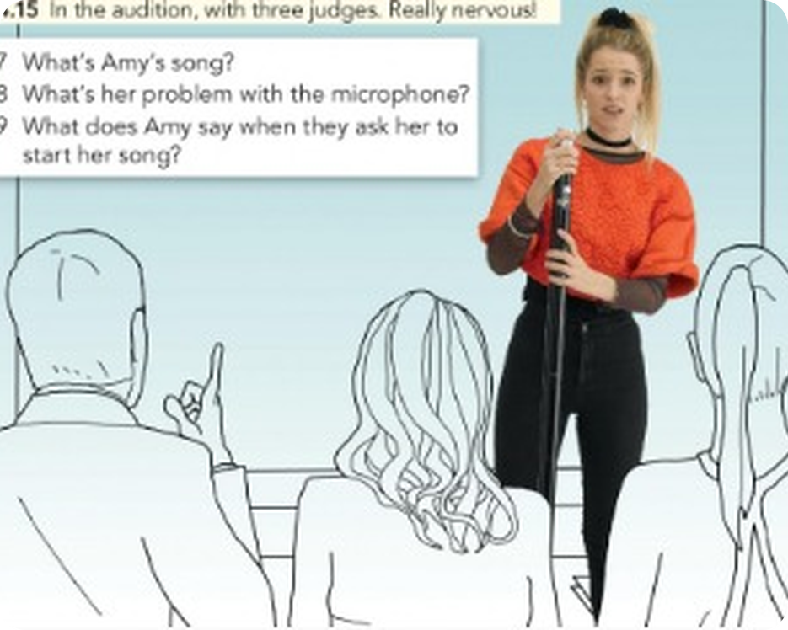


English File Elementary · SB pp.38–39 · VB p.158
💡 THINK · PENSA
5A
Vote for me!
can / can't · verb phrases
🎯
Today you're going to…
🎤 say what you can and can't do
🔤 learn 25 verb phrases: meet a friend, take a photo…
🎧 listen to Amy's audition
🔊 hear the difference: can /kən/ – can't /kɑːnt/
🌟 find your partner's talent
Can you sing? Can you dance? Do you watch TV talent shows?
EXAMPLE Yes, but I can't dance! I sometimes watch X Factor.
Notes:
1. OPENING (2 min)
OPENING (2 min). TG lead-in on the next slide revises can for requests.

Slide 2

2
Can I…? Can you…?
💡 THINK → 🔊 SAY IT
⏱ 3 min 👥 pairs
What do you say? Start with Can…
Cosa dici? Inizia con Can…
⭐
Example
1
You want a photocopy.
Can I have a photocopy, please?
Can I have…? = ask for something · Can you…? = ask a person to do something
2
You're in a café and you want a Coke.
Can I have a Coke, please?
3
You want another person to sign something.
Can you sign this, please?
4
You want another person to open the window.
Can you open the window, please?
5A · Warm-up · can for asking · 📖 TG optional lead-in (TG key)
Notes:
2. Warm-up · can for asking (3 min)
WARM-UP (3 min). From the TG lead-in. Today: other uses of can (ability, possibility, permission).

Slide 3

3
Remember?
💡 THINK → 💬 TALK
⏱ 2 min 👥 pairs
🎯 Revision · Retrieval
Can you remember? Say it – then use it in a sentence!
Ti ricordi? Dillo – poi usalo in una frase!
🔤 Can you remember these words? What do they mean?
go to the gym
play the guitar
do exercise
watch TV
have a coffee
listen to music
hardly ever
twice a week
⭐ What does it mean?
⭐⭐ Use it in a sentence.
⭐⭐⭐ Make it negative or a question!
📅
Last lesson…
R3-4: Revise and Check
Files 3–4
5A · Revision · last lesson
Notes:
3. Revision · last lesson (2 min)
RECAP (2 min). SB 1a: match the verbs and words (TG key: go to the gym, play the guitar, do exercise, watch TV, have a coffee, listen to music). How often do you…?
HOW TO RUN IT (active recap): pairs. Words: A points at a word, B says what it means (⭐); then a sentence with it (⭐⭐); strong students make it negative or a question (⭐⭐⭐). Grammar: pairs make their own example for each use (offer, plan…) BEFORE you click – then click to show the model answers.

Slide 4

4
More verb phrases
✅ CHECK · CONTROLLA
⏱ 5 min 🙋 whole class
🎯 Vocabulary · TPRS · meaning
Vocabulary Bank: more verb phrases. Say the phrase, then click!
Vocabulary Bank: altre espressioni. Di' la frase, poi clicca!
🚕
call a taxi
🅿️
find a parking space
🤔
forget somebody's name
💐
give somebody flowers
chiamare un taxi
trovare parcheggio
dimenticare il nome di qualcuno
regalare fiori
👂
hear a noise
👜
leave your bag on a train
🔑
look for your keys
🏃
run a race
sentire un rumore
lasciare la borsa sul treno
cercare le chiavi
fare una gara di corsa
📱
send a text message
🤫
tell somebody a secret
💪
try to do something difficult
🚏
wait for a bus
mandare un messaggio
dire un segreto
provare a fare qualcosa di difficile
aspettare l'autobus
⚠ Watch out! Don't forget your bag (no place) · Don't leave your bag in class (+ place) · look for = cercare · wait for = aspettare
🎧 5.1
5A · Vocabulary Bank p.158 · more verb phrases · 📖 VB p.158 · a, b · audio 5.1 (TG list + notes)
Notes:
4. Vocabulary Bank p.158 · more verb phrases (5 min)
VERB PHRASES (5 min). 12 of the 25 phrases (5.1 has them all). TG notes: remember complete phrases (meet a friend, not just meet); forget vs leave. Activation: cover the verbs, test your partner.

Slide 5
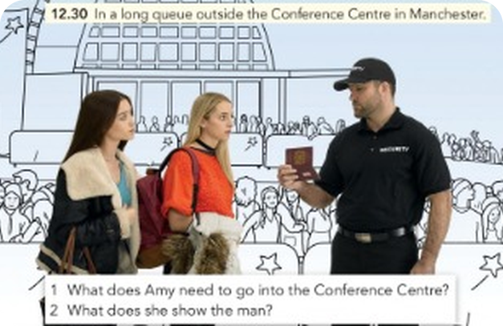
5
The audition (1)
🎧 LISTEN → ✅ CHECK
⏱ 5 min 👤 alone
🎯 Listening · for detail
Amy goes to an audition for a TV singing competition. Listen and answer 1–5.
Amy va a un'audizione per un talent show. Ascolta e rispondi 1–5.
🎧 5.2 · play twice
1 What does Amy need to go into the Conference Centre?
She needs ID.
2 What does she show the man?
Her passport.
3 Where does Amy's friend wait?
She waits with Amy.
4 How many people does the woman call?
Three.
5 What does Amy's friend say before she goes to the audition?
'Good luck, Amy! You can do it!'
💡
audition = a short performance · nervous · It's your turn
5A · Listening · Amy's audition (1) · 📖 SB p.38 · 2a, 2b · audio 5.2 (TG key + script p.119)
Notes:
5. Listening · Amy's audition (1) (5 min)
AUDITION 1 (5 min). 2a: do you watch shows like this? Pre-teach audition, nervous, It's your turn (TG). Play 5.2, pause after each answer. Key (TG).

Slide 6
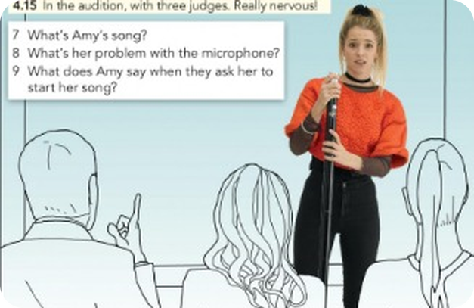
6
The audition (2)
🎧 LISTEN → ✅ CHECK
⏱ 4 min 👤 alone
🎯 Listening · for detail
Listen again. Answer 6–9.
Ascolta di nuovo. Rispondi 6–9.
🎧 5.2 · play again
6 What does Amy do with her bag?
She leaves it with her friend.
7 What's Amy's song?
One Day.
8 What's her problem with the microphone?
It isn't on.
9 What does Amy say when they ask her to start her song?
'Oh no! I can't remember the first line.'
💡
Listen for can and can't!
5A · Listening · Amy's audition (2) · 📖 SB p.38 · 2b · audio 5.2 (TG key)
Notes:
6. Listening · Amy's audition (2) (4 min)
AUDITION 2 (4 min). Key (TG). From the script: 'You can't take your bag into the audition.' · 'We can't hear you.' · 'Can you hear me now?'

Slide 7
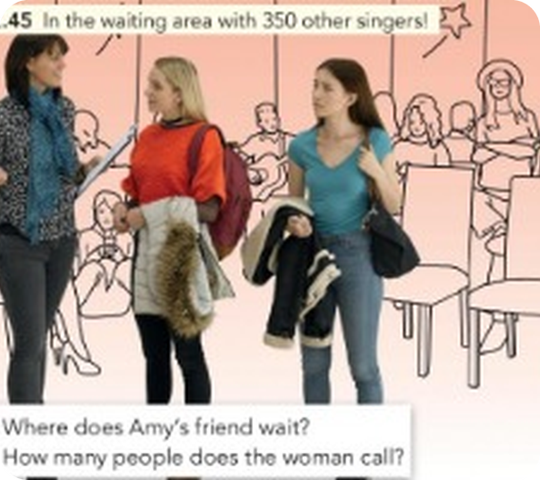
7
Retell it!
💬 TALK · PARLA
⏱ 3 min 👥 pairs
🎯 Speaking · TPRS · retell
Retell Amy's story to your partner. Use the prompts!
Racconta di nuovo la storia di Amy. Usa gli spunti!
1
12.30 · long queue · need ID · passport
💬 At half past twelve Amy is…
2
12.45 · 350 other singers · her friend
💬 In the waiting area…
3
4.00 · her turn · Good luck!
💬 Three hours later…
4
can't take her bag · leaves it
💬 The organizer says…
5
4.15 · One Day · microphone isn't on
💬 In the audition…
6
can't remember the first line
💬 Oh no!
7
Change 2 things in the story!
💬 In my story…
5A · Speaking · retell
Notes:
7. Speaking · retell (3 min)
RETELL (3 min). A tells lines 1–3, B the rest, then swap. Prompts only. Listen for can / can't.

Slide 8
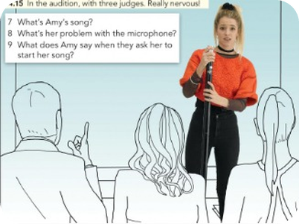
8
Vote for me!
🎧 LISTEN → 💬 TALK
⏱ 4 min 👥 pairs
🎯 Listening · Controlled practice
Listen to Amy, Justin and Naomi sing. Give a score out of 10. Then: what do the judges say?
Ascolta Amy, Justin e Naomi. Dai un voto su 10. Poi: cosa dicono i giudici?
⭐
Example
1
Amy
very nervous at the beginning, but in the end very good – a great performance
Play 5.3 (the songs) → vote with a show of hands → play 5.4 (the judges)
2
Justin
terrible – good-looking, moves well, but he can't sing!
3
Naomi
quite good, a nice voice – but 'I can't hear the feeling'
4
Who's on the show next week? How does Amy feel?
Amy – she feels very happy: 'Fantastic!'
🎧 5.4
5A · Listening · vote for me! · 📖 SB p.38 · 2c, 2d · audio 5.3, 5.4 (TG key + script)
Notes:
8. Listening · vote for me! (4 min)
VOTE (4 min). 5.3: pause after each singer – pairs give a score out of 10. Show of hands, scores on the board. 5.4: do the judges agree with the class? Key (TG).

Slide 9
9
What does can mean?
💡 THINK → ✅ CHECK
⏱ 3 min 👥 pairs
🎯 Grammar · Controlled practice
Match the sentences from Amy's story to their meanings.
Abbina le frasi della storia ai significati.
⭐
Example
1
You can't sing!
d – you don't know how
a It isn't OK. · b It's possible. · c Please do it. · d You don't know how.
2
You can't come in if you don't have ID.
a – it isn't OK
3
Can you come with me, please?
c – please do it
4
She can wait there.
b – it's possible
5A · Grammar · can / can't – meanings · 📖 SB p.39 · 3a (TG key 1d 2a 3c 4b)
Notes:
9. Grammar · can / can't – meanings (3 min)
MEANINGS (3 min). TG notes: Italian uses saper fare for ability (so cantare) and potere for possibility / permission – English uses can for all of them.

Slide 10

10
can / can't
👀 LOOK · GUARDA
⏱ 3 min 🙋 whole class
🎯 Grammar · Guided discovery
Read the examples. Then click!
Leggi gli esempi. Poi clicca!
+ and −
?
I / you / he / she / we / they can sing.
He can't dance.
(✗ he cans · ✗ I don't can)
Can you swim? – Yes, I can. / No, I can't.
Can I park here?
(✗ Do you can…? · ✗ can to swim)
can = stesso per tutti · can't = cannot
can + soggetto + verbo (senza to)
⚠ ✗ She cans play → ✓ She can play · ✗ I can to swim → ✓ I can swim · ✗ Do you can…? → ✓ Can you…?
5A · Grammar Bank 5A · the rule · 📖 Grammar Bank 5A p.132 · audio 5.5 (TG grammar notes)
Notes:
10. Grammar Bank 5A · the rule (3 min)
RULE (3 min). TG notes: modal verb – no s, no do / does, no to. Play 5.5 for listen and repeat.

Slide 11
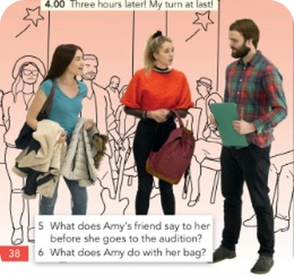
11
Grammar Bank practice
✍️ WRITE → ✅ CHECK
⏱ 4 min 👤 alone
🎯 Grammar · TPRS · reading
Grammar Bank 5A b: make sentences with can or can't.
Grammar Bank 5A b: fai frasi con can o can't.
Make the sentence
1 she / meet me after work (+) → (1) ________
1 she / meet me after work (+) → She can meet me after work.
2 you / open the door, please (?) → (2) ________
2 you / open the door, please (?) → Can you open the door, please?
3 my boyfriend / ski (−) → (3) ________
3 my boyfriend / ski (−) → My boyfriend can't ski.
4 I / use your car (?) → (4) ________
4 I / use your car (?) → Can I use your car?
💡
Remember
5 you / take photos here (−) → (5) ________
5 you / take photos here (−) → You can't take photos here.
can / can't + verb
Can + subject + verb?
5A · Grammar Bank 5A p.133 · b · 📖 Grammar Bank 5A p.133 · b (TG key)
Notes:
11. Grammar Bank 5A p.133 · b (4 min)
GRAMMAR BANK b (4 min). Prompts made from the TG answers. Grammar Bank a key (TG): 1 can speak 2 Can…help 3 can't see 4 Can…close 5 Can…repeat 6 can't park 7 can't swim 8 Can…use.

Slide 12
12
can /kən/ – can't /kɑːnt/
🎧 LISTEN → 🔊 SAY IT
⏱ 4 min 👥 pairs
🎯 Pronunciation · Controlled practice
Listen and repeat. Copy the rhythm. Then: can or can't?
Ascolta e ripeti. Copia il ritmo. Poi: can o can't?
⭐
Example
1
a I can sing. b I can't sing.
b – I can't sing.
I can SING. (can = short, quick) · I CAN'T sing. (can't = long, stressed!)
2
a She can dance very well. b She can't…
a – She can dance very well.
3
a He can cook. b He can't cook.
a – He can cook.
4
a I can come to the meeting. b I can't…
b – I can't come to the meeting.
5
a You can park here. b You can't…
b – You can't park here.
6
a I can drive. b I can't drive.
a – I can drive.
🎧 5.8
5A · Pronunciation · sentence stress · 📖 SB p.39 · 4a–4c · audio 5.6, 5.7, 5.8 (TG key)
Notes:
12. Pronunciation · sentence stress (4 min)
CAN / CAN'T (4 min). 5.6: practise the 3 conversations (Can you play a musical instrument? – Yes, I can…). 5.7: hear the difference. 5.8: circle a or b – TG key 1b 2a 3a 4b 5b 6a. TG: unstressed can /kən/ – stress it and people think can't! EXTRA: pairs say 4 jumbled sentences, partner says positive or negative.

Slide 13
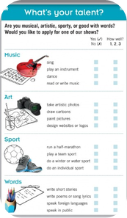
13
What's your talent?
💬 TALK → ✍️ WRITE
⏱ 8 min 👥 pairs
🎯 Speaking · Communicative
What's your talent? Interview your partner: Can you…? How well? 1, 2 or 3.
Qual è il tuo talento? Intervista il compagno: Can you…? Quanto bene? 1, 2 o 3.
1
Music: sing · play an instrument · dance · read or write music
e.g. Can you play an instrument? – Yes, the guitar. Quite well.
2
Art: take artistic photos · draw cartoons · paint pictures · design websites
e.g. Can you draw cartoons? – No, I can't!
3
Sport: run a half-marathon · play a team sport · do a water sport
e.g. Can you run a half-marathon?
💬
Useful phrases
4
Words: write stories · write poems · speak foreign languages · speak in public
e.g. Can you speak in public?
Can you sing?
Yes, I can. / No, I can't.
How well? 1 = not very well · 2 = quite well · 3 = very well
talent = a natural ability
5
What's your partner's talent? Tell a new partner!
e.g. Marco can sing very well – he can enter X Factor!
5A · Speaking · What's your talent? · 📖 SB p.39 · 5a–5c
Notes:
13. Speaking · What's your talent? (8 min)
TALENT (8 min). Mark the PARTNER's answers. 5b: what's their talent – any competitions or TV shows? 5c: new partners report: He / She can… (no s!).

Slide 14
14
Prove it!
🎲 PLAY → 💬 TALK
⏱ 5 min 🏆 teams
🎯 Speaking · Communicative game
Can you…? Do it now! Teams challenge each other.
Can you…? Fallo adesso! Le squadre si sfidano.
🎲
How to play
Can you say the months in 10 seconds?
→ Yes, we can! January, February…
1
Team A asks: Can you say the alphabet backwards?
Team B says Yes, we can! – and does it in 30 seconds.
Yes + do it = 2 points. No, we can't = 0. Swap!
Can you spell 'nephew'?
→ N-E-P-H-E-W
2
Can you sing a song in English?
→ Yes, we can!
3
Can you name 10 jobs in 30 seconds?
→ nurse, lawyer, vet…
4
TEAM A ☆☆☆☆☆
TEAM B ☆☆☆☆☆
5A · Game · prove it! · 📖 Extra · zero-prep game
Notes:
14. Game · prove it! (5 min)
PROVE IT (5 min). Ask with Can you…? – answer with short answers. Silly challenges are welcome.

Slide 15
15
3 · 2 · 1
⏱ 2 min 👥 pairs
🎯 Revision · Retrieval
Books closed! Tell your partner…
Libri chiusi! Di' al compagno…
3
Tell me 3 new verb phrases.
📝
Homework · Compiti
Workbook 5A pp.32–33
2
Tell me 2 things you can do and 1 you can't.
Next lesson: 5B A quiet life? – present continuous (SB p.40)
1
Tell me 1 thing about Amy's audition.
5A · Exit · what can you remember?
Notes:
15. Exit · what can you remember? (2 min)
EXIT (2 min). Pairs, books closed. Listen for can /kən/ vs can't /kɑːnt/.

Slide 16
16
Today you…
💡 THINK · PENSA
⏱ 1 min 🙋 whole class
🎯 Revision · Reflection
Can you do it now? Thumbs up or thumbs down!
Ora sai farlo? Pollice su o pollice giù!
🎤
Said what you can and can't do
✅
👍 👌 👎
Can you do it now?
Ora sai farlo?
🔤
Learnt 25 verb phrases: meet a friend, take a photo…
✅
🎧
Listened to Amy's audition
✅
🔊
Heard the difference: can /kən/ – can't /kɑːnt/
✅
🌟
Found your partner's talent
✅
5A · Review · what did you do today?
Notes:
16. Review · what did you do today? (1 min)
TODAY YOU… (1 min). Read each line (one per click: the tick appears). Students show thumbs up / middle / down: can they do it now? Note any thumbs down for the next lesson's recap.

