Slide 1


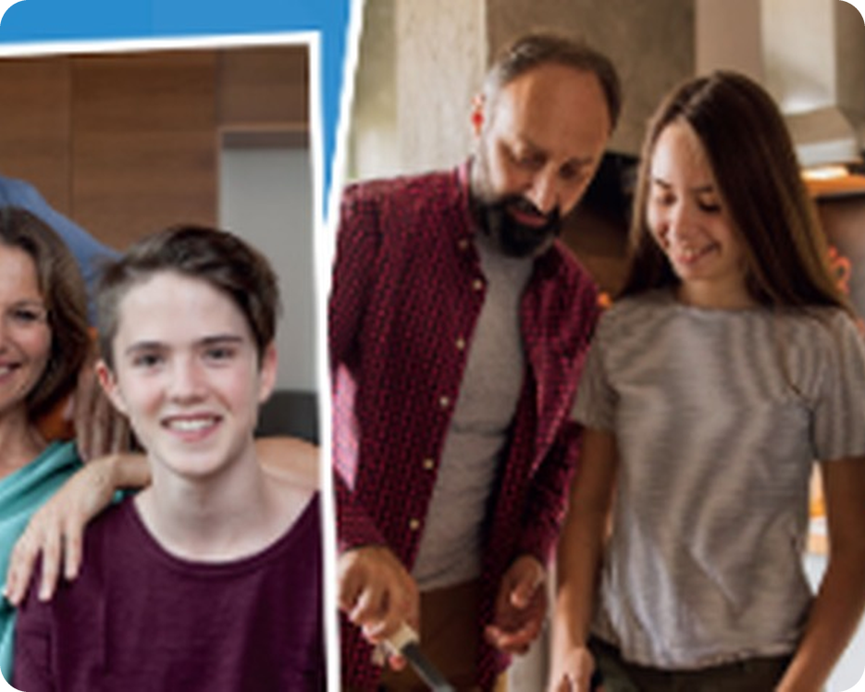


Prepare · Unit 1 · SB pp.10–11
💡 THINK · PENSA
1A
All about me
Describing people · online profiles
🎯
Today you're going to…
🙂 describe what people look like
💬 learn 6 personality adjectives + opposites
📖 read three online profiles
🔑 learn 6 useful phrases from the texts
🗣️ tell a class story and describe your friends
What do you look like? What type of person are you?
EXAMPLE I've got short dark hair. I'm quite friendly, but a bit shy.
Notes:
1. OPENING (2 min)
OPENING (2 min). SB 'About you'. Ask both questions; point out that Q1 = appearance (looks), Q2 = personality. Model with yourself first (click: the example answer). Take 3–4 answers – don't correct much yet, just collect words on the board.

Slide 2

2
30-second word race
🎲 PLAY GIOCA
⏱ 4 min 🏆 teams
Teams: 30 seconds! How many words can you write?
🎯 Revision · Communicative game
Squadre: 30 secondi! Quante parole sapete scrivere?
🎲
How to play
Words for HAIR
→ long, short, dark, blonde, curly, straight…
1
30 seconds per round. Write as many words as you can.
Spell it right = 1 point.
Say it in a sentence = 1 more point!
Words for AGE
→ young, old, teenage, middle-aged…
2
Words for PERSONALITY
→ friendly, funny, shy, kind, lazy…
3
Words for your FAMILY
→ mum, dad, brother, sister, cousin, aunt…
4
TEAM A ☆☆☆☆☆
TEAM B ☆☆☆☆☆
1A · Warmer · words you know · 📖 TB p.17 · warmer
Notes:
2. Warmer · words you know (4 min)
WARMER (4 min) – TB warmer, made into a team race. Read the round title; teams have 30 seconds to write words on paper. Click: example words. Teams read their lists: a correctly spelt word = 1 point; using it in a sentence ('My dad has got curly hair') = 1 more point. Write good words on the board – you'll use them on the next slides.

Slide 3

3
What do they look like?
✅ CHECK CONTROLLA
⏱ 4 min 🙋 whole class
Explain it in English (harder) – or say it in Italian (easier). Click.
🎯 Vocabulary · TPRS · meaning
Spiegalo in inglese (più difficile) – o dillo in italiano (più facile). Clicca.
👨‍🦲
bald
🌀
curly hair
📏
straight hair
👱
fair hair
no hair on your head
hair with lots of curls
hair with no curls
light-coloured hair
calvo
capelli ricci
capelli lisci
capelli chiari, biondi
👴
elderly
🧔
middle-aged
🎓
in his early twenties
😎
good-looking
old (a polite word)
about 45 to 60 years old
about 20 to 23 years old
attractive (men and women)
anziano
di mezza età
sui vent'anni
di bell'aspetto
⚠ Watch out! handsome = for men · pretty = for girls and women · fair hair = blonde, not 'fiera' · bald /bɔːld/
1A · Vocabulary · describing people (looks) · 📖 SB p.10 · 2
Notes:
3. Vocabulary · describing people (looks) (4 min)
KEY WORDS (4 min). SB ex.2. Two levels: strong students explain each word in English; others say the Italian. Click 1 = English meaning, click 2 = Italian. Drill: bald /bɔːld/, curly /ˈkɜːli/, straight /streɪt/, thirties /ˈθɜːtiz/. Then SB table: Age = elderly, middle-aged, teenage, in his/her (early/late) twenties/thirties · Looks = attractive, good-looking, handsome, pretty · Hair = bald, blonde, curly, dark, fair, straight.

Slide 4
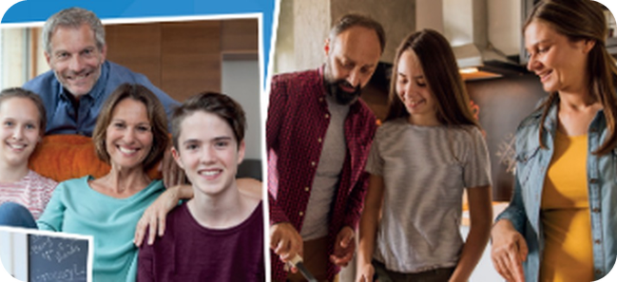
4
Who is it?
👀 LOOK GUARDA
💬 TALK PARLA
Describe someone in the photo. Your partner guesses who it is.
⏱ 4 min 👥 pairs
Descrivi una persona nella foto. Il compagno indovina chi è.
🎯 Speaking · Communicative
1
Model: describe one person. The class guesses.
e.g. He's a teenage boy and he's good-looking. – Is it Alfie?
2
A describes, B guesses. Use 2 words from the last slide!
e.g. She's middle-aged and she's got long fair hair. – Is it Grace's mum?
3
Swap! B describes, A guesses.
e.g. He's got short dark hair and he's in his forties.
💬
Useful phrases
4
Challenge: describe someone in the CLASS. Don't say their name!
e.g. She's got long straight hair and she's always smiling.
He's / She's got … hair.
He's / She's in his / her … .
He's / She's middle-aged.
He's quite good-looking.
Is it the … ?
1A · Speaking · describe and guess · 📖 SB p.10 · 3
Notes:
4. Speaking · describe and guess (4 min)
SPEAKING (4 min). SB ex.3. Model with the class first (line 1). Then pairs: A describes a person in the photos, B guesses. Swap. Line 4 (challenge): describe a classmate – keep it kind! Listen for has got + hair word order: 'long straight dark hair' (length → type → colour).

Slide 5

5
Polite or careless?
👀 READ LEGGI
🔍 FIND TROVA
Choose the correct adjective. Say the full sentence.
⏱ 5 min 👥 pairs
Scegli l'aggettivo giusto. Di' la frase intera.
🎯 Vocabulary · Controlled practice
1
I think Lucas is really polite / careless. When he wants to borrow something, he always says please.
4
Alfie talks a lot – like his mum! He's sometimes a bit confident / careless with homework. He doesn't always check it.
I think Lucas is really polite. He always says please.
He's sometimes a bit careless with homework.
2
My brother's called Alfie. He takes my things without asking. He thinks he's funny / polite, but he doesn't make me laugh!
5
Grace is a great friend. She's always smiling, and she's never miserable / polite. She really makes me laugh.
He thinks he's funny, but he doesn't make me laugh!
She's always smiling, and she's never miserable.
3
Grace is very miserable / friendly. I see her every morning on her way to school. She always says hello.
6
Lucas knows what he's good at, so he's quite a careless / confident boy. His room is always really untidy!
Grace is very friendly. She always says hello.
He's quite a confident boy.
1A · Vocabulary · personality adjectives · 📖 SB p.10 · 4 (no audio – check on the slide)
Notes:
5. Vocabulary · personality adjectives (5 min)
PERSONALITY ADJECTIVES (5 min). SB ex.4 – the descriptions are on the slide. Pairs choose; click once per item: the answer highlighted. Key (TB): 1 polite 2 funny 3 friendly 4 careless 5 miserable 6 confident. No audio: instead of 'listen and check', ask 'Which words in the sentence helped you?' (says please → polite; always smiling → not miserable). Check other adjectives in the texts: clever, great, lazy, untidy.

Slide 6
6
Opposites ping-pong
🎲 PLAY GIOCA
⏱ 4 min 🏆 teams
Say the opposite – then use it in a sentence!
🎯 Vocabulary · Communicative game
Di' il contrario – poi usalo in una frase!
🎲
How to play
1
careful
→ careless – 'He's careless with his homework.'
Teacher says a word. Your team says the OPPOSITE.
Opposite = 1 point.
A sentence with it = 1 more point!
cheerful
→ miserable – 'She's never miserable.'
2
3
rude
→ polite – 'He always says please. He's polite.'
4
serious
→ funny – 'My dad is really funny.'
5
shy
→ confident – 'She's confident in English class.'
TEAM A ☆☆☆☆☆
TEAM B ☆☆☆☆☆
6
unfriendly
→ friendly – 'Our neighbours are very friendly.'
1A · Vocabulary · opposites · 📖 SB p.10 · 5
Notes:
6. Vocabulary · opposites (4 min)
OPPOSITES (4 min). SB ex.5 as a quick team game. Say the word on the left; the first team to say the opposite gets a point; a correct sentence gets a second point. Click: the answer + an example. Key (TB): careful–careless, cheerful–miserable, rude–polite, serious–funny, shy–confident, unfriendly–friendly. Drill: miserable /ˈmɪzrəbl/.

Slide 7
7
Guess who!
💬 TALK PARLA
⏱ 4 min 👥 pairs
Describe someone you both know: looks AND personality. Your partner guesses!
🎯 Speaking · Communicative
Descrivi una persona che conoscete: aspetto E carattere. Il compagno indovina!
💬
Useful phrases
1
Which adjectives describe YOU? Tell your partner.
e.g. I'm quite confident, but I'm a bit careless with homework.
He's / She's got…
He's / She's quite / really…
He's / She's a bit…
He's never… / always…
Is it…?
2
Think of someone you both know: a teacher, a singer, a footballer…
e.g. Don't say the name!
3
Describe their looks AND their personality.
e.g. She's got straight dark hair and she's very confident.
4
Your partner asks 2 questions, then guesses.
e.g. Is she on TV? … Is it Ana?
1A · Speaking · describe a person · 📖 SB p.10 · 6, 7
Notes:
7. Speaking · describe a person (4 min)
SPEAKING (4 min). SB ex.6–7. Model first: describe yourself (line 1), then describe a famous person the class knows and let them guess. Pairs: looks + personality, 2 yes/no questions, then a guess. Push for 'quite / really / a bit + adjective'.

Slide 8
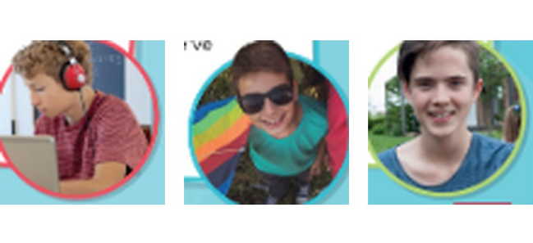
8
Bryans High School: all.about.me
👀 READ LEGGI
💬 TALK PARLA
Look at the website. Answer the questions.
⏱ 2 min 👥 pairs
Guarda il sito. Rispondi alle domande.
🎯 Reading · Communicative
1
Would you like to meet other students who share your hobbies? It's easy with all.about.me: 1 create an account · 2 post a photo and your profile · 3 read about other students and click 'Connect'.
e.g. Sounds fun – I'd look for people who play basketball!
2
Have you got something similar in your school?
e.g. No, we haven't. We use WhatsApp groups.
3
What do you think of the idea?
e.g. I think it's a good idea – but I wouldn't post my photo.
💬
Useful phrases
Yes, we've got…
No, we haven't got…
I think it's a good idea because…
I wouldn't use it because…
1A · Reading · lead-in · 📖 SB p.11 · Reading 1
Notes:
8. Reading · lead-in (2 min)
LEAD-IN (2 min). SB Reading ex.1 – the website text is in question 1. Quick discussion: privacy is a good point to raise ('Would you post your photo?'). Then: 'Three students posted profiles – Lucas, Grace and Alfie (photo).'

Slide 9
9
all.about.me (1)
👀 READ LEGGI
⏱ 4 min 👤 alone
Read Lucas and Grace. Which interest is each person's?
🎯 Reading · for gist
Leggi Lucas e Grace. Qual è l'interesse di ciascuno?
Lucas
Hi everyone. I'm Lucas. I live with my parents, my sister and my two brothers. Some of my classmates think I'm quite serious, but I don't agree. I'm just a bit shy, and I'm quite independent. My main interest outside of school is computers and gaming. But I'm not just a gamer. Right now, I'm taking part in a competition for young game designers. So at weekends, I'm learning to code with my aunt. She's a professional coder. She's also a really patient teacher – I'm finding coding impossible at the moment!
Grace
Hello! I'm Grace. I live with my mum and dad. I'm an only child – so no brothers or sisters. My friends and family say I'm a cheerful person. And they're right. I think there's always something to smile about! In my free time, I'm into various typical teenage hobbies, but my favourite is sport. I'm in the school hockey and football teams. And this year I'm having tennis lessons. I'm really making progress, I think. In a few months, I'm going on a kayaking trip with my cousin. We've never done it before but we're really excited.
🤔
Which interest?
going to the cinema
fashion
technology
fitness
✓ Lucas – technology · Grace – fitness (Alfie: next slide!)
1A · Reading · gist (top-down) · 📖 SB p.11 · Reading 2 (the text is on the slide)
Notes:
9. Reading · gist (top-down) (4 min)
GIST (4 min). SB Reading ex.2 – the profiles are on the slides, no books. 2 minutes: read fast, match each person to ONE interest (one interest is extra). Click: the answer. Ask: 'Which words tell you?' (Lucas: computers and gaming, code · Grace: sport, hockey, football, tennis). TB answers: Lucas – technology, Grace – fitness, Alfie – going to the cinema.

Slide 10
10
all.about.me (2): Alfie
👀 READ LEGGI
✏️ FILL THE GAPS COMPLETA
Read Alfie's profile. Write ONE word in each gap.
⏱ 5 min 👥 pairs
Leggi il profilo di Alfie. Scrivi UNA parola per ogni spazio.
🎯 Reading · Exam practice
Alfie
My name's Alfie. I live with my mum, dad and sister, Melissa, right opposite the school. I'm quite friendly and funny, but I (1) ________ be quite serious at times, too. One (2) ________ my biggest interests is film: thrillers, drama, science fiction – I don't mind. I like watching (3) ________ all. One day, I think I'd like to work (4) ________ film.
This year, I want to visit a film studio. There's (5) ________ near London where all eight Harry Potter films were made. My dream is (6) ________ fly to Hollywood and see a studio there.
💡
Exam tip
Alfie
My name's Alfie. I live with my mum, dad and sister, Melissa, right opposite the school. I'm quite friendly and funny, but I (1) can be quite serious at times, too. One (2) ________ my biggest interests is film: thrillers, drama, science fiction – I don't mind. I like watching (3) ________ all. One day, I think I'd like to work (4) ________ film.
This year, I want to visit a film studio. There's (5) ________ near London where all eight Harry Potter films were made. My dream is (6) ________ fly to Hollywood and see a studio there.
Alfie
My name's Alfie. I live with my mum, dad and sister, Melissa, right opposite the school. I'm quite friendly and funny, but I (1) can be quite serious at times, too. One (2) of my biggest interests is film: thrillers, drama, science fiction – I don't mind. I like watching (3) ________ all. One day, I think I'd like to work (4) ________ film.
This year, I want to visit a film studio. There's (5) ________ near London where all eight Harry Potter films were made. My dream is (6) ________ fly to Hollywood and see a studio there.
Alfie
My name's Alfie. I live with my mum, dad and sister, Melissa, right opposite the school. I'm quite friendly and funny, but I (1) can be quite serious at times, too. One (2) of my biggest interests is film: thrillers, drama, science fiction – I don't mind. I like watching (3) them all. One day, I think I'd like to work (4) ________ film.
This year, I want to visit a film studio. There's (5) ________ near London where all eight Harry Potter films were made. My dream is (6) ________ fly to Hollywood and see a studio there.
Alfie
My name's Alfie. I live with my mum, dad and sister, Melissa, right opposite the school. I'm quite friendly and funny, but I (1) can be quite serious at times, too. One (2) of my biggest interests is film: thrillers, drama, science fiction – I don't mind. I like watching (3) them all. One day, I think I'd like to work (4) in film.
This year, I want to visit a film studio. There's (5) ________ near London where all eight Harry Potter films were made. My dream is (6) ________ fly to Hollywood and see a studio there.
Alfie
My name's Alfie. I live with my mum, dad and sister, Melissa, right opposite the school. I'm quite friendly and funny, but I (1) can be quite serious at times, too. One (2) of my biggest interests is film: thrillers, drama, science fiction – I don't mind. I like watching (3) them all. One day, I think I'd like to work (4) in film.
This year, I want to visit a film studio. There's (5) one near London where all eight Harry Potter films were made. My dream is (6) ________ fly to Hollywood and see a studio there.
Alfie
My name's Alfie. I live with my mum, dad and sister, Melissa, right opposite the school. I'm quite friendly and funny, but I (1) can be quite serious at times, too. One (2) of my biggest interests is film: thrillers, drama, science fiction – I don't mind. I like watching (3) them all. One day, I think I'd like to work (4) in film.
This year, I want to visit a film studio. There's (5) one near London where all eight Harry Potter films were made. My dream is (6) to fly to Hollywood and see a studio there.
Read the words BEFORE and AFTER the gap.
What kind of word? A verb, a preposition, a pronoun…?
Only ONE word!
Alfie's interest: going to the cinema 🎬
1A · Reading · open cloze (B1 Preliminary Reading Part 6) · 📖 SB p.11 · Reading 3 (the text is on the slide)
Notes:
10. Reading · open cloze (B1 Preliminary Reading Part 6) (5 min)
OPEN CLOZE (5 min). SB Reading ex.3 = B1 Preliminary for Schools Reading Part 6. Do gap 1 together: 'but I ___ be quite serious' – a word before a base form → a modal verb (can). Pairs do 2–6. Click 1 = Alfie's interest (cinema), then one click per gap: the word appears in the text. Key (TB): 1 can (modal verb) 2 of (preposition) 3 them (pronoun) 4 in (preposition) 5 one (pronoun) 6 to (part of the infinitive). Weaker students: tell them the TYPE of word for each gap first.

Slide 11
11
Lucas, Grace or Alfie?
👀 READ LEGGI
🔗 MATCH ABBINA
Who…? Find the words in the profiles.
⏱ 4 min 👥 pairs
Chi…? Trova le parole nei profili.
🎯 Reading · Scanning
1
…is interested in doing a job related to his / her hobby.
4
…agrees with other people about his / her personality.
Alfie: 'One day, I think I'd like to work in film.'
Grace: 'My friends and family say I'm a cheerful person. And they're right.'
2
…is looking forward to learning a new activity.
5
…would like to go to another country.
Grace: 'I'm going on a kayaking trip… We've never done it before but we're really excited.'
Alfie: 'My dream is to fly to Hollywood and see a studio there.'
3
…is learning a new skill with help from a relative.
6
…might get a prize soon.
Lucas: 'at weekends, I'm learning to code with my aunt.'
Lucas: 'Right now, I'm taking part in a competition for young game designers.'
1A · Reading · detail (scanning) · 📖 SB p.11 · Reading 4
Notes:
11. Reading · detail (scanning) (4 min)
DETAIL (4 min). SB Reading ex.4. Pairs find the person AND the words that prove it (they can go back to the two text slides). Click once per line: the name + the words from the text. Always ask: 'Where does it say that?' Key (TB): 1 Alfie 2 Grace 3 Lucas 4 Grace 5 Alfie 6 Lucas.

Slide 12
12
Find the phrase
🔍 FIND TROVA
⏱ 3 min 👥 pairs
Find the highlighted words in the profiles. Say the full sentence.
🎯 Vocabulary · Guided discovery
Trova le parole evidenziate nei profili. Di' la frase intera.
1
be involved in an activity with other people
Lucas: 'I'm taking part in a competition for young game designers.'
2
become better
Grace: 'I'm really making progress, I think.'
3
someone with no brothers or sisters
Grace: 'I'm an only child.'
4
write computer programs
Lucas: 'I'm learning to code with my aunt.'
5
be very interested in something
Grace: 'I'm into various typical teenage hobbies.'
6
able to stay calm and not get angry
Lucas: 'She's also a really patient teacher.'
1A · Vocabulary · useful phrases from the texts · 📖 SB p.11 · Reading 5
Notes:
12. Vocabulary · useful phrases from the texts (3 min)
USEFUL PHRASES (3 min). SB Reading ex.5. Pairs scan for the phrase that matches each meaning. Click: the full sentence from the text, phrase highlighted. Key (TB): 1 take part 2 make progress 3 only child 4 code 5 be into (something) 6 patient. Fast finishers (TB): choose 3 phrases and write a sentence about yourself.

Slide 13
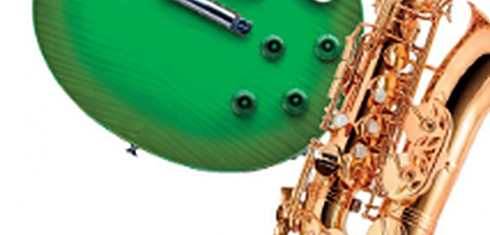
13
Marco's new hobby
👀 READ LEGGI
💬 TALK PARLA
Read the story line by line. Answer the questions.
⏱ 4 min 🙋 whole class
Leggi la storia riga per riga. Rispondi alle domande.
🎯 Speaking · TPRS · story
1
Marco is 14 and he lives in Bagheria. He's an only child, so he's often a bit bored at home.
❓ How old is Marco? · Has he got brothers or sisters? · Are you an only child?
2
He's into music, but he can't play an instrument.
❓ What is Marco into? · What are YOU into?
3
So he's learning the guitar with his grandad. Grandad is very patient.
❓ Who is teaching Marco? · Why is a patient teacher important?
🔑
Story phrases
4
At first Marco was terrible. But now he's making progress.
❓ Was Marco good at first? · What are you making progress in?
be into – essere appassionato di
take part in – partecipare a
make progress – fare progressi
patient – paziente
an only child – figlio unico
5
Next month he's taking part in a talent show at school!
❓ What's he taking part in? · Is Marco confident or shy, do you think?
6
And Grandad? He's coming to watch – in the front row!
❓ Where is Grandad sitting? · How do you think Marco feels?
1A · Speaking · class story (TPRS)
Notes:
13. Speaking · class story (TPRS) (4 min)
TPRS CLASS STORY (4 min) – you READ it, line by line (click). Ask the grey questions round the class: easy facts first, then personal questions. Let students change details ('Is it the guitar? The drums?') and use their ideas. The highlighted phrases are today's phrases from the profiles.

Slide 14
14
Retell it!
💬 TALK PARLA
⏱ 3 min 👥 pairs
Retell Marco's story to your partner. One word per line helps.
🎯 Speaking · TPRS · retell
Racconta di nuovo la storia di Marco al compagno. Una parola per riga ti aiuta.
1
only child
2
into music
3
Grandad
4
progress
5
talent show
6
front row
1A · Speaking · retell (TPRS)
Notes:
14. Speaking · retell (TPRS) (3 min)
RETELL (3 min). Only one word per line. A tells lines 1–3, B tells 4–6, then swap. Challenge: tell it as Marco ('I'm an only child…') or add one new detail to each line. Listen for: I'm into / I'm taking part in / I'm making progress (present continuous for now – next lesson's grammar!).

Slide 15
15
Talking points
💬 TALK PARLA
⏱ 4 min 👨‍👩‍👧 groups
Discuss in groups of 3. Give reasons!
🎯 Speaking · Communicative
Discutete in gruppi di 3. Date motivi!
💬
Useful phrases
1
Who would you most like to spend time with – Alfie, Lucas or Grace? Why?
e.g. Grace – she's cheerful and we're both into sport.
I'd like to spend time with… because…
We're both into…
I don't think it's important because…
My best friend and I are different, but…
2
Class vote! Hands up: Alfie? Lucas? Grace?
e.g. Grace won: 6 votes!
3
Is it important to have the same interests as your friends? Why? / Why not?
e.g. Not really – my best friend hates football, but we always have fun.
1A · Speaking · talking points · 📖 SB p.11 · Talking points
Notes:
15. Speaking · talking points (4 min)
TALKING POINTS (4 min). TB: class vote first (line 2), then groups discuss the second question. Monitor and give positive feedback on good ideas; note 2–3 mistakes for the board at the end.

Slide 16
16
3 · 2 · 1
⏱ 2 min 👥 pairs
🎯 Revision · Retrieval
Books closed! Tell your partner…
Libri chiusi! Di' al compagno…
3
Tell me 3 words to describe what someone looks like.
📝
Homework · Compiti
Workbook p.4: exercises 1–4 (describing people)
Workbook p.5: read 'Birth order', exercises 1–4
2
Tell me 2 personality adjectives and their opposites.
Next lesson: present simple and continuous (SB p.12)
1
Tell me 1 thing you're into – and 1 thing you're making progress in.
1A · Exit · what can you remember?
Notes:
16. Exit · what can you remember? (2 min)
EXIT (2 min). Pairs, books closed. Ask 3 students for their '1'. Homework is in the students' app.

Slide 17
17
Today you…
💡 THINK PENSA
⏱ 1 min 🙋 whole class
Can you do it now? Thumbs up or thumbs down!
🎯 Revision · Reflection
Ora sai farlo? Pollice su o pollice giù!
🙂
Described what people look like
✅
👍 👌 👎
Can you do it now?
Ora sai farlo?
💬
Learnt 6 personality adjectives + opposites
✅
📖
Read three online profiles
✅
🔑
Learnt 6 useful phrases from the texts
✅
🗣️
Told a class story and described your friends
✅
1A · Review · what did you do today?
Notes:
17. Review · what did you do today? (1 min)
TODAY YOU… (1 min). Read each line (one per click: the tick appears). Students show thumbs up / middle / down: can they do it now? Note any thumbs down for the next lesson's recap.

