Slide 1

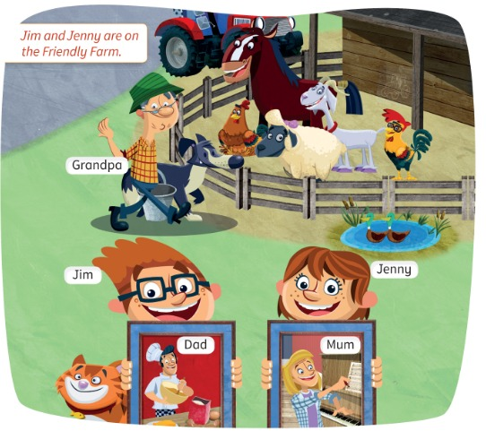
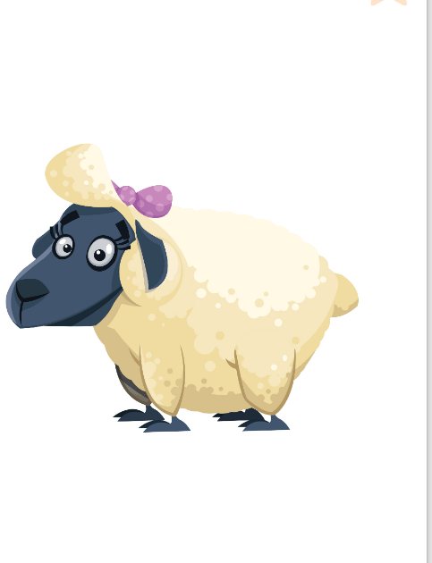
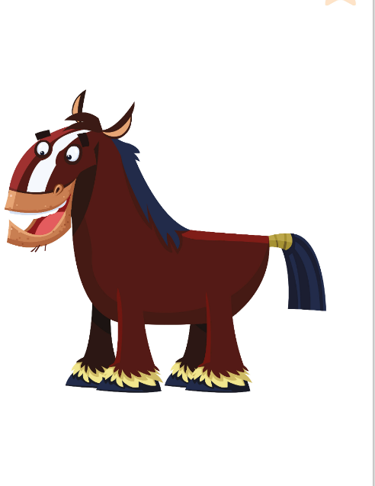
STARTER · LESSON 1
Today: hello, names, ages and the Friendly Farm animals 🐴🐑🐐
Oggi: salutare, nomi, età e gli animali della Friendly Farm
Meet the family
1
💬 SPEAK
Say hello, your name and age.
Saluta, di' nome ed età.
Welcome to the Friendly Farm!
Benvenuti alla Friendly Farm!
2
👂 LISTEN
Listen to the farm story.
Ascolta la storia della fattoria.
3
🏃 MOVE
Be the farm animals!
Fai gli animali!
📘 Pupil's Book pp.4–5 · 🎧 1.02–1.06
Notes:
COVER (2 min). HOOK: 'Where's this?' (a farm). 'What animals can you see?' Pairs whisper 3 animals in 20 s (Italian OK) – then say them in English together (a horse, a goat, a sheep, a cat, chickens). Accept Italian, recast in English.

Slide 2
WARM-UP
Walk. STOP! Say hello!
Cammina. STOP! Saluta!
Nice to meet you!
🚶 WHOLE CLASS · ⏱ 5 MIN
1
🏃 MOVE
A: Hello! My name's Mario. Nice to meet you.
B: Hi! My name's Sara. Nice to meet you, too.
A: How are you? B: I'm fine, thank you!
Walk around.
Cammina.
2
👂 LISTEN
Teacher: STOP!
L'insegnante: STOP!
3
💬 SPEAK
Say hello to a friend.
Saluta un compagno.
⭐ My name's … Nice to meet you.
Notes:
GAME PLAN
SEE: 3 model lines (Hello… Nice to meet you).
TEACHER: MODEL first with 2 learners (you say A, they say B). Then 'Stand up! Walk!' … 'STOP!'
STUDENTS: Walk; on STOP greet the nearest person with the model lines.
GROUPING: Whole class, then pairs at each STOP.
SCORE / WIN: No points – fun warm-up. Round 4–5: 'STOP – whisper!' / 'STOP – robot voice!'
TIME: 5 min (5–6 rounds).
LANGUAGE: Hello. My name's … Nice to meet you (too). How are you? I'm fine, thank you.
REVEAL: None needed.
AIM: Activate greetings; break the ice on the first lesson.

Slide 3


MEET THE FAMILY
Look! Who is it? Say it before it appears!
Guarda! Chi è? Dillo prima che appaia!
Who's this?
🏃 TPR Wave and say: Hi, I'm Jim! 👋
Jim – il fratello (7 anni)
Jim
📘 Pupil's Book p.4 · the family
1 / 5
Notes:
MEET THE FAMILY (5 min) – introduce the people BEFORE the listening, so the children know who they will hear about. PROMPT: picture only – 'Who's this? Is he a boy or a man?' THINK 3 s, COMMIT: everybody says it on your signal. Click 1: name. Click 2: Italian (Jim and Jenny are TWINS, they're seven). Click 3: action – everyone does it. Teach: Mum, Dad, Grandpa, twins (gemelli), cook (cuoco). TPR: Wave and say: Hi, I'm Jim! 👋

Slide 4
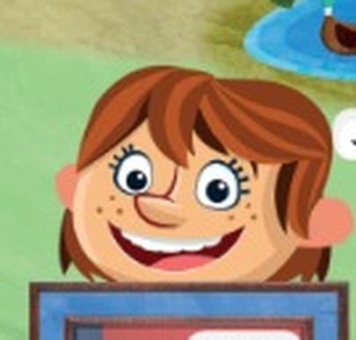
MEET THE FAMILY
Look! Who is it? Say it before it appears!
Guarda! Chi è? Dillo prima che appaia!
Who's this?
🏃 TPR Show 7 fingers: I'm seven! ✋✌️
Jenny – la sorella (7 anni)
Jenny
📘 Pupil's Book p.4 · the family
2 / 5
Notes:
MEET THE FAMILY (5 min) – introduce the people BEFORE the listening, so the children know who they will hear about. PROMPT: picture only – 'Who's this? Is he a boy or a man?' THINK 3 s, COMMIT: everybody says it on your signal. Click 1: name. Click 2: Italian (Jim and Jenny are TWINS, they're seven). Click 3: action – everyone does it. Teach: Mum, Dad, Grandpa, twins (gemelli), cook (cuoco). TPR: Show 7 fingers: I'm seven! ✋✌️

Slide 5

MEET THE FAMILY
Look! Who is it? Say it before it appears!
Guarda! Chi è? Dillo prima che appaia!
Who's this?
🏃 TPR Play the piano! 🎹
la mamma – suona il piano
Mum
📘 Pupil's Book p.4 · the family
3 / 5
Notes:
MEET THE FAMILY (5 min) – introduce the people BEFORE the listening, so the children know who they will hear about. PROMPT: picture only – 'Who's this? Is he a boy or a man?' THINK 3 s, COMMIT: everybody says it on your signal. Click 1: name. Click 2: Italian (Jim and Jenny are TWINS, they're seven). Click 3: action – everyone does it. Teach: Mum, Dad, Grandpa, twins (gemelli), cook (cuoco). TPR: Play the piano! 🎹

Slide 6
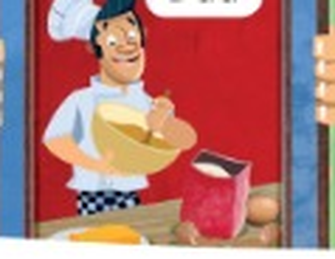
MEET THE FAMILY
Look! Who is it? Say it before it appears!
Guarda! Chi è? Dillo prima che appaia!
Who's this?
🏃 TPR Make a cake – stir, stir! 🥣
il papà – fa il cuoco
Dad
📘 Pupil's Book p.4 · the family
4 / 5
Notes:
MEET THE FAMILY (5 min) – introduce the people BEFORE the listening, so the children know who they will hear about. PROMPT: picture only – 'Who's this? Is he a boy or a man?' THINK 3 s, COMMIT: everybody says it on your signal. Click 1: name. Click 2: Italian (Jim and Jenny are TWINS, they're seven). Click 3: action – everyone does it. Teach: Mum, Dad, Grandpa, twins (gemelli), cook (cuoco). TPR: Make a cake – stir, stir! 🥣

Slide 7

MEET THE FAMILY
Look! Who is it? Say it before it appears!
Guarda! Chi è? Dillo prima che appaia!
Who's this?
🏃 TPR Walk like Grandpa with a bucket! 🪣
il nonno – il contadino
Grandpa
📘 Pupil's Book p.4 · the family
5 / 5
Notes:
MEET THE FAMILY (5 min) – introduce the people BEFORE the listening, so the children know who they will hear about. PROMPT: picture only – 'Who's this? Is he a boy or a man?' THINK 3 s, COMMIT: everybody says it on your signal. Click 1: name. Click 2: Italian (Jim and Jenny are TWINS, they're seven). Click 3: action – everyone does it. Teach: Mum, Dad, Grandpa, twins (gemelli), cook (cuoco). TPR: Walk like Grandpa with a bucket! 🪣

Slide 8
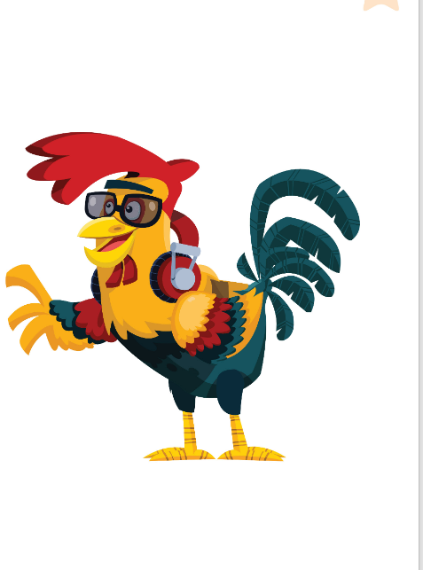
MEET THE ANIMALS
Look! Say the name before it appears!
Guarda! Di' il nome prima che appaia!
Who's this?
🏃 TPR Flap your wings! Cock-a-doodle-doo! 🐓
il gallo (rooster)
Rocky
📘 Friendly Farm flashcards · Pupil's Book p.5
1 / 6
Notes:
CHARACTER FLASHCARDS (6 min). PROMPT: picture only – 'Who's this? Is it a boy or a girl?' THINK: 3 seconds. COMMIT: everybody says it together on your signal (some will know them from Power Up 2). REVEAL click 1: name. Click 2: Italian. Click 3: action – everyone does it. Stress HIS (boy) / HER (girl): 'What's his name?' Ages (TB extension, for the hot seat later): Rocky 3, Shelly 3, Cameron 4, Henrietta 6, Harry 9, Gracie 11. TPR: Flap your wings! Cock-a-doodle-doo! 🐓

Slide 9
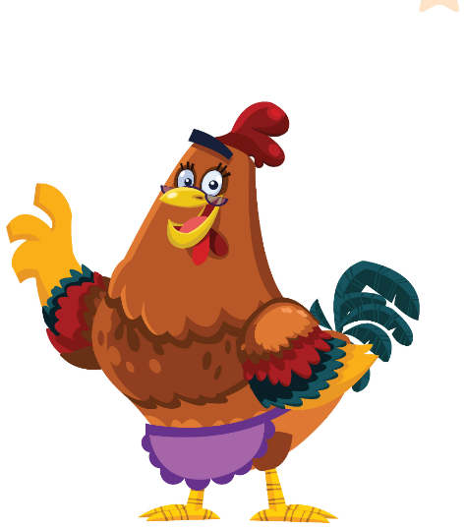
MEET THE ANIMALS
Look! Say the name before it appears!
Guarda! Di' il nome prima che appaia!
Who's this?
🏃 TPR Sit on your eggs. Shh! She's asleep. 😴
la gallina, mamma di Rocky
Henrietta
📘 Friendly Farm flashcards · Pupil's Book p.5
2 / 6
Notes:
CHARACTER FLASHCARDS (6 min). PROMPT: picture only – 'Who's this? Is it a boy or a girl?' THINK: 3 seconds. COMMIT: everybody says it together on your signal (some will know them from Power Up 2). REVEAL click 1: name. Click 2: Italian. Click 3: action – everyone does it. Stress HIS (boy) / HER (girl): 'What's his name?' Ages (TB extension, for the hot seat later): Rocky 3, Shelly 3, Cameron 4, Henrietta 6, Harry 9, Gracie 11. TPR: Sit on your eggs. Shh! She's asleep. 😴

Slide 10
MEET THE ANIMALS
Look! Say the name before it appears!
Guarda! Di' il nome prima che appaia!
Who's this?
🏃 TPR Sing like Shelly! La-la-la! 🎤
la pecora (sheep)
Shelly
📘 Friendly Farm flashcards · Pupil's Book p.5
3 / 6
Notes:
CHARACTER FLASHCARDS (6 min). PROMPT: picture only – 'Who's this? Is it a boy or a girl?' THINK: 3 seconds. COMMIT: everybody says it together on your signal (some will know them from Power Up 2). REVEAL click 1: name. Click 2: Italian. Click 3: action – everyone does it. Stress HIS (boy) / HER (girl): 'What's his name?' Ages (TB extension, for the hot seat later): Rocky 3, Shelly 3, Cameron 4, Henrietta 6, Harry 9, Gracie 11. TPR: Sing like Shelly! La-la-la! 🎤

Slide 11

MEET THE ANIMALS
Look! Say the name before it appears!
Guarda! Di' il nome prima che appaia!
Who's this?
🏃 TPR Eat paper and books! Munch, munch! 📖
la capra (goat)
Gracie
📘 Friendly Farm flashcards · Pupil's Book p.5
4 / 6
Notes:
CHARACTER FLASHCARDS (6 min). PROMPT: picture only – 'Who's this? Is it a boy or a girl?' THINK: 3 seconds. COMMIT: everybody says it together on your signal (some will know them from Power Up 2). REVEAL click 1: name. Click 2: Italian. Click 3: action – everyone does it. Stress HIS (boy) / HER (girl): 'What's his name?' Ages (TB extension, for the hot seat later): Rocky 3, Shelly 3, Cameron 4, Henrietta 6, Harry 9, Gracie 11. TPR: Eat paper and books! Munch, munch! 📖

Slide 12
MEET THE ANIMALS
Look! Say the name before it appears!
Guarda! Di' il nome prima che appaia!
Who's this?
🏃 TPR Gallop like a horse! 🐴
il cavallo (horse)
Harry
📘 Friendly Farm flashcards · Pupil's Book p.5
5 / 6
Notes:
CHARACTER FLASHCARDS (6 min). PROMPT: picture only – 'Who's this? Is it a boy or a girl?' THINK: 3 seconds. COMMIT: everybody says it together on your signal (some will know them from Power Up 2). REVEAL click 1: name. Click 2: Italian. Click 3: action – everyone does it. Stress HIS (boy) / HER (girl): 'What's his name?' Ages (TB extension, for the hot seat later): Rocky 3, Shelly 3, Cameron 4, Henrietta 6, Harry 9, Gracie 11. TPR: Gallop like a horse! 🐴

Slide 13
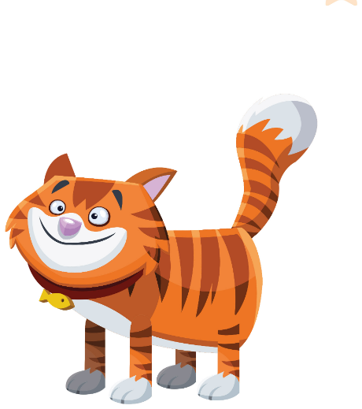
MEET THE ANIMALS
Look! Say the name before it appears!
Guarda! Di' il nome prima che appaia!
Who's this?
🏃 TPR Cover your ears! My ears! 🙉
il gatto (cat)
Cameron
📘 Friendly Farm flashcards · Pupil's Book p.5
6 / 6
Notes:
CHARACTER FLASHCARDS (6 min). PROMPT: picture only – 'Who's this? Is it a boy or a girl?' THINK: 3 seconds. COMMIT: everybody says it together on your signal (some will know them from Power Up 2). REVEAL click 1: name. Click 2: Italian. Click 3: action – everyone does it. Stress HIS (boy) / HER (girl): 'What's his name?' Ages (TB extension, for the hot seat later): Rocky 3, Shelly 3, Cameron 4, Henrietta 6, Harry 9, Gracie 11. TPR: Cover your ears! My ears! 🙉

Slide 14

SAY IT!
Hand in front of your mouth. Feel the H!
Mano davanti alla bocca. Senti la H!
The H huff! ✋
🗣 WHOLE CLASS · ⏱ 3 MIN
1
👂 LISTEN
Teacher says the word.
L'insegnante dice la parola.
2
💬 SPEAK
Say it. Feel the air on your hand!
Ripeti. Senti l'aria sulla mano!
3
👀 LOOK
Harry · Henrietta · Hello! · How are you? · How old…?
Teacher says it wrong? Shout STOP!
Errore? Grida STOP!
Notes:
PRONUNCIATION (3 min). Italians often drop /h/ ('Arry', 'ow are you'). MODEL: hand in front of your mouth – 'Harry' – feel the warm air (like fogging a mirror: haaa). Learners copy: whisper → normal → MONSTER voice. GAME 'Catch the teacher': say the words, sometimes WITHOUT h ('Ello! 'Ow are you?'). Learners shout STOP! and say it correctly. A learner who catches you gets to be the teacher for the next word.

Slide 15
LISTEN 1
Listen (🎧 1.02 from the book CD). Choose a or b!
Ascolta. Scegli a o b!
Meet Jim and Jenny
👂 LISTEN · ⏱ 6 MIN
1 Mum: a) cooking b) writing a song 🎹
b) She's writing a song.
2 Dad: a) making a cake b) playing the piano
a) He's making a cake. He's a cook!
3 Jim and Jenny are… 7, 8 or 9? 🤔
They're seven. They're twins!
4 Find the small tractor!
Point to it! 🔎
📘 Pupil's Book p.4 · 🎧 1.02
Notes:
EX 1 (6 min). AUDIO: 🎧 1.02 is on the book CD (not inside this PowerPoint) – play it from the CD / Teacher's Resources. If you have no audio, READ the facts yourself: 'This is Jim and Jenny's dad. He's a cook – he loves making food. He's making a cake. This is their mum. She loves music – she's writing a song on the piano. Jim and Jenny are seven. They're twins!' The children already met the family on the flashcards, so they listen for the details. Choices make it possible for everybody to answer (hold up 1 or 2 fingers for a/b, fingers for the age). PROMPT: read the caption 'Jim and Jenny are on the Friendly Farm.' Point: 'Is this Jenny's dad?' (No, it's her grandpa). Read question 1 aloud BEFORE listening. THINK/COMMIT: play 🎧 1.02 – learners whisper the answer to a partner, then hands up. REVEAL: click. KEY (TB): She's writing a song. Audio facts: Dad's a cook and loves making food – he's making a cake; Mum loves music and playing the piano; Jim and Jenny are seven (twins). NEW WORD: cook (mime stirring a bowl). Hidden tractor: first learner to point wins a cheer.

Slide 16
CHANT
Jim group 👦 and Jenny group 👧. Say YOUR lines!
Gruppo Jim e gruppo Jenny. Di' le TUE frasi!
Say the chant!
👥👥 2 GROUPS · ⏱ 5 MIN
JIM GROUP 👦
JENNY GROUP 👧
👧 What's your name? What's your name?
👦 My name's Jim!
👦 What's your name? What's your name?
👧 My name's Jenny!
👧 How old are you? How old are you?
👦 I'm seven! ✋✌️
📘 Pupil's Book p.4 · 🎧 1.03 (book CD) · 🎬 chant video
Notes:
CHANT (5 min). 1) Play 🎧 1.03 (book CD) once – children just listen and POINT at Jim or Jenny when they speak (no audio? clap the rhythm and chant it yourself). 2) Split the class: left side = JIM GROUP (blue), right side = JENNY GROUP (pink). Click: the lines appear one by one, in order – each group says only its colour. 3) Swap groups. 4) FINAL ROUND: their OWN names and ages ('My name's Luca! I'm nine!'). Actions: wave on 'My name's…', show the age with fingers. Listen for the H in 'How' (huff!). The book chant also has 'How are you? – I'm fine, thank you.' – add it as a 4th pair if your class is fast.

Slide 17
WATCH OUT 🇮🇹
Ho nove anni = ? Think! Then click.
Come si dice? Pensa! Poi clicca.
Italian trap!
👥 PAIRS · ⏱ 2 MIN
🇮🇹 Ho nove anni. → 🇬🇧 ???
1 I have nine years. ✗ What do we say?
I'm nine! ✓
2 How many years have you? ✗
How old are you? ✓
3 My brother has twelve years. ✗
My brother is twelve. ✓
Notes:
ITALIAN TRAP (2 min). PROMPT: show 'Ho nove anni.' THINK 5 s: how do we say it in English? COMMIT: pairs whisper. REVEAL row by row (click): in English we use BE for age – I'm nine / How old are you? Make it physical: every time someone says 'I have … years', the class makes a buzzer noise 'BZZZ!' for the rest of the year.

Slide 18
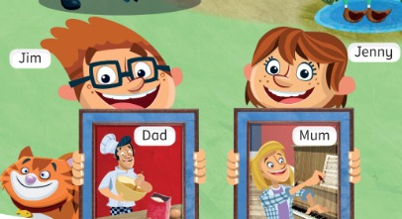
SPEAK 3
Listen and answer. Then ask a friend.
Ascolta e rispondi. Poi chiedi a un compagno.
Ask and answer
👥 PAIRS · ⏱ 6 MIN
1 What's your name?
My name's …
2 How are you?
I'm fine, thank you.
3 How old are you?
I'm nine. (NOT I have…!)
4 Where do you live?
I live in Bagheria.
📘 Pupil's Book p.4 · 🎧 1.04
⭐ I'm … · I live in …
🔥 Ask about a friend!
Notes:
EX 3 (6 min). MODEL → SUPPORTED → INDEPENDENT. 1) Play 🎧 1.04, pause after each question: the class answers together; click for a model answer (answers are personal). 2) Pairs ask and answer looking at the slide (⭐ starters). 3) Blank the screen (press B) and pairs do it again from memory with a NEW partner. 🔥 Fast finishers ask about a friend: 'What's his name? How old is she?'

Slide 19
SONG
Listen, sing and tap the rhythm!
Ascolta, canta e batti il ritmo!
The Friendly Farm song
🎵 SING · ⏱ 3 MIN
▶ Power Up 3 – Friendly Farm song (search)
🎵 The Friendly Farm, the Friendly Farm,
Fun and games on the Friendly Farm,
With the animals in the barn,
Fun and games on the Friendly Farm.
Teacher: preview every link before class (ads, content). The lesson works without it. · Controllare i link prima della lezione.
📘 Pupil's Book p.5 · 🎧 1.05 (song at the start)
Notes:
SONG (3 min). Play the song at the beginning of the cartoon (🎧 1.05). Tap the rhythm on the table – learners copy. Sing twice. barn = stalla. Use the book audio; the link is only a backup search. External resources are suggestions only: the teacher must preview and check all links, videos, adverts and content before using them with children. Always have the PowerPoint/classroom alternative ready.

Slide 20
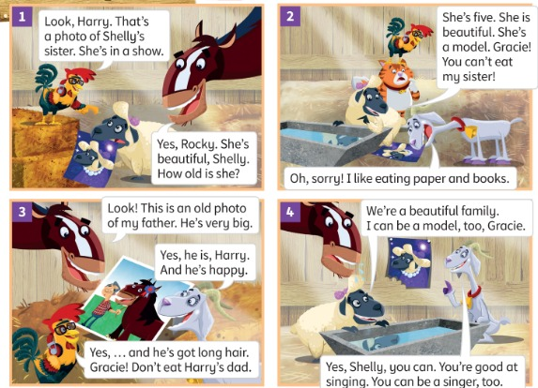
STORY
Who's in Harry's picture? Guess!
Chi c'è nella foto di Harry? Indovina!
The Friendly Farm (1)
👂 LISTEN · ⏱ 5 MIN
1 Who's in the photo? (pic 1)
Shelly's sister.
2 How old is Shelly's sister?
She's five.
3 Who's in Harry's picture? (pic 3)
His father.
4 Has Harry's father got short hair?
No, long hair. He's happy.
📘 Pupil's Book p.5 · 🎧 1.05 · 🎬 video
Notes:
STORY (8 min with part 2). PREDICT: 'Who's in Harry's picture? His mum? His dad? His friend?' Each learner COMMITS by holding up 1 (mum), 2 (dad) or 3 (friend) fingers. Play 🎧 1.05 / video. REVEAL: his father (TB key). Then play again, pause after each picture, ask the questions – pairs agree, then click. Mime 'model' (pose!). Gracie eats paper: 'Gracie, don't eat Harry's dad!'

Slide 21
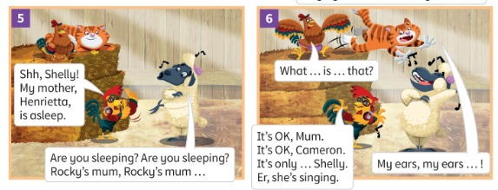
STORY
Who's sleeping? Who's singing?
Chi dorme? Chi canta?
The Friendly Farm (2)
👂 LISTEN · ⏱ 3 MIN
1 Who's sleeping? (pic 5)
Henrietta – Rocky's mum.
2 Who's singing? (pic 6)
Shelly.
3 Is her singing nice?
No! 🙉
📘 Pupil's Book p.5 · 🎧 1.05 · 🎬 video
Notes:
STORY part 2 (TB answers). COMMIT: learners point at the character on the screen before you click. Act it out: one Shelly sings, the class are Cameron and cover their ears.

Slide 22
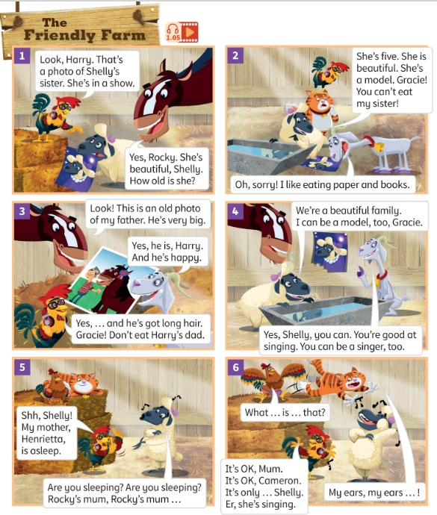
LISTEN 4
Listen. Point to the animal!
Ascolta. Indica l'animale!
Who says it? (1)
👂 LISTEN · ⏱ 3 MIN
1 “How old is she?”
Harry 🐴
2 “What … is … that?”
Henrietta 🐔
3 “I like eating paper and books.”
Gracie 🐐
4 “That's a photo of Shelly's sister.”
Rocky 🐓
📘 Pupil's Book p.5 · 🎧 1.06
Notes:
EX 4 (5 min, 2 slides). Before: give 6 learners the character flashcards (or stick them on the board with names = TB extra support). Play 🎧 1.06, pause after each line. COMMIT: the class points at the board / the learner holding that card stands up. REVEAL click. KEY (TB): 1 Harry 2 Henrietta 3 Gracie 4 Rocky 5 Shelly 6 Cameron 7 Harry 8 Shelly.

Slide 23
LISTEN 4
Listen. Point to the animal!
Ascolta. Indica l'animale!
Who says it? (2)
👂 LISTEN · ⏱ 2 MIN
1 “We're a beautiful family.”
Shelly 🐑
2 “My ears, my ears …”
Cameron 🐱
3 “Look! This is an old photo of my father.”
Harry 🐴
4 “You can't eat my sister!”
Shelly 🐑
📘 Pupil's Book p.5 · 🎧 1.06
Notes:
EX 4 lines 5–8. KEY: 5 Shelly 6 Cameron 7 Harry 8 Shelly. Bonus point for saying it in the character's voice.

Slide 24
GAME
Listen to the noise. Who is it?
Ascolta il verso. Chi è?
Animal noises!
👥👥 TEAMS · ⏱ 5 MIN
1
👀 LOOK
Take a card. Shh! Secret!
Prendi una carta. Segreto!
2
rocky
henrietta
shelly
gracie
💬 SPEAK
Make the animal noise.
Fai il verso.
3
💬 SPEAK
Is it Rocky? – Yes, it is!
È Rocky? – Sì!
harry
cameron
⭐ Is it Rocky?
Notes:
GAME PLAN
SEE: The 6 characters with names.
TEACHER: Hold a flashcard so nobody sees it, make the noise. Then hand the cards to learners.
STUDENTS: A learner makes the noise; the other team asks 'Is it Rocky?'
GROUPING: Two teams take turns.
SCORE / WIN: Guess in 1 try = 2 points, 2 tries = 1 point.
TIME: 5 min.
LANGUAGE: Is it …? Yes, it is. / No, it isn't.
REVEAL: The noise-maker shows the card.
AIM: Recycle the names + yes/no questions.

Slide 25
GAME
👀 Look for 10 seconds. Remember ALL the pictures!
Guarda e ricorda tutte le immagini!
Look and remember!
rocky
henrietta
shelly
gracie
harry
cameron
Notes:
WHAT'S MISSING? Step 1 – LOOK (10 s). Say the words together first (choral). Count down aloud. Then: "Close your eyes!" and go to the next slide.

Slide 26
GAME
Open your eyes! What's missing? Write it or whisper it to your partner.
Apri gli occhi! Cosa manca? Scrivilo o dillo al compagno.
What's missing?
?
rocky
henrietta
shelly
harry
cameron
Notes:
Step 2 – COMMIT. Students write the word on a mini-whiteboard / paper (or teams agree in 10 s). 'Show me!' Then go to the next slide. Points: 1 per team with the right word, +1 if spelt correctly.

Slide 27
ANSWER
It's Gracie!
È Gracie!
Were you right?
rocky
henrietta
shelly
gracie
harry
cameron
Notes:
Step 3 – REVEAL. The missing card comes back with a green frame. Everybody says the word 3 ways: whisper, normal, monster voice. Two teams. Round 1 = one card, round 2 🔥 = two cards. Weaker learners can point/whisper; stronger ones must say the full sentence 'Gracie is missing!' for a bonus point.

Slide 28
GAME · ROUND 2 🔥
👀 Look for 15 seconds. Remember ALL the pictures!
Guarda e ricorda tutte le immagini!
Look and remember!
rocky
henrietta
shelly
gracie
harry
cameron
Notes:
WHAT'S MISSING? Step 1 – LOOK (15 s). Say the words together first (choral). Count down aloud. Then: "Close your eyes!" and go to the next slide.

Slide 29
GAME · ROUND 2 🔥
TWO pictures are missing! Write them down.
Mancano DUE immagini! Scrivile.
What's missing?
?
henrietta
shelly
gracie
?
harry
Notes:
Step 2 – COMMIT. Students write the word on a mini-whiteboard / paper (or teams agree in 10 s). 'Show me!' Then go to the next slide. Points: 1 per team with the right word, +1 if spelt correctly.

Slide 30
ANSWER
It's: rocky and cameron!
Were you right?
rocky
henrietta
shelly
gracie
harry
cameron
Notes:
Step 3 – REVEAL. The missing card comes back with a green frame. Everybody says the word 3 ways: whisper, normal, monster voice. Two teams. Round 1 = one card, round 2 🔥 = two cards. Weaker learners can point/whisper; stronger ones must say the full sentence 'Gracie is missing!' for a bonus point.

Slide 31
GAME
Listen. Do it – fast!
Ascolta. Fallo – veloce!
Be the animals!
🏃 WHOLE CLASS · ⏱ 4 MIN
Rocky! Flap your wings!
Henrietta! Go to sleep. Zzz…
Shelly! Sing very loudly!
Cameron! Cover your ears!
Harry! Gallop!
Gracie! Eat a book!
Notes:
GAME PLAN
SEE: 6 characters + action phrases.
TEACHER: Say a NAME only (not the action) – faster and faster. Round 2: say two names together ('Harry + Shelly!').
STUDENTS: Do the right action immediately.
GROUPING: Whole class standing.
SCORE / WIN: Round 3 'Last one standing': wrong action or too slow = sit down. Last 3 standing are the champions.
TIME: 4 min.
LANGUAGE: Character names (listening); learners echo the name as they move.
REVEAL: Click to show the actions if learners forget.
AIM: Fix the 6 names with movement before the exit.

Slide 32
WELL DONE!
Today I can… · Oggi so…
Show me with your thumbs! 👍 👌 👎
Bye bye! 👋
⭐ I can say my name, my age and where I live.
So dire nome, età e dove abito.
🏠 HOMEWORK · COMPITI
• Homework sheet: Meet the family
• Activity Book p.4 ex 1 · p.5 ex 2
⭐ I can say the names of the Friendly Farm animals.
So dire i nomi degli animali.
⭐ I can say: I'm nine! (not I have…)
So dire la mia età in inglese.
➡ Next: Unit 1 – A day on the farm! 🚜
Notes:
EXIT (3 min). EXIT CHALLENGE: point at 3 learners: 'How old are you?' – they must answer 'I'm …' (BZZZ if 'I have'!). Thumbs for each 'I can'. Give out the homework. AB p.4 ex 2 (🎧 4.07) and p.5 ex 1 (🎧 4.08) are listening – do in class if there's time.

Slide 33
EXTRA
You are an animal. The class asks.
Sei un animale. La classe chiede.
EXTRA: Hot seat!
🪑 WHOLE CLASS · ⏱ 5 MIN
1
⚙️ DO
Are you a horse? Are you big? Are you nine?
Can you sing? Do you like eating paper?
Choose an animal. Secret!
Scegli un animale. Segreto!
2
💬 SPEAK
Class asks yes/no questions.
La classe fa domande sì/no.
3
💬 SPEAK
Yes, I am. / No, I'm not.
Sì / No.
⭐ Are you …? Can you …?
Notes:
GAME PLAN
SEE: Example questions.
TEACHER: Go first: sit in the 'hot seat', think of an animal, answer.
STUDENTS: Ask yes/no questions; the guesser takes the hot seat. 🔥 Challenge: use 'Have you got…?'
GROUPING: Whole class.
SCORE / WIN: The class wins if they guess in fewer than 6 questions; otherwise the hot-seat learner wins.
TIME: 5 min.
LANGUAGE: Are you…? Can you…? Do you like…? Have you got…? + short answers. Ages: Rocky 3, Shelly 3, Cameron 4, Henrietta 6, Harry 9, Gracie 11.
REVEAL: The hot-seat learner says 'I'm Gracie!'
AIM: Question forms + recycling the story.

