Slide 1


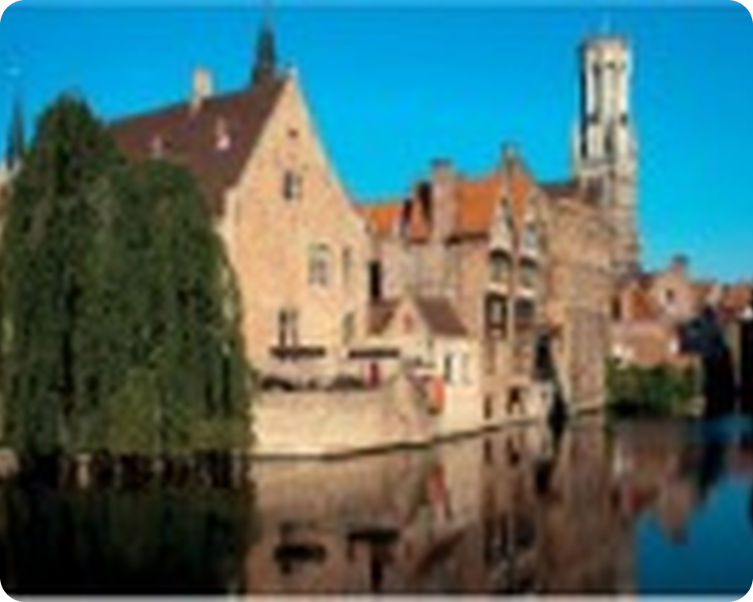


English File Pre-intermediate · SB pp.20–21
💡 THINK · PENSA
R1-2
Revise and Check 1&2
Files 1 and 2: test, games, reading and speaking
🎯
Today you're going to…
📝 do a mini-test on Files 1 and 2
🔤 revise verbs, at / in / on, and word groups
🔊 practise sounds and word stress
📷 read tips for better holiday photos
🗣️ check what you can say in English
Files 1 and 2: family, personality, clothes, holidays, photos… What can you remember?
EXAMPLE I remember 'extrovert', 'wear a blue skirt' and 'I was walking when…'!
Notes:
1. OPENING (2 min)
OPENING (2 min). Revision lesson for Files 1–2. TG: the first page adds up to 50 (grammar 15, vocabulary 25, pronunciation 10) – a mini-test. Tell students they'll score themselves.

Slide 2

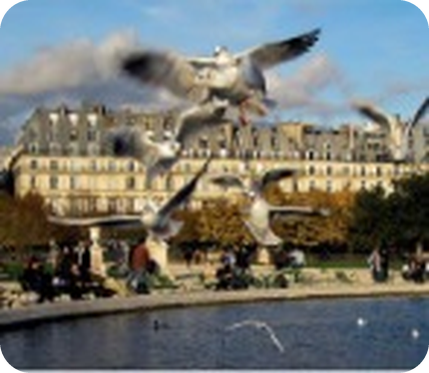
2
Remember last lesson?
💡 THINK → 💬 TALK
⏱ 3 min 👥 pairs
🎯 Revision · Retrieval
Can you remember? Say it – then use it in a sentence!
Ti ricordi? Dillo – poi usalo in una frase!
🔤 Can you remember these words? What do they mean?
invite somebody to dinner
give somebody your phone number
wait for somebody
be in a hurry
have a great time
run across the road
📅
Last lesson…
⭐ What does it mean?
⭐⭐ Use it in a sentence.
⭐⭐⭐ Make it negative or a question!
2C: One dark October evening
connectors · verb phrases · 2 endings
Your turn: time sequencers
Your turn: so · because · although
Make an order of events in a story
Make a result · a reason · a contrast
Two minutes later he said…
When Hannah left the club…
Suddenly, a man ran across the road.
She was driving fast because she was in a hurry.
Although the food wasn't very good, they had a wonderful time.
R1-2 · Revision · last lesson
Notes:
2. Revision · last lesson (3 min)
ACTIVE RECAP (3 min). Words: ⭐ meaning ⭐⭐ sentence ⭐⭐⭐ negative or question. Then: 'Happy ending or sad ending – which did you prefer?' Pairs retell the end of the story in 3 sentences with Suddenly / When / so.
HOW TO RUN IT (active recap): pairs. Words: A points at a word, B says what it means (⭐); then a sentence with it (⭐⭐); strong students make it negative or a question (⭐⭐⭐). Grammar: pairs make their own example for each use (offer, plan…) BEFORE you click – then click to show the model answers.

Slide 3

3
Word race: Files 1 & 2
🎲 PLAY · GIOCA
⏱ 4 min 🏆 teams
🎯 Revision · Communicative game
Teams: 30 seconds per round! Write the words.
Squadre: 30 secondi per round! Scrivete le parole.
🎲
How to play
Personality adjectives
→ extrovert, generous, lazy, mean, funny, kind, shy…
e.g.
30 seconds per round. Write as many words as you can.
Correct spelling = 1 point.
Use one in a sentence = 1 more point!
Hair and appearance
→ curly, straight, long, beard, slim, overweight…
1
Clothes and jewellery
→ skirt, trainers, sandals, scarf, necklace, bracelet…
2
Holiday words
→ book a hotel, stay, sunbathe, sightseeing, crowded, windy…
3
TEAM A ☆☆☆☆☆
TEAM B ☆☆☆☆☆
R1-2 · Warmer · word race · 📖 Recycles the Vocabulary Banks of Files 1–2
Notes:
3. Warmer · word race (4 min)
WARMER (4 min). Round 1 is the example. Bonus point for a sentence ('My brother is very generous').

Slide 4

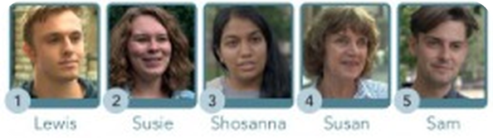
4
Grammar test (1)
✏️ FILL THE GAPS → ✅ CHECK
⏱ 5 min 👤 alone
🎯 Grammar · TPRS · reading
Mini-test! Choose a, b or c. Alone – 5 minutes.
Mini-test! Scegli a, b o c. Da soli – 5 minuti.
Circle a, b or c
1 (1) ________ any brothers or sisters? (a Have you · b Do you · c Do you have)
1 c Do you have any brothers or sisters? (a Have you · b Do you · c Do you have)
2 (2) ________ last night? (a Where you went · b Where did you go · c Where you did go)
2 b Where did you go last night? (a Where you went · b Where did you go · c Where you did go)
3 My brother (3) ________ football. (a doesn't like · b don't like · c doesn't likes)
3 My brother a doesn't like football. (a doesn't like · b don't like · c doesn't likes)
4 Her parents (4) ________ a small business. (a has · b haves · c have)
4 Her parents c have a small business. (a has · b haves · c have)
5 I (5) ________ to music when I'm working. (a never listen · b don't never listen · c listen never)
5 I a never listen to music when I'm working. (a never listen · b don't never listen · c listen never)
6 In the picture the woman (6) ________ a blue skirt. (a wears · b wearing · c is wearing)
6 In the picture the woman c is wearing a blue skirt. (a wears · b wearing · c is wearing)
7 A What (7) ________ ? B I'm looking for my keys. (a you are doing · b do you do · c are you doing)
💡
Remember
7 A What c are you doing? B I'm looking for my keys. (a you are doing · b do you do · c are you doing)
8 She's at university. She (8) ________ history. (a 's studing · b 's studying · c studying)
Alone · no talking
1 point each · ___ / 15
8 She's at university. She b 's studying history. (a 's studing · b 's studying · c studying)
R1-2 · Grammar · SB p.20 · 1–8 · 📖 SB p.20 · Grammar 1–8 (TG key)
Notes:
4. Grammar · SB p.20 · 1–8 (5 min)
MINI-TEST 1 (5 min). Students write a / b / c on paper, alone. Then click once per item. Key (TG): 1 c 2 b 3 a 4 c 5 a 6 c 7 c 8 b. After each answer ask WHY (e.g. 4: parents = they → have).

Slide 5
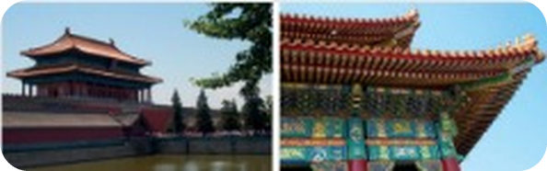
5
Grammar test (2)
✏️ FILL THE GAPS → ✅ CHECK
⏱ 5 min 👤 alone
🎯 Grammar · TPRS · reading
Mini-test! Choose a, b or c. Then count your score.
Mini-test! Scegli a, b o c. Poi conta i punti.
Circle a, b or c
9 We (9) ________ to Malta last August. (a were · b went · c did go)
9 We b went to Malta last August. (a were · b went · c did go)
10 I saw the film, but I (10) ________ it. (a didn't liked · b don't liked · c didn't like)
10 I saw the film, but I c didn't like it. (a didn't liked · b don't liked · c didn't like)
11 When I got home, my parents (11) ________ on the sofa. (a were sitting · b was sitting · c were siting)
11 When I got home, my parents a were sitting on the sofa. (a were sitting · b was sitting · c were siting)
12 What (12) ________ at 11 p.m.? You didn't answer my call. (a you were doing · b you was doing · c were you doing)
12 What c were you doing at 11 p.m.? You didn't answer my call. (a you were doing · b you was doing · c were you doing)
13 She couldn't see him because she (13) ________ her glasses. (a wasn't wearing · b didn't wear · c didn't wearing)
13 She couldn't see him because she a wasn't wearing her glasses. (a wasn't wearing · b didn't wear · c didn't wearing)
14 We had lunch in a restaurant. (14) ________ we decided to go for a walk. (a After · b Then · c When)
💡
Remember
14 We had lunch in a restaurant. b Then we decided to go for a walk. (a After · b Then · c When)
15 We had a great time, (15) ________ the weather wasn't very good. (a so · b because · c although)
Count your points: ___ / 15
13+ = excellent!
15 We had a great time, c although the weather wasn't very good. (a so · b because · c although)
R1-2 · Grammar · SB p.20 · 9–15 · 📖 SB p.20 · Grammar 9–15 (TG key)
Notes:
5. Grammar · SB p.20 · 9–15 (5 min)
MINI-TEST 2 (5 min). Key (TG): 9 b 10 c 11 a 12 c 13 a 14 b 15 c. Score /15. Board: the most common mistakes – go over them with the auction game next.

Slide 6
6
Grammar auction
🎲 PLAY · GIOCA
⏱ 6 min 🏆 teams
🎯 Grammar · Communicative game
You have €1,000. Buy the CORRECT sentences!
Avete 1.000 €. Comprate le frasi GIUSTE!
🎲
How to play
1
She don't like her job.
→ ✗ She doesn't like her job.
Each team has €1,000.
Bid for the sentences you think are CORRECT.
Most correct sentences wins!
2
What are you wearing today?
→ ✓ now → present continuous
3
I'm not knowing his name.
→ ✗ I don't know his name. (no -ing)
4
Where did you stay last summer?
→ ✓ past simple question
5
I was having a shower when the phone rang.
→ ✓ past continuous + past simple
TEAM A ☆☆☆☆☆
TEAM B ☆☆☆☆☆
6
We didn't went out last night.
→ ✗ We didn't go out.
7
Although it was cold, we went to the beach.
→ ✓ contrast
8
He was walk to work when he saw her.
→ ✗ He was walking…
R1-2 · Game · grammar auction · 📖 Review of Grammar Banks 1A–2C
Notes:
6. Game · grammar auction (6 min)
AUCTION (6 min). Teach 'auction' (asta) and 'bid' (offerta). Read each sentence; teams bid €50–€500. Click to reveal. A team that buys a WRONG sentence loses the money. Most correct sentences wins (money left decides a tie).

Slide 7
7
Which verb?
👀 READ → ✏️ FILL THE GAPS
⏱ 4 min 👥 pairs
🎯 Vocabulary · Controlled practice
Complete the phrases with a verb from the box.
Completa le frasi con un verbo del riquadro.
Complete the phrases
1 A What do you (1) do ? B I'm a doctor.
2 A What does she (2) ________ like? B She's tall and slim.
3 She doesn't usually (3) ________ jewellery, only her wedding ring.
4 A Did you (4) ________ any photos? B No, I didn't.
5 A Where did you (5) ________ ? B In a small hotel.
6 Did you (6) ________ your flight online?
7 A Let's (7) ________ your parents to dinner. B Good idea.
8 A Are you going to (8) ________ there? B No, we're going to get the train.
9 A Go on! Ask the DJ to (9) ________ our song! B OK.
10 A What time do we need to (10) ________ home tomorrow? B About 6.00. Our flight is at 9.00.
📦
The verbs
Complete the phrases
1 A What do you (1) do ? B I'm a doctor.
2 A What does she (2) look like? B She's tall and slim.
3 She doesn't usually (3) ________ jewellery, only her wedding ring.
4 A Did you (4) ________ any photos? B No, I didn't.
5 A Where did you (5) ________ ? B In a small hotel.
6 Did you (6) ________ your flight online?
7 A Let's (7) ________ your parents to dinner. B Good idea.
8 A Are you going to (8) ________ there? B No, we're going to get the train.
9 A Go on! Ask the DJ to (9) ________ our song! B OK.
10 A What time do we need to (10) ________ home tomorrow? B About 6.00. Our flight is at 9.00.
Complete the phrases
1 A What do you (1) do ? B I'm a doctor.
2 A What does she (2) look like? B She's tall and slim.
3 She doesn't usually (3) wear jewellery, only her wedding ring.
4 A Did you (4) ________ any photos? B No, I didn't.
5 A Where did you (5) ________ ? B In a small hotel.
6 Did you (6) ________ your flight online?
7 A Let's (7) ________ your parents to dinner. B Good idea.
8 A Are you going to (8) ________ there? B No, we're going to get the train.
9 A Go on! Ask the DJ to (9) ________ our song! B OK.
10 A What time do we need to (10) ________ home tomorrow? B About 6.00. Our flight is at 9.00.
Complete the phrases
1 A What do you (1) do ? B I'm a doctor.
2 A What does she (2) look like? B She's tall and slim.
3 She doesn't usually (3) wear jewellery, only her wedding ring.
4 A Did you (4) take any photos? B No, I didn't.
5 A Where did you (5) ________ ? B In a small hotel.
6 Did you (6) ________ your flight online?
7 A Let's (7) ________ your parents to dinner. B Good idea.
8 A Are you going to (8) ________ there? B No, we're going to get the train.
9 A Go on! Ask the DJ to (9) ________ our song! B OK.
10 A What time do we need to (10) ________ home tomorrow? B About 6.00. Our flight is at 9.00.
Complete the phrases
1 A What do you (1) do ? B I'm a doctor.
2 A What does she (2) look like? B She's tall and slim.
3 She doesn't usually (3) wear jewellery, only her wedding ring.
4 A Did you (4) take any photos? B No, I didn't.
5 A Where did you (5) stay ? B In a small hotel.
6 Did you (6) ________ your flight online?
7 A Let's (7) ________ your parents to dinner. B Good idea.
8 A Are you going to (8) ________ there? B No, we're going to get the train.
9 A Go on! Ask the DJ to (9) ________ our song! B OK.
10 A What time do we need to (10) ________ home tomorrow? B About 6.00. Our flight is at 9.00.
Complete the phrases
1 A What do you (1) do ? B I'm a doctor.
2 A What does she (2) look like? B She's tall and slim.
3 She doesn't usually (3) wear jewellery, only her wedding ring.
4 A Did you (4) take any photos? B No, I didn't.
5 A Where did you (5) stay ? B In a small hotel.
6 Did you (6) book your flight online?
7 A Let's (7) ________ your parents to dinner. B Good idea.
8 A Are you going to (8) ________ there? B No, we're going to get the train.
9 A Go on! Ask the DJ to (9) ________ our song! B OK.
10 A What time do we need to (10) ________ home tomorrow? B About 6.00. Our flight is at 9.00.
Complete the phrases
1 A What do you (1) do ? B I'm a doctor.
2 A What does she (2) look like? B She's tall and slim.
3 She doesn't usually (3) wear jewellery, only her wedding ring.
4 A Did you (4) take any photos? B No, I didn't.
5 A Where did you (5) stay ? B In a small hotel.
6 Did you (6) book your flight online?
7 A Let's (7) invite your parents to dinner. B Good idea.
8 A Are you going to (8) ________ there? B No, we're going to get the train.
9 A Go on! Ask the DJ to (9) ________ our song! B OK.
10 A What time do we need to (10) ________ home tomorrow? B About 6.00. Our flight is at 9.00.
Complete the phrases
1 A What do you (1) do ? B I'm a doctor.
2 A What does she (2) look like? B She's tall and slim.
3 She doesn't usually (3) wear jewellery, only her wedding ring.
4 A Did you (4) take any photos? B No, I didn't.
5 A Where did you (5) stay ? B In a small hotel.
6 Did you (6) book your flight online?
7 A Let's (7) invite your parents to dinner. B Good idea.
8 A Are you going to (8) drive there? B No, we're going to get the train.
9 A Go on! Ask the DJ to (9) ________ our song! B OK.
10 A What time do we need to (10) ________ home tomorrow? B About 6.00. Our flight is at 9.00.
Complete the phrases
1 A What do you (1) do ? B I'm a doctor.
2 A What does she (2) look like? B She's tall and slim.
3 She doesn't usually (3) wear jewellery, only her wedding ring.
4 A Did you (4) take any photos? B No, I didn't.
5 A Where did you (5) stay ? B In a small hotel.
6 Did you (6) book your flight online?
7 A Let's (7) invite your parents to dinner. B Good idea.
8 A Are you going to (8) drive there? B No, we're going to get the train.
9 A Go on! Ask the DJ to (9) play our song! B OK.
10 A What time do we need to (10) ________ home tomorrow? B About 6.00. Our flight is at 9.00.
Complete the phrases
1 A What do you (1) do ? B I'm a doctor.
2 A What does she (2) look like? B She's tall and slim.
3 She doesn't usually (3) wear jewellery, only her wedding ring.
4 A Did you (4) take any photos? B No, I didn't.
5 A Where did you (5) stay ? B In a small hotel.
6 Did you (6) book your flight online?
7 A Let's (7) invite your parents to dinner. B Good idea.
8 A Are you going to (8) drive there? B No, we're going to get the train.
9 A Go on! Ask the DJ to (9) play our song! B OK.
10 A What time do we need to (10) leave home tomorrow? B About 6.00. Our flight is at 9.00.
book · do · drive · invite · leave
look · play · stay · take · wear
R1-2 · Vocabulary a · SB p.20 · 📖 SB p.20 · Vocabulary a (TG key)
Notes:
7. Vocabulary a · SB p.20 (4 min)
VERBS (4 min). 1 is the example. One click per gap. Key (TG): 1 do 2 look 3 wear 4 take 5 stay 6 book 7 invite 8 drive 9 play 10 leave.

Slide 8
8
At, in or on?
👀 READ → ✏️ FILL THE GAPS
⏱ 3 min 👥 pairs
🎯 Vocabulary · Controlled practice
Complete with at, in or on.
Completa con at, in o on.
at · in · on
1 The meeting is (1) on 13th March.
2 A Where's Mum? B She's (2) ________ the kitchen.
3 He was born (3) ________ 1989.
4 A Where's the dictionary? B It's (4) ________ the shelf in my room.
5 Mark's not back yet – he's still (5) ________ school.
6 It's a very quiet town, especially (6) ________ night.
7 We went on holiday to Iceland (7) ________ 2017.
💡
Remember
at · in · on
1 The meeting is (1) on 13th March.
2 A Where's Mum? B She's (2) in the kitchen.
3 He was born (3) ________ 1989.
4 A Where's the dictionary? B It's (4) ________ the shelf in my room.
5 Mark's not back yet – he's still (5) ________ school.
6 It's a very quiet town, especially (6) ________ night.
7 We went on holiday to Iceland (7) ________ 2017.
at · in · on
1 The meeting is (1) on 13th March.
2 A Where's Mum? B She's (2) in the kitchen.
3 He was born (3) in 1989.
4 A Where's the dictionary? B It's (4) ________ the shelf in my room.
5 Mark's not back yet – he's still (5) ________ school.
6 It's a very quiet town, especially (6) ________ night.
7 We went on holiday to Iceland (7) ________ 2017.
at · in · on
1 The meeting is (1) on 13th March.
2 A Where's Mum? B She's (2) in the kitchen.
3 He was born (3) in 1989.
4 A Where's the dictionary? B It's (4) on the shelf in my room.
5 Mark's not back yet – he's still (5) ________ school.
6 It's a very quiet town, especially (6) ________ night.
7 We went on holiday to Iceland (7) ________ 2017.
at · in · on
1 The meeting is (1) on 13th March.
2 A Where's Mum? B She's (2) in the kitchen.
3 He was born (3) in 1989.
4 A Where's the dictionary? B It's (4) on the shelf in my room.
5 Mark's not back yet – he's still (5) at school.
6 It's a very quiet town, especially (6) ________ night.
7 We went on holiday to Iceland (7) ________ 2017.
at · in · on
1 The meeting is (1) on 13th March.
2 A Where's Mum? B She's (2) in the kitchen.
3 He was born (3) in 1989.
4 A Where's the dictionary? B It's (4) on the shelf in my room.
5 Mark's not back yet – he's still (5) at school.
6 It's a very quiet town, especially (6) at night.
7 We went on holiday to Iceland (7) ________ 2017.
at · in · on
1 The meeting is (1) on 13th March.
2 A Where's Mum? B She's (2) in the kitchen.
3 He was born (3) in 1989.
4 A Where's the dictionary? B It's (4) on the shelf in my room.
5 Mark's not back yet – he's still (5) at school.
6 It's a very quiet town, especially (6) at night.
7 We went on holiday to Iceland (7) in 2017.
on + day / date
in + month / year / room
at + night / school / home
R1-2 · Vocabulary b · SB p.20 · 📖 SB p.20 · Vocabulary b (TG key)
Notes:
8. Vocabulary b · SB p.20 (3 min)
AT / IN / ON (3 min). 1 is the example. Key (TG): 1 on 2 in 3 in 4 on 5 at 6 at 7 in.

Slide 9
9
Odd one out
🎲 PLAY · GIOCA
⏱ 4 min 🏆 teams
🎯 Vocabulary · Communicative game
Teams: which word is different? Say WHY!
Squadre: quale parola è diversa? Dite PERCHÉ!
🎲
How to play
e.g.
straight · long · curly · beard
→ beard (the others describe hair)
Read the 4 words.
Find the different one = 1 point.
Say why = 1 more point!
1
kind · lazy · generous · funny
→ lazy (the others are positive)
2
clever · mean · unfriendly · unkind
→ clever (the others are negative)
3
dress · shirt · tie · jacket
→ dress (the others are worn by men)
4
socks · gloves · trainers · sandals
→ gloves (the others are for your feet)
TEAM A ☆☆☆☆☆
TEAM B ☆☆☆☆☆
5
necklace · bracelet · ring · scarf
→ scarf (the others are jewellery)
6
windy · foggy · noisy · sunny
→ noisy (the others are weather)
7
basic · dirty · luxurious · uncomfortable
→ luxurious (the others are negative)
R1-2 · Vocabulary c · odd one out · 📖 SB p.20 · Vocabulary c (TG key)
Notes:
9. Vocabulary c · odd one out (4 min)
ODD ONE OUT (4 min). Item 1 is the example. Key (TG). Accept other answers if the reason is good!

Slide 10
10
Which sound?
🔊 SAY IT → 🔗 MATCH
⏱ 3 min 👥 pairs
🎯 Pronunciation · Guided discovery
Say the words. Which sound are the pink letters?
Di' le parole. Che suono hanno le lettere rosa?
🏷️
The sounds
e.g. quiet
🚲 bike /aɪ/
🌳 tree /iː/
🚗 car /ɑː/
skiing
🌳 tree /iː/
🐟 fish /ɪ/
🚲 bike /aɪ/
booked
👔 tie /t/
🐍 snake /s/
🦓 zebra /z/
🐶 dog /d/
👔 tie /t/
listened
🐶 dog /d/
noisy
🦓 zebra /z/
R1-2 · Pronunciation c · sounds · 📖 SB p.20 · Pronunciation a, c (Sound Bank pp.166–167)
Notes:
10. Pronunciation c · sounds (3 min)
SOUNDS (3 min). Drill the 8 sound words first (Pronunciation a). Then pairs match. Key: quiet /aɪ/ bike · skiing /iː/ tree · booked /t/ tie · listened /d/ dog · noisy /z/ zebra. (The TG key has 'waited /ɪd/' for 4 – the SB now has 'listened' = /d/.)

Slide 11
11
Word stress
🔊 SAY IT → ✅ CHECK
⏱ 2 min 👥 pairs
🎯 Pronunciation · Controlled practice
Underline the stressed syllable. Say the word!
Sottolinea la sillaba accentata. Di' la parola!
⭐
Example
1
ex|tro|vert
EXtrovert
ho|li|day → HOliday
2
o|ver|weight
OVERweight
3
brace|let
BRACElet
4
on|line
ONline
5
com|for|ta|ble
COMfortable (3 syllables: /ˈkʌmftəbl/)
R1-2 · Pronunciation d · word stress · 📖 SB p.20 · Pronunciation d (TG key)
Notes:
11. Pronunciation d · word stress (2 min)
WORD STRESS (2 min). Key (TG): 1 extrovert 2 overweight 3 bracelet 4 online 5 comfortable. Clap the rhythm.

Slide 12
12
How to take better holiday photos
👀 READ · LEGGI
⏱ 5 min 👤 alone
🎯 Reading · for gist
Read the article. Match the headings A–C to tips 1–3.
Leggi l'articolo. Abbina i titoli A–C ai consigli 1–3.
How to take better holiday photos
Holiday time is the one time we all take photos. We're in a strange new place, the sun is shining, and we want to record our surroundings and happy memories. So how do we take the perfect holiday photos? Here are three useful tips…
1 ____ I took this photo in Bruges in Belgium. I got up and, when my friends were having breakfast, I went for a walk with my camera. This gave me three advantages: – The sun was low in the sky and the light was beautiful and warm. – There were no people around. – My friends didn't need to wait patiently when I was taking photos. The light in the evening is also good, but there are a lot more people around. There are times, in the local market, for example, when having lots of people in the photo can be a good thing, but most of the time I prefer my photos to be less crowded.
2 ____ I took these two photos of the Forbidden City in Beijing, and I think the picture on the right is much better. Try not to take exactly the same picture as millions of other people – look for little details that other photographers haven't seen. Although I am a very enthusiastic photographer, I often buy a nice postcard of the places I visit – much better than going home with pictures that aren't very good.
3 ____ These are the gardens outside the Louvre in Paris. We spent all day looking at the paintings, and we were walking back to the hotel when we saw someone feeding the birds. I only had my little camera with me, but it was all I needed. I quickly took maybe 30 photos from different angles, and this one is the best.
🏷️
Headings
How to take better holiday photos
Holiday time is the one time we all take photos. We're in a strange new place, the sun is shining, and we want to record our surroundings and happy memories. So how do we take the perfect holiday photos? Here are three useful tips…
1 ____ I took this photo in Bruges in Belgium. I got up and, when my friends were having breakfast, I went for a walk with my camera. This gave me three advantages: – The sun was low in the sky and the light was beautiful and warm. – There were no people around. – My friends didn't need to wait patiently when I was taking photos. The light in the evening is also good, but there are a lot more people around. There are times, in the local market, for example, when having lots of people in the photo can be a good thing, but most of the time I prefer my photos to be less crowded.
2 ____ I took these two photos of the Forbidden City in Beijing, and I think the picture on the right is much better. Try not to take exactly the same picture as millions of other people – look for little details that other photographers haven't seen. Although I am a very enthusiastic photographer, I often buy a nice postcard of the places I visit – much better than going home with pictures that aren't very good.
3 ____ These are the gardens outside the Louvre in Paris. We spent all day looking at the paintings, and we were walking back to the hotel when we saw someone feeding the birds. I only had my little camera with me, but it was all I needed. I quickly took maybe 30 photos from different angles, and this one is the best.
A Take more than one
B Start early
C Zoom in
1 B Start early · 2 C Zoom in · 3 A Take more than one
R1-2 · Reading a · Can you understand this text? · 📖 SB p.21 · Can you understand this text? a (TG key)
Notes:
12. Reading a · Can you understand this text? (5 min)
GIST (5 min). Students read once, fast, and match. Click: answers + the proof lights up. Key (TG): 1 B 2 C 3 A.

Slide 13
13
True or false?
👀 READ → 🔍 FIND
⏱ 5 min 👥 pairs
🎯 Reading · for detail
Read again. True or false? Find the words.
Rileggi. Vero o falso? Trova le parole.
1
1 The best time to take photos is early evening.
How to take better holiday photos
1 Start early I took this photo in Bruges in Belgium. I got up and, when my friends were having breakfast, I went for a walk with my camera. This gave me three advantages: – The sun was low in the sky and the light was beautiful and warm. – There were no people around. – My friends didn't need to wait patiently when I was taking photos. The light in the evening is also good, but there are a lot more people around. There are times, in the local market, for example, when having lots of people in the photo can be a good thing, but most of the time I prefer my photos to be less crowded.
2 Zoom in I took these two photos of the Forbidden City in Beijing, and I think the picture on the right is much better. Try not to take exactly the same picture as millions of other people – look for little details that other photographers haven't seen. Although I am a very enthusiastic photographer, I often buy a nice postcard of the places I visit – much better than going home with pictures that aren't very good.
3 Take more than one These are the gardens outside the Louvre in Paris. We spent all day looking at the paintings, and we were walking back to the hotel when we saw someone feeding the birds. I only had my little camera with me, but it was all I needed. I quickly took maybe 30 photos from different angles, and this one is the best.
How to take better holiday photos
1 Start early I took this photo in Bruges in Belgium. I got up and, when my friends were having breakfast, I went for a walk with my camera. This gave me three advantages: – The sun was low in the sky and the light was beautiful and warm. – There were no people around. – My friends didn't need to wait patiently when I was taking photos. The light in the evening is also good, but there are a lot more people around. There are times, in the local market, for example, when having lots of people in the photo can be a good thing, but most of the time I prefer my photos to be less crowded.
2 Zoom in I took these two photos of the Forbidden City in Beijing, and I think the picture on the right is much better. Try not to take exactly the same picture as millions of other people – look for little details that other photographers haven't seen. Although I am a very enthusiastic photographer, I often buy a nice postcard of the places I visit – much better than going home with pictures that aren't very good.
3 Take more than one These are the gardens outside the Louvre in Paris. We spent all day looking at the paintings, and we were walking back to the hotel when we saw someone feeding the birds. I only had my little camera with me, but it was all I needed. I quickly took maybe 30 photos from different angles, and this one is the best.
F – early morning: 'The sun was low…'
2
2 The writer prefers taking photos with people in them.
F – 'I prefer my photos to be less crowded'
3
3 Try to make your photos different from other people's.
T – 'Try not to take exactly the same picture'
4
4 Your own photos are always better than postcards.
F – 'I often buy a nice postcard'
5
5 The writer went to the Louvre to see the paintings.
T – 'We spent all day looking at the paintings'
6
6 He was sorry that he only had his small camera.
F – 'it was all I needed'
R1-2 · Reading b · detail · 📖 SB p.21 · Can you understand this text? b (TG key)
Notes:
13. Reading b · detail (5 min)
DETAIL (5 min). The T/F statements are exactly as in the book. Pairs find the words that prove each answer. Key (TG): 1 F 2 F 3 T 4 F 5 T 6 F.

Slide 14
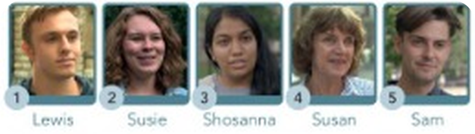
14
Street interviews
🎧 LISTEN → ✅ CHECK
⏱ 5 min 👤 alone
🎯 Listening · Controlled practice
Listen to 5 people. Choose a, b or c.
Ascolta 5 persone. Scegli a, b o c.
1 Lewis looks like… a his father b his mother c his mother and his father
c – dad's face, mum's hair and eyes
2 In the Dali painting that Susie likes there are some dripping… a clocks b rocks c socks
a – clocks
3 Shosanna went to Guyana because she wanted to learn… a about the animals and plants b about her family history c the language
b – how her parents grew up
4 Susan doesn't put photos of ___ on Instagram. a gardens b flowers c her family
c – 'I never post photos of people'
5 Sam only likes watching… a films with a sad ending b films with a happy ending c good films
c – 'it just has to be a good film'
💡
Teacher reads the interviews – or play the book video 2.23
R1-2 · Listening · Can you understand these people? · 📖 SB p.21 · Can you understand these people? · 2.23 (script TG p.40)
Notes:
14. Listening · Can you understand these people? (5 min)
LISTENING (5 min). Audio 2.23 isn't in our files: play the book video, or READ these aloud (2 voices if possible). Key (TG): 1c 2a 3b 4c 5c.
1 LEWIS – Who do you look like in your family? – Well, people say I often look like my dad a lot. We've got the same sort of nose and the same face shape, but I've got my mum's hair colour and my mum's eyes. – Do you have a similar personality? – There are quite a lot of similarities between me and my dad. We're both into German and speaking German, and also into architecture.
2 SUSIE – Do you have a favourite painting? – I'm not sure of the name of the painting, but I like Salvador Dali. I really like the painting with the dripping clocks. – Can you describe it? – There are dripping clocks. It's an interesting style. It's not something you see all the time, and it's very colourful.
3 SHOSANNA – Where did you go for your last holiday? – My last vacation I went to Guyana, which is my parents' country in South America. – Did you have a good time? – I did. It was one of the best vacations I had. It was really educational, and I was able to see how my parents grew up.
4 SUSAN – Do you take a lot of photos? – I take a lot of photos. My telephone is full of photos and I use Instagram. – What do you usually take photos of? – Mostly people, places, gardens, lots of flowers. I never post photos of people, but I take photos of family, but lots of gardens and flowers.
5 SAM – Do you prefer films with a happy or sad ending? – It just has to be a good film. I don't mind if it's a happy ending or a sad ending.

Slide 15
15
Can you…?
💬 TALK · PARLA
⏱ 6 min 👥 pairs
🎯 Speaking · Communicative
Can you say this in English? Show your partner – then tick!
Sai dirlo in inglese? Dimostralo al compagno – poi spunta!
💬
Useful phrases
1
ask and answer six questions about your home and family, work / studies, and free time
e.g. Where do you live? Have you got any brothers or sisters?
I usually… / I'm…ing at the moment
He's got… hair. He's quite…
In the picture, a man is wearing…
Last summer I went to…
When I took this photo, we were…
2
describe the appearance and personality of a person you know well
e.g. My sister has got long curly hair. She's very generous.
3
describe a picture in this book and say what is happening, what the people are wearing
e.g. A woman is smiling. She's wearing a red jacket.
4
ask and answer three questions about a holiday
e.g. Where did you go? Where did you stay? What was the weather like?
5
describe a favourite photo and say what was happening when you took it
e.g. We were having dinner on the beach…
6
say three true sentences using so, because and although
e.g. Although it rained, we had a great time.
R1-2 · Speaking · Can you say this in English? · 📖 SB p.21 · Can you say this in English? 1–6
Notes:
15. Speaking · Can you say this in English? (6 min)
CAN-DO (6 min). Pairs: A does 1–3, B does 4–6, then swap. They tick only what they can do WELL. Use a photo on their phone for 5.

Slide 16
16
3 · 2 · 1
⏱ 2 min 👥 pairs
🎯 Revision · Retrieval
Books closed! Tell your partner…
Libri chiusi! Di' al compagno…
3
Tell me 3 personality adjectives – 2 positive, 1 negative.
📝
Homework · Compiti
Redo the test questions you got wrong
Write 6 sentences: family · now · last holiday
2
Tell me 2 sentences: one with at, one with on.
Next lesson: 3A TripAside – be going to (SB p.22)
1
Tell me 1 thing you were doing at 8 o'clock last night.
R1-2 · Exit · what can you remember?
Notes:
16. Exit · what can you remember? (2 min)
EXIT (2 min). Pairs, books closed.

Slide 17
17
Today you…
💡 THINK · PENSA
⏱ 1 min 🙋 whole class
🎯 Revision · Reflection
Can you do it now? Thumbs up or thumbs down!
Ora sai farlo? Pollice su o pollice giù!
📝
Did a mini-test on Files 1 and 2
✅
👍 👌 👎
Can you do it now?
Ora sai farlo?
🔤
Revised verbs, at / in / on, and word groups
✅
🔊
Practised sounds and word stress
✅
📷
Read tips for better holiday photos
✅
🗣️
Checked what you can say in English
✅
R1-2 · Review · what did you do today?
Notes:
17. Review · what did you do today? (1 min)
TODAY YOU… (1 min). Read each line (one per click: the tick appears). Students show thumbs up / middle / down: can they do it now? Note any thumbs down for the next lesson's recap.

