Slide 1


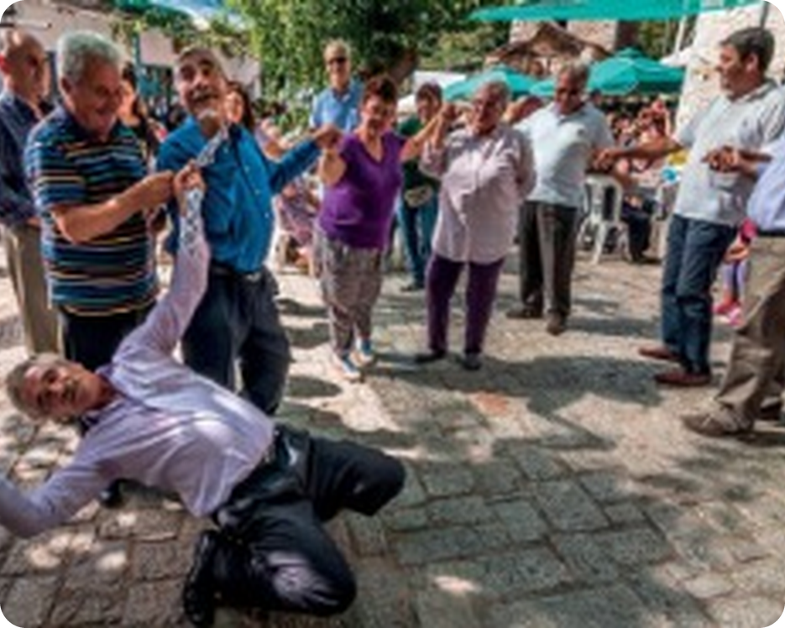


English File Elementary · SB pp.34–35 · VB p.157
💡 THINK · PENSA
4C
Blue Zones
Adverbs and expressions of frequency · months
🎯
Today you're going to…
📅 say the months: January, February…
🔁 say how often: always, hardly ever, twice a week
📍 put the adverb in the right place
🔤 say h: house, happy, hungry
📖 read about places where people live to 100
How often do you eat fish? Who's the oldest person you know?
EXAMPLE Hardly ever. Maybe once a month. My grandmother is 94!
Notes:
1. OPENING (2 min)
OPENING (2 min). Speech bubbles on the page: How often do you eat fish? – Hardly ever. Maybe once a month.

Slide 2

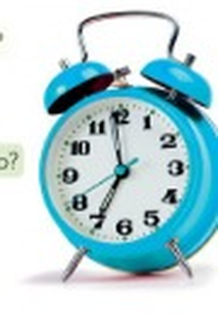
2
Remember last lesson?
💡 THINK → 💬 TALK
⏱ 3 min 👥 pairs
🎯 Revision · Retrieval
Can you remember? Say it – then use it in a sentence!
Ti ricordi? Dillo – poi usalo in una frase!
🔤 Can you remember these words? What do they mean?
get up
have a shower
get dressed
get to work
get home
do the housework
have a bath
go to bed
⭐ What does it mean?
⭐⭐ Use it in a sentence.
⭐⭐⭐ Make it negative or a question!
📅
Last lesson…
4B: From morning to night
daily routine · at, in, on
Your turn: at, in, on
at seven o'clock · at night · at the weekend
in the morning · in July
on Monday · on Tuesday morning
4C · Revision · last lesson
Notes:
2. Revision · last lesson (3 min)
ACTIVE RECAP (3 min). Pairs: tell your partner 3 things about yesterday morning with a time.
HOW TO RUN IT (active recap): pairs. Words: A points at a word, B says what it means (⭐); then a sentence with it (⭐⭐); strong students make it negative or a question (⭐⭐⭐). Grammar: pairs make their own example for each use (offer, plan…) BEFORE you click – then click to show the model answers.

Slide 3
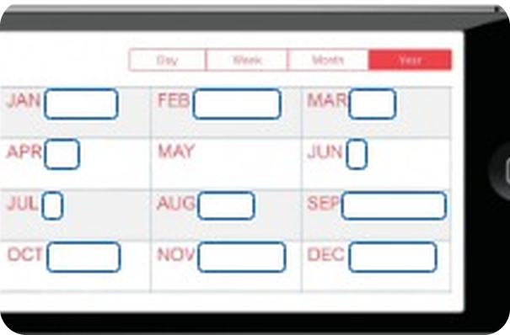
3
January, February…
🔊 SAY IT → ✅ CHECK
⏱ 5 min 🙋 whole class
🎯 Vocabulary · Controlled practice
Complete the months. Then say them. Which five are stressed on the 2nd syllable?
Completa i mesi. Poi dilli. Quali cinque hanno l'accento sulla 2ª sillaba?
⭐
Example
1
JAN · FEB · MAR
January · February · March
JAN → January
2
APR · MAY · JUN
April · May · June
3
JUL · AUG · SEP
July · August · September
4
OCT · NOV · DEC
October · November · December
5
Stressed on the 2nd syllable?
JuLY · SepTEMber · OcTOber · NoVEMber · DeCEMber
6
Say your birthday month round the class!
My birthday's in March.
🎧 4.16
4C · Vocabulary · months · 📖 SB p.34 · 1a–1c · audio 4.16 (SB key)
Notes:
3. Vocabulary · months (5 min)
MONTHS (4 min). Capital letters in English! Key 1b (SB): July, September, October, November, December. 1c: round the class – My birthday's in… (in + month).

Slide 4
4
How often?
🔊 SAY IT → ✅ CHECK
⏱ 3 min 🙋 whole class
🎯 Vocabulary · Controlled practice
How often? Say the expression, then click!
Quanto spesso? Di' l'espressione, poi clicca!
⭐
Example
1
every 🌞
every day
1 time a week = once a week · 2 times = twice · 3+ = three times
2
every 7 days
every week
3
every 30 days
every month
4
every 365 days
every year
5
a week: 1 time
once a week
6
a week: 2 times
twice a week
7
a week: 3 times
three times a week
🎧 4.17
8
a year: 4 times
four times a year
4C · Vocabulary Bank p.157 · expressions of frequency · 📖 VB p.157 · Time Part 2 · audio 4.17 (SB key)
Notes:
4. Vocabulary Bank p.157 · expressions of frequency (3 min)
EXPRESSIONS (3 min). once = 1 time, twice = 2 times. Never say 'one time a week' / 'two times a week' at this level.

Slide 5
5
Always or never?
💡 THINK → ✅ CHECK
⏱ 4 min 👥 pairs
🎯 Vocabulary · Controlled practice
Match the sentences. Then put the adverbs in order: 100% → 0%.
Abbina le frasi. Poi metti gli avverbi in ordine: 100% → 0%.
⭐
Example
1
I always get up at seven o'clock during the week.
I start work at eight o'clock every day.
100% always · usually · often · sometimes · hardly ever · never 0%
2
I often go to the cinema after work.
About seven or eight times a month.
3
I usually finish work at six o'clock.
But on Fridays we stop at three o'clock.
4
I sometimes meet a friend for lunch.
About once or twice a month.
5
I hardly ever go to the theatre.
Only once or twice a year.
6
I never have coffee.
I don't like it.
🎧 4.18
4C · Vocabulary Bank p.157 · adverbs of frequency · 📖 VB p.157 · Time Part 3 · audio 4.18, 4.19 (SB key)
Notes:
5. Vocabulary Bank p.157 · adverbs of frequency (4 min)
ADVERBS (4 min). Pairs say the second half before you click. Play 4.19 to repeat the 6 adverbs: hardly ever = quasi mai (NOT 'hardly' = difficilmente).

Slide 6

6
Teenagers in trouble
👀 READ → 💬 TALK
⏱ 4 min 👥 pairs
🎯 Grammar · Reading → grammar
Read the text about teenagers in the USA. Are teenagers in your country similar?
Leggi il testo sugli adolescenti americani. In Italia è uguale?
Teenagers in trouble
American teenagers may, for the first time in the nation's history, live shorter lives than their parents because of their unhealthy lifestyles. According to recent research:
• 96% spend more than five hours looking at a screen every day.
• 86% hardly ever eat fruit or green vegetables.
• 75% don't usually sleep for eight hours a day – the average is seven hours.
• 34% eat fast food at least once a day.
• 33% drink more than four sugary drinks every day.
• 31% are often very stressed.
• 25% never do sport or exercise.
📍
Where's the adverb?
hardly ever eat · never do · don't usually sleep
are often stressed
every day · once a day
Adverbs: before the main verb, after be. Expressions: at the end.
4C · Grammar · position of adverbs · 📖 SB p.34 · 2a, 2b (SB key)
Notes:
6. Grammar · position of adverbs (4 min)
TEENAGERS (4 min). Read, then: are teenagers in Italy similar? 2b rule (SB key): 1 adverbs of frequency go before a main verb, after the verb be; 2 expressions of frequency go at the end of a phrase or sentence.

Slide 7
7
Before the verb, after be
👀 LOOK → 🔊 SAY IT
⏱ 4 min 🙋 whole class
🎯 Grammar · Communicative
Put the adverb in the right place. Say it, then click!
Metti l'avverbio al posto giusto. Dillo, poi clicca!
I watch TV in the evening. (always)
main verb
before
I always watch TV in the evening.
Do you sleep eight hours? (usually)
question
before verb
Do you usually sleep eight hours a day?
She doesn't go to bed late. (often)
negative
after don't
She doesn't often go to bed late.
They're late. (hardly ever)
be
after
They're hardly ever late.
He isn't stressed. (often)
be −
after isn't
He isn't often stressed.
I have English classes. (twice a week)
expression
end
I have English classes twice a week.
4C · Grammar Bank 4C · the rule · 📖 Grammar Bank 4C p.130 · audio 4.20 (SB script)
Notes:
7. Grammar Bank 4C · the rule (4 min)
RULE (4 min). Italian puts sempre after the verb (vado sempre) – English: I always go. But with be: I'm always tired. Students say it, then click.

Slide 8
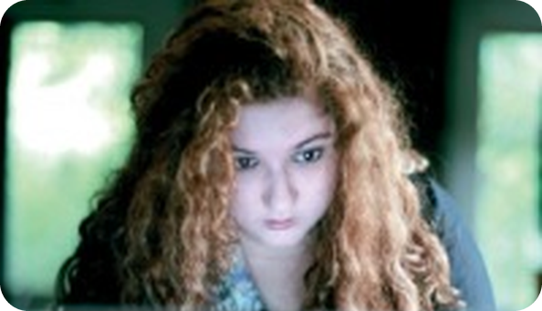
8
Grammar Bank practice
✍️ WRITE → ✅ CHECK
⏱ 5 min 👤 alone
🎯 Grammar · TPRS · reading
Grammar Bank 4C b: rewrite with the adverb or expression.
Grammar Bank 4C b: riscrivi con l'avverbio.
Put it in the right place
1 I am late for class. (never) → (1) ________
1 I am late for class. (never) → I am never late for class.
2 We eat fast food. (hardly ever) → (2) ________
2 We eat fast food. (hardly ever) → We hardly ever eat fast food.
3 What time do you finish work? (usually) → (3) ________
3 What time do you finish work? (usually) → What time do you usually finish work?
4 My parents don't go out at night. (often) → (4) ________
4 My parents don't go out at night. (often) → My parents don't often go out at night.
5 My brother is hungry at lunchtime. (always) → (5) ________
5 My brother is hungry at lunchtime. (always) → My brother is always hungry at lunchtime.
6 We don't do our homework. (always) → (6) ________
6 We don't do our homework. (always) → We don't always do our homework.
💡
Remember
7 Do you drive to work? (usually) → (7) ________
7 Do you drive to work? (usually) → Do you usually drive to work?
8 Our teacher is angry. (hardly ever) → (8) ________
adverb + main verb
be + adverb
8 Our teacher is angry. (hardly ever) → Our teacher is hardly ever angry.
4C · Grammar Bank 4C p.131 · b · 📖 Grammar Bank 4C p.131 · b (SB key)
Notes:
8. Grammar Bank 4C p.131 · b (5 min)
GRAMMAR BANK b (5 min). Prompts made from the SB key. Alone, then click once per sentence. Is no. 8 true?!

Slide 9

9
Harry's a hairdresser
🎧 LISTEN → 🔊 SAY IT
⏱ 4 min 👥 pairs
🎯 Pronunciation · Guided discovery
Listen. Where is h NOT pronounced? Then practise the sentences.
Ascolta. Dove NON si pronuncia la h? Poi esercitati.
🏷️
The letter h
how
🏠 /h/ house
hardly
🏠 /h/ house
🏠 /h/ house
🔇 silent h
happy
🏠 /h/ house
healthy
🏠 /h/ house
high
🏠 /h/ house
🎧 4.22
have
🏠 /h/ house
hungry
🏠 /h/ house
hour
🔇 silent h
Harry's a hairdresser.
🏠 /h/ house
He usually has half an hour for lunch.
🔇 silent h
4C · Pronunciation · the letter h · 📖 SB p.35 · 3a, 3b · audio 4.21, 4.22 (SB key)
Notes:
9. Pronunciation · the letter h (4 min)
LETTER H (4 min). Italians drop the h! Breathe on your hand: house. Key 3b (SB): in hour the h is not pronounced. Sentences (4.22): Harry's a hairdresser. He hardly ever has breakfast. He's often in a hurry. He usually has half an hour for lunch. He often has a hamburger for dinner. Harry isn't very healthy.

Slide 10
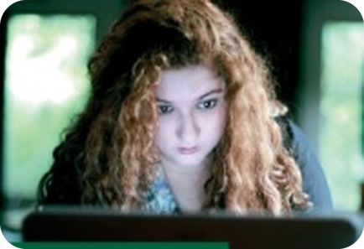
10
I'm not usually at home…
💬 TALK · PARLA
⏱ 4 min 👥 pairs
🎯 Speaking · Communicative
Make true sentences about you with a verb phrase + an adverb or expression of frequency.
Fai frasi vere su di te con un avverbio o espressione di frequenza.
1
be at home on Saturday night
e.g. I'm not usually at home on Saturday night.
2
go to the hairdresser
e.g. I go to the hairdresser once a month.
3
have a healthy lunch · sleep for eight hours
e.g. I hardly ever sleep for eight hours!
💬
Useful phrases
4
Now ask: How often do you…?
e.g. How often do you have a hot bath? – Never!
be at home on Saturday night
be in a hurry
do housework
go to the hairdresser
have a healthy lunch
have a hot bath
sleep for eight hours
4C · Speaking · about me · 📖 SB p.35 · 3c
Notes:
10. Speaking · about me (4 min)
ABOUT ME (4 min). Then partners ask How often…? and answer with an expression.

Slide 11
11
What are their secrets?
👀 READ → 💡 THINK
⏱ 4 min 👥 pairs
🎯 Reading ·
Read the text. What are the 'Blue Zones'? How old do you think Alexis and María are?
Leggi il testo. Cosa sono le 'Blue Zones'? Quanti anni hanno Alexis e María?
What are their secrets?
What do the Greek island of Ikaria, the Nicoya peninsula in Costa Rica, and the island of Okinawa in Japan have in common? The answer is that, together with Loma Linda in California and Sardinia in Italy, they are the five so-called 'Blue Zones', the best places in the world to live if you want to have a long and healthy life. Many people there live until they are 100 or more. So what are their secrets?
Alexis is a builder from Ikaria.
María from Nicoya cooks and goes to the market every day.
🌍
Guess!
Sardinia is a Blue Zone – why?
Blue Zones = 5 places where many people live a long time. Alexis is 102 · María is 97.
4C · Reading · What are their secrets? · 📖 SB p.35 · 4a (SB key)
Notes:
11. Reading · What are their secrets? (4 min)
BLUE ZONES (4 min). Key (SB): Alexis is 102 and María is 97. Ask: Sardinia is in Italy – why do people live a long time there? What about Sicily?

Slide 12
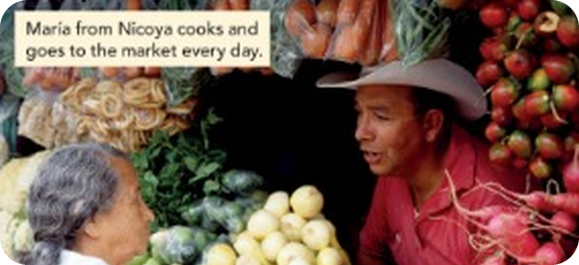
12
Food and exercise
💡 THINK → 💬 TALK
⏱ 5 min 👥 pairs
🎯 Speaking · Communicative
What do people in Blue Zones eat and do? Make two lists with your partner.
Cosa mangiano e fanno nelle Blue Zones? Fate due liste.
1
Food and drink?
e.g. potatoes, green vegetables, fish, rice, sweet potatoes, eggs, cheese, fruit, herbal tea, red wine, water
2
Physical exercise?
e.g. work in their gardens, walk everywhere, ride horses, go to a gym, do exercise
3
And you? How often do you eat fish? Do you walk everywhere?
e.g. I hardly ever walk – I always drive!
💬
Useful phrases
4
Would you like to live in a Blue Zone?
e.g. Yes – I'd like to live in Ikaria!
They often eat…
They hardly ever…
They walk everywhere.
They work in their gardens.
They drink herbal tea / red wine.
4C · Speaking · their secrets · 📖 SB p.35 · 4c (SB key – words from the Communication articles pp.104, 110)
Notes:
12. Speaking · their secrets (5 min)
SECRETS (5 min). The full articles are Communication A p.104 (Ikaria) / B p.110 (Nicoya) – use them if you have the books in class (A and B read and tell). Words for 4c from the SB key. Click for the lists.

Slide 13
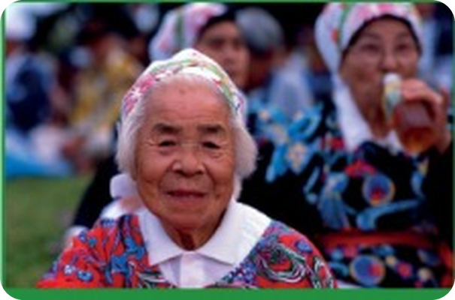
13
The island of Okinawa
🎬 WATCH → ✅ CHECK
⏱ 6 min 👤 alone
🎯 Listening · Controlled practice
Video: The island of Okinawa. True or false? Then correct the false sentences.
Video: L'isola di Okinawa. Vero o falso? Poi correggi le false.
⭐
Example
1
The island of Okinawa is north of Japan.
F – it's south of Japan.
2
70-year-old Okinawans have the bodies of 50-year-olds.
T
3
Hara hachi means stop eating before you're full.
T
4
The Okinawans don't eat meat or fish.
F – they eat fish.
5
They eat a lot of seaweed.
T
6
They do yoga every day.
F – t'ai chi or martial arts.
7
The Okinawans are often in a hurry.
F – they're never in a hurry.
8
When Okinawans reach 100 they have a ceremony called kajimaya.
F – at 97.
4C · Video listening · The island of Okinawa · 📖 SB p.35 · 5a, 5b (SB key) · video not in our files yet
Notes:
13. Video listening · The island of Okinawa (6 min)
VIDEO (6 min). The Okinawa documentary isn't in our files yet – ask Cole / use the Teacher's Resource Centre or the class DVD. Key from the SB answer key. 5c: what does Okinawa have in common with Ikaria and Nicoya? Is your lifestyle similar?

Slide 14
14
3 · 2 · 1
⏱ 2 min 👥 pairs
🎯 Revision · Retrieval
Books closed! Tell your partner…
Libri chiusi! Di' al compagno…
3
Tell me 3 months stressed on the 2nd syllable.
📝
Homework · Compiti
Workbook 4C pp.30–31
2
Tell me 2 true sentences: I always… / I'm never…
Next lesson: Revise and Check 3&4 (SB pp.36–37)
1
Tell me 1 secret of the Blue Zones.
4C · Exit · what can you remember?
Notes:
14. Exit · what can you remember? (2 min)
EXIT (2 min). Pairs, books closed.

Slide 15
15
Today you…
💡 THINK · PENSA
⏱ 1 min 🙋 whole class
🎯 Revision · Reflection
Can you do it now? Thumbs up or thumbs down!
Ora sai farlo? Pollice su o pollice giù!
📅
Said the months: January, February…
✅
👍 👌 👎
Can you do it now?
Ora sai farlo?
🔁
Said how often: always, hardly ever, twice a week
✅
📍
Practised put the adverb in the right place
✅
🔤
Said h: house, happy, hungry
✅
📖
Read about places where people live to 100
✅
4C · Review · what did you do today?
Notes:
15. Review · what did you do today? (1 min)
TODAY YOU… (1 min). Read each line (one per click: the tick appears). Students show thumbs up / middle / down: can they do it now? Note any thumbs down for the next lesson's recap.

Slide 16
⭐
Optional extensions
Only if there's time – the lesson is finished. · Solo se c'è tempo – la lezione è finita.
Notes:
16. OPTIONAL EXTENSIONS
The lesson ended on the previous slide ("Today you…"). Use the next slides only if there is time left, or keep them for a quick start next lesson.

Slide 17
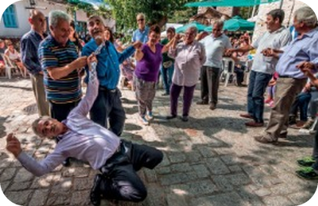
17
Find someone who…
🎲 PLAY → 💬 TALK
⏱ 6 min 🙋 whole class
🎯 Speaking · Communicative game
How often…? Find someone who! Stand up and ask.
How often…? Trova qualcuno che! Alzati e chiedi.
🎲
How to play
1
…eats fish twice a week
→ How often do you eat fish?
Find a different person for each line. Write the name.
First to 6 names wins!
…hardly ever sleeps eight hours
→ Do you usually sleep for eight hours?
2
3
…goes to the gym three times a week
→ How often do you go to the gym?
4
…is never late
→ Are you ever late?
5
…always walks to work
→ How do you go to work?
6
…has a birthday in the summer
→ When's your birthday?
⭐ OPTIONAL EXTENSION · only if there's time
4C · Game · find someone who · 📖 Extra · zero-prep game
Notes:
17. Game · find someone who (6 min)
FIND SOMEONE WHO (6 min, extra). Feedback: full sentences with the adverb in the right place.

