Slide 1



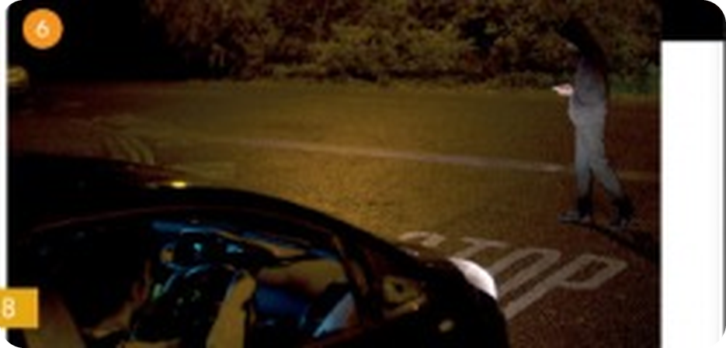

English File Pre-intermediate · SB pp.18–19
💡 THINK · PENSA
2C
One dark October evening
Time sequencers and connectors · verb phrases
🎯
Today you're going to…
📖 read a love story with a twist
🔗 use after that, suddenly, so, because, although
🔊 find the stress in two-syllable words
🎬 watch a happy or a sad ending
🗣️ retell the story as Hannah or Jamie
Look at the title and the photos. What do you think the story is about?
EXAMPLE I think it's a love story – but something bad happens in the car…
Notes:
1. OPENING (2 min)
OPENING (2 min). SB 1a. TG lead-in: bands with colours (Green Day, Black Sabbath, Red Hot Chili Peppers, Black Eyed Peas, The White Stripes, Deep Purple, Pink) → 'today's story has a song by Pink'.

Slide 2

2
One dark October evening (1)
👀 READ → ✏️ FILL THE GAPS
⏱ 4 min 👥 pairs
🎯 Grammar · Reading · text order
Read the story. Complete it with a word or phrase from the box.
Leggi la storia. Completala con una parola o frase del riquadro.
One dark October evening
Hannah met Jamie last summer. It was Hannah's birthday and she and her friends went to a club. They wanted to dance, but they didn't like the music, so Hannah went to speak to the DJ. 'This music is awful,' she said. 'Could you play something else?' The DJ looked at her and said, 'Don't worry, I have the perfect song for you.'
' (1) Two minutes later he said, 'The next song is by Pink. It's called Get the Party Started and it's for a beautiful girl over there who's wearing a pink dress.' Hannah knew that the song was for her.
(2) ________ Hannah and her friends left the club, the DJ was waiting for her at the door. 'Hi, I'm Jamie,' he said to Hannah. 'Can I see you again?' So Hannah gave him her phone number.
(3) ________ Jamie phoned Hannah and invited her to dinner. He took her to a very romantic French restaurant and they talked all evening. Although the food wasn't very good, they had a wonderful time.
📦
The box
One dark October evening
Hannah met Jamie last summer. It was Hannah's birthday and she and her friends went to a club. They wanted to dance, but they didn't like the music, so Hannah went to speak to the DJ. 'This music is awful,' she said. 'Could you play something else?' The DJ looked at her and said, 'Don't worry, I have the perfect song for you.'
' (1) Two minutes later he said, 'The next song is by Pink. It's called Get the Party Started and it's for a beautiful girl over there who's wearing a pink dress.' Hannah knew that the song was for her.
(2) When Hannah and her friends left the club, the DJ was waiting for her at the door. 'Hi, I'm Jamie,' he said to Hannah. 'Can I see you again?' So Hannah gave him her phone number.
(3) ________ Jamie phoned Hannah and invited her to dinner. He took her to a very romantic French restaurant and they talked all evening. Although the food wasn't very good, they had a wonderful time.
One dark October evening
Hannah met Jamie last summer. It was Hannah's birthday and she and her friends went to a club. They wanted to dance, but they didn't like the music, so Hannah went to speak to the DJ. 'This music is awful,' she said. 'Could you play something else?' The DJ looked at her and said, 'Don't worry, I have the perfect song for you.'
' (1) Two minutes later he said, 'The next song is by Pink. It's called Get the Party Started and it's for a beautiful girl over there who's wearing a pink dress.' Hannah knew that the song was for her.
(2) When Hannah and her friends left the club, the DJ was waiting for her at the door. 'Hi, I'm Jamie,' he said to Hannah. 'Can I see you again?' So Hannah gave him her phone number.
(3) The next day Jamie phoned Hannah and invited her to dinner. He took her to a very romantic French restaurant and they talked all evening. Although the food wasn't very good, they had a wonderful time.
After that
One afternoon in October
Suddenly
The next day
Two minutes later ✓
When
2C · Grammar · time sequencers (the story) · 📖 SB p.18 · 1b (the story is on the slide · TG key 2.16)
Notes:
2. Grammar · time sequencers (the story) (4 min)
STORY (6 min). Gap 1 is the example. No audio 2.16: after they finish, YOU read the story aloud as the 'listen and check' (voices for Hannah, Jamie, the DJ!). One click per gap. Key (TG): 2 When 3 The next day (4–6 next slide). Stop at 'the brake…' – don't say what happens!

Slide 3
3
One dark October evening (2)
👀 READ → ✏️ FILL THE GAPS
⏱ 3 min 👥 pairs
🎯 Grammar · Reading · text order
Read part 2. Complete it with a word or phrase from the box.
Leggi la parte 2. Completala con una parola o frase del riquadro.
One dark October evening (2)
(4) ________ Jamie and Hannah saw each other every day. Every evening when Hannah finished work they met at 5.30 in a coffee bar in the high street. They were madly in love.
(5) ________ Hannah was at work. As usual she was going to meet Jamie at 5.30. It was dark and it was raining. She looked at her watch. It was 5.20! She was going to be late! She ran to her car and got in.
At 5.25 she was driving along the high street. She was going very fast because she was in a hurry. (6) ________ , a man ran across the road. He was wearing a dark coat, so Hannah didn't see him at first. Quickly, she put her foot on the brake…
📦
The box
One dark October evening (2)
(4) After that Jamie and Hannah saw each other every day. Every evening when Hannah finished work they met at 5.30 in a coffee bar in the high street. They were madly in love.
(5) ________ Hannah was at work. As usual she was going to meet Jamie at 5.30. It was dark and it was raining. She looked at her watch. It was 5.20! She was going to be late! She ran to her car and got in.
At 5.25 she was driving along the high street. She was going very fast because she was in a hurry. (6) ________ , a man ran across the road. He was wearing a dark coat, so Hannah didn't see him at first. Quickly, she put her foot on the brake…
One dark October evening (2)
(4) After that Jamie and Hannah saw each other every day. Every evening when Hannah finished work they met at 5.30 in a coffee bar in the high street. They were madly in love.
(5) One afternoon in October Hannah was at work. As usual she was going to meet Jamie at 5.30. It was dark and it was raining. She looked at her watch. It was 5.20! She was going to be late! She ran to her car and got in.
At 5.25 she was driving along the high street. She was going very fast because she was in a hurry. (6) ________ , a man ran across the road. He was wearing a dark coat, so Hannah didn't see him at first. Quickly, she put her foot on the brake…
One dark October evening (2)
(4) After that Jamie and Hannah saw each other every day. Every evening when Hannah finished work they met at 5.30 in a coffee bar in the high street. They were madly in love.
(5) One afternoon in October Hannah was at work. As usual she was going to meet Jamie at 5.30. It was dark and it was raining. She looked at her watch. It was 5.20! She was going to be late! She ran to her car and got in.
At 5.25 she was driving along the high street. She was going very fast because she was in a hurry. (6) Suddenly , a man ran across the road. He was wearing a dark coat, so Hannah didn't see him at first. Quickly, she put her foot on the brake…
After that
One afternoon in October
Suddenly
The next day
Two minutes later ✓
When
2C · Grammar · time sequencers (the story) · 📖 SB p.18 · 1b (the story is on the slide · TG key 2.16)
Notes:
3. Grammar · time sequencers (the story) (3 min)
STORY PART 2 (3 min). Key (TG): 4 After that 5 One afternoon in October 6 Suddenly. (STORY (6 min) – Gap 1 is the example. No audio 2.16: after they finish, YOU read the story aloud as the 'listen and check' (voices for Hannah, Jamie, the DJ!). One click per gap. Key (TG): 2 When 3 The next day 4 After that 5 One afternoon in October 6 Suddenly. Stop at 'the brake…' – don't say what happens!

Slide 4

4
Why…?
👀 READ → 💬 TALK
⏱ 5 min 👥 pairs
🎯 Reading · for detail
Read the story again. Answer the questions.
Rileggi la storia. Rispondi alle domande.
1
Why did Hannah go and speak to Jamie?
5
Where did they go every evening after that?
Because she didn't like the music.
To a coffee bar in the high street.
2
Why did Jamie play Get the Party Started?
6
What was the weather like that evening in October?
Because it's by Pink, and Hannah was wearing a pink dress.
It was dark and raining.
3
What happened when Hannah left the club?
7
Why was Hannah driving fast?
Jamie was waiting at the door and asked to see her again.
Because she was in a hurry.
4
What was the restaurant like?
8
Why didn't she see the man?
Very romantic, but the food wasn't very good.
Because he was wearing a dark coat.
2C · Reading · detail · 📖 SB p.19 · 1c (TG key)
Notes:
4. Reading · detail (5 min)
DETAIL (5 min). Pairs answer (TG extra challenge: from memory!). Go back to the story slide if they need it. One click per question.

Slide 5
5
So, because, although
💡 THINK → ✏️ FILL THE GAPS
⏱ 3 min 👥 pairs
🎯 Grammar · Noticing
From memory: so, because or although? Then check in the story.
A memoria: so, because o although? Poi controlla nella storia.
From the story
1 She was going very fast (1) ________ she was in a hurry.
2 (2) ________ the food wasn't very good, they had a wonderful time.
3 He was wearing a dark coat, (3) ________ Hannah didn't see him at first.
🔗
What do they show?
From the story
1 She was going very fast (1) because she was in a hurry.
2 (2) ________ the food wasn't very good, they had a wonderful time.
3 He was wearing a dark coat, (3) ________ Hannah didn't see him at first.
From the story
1 She was going very fast (1) because she was in a hurry.
2 (2) Although the food wasn't very good, they had a wonderful time.
3 He was wearing a dark coat, (3) ________ Hannah didn't see him at first.
From the story
1 She was going very fast (1) because she was in a hurry.
2 (2) Although the food wasn't very good, they had a wonderful time.
3 He was wearing a dark coat, (3) so Hannah didn't see him at first.
because → reason
so → result
although → contrast (= but)
but → contrast
2C · Grammar · connectors · 📖 SB p.19 · 1d (TG key)
Notes:
5. Grammar · connectors (3 min)
CONNECTORS (3 min). Key (TG): 1 because 2 Although 3 so. Drill: so /səʊ/, because /bɪˈkɒz/, although /ɔːlˈðəʊ/. TG: comma before so, although, but.

Slide 6

6
Sequencers and connectors
👀 LOOK · GUARDA
⏱ 3 min 🙋 whole class
🎯 Grammar · Guided discovery
Read the examples. Then click!
Leggi gli esempi. Poi clicca!
time sequencers
so · because
but · although
One afternoon in October…
The next day… / After that…
Two minutes later… / Suddenly…
When Hannah left the club…
It was late, so I took a taxi.
I took a taxi because it was late.
It was raining, but we went out.
Although it was raining, we went out.
ordine degli eventi
so = quindi · because = perché
ma · anche se
⚠ ✗ Although it was cold, but we went out. → ✓ Although it was cold, we went out. (only ONE connector!)
2C · Grammar Bank 2C · the rule · 📖 Grammar Bank 2C p.128 (TG notes)
Notes:
6. Grammar Bank 2C · the rule (3 min)
RULE (3 min). Click once per column. TG: 'though' = informal, not at the start – learn although. 'so' also = very (so tired) – different meaning. GB exercises p.129: a 2G 3B 4E 5A 6F 7H 8D · b see TG (1 Although it was very cold, she wasn't wearing a coat… 9 Although the team played well, they didn't win).

Slide 7
7
Connect it!
🎲 PLAY · GIOCA
⏱ 4 min 🏆 teams
🎯 Speaking · Communicative game
Teams: so, because, but or although? Then finish the sentence!
Squadre: so, because, but o although? Poi finite la frase!
🎲
How to play
e.g.
It was very cold. She wasn't wearing a coat.
→ Although it was very cold, she wasn't wearing a coat.
Read the two halves.
Choose the connector = 1 point.
Make it into one sentence = 1 more point!
I woke him up in the night. There was a noise.
→ I woke him up because there was a noise.
1
2
I called him. His mobile was turned off.
→ I called him, but his mobile was turned off.
3
There was nothing on TV. I went to bed.
→ There was nothing on TV, so I went to bed.
TEAM A ☆☆☆☆☆
TEAM B ☆☆☆☆☆
She wanted to be a doctor. She failed her exams.
→ She wanted to be a doctor, but she failed her exams.
4
5
The team played well. They didn't win.
→ Although the team played well, they didn't win.
2C · Game · connectors · 📖 Grammar Bank 2C p.129 b (TG key)
Notes:
7. Game · connectors (4 min)
CONNECT IT (4 min). Item 1 is the example. Sentences = GB 2C exercise b (TG key). Accept other correct answers.

Slide 8
8
Your endings
✍️ WRITE → 💬 TALK
⏱ 4 min 👥 pairs
🎯 Grammar · Communicative
Finish the sentences in your own words. Compare with a partner.
Completa le frasi con parole tue. Confronta con un compagno.
💬
Useful phrases
1
We fell in love on our first date. Two months later…
e.g. …we got married in Las Vegas!
…so I…
…because…
…but / although…
Suddenly, …
2
I went to bed early last night because…
e.g. …I was really tired.
3
The weather was beautiful, so we decided…
e.g. …to go to the beach.
4
It was really cold last night, and when I woke up this morning…
e.g. …there was snow on the car!
5
Although we didn't play well in the final…
e.g. …we won 1–0.
6
I was driving along the high street listening to the radio. Suddenly…
e.g. …a dog ran across the road.
2C · Grammar · personalise · 📖 SB p.19 · 1f
Notes:
8. Grammar · personalise (4 min)
YOUR ENDINGS (4 min). SB 1f. Students write, then compare. Board 3–4 of the funniest.

Slide 9
9
Stress in two-syllable words
🔊 SAY IT → 🔗 MATCH
⏱ 3 min 👥 pairs
🎯 Pronunciation · Guided discovery
Where's the stress? 1st or 2nd syllable? Say the words!
Dov'è l'accento? 1ª o 2ª sillaba? Di' le parole!
🏷️
The stress
e.g. across
○ ● 2nd syllable
after
● ○ 1st syllable
● ○ 1st syllable
○ ● 2nd syllable
again
○ ● 2nd syllable
along
○ ● 2nd syllable
although
○ ● 2nd syllable
awful
● ○ 1st syllable
because
○ ● 2nd syllable
birthday
● ○ 1st syllable
evening
● ○ 1st syllable
invite
○ ● 2nd syllable
perfect
● ○ 1st syllable
quickly
● ○ 1st syllable
2C · Pronunciation · word stress · 📖 SB p.19 · 2a, 2b (TG key 2.20)
Notes:
9. Pronunciation · word stress (3 min)
WORD STRESS (3 min). Box: ~80% of two-syllable words are stressed on the 1st syllable (nouns, adjectives, adverbs); many verbs, prepositions and connectors on the 2nd (arrive, behind, before). Click: the answer. 2c: pairs write a sentence with 2+ of the words ('After dinner, we walked home across the park').

Slide 10
10
Verb phrases
🔗 MATCH → 🔊 SAY IT
⏱ 4 min 👥 pairs
🎯 Vocabulary · Controlled practice
Make verb phrases from the story. Match a verb and a phrase.
Forma espressioni dalla storia. Abbina un verbo e una frase.
1
e.g. invite + somebody to dinner
7
wait + for somebody
invite somebody to dinner
wait for somebody
2
have + a great time
8
be + in a hurry
have a great time
be in a hurry
3
drive + along the high street
9
play + a song
drive along the high street
play a song
4
meet + in a coffee bar
10
leave + the club (very late)
meet in a coffee bar
leave the club (very late)
5
give + somebody your phone number
11
run + across the road
give somebody your phone number
run across the road
6
take + somebody to a restaurant
take somebody to a restaurant
2C · Vocabulary · verb phrases · 📖 SB p.19 · 3a (TG key)
Notes:
10. Vocabulary · verb phrases (4 min)
VERB PHRASES (4 min). Read only the phrase (in a coffee bar…) and let students say the verb, THEN click. 3b: cover the verbs and remember them (TG extra idea: say 'in a coffee bar' → 'meet in a coffee bar').

Slide 11
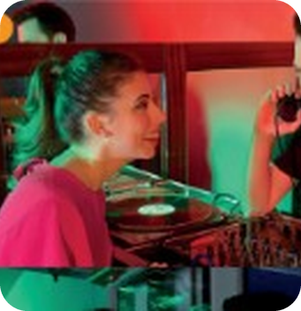
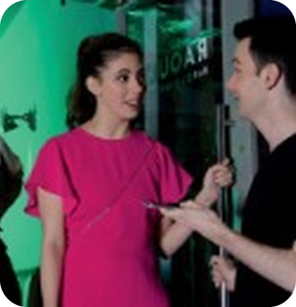
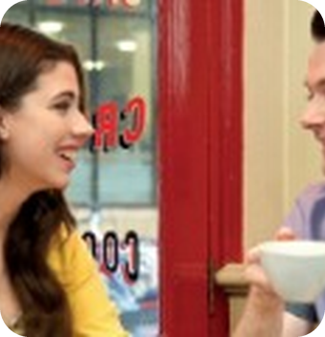
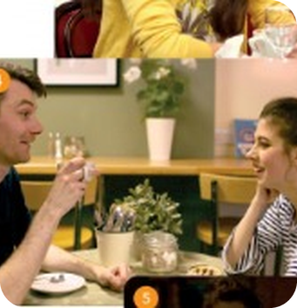
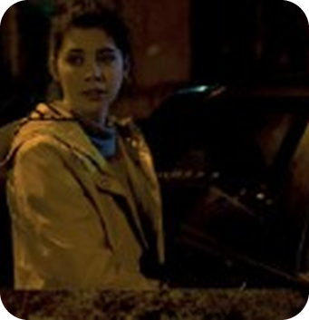
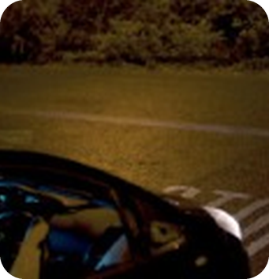
11
Tell the story!
💬 TALK · PARLA
⏱ 5 min 👥 pairs
🎯 Speaking · Controlled practice
Retell the story! A = Jamie (photos 1–3), B = Hannah (photos 4–6).
Racconta la storia! A = Jamie (foto 1–3), B = Hannah (foto 4–6).
A
B
C
e.g. A (Jamie)
I met Hannah last summer. It was her birthday, and she came to the club with some friends…
B (Jamie)
When she left the club, I was waiting at the door…
C (Jamie)
The next day, I phoned her and invited her to dinner…
D
E
F
D (Hannah)
After that, we saw each other every day…
E (Hannah)
One afternoon in October, I was at work…
F (Hannah)
I was driving along the high street. Suddenly…
2C · Speaking · retell · 📖 SB p.19 · 3c, 3d
Notes:
11. Speaking · retell (5 min)
RETELL (5 min). SB 3d – in the first person, with connectors and verb phrases. A covers the text and tells photos A–C as Jamie; B checks with the story slide. Then swap (D–F as Hannah). Click: the book's model starts.

Slide 12
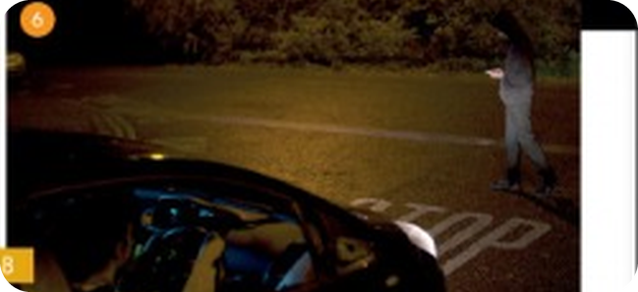
12
Happy or sad?
💡 THINK → 💬 TALK
⏱ 8 min 🙋 whole class
🎯 Listening · Communicative
Class vote! Happy ending or sad ending? What do you think happens?
Votate! Finale felice o triste? Cosa pensate che succeda?
1
Class vote: hands up! Happy ending? Sad ending?
e.g. Happy: 5 · Sad: 7 → we watch the sad ending!
2
Before you watch: what do you think happens?
e.g. I think the man is Jamie!
3
Watch the ending you chose (book video 2.21 happy / 2.22 sad). What happens?
e.g. She stopped just in time. It was Jamie!
💬
Useful phrases
4
Want to watch the other ending too?
e.g. Yes!
I think she stops just in time.
I think she hits the man.
Maybe the man is… Jamie!
I want the happy / sad ending because…
2C · Video listening · two endings · 📖 SB p.19 · 4a, 4b · video 2.21 / 2.22 (scripts TG p.38)
Notes:
12. Video listening · two endings (8 min)
VIDEO (8 min). Show of hands, then play the book video (Online Practice / Class DVD) – or READ the script. Then the Communication questions (next slides).
HAPPY (2.21): She stopped just in time. She got out and shouted: 'Don't you usually look before you cross the road?' – 'Sorry! Hey, Hannah, it's me. It's Jamie.' – 'What are you doing here? I nearly killed you!' – 'I was buying something. I was in a hurry and I crossed the road without looking.' They drove to the coffee bar and ordered two cappuccinos. 'What were you doing in the high street?' – 'I went to the theatre to buy these tickets for the Pink concert. It's on the fifteenth of October – next Saturday. Our anniversary. Three months since we first met. We met on Saturday the fifteenth of July.' – 'I can't believe you remember the exact day! What a romantic!'
SAD (2.22): Although Hannah tried to stop, she couldn't. She hit the man. Hannah panicked. She drove away as fast as she could. At the coffee bar, Jamie wasn't there. She called him, but his phone was turned off. She waited ten minutes and went home. Two hours later a policewoman knocked at the door. 'Are you a friend of Jamie Dixon? I'm afraid I have some bad news. Jamie had an accident this evening. He was crossing the road in the high street, by the theatre, and a car hit him. He's in hospital: a bad injury to his head and two broken legs. He's in intensive care. The driver didn't stop. It was a woman in a black car. Somebody saw the number. You have a black car outside, don't you, Madam? Is your number plate GY56 RZR? … Can you tell me where you were at twenty-five past five this evening?'

Slide 13
13
The happy ending
💬 TALK → ✅ CHECK
⏱ 4 min 👥 pairs
Happy ending: answer the questions.
Finale felice: rispondi alle domande.
1
Why didn't Hannah see the man at first?
5
What did they order?
Because he was wearing a dark coat.
Two cappuccinos.
2
Who was the man?
6
What was Jamie doing in the high street?
Jamie.
He was buying tickets for a concert.
3
Why did he cross the road without looking?
7
What were the tickets for?
He was in a hurry.
The Pink concert on 15th October.
4
Where did they go?
8
Why is 15th October important?
To a coffee bar.
It's their three-month anniversary.
2C · Communication · Happy ending (p.103) · 📖 SB p.103 Communication Happy ending (TG key)
Notes:
13. Communication · Happy ending (p.103) (4 min)
HAPPY ENDING (4 min) – only if the class chose it. Key (TG). Skip this slide if you watched the sad ending.

Slide 14
14
The sad ending
💬 TALK → ✅ CHECK
⏱ 4 min 👥 pairs
Sad ending: answer the questions.
Finale triste: rispondi alle domande.
1
Why didn't Hannah see the man at first?
5
What did she tell Hannah?
Because he was wearing a dark coat.
That Jamie was in a car accident.
2
What happened?
6
How is Jamie?
She hit him.
A bad injury to his head and two broken legs. He's in intensive care.
3
What did Hannah do then?
7
What did someone see?
She went to the coffee bar and called Jamie.
The driver was a woman in a black car – and the number.
4
Who came to Hannah's house?
8
What did the policewoman ask Hannah at the end?
A policewoman.
About her number plate and where she was at 5.25 p.m.
2C · Communication · Sad ending (p.109) · 📖 SB p.109 Communication Sad ending (TG key)
Notes:
14. Communication · Sad ending (p.109) (4 min)
SAD ENDING (4 min) – only if the class chose it. Key (TG; Q7 in the TG key says 'white' – the script says a black car: go with the script). Skip if you watched the happy ending.

Slide 15
15
3 · 2 · 1
⏱ 2 min 👥 pairs
🎯 Revision · Retrieval
Books closed! Tell your partner…
Libri chiusi! Di' al compagno…
3
Tell me 3 time sequencers from the story.
📝
Homework · Compiti
Workbook 2C pp.16–17: exercises 1–3
2
Tell me 2 sentences: one with so, one with although.
Next lesson: Revise and Check 1&2 (SB p.20)
1
Tell me 1 verb phrase from the story – in a sentence about you.
2C · Exit · what can you remember?
Notes:
15. Exit · what can you remember? (2 min)
EXIT (2 min). Pairs, books closed.

Slide 16
16
Today you…
💡 THINK · PENSA
⏱ 1 min 🙋 whole class
🎯 Revision · Reflection
Can you do it now? Thumbs up or thumbs down!
Ora sai farlo? Pollice su o pollice giù!
📖
Read a love story with a twist
✅
👍 👌 👎
Can you do it now?
Ora sai farlo?
🔗
Used after that, suddenly, so, because, although
✅
🔊
Found the stress in two-syllable words
✅
🎬
Watched a happy or a sad ending
✅
🗣️
Practised retell the story as Hannah or Jamie
✅
2C · Review · what did you do today?
Notes:
16. Review · what did you do today? (1 min)
TODAY YOU… (1 min). Read each line (one per click: the tick appears). Students show thumbs up / middle / down: can they do it now? Note any thumbs down for the next lesson's recap.

