Slide 1


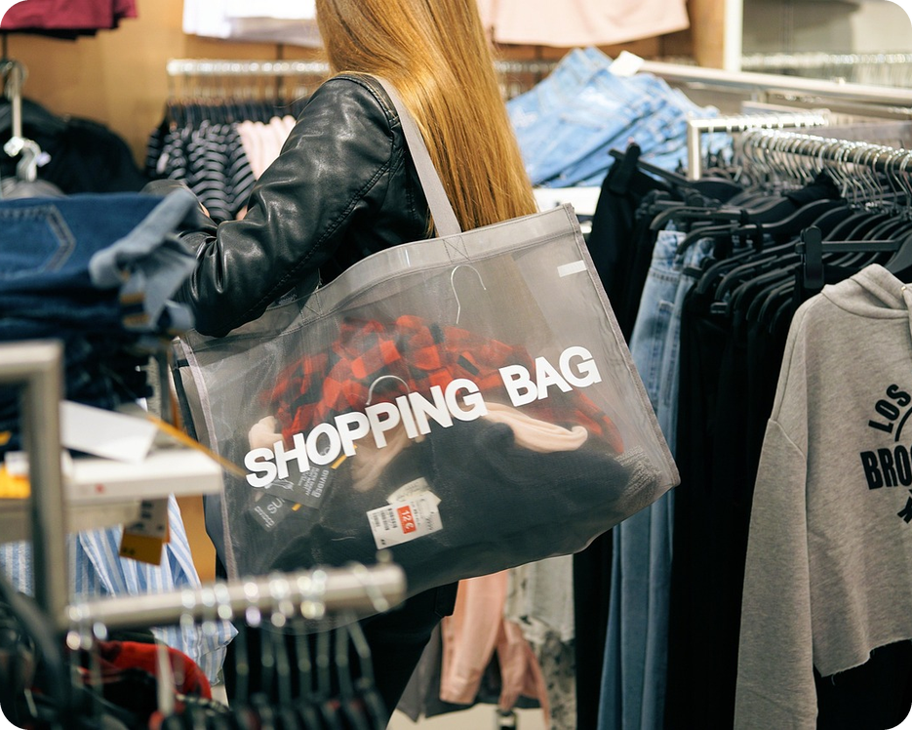


English File B1 · SB pp.80–81
💡 THINK · PENSA
8B-1
Have a nice day!
Shopping and reported speech
🎯
Today you're going to…
👀 read about a VERY helpful shop assistant
✏️ report what people said and asked
🛍️ learn shopping words: receipt, refund, bargain…
💬 talk about your shopping habits
Do you like it when shop assistants talk to you?
EXAMPLE Not really – I prefer to look in peace! I only ask if I need help.
Notes:
1. OPENING (2 min)
Show the photo. Act out an over-friendly shop assistant: 'Hello! Do you need any help? Are you going anywhere nice?' Ask the THINK question; take 3–4 answers. Click: the example. Read 'Today you're going to…'.

Slide 2

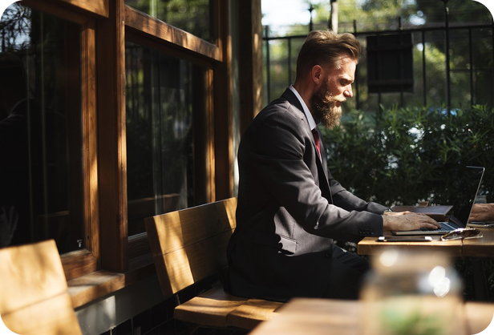
2
Remember last lesson?
💡 THINK PENSA
⏱ 3 min 🙋 whole class
What did we do? Read the examples.
Cosa abbiamo fatto? Leggi gli esempi.
Dragons' Den
Gerund or infinitive?
Entrepreneurs present a product to 'Dragons'.
'I'm out.' = I won't invest.
Slappie watches = success · Tangle Teezer = success without them!
I enjoy working with people.
I'd like to start my own business.
It's hard to find a good job.
📅
Last lesson…
8A: The right job for you
Dragons' Den · gerunds and infinitives
🔤 KEY WORDS
invest
pitch
product
entrepreneur
I'm out
regret
8B-1 · Revision · last lesson
Notes:
2. Revision · last lesson (3 min)
REVISION (2 min). Read the examples. Ask 2 students: 'Would you like to be on Dragons' Den? What product would you present?' Then the warmer game uses this language.

Slide 3

3
Answers first!
🎲 PLAY GIOCA
⏱ 4 min 🏆 teams
Read the answer. Write the question!
Leggi la risposta. Scrivi la domanda!
🎲
How to play
1
"I'm out."
→ What do the Dragons say when they don't want to invest?
Read the ANSWER.
Teams write the QUESTION.
Correct question = 1 point.
Slappie watches
→ Which product did they invest in (a success)?
2
3
Tangle Teezer
→ Which product did they NOT invest in – but was a success?
4
At half past five in the morning
→ What time did the car pick Joe and Jake up?
5
A job
→ What did Peter offer them?
TEAM A ☆☆☆☆☆
TEAM B ☆☆☆☆☆
6
"No, not for a second."
→ Have you ever regretted saying no?
8B-1 · Warmer · last lesson · 📖 Recycles 8A part 2 · audio 8.9–8.11
Notes:
3. Warmer · last lesson (4 min)
RETRIEVAL WARMER (4 min). Two teams, 30 seconds per answer. Click to show a model question; accept any correct question. Facts (TG 8A): Slappie = invested, successful · Tingatang = invested, failure · Tangle Teezer = not invested, very successful · the car came at 5.30 a.m.; Peter offered them a job; they never regretted saying no. Warms up question forms for today's reported questions.

Slide 4
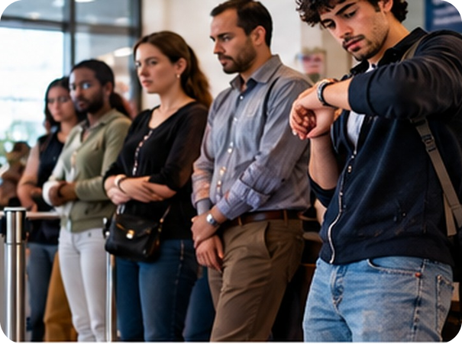
4
Who says it?
💡 THINK PENSA
⏱ 3 min 👥 pairs
Customer (C) or shop assistant (SA)?
Cliente (C) o commesso (SA)?
⭐
Example
1
Do you need any help?
SA
0 "Can I help you?" → SA
2
What size are you?
SA
3
Do you have this in blue?
C
4
Have a nice day!
SA
5
No, thanks, I'm just looking.
C
6
Can I try these on?
C
7
Shall I put your receipt in the bag?
SA
8
The changing rooms are over there.
SA
8B-1 · Reading · lead-in · 📖 SB p.80 · 1a
Notes:
4. Reading · lead-in (3 min)
LEAD-IN (3 min). Pairs decide C or SA; click once per line. Answers (TG): the book's 10 phrases – here 8 of them. Teach changing rooms (= fitting rooms). Quick question: in Bagheria, do shop assistants usually say 'Can I help you?' or leave you alone?

Slide 5

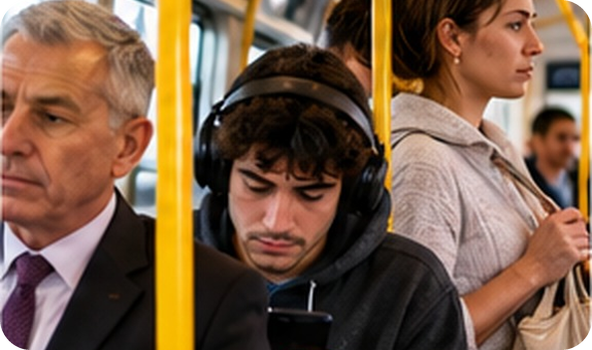
5
Too helpful? (adapted)
👀 READ LEGGI
⏱ 6 min 👤 alone
Read. Did the second assistant help Jonathan?
Leggi. Il secondo commesso ha aiutato Jonathan?
When 'happy to help' becomes a problem
Jonathan goes into a shop at King's Cross station to buy a wallet.
Assistant 1: 'Do you need any help?' Jonathan: 'I'm just looking, thanks.'
Then a second assistant arrives: 'Hello, do you need any help? … Are you going anywhere nice?'
'No. I work near here.' 'Where do you work?' … 'Do you like football?' … 'Are you going to watch the England match?'
… 'What are you doing after work?' … 'Are you doing anything for the rest of the day?'
💡
Remember
Jonathan runs away – without a wallet. 'His never-ending questions lost him the sale.'
appropriate = right for the situation
wallet = portafoglio
8B-1 · Reading · When 'happy to help' becomes a problem · 📖 SB p.80 · 1b, 1c (full article in the book)
Notes:
5. Reading · When 'happy to help' becomes a problem (6 min)
READING (5 min). The slide is a short adapted version – students can read the full article on p.80. 1b: Did the second assistant help? (TG: No – he talked too much and kept asking questions.) 1c: underline his questions – which are NOT appropriate? (TG: seven different questions, one repeated; many people think only the first is appropriate.) 'Are you going anywhere nice?' – because the shop is in a train station. 1d: are the assistants in your shops helpful or unhelpful?

Slide 6
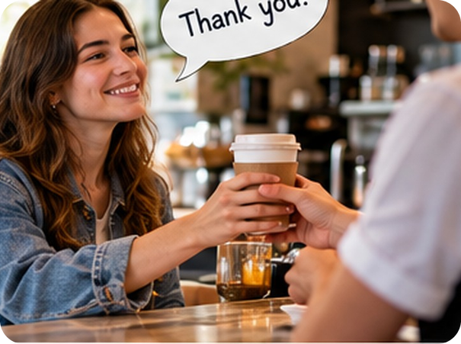
6
Rewind! What did they say?
🔍 FIND TROVA
✍️ WRITE SCRIVI
Write the REAL words he said.
⏱ 5 min 👥 pairs
Scrivi le parole ESATTE.
⭐
Example
1
He asked me where I worked.
'Where do you work?'
0 He asked me if I needed any help. → 'Do you need any help?'
2
I said I worked in an office round the corner.
'I work in an office round the corner.'
3
He asked me if I liked football.
'Do you like football?'
4
He asked me if I was going to watch the match.
'Are you going to watch the England match?'
5
He asked me what I was doing after work.
'What are you doing after work?'
6
I told him I was having dinner with a friend.
'I'm having dinner with a friend.'
8B-1 · Grammar · noticing · 📖 SB p.81 · 2a
Notes:
6. Grammar · noticing (5 min)
NOTICING (5 min). Pairs rebuild the direct speech BEFORE seeing the rule. Click once per line (TG key). Then ask: What happens to the verb when we report? (goes back: work → worked, am having → was having). And to questions? (no do, normal word order: where I worked; yes/no → if).

Slide 7
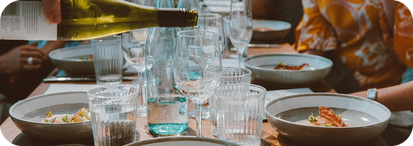
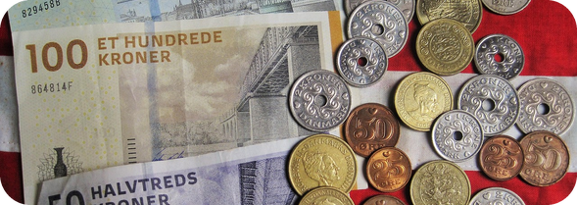

7
Reported speech
👀 LOOK GUARDA
⏱ 5 min 🙋 whole class
How does the verb change?
🎧 8.13 + 8.14
Come cambia il verbo?
⚠ Play it from the book audio
Sentences
Tense goes back
Questions
say (that) · tell + person
one step into the past
no do / did · normal word order
'I like shopping.' → She said she liked shopping.
'I've forgotten my keys.' → He told me he had forgotten his keys.
am / is → was · will → would
can → could · must → had to
past / pres. perfect → had + p.p.
'Where do you live?' → She asked me where I lived.
'Are you married?' → She asked him if he was married.
ha detto che…
tomorrow → the next day
yes/no → if / whether
⚠ ✗ He said me → ✓ He told me / He said ✗ She asked me where did I live → ✓ where I lived
8B-1 · Grammar · reported speech · 📖 Grammar Bank 8B p.147 · audio 8.13, 8.14
Notes:
7. Grammar · reported speech (5 min)
RULE (5 min). Elicit each column before clicking. Play 8.13/8.14 if available (listen and repeat). TG notes: tenses move back; mustn't stays the same; 'that' optional; tell needs a person; questions: no auxiliary, subject + verb, if/whether for yes/no. Typical mistakes: He said me… · She asked him what was his name.

Slide 8
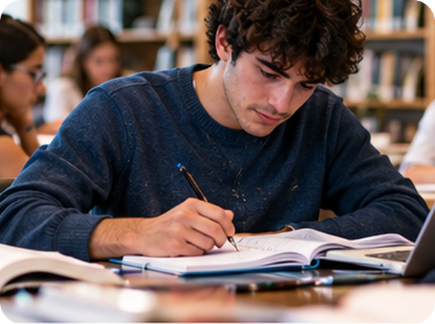
8
Report it correctly
✍️ WRITE SCRIVI
⏱ 6 min 👤 alone
Report it! Then check.
Riportalo! Poi controlla.
⭐
Example
1
'I've booked the flights.' → Emma told me she…
had booked the flights
0 'I'm selling all my books.' → Tim said he was selling all his books.
2
'Your new dress doesn't suit you.' → My mum told me…
my new dress didn't suit me
3
'I might not be able to go.' → Matt said he…
might not be able to go
4
'When are you leaving?' → My parents asked me…
when I was leaving
5
'Have you ever been married?' → She asked him…
if / whether he had ever been married
6
'Will you be home early?' → Anna asked Robert…
if / whether he would be home early
8B-1 · Grammar · practice · 📖 Grammar Bank 8B p.147 · a 2–4, b 1–3
Notes:
8. Grammar · practice (6 min)
PRACTICE (6 min). Alone, then compare. Click once per answer (TG key). Read full sentences aloud. Homework: Grammar Bank a 5–7, b 5–7.

Slide 9
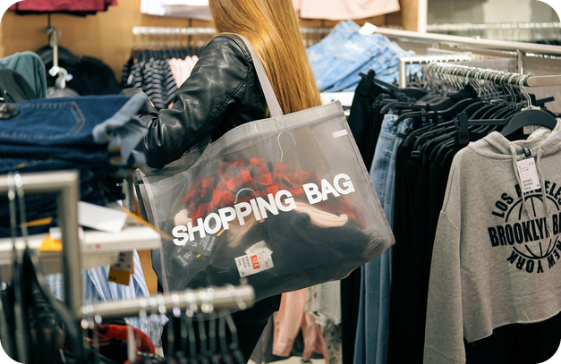
9
He asked her…
🎧 LISTEN ASCOLTA
🔊 SAY IT PRONUNCIA
Listen. Report the question before the narrator!
⏱ 4 min 🙋 whole class
Ascolta. Riporta la domanda prima del narratore!
🎧 8.15 · pause after each question
'Where do you live?'
He asked her where she lived.
⚠ Play it from the book audio
'What are you doing in the evening?'
She asked him what he was doing in the evening.
'Will you be at home at eight?'
He asked if she would be at home at eight.
'Where did you buy your bag?'
He asked her where she'd bought her bag.
'Have you seen the new Bond film?'
She asked him if he'd seen it.
💡
Guess first, then listen!
'Can I try on the jacket?'
He asked her if he could try it on.
8B-1 · Grammar · oral practice · 📖 SB p.81 · 2c · audio 8.15
Notes:
9. Grammar · oral practice (4 min)
ORAL PRACTICE (4 min). If 8.15 isn't available, READ the questions yourself; the class reports chorally, then individuals. Click once per item (audio script). Reported answers (script): she lived in the city centre · he was going to the cinema · she was going out · she'd bought it online · he'd seen it twice · the changing rooms were over there.

Slide 10
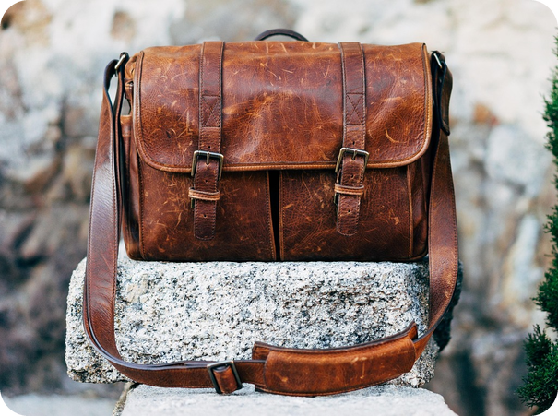
10
What's the difference?
💬 TALK PARLA
⏱ 5 min 👥 pairs
Explain the difference to your partner.
Spiega la differenza al compagno.
⭐
Example
1
credit card / debit card
pay later / the money goes immediately
0 basket / trolley → small, you carry it / big, on wheels
2
receipt / refund
paper that proves you paid / money back
3
discount / bargain
money off the price / a very cheap thing
4
chain store / department store
one of many similar shops / big shop, many sections
5
library / bookshop
borrow books / buy books
6
put on / try on
get dressed / put on before you buy
7
It fits you / It suits you
right size / looks good on you
8B-1 · Vocabulary · shopping · 📖 SB p.81 · 3a
Notes:
10. Vocabulary · shopping (5 min)
VOCABULARY (5 min). Elicit first: pairs explain each pair, then click once per line (TG). False friends for Italians: library ≠ libreria (= bookshop!), discount, fit vs suit.

Slide 11
11
Shopping words in Italian
✅ CHECK CONTROLLA
⏱ 2 min 🙋 whole class
Say it in Italian. Then click!
Dillo in italiano. Poi clicca!
🧾
receipt
💶
refund
🏷️
discount
🤑
bargain
scontrino / ricevuta
rimborso
sconto
affare
🛒
trolley
🧺
basket
📚
library
📖
bookshop
carrello
cestino
biblioteca
libreria
👗
changing room
🏬
department store
👔
It suits you
📏
It fits
camerino
grande magazzino
ti sta bene
è della taglia giusta
⚠ Watch out! library = biblioteca (NOT libreria!) · He told me / He said (✗ said me)
8B-1 · Vocabulary · in Italian
Notes:
11. Vocabulary · in Italian (2 min)
CONSOLIDATION (2 min). Class says the Italian, one click shows all.

Slide 12
12
Report it!
🎲 PLAY GIOCA
⏱ 9 min 👥 pairs
Ask your partner. Then report to a new partner!
Chiedi al compagno. Poi riferisci a un altro!
🎲
How to play
1
Where do you usually buy clothes?
→ She asked me where I usually bought clothes.
Ask your partner 3 questions.
Change partners. Report: "Luca asked me if… I told him…"
Correct reported sentence = 1 point.
Do you enjoy shopping?
→ He asked me if I enjoyed shopping.
2
3
What's your favourite shop?
→ She asked me what my favourite shop was.
4
Have you ever returned something?
→ He asked me if I had ever returned something.
5
Do you prefer online or in shops?
→ She asked me if I preferred buying online.
TEAM A ☆☆☆☆☆
TEAM B ☆☆☆☆☆
6
What did you buy last week?
→ He asked me what I had bought the week before.
8B-1 · Speaking game · reported speech · 📖 SB p.81 · 3b questionnaire
Notes:
12. Speaking game · reported speech (9 min)
FREER PRACTICE + GAME (8 min). Model first: a student asks YOU two questions, then report: 'Luca asked me if I liked shopping. I told him I hated it!' Pairs ask 3 questions each (3 min), change partners and report (3 min). Click to show the model reported question. Listener gives a point for each correct reported sentence (tense back, said/told, question word order). Monitor for 'said me', 'asked me where did you buy', missing if.

Slide 13
13
3 · 2 · 1
⏱ 2 min 👥 pairs
Books closed! What can you remember?
Libri chiusi! Cosa ricordi?
3
shopping words (receipt…)
📝
Homework · Compiti
Workbook 8B: 1a, 1b, 1c, 2a
Grammar Bank 8B: a 5–7, b 5–7
Homework sheet in the LLS app
2
things your partner told you – reported!
1
rule: how do reported questions change?
Next lesson: 8B part 2 · Going the extra mile · complaining
8B-1 · Exit · what can you remember?
Notes:
13. Exit · what can you remember? (2 min)
RETRIEVAL EXIT (2 min). Books closed. Set homework.

