Slide 1


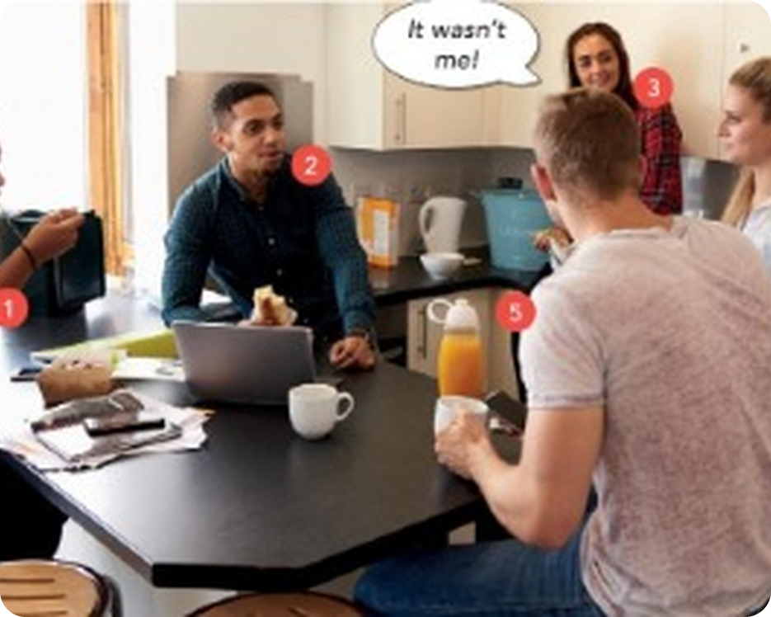


English File Upper-intermediate · SB pp.66–67
💡 THINK · PENSA
7A-1
Let's not argue
Past modals: must have, might have, can't have, should have
🎯
Today you're going to…
🕵️ make deductions about the past: must have, can't have…
🙈 criticise: you should have…
🔊 say the weak form of have
🏠 read about student house arguments
🎲 play Guess my verb
'Don't raise your voice, improve your argument.' (Desmond Tutu) – What does it mean? Do you agree?
EXAMPLE It means shouting doesn't help – a good reason is stronger than a loud voice.
Notes:
1. OPENING (2 min)
OPENING (2 min). TG lead-in: the quote on p.66. Desmond Tutu = South African archbishop and human rights activist. Elicit the meaning; take 2–3 opinions.

Slide 2

2
Remember Files 5 & 6?
💡 THINK → 💬 TALK
⏱ 3 min 👥 pairs
🎯 Revision · Retrieval
Can you remember? Say it – then use it in a sentence!
Ti ricordi? Dillo – poi usalo in una frase!
🔤 Can you remember these words? What do they mean?
get used to
insomnia
oversleep
uplifting
soothing
regret
hum
I wish
⭐ What does it mean?
⭐⭐ Use it in a sentence.
⭐⭐⭐ Make it negative or a question!
📅
Last lesson…
Revise and Check 5 & 6
conditionals · used to · -ing / to · sleep · music
7A-1 · Revision · last lesson
Notes:
2. Revision · last lesson (3 min)
ACTIVE RECAP (3 min). ⭐ meaning ⭐⭐ sentence ⭐⭐⭐ negative or question ('Have you got used to getting up early?'). Ask 2 pairs for their best sentence.
HOW TO RUN IT (active recap): pairs. Words: A points at a word, B says what it means (⭐); then a sentence with it (⭐⭐); strong students make it negative or a question (⭐⭐⭐). Grammar: pairs make their own example for each use (offer, plan…) BEFORE you click – then click to show the model answers.

Slide 3
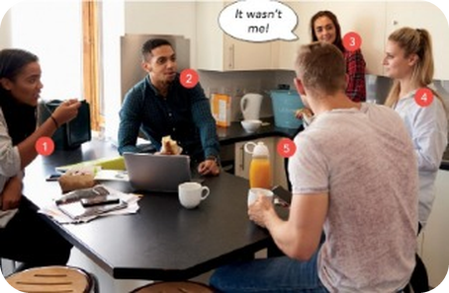
3
It wasn't me!
👀 LOOK → 💬 TALK
⏱ 3 min 👥 pairs
🎯 Grammar · Communicative
Who are they? Where are they? What are they arguing about? Use can't be, must be, could be.
Chi sono? Dove sono? Di cosa discutono? Usa can't be, must be, could be.
1
Who are they?
e.g. They can't be a family, because they're all the same age. They must be friends or flatmates.
2
Where are they?
e.g. They must be in a kitchen – maybe a shared house.
3
What are they arguing about?
e.g. It could be about food… or the washing-up!
💬
Useful phrases
4
Who said 'It wasn't me!'?
e.g. Number 3 – she looks very innocent!
They can't be a family, because…
Number 2 might be…
7A-1 · Grammar · present deduction (warm-up) · 📖 SB p.66 · 1a
Notes:
3. Grammar · present deduction (warm-up) (3 min)
PREDICT (3 min). SB 1a. Don't say if they're right – the next slide checks it. Present modals of deduction should be revision (Intermediate).

Slide 4


4
Where's my milk?
🎧 LISTEN → ✅ CHECK
⏱ 4 min 👥 pairs
🎯 Listening · for detail
Listen. Who are they? Who is 'guilty'?
Ascolta. Chi sono? Chi è il 'colpevole'?
🎧 7.1 · play once
Who are they?
flatmates
Where are they?
in the kitchen of their shared house
What's the argument about?
one girl's milk – someone used it
Who is guilty?
Jack (man 2) – he used it in his coffee
💡
Listen for: who, where, what – and who did it!
▶ normal
🐢 slower
7A-1 · Listening · the missing milk · 📖 SB p.66 · 1b · audio 7.1 (script SB p.127)
Notes:
4. Listening · the missing milk (4 min)
LISTENING (4 min). Play 7.1 once. Key (TG): flatmates in the kitchen of their shared house; one girl is accusing the others of using her milk; Jack used it in his white coffee. Script: SB p.127 / TG p.101.

Slide 5

5
What did they say?
🎧 LISTEN → ✏️ FILL THE GAPS
⏱ 4 min 👤 alone
🎯 Grammar · TPRS · reading
Listen again. Complete the extracts with could, might, must, can't or should + have.
Ascolta di nuovo. Completa con could, might, must, can't o should + have.
From the conversation
🎧 7.2
1 You (1) ________ finished it.
1 You must have finished it.
2 One of you (2) ________ used it.
2 One of you must have used it.
3 It (3) ________ been me.
3 It can't have been me.
4 (4) ________ you (5) ________ drunk it last night…?
4 Could you have drunk it last night…?
5 Someone (6) ________ given it to the cat.
5 Someone might have given it to the cat.
💡
Remember
6 …you (7) ________ put your name on it.
6 …you should have put your name on it.
modal + have + past participle
have = /əv/ (weak)
▶ normal
🐢 slower
7A-1 · Grammar · noticing · 📖 SB p.66 · 1c · audio 7.2 (TG key)
Notes:
5. Grammar · noticing (4 min)
EXTRACTS (4 min). Play 7.2, pausing after each extract. One click per gap. Key (TG): 1 must have 2 must have 3 can't have 4 Could…have 5 might have 6 should have.

Slide 6
6
What does it mean?
💡 THINK → 🔗 MATCH
⏱ 3 min 👥 pairs
🎯 Grammar · Controlled practice
Which phrase means you think…? Match 1–6 to A–D.
Quale frase significa…? Abbina 1–6 a A–D.
⭐
Example
1
A it's very probable that something happened
must have (1, 2)
A = 1, 2 → must have (you're almost sure)
2
B it's possible that something happened
might / could have (4, 5)
3
C it's impossible that something happened
can't have (3)
4
D somebody didn't do the right thing
should have (6)
7A-1 · Grammar · meaning · 📖 SB p.66 · 1d (TG key)
Notes:
6. Grammar · meaning (3 min)
MEANING (3 min). SB 1d – A is done as the example (from the book). Key (TG): A 1, 2 · B 4, 5 · C 3 · D 6.

Slide 7
7
Sure, maybe, impossible, wrong?
👀 LOOK → 🔊 SAY IT
⏱ 5 min 🙋 whole class
🎯 Grammar · Communicative
Read the situation. Make the deduction – then click!
Leggi la situazione. Fai la deduzione – poi clicca!
I can't find my phone. I definitely remember having it at Anna's.
almost sure ✓
must have
I must have left my phone at Anna's.
You were there when the accident happened.
almost sure ✓
must have
You must have seen something.
My wallet isn't in my bag.
possible ?
might / could have
Somebody might have stolen your wallet on the train.
He still hasn't arrived.
possible ?
may not have
He may not have been given the right directions.
Her car's still there.
impossible ✗
can't have
She can't have gone to work.
It was too dark.
impossible ✗
couldn't have
You couldn't have seen their faces very clearly.
We've gone the wrong way.
criticism
should have
We should have turned left at the traffic lights.
It's my fault.
criticism
ought to have
I ought to have told you earlier that my party was on Saturday.
7A-1 · Grammar Bank 7A · past modals · 📖 Grammar Bank 7A p.144 · audio 7.3, 7.4
Notes:
7. Grammar Bank 7A · past modals (5 min)
GRAMMAR BANK CHART (5 min). The Grammar Bank 7A examples as a chart. Read the situation, students say the sentence, then click: meaning + modal + sentence. Play 7.3 (and 7.4) for listen and repeat. TG notes: ✗ mustn't have does not exist → can't have · may / might / could have are the same · couldn't have ≠ might not have · should have / ought to have = criticism or regret.

Slide 8
8
Grammar Bank practice
✍️ WRITE → ✅ CHECK
⏱ 5 min 👤 alone
🎯 Grammar · TPRS · reading
Grammar Bank 7A a: rewrite the bold sentences with must / might (not) / can't + have.
Grammar Bank 7A a: riscrivi le frasi in grassetto.
Rewrite the sentence
e.g. I'm certain I left my umbrella at home. → I must have left my umbrella at home.
1 Holly's crying. Perhaps she's had an argument with her boyfriend. → She (1) ________ .
1 Holly's crying. Perhaps she's had an argument with her boyfriend. → She might have had an argument with her boyfriend.
2 I'm sure Ben has read my email. → Ben (2) ________ .
2 I'm sure Ben has read my email. → Ben must have read my email.
3 I'm sure Sam and Ginny haven't got lost. → They (3) ________ .
3 I'm sure Sam and Ginny haven't got lost. → They can't have got lost.
4 You saw Ellie yesterday? That's impossible. → You (4) ________ .
4 You saw Ellie yesterday? That's impossible. → You can't have seen Ellie yesterday.
5 Perhaps John didn't see you. → John (5) ________ .
5 Perhaps John didn't see you. → John might not have seen you.
6 I'm sure Lucy has bought a new car. → Lucy (6) ________ .
6 I'm sure Lucy has bought a new car. → Lucy must have bought a new car.
7 I'm sure Alex wasn't very ill. → Alex (7) ________ .
7 I'm sure Alex wasn't very ill. → Alex can't have been very ill.
💡
Remember
8 Maybe they weren't invited. → They (8) ________ .
8 Maybe they weren't invited. → They might not have been invited.
9 I'm sure you used too much sugar. → You (9) ________ .
9 I'm sure you used too much sugar. → You must have used too much sugar.
sure ✓ → must have
impossible → can't have
10 It definitely wasn't my phone. → It (10) ________ .
10 It definitely wasn't my phone. → It can't have been my phone.
7A-1 · Grammar Bank 7A p.144 · a · 📖 Grammar Bank 7A p.144 · a (TG key)
Notes:
8. Grammar Bank 7A p.144 · a (5 min)
GRAMMAR BANK a (5 min). The book's sentences shortened to the bold part (context in the GB). Alone, then click once per answer (TG key).

Slide 9

9
Must, might, can't or should?
🎲 PLAY · GIOCA
⏱ 4 min 🏆 teams
🎯 Grammar · Communicative game
Teams: choose the correct option. Say WHY!
Squadre: scegliete l'opzione giusta. Dite PERCHÉ!
🎲
How to play
e.g.
He's not answering. He must / can't have gone to bed.
→ must (almost sure)
Read the sentence. Choose A or B.
Correct = 1 point.
Say the meaning (sure / maybe / impossible / criticism) = 1 more point!
1
She can't / mustn't have seen me – I was in bed all day.
→ can't (✗ mustn't have)
2
You should / must have told me it was your birthday!
→ should (criticism)
3
I don't know where Tom is. He might / must have missed the bus.
→ might (possible)
4
They can't / should have got lost – they've got satnav.
→ can't (impossible)
TEAM A ☆☆☆☆☆
TEAM B ☆☆☆☆☆
5
You shouldn't / can't have driven here – you'd had a glass of wine.
→ shouldn't (criticism)
6
The lights are off. They must / should have gone out.
→ must (almost sure)
7A-1 · Grammar · choose the right option · 📖 Grammar Bank 7A rules 1–3 + should have (TG grammar notes)
Notes:
9. Grammar · choose the right option (4 min)
CHOOSE (4 min). The first is the example. Item 2 is the TG's typical mistake (mustn't have doesn't exist). Extra point for the meaning.

Slide 10
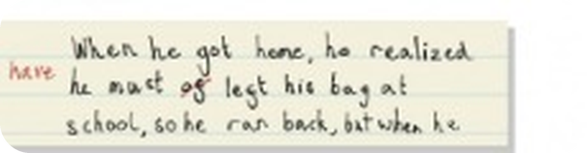
10
Have or of?
🎧 LISTEN → ✍️ WRITE
⏱ 4 min 👤 alone
🎯 Pronunciation · Controlled practice
Listen and write the sentences. Have or of?
Ascolta e scrivi le frasi. Have o of?
⭐
Example
1
1
Where have you been all morning?
He must of left his bag at school. ✗ → He must HAVE left… ✓ (have = /əv/, sounds like of!)
2
2
I woke up in the middle of the night.
3
3
Of course I'll be there on time!
4
4
We can't have gone the wrong way!
5
5
I'll have finished in about ten minutes.
6
6
What's the point of arguing?
🎧 7.6
▶ normal
🐢 slower
7A-1 · Pronunciation · weak form of have · 📖 SB p.66 · 2a, 2c · audio 7.5, 7.6 (TG script)
Notes:
10. Pronunciation · weak form of have (4 min)
WEAK FORM (4 min). 2a: the child wrote 'must of' because weak have /əv/ sounds like of. 2b: play 7.5 (repeat): He must have left his bag at school. · You must have known it would happen. · It can't have been a very good concert. · Could you have left it on the bus? · There might have been some witnesses. · You should have phoned me. 2c: play 7.6, students write; click to check. Stress the modal and the participle, never have.

Slide 11
11
You should have told me!
✍️ WRITE → 💬 TALK
⏱ 4 min 👥 pairs
🎯 Speaking · Communicative
Complete B's answers with your own ideas. Then practise – weak have!
Completa le risposte di B con idee tue. Poi esercitati – have debole!
💬
Useful phrases
1
A It was my birthday yesterday! B You should have told me.
e.g. (the book's example)
You must have…
They may have…
You shouldn't have…
He might have…
We should have…
2
A I can't find my phone anywhere. B You must have…
e.g. left it at work
3
A I definitely said we were meeting them at 7.00. B They may have…
e.g. forgotten
4
A I'm so tired. I can't keep my eyes open. B You shouldn't have…
e.g. gone to bed so late last night
5
A I failed my piano exam. B … · A Why do you think Fiona and Brian broke up? B …
e.g. You should have practised more. · One of them might have met someone else.
6
A Alberto didn't come to class yesterday. B … · A We're going to be late. There's so much traffic. B …
e.g. He might have been ill. · We should have left earlier.
7A-1 · Speaking · past modals · 📖 SB p.66 · 2d (TG possible answers)
Notes:
11. Speaking · past modals (4 min)
CONVERSATIONS (4 min). SB 2d. The e.g. lines are the TG's possible answers – accept anything correct and logical. Pairs read them aloud: stress the modal and the participle, weak have.

Slide 12
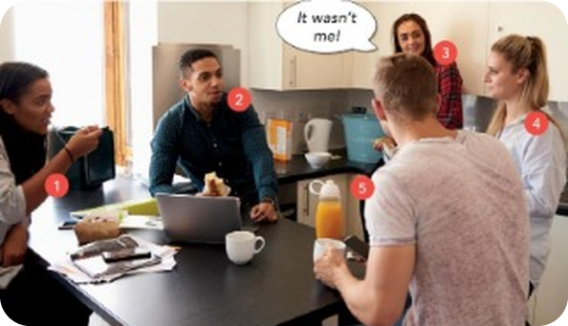
12
Solutions A–H
👀 READ · LEGGI
⏱ 2 min 👥 pairs
🎯 Reading · TPRS · reading
First read solutions A–H. Then read the article and match them.
Prima leggi le soluzioni A–H. Poi leggi l'articolo e abbinale.
Solutions A–H (SB p.67 · 3c)
A Don't pay in your share, either, and wait until the wi-fi gets cut off. Then suddenly, everyone will pay.
B Before you move in, get everyone to write their name on a piece of paper, and put them in a hat. The first person to be picked chooses first.
C Encourage everyone to have a go. Don't criticize other people's attempts. Try to help them improve.
D Get some ear plugs. Wax ones are the best.
E Have a rota for all jobs, including washing-up, drying, cleaning, and tidying.
F If you often need to get ready at similar times, take turns to go first.
💡
Remember
G Make sure everyone has their own fridge shelf space and cupboard space.
H Suggest that if they are going to stay over often, then maybe they should contribute to rent / bills.
ear plugs = tappi per le orecchie
rota = turni
7A-1 · Reading · Classic student house arguments · 📖 SB p.67 · 3a, 3c
Notes:
12. Reading · Classic student house arguments (2 min)
SOLUTIONS (2 min). 3a first (30 sec): rank food, housework, money, noise, visitors 1–5 – which causes most arguments? Then students read solutions A–H (exactly as in the book). On the next slides the article is in full, with short cues for A–H.

Slide 13
13
Student house arguments (1)
👀 READ → 🔗 MATCH
⏱ 3 min 👥 pairs
🎯 Reading · for detail
Read problems 1–3. Which solution A–H goes with each one?
Leggi i problemi 1–3. Quale soluzione A–H va con ognuno?
Solutions A–H (cues)
Classic student house arguments – and how to avoid them
Living in a shared student house can be one of university's greatest pleasures, but arguments will happen. What are the solutions?
Who gets the biggest room when moving in? There's always one housemate who is convinced they have the right to the biggest room. Solutions: • Adjust the rent, so that the person with the biggest room pays more. • (1) B
The mess in the kitchen You come home from a long day at uni and can't get to the sink because of the enormous pile of pots and pans. Solutions: • Establish the 30-minute rule – nothing stays unwashed for over 30 minutes. • (2) ________
The housemate whose boyfriend / girlfriend spends more time in your house than their own They definitely do not live at your house, but you see them more than some of your housemates. And they use the electricity, the water, the wi-fi… Solutions: • Explain why it's annoying. It isn't personal, but with them there, there's less space for the rest of you. • (3) ________
Classic student house arguments – and how to avoid them
Living in a shared student house can be one of university's greatest pleasures, but arguments will happen. What are the solutions?
Who gets the biggest room when moving in? There's always one housemate who is convinced they have the right to the biggest room. Solutions: • Adjust the rent, so that the person with the biggest room pays more. • (1) B
The mess in the kitchen You come home from a long day at uni and can't get to the sink because of the enormous pile of pots and pans. Solutions: • Establish the 30-minute rule – nothing stays unwashed for over 30 minutes. • (2) E
The housemate whose boyfriend / girlfriend spends more time in your house than their own They definitely do not live at your house, but you see them more than some of your housemates. And they use the electricity, the water, the wi-fi… Solutions: • Explain why it's annoying. It isn't personal, but with them there, there's less space for the rest of you. • (3) ________
Classic student house arguments – and how to avoid them
Living in a shared student house can be one of university's greatest pleasures, but arguments will happen. What are the solutions?
Who gets the biggest room when moving in? There's always one housemate who is convinced they have the right to the biggest room. Solutions: • Adjust the rent, so that the person with the biggest room pays more. • (1) B
The mess in the kitchen You come home from a long day at uni and can't get to the sink because of the enormous pile of pots and pans. Solutions: • Establish the 30-minute rule – nothing stays unwashed for over 30 minutes. • (2) E
The housemate whose boyfriend / girlfriend spends more time in your house than their own They definitely do not live at your house, but you see them more than some of your housemates. And they use the electricity, the water, the wi-fi… Solutions: • Explain why it's annoying. It isn't personal, but with them there, there's less space for the rest of you. • (3) H
A
don't pay your share either
B
names in a hat
C
everyone has a go
D
ear plugs
E
a rota for all jobs
F
take turns to go first
G
own fridge shelf
H
contribute to rent / bills
7A-1 · Reading · Classic student house arguments (1) · 📖 SB p.67 · 3a, 3b, 3c (the article is on the slide · TG key)
Notes:
13. Reading · Classic student house arguments (1) (3 min)
READING 1 (5 min). 3a first (30 sec): rank food, housework, money, noise, visitors 1–5. 3b: which two categories are not in the list? (who gets the biggest room, taking too long in the bathroom – TG). 3c: problem 1 is the example (B). Click once per gap. Key (TG): 1 B 2 E 3 H 4 A. Glossary: direct debit 'bounced' = the bill wasn't paid because there wasn't enough money in the account.

Slide 14
14
Student house arguments (2)
👀 READ → 🔗 MATCH
⏱ 4 min 👥 pairs
🎯 Reading · for detail
Read problems 4–6. Which solution A–H goes with each one?
Leggi i problemi 4–6. Quale soluzione A–H va con ognuno?
Solutions A–H (cues)
Classic student house arguments (2)
How to pay and split the bills The joint account seemed like a good idea until some people's money stopped going in, and the direct debit 'bounced' (incurring a charge), and the electricity bill, which was enormous, was forgotten about (another charge), and someone has gone to South America for three months. Solutions: • Get everyone to put in more money than will be needed in the account – then later pay the excess back (this is a good way of keeping a little extra cash in reserve, too). • (4) ________
Taking too long in the bathroom What are they doing in there? Solutions: • Have a kind word about the fact that there's only one bathroom. • (5) ________
When they come in at 3 a.m., waking everybody up the night before an exam. Solutions: • Make sure your housemates know if you have to be up early for something. Likewise, let them know if you intend to be back late. • (6) ________
Classic student house arguments (2)
How to pay and split the bills The joint account seemed like a good idea until some people's money stopped going in, and the direct debit 'bounced' (incurring a charge), and the electricity bill, which was enormous, was forgotten about (another charge), and someone has gone to South America for three months. Solutions: • Get everyone to put in more money than will be needed in the account – then later pay the excess back (this is a good way of keeping a little extra cash in reserve, too). • (4) A
Taking too long in the bathroom What are they doing in there? Solutions: • Have a kind word about the fact that there's only one bathroom. • (5) ________
When they come in at 3 a.m., waking everybody up the night before an exam. Solutions: • Make sure your housemates know if you have to be up early for something. Likewise, let them know if you intend to be back late. • (6) ________
Classic student house arguments (2)
How to pay and split the bills The joint account seemed like a good idea until some people's money stopped going in, and the direct debit 'bounced' (incurring a charge), and the electricity bill, which was enormous, was forgotten about (another charge), and someone has gone to South America for three months. Solutions: • Get everyone to put in more money than will be needed in the account – then later pay the excess back (this is a good way of keeping a little extra cash in reserve, too). • (4) A
Taking too long in the bathroom What are they doing in there? Solutions: • Have a kind word about the fact that there's only one bathroom. • (5) F
When they come in at 3 a.m., waking everybody up the night before an exam. Solutions: • Make sure your housemates know if you have to be up early for something. Likewise, let them know if you intend to be back late. • (6) ________
Classic student house arguments (2)
How to pay and split the bills The joint account seemed like a good idea until some people's money stopped going in, and the direct debit 'bounced' (incurring a charge), and the electricity bill, which was enormous, was forgotten about (another charge), and someone has gone to South America for three months. Solutions: • Get everyone to put in more money than will be needed in the account – then later pay the excess back (this is a good way of keeping a little extra cash in reserve, too). • (4) A
Taking too long in the bathroom What are they doing in there? Solutions: • Have a kind word about the fact that there's only one bathroom. • (5) F
When they come in at 3 a.m., waking everybody up the night before an exam. Solutions: • Make sure your housemates know if you have to be up early for something. Likewise, let them know if you intend to be back late. • (6) D
A
don't pay your share either
B
names in a hat
C
everyone has a go
D
ear plugs
E
a rota for all jobs
F
take turns to go first
G
own fridge shelf
H
contribute to rent / bills
7A-1 · Reading · Classic student house arguments (2) · 📖 SB p.67 · 3c (TG key)
Notes:
14. Reading · Classic student house arguments (2) (4 min)
READING 2 (4 min). Key (TG): 4 A 5 F 6 D. Glossary: direct debit 'bounced' = the bill wasn't paid because there wasn't enough money in the account.

Slide 15
15
Student house arguments (3)
👀 READ → 🔗 MATCH
⏱ 2 min 👥 pairs
🎯 Reading · for detail
Read problems 7–8. Which solution goes with each one?
Leggi i problemi 7–8. Quale soluzione va con ognuno?
Solutions A–H (cues)
Classic student house arguments (3)
Food stealing, 'borrowing' clothes, etc. 'It was just there, so I took it.' Solutions: • Label your stuff, so that it's obvious what's yours. • (7) ________
Who can't cook, who won't cook? Why is it always you who's left alone to make dinner in the evening? How come as soon as you've finished, everyone suddenly appears? Solutions: • Draw up a cooking rota, so you know whose turn it is. • (8) ________
Classic student house arguments (3)
Food stealing, 'borrowing' clothes, etc. 'It was just there, so I took it.' Solutions: • Label your stuff, so that it's obvious what's yours. • (7) G
Who can't cook, who won't cook? Why is it always you who's left alone to make dinner in the evening? How come as soon as you've finished, everyone suddenly appears? Solutions: • Draw up a cooking rota, so you know whose turn it is. • (8) ________
Classic student house arguments (3)
Food stealing, 'borrowing' clothes, etc. 'It was just there, so I took it.' Solutions: • Label your stuff, so that it's obvious what's yours. • (7) G
Who can't cook, who won't cook? Why is it always you who's left alone to make dinner in the evening? How come as soon as you've finished, everyone suddenly appears? Solutions: • Draw up a cooking rota, so you know whose turn it is. • (8) C
A
don't pay your share either
B
names in a hat
C
everyone has a go
D
ear plugs
E
a rota for all jobs
F
take turns to go first
G
own fridge shelf
H
contribute to rent / bills
7A-1 · Reading · Classic student house arguments (3) · 📖 SB p.67 · 3c (TG key)
Notes:
15. Reading · Classic student house arguments (3) (2 min)
READING 3 (2 min). Key (TG): 7 G 8 C. Teach ear plugs, wax, rota (TG).

Slide 16
16
Which solution is better?
💬 TALK · PARLA
⏱ 3 min 👥 pairs
🎯 Speaking · Communicative
Talk to a partner. Then judge your flatmates – use past modals!
Parla con un compagno. Poi giudica i coinquilini – usa i past modals!
💬
Useful phrases
1
Look at the two solutions to each problem. Which one do you think is better? Can you suggest any other solutions?
e.g. I prefer the hat – it's fairer than paying more rent.
I think the second solution is better because…
They should have…
He must have…
The most annoying is…
Once, my brother…
2
Which problem would you find the most annoying? Have you ever had to deal with any of these problems yourself? What did you do?
e.g. Food stealing! My brother always eats my yoghurts.
3
Back to the milk: what should Jack have done? What should the girl have done?
e.g. He should have asked! She should have hidden it.
7A-1 · Speaking · the solutions · 📖 SB p.67 · 3d
Notes:
16. Speaking · the solutions (3 min)
SPEAKING (4 min). SB 3d 1–2 (+ line 3 to recycle the grammar). TG: quick show of hands for the better solution to each problem.

Slide 17
17
Guess my verb
🎲 PLAY → 💬 TALK
⏱ 4 min 👥 pairs
🎯 Speaking · Communicative game
Guess my verb! Read the sentence. Your partner guesses the ending – 3 tries.
Indovina il mio verbo! Leggi la frase. Il compagno indovina la fine – 3 tentativi.
🎲
How to play
e.g.
Greg's really late. He may have…
→ got lost
Your partner says an ending with a past participle.
Same as the card = 'That's right!' Not the same = 'Try again' (3 tries).
1
You can't have finished that book. You only started it yesterday and it's got over 600 pages!
→ (can't have) finished that book
2
Maria looks so tired. She can't have…
→ slept very well last night
3
Ellie usually rings me on my birthday, but this year she didn't. She must have…
→ forgotten
4
My neighbour's just bought a really expensive new car. She might have…
→ won the lottery!
5
Have you seen Kathy's huge engagement ring? It must have…
→ cost a fortune!
6
I've got a stomach ache. I shouldn't have…
→ eaten so much
7A-1 · Game · Guess my verb (Communicative 7A) · 📖 Photocopiable Communicative 7A 'Guess my verb' (TG p.205)
Notes:
17. Game · Guess my verb (Communicative 7A) (4 min)
GUESS MY VERB (5 min). Endings exactly as on the photocopiable (the answers are printed on the partner's sheet). Model the first with a strong student. Print the PCM (TG p.205) for the full 12 sentences in A/B pairs.

Slide 18
18
3 · 2 · 1
⏱ 2 min 👥 pairs
🎯 Revision · Retrieval
Books closed! Tell your partner…
Libri chiusi! Di' al compagno…
3
Tell me 3 sentences: one with must have, one with might have, one with can't have.
📝
Homework · Compiti
Workbook 7A pp.46–47: 1a–1d, 2a
Grammar Bank 7A p.144: exercise b
2
Tell me 2 things you should have done last week (but didn't!).
Next lesson: 7A part 2 – how to argue better · would rather (SB p.68)
1
Tell me 1 house rule that would stop arguments in your home.
7A-1 · Exit · what can you remember?
Notes:
18. Exit · what can you remember? (2 min)
EXIT (2 min). Pairs, books closed. Homework is in the students' app.

Slide 19
19
Today you…
💡 THINK · PENSA
⏱ 1 min 🙋 whole class
🎯 Revision · Reflection
Can you do it now? Thumbs up or thumbs down!
Ora sai farlo? Pollice su o pollice giù!
🕵️
Made deductions about the past: must have, can't have…
✅
👍 👌 👎
Can you do it now?
Ora sai farlo?
🙈
Practised criticise: you should have…
✅
🔊
Said the weak form of have
✅
🏠
Read about student house arguments
✅
🎲
Played Guess my verb
✅
7A-1 · Review · what did you do today?
Notes:
19. Review · what did you do today? (1 min)
TODAY YOU… (1 min). Read each line (one per click: the tick appears). Students show thumbs up / middle / down: can they do it now? Note any thumbs down for the next lesson's recap.

Slide 20
⭐
Optional extensions
Only if there's time – the lesson is finished. · Solo se c'è tempo – la lezione è finita.
Notes:
20. OPTIONAL EXTENSIONS
The lesson ended on the previous slide ("Today you…"). Use the next slides only if there is time left, or keep them for a quick start next lesson.

Slide 21
21
You should have…
✍️ WRITE → ✅ CHECK
⏱ 4 min 👤 alone
🎯 Grammar · TPRS · reading
Grammar Bank 7A b: answer with should / shouldn't have + a verb.
Grammar Bank 7A b: rispondi con should / shouldn't have + verbo.
buy · drive · go · invite · learn · sit · take · write
e.g. A We couldn't understand anybody in Paris. B You should have learned some French before going.
1 Tom told me the date of his party, but I've forgotten it. → You (1) ________ it down.
1 Tom told me the date of his party, but I've forgotten it. → You should have / ought to have written it down.
2 Sorry I'm late! The traffic was terrible. → You (2) ________ here. The metro is faster.
2 Sorry I'm late! The traffic was terrible. → You shouldn't have / oughtn't to have driven here. The metro is faster.
3 Amanda was rude to everyone at my party. → You (3) ________ her.
3 Amanda was rude to everyone at my party. → You shouldn't have / oughtn't to have invited her.
4 I don't have any money left after going shopping. → You (4) ________ so many shoes.
4 I don't have any money left after going shopping. → You shouldn't have / oughtn't to have bought so many shoes.
5 You look really tired. → I know. I (5) ________ to bed earlier last night.
5 You look really tired. → I know. I should have / ought to have gone to bed earlier last night.
6 The chicken's still frozen solid. → I know. You (6) ________ it out of the freezer earlier.
💡
Remember
6 The chicken's still frozen solid. → I know. You should have / ought to have taken it out of the freezer earlier.
7 I think I've burned my face. → I'm not surprised. You (7) ________ in the sun all afternoon without any sunscreen.
7 I think I've burned my face. → I'm not surprised. You shouldn't have / oughtn't to have sat in the sun all afternoon without any sunscreen.
should have = criticism / regret
ought to have = the same
⭐ OPTIONAL EXTENSION · only if there's time
7A-1 · Grammar Bank 7A p.144 · b · 📖 Grammar Bank 7A p.144 · b (TG key)
Notes:
21. Grammar Bank 7A p.144 · b (4 min)
EXTRA (4 min) – or homework. Key (TG p.102).

