Slide 1


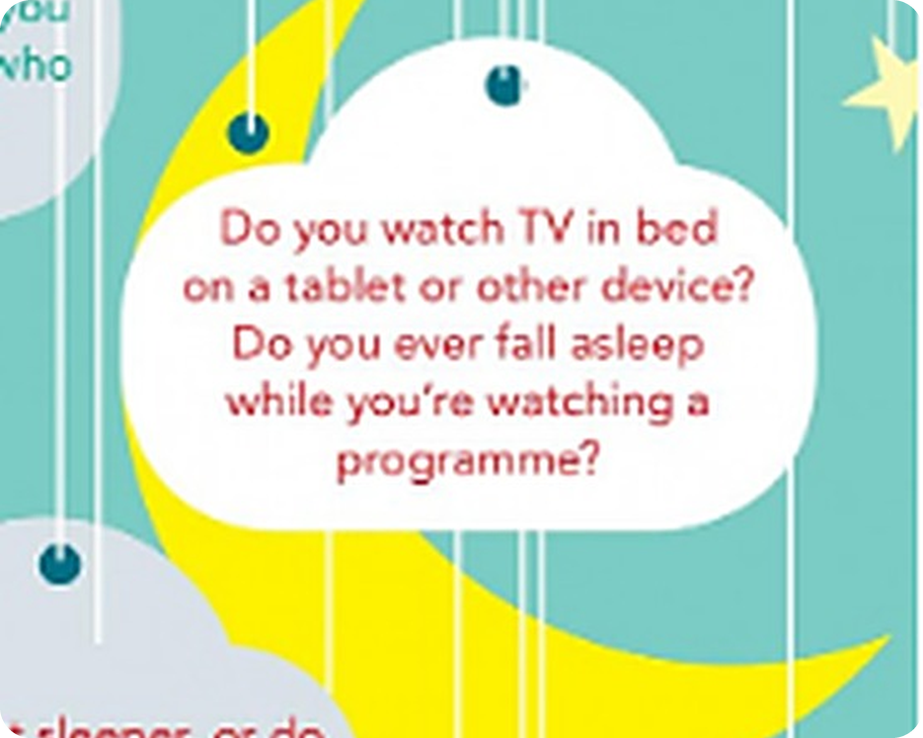


English File Upper-intermediate · SB pp.58–59
💡 THINK · PENSA
6A-2
Night night
Sleep habits and a sleep expert
🎯
Today you're going to…
😴 learn precise sleep expressions (fast asleep, oversleep…)
🎧 listen to a sleep expert's bedtime routine
🗣️ find out how well you know your partner's sleep habits
📝 B2 First practice: sleep collocations
Are you a night owl or an early bird?
EXAMPLE Definitely a night owl – I'm wide awake at midnight and useless at 8 a.m.!
Notes:
1. OPENING (2 min)
OPENING (2 min). night owl = person who stays up late; early bird = gets up early. Hands up for each; 2–3 students give a reason. Click: example.

Slide 2

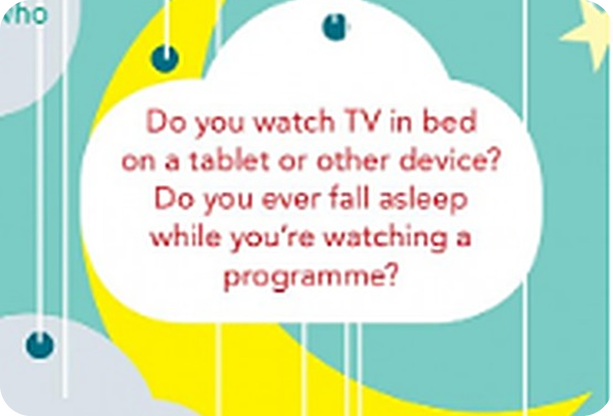
2
Remember last lesson?
💡 THINK PENSA
⏱ 3 min 👥 pairs
Tell your partner 1 true sentence for each colour.
Leggi gli esempi. Poi di' al compagno una frase vera per ogni colore.
used to + verb (past habit)
be / get used to + -ing (new = normal)
I used to sleep with a teddy bear.
I didn't use to have a phone in bed.
My dad would read me a story.
I'm used to getting up at 6.
I'm still getting used to my new timetable.
→ be used to = normal now · get used to = becoming normal
📅
Last lesson…
6A part 1: used to, be used to, get used to
sleep pattern article
🔤 KEY WORDS
used to
would
be used to
get used to
sleep pattern
6A-2 · Revision · 6A part 1
Notes:
2. Revision · 6A part 1 (3 min)
REVISION (3 min). Pairs say one TRUE sentence per colour about themselves. Correct: 'Did you used to' ✗ → Did you use to; 'I'm used to get up' ✗ → getting up.

Slide 3
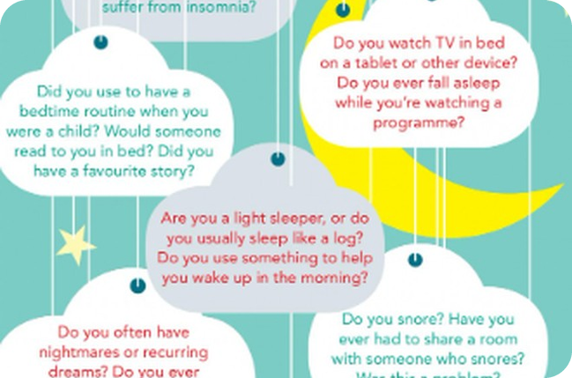
3
How do YOU sleep?
💬 TALK PARLA
⏱ 4 min 🙋 whole class
Answer the teacher's questions about YOUR sleep.
Rispondi alle domande dell'insegnante sul TUO sonno.
1
What time did you go to bed last night? Why so late/early?
e.g. About 1 a.m. – I was watching a series.
2
How many hours do you need to feel OK?
e.g. At least 8, or I'm a zombie.
3
Do you ever check your phone in bed?
e.g. Every night – I know it's bad!
4
Who in this class is the worst sleeper?
e.g. Marco! He's always yawning.
💬
Useful phrases
I usually… · I hardly ever…
It depends on…
Really? I'm the opposite!
6A-2 · Warm-up · your sleep (PQA)
Notes:
3. Warm-up · your sleep (PQA) (4 min)
PQA (4 min, teacher-led). Ask several students each question; circle ('So Anna goes to bed at 1 – does Luca go to bed at 1 or at 11? Who goes to bed later?'). Use and write the target collocations naturally as students answer (yawning, nap, fall asleep).

Slide 4

4
Sleep words
👀 LOOK GUARDA
⏱ 5 min 👥 pairs
Explain the word in English first. Click 1: definition. Click 2: Italian.
Spiega la parola in inglese. Clic 1: definizione. Clic 2: italiano.
🥱
yawn /jɔːn/
💤
a nap
😪
snore /snɔː/
🛏️
a pillow
open your mouth wide when tired or bored
a short sleep in the day
breathe noisily while asleep
you rest your head on it
sbadigliare
un pisolino
russare
cuscino (del letto)
🛌
a duvet /ˈduːveɪ/
📃
sheets
👁️
insomnia
💊
sleeping pills
thick cover filled with feathers
thin cloth you lie on or under
you can't sleep
pills that help you sleep
piumone
lenzuola
insonnia
sonniferi
⚠ Watch out! pillow (letto) ≠ cushion (divano) · duvet: silent t /ˈduːveɪ/ · yawn /jɔːn/ – not 'yown'
6A-2 · Vocabulary · from the article (SB 4b) · 📖 SB p.58 · 4b (definitions: SB key)
Notes:
4. Vocabulary · from the article (SB 4b) (5 min)
VOCABULARY (5 min). Pairs explain each word in English from the article context; click 1 shows the definition (SB key), click 2 the Italian. Drill: yawn, duvet, pillow, insomnia.

Slide 5
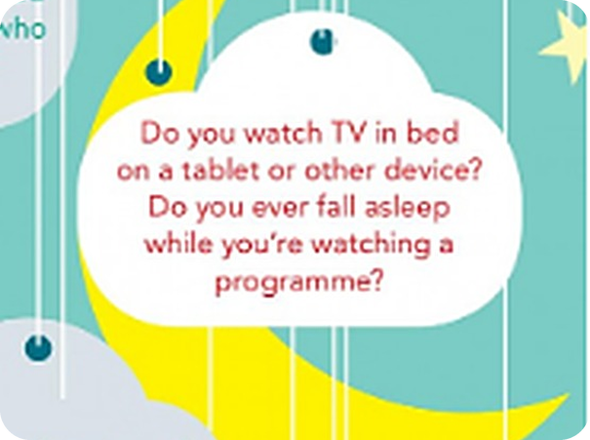
5
What do they mean?
💬 TALK PARLA
⏱ 4 min 👥 pairs
Explain each phrase to your partner in English. Then click.
Spiega ogni espressione al compagno in inglese. Poi clicca.
⭐
Example
1
fall asleep
go / get to sleep
0 be a light sleeper → wake up easily (≠ a heavy sleeper)
2
be fast asleep
be sleeping deeply
3
have nightmares
have unpleasant or frightening dreams
4
keep you awake
make you stay awake
5
oversleep
sleep longer than you intended
6
set the alarm
prepare the alarm to wake you
7
sleep like a log
sleep very well, deeply (= come un ghiro)
8
sleepwalk
walk around while asleep
6A-2 · Vocabulary · sleeping habits (SB 4c) · 📖 SB p.58 · 4c (answers: SB key)
Notes:
5. Vocabulary · sleeping habits (SB 4c) (4 min)
VOCABULARY (4 min). Pairs explain, click once per line (SB key definitions). Stress: FALL aSLEEP, overSLEEP.

Slide 6


6
The sleep race
🎲 PLAY GIOCA
⏱ 6 min 👥 pairs
Cover 4a–c. Fill gaps 1–18 in 4d as fast as you can.
Copri 4a–c. Completa gli spazi 1–18 del 4d il più veloce possibile.
🎲
How to play
1
2–5
→ yawn · pillow · duvet · sheets, blankets
Book p.58, exercise 4d. Cover a–c.
GO! Write the missing words 1–18.
Finished? Hands up! Then listen (6.8) and check.
6–9
→ insomnia · sleeping pills · snore · nap
2
3
10–13
→ sleeps like a log · light sleeper · have nightmares · keep you awake
4
14–18
→ fast asleep · sleepwalk · set the alarm · oversleep · fall asleep
🎧 6.8
▶ normal · 🐢 slower
6A-2 · Game · vocabulary race (SB 4d–e) · 📖 SB p.58 · 4d–e · audio 6.8 (answers: SB key)
Notes:
6. Game · vocabulary race (SB 4d–e) (6 min)
GAME (6 min). Pairs race; note finishing order. Play 6.8 to check (speaker bottom right). Click once per group of answers. Fastest pair with most correct wins. Answers (SB key 4e): 2 yawn 3 pillow 4 duvet 5 sheets, blankets 6 insomnia 7 sleeping pills 8 snore 9 nap 10 sleeps like a log 11 light sleeper 12 have nightmares 13 keep you awake 14 fast asleep 15 sleepwalk 16 set the alarm 17 oversleep 18 fall asleep.

Slide 7
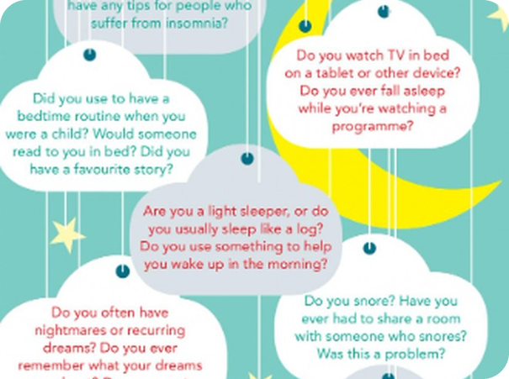
7
Not quite the same!
✅ CHECK CONTROLLA
⏱ 4 min 👥 pairs
Choose the natural option. Say why the other is wrong.
Scegli l'opzione naturale. Spiega perché l'altra è sbagliata.
⭐
Example
1
I couldn't (get / fall) to sleep – the party was too loud.
get to sleep = manage to
0 I was so tired I (fell / went) asleep on the sofa. → fell – it wasn't planned
2
Shh! The baby's (fast / deep) asleep.
fast asleep (fixed phrase)
3
After three coffees I was (wide / fast) awake at 2 a.m.
wide awake
4
I (overslept / slept in) and missed the bus.
overslept – an accident
5
It's Sunday – I'm going to (oversleep / sleep in)!
sleep in – on purpose
6A-2 · Vocabulary · precision (B2)
Notes:
7. Vocabulary · precision (B2) (4 min)
PRECISION (4 min). Italian 'dormire fino a tardi' covers both oversleep (accident) and sleep in (choice). ✗ deep asleep, ✗ fast awake. Extension: 'When did you last oversleep? What happened?'

Slide 8

8
How does the expert sleep?
🤔 GUESS INDOVINA
✍️ WRITE SCRIVI
Guess the sleep expert's habits: 1 word per gap.
⏱ 3 min 👥 pairs
Il Dr Stanley è un esperto del sonno. Indovina le sue abitudini.
⭐
Example
1
1 I sleep in a different ___ from my partner.
→ listen and check
0 I sleep in a different ___ from my partner. → room?
2
2 I sleep under natural ___.
→ listen and check
3
3 I'm obsessive about ___.
→ listen and check
4
4 I sleep with the ___ open.
→ listen and check
5
5 I don't have ___ late. · 6 I drink ___ in the evenings.
→ listen and check
6
7 I need ___ hours' sleep. · 8 I ___ before going to sleep.
→ listen and check
6A-2 · Listening · predict (SB 5a) · 📖 SB p.59 · 5a
Notes:
8. Listening · predict (SB 5a) (3 min)
PREDICTION (3 min). Pairs write a guess for every gap – no answers here (rule 1). They keep their guesses for the next slide: 1 point per correct guess.

Slide 9

9
Listen and check
🎧 LISTEN ASCOLTA
✏️ FILL THE GAPS COMPLETA
Listen. Complete 1–8. How many guesses were right?
⏱ 5 min 👥 pairs
Ascolta. Completa 1–8. Quante ipotesi erano giuste?
🎧 6.9 · play once, then check
1 a different ___
bedroom
2 natural ___
materials
3 obsessive about ___
pillows
4 the ___ open
window
5 ___ late
dinner
6 I drink ___
coffee
7 ___ hours' sleep
9.5
💡
Guess first, then listen!
8 I ___ before sleep
read a book
▶ normal · 🐢 slower
6A-2 · Listening · Dr Stanley (SB 5b) · 📖 SB p.59 · 5b · audio 6.9 (answers: SB key)
Notes:
9. Listening · Dr Stanley (SB 5b) (5 min)
LISTENING (5 min). Play 6.9 once (🐢 slower copy available). Pairs compare, then click one answer at a time. Answers (SB key): 1 bedroom 2 materials 3 pillows 4 window 5 dinner 6 coffee 7 9.5 8 read a book. Ask: 'Were you surprised? What kind of person is he?'

Slide 10
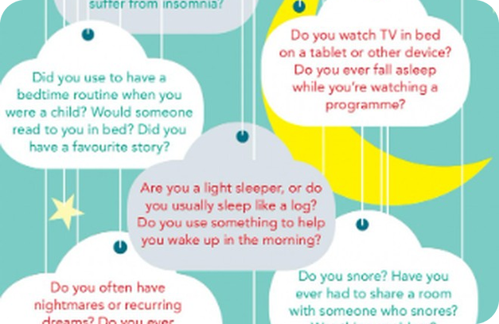
10
Why does he do it?
🎧 LISTEN ASCOLTA
💬 TALK PARLA
Listen again. Explain his reason for each habit.
⏱ 5 min 👥 pairs
Riascolta. Spiega il motivo di ogni abitudine.
🎧 6.9 · play again
1 Because then you don't…
get disturbed / listen to your partner snoring
2 Because you don't sleep well if…
you're really hot (cotton is cooler)
3 Because it's really important to…
sleep in the right position
4 Because you need…
fresh air, even if it's cold
5 Because your body…
will still be digesting the meal
6 Because he isn't…
affected by caffeine
7 Because that's the amount…
that's right for him
💡
Guess first, then listen!
8 Because it's his way of…
relaxing before sleep
▶ normal · 🐢 slower
6A-2 · Listening · reasons (SB 5c) · 📖 SB p.59 · 5c · audio 6.9 (answers: SB key)
Notes:
10. Listening · reasons (SB 5c) (5 min)
DETAIL (5 min). Play again; pairs explain; click one reason at a time (SB key). 5d extension: 'Which of his habits would you try? Which would you never do? Convince your partner.'

Slide 11
11
How well do you know your partner?
🎲 PLAY GIOCA
💬 TALK PARLA
Predict your partner's answers secretly. Then ask!
⏱ 10 min 👥 pairs
Scrivi una previsione SEGRETA della risposta del compagno. Poi chiedi.
🎲
How to play
1
Are you a light sleeper, or do you sleep like a log?
→ I bet you sleep like a log! – 'Not at all! The smallest noise wakes me up.'
A: green questions · B: red questions (p.59). Choose 4.
Write your prediction for each one. Hide it!
Ask + 2 follow-ups each. Reveal: 1 point per correct guess.
Have you ever overslept and missed something important?
→ Follow-up: What was it? What happened next?
2
3
Do you ever fall asleep in front of the TV?
→ Follow-up: What were you watching?! How often?
4
Useful: Really? How come? · No way! · Me neither!
→ Challenge: Is that always true, though?
TEAM A ☆☆☆☆☆
TEAM B ☆☆☆☆☆
6A-2 · Speaking game · predict your partner (SB 6) · 📖 SB p.59 · 6 (question clouds)
Notes:
11. Speaking game · predict your partner (SB 6) (10 min)
SPEAKING GAME (10 min). The book's question clouds become an information gap: secret predictions, then interview. Follow-ups compulsory. Click the model exchanges first (one per click). Monitor and note 4 errors + 4 good collocations for feedback. Students may say 'Pass!' to any question.

Slide 12
12
B2 First: sleep collocations
✍️ WRITE SCRIVI
✅ CHECK CONTROLLA
Use the word in CAPITALS. Write 2–5 words.
⏱ 5 min 👤 alone
B2 First Parte 4: completa la seconda frase con la parola in MAIUSCOLO (2–5 parole).
⭐
Example
1
1 The noise from the street stopped me from sleeping. KEPT → The noise from the street ___ .
kept me awake
0 I woke up too late this morning. OVERSLEPT → I overslept this morning.
2
2 I find it hard to start sleeping at night. GET → I find it hard ___ at night.
to get to sleep
3
3 My brother sleeps very deeply. LOG → My brother ___ .
sleeps like a log
4
4 The smallest noise wakes me up. LIGHT → I'm ___ – the smallest noise wakes me up.
a light sleeper
6A-2 · Exam · key word transformation
Notes:
12. Exam · key word transformation (5 min)
EXAM PRACTICE (5 min). Our own Part 4 items (not from the book) – answers follow from the SB 4c definitions. Strategy: count the words (2–5, contractions count as 2); don't change the key word. Click one answer at a time.

Slide 13
13
3 · 2 · 1
⏱ 2 min 👥 pairs
Books closed! What can you remember?
Libri chiusi! Cosa ricordi?
3
sleep expressions you didn't know before today
📝
Homework · Compiti
Workbook 6A: 3 Vocabulary a–d (sleep)
Workbook 6A: 2 Pronunciation /s/ and /z/ a–e
Write 80 words: your ideal bedtime routine (use 5 sleep expressions)
2
of Dr Stanley's habits – and his reasons
1
difference: oversleep vs sleep in
Next lesson: 6B · Music to my ears · gerunds and infinitives
6A-2 · Exit · what can you remember?
Notes:
13. Exit · what can you remember? (2 min)
EXIT (2 min). Vocabulary list: yawn, nap, snore, pillow, duvet, sheets, insomnia, sleeping pills, light sleeper, fast asleep, oversleep, keep you awake, sleep like a log, sleep in. Homework from the Workbook 6A pages (owner's photos).

