Slide 1


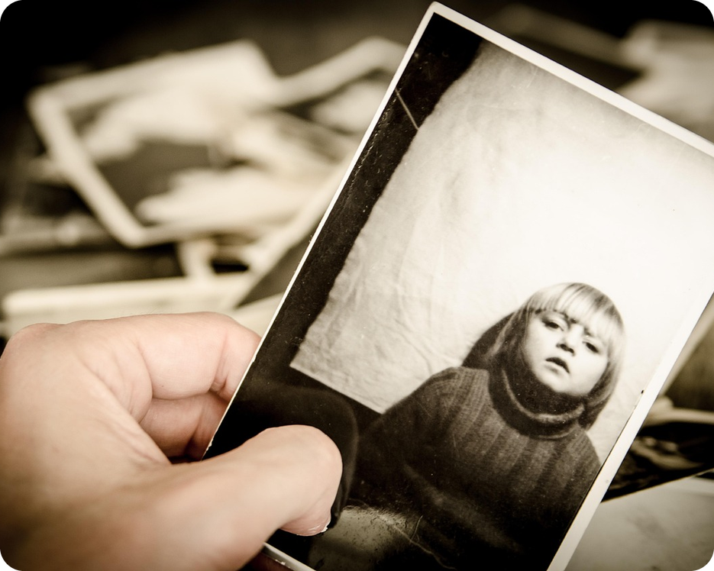


English File Pre-intermediate · SB pp.10–11 · VB p.151
💡 THINK · PENSA
1C
The Remake Project
Clothes, photos and what people are doing
🎯
Today you're going to…
👕 describe what people are wearing
📸 say what people are doing in a photo
📍 say where people are: next to, behind…
🔍 play spot the difference
Have you got an old family photo you love?
EXAMPLE Yes! Me and my brother on the beach in 1995 – we're wearing terrible hats!
Notes:
1. OPENING (2 min)
Show the old photo. Ask the THINK question; take 3–4 answers. Click: the example answer appears – read it and point out 'we're WEARING' (today's grammar). SB 1C 'The Remake Project' = people recreating old family photos years later: if students know the idea, ask 'Would you do it with your family?'. Read the 'Today you're going to…' list together.

Slide 2

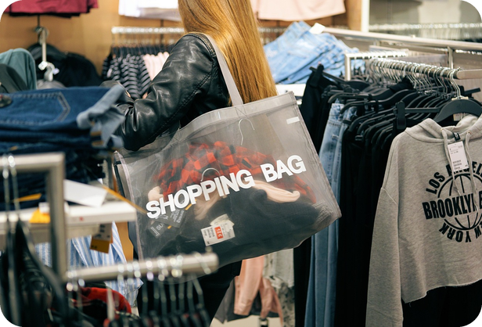
2
Remember last lesson?
💡 THINK PENSA
⏱ 3 min 🙋 whole class
What did we learn? Read the examples.
Cosa abbiamo imparato? Leggi gli esempi.
Clothes · careful with plurals!
Present simple = habits
My jeans ARE new. (not is)
These trousers are too long.
a T-shirt · a dress · a coat · a scarf
→ plural: jeans · trousers · shorts · socks · gloves
He wears a suit for work.
I don't usually wear a tie.
Do you wear glasses?
→ always · usually · every day
📅
Last lesson…
6 Oct: clothes · speaking in pairs
1A: present simple
🔤 KEY WORDS
T-shirt
jeans
dress
coat
scarf
gloves
cap
trainers
socks
suit
tie
sandals
1C · Revision · last lesson
Notes:
2. Revision · last lesson (3 min)
REVISION (3 min). Read the examples together. Point at 'My jeans ARE new' – Italians say 'il jeans è' → typical mistake. Quick check: 'Point to something you're wearing today and say it.' Then play Describe it! with exactly these clothes words.

Slide 3

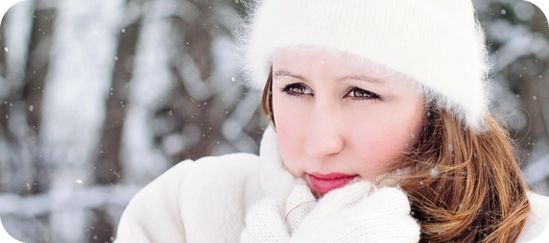
3
Describe it!
🎲 PLAY GIOCA
⏱ 4 min 👥 pairs
Explain the clothes. Don't say the word!
Spiega il capo. Non dire la parola!
🎲
How to play
ROUND 1 · A explains
ROUND 2 · B explains
A looks at the screen. B turns around.
A explains the word. Don't say it!
B guesses. Then swap.
a scarf
sandals
trainers
a cap
a suit
a tie
gloves
socks
1C · Warmer · clothes
Notes:
3. Warmer · clothes (4 min)
RETRIEVAL WARMER (4 min) – it worked very well in B1. Demo first: 'You wear them on your hands when it's cold' → gloves. Click once per word (round 1 = A explains, round 2 = B faces the screen). 20 seconds per word. Useful language on the board: You wear it on your… · It's for… · Men wear it to work… ICQ: 'Can you say the word?' (no).

Slide 4
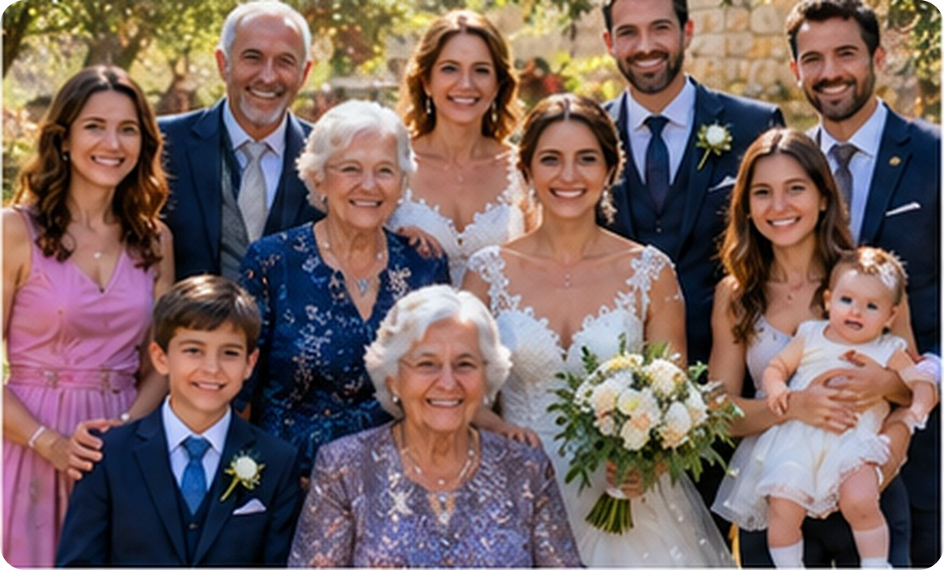
4
What are they wearing? Doing?
👀 LOOK GUARDA
💬 TALK PARLA
Look at the photo. Answer 1–6.
⏱ 5 min 👥 pairs
Guarda la foto. Rispondi alle domande 1–6.
1
What's the groom wearing?
6
He's wearing a dark blue suit and a tie.
1
2
What's the bride holding?
She's holding flowers.
3
What's she wearing?
3
She's wearing a pink dress.
5
4
What's the boy wearing?
2
4
a suit, a white shirt and a blue tie
5
What's she doing?
She's holding a baby.
6
What's Grandad doing?
He's smiling. He's wearing a grey tie.
1C · Grammar in a photo · present continuous · 📖 SB p.10 · present continuous in a photo
Notes:
4. Grammar in a photo · present continuous (5 min)
PRESENT in context (5 min). Pairs answer 1–6 in full sentences (1 min each pair, then check). Click once per number. Model the first answer: 'He IS wearING a dark blue suit.' Write two answers on the board: He's wearing / She's holding. Ask: 'Now, in the photo – or every day?' (now, in the photo). Don't give the rule yet – next slide.

Slide 5
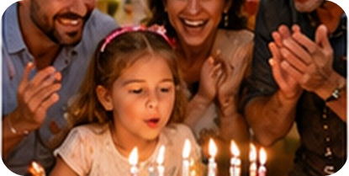
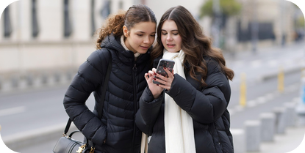
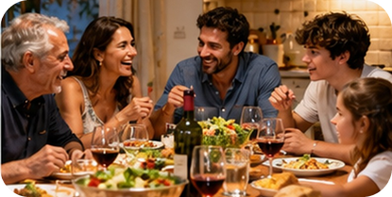
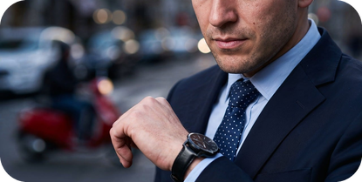
5
be + verb-ing
👀 LOOK GUARDA
⏱ 3 min 🙋 whole class
Look at the examples. How do we make it?
Guarda gli esempi. Come si forma?
+
−
?
spelling
what's happening now / in a photo
be + not + -ing
Is / Are + person + -ing
verb + -ing
I'm wearing jeans.
She's smiling.
They're clapping.
I'm not working today.
She isn't wearing a hat.
They aren't listening.
Is he wearing a tie?
What are you doing?
Yes, he is. / No, he isn't.
wear → wearing
smile → smiling
sit → sitting
sta sorridendo · stanno applaudendo
non sta… · non stanno…
Sta…? · Cosa stai facendo?
-e sparisce · sit → sitting
⚠ Don't forget be! ✗ She wearing a dress → ✓ She's wearing a dress. ✗ What you doing? → ✓ What ARE you doing?
1C · Grammar · present continuous · 📖 Grammar Bank 1C p.125
Notes:
5. Grammar · present continuous (3 min)
CLARIFY (3 min). Elicit each column before you click (they've just used the form). Click once per column, last click = the warning. 10-second Italian link: sta leggendo = is reading. Main Italian error: missing 'be'. CCQ: 'She's smiling – now or every day?' (now).

Slide 6
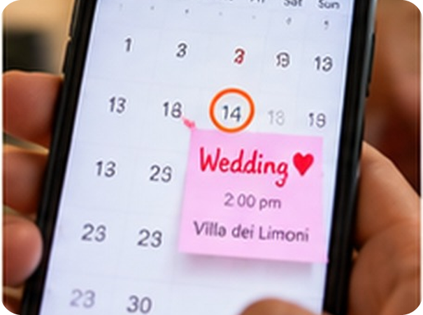
6
Now or every day?
✏️ FILL THE GAPS COMPLETA
⏱ 4 min 👤 alone
Now or every day? Write the right form.
Adesso o ogni giorno? Scrivi la forma giusta.
⭐
Example
1
Look! Your phone ___ (ring).
's ringing (look! = now)
0 Look! It ___ (rain). → Look! It's raining. (look! = now)
2
We usually ___ (have) lunch at 2.
have (usually = habit)
3
Why ___ you ___ (laugh)?
are … laughing (now)
4
Paolo ___ (not / wear) a tie today.
isn't wearing (today)
5
I ___ (go) to the gym on Mondays.
go (on Mondays = habit)
6
It's 10 p.m. The kids ___ (sleep).
are sleeping (now)
1C · Practice · simple or continuous? · 📖 Grammar Bank 1C p.125 · b
Notes:
6. Practice · simple or continuous? (4 min)
PRACTICE (4 min). Students write alone (2 min), compare with a partner, then click once per answer. For each one ask: 'Which word tells you?' (look!, usually, today, on Mondays…). Fast finishers: write 2 true sentences: one about now, one about every day.

Slide 7
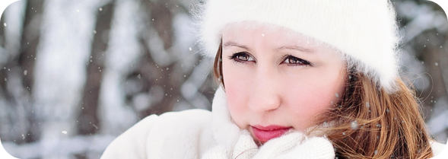
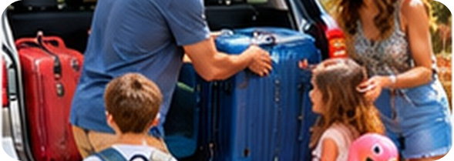
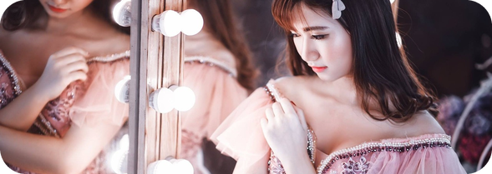
7
Wear or carry?
👀 LOOK GUARDA
⏱ 3 min 🙋 whole class
Italian 'portare' = two English verbs!
'Portare' in italiano = due verbi inglesi!
WEAR
CARRY
GET DRESSED
ON your body: clothes, shoes, glasses, a ring
IN your hand or in a bag
put on your clothes
She's wearing a white hat.
I wear glasses for reading.
He's carrying a suitcase.
I always carry an umbrella.
I have a shower and get dressed.
Hurry up! Get dressed!
indossare · portare addosso
portare in mano
vestirsi
⚠ Porto gli occhiali = I WEAR glasses (✗ carry) · Porto la borsa = I CARRY a bag · Mi vesto = I get dressed
1C · Vocabulary · wear or carry? · 📖 VB p.151 · Things you wear
Notes:
7. Vocabulary · wear or carry? (3 min)
PRESENT (3 min). Mime: wear (touch your clothes), carry (hold your bag). Click once per column. CCQs: 'Your glasses – wear or carry?' (wear) · 'Your shopping – wear or carry?' (carry) · 'After the shower in the morning?' (get dressed).

Slide 8
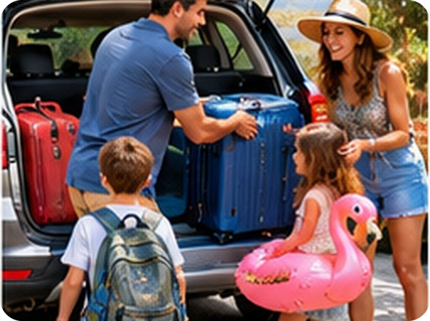
8
Look at the family!
✏️ FILL THE GAPS COMPLETA
⏱ 4 min 👥 pairs
Wear, carry or get dressed? Use the right form.
Wear, carry o get dressed? Usa la forma giusta.
⭐
Example
1
The mum ___ a big hat.
is wearing
0 The mum ___ shorts. → The mum is wearing shorts.
2
The dad ___ a blue suitcase.
is carrying
3
The boy ___ a backpack.
is carrying (on his back)
4
The girl ___ a pink flamingo!
is carrying / holding
5
My dad always ___ glasses.
wears
6
I get up, have a shower and ___.
get dressed
1C · Practice · wear, carry, get dressed · 📖 VB p.151 · practice
Notes:
8. Practice · wear, carry, get dressed (4 min)
PRACTICE (4 min). Items 1–4 = the photo (now → present continuous); 5–6 = habits (present simple). Pairs say the sentences aloud, then click once per answer. Ask WHY each time (on your body / in your hand).

Slide 9
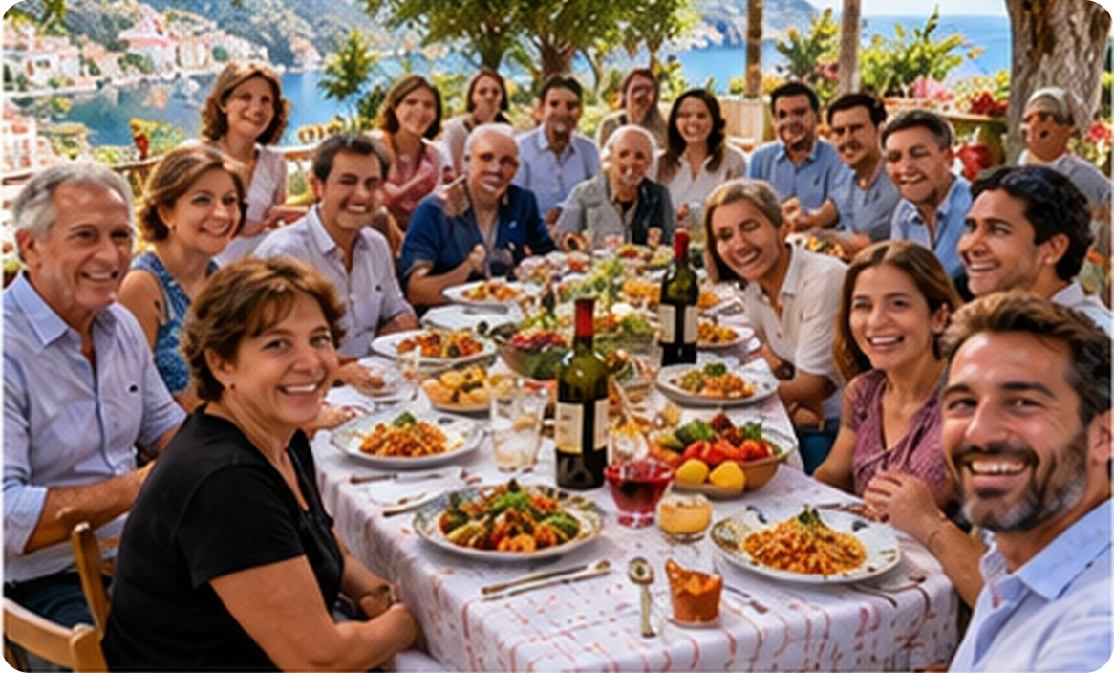
9
Sunday lunch: where are they?
👀 LOOK GUARDA
💬 TALK PARLA
Where are they? Answer 1–6.
⏱ 5 min 👥 pairs
Dove sono? Rispondi alle domande 1–6.
6
1
Where's this man? What's he doing?
on the right, at the front · He's taking a selfie.
2
Where's the woman in black?
4
on the left, in front of the table
3
Where's the bottle of wine?
on the table, in the middle
3
1
4
Where's the man in the blue shirt?
2
5
at the back, behind the table
5
Where are the lemons?
in a bowl, next to the tomatoes
6
Where's the sea?
behind the people / at the back
1C · Vocabulary · prepositions of place · 📖 SB p.11 · prepositions of place
Notes:
9. Vocabulary · prepositions of place (5 min)
ELICIT FIRST (5 min). Pairs try 1–6 with the prepositions they know. Click once per number; gesture each preposition as you click (on, in, behind, in front of, next to, on the left / right, at the back / front). Then pairs test each other: point to someone in the photo – 'Where is she?' – 'Next to the man in the white shirt.' The next slide gives the Italian for slower students.

Slide 10

10
Prepositions in Italian
✅ CHECK CONTROLLA
⏱ 2 min 🙋 whole class
Say it in Italian. Then click!
Dillo in italiano. Poi clicca!
🍽️
on the table
🐈
under the table
🧍
next to Luca
↔️
between Anna and Luca
sul tavolo
sotto il tavolo
accanto a Luca
tra Anna e Luca
🚪
behind the door
📺
in front of the TV
⬅️
on the left / right
🎯
in the middle
dietro la porta
davanti alla TV
a sinistra / a destra
in mezzo / al centro
📸
at the front / back
🥣
in a bowl
🏠
at home
🪑
opposite me
davanti / in fondo (in una foto)
in una ciotola
a casa
di fronte a me
⚠ Watch out! in front of = davanti a (✗ in front to) · opposite = di fronte (facing you) · on the left (✗ at the left)
1C · Vocabulary · in Italian
Notes:
10. Vocabulary · in Italian (2 min)
CONSOLIDATION (2 min). Class says the Italian for each tile, ONE click shows all. 20 seconds on the warnings: 'in front OF', 'ON the left'. 'Opposite' is new: show it – sit facing a student.

Slide 11
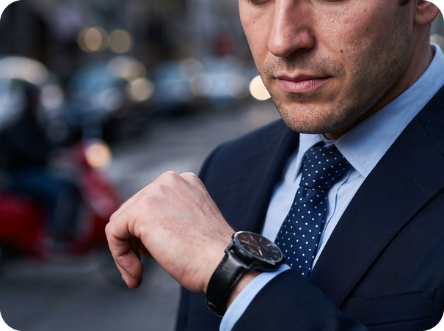
11
The /ɜː/ sound
🔊 SAY IT PRONUNCIA
⏱ 4 min 👥 pairs
Say the words. Which one is different?
Di' le parole. Quale è diversa?
⭐
Example
1
shirt · skirt · short
short /ɔː/
/ɜː/ = shirt · skirt · work · her · Thursday · first (mouth relaxed, lips NOT round)
2
work · walk · word
walk /ɔː/
3
her · hair · bird
hair /eə/
4
first · fast · Thursday
fast /ɑː/
5
T-shirt · third · sport
sport /ɔː/
6
Say it! Her first shirt is dirty on Thursday.
slowly… then fast ×3!
1C · Pronunciation · /ɜː/ as in shirt · 📖 SB p.10 · Pronunciation /ɜː/
Notes:
11. Pronunciation · /ɜː/ as in shirt (4 min)
PRONUNCIATION (4 min) – one sound. 1) Model the example words; class repeats (chorus, then individuals). Show the mouth: relaxed, lips not rounded – Italians say 'shert' or 'shurt'. 2) Say each group aloud TWICE, pairs decide which word is different, then click. The odd words show the sounds Italians confuse it with. 3) Tongue twister: slowly, then fast; volunteers. Why it matters: shirt / short, work / walk change the meaning! (No A2 audio in the deck – teacher models.)

Slide 12
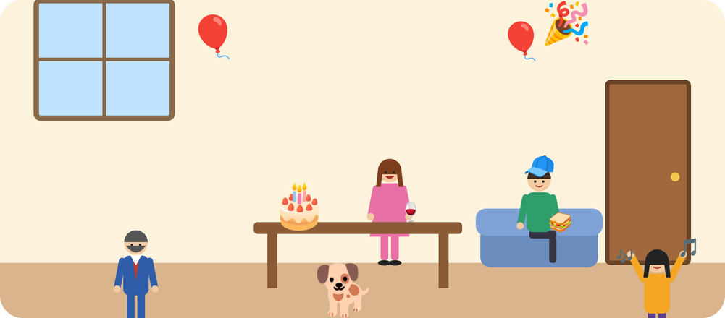
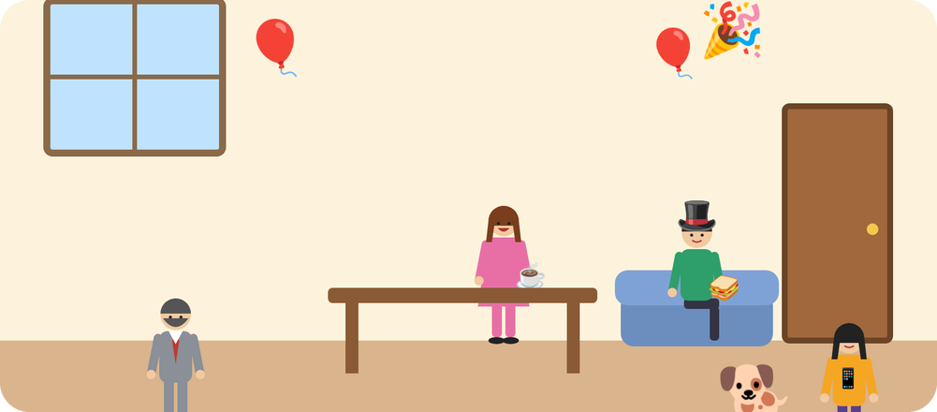
12
Grandma's party: A or B?
👀 LOOK GUARDA
💬 TALK PARLA
Find 6 differences. Say them in English!
⏱ 9 min 👥 pairs
Trova 6 differenze. Dille in inglese!
A
B
1
the man on the left: a blue suit (A) / a grey suit (B)
2
the woman: a glass of wine (A) / a cup of coffee (B)
3
the dog: under the table (A) / next to the girl (B)
4
the young man: a cap (A) / a top hat (B)
5
the girl: dancing (A) / looking at her phone (B)
6
the cake: on the table (A) / on the floor (B)
EXAMPLE In picture A the man on the left is wearing a blue suit, but in picture B he's wearing a grey suit.
1C · Speaking game · spot the difference · 📖 SB p.11 · Communication (our version)
Notes:
12. Speaking game · spot the difference (9 min)
USE (9 min). Option 1 (information gap, better): print A2_1C_Role_cards.pdf – A and B have different pictures and must NOT show them; they ask 'What's the man wearing? Where's the dog?' and write the differences. Option 2 (quick): show this slide, pairs find the 6 differences and SAY each one with the model sentence (present continuous + prepositions). Click once per difference. Challenge: 'Why is the cake on the floor?! Invent the story.' Note errors for 1 minute of correction at the end.

Slide 13
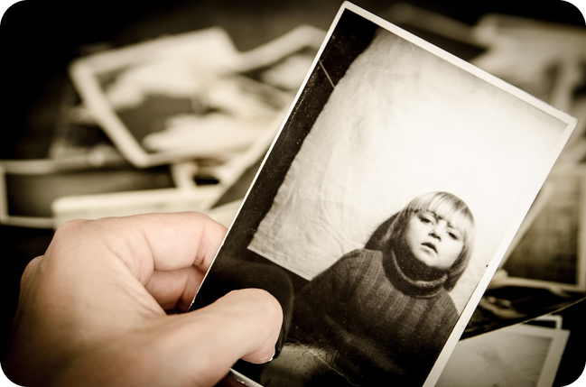
13
Show and tell: your photo
💬 TALK PARLA
⏱ 7 min 👥 pairs
Show a photo on your phone. Describe it!
Mostra una foto sul telefono. Descrivila!
1
Choose a photo with people. Where and when is it?
e.g. This is my cousin's wedding in Palermo, last June.
2
Who's in it? Where are they?
e.g. My mum is on the left, next to my aunt.
3
What are they wearing?
e.g. My dad is wearing a terrible tie!
4
What are they doing?
e.g. My brother is dancing and my grandma is laughing.
💬
Useful phrases
This is a photo of… last summer.
On the left… / In the middle…
He's wearing… · They're laughing.
5
Partner: ask 2 questions!
e.g. Who's the man behind you? Why is he laughing?
1C · Speaking · your photo
Notes:
13. Speaking · your photo (7 min)
FREER PRACTICE (7 min). Students choose a photo they're happy to show (privacy: their choice – a photo from the internet is fine too). Questions appear ONE per click: give pairs about a minute per question. Model it first with a photo of your own. Monitor and note 4–5 errors (be + -ing, prepositions, wear/carry) for 1–2 minutes of delayed correction on the board.

Slide 14
14
3 · 2 · 1
⏱ 2 min 👥 pairs
Books closed! What can you remember?
Libri chiusi! Cosa ricordi?
3
clothes words – no looking!
📝
Homework · Compiti
Homework sheet 1C (normal / easier) in the LLS app
Workbook 1C (teacher's choice)
Describe a photo from your phone: 50–70 words
2
sentences about the class NOW: "Anna is wearing…"
1
difference: wear or carry?
Next lesson: Practical English 1 · Hotel problems
1C · Exit · what can you remember?
Notes:
14. Exit · what can you remember? (2 min)
RETRIEVAL EXIT (2 min). Books closed. Pairs: 3 clothes words, 2 sentences about people in the room now (present continuous), 1 explanation of wear vs carry. Set homework.

