Slide 1


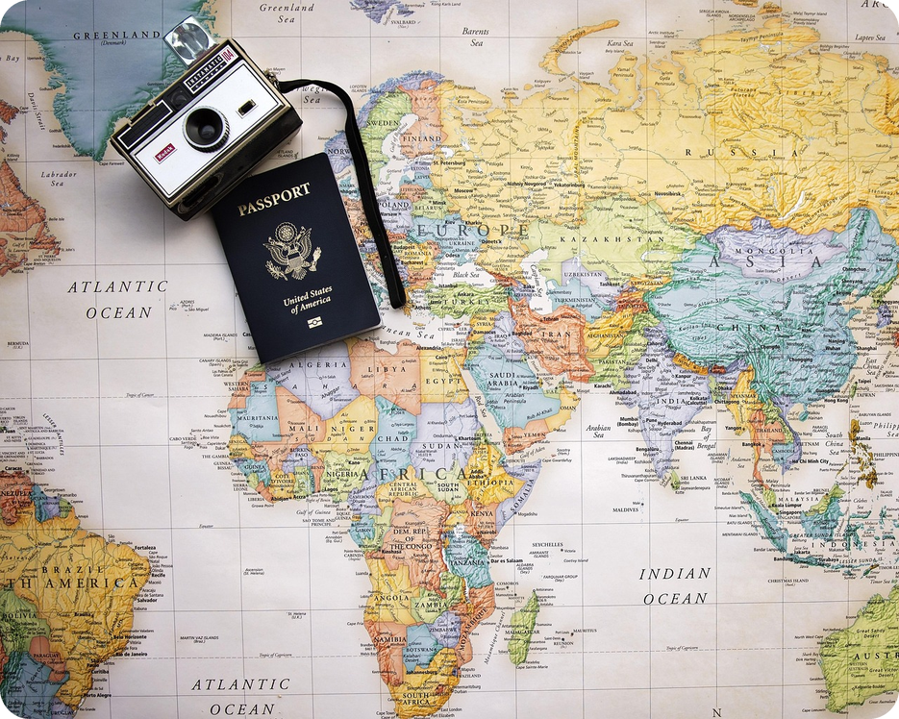


English File Pre-intermediate · SB pp.14–15 · VB p.152
💡 THINK · PENSA
2A
OMG! Where's my passport?
Holidays, stories and the past simple
🎯
Today you're going to…
🏖️ talk about holidays
👀 read and listen to two holiday disasters
✏️ past simple: regular and irregular verbs
🔊 say -ed endings: /t/ /d/ /ɪd/
💬 tell a partner about your last holiday
Have you ever lost something on holiday?
EXAMPLE Yes! I left my sunglasses on a train in Rome. I never found them!
Notes:
1. OPENING (2 min)
Show the photo (passport, camera, map). Ask the THINK question; take 3–4 answers – don't correct the past simple yet, just note mistakes. Click: the example. Read 'Today you're going to…' together. The title 'OMG!' = Oh my God! – what we say when something goes wrong.

Slide 2

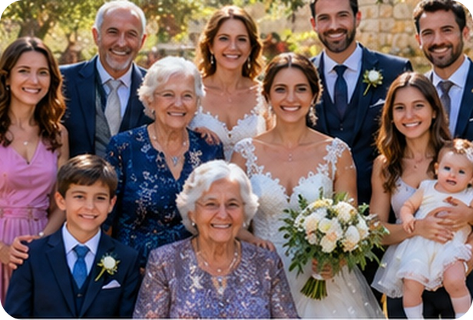
2
Remember last lesson?
💡 THINK PENSA
⏱ 3 min 🙋 whole class
What did we learn? Read the examples.
Cosa abbiamo imparato? Leggi gli esempi.
Present continuous = now / in a photo
Where are they?
She's wearing a pink dress.
He's holding a baby.
Are they smiling? Yes, they are.
→ now · look! · in the photo
The wine is on the table.
The sea is behind the people.
The lemons are next to the tomatoes.
→ in front of · between · on the left · at the back
📅
Last lesson…
1C: clothes and photos
present continuous · prepositions
🔤 KEY WORDS
wear
carry
get dressed
suit
scarf
behind
next to
opposite
2A · Revision · last lesson
Notes:
2. Revision · last lesson (3 min)
REVISION (3 min). Read the examples together. Ask 2 students: 'What are you wearing today?' 'Who is sitting next to you?' Then play Photo memory: the questions are about the two photos from last lesson.

Slide 3

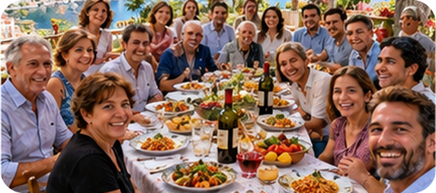
3
Photo memory!
🎲 PLAY GIOCA
⏱ 4 min 🏆 teams
No looking back! Answer from memory.
Senza guardare! Rispondi a memoria.
🎲
How to play
1
The wedding: what's the bride holding?
→ She's holding flowers.
Remember last lesson's photos.
Teams answer in full sentences.
Right answer + right grammar = 1 point.
What's the groom wearing?
→ a dark blue suit and a tie
2
3
The woman on the left: what's she wearing?
→ a pink dress
4
Sunday lunch: what's the man on the right doing?
→ He's taking a selfie.
5
Where's the bottle of wine?
→ on the table, in the middle
6
Glasses: wear or carry?
→ wear! (I wear glasses.)
2A · Warmer · last lesson · 📖 Recycles 1C
Notes:
3. Warmer · last lesson (4 min)
RETRIEVAL WARMER (4 min). Two teams, books closed. Read each question; teams have 15 seconds; click to show the answer. Point only for a full sentence with be + -ing or the right preposition. The photo in the corner is a clue only if they're stuck.

Slide 4
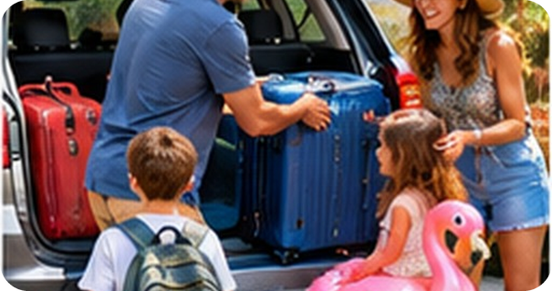

4
Holiday phrases
✏️ FILL THE GAPS COMPLETA
💬 TALK PARLA
Complete the holiday phrases. Then click.
⏱ 4 min 👥 pairs
Completa le espressioni. Poi clicca.
⭐
Example
1
___ abroad
go abroad
0 ___ camping → go camping
2
___ away for the weekend
go away for the weekend
3
___ in a hotel / at a campsite
stay in a hotel / at a campsite
4
___ an apartment
rent an apartment
5
___ a bicycle
hire a bicycle
6
___ sightseeing
go sightseeing
7
___ on the beach
sunbathe on the beach
🎧 2.6 + 2.7
8
___ a flight online
book a flight online
🔈 click ▶
2A · Vocabulary · holidays · 📖 VB p.152 · Holidays 1
Notes:
4. Vocabulary · holidays (4 min)
ELICIT FIRST (4 min). Pairs complete the phrases (go, stay, rent, hire, take, buy, book). Click once per phrase, then play 2.6 (phrases with go) and 2.7 (other holiday phrases) to drill. Point out: go + -ing for activities (go swimming, go skiing) and go abroad (NOT go to abroad); go out (at night) = leave your house vs go away (for the weekend) = leave your town (TG). Rent an apartment vs hire a bicycle (short time). The next slide gives the Italian.

Slide 5

5
Holiday words in Italian
✅ CHECK CONTROLLA
⏱ 2 min 🙋 whole class
Say it in Italian. Then click!
Dillo in italiano. Poi clicca!
✈️
go abroad
🏛️
go sightseeing
🏖️
sunbathe
⛺
stay at a campsite
andare all'estero
fare un giro turistico
prendere il sole
stare in campeggio
🚲
hire a bicycle
🎁
buy souvenirs
😀
have a good time
💶
spend money
noleggiare una bici
comprare souvenir
divertirsi
spendere soldi
👥
crowded
🔊
noisy
🛋️
comfortable
🙋
helpful
affollato
rumoroso
comodo
disponibile
⚠ Watch out! go abroad (✗ go to abroad) · have a good time = divertirsi · helpful ≠ unhelpful · comfortable ≠ uncomfortable
2A · Vocabulary · in Italian · 📖 VB p.152 · Holidays
Notes:
5. Vocabulary · in Italian (2 min)
CONSOLIDATION (2 min). Class says the Italian for each tile, ONE click shows all. Drill the stress: COMfortable (3 syllables: /ˈkʌmftəbl/), CROWDed, HELPful.

Slide 6
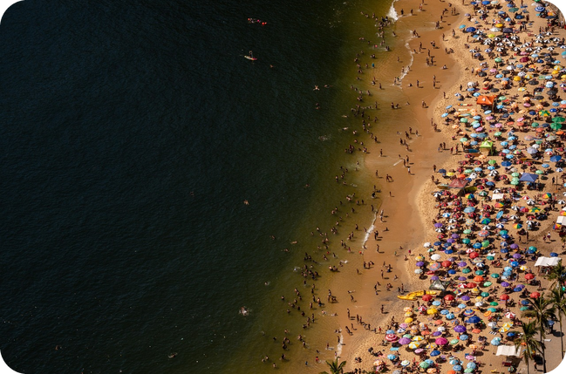
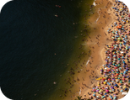
6
Your holidays
💬 TALK PARLA
⏱ 3 min 👥 pairs
Answer with a reason. Then ask: And you?
Rispondi con un motivo. Poi chiedi: E tu?
1
Do you usually go abroad or stay in Italy?
e.g. I usually stay in Sicily – I love the beaches here.
2
Hotel, apartment or campsite?
e.g. An apartment – it's cheaper and more comfortable.
3
Do you take a lot of photos on holiday?
e.g. Yes, hundreds! My family hates it.
4
Do you buy souvenirs? For who?
e.g. Only magnets for my fridge!
💬
Useful phrases
I prefer… because…
I never… · I usually…
And you?
5
What do you hate on holiday?
e.g. Crowded beaches and noisy hotels!
2A · Speaking · your holidays · 📖 VB p.152 · practice
Notes:
6. Speaking · your holidays (3 min)
SPEAKING (4 min). Present simple for habits (they know it) + the new phrases. Questions appear ONE per click (about 45 seconds each). Monitor for the new phrases; praise 'go abroad', 'stay in…'.

Slide 7
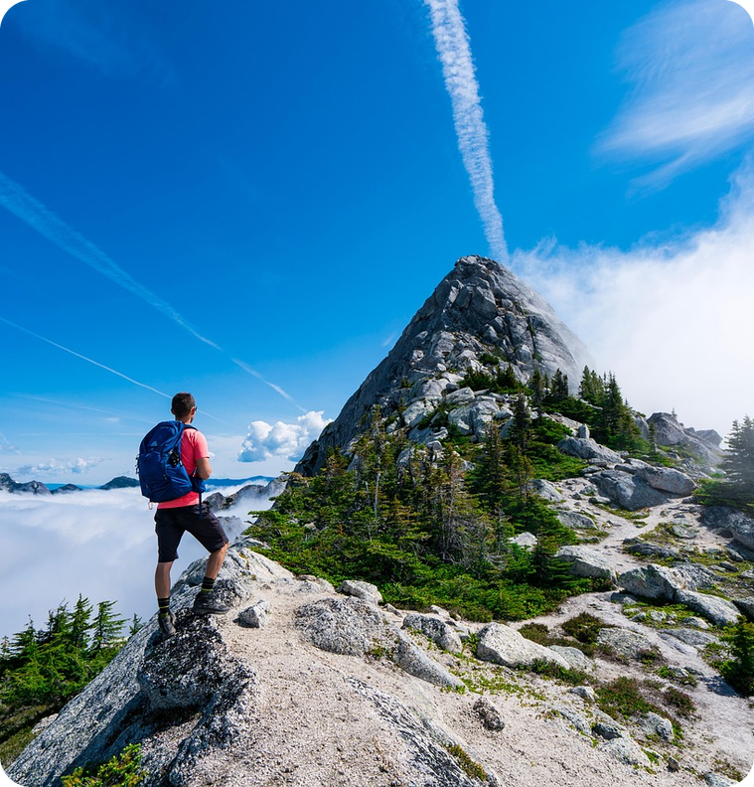
7
What happened to Stuart?
👀 READ LEGGI
🤔 GUESS INDOVINA
Read the intro. Guess the story from 6 words!
⏱ 2 min 👥 pairs
Leggi l'intro. Indovina la storia da 6 parole!
Stuart's story
'Passport, tickets, money, phone' – it's the mantra we always say to ourselves when we go on holiday. But what happens when one of those things is suddenly missing?
➡ NEXT The story on the next 2 slides has 11 gaps. Write the verb in the past simple.
🔤 6 WORDS FROM THE STORY · what happened?
Alps
lunch
car
phone
bag
jacket
2A · Reading · prediction · 📖 SB p.14 · 1
Notes:
7. Reading · prediction (2 min)
PREDICTION (2 min). Read the introduction aloud ('mantra' = something you repeat). Pairs use the 6 words to guess Stuart's story in 1 minute: 'I think he lost his phone in the Alps…'. Take 2 guesses – don't confirm. ICQ: 'Are you reading the story yet?' (no, guessing).

Slide 8
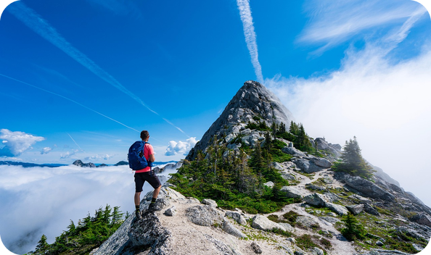
8
Stuart's story 1/2
👀 READ LEGGI
✏️ FILL THE GAPS COMPLETA
Write the verbs in the past simple.
⏱ 4 min 👥 pairs
Scrivi i verbi al past simple.
Last year in the Alps…
Last year, I (1 go) _____ on holiday to the Alps with a group of friends.
Last year, I went on holiday to the Alps with a group of friends.
One day, we (2 climb) _____ a mountain – it (3 take) _____ about two hours to get to the top.
One day, we climbed a mountain – it took about two hours to get to the top.
When we got there, we (4 have) _____ lunch. The view was amazing – we could see the sea!
When we got there, we had lunch. The view was amazing – we could see the sea!
Back at the car, I (5 want) _____ to take another photo, but I couldn't find my phone.
Back at the car, I wanted to take another photo, but I couldn't find my phone.
💡
Remember
I (6 decide) _____ to go back up. My friends said 'You can't go on your own', so we all went up again.
I decided to go back up. My friends said 'You can't go on your own', so we all went up again.
regular: + -ed (climbed)
irregular: learn them! (go → went)
2A · Reading · Stuart's story · 📖 SB p.14 · text adapted
Notes:
8. Reading · Stuart's story (4 min)
READ + COMPLETE (4 min). The verb in brackets is the infinitive. Students write alone, then compare. Click once per sentence: the answers appear IN the text. Answers (text): 1 went · 2 climbed · 3 took · 4 had · 5 wanted · 6 decided. Ask after 5: 'Where do you think the phone is?'

Slide 9
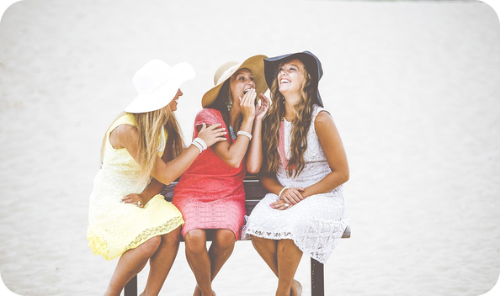
9
Stuart's story 2/2
👀 READ LEGGI
✏️ FILL THE GAPS COMPLETA
Write the verbs in the past simple.
⏱ 4 min 👥 pairs
Scrivi i verbi al past simple.
…and back to the top!
At the top we (7 spend) _____ half an hour looking for the phone, but we couldn't find it anywhere.
At the top we spent half an hour looking for the phone, but we couldn't find it anywhere.
Then it (8 start) _____ to get colder, so I (9 take) _____ my jacket out of my bag, and…
Then it started to get colder, so I took my jacket out of my bag, and…
… my phone was in my jacket pocket!
I (10 feel) _____ terrible, and really stupid! My friends were very nice about it…
I felt terrible, and really stupid! My friends were very nice about it…
💡
Remember
… but they never (11 let) _____ me forget it! (Stuart, from Exeter, UK)
… but they never let me forget it! (Stuart, from Exeter, UK)
let → let (same!)
spend → spent · feel → felt
2A · Reading · Stuart's story · 📖 SB p.14 · text adapted
Notes:
9. Reading · Stuart's story (4 min)
READ + COMPLETE (4 min). Same procedure. Answers: 7 spent · 8 started · 9 took · 10 felt · 11 let. Reaction question: 'What do you think of Stuart? What would you do?' (They walked up the mountain twice – about two hours each time!)

Slide 10
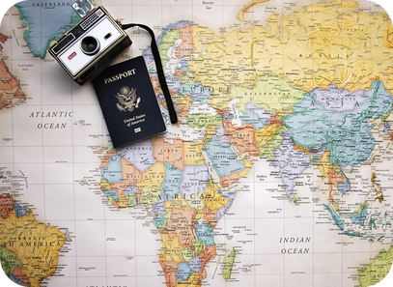
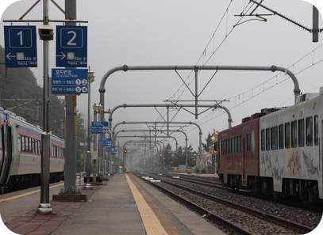
10
Another disaster: Marta
🎧 LISTEN ASCOLTA
⏱ 3 min 👤 alone
Listen to Marta. Answer the 2 questions.
Ascolta Marta. Rispondi alle 2 domande.
🎧 2.1 · play once
↘ speaker bottom right
A
B
What did she lose?
her ID card
Did she find it?
No.
🎧
While you listen
Listen to Marta's holiday story.
What did she lose? Did she find it?
🔈 click ▶
2A · Listening · Marta's story · 📖 SB p.14 · 1d · audio 2.1 (script SB p.120)
Notes:
10. Listening · Marta's story (3 min)
GIST (3 min). Write the 2 questions on the board, books closed. Play 2.1 once. Pairs compare. Answers (TG): Marta lost her ID card. No. Background: Spanish, working in Dublin, flying Dublin → Brussels → Lyon to visit friends.

Slide 11
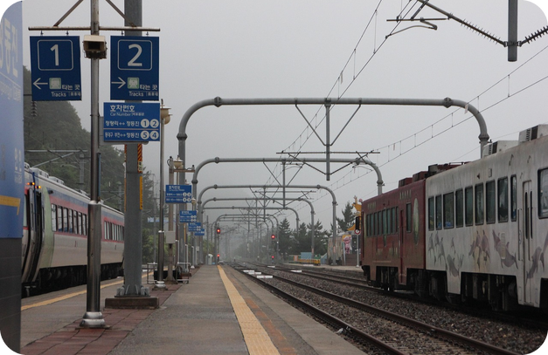
11
Marta: listen again
🎧 LISTEN ASCOLTA
✏️ FILL THE GAPS COMPLETA
Listen again. Answer questions 1–7.
⏱ 4 min 👥 pairs
Riascolta. Rispondi alle domande 1–7.
🎧 2.1 · play again
1 When did it happen?
two years ago
2 Where was she going? Why?
Lyon – friends invited her
3 Why did she fly via Brussels?
no cheap direct flights
4 What was the problem at the gate?
couldn't find her ID card
5 How did she feel?
stressed and unhappy
6 What did the policeman say?
she couldn't go to France
💡
Guess first, then listen!
7 Where did she go in the end?
Madrid – to get a new ID card
🔈 click ▶
2A · Listening · detail · 📖 SB p.14 · 1e · audio 2.1
Notes:
11. Listening · detail (4 min)
DETAIL (4 min). Give time to read 1–7. Play 2.1 again, pausing if needed. Pairs compare, then click once per answer. Answers (TG): 1 Two years ago · 2 Lyon. Her friends invited her to come and stay. · 3 There were no cheap direct flights. · 4 She couldn't find her ID card. · 5 She felt stressed and unhappy. · 6 She couldn't go to France because she didn't have any ID. · 7 Madrid. She got a new ID card. EXTRA (TG 1f): 'Have you or your family ever lost something on holiday?' – Where were you? What happened? What did you do next? How did it end?

Slide 12
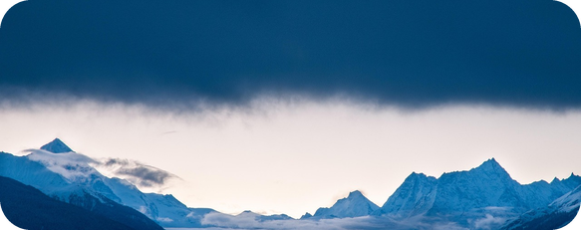
12
Regular or irregular?
🔗 MATCH ABBINA
⏱ 3 min 👥 pairs
Regular or irregular? Match the colour.
Regolare o irregolare? Abbina il colore.
🏷️
Two types
go → went
irregular
regular -ed
irregular
climb → climbed
regular -ed
take → took
irregular
want → wanted
regular -ed
spend → spent
irregular
decide → decided
regular -ed
feel → felt
irregular
2A · Grammar · noticing · 📖 SB p.15 · 2
Notes:
12. Grammar · noticing (3 min)
NOTICING (3 min). Pairs sort the verbs from the story. Click once per verb. Then ask: 'How do we make the past of regular verbs?' (+ -ed; decide → decided: just + d). 'And irregular?' (no rule – learn them: Irregular verbs list, Student's Book p.164).

Slide 13
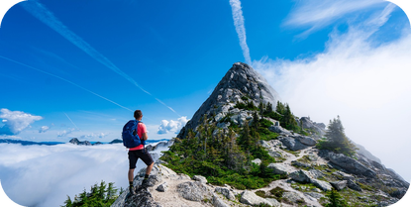
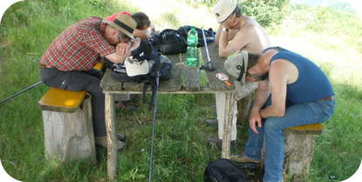
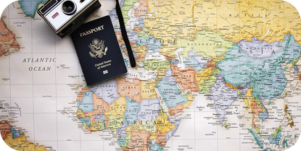
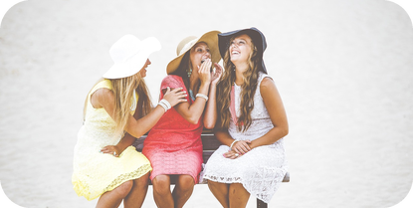
13
The past simple
👀 LOOK GUARDA
⏱ 4 min 🙋 whole class
How do we make it?
🎧 2.2
Come si forma?
+
−
?
be · can
regular -ed · irregular
didn't + infinitive
Did + person + infinitive
was / were · could
We climbed a mountain.
I went to the Alps.
I didn't find my phone.
We didn't stay long.
Where did you go?
Did you have a good time?
Yes, I did. / No, I didn't.
The view was amazing.
We could see the sea.
I couldn't find it.
uguale per tutte le persone!
✗ didn't found
✗ Where you went?
no did!
⚠ After did / didn't = infinitive: ✗ Did you went? → ✓ Did you go? ✗ I didn't took it → ✓ I didn't take it
🔈 click ▶
2A · Grammar · past simple · 📖 Grammar Bank 2A p.128 · audio 2.2
Notes:
13. Grammar · past simple (4 min)
CLARIFY (4 min). Elicit each column before you click. Play 2.2 (Grammar Bank 2A p.128, listen and repeat – copy the rhythm). TG reminder: irregular forms (went, had…) are only for POSITIVE sentences; most verbs are regular; Irregular verbs list SB p.164. Key Italian-speaker errors: past form after did/didn't; missing 'did' in questions; 'Did you was…?' (use Were you…?). CCQ: 'Did you went?' – right or wrong? (wrong: Did you go?).

Slide 14
14
-ed: /t/, /d/ or /ɪd/?
🔊 SAY IT PRONUNCIA
⏱ 4 min 👥 pairs
/t/, /d/ or /ɪd/? Say the verb. Then click.
/t/, /d/ o /ɪd/? Di' il verbo. Poi clicca.
🏷️
-ed sounds
asked
/t/ looked
called
/d/ stayed
/t/ looked
/d/ stayed
decided
/ɪd/ wanted
/ɪd/ wanted
happened
/d/ stayed
rented
/ɪd/ wanted
🎧 2.5
stopped
/t/ looked
thanked
/t/ looked
wanted
/ɪd/ wanted
🔈 click ▶
2A · Pronunciation · -ed endings · 📖 SB p.15 · 3 Pronunciation · audio 2.5
Notes:
14. Pronunciation · -ed endings (4 min)
PRONUNCIATION (4 min). Play 2.3 (looked · happened · waited from Marta's story) and 2.4 (the three sounds) – they're on the extra audio slide – or model them. Then pairs decide, play 2.5 to check. Rule: /ɪd/ (an extra syllable) ONLY after t or d: wanted, decided, started, rented. All the others: NO extra syllable – 'climbed' = 1 syllable /klaɪmd/, NOT 'climb-ed'. Italians often pronounce every -ed as /ɪd/ – that's the main thing to fix. Pairs say each verb, decide, click to check. Then drill: 'We walked, we climbed, we started, we arrived!'

Slide 15
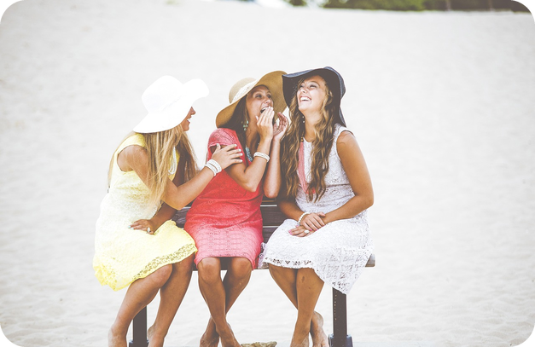
15
Wow! Oh no! Really?
🎧 LISTEN ASCOLTA
🔊 SAY IT PRONUNCIA
Listen. Complete B's replies. Then copy the voice!
⏱ 3 min 👥 pairs
Ascolta. Completa le risposte di B. Poi imita il tono!
🎧 2.9 · pause after B
A: I went to New York last week. B: ___! Did you like it?
Wow
A: It rained every day. B: Oh ___! What a ___!
no · pity
A: We went to a show in the West End. B: ___! What show was it?
Fantastic
A: I lost my phone on the first day. B: ___? How ___!
Really · awful
💡
Guess first, then listen!
🔈 click ▶
2A · Speaking · showing interest · 📖 SB p.15 · 5a, 5b · audio 2.9
Notes:
15. Speaking · showing interest (3 min)
SHOWING INTEREST (3 min). Pairs guess, play 2.9, click once per line. Answers (TG): 1 Wow · 2 no, pity · 3 Fantastic · 4 Really, awful. Play again pausing after B; students copy B's intonation – big and interested, not flat! They use these in the final speaking.

Slide 16
16
Make the question!
🎲 PLAY GIOCA
⏱ 3 min 🏆 teams
Make the question! Then ask your teacher.
Fai la domanda! Poi chiedi all'insegnante.
🎲
How to play
1
Where / go / last summer?
→ Where did you go last summer?
Read the words.
Teams write the past simple question.
Correct question = 1 point. Ask the teacher!
How / get there?
→ How did you get there?
2
3
Where / stay?
→ Where did you stay?
4
What / do there?
→ What did you do there?
5
What / weather / like?
→ What was the weather like?
TEAM A ☆☆☆☆☆
TEAM B ☆☆☆☆☆
6
have / a good time?
→ Did you have a good time?
2A · Grammar game
Notes:
16. Grammar game (3 min)
GAME (4 min). Teams write each question (20 seconds), click to show the model. Point for a correct question; +1 bonus if the team then ASKS you and you answer (tell a short true story about your last holiday – students love it). These are exactly the questions for the final speaking.

Slide 17
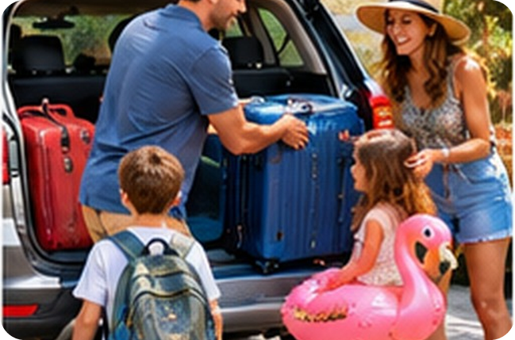
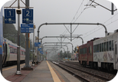
17
Tell me about your last holiday!
💬 TALK PARLA
⏱ 6 min 👥 pairs
Ask about your partner's last holiday.
Chiedi al compagno della sua ultima vacanza.
1
Where did you go last summer?
e.g. I went to Cefalù with my family.
2
How did you get there? Where did you stay?
e.g. We went by car and we rented an apartment.
3
What did you do there?
e.g. We sunbathed, went swimming and ate a lot of arancine!
4
What was the weather like?
e.g. It was really hot – 38 degrees!
💬
Useful phrases
5
Did anything go wrong?
e.g. Yes! I lost my sunglasses on the first day.
Wow! · Fantastic! · Really?
Oh no! What a pity! · How awful!
What was it like?
6
Did you have a good time?
e.g. Yes, I did. It was fantastic!
2A · Speaking · your last holiday · 📖 SB p.15 · 5 Speaking
Notes:
17. Speaking · your last holiday (6 min)
FREER PRACTICE (7 min). Model first: a student asks YOU the questions. Questions appear one per click (about a minute each). The listener must react (useful phrases) and ask one extra question. Monitor: past simple form + -ed pronunciation. Delayed correction (2 min): write 4–5 errors on the board, pairs correct them.

Slide 18
18
3 · 2 · 1
⏱ 2 min 👥 pairs
Books closed! What can you remember?
Libri chiusi! Cosa ricordi?
3
holiday phrases (go…, stay…, hire…)
📝
Homework · Compiti
Workbook 2A (teacher's choice)
Write 60–80 words: My last holiday (past simple!)
Learn 10 irregular verbs (Student's Book p.164)
2
irregular verbs from Stuart's story
1
question for your teacher about the weekend: "Did you…?"
Next lesson: 2B · That's me in the picture! · past continuous
2A · Exit · what can you remember?
Notes:
18. Exit · what can you remember? (2 min)
RETRIEVAL EXIT (2 min). Books closed. Pairs: 3 holiday phrases, 2 irregular verbs, 1 'Did you…?' question for the teacher – answer a couple. Set homework.

Slide 19
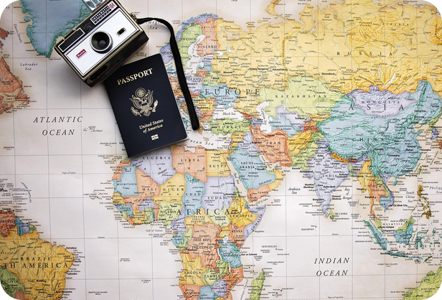
19
Student's Book audio 2A
🎧 LISTEN ASCOLTA
🙋 whole class
Click a speaker to play the book audio.
Clicca un altoparlante per l'audio del libro.
🎧 2.3 -ed endings: 3 sentences from Marta's story (p.15 · 3a)
🎧 2.4 Sounds /t/ /d/ /ɪd/ (p.15 · 3b)
🎧 2.8 Holiday adjectives: What was it like? (VB p.152 · 3)
💡
Remember
Track numbers = Student's Book 2A (pp.14–15)
Exercises checked in the Teacher's Guide
Click the speaker: play / pause
2A · Book audio · 2A
EXTRA · if there's time
Notes:
19. Book audio · 2A (0 min)
BOOK AUDIO. The other 2A tracks are on their slides: 2.1 Marta (slides 10–11), 2.2 Grammar Bank (rule), 2.5 -ed check, 2.6/2.7 holiday phrases, 2.9 showing interest.

