Slide 1





6A
ENGLISH FILE B1 · 6A · Part 1 · SB pp.56–57
BEHIND THE SCENES
READING · The world of extras
GRAMMAR · the passive (all tenses)
PRONUNCIATION · past participles
Who are these people in the crowd?
They're extras – they're paid to be there!
Teacher: timings, answers and tips are in the slide notes.
6A · Part 1
Notes:
6A PART 1 (60 min) · SB pp.56–57. Aims: read an article about the world of film extras; the passive in all tenses (Grammar Bank 6A p.142); regular and irregular past participles. Part 2 (pp.58–59) = cinema vocabulary, the Dagmara / Spielberg listening, cinema interview, film review. Timing: cover 2 · revision 5 · lead-in 4 · reading 7 · memory questions 6 · tenses 5 · rule 6 · practice 6 · pronunciation 6 · game 6 · exit 3 = 56 min. Click 1: question (show any crowd scene from a film if you like); click 2 introduces the word extra. (2 min)

Slide 2



REVISION · Practical English 3 · Requests
⏱ 5 min
5.25
5.28
Yes or no? The 'mind' trap
THINK! PENSA!
1 Would you mind closing the window? – Not at all.
YES 👍 – I'll close it.
Does the answer mean YES or NO? Thumbs up or down!
La risposta vuol dire SÌ o NO? Pollice su o giù!
2 Do you mind if I sit here? – Of course not.
YES 👍 – sit down!
3 Do you mind if I join you? – Yes, I do, actually.
NO 👎 – rude, but clear!
4 Could you do me a big favour? – Sure. What's up?
YES 👍 (probably…)
5 Is it OK if I use your phone? – I'm sorry, the battery's dead.
NO 👎 – polite no + reason
6 BONUS: 'How come you're so late?' means…?
Why are you so late?
📖 Teacher: revision of Practical English 3 pp.54–55 · audio 5.25, 5.28
6A · Part 1
Notes:
REVISION of Practical English 3 (5 min). VARIATION: reverse the obvious / trap – with 'mind', NO means YES. Read each mini-dialogue aloud with feeling; the class shows thumbs up (yes) or thumbs down (no) before you click. Item 3 is the trap (Yes, I do = I DO mind = no!). Item 6: what does How come…? mean? (= Why…?). Then pairs ask each other two requests from the episode: 'Would you mind meeting my friend at the airport?' – 'Not at all.'

Slide 3
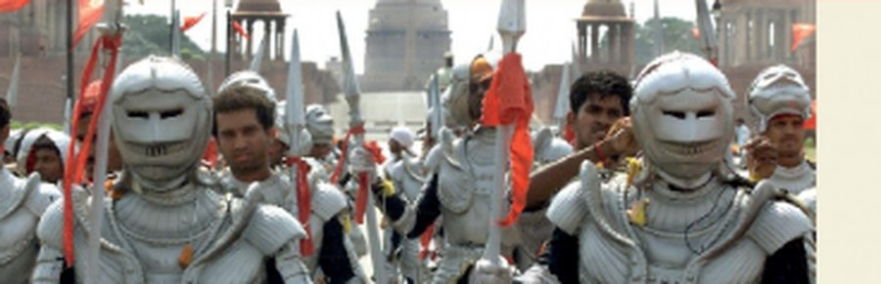
READING · Lead-in · Prediction
⏱ 4 min
What's an extra?
SPEAK! PARLA!
extra /ˈekstrə/ n. a person who is employed to play a very small part in a film, usually as a member of a crowd (una comparsa)
Pairs: think of 3 NEGATIVE things about being an extra.
In coppia: pensate a 3 cose NEGATIVE dell'essere una comparsa.
3 negative things? Then read p.56 – were you right?
long days, waiting · repeating scenes · bad weather / wrong clothes · no phones · bad pay
On the set of Nayak
📖 Teacher: Student's Book p.56 · 1a, 1b
6A · Part 1
Notes:
LEAD-IN + PREDICTION (4 min). 1a: focus on the definition and the photos (Bollywood film Nayak; Ripper Street); pairs think of three negative things about being an extra; write some ideas on the board. VARIATION: negative experiences + prediction. 1b: students read the article on pp.56–57 quickly to see if their ideas are mentioned. Click 1 – TG answers: days can be very long and extras spend a lot of time waiting · they have to repeat scenes many times · they have to work in all kinds of weather, often in unsuitable clothes · they can't use phones on set · they aren't well paid. Pre-teach if necessary: on set, scene, shot (= filmed), epic, crowd.

Slide 4
READING · The world of extras
⏱ 7 min
Complete the headings
READ! LEGGI!
1 They have to be ___ .
patient
Read again. Complete the 7 headings with a word from the list.
Rileggi. Completa i 7 titoli con una parola della lista.
2 They need to be good at ___ .
miming
3 They have to put up with all kinds of ___ .
weather
4 They have to be able to keep ___ .
secrets
5 They are extremely ___ .
expensive
expensive · miming · ordinary · patient · real · secrets · weather
6 Sometimes they are not ___ .
real
7 They can't watch films like ___ people.
ordinary
📖 Teacher: Student's Book pp.56–57 · 1c
6A · Part 1
Notes:
READING (7 min). 1c: students read the article again and complete headings 1–7 with the words from the list in the book: expensive · miming · ordinary · patient · real · secrets · weather (the sticky shows the same 7 words – the book's list has exactly these seven; headings 1–7 on the slide are the book's wording). Make sure they understand the words first (miming = acting without words). Pairs compare; click 1 for all answers (TG): 1 patient · 2 miming · 3 weather · 4 secrets · 5 expensive · 6 real · 7 ordinary. While checking, ask for the evidence in each paragraph (e.g. 5 expensive – Gandhi's funeral scene needed 300,000 extras). Deal with new vocabulary: put up with, fake, budget, inflatable, cardboard cut-outs.

Slide 5
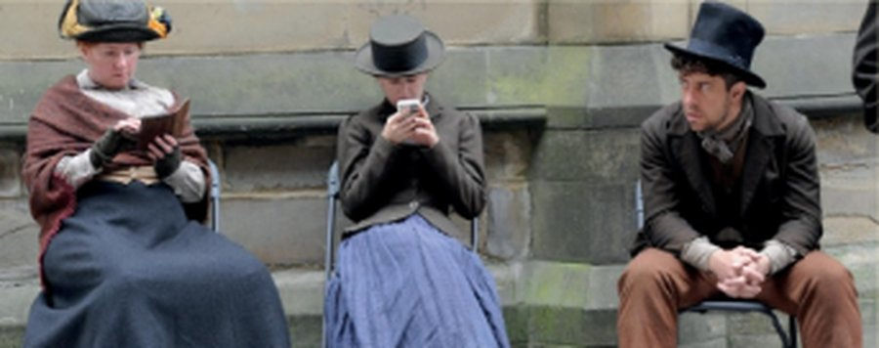
READING · Memory challenge
⏱ 6 min
Cover the text!
REMEMBER! RICORDA!
1 What do extras often do while they're waiting?
read or play cards
Cover the article. Answer from memory. Then check!
Copri l'articolo. Rispondi a memoria. Poi controlla!
2 What did the extras have to do in the crowd scene in Jersey Girl?
pretend to clap and cheer – in silence
3 How do you know if the snow is real or not in winter scenes?
you can see people's breath
4 What did an extra do during the filming of Insurgent, and what happened as a result?
posted a set photo online → never employed again
5 Why are a lot of British films made in Eastern Europe?
extras are paid less there
6 Why are inflatable extras popular nowadays?
look more real · can be stored and reused
On the set of Ripper Street
7 What happens when extras watch TV?
they watch the extras: right or wrong?
📖 Teacher: Student's Book pp.56–57 · 1d, 1e
6A · Part 1
Notes:
READING (6 min). 1d: 'Work in pairs. Can you answer these questions from memory? Then quickly look back at the article to check.' (questions 1–7 on the slide = book wording; the book prints 'Jersey Girls', the film is Jersey Girl); pairs answer from memory, then check in the article. VARIATION: memory challenge. Click 1 for all answers (TG): 1 They read or play cards. 2 They had to pretend to clap and cheer, but in silence. 3 The snow is real if you can see the breath coming out of people's mouths. 4 She took a photo of the set and posted it online. She's never been employed as an extra again. 5 Because extras are paid less than in Britain. 6 Because they look more real than digital extras, and can be stored and reused. 7 They look at the extras to see who's doing things right or wrong. 1e (1 min) – book: 'Do you know anybody who's been an extra? What in? Why do you think some people enjoy being extras? Would you like to be one? Why (not)?' Finish with a forced choice: show of hands – who would like to be an extra?

Slide 6
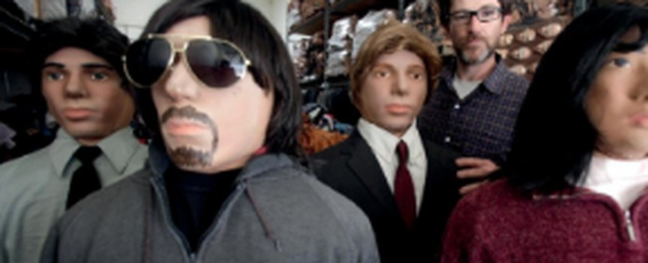
GRAMMAR · Presentation · SB p.57
⏱ 5 min
Which tense?
THINK! PENSA!
1 You wait and wait, but you aren't used.
present simple
Six extracts from the text. What tense or form of the passive?
Sei estratti dal testo. Che tempo o forma del passivo?
2 When a crowd scene was being filmed,…
past continuous
3 But it was all done in silence…
past simple
4 Sometimes, when a winter scene is being filmed,…
present continuous
5 …the air conditioning has to be turned off…
infinitive
'Inflatable crowd' dolls
6 Since then, she has never been employed…
present perfect
📖 Teacher: Student's Book p.57 · 2a
6A · Part 1
Notes:
GRAMMAR PRESENTATION (5 min). SB 2a: 'Look at six extracts from the text. What tense or form of the passive are the verbs?' (the slide extracts = the book's six). Pairs, then click once per item. TG ANSWERS (in order): 1 present simple · 2 past continuous · 3 past simple · 4 present continuous · 5 infinitive · 6 present perfect. Elicit the pattern: be (in the right tense) + past participle. VARIATION: curiosity gap / student as teacher (pairs explain how they recognised each tense).

Slide 7
GRAMMAR · Grammar Bank 6A p.142
⏱ 6 min
6.1
The passive
be + past participle
…in every form
by + person
A lot of films are shot on location.
When is our car being repaired?
Andy's bike has been stolen.
change be for the tense; the participle stays the same
The director died when the film was being made.
You'll be picked up at the airport.
This bill must be paid tomorrow.
I love being given a massage.
Gladiator was directed by Ridley Scott.
The new concert hall will be opened by the Queen.
only when it's important WHO did it
Watch out! ✗ The tickets sell at the box office → ✓ are sold. ✗ The film directed by… → ✓ was directed by… You don't always need by!
📖 Teacher: Grammar Bank 6A p.142 · audio 6.1
6A · Part 1
Notes:
GRAMMAR (6 min). Students open Grammar Bank 6A p.142; play 6.1 to listen and repeat (copy the rhythm) – all slide examples are from 6.1. TG grammar notes: there are two ways of saying the same thing (active and passive) with a different focus; we use the passive when the action is more important than who does it, or when we don't know who does it. Italian often uses an impersonal 'si' where English uses the passive: Rice is grown in this area (Qui si coltiva il riso). Typical mistakes (TG): using the active instead of the passive (✗ The tickets sell at a newsagent's) · leaving out be or using the wrong participle · thinking you always need by (somebody). Quick check: 'Bagheria – what is made / grown / visited here?' (elicit 2 answers).

Slide 8

GRAMMAR · Grammar Bank 6A · practice
⏱ 6 min
Make it passive!
WRITE! SCRIVI!
a 1–5 (in your book, p.142)
1 are being made · 2 inspired · 3 hasn't been inhabited · 4 is set · 5 will be shot
Grammar Bank 6A: a 1–5 and b 1–5. Then check!
Grammar Bank 6A: a 1–5 e b 1–5. Poi controlla!
b1 They subtitle a lot of foreign films.
A lot of foreign films are subtitled.
b2 García Márquez wrote Love in the Time of Cholera in 1985.
…was written by García Márquez in 1985.
b3 They're repairing my laptop at the moment.
My laptop is being repaired…
b4 They haven't released the DVD of the film yet.
The DVD… hasn't been released yet.
b5 They won't finish the film until the spring.
The film won't be finished until the spring.
📖 Teacher: Grammar Bank 6A p.142 · a 1–5, b 1–5 (a 6–10, b 6–10 = homework)
6A · Part 1
Notes:
PRACTICE (6 min). Students do Grammar Bank 6A a 1–5 and b 1–5 in the book, then compare. Click 1 for all answers (TG key): a 1 are being made · 2 inspired · 3 hasn't been inhabited · 4 is set · 5 will be shot. b 1 A lot of foreign films are subtitled. · 2 Love in the Time of Cholera was written by García Márquez in 1985. · 3 My laptop is being repaired at the moment. · 4 The DVD of the film hasn't been released yet. · 5 The film won't be finished until the spring. ⚠ The active prompts on the slide are our reconstruction from the key – the book's prompts may be worded differently. Homework: a 6–10, b 6–10. VARIATION: student as teacher – partner says which tense each answer is. EXTRA SUPPORT: Grammar photocopiable p.159 (⚠ not in our files).

Slide 9
PRONUNCIATION · Past participles · audio 6.2, 6.3
⏱ 6 min
6.2
6.3
Sound intruders
THINK! PENSA!
1 dog /d/: filmed · used · recorded · owned
recorded /ɪd/
Same sound? Circle the participle with a different sound.
Stesso suono? Cerchia il participio con un suono diverso.
2 tie /t/: finished · directed · released · booked
directed /ɪd/
3 clock /ɒ/: shot · gone · lost · done
done /ʌ/
4 phone /əʊ/: forgotten · spoken · stolen · known
forgotten /ɒ/
5 train /eɪ/: made · paid · taken · fallen
fallen /ɔː/
6 up /ʌ/: won · put · sung · drunk
put /ʊ/
📖 Teacher: Student's Book p.57 · 3a, 3b, 3c · audio 6.2, 6.3
6A · Part 1
Notes:
PRONUNCIATION (6 min). 3a: elicit the nine sound words (dog /d/, tie /t/, horse /ɔː/…). Students find the groups where all the pink letters have the same sound and circle the intruders – the slide shows the six groups that HAVE an intruder (groups 3 horse, 6 egg and 9 fish are all the same – ✓). 3b: play 6.2 group by group; click once per group. TG ANSWERS: 1 recorded · 2 directed · 3 ✓ · 4 done · 5 forgotten · 6 ✓ · 7 fallen · 8 put · 9 ✓; sounds: recorded /ɪd/, directed /ɪd/, done /ʌ/, forgotten /ɒ/, fallen /ɔː/, put /ʊ/. TG notes: -ed = /ɪd/ only after /t/ or /d/ – the one that really matters; hand on throat to feel voiced /d/ vs unvoiced /t/. 3c: play 6.3 – students change the active sentences to passive in the pause (1 They shot the film in Poland → The film was shot in Poland … 8 They don't use this office any more → This office isn't used any more). Then elicit from individuals. VARIATION: sound intruder (odd one out by sound).

Slide 10

GAME · Passive challenge
⏱ 6 min
Made in Sicily
PLAY! GIOCA!
1
Teams of 3. You have 3 minutes.
Teams: write passive sentences about Sicily! 3 minutes.
Squadre: scrivete frasi passive sulla Sicilia! 3 minuti.
2
Write true passive sentences about Sicily or Bagheria: things that are made, grown, eaten, built, visited, sold…
3
Use different tenses: is grown · was built · is being restored · has been opened · will be visited…
4
Read them out. Correct passive = 1 point. A tense nobody else used = +1.
5
Not sure it's true? The other teams can challenge!
Cannoli are made with ricotta. Lemons are grown near Bagheria. Our town is visited by…
📖 Teacher: free practice of Grammar Bank 6A (the passive)
6A · Part 1
Notes:
GAME (6 min). VARIATION: constraint challenge (only passive sentences; bonus for tense variety) + local personalisation. Teams write as many sentences as they can; then each team reads its best five. Judge the grammar; for the facts, let the class challenge ('Are you sure?') – you decide. Good verbs to elicit: made, grown, produced, built, painted, visited, eaten, sold, exported, filmed (link to part 2: films shot in Sicily!).

Slide 11
Look what you can do!
Guarda cosa sai fare adesso!
HOMEWORK · COMPITI
• Workbook 6A: 1a, 1b, 1c, 2a
• Grammar Bank 6A: a 6–10, b 6–10
• Homework sheet 6A-1
📷 Hand it in on the LLS app · Consegna nell'app LLS
✓ I can understand an article about film extras.
😀 🙂 😐
✓ I can use the passive in different tenses.
😀 🙂 😐
✓ I can pronounce regular and irregular past participles.
😀 🙂 😐
Next lesson: 6A part 2 · Cinema · Spielberg's interpreter
6A · Part 1
Notes:
EXIT (3 min). Students choose a face for each can-do. Homework: Workbook 6A 1a, 1b, 1c (the passive) and 2a (past participles; 2b is audio – optional at home) + Grammar Bank 6A a 6–10, b 6–10 + the 6A-1 homework sheet (easier version available). Answers are in the teacher key PDF.

Slide 12

EXTRA · Writing · Job advert
EXTRA
⏱ 8 min
Extras wanted!
WRITE! SCRIVI!
Pairs: a film is going to be shot in Bagheria next month. You need 200 extras!
1
Write a job advert for extras. Use 5 passives!
Scrivi un annuncio di lavoro per comparse. Usa 5 passivi!
Write a short advert (50–70 words) using information from the article.
2
Use at least 5 passives: Lunch will be provided… Phones are not allowed… You will be paid…
3
Read it out. Would the class apply?
4
EXTRAS WANTED! A historical film will be shot in Bagheria in May. You will be picked up at 6 a.m. …
6A · Part 1
Notes:
EXTRA (8 min). VARIATION: perspective change (from extra to film producer) + student-generated content. Recycles the article (patience, secrets, weather, pay) and the passive in different tenses.

Slide 13

EXTRA · Game · Running dictation
EXTRA
⏱ 8 min
Running dictation
PLAY! GIOCA!
1
Teacher sticks 5 passive sentences from the article on the wall outside / at the back of the room.
Runner: read, remember, run back, dictate!
Corridore: leggi, ricorda, torna indietro, detta!
2
Pairs: A is the runner, B is the writer. A runs to the wall, reads and remembers – no phones, no pens!
3
A runs back and dictates to B. Swap roles after sentence 3.
4
First pair with all 5 sentences correct (spelling too!) wins.
5
Then: underline the passives and name the tense.
Phones aren't allowed on set, and photos are strictly forbidden.
6A · Part 1
Notes:
EXTRA GAME (8 min). VARIATION: change the energy + memory. Use 5 sentences from the article (e.g. A lot of that time is spent just sitting around… / When a crowd scene was being filmed for the movie Jersey Girl, the extras had to pretend to clap and cheer. / Phones aren't allowed on set, and photos are strictly forbidden. / Since then, she has never been employed as an extra again. / Nowadays, where possible, crowds are digitized.). Print them in large font. Afterwards students check against the book p.56–57.

Slide 14

EXTRA · Grammar photocopiable · the passive
EXTRA
⏱ 8 min
Passive: all tenses
WRITE! SCRIVI!
a: complete sentences 1–12 with the right passive form (1 = was played).
1
a Write the passive form. b Active or passive? Circle.
a Scrivi la forma passiva. b Attivo o passivo? Cerchia.
b: read 'My favourite film: Sully' and circle active or passive.
2
Compare with a partner. Then check.
3
Cover the answers in a: read the sentences aloud with the passive.
4
📄 Print: B1_6A_Photocopiables.pdf, page 1
📖 Teacher: Grammar photocopiable 6A passive (all tenses) (TG p.159)
6A · Part 1
Notes:
EXTRA (8 min) or HOMEWORK (a in class, b at home). Grammar photocopiable 6A 'passive (all tenses)' – print B1_6A_Photocopiables.pdf, page 1. OFFICIAL ANSWERS (TG): a 1 was played (example) · 2 is watched · 3 be shot · 4 was being interviewed · 5 Has (the thief) been caught · 6 Have (you ever) been told · 7 has been robbed · 8 had already been made · 9 is being painted · 10 wasn't offered · 11 be returned · 12 had been stolen. b 1 is based (example) · 2 is known · 3 plays · 4 was directed · 5 is hit · 6 lose · 7 lands · 8 is killed · 9 are rescued · 10 believes · 11 received · 12 was nominated. ACTIVATION: cover the column in a and read the sentences aloud with the passive. VARIATION: spot the trap – in b, some verbs must stay active (plays, lose, lands, believes, received).

