Slide 1





6B
ENGLISH FILE B1 · 6B · Part 1 · SB pp.60–61
EVERY PICTURE TELLS A STORY
READING · What your profile photo says
GRAMMAR · must, might, can't (deduction)
SPEAKING · Judging by appearances
A photo of a dog. Whose profile is it?
It must be an animal lover!
Teacher: timings, answers and tips are in the slide notes.
6B · Part 1
Notes:
6B PART 1 (60 min) · SB pp.60–61. Aims: read a light-hearted article about profile photos; modals of deduction must / might / may / could / can't (Grammar Bank 6B); make deductions about people from their appearance (Communication 'Judging by appearances' p.107). Timing: cover 2 · revision 5 · lead-in 5 · reading 8 · debate 4 · listening 6.10 5 · rule 6 · practice 6 · Communication 7 · game 6 · exit 3 = 57 min. Click 1: question; let them guess before click 2 (the answer already uses today's grammar — don't explain it yet: 'You'll see why we say must in 20 minutes'). (2 min)

Slide 2



REVISION · 6A part 2 · Cinema
⏱ 5 min
6.7
6.8
6.9
Beat the clock!
PLAY! GIOCA!
1 all the people who act in a film
the cast
Two teams. 15 seconds for each answer!
Due squadre. 15 secondi per ogni risposta!
2 the music of a film
the soundtrack
3 a film which continues the story of an earlier film
a sequel
4 a person who plays a very small part, e.g. in a crowd
an extra
5 the translation of the dialogue on the screen
subtitles
6 Dagmara interpreted for which director? On which film?
Steven Spielberg · Schindler's List
📖 Teacher: revision of 6A pp.58–59 · Vocabulary Bank Cinema p.159 · audio 6.7–6.9
6B · Part 1
Notes:
REVISION of 6A part 2 (5 min). VARIATION: beat the clock (speed + team competition). Two teams. Read definition 1; teams have 15 seconds to write the word (team secretary writes, no shouting). Click once per item to show its answer (answers appear one per click). 1 point per correct word, +1 bonus for correct pronunciation of tricky words: soundtrack, sequel /ˈsiːkwəl/, subtitles /ˈsʌbtaɪtlz/. Definitions are from Vocabulary Bank Cinema (TG 6A). Item 6 recalls the 6A listening (audio 6.7: Dagmara, a student from Krakow, interpreted for Steven Spielberg on Schindler's List). If there's time, quick follow-up: 'Name a film that is dubbed / was shot on location / is based on a true story.'

Slide 3







READING · Lead-in · Prediction
⏱ 5 min
What's your profile photo?
SPEAK! PARLA!
A The portrait
B The childhood photo
primo piano / selfie
foto da bambino
Which one is YOUR profile photo? What does it say about you?
Qual è la TUA foto profilo? Cosa dice di te?
C The pet
D The wedding photo
animale domestico
foto del matrimonio
E The family photo
F The popular culture reference
foto dei figli
film, cartone, cantante…
G The party photo
H No photo at all
foto a una festa
nessuna foto, solo un'icona
📖 Teacher: Student's Book p.60 · 1a
6B · Part 1
Notes:
LEAD-IN + PREDICTION (5 min). SB 1a: 'Do you have a profile photo or photos that you use on social media? Show any that you can to your partner. Why did you choose them? How often do you change them?' Then show the 8 types (A–H = the article's headings: The portrait · The childhood photo · The pet · The wedding photo · The family photo · The popular culture reference · The party photo · No photo at all). VARIATION: prediction + curiosity gap — before reading, pairs predict what each type of photo 'says' about the person (e.g. 'Someone with a party photo must love going out'). Keep 2–3 predictions on the board to check after reading. Click 1 shows the Italian. Privacy: nobody has to show their own photo — they can describe it or choose 'a friend's'. Teach: profile photo, selfie, cute, adorable.

Slide 4

READING · What your profile photo says
⏱ 8 min
The positive version
READ! LEGGI!
1 You adore animals – in fact, in many ways, you prefer them to people.
C · the pet
2 You are a normal person and are happy with your appearance.
A · the portrait
Read the article. Then match each reason to a photo type.
Leggi l'articolo. Poi abbina ogni motivo a un tipo di foto.
3 You're a dedicated parent and your children always come first.
E · the family photo
4 You're a very private person. You prefer to talk to people face to face rather than use social media.
H · no photo
5 You're very up to date – you know everything about the latest films, TV, and books.
F · popular culture
6 Your friends and your social life are what matter most to you.
G · the party photo
7 The day you got married was the happiest day of your life.
D · the wedding photo
8 You had a wonderful childhood.
B · the childhood photo
📖 Teacher: Student's Book p.60 · 1b, 1c
6B · Part 1
Notes:
READING (8 min). 1b (3 min): students read the article on p.60 quickly and tick the two true statements: 1 The writer only likes certain types of profile photos. 2 The writer jokes about why people choose common types of photos. 3 The article is funny because the writer is rude about common types of profile photos. ANSWER: 2 and 3. Check their predictions from the previous slide: were they right? 1c (5 min): the article is rude and funny; now students read 'a positive interpretation of each type of profile photo and match it to A–H' (the book's sentences 1–8 are on the slide). Pairs compare, click 1 for all answers: 1 C · 2 A · 3 E · 4 H · 5 F · 6 G · 7 D · 8 B. VARIATION: perspective change — the same photo, a negative and a positive interpretation. Vocabulary to check: adore, dedicated, private, up to date, accomplish, incompetent, annoying.

Slide 5

SPEAKING · Mini debate
⏱ 4 min
Agree or no way?
SPEAK! PARLA!
"You can tell a lot about a person from their profile photo."
AGREE
NO WAY
Agree or no way? Give a reason!
D'accordo o per niente? Dai un motivo!
"A selfie as a profile photo is annoying."
AGREE
NO WAY
"Having no profile photo is cool."
AGREE
NO WAY
"You should have the same profile photo for friends and for work."
AGREE
NO WAY
I agree, because… · I'm not so sure… · No way! In my opinion…
📖 Teacher: Student's Book p.60 · 1d
6B · Part 1
Notes:
SPEAKING (4 min). SB 1d – book: 'Talk to a partner. Is your profile photo type included? If yes, do you agree with any of the positive or negative interpretations of your profile photo(s)? If not, what is your interpretation of your photo? Can you think of any friends or family members whose photos fit with the interpretations in the article?' Ask 1–2 of these first, then the statements. VARIATION: mild controversy / mini debate. Pairs choose AGREE or NO WAY for each statement and must give a reason; then find one person in the class who disagrees with them. Feedback: one statement, show of hands. If you have a profile photo, tell them which type yours is and whether the article is right about you (TG suggestion). Keep it light — nobody has to show their own photo.

Slide 6
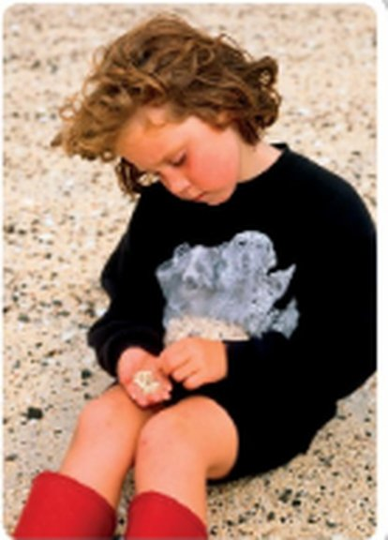
GRAMMAR · Presentation · audio 6.10
⏱ 5 min
Where is she?
LISTEN! ASCOLTA!
🎧 6.10
Look at the photo on p.61. Guess first! Then listen and complete.
Guarda la foto a p.61. Indovina prima! Poi ascolta e completa.
1 A: I love your profile picture. How old are you in the photo? Where are you?
2 B: I ___ be about five or six. Definitely not more than that.
must
3 B: Do you know, I can't remember. It ___ be the south of France.
might
4 A: It ___ be the south of France – not in summer.
can't
5 B: No, you're right. It ___ be Scotland, then.
could
6 2b It's possible? might, ___ · very probable? · impossible?
could · must · can't
📖 Teacher: Student's Book p.61 · 2a, 2b · audio 6.10
6B · Part 1
Notes:
LISTENING / PRESENTATION (5 min). VARIATION: prediction. Books open at the photo on p.61: pairs guess how old the child is and where (1 minute — they will naturally say 'maybe', 'I'm sure'). Play 6.10 once; students complete the gaps; play again if needed. Click 1 for answers (from the audio script): 1 must · 2 might · 3 can't · 4 could. Why can't it be the south of France? — She's wearing boots and a sweater, and it doesn't look like a Mediterranean beach. 2b: 'Look at the highlighted modal verbs and answer the questions. 1 Which modal verbs mean it's possible? might, ___ 2 Which modal verb means it's very probable? 3 Which modal verb means it's impossible?' – answers (TG): 1 could; 2 must; 3 can't.

Slide 7
GRAMMAR · Grammar Bank 6B p.143
⏱ 6 min
6.11
6.12
6.13
must, might, can't
must ✓✓
might / may / could ?
can't ✗✗
The neighbours must be out. There aren't any lights on.
Your sister must have a lot of money if she drives a Porsche.
= sono quasi sicuro che è vero (deve essere)
Tony's phone is off. He might be on the plane now.
It could be Scotland.
Laura might not / may not like that skirt.
= forse (potrebbe essere)
That woman can't be Jack's wife. Jack's wife has dark hair.
Nigel can't earn much money.
= sono sicuro che NON è vero (non può essere)
Watch out! ✗ It mustn't be true → ✓ It can't be true. ✗ He can be Spanish → ✓ He might / could be Spanish. ✗ must to be → ✓ must be
📖 Teacher: Grammar Bank 6B p.143 · audio 6.11, 6.12, 6.13
6B · Part 1
Notes:
GRAMMAR (6 min). Students open Grammar Bank 6B p.143; play 6.11–6.13 to listen and repeat (copy the rhythm). The example sentences on the slide are from audio 6.11–6.13. Rules (TG grammar notes + Grammar Bank examples): we use must, might / may / could and can't + infinitive (no 'to') to make deductions = guesses based on evidence. must = we're almost sure something is true; might / may / could = it's possibly true; might not / may not = possibly not true; can't = we're almost sure something is NOT true. They can be used with any verb, not only be (She must have a lot of money), and with be + -ing (She can't be working very hard). Italian learners: the opposite of must here is can't, NOT mustn't (mustn't = prohibition); can is not used for a possibility (✗ He can be Spanish). Quick check: hold up your phone — 'Who might be calling me?' — elicit 3 deductions.

Slide 8

GRAMMAR · Grammar Bank 6B · practice
⏱ 6 min
Complete B's answer
WRITE! SCRIVI!
a 1–5 (match in your book, p.143)
1 I · 2 J · 3 A · 4 C · 5 H
Grammar Bank 6B: a 1–5 and b 1–5. Then check!
Grammar Bank 6B: a 1–5 e b 1–5. Poi controlla!
b1 …I don't know his salary, but he ___ a fortune!
must earn
b2 I'm not sure. She ___ it. It's a bit short for her.
might not like
b3 She ___ a lot of languages to work there.
must speak
b4 Poor Andy. He ___ very happy about that.
can't be
b5 I'm not sure. I suppose they ___ on holiday.
might be
📖 Teacher: Grammar Bank 6B p.143 · a 1–5, b 1–5 (a 6–9, b 6–10 = homework)
6B · Part 1
Notes:
PRACTICE (6 min). Students do Grammar Bank 6B a 1–5 and b 1–5 in the book, individually then in pairs. Click 1 for the answers (TG key): a 1 I · 2 J · 3 A · 4 C · 5 H. b 1 must earn · 2 might not like · 3 must speak · 4 can't be · 5 might be (may is also correct where the key has might). Get them to read the full sentences aloud with natural stress. The slide shows B's lines from the key with the modal + verb gapped; students work from the full exercise in the book (⚠ the exact prompt wording is only in the Student's Book). The rest (a 6–9, b 6–10) is homework. VARIATION: student as teacher — fast finishers explain to their partner WHY (what is the evidence?). EXTRA SUPPORT: Grammar photocopiable p.160 (modals of deduction) if the class needs more practice.

Slide 9
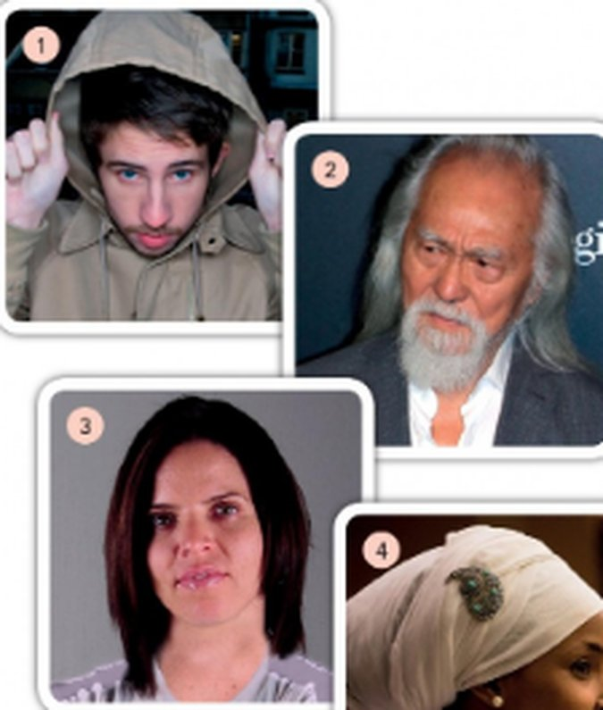
SPEAKING · Communication p.107
⏱ 7 min
Judging by appearances
SPEAK! PARLA!
1
The four people in 2d (p.61): four deductions each – with must, might / could / may and can't.
Pairs: who are they? Make deductions. Then check on p.107!
In coppia: chi sono? Fate deduzioni. Poi controllate a p.107!
2
be American / Asian / English… · be a criminal / a model… · have a degree / an Olympic medal… · be in his / her 20s / 30s / 50s / 80s
3
Go to Communication 'Judging by appearances', p.107. Student A reads the information about the first half of the people, Student B the second half.
4
Tell your partner what you read – don't show the page! Were your deductions right?
5
React: I knew it! / I'm really surprised – I thought she might be…
(I think) he might be English. – True, but he could be American, too.
📖 Teacher: Student's Book p.61 · 2d, 2e · Communication p.107
6B · Part 1
Notes:
COMMUNICATION / INFORMATION GAP (7 min). 2d (3 min): 'Look at the photos of four people. Make four deductions about each person, one with must, one with might / could / may, and one with can't + the phrases in the list. You can use the phrases more than once.' (the phrase list is on the slide, step 2; the four photos are in the picture). Elicit a few deductions for each photo but DON'T say if they're right. 2e (4 min): 'Communication Judging by appearances p.107. Find out who the four people are. Were you surprised?' — to make it a real information gap, A reads about the first half of the people and B about the second half, then they tell each other and say if they're surprised (⚠ check p.107 before the lesson and split the people between A and B — the page is not in our files). VARIATION: curiosity gap + perspective change (first impressions vs reality). Feedback: Who was the biggest surprise? Why do we judge people by appearance?

Slide 10
GAME · Clues + deductions
⏱ 6 min
You must be a…!
PLAY! GIOCA!
1
The CLUE-GIVER stands next to the screen, looking at it.
Listen to the clues. Answer only with must, might or can't!
Ascolta gli indizi. Rispondi solo con must, might o can't!
2
Everybody else: you must NOT see the screen – turn round or close your eyes!
3
Teacher clicks → a secret job. The clue-giver gives ONE clue at a time: I work at night. I wear a uniform…
4
Teams answer only with deductions: You might be a nurse! You can't be a pilot! You must be a…!
5
'You're a chef' = 0 points. 'You must be a chef!' + correct = 1 point. Red words = no point.
📖 Teacher: extra practice of Grammar Bank 6B (modals of deduction)
6B · Part 1
Notes:
GAME (6 min). VARIATION: constraint challenge — guesses only count if they use a modal of deduction, so the grammar is needed to score. Two teams; a clue-giver from team A, then team B, alternating. Model first: 'I work with my hands. I use a lot of water. I don't work in an office.' → 'You might be a plumber! You can't be a teacher!' After each correct answer the clue-giver's team gets the point only if the guess used must / might / can't. Fewer clues = better: you can give 2 points if they guess after 1–2 clues. IMPORTANT: guessers must not see the screen. Check they have turned round BEFORE you click each card. Every card is on its own slide.

Slide 11
GAME · Clues + deductions · card 1 of 6
👀 Guessers: don't look! · Non guardate!
PILOT
Don't say:
plane · fly · airport
6B · Part 1
Notes:
Card 1. Check the guessers can't see the screen, THEN click to show it.

Slide 12
GAME · Clues + deductions · card 2 of 6
👀 Guessers: don't look! · Non guardate!
CHEF
Don't say:
cook · kitchen · food
6B · Part 1
Notes:
Card 2. Check the guessers can't see the screen, THEN click to show it.

Slide 13
GAME · Clues + deductions · card 3 of 6
👀 Guessers: don't look! · Non guardate!
DENTIST
Don't say:
teeth · doctor · mouth
6B · Part 1
Notes:
Card 3. Check the guessers can't see the screen, THEN click to show it.

Slide 14
GAME · Clues + deductions · card 4 of 6
👀 Guessers: don't look! · Non guardate!
PHOTOGRAPHER
Don't say:
photo · camera · picture
6B · Part 1
Notes:
Card 4. Check the guessers can't see the screen, THEN click to show it.

Slide 15
GAME · Clues + deductions · card 5 of 6
👀 Guessers: don't look! · Non guardate!
FOOTBALLER
Don't say:
ball · football · goal
6B · Part 1
Notes:
Card 5. Check the guessers can't see the screen, THEN click to show it.

Slide 16
GAME · Clues + deductions · card 6 of 6
👀 Guessers: don't look! · Non guardate!
FIREFIGHTER
Don't say:
fire · water · truck
6B · Part 1
Notes:
Card 6. Check the guessers can't see the screen, THEN click to show it.

Slide 17
Look what you can do!
Guarda cosa sai fare adesso!
HOMEWORK · COMPITI
• Workbook 6B: 1a, 1b, 1c
• Grammar Bank 6B: a 6–9, b 6–10
• Homework sheet 6B-1
📷 Hand it in on the LLS app · Consegna nell'app LLS
✓ I can understand an article about profile photos.
😀 🙂 😐
✓ I can make deductions with must, might and can't.
😀 🙂 😐
✓ I can guess who people are from their appearance.
😀 🙂 😐
Next lesson: 6B part 2 · The body · Charisma
6B · Part 1
Notes:
EXIT (3 min). Students choose a face for each can-do. Homework: Workbook 6B 1a, 1b, 1c (grammar) + Grammar Bank 6B a 6–9, b 6–10 + the 6B-1 homework sheet (easier version available). Answers are in the teacher key PDF.

Slide 18

EXTRA · Game · Deductions
EXTRA
⏱ 8 min
Whose bag is it?
PLAY! GIOCA!
1
Teacher shows (or lists on the board) 5 objects 'found' in a bag: e.g. a train ticket to Catania, a guitar pick, sun cream, a dog lead, a library card.
Look at what's in the bag. Who is the owner?
Guarda cosa c'è nella borsa. Di chi è?
2
Pairs make 5 deductions about the owner: age, job, hobbies, where he / she lives.
3
Use must, might / could, can't + evidence: She must have a dog because…
4
Compare with another pair. The most convincing 'portrait' wins!
5
Round 2: pairs invent a bag for another pair.
The owner must play the guitar. She can't live in Catania – she's got a ticket to go there.
6B · Part 1
Notes:
EXTRA GAME (8 min) if there's time, or as a warmer in part 2. VARIATION: student-generated content (round 2). Real objects work best — bring an old bag with 5 things in it. There are no 'right' answers: reward good evidence. Printed alternative: Communicative photocopiable 'Who do you think they might be?' (next slides).

Slide 19
EXTRA · Speaking · Deductions
EXTRA
⏱ 6 min
What's going on?
SPEAK! PARLA!
1 Your friend is smiling at her phone and won't tell you why.
Make 3 deductions for each situation: must / might / can't.
Fai 3 deduzioni per ogni situazione: must / might / can't.
2 There's a lot of noise and music from the flat next door.
3 Your teacher arrives with a big cake.
4 A man is standing outside the school with a lot of flowers.
It must be… / He might have… / She can't be…
5 Your brother comes home very wet and very happy.
6B · Part 1
Notes:
EXTRA (6 min). VARIATION: forbidden easy answer — 'I don't know' is not allowed; every pair must give 3 deductions (one must, one might, one can't) for each situation, with evidence. Then the class votes for the funniest and the most logical deduction.

Slide 20

EXTRA · Grammar photocopiable · must / might / can't
EXTRA
⏱ 8 min
Isn't that Karen?
WRITE! SCRIVI!
a: read the conversation about Karen. Circle the right verb.
1
a Circle the right verb. b Complete with must, might, might not or can't.
a Cerchia il verbo giusto. b Completa con must, might, might not o can't.
b: complete conversations 1–4. Sometimes more than one answer is possible!
2
Compare with a partner. Then check.
3
Practise the conversations with a partner.
4
📄 Print: B1_6B_Photocopiables.pdf, page 1
📖 Teacher: Grammar photocopiable 6B modals of deduction (TG p.160)
6B · Part 1
Notes:
EXTRA (8 min) or HOMEWORK. Grammar photocopiable 6B 'modals of deduction: might, can't, must' – print B1_6B_Photocopiables.pdf, page 1. OFFICIAL ANSWERS (TG): a 1 can't (example) · 2 might · 3 must · 4 can't · 5 can't · 6 may. b 1 (must – example) can't / might not, must · 2 can't, might, might, might · 3 can't, must / might, might · 4 can't, must. ACTIVATION: practise the conversations with a partner. VARIATION: change the energy – act the Karen dialogue in a whisper, as if she's at the next table.

Slide 21
EXTRA · Communicative photocopiable · deduction
EXTRA
⏱ 10 min
Who might they be?
SPEAK! PARLA!
1
Jobs: boxer · hairdresser · mathematician · model · musician · poet · politician · yoga teacher.
Pairs: 8 photos, 8 jobs. Who does which job? Say why!
In coppia: 8 foto, 8 lavori. Chi fa quale lavoro? Spiega perché!
2
Alone: think which person might do which job.
3
Pairs: eliminate jobs – He / She can't be a… because…
4
Possible jobs: He / She might be… Final choice: He / She must be… because…
5
Teacher gives the answers. Who got the most right?
📄 Print: B1_6B_Photocopiables.pdf, page 2 · She can't be a boxer because she has long hair.
📖 Teacher: Communicative photocopiable 6B Who do you think they might be? (TG p.189)
6B · Part 1
Notes:
EXTRA (10 min) – or use it instead of the 'You must be a…!' game if the class needs more must / might / can't. Communicative photocopiable 6B 'Who do you think they might be?' – print B1_6B_Photocopiables.pdf, page 2 (one per pair). TG procedure: go through the jobs; tell students they are all real people who do one of these jobs; students first think alone, then in pairs focus on photo 1 – elicit a sentence why she can't be a boxer (e.g. She can't be a boxer because she has long hair) – then they do c and d for every photo, always saying why. Check they've made a final decision for each person, elicit opinions, then give the answers. EXTRA SUPPORT: write We think he / she must be… on the board. OFFICIAL ANSWERS (TG): 1 Gloria de Piero – a British politician and journalist, first elected in 2010 · 2 Richard Ward – an award-winning hairdresser to Royals and celebrities · 3 Sheku Kanneh-Mason – a musician, plays the cello; BBC Young Musician of the Year 2016 · 4 Ina Menzer – a German boxer, World Champion 2005–2010 · 5 Rachel Riley – a mathematician (studied at Oxford), also a TV presenter on the quiz show Countdown · 6 John Cooper Clarke – a British poet who performs his poems in front of an audience and records them · 7 Jessamyn Stanley – a yoga teacher who works to make yoga available to everyone · 8 Terry Hollands – a model for the clothes company Big Tall Order. VARIATION: curiosity gap + judging by appearances (link to 2e).

