Slide 1


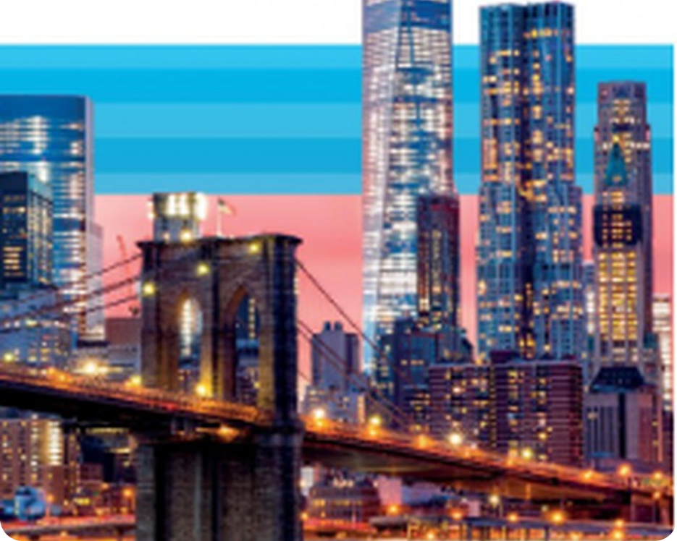


English File Elementary · SB pp.16–17
💡 THINK · PENSA
2B
Made in America
Colours, adjectives, very / quite
🎯
Today you're going to…
🎨 learn colours and adjectives
🇺🇸 name American icons: a hot dog, yellow taxis…
📖 listen to a class story and answer questions
🔊 hear long and short sounds: cheap, rich
👀 read about British and American English
What's typically American? Name 3 things!
EXAMPLE Hamburgers, yellow taxis and Hollywood films!
Notes:
1. OPENING (2 min)
OPENING (2 min). TG optional lead-in: books closed, ask what is typically American; write the ideas on the board (Hollywood films, hamburgers, yellow taxis, jeans…). Click: example answer. Keep the list – some of the words come back in the American icons slide.

Slide 2

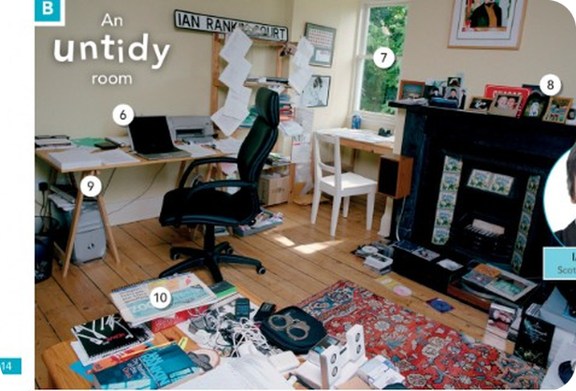
2
Remember 2A?
💡 THINK PENSA
⏱ 3 min 👥 pairs
Ask your partner: What's in your bag? Where are your keys?
🎯 Revision · Retrieval
Chiedi al compagno: Cosa c'è nella tua borsa? Dove sono le tue chiavi?
Things
Where?
What is it? – It's a wallet.
What are they? – They're sunglasses.
two watches · two keys
My phone is in my bag.
My keys are on the table.
The cat is under the sofa.
📅
Last lesson…
2A: things in your bag
plurals: keys, glasses
in, on, under
🔤 KEY WORDS
wallet
purse
keys
sunglasses
tissues
charger
2B · Revision · last lesson 2A
Notes:
2. Revision · last lesson 2A (3 min)
REVISION (3 min). Pairs ask the two questions with their real bags (2–3 things each). Quick check of /ɪz/: glasses, watches, pieces. Leads in: today we DESCRIBE things – colours and adjectives.

Slide 3


3
What colour is it?
👀 LOOK GUARDA
🎧 LISTEN ASCOLTA
Say the colour in English. Click: the Italian.
⏱ 3 min 🙋 whole class
Di' il colore in inglese. Clicca: l'italiano.
🎯 Vocabulary · TPRS · meaning
⚫
black
🟡
yellow
🐘
grey
🟠
orange
nero
giallo
grigio
arancione
🟤
brown
🌸
pink
🟢
green
🟣
purple
marrone
rosa
verde
viola
🥈
silver
🥇
gold
🔴
red
🔵
blue
argento
oro
rosso
blu / azzurro
⚠ Watch out! grey (UK) = gray (US) · orange /ˈɒrɪndʒ/ · the American flag is red, white and blue
🎧 2.6
▶ normal · 🐢 slower
2B · Vocabulary · colours · 📖 SB p.16 · 1a, 1b · audio 2.6
Notes:
3. Vocabulary · colours (3 min)
VOCABULARY (3 min). SB 1a: What colour is the American flag? (red, white, blue). Play 2.6 – students listen and repeat. Then point at each circle: the class says the colour, click once per colour for the Italian. Drill orange /ˈɒrɪndʒ/ (TG note), purple /ˈpɜːpl/, silver, gold. Answers 1b (TG): black, yellow, grey, orange, brown, pink, green, purple, silver, gold.

Slide 4

4
What colour is your bag?
💬 TALK PARLA
⏱ 3 min 👥 pairs
Ask your partner. Answer: It's… / They're…
🎯 Speaking · Controlled practice
Chiedi al compagno. Rispondi: It's… / They're…
⭐
Example
1
What colour is the Italian flag?
It's green, white and red.
What colour is the American flag? → It's red, white and blue.
2
What colour are New York taxis?
They're yellow.
3
What colour is your bag?
It's black. / It's brown…
4
What colour are your shoes?
They're white…
5
What colour is a Sicilian lemon?
It's yellow (and green)!
6
What colour is that? (point!)
It's grey. / It's blue…
2B · Speaking · colours · 📖 SB p.16 · 1c
Notes:
4. Speaking · colours (3 min)
SPEAKING (3 min). SB 1c: model and drill the two questions (What colour is…? / What colour are…?). Pairs ask and answer; click once per line for a model answer. Point out: is + one thing → It's…, are + plural → They're… (like 2A). TG extra support: other flags – What colour is the French / Polish flag?

Slide 5
5
Big or small?
👀 LOOK GUARDA
🎧 LISTEN ASCOLTA
Say the opposite. Click 1: example. Click 2: Italian.
⏱ 4 min 👥 pairs
Di' il contrario. Clic 1: esempio. Clic 2: italiano.
🎯 Vocabulary · TPRS · meaning
🐘
big ≠ small
💶
cheap ≠ expensive
🏎️
fast ≠ slow
🔥
hot ≠ cold
an elephant ≠ a mouse
a pizza ≠ a Ferrari
a train ≠ a bus in traffic
Sicily in July ≠ London in January
grande ≠ piccolo
economico ≠ caro
veloce ≠ lento
caldo ≠ freddo
👍
good ≠ bad
📝
easy ≠ difficult
💰
rich ≠ poor
🧓
old ≠ new / young
a good film ≠ a bad film
2 + 2 ≠ Chinese
a millionaire ≠ no money
an old car ≠ a new car · an old man ≠ a young man
buono ≠ cattivo
facile ≠ difficile
ricco ≠ povero
vecchio ≠ nuovo / giovane
⚠ Watch out! old ≠ new (things) · old ≠ young (people) · right ≠ wrong (answers) · right ≠ left (hands) · short ≠ long / tall
🎧 2.7
▶ normal · 🐢 slower
2B · Vocabulary · opposite adjectives · 📖 Vocabulary Bank Adjectives p.152 · audio 2.7
Notes:
5. Vocabulary · opposite adjectives (4 min)
OPPOSITES (4 min). Max 8 pairs today (A1–A2); the Vocabulary Bank has 21 – play 2.7 for the whole list if the class is strong. For each tile: students say the opposite, click 1 = an English example, click 2 = the Italian. TG vocabulary note: old, right and short have TWO opposites (Watch out box). Pairs test each other: A says an adjective, B says the opposite (TG 1c).

Slide 6
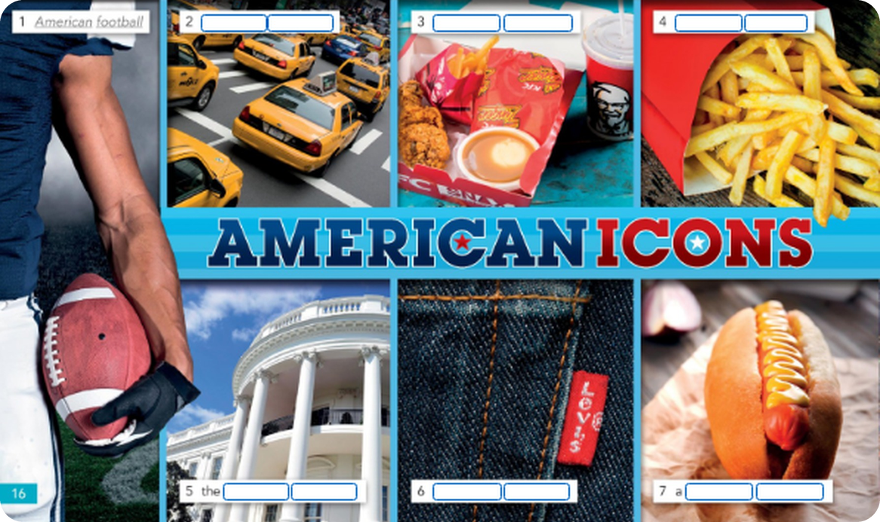
6
American icons
👀 LOOK GUARDA
💬 TALK PARLA
Adjective + noun: what are 1–7?
⏱ 4 min 👥 pairs
Aggettivo + nome: cosa sono 1–7?
🎯 Grammar · Communicative
1
A sport (1 = example)
American football
2
3
4
2
Cars in New York
yellow taxis
3
Quick food: burgers, chicken
fast food
1
4
Patatine fritte
French fries
5
The President's house
5
6
7
the White House
6
Trousers
blue jeans
7
A sausage in bread
a hot dog
2B · Grammar · American icons · 📖 SB p.16 · 2a (answers: SB key) · 8 = New York
Notes:
6. Grammar · American icons (4 min)
GRAMMAR IN CONTEXT (4 min). SB 2a: label the photos with an adjective (American, French, blue, hot, fast, White, yellow, New) + a noun (football, fries, jeans, dog, food, House, taxis, York). Pairs, 2 minutes, then click once per number. Answers (SB key): 1 American football (example) · 2 yellow taxis · 3 fast food · 4 French fries · 5 White House · 6 blue jeans · 7 hot dog · 8 New York (the city photo – ask it last). SB 2b: Can I have a hot dog / dog hot? (hot dog) · The taxis are yellow / yellows (yellow) → adjectives go BEFORE the noun and don't change.

Slide 7

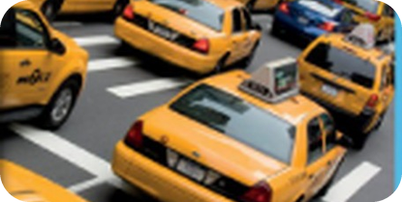
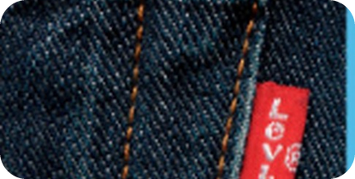
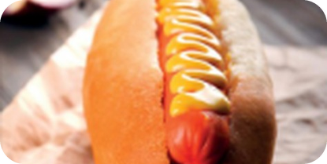

7
A yellow taxi
👀 LOOK GUARDA
⏱ 4 min 🙋 whole class
Look at the coloured words. What's the rule?
🎯 Grammar · Guided discovery
Guarda le parole colorate. Qual è la regola?
before the noun
never + s
be + adjective
very / quite
adjective + noun
no plural adjectives
after be
how much?
a yellow taxi
a hot dog
blue jeans
yellow taxis
The taxis are yellow.
Is it cheap?
It's very big.
It's quite cheap.
PRIMA del nome (≠ italiano!)
l'aggettivo non cambia
dopo il verbo essere
very / really = molto · quite = abbastanza
⚠ ✗ a car red → ✓ a red car · ✗ yellows taxis → ✓ yellow taxis · ✗ It's a very car fast → ✓ It's a very fast car
🎧 2.8 ▶ normal · 🐢 slower
2B · Pop-up grammar · adjectives · 📖 Grammar Bank 2B p.126 · audio 2.8
Notes:
7. Pop-up grammar · adjectives (4 min)
POP-UP GRAMMAR (4 min). Point back to the icons: yellow taxis – not 'taxis yellow', not 'yellows'. Elicit each column before clicking. Play 2.8 (Grammar Bank sentences: The White House is in Washington DC. It's a beautiful picture… He's strong. We aren't rich. Is your car new? She's quite famous. It's a very big city. We're really tired.) – listen and repeat. TG grammar note: one form only; with be, the adjective comes after: Is your car fast? Italian speakers say 'a car red' – correct it every time today.

Slide 8
8
Frank's yellow taxi
🎧 LISTEN ASCOLTA
💬 TALK PARLA
Listen to the story. Answer the questions!
⏱ 5 min 🙋 whole class
Ascolta la storia. Rispondi alle domande!
🎯 Speaking · TPRS · story
🔑
Story phrases
1
This is Frank. He's from New York. He has a very old yellow taxi.
❓ Is Frank from New York or London? · Is his taxi new or old? · What colour is it?
a very old taxi
un taxi molto vecchio
quite slow ≠ fast
abbastanza lento ≠ veloce
really late
molto in ritardo
rich ≠ poor
ricco ≠ povero
long ≠ short
lungo ≠ corto
cheap ≠ expensive
economico ≠ caro
Frank's taxi is quite slow, but it's very clean.
❓ Is the taxi fast? · Is it clean or dirty?
2
3
One day a rich woman gets in. She has a big purple bag.
❓ Is she rich or poor? · What colour is her bag?
4
'The White House, please! I'm really late!'
❓ Where does she want to go? · Is she late?
5
But the White House isn't in New York! It's a very long trip.
❓ Is the White House in New York? · Is the trip short?
6
Frank is very happy. It's a really expensive trip! 💵
❓ Is Frank happy or sad? · And you – is your car old or new?
2B · Speaking · class story (TPRS)
Notes:
8. Speaking · class story (TPRS) (5 min)
TPRS CLASS STORY (5 min) – the adjectives, colours and very / quite from today, heard many times before the practice. Click once per line. For each line: 1) say it, 2) ask the questions round the class (yes/no → either/or → what/where), 3) let the CLASS change details (accept their idea and use it in later lines): 'Is the woman's bag purple? No? What colour is it?' Students answer with one word or a short phrase – that's fine; repeat the full sentence yourself. Recycles: adjective before the noun (an old taxi, a big bag), be + adjective (the taxi is slow), very / really / quite, opposites. Finish: 'What happens next?' (the White House is in Washington DC!).

Slide 9
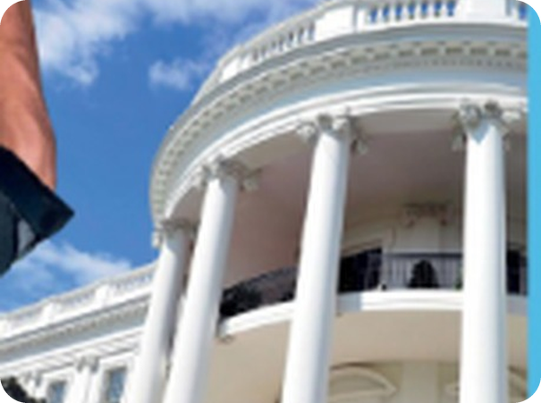
9
Word order
🔀 REORDER RIORDINA
💬 TALK PARLA
Put the words in order. Say the sentence.
⏱ 4 min 👥 pairs
Metti le parole in ordine. Di' la frase.
🎯 Grammar · Controlled practice
⭐
Example
1
Louis / French / Is ?
Is Louis French?
big / It's / a / house / very → It's a very big house.
2
watch / an / It's / expensive
It's an expensive watch.
3
easy / it / an / exercise / Is ?
Is it an easy exercise?
4
girlfriend / Spanish / your / Is ?
Is your girlfriend Spanish?
5
difficult / very / questions / are / These
These questions are very difficult.
6
tickets / they / Are / cheap ?
Are they cheap tickets?
2B · Grammar · practice · 📖 Grammar Bank 2B p.127 · a (answers: SB key)
Notes:
9. Grammar · practice (4 min)
CONTROLLED PRACTICE (4 min). Grammar Bank 2B exercise a (the book's answers). Pairs say each sentence, then click to check. Highlight: an expensive / an easy (vowel sound, from 2A); questions with be: Is Louis French? (not 'Louis is French?').

Slide 10
10
Fish or tree?
🔊 SAY IT PRONUNCIA
🎧 LISTEN ASCOLTA
Say the word. Which sound picture?
⏱ 4 min 👥 pairs
Di' la parola. Quale immagine-suono?
🎯 Pronunciation · Guided discovery
🏷️
The colours
cheap
🌳 tree /iː/
hot
⏰ clock /ɒ/
🐟 fish /ɪ/
🌳 tree /iː/
rich
🐟 fish /ɪ/
🐱 cat /æ/
🚗 car /ɑː/
⏰ clock /ɒ/
🐴 horse /ɔː/
fast
🚗 car /ɑː/
🐂 bull /ʊ/
👢 boot /uː/
new
👢 boot /uː/
black
🐱 cat /æ/
good
🐂 bull /ʊ/
🎧 2.9 + 2.10
small
🐴 horse /ɔː/
▶ normal · 🐢 slower
2B · Pronunciation · long and short vowels · 📖 SB p.17 · 3a, 3b · audio 2.9, 2.10
Notes:
10. Pronunciation · long and short vowels (4 min)
PRONUNCIATION (4 min). Play 2.9: the 8 sound pictures – listen, then listen and repeat. The two dots /ː/ = a LONG sound (tree, car, horse, boot). Pairs say each adjective (the vowel is highlighted) and match it to a picture; play 2.10 to check (it has two adjectives per sound); click once per word. Answers (TG 2.10): fish rich, big · tree easy, cheap · cat black, bad · car fast, dark · clock hot, wrong · horse small, short · bull full, good · boot blue, new. TG note: exaggerate the long sounds – Italian has one i and one u.

Slide 11
11
Same sound!
🎲 PLAY GIOCA
🔊 SAY IT PRONUNCIA
Same sound! Choose the noun. Be quick!
⏱ 3 min 🏆 teams
Stesso suono! Scegli il nome. Veloci!
🎯 Pronunciation · Communicative game
🎲
How to play
1
a big … (city · car · cat)
→ a big city /ɪ/
Read the adjective and the 3 nouns.
Leggi l'aggettivo e i 3 nomi.
Find the noun with the SAME vowel sound.
Trova il nome con lo STESSO suono vocalico.
Say the phrase first = 1 point.
Chi dice prima la frase = 1 punto.
a black … (bag · book · boot)
→ a black bag /æ/
2
3
cheap … (jeans · shoes · bags)
→ cheap jeans /iː/
4
dark … (glasses · dogs · books)
→ dark glasses /ɑː/
5
a good … (book · day · cat)
→ a good book /ʊ/
🎧 2.11
6
new … (boots · bags · jeans)
→ new boots /uː/
▶ normal · 🐢 slower
2B · Pronunciation game · 📖 SB p.17 · 3c, 3d · audio 2.11
Notes:
11. Pronunciation game (3 min)
GAME (3 min). SB 3c as a team race (TG extra idea: race with a time limit). Teams say the phrase with a / an; click once per line, then play 2.11 to check and drill. Answers (TG 2.11): a big city · a black bag · cheap jeans · dark glasses · a good book · a grey day · new boots · an old photo · a short story. Extra challenge (TG): phrases about the classroom – a dirty board, big windows, a brown bag.

Slide 12
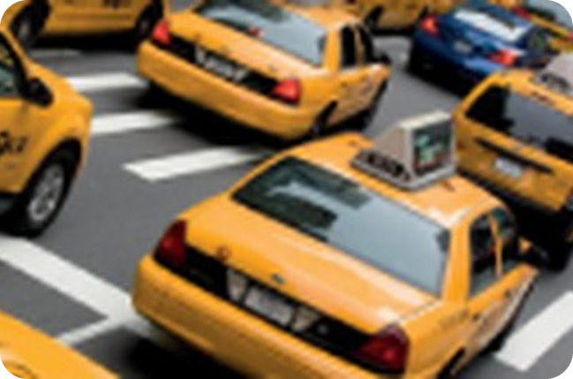
12
I have a red car!
💬 TALK PARLA
⏱ 4 min 👥 pairs
Tell your partner about 8 things you have. Use a colour or an adjective.
🎯 Speaking · Communicative
Parla al compagno di 8 cose che hai. Usa un colore o un aggettivo.
1
Your phone
e.g. I have a new black phone.
2
Your car / bike / scooter
e.g. I have a very old red car.
3
Your bag
e.g. My bag is quite big and brown.
4
Your house or flat
e.g. I have a small flat – it's really nice.
💬
Useful phrases
5
Something in your fridge
e.g. I have some very good cheese!
I have a very old… · a new…
It's quite big / really small.
Really? Me too! / What colour is it?
6
Extension: something you DON'T want
e.g. I have a really ugly jumper – it's a present from my aunt! 😄
2B · Speaking · 8 things you have · 📖 SB p.17 · 4a
Notes:
12. Speaking · 8 things you have (4 min)
SPEAKING (4 min). Give students 1 minute to think of 8 things (TG extra support: write them). Prompts appear one per click – model each. Pairs tell each other; the partner asks one question (What colour is it? Is it new?). TG extra idea: before feedback, can you remember your partner's 8 things? 'You have a…'. Note 3–4 word-order errors (a car red) for correction.

Slide 13
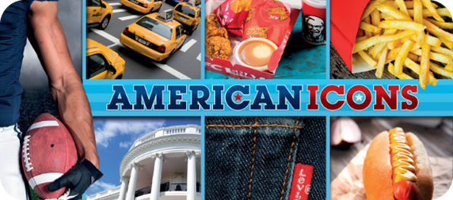
13
What is it?
🎲 PLAY GIOCA
⏱ 4 min 👥 pairs
Describe it! Your partner guesses.
🎯 Speaking · Communicative game
Descrivilo! Il compagno indovina.
🎲
How to play
A describes
B describes
A looks at the screen. B doesn't look.
A guarda lo schermo. B non guarda.
A describes it: colour + 2 adjectives.
A lo descrive: colore + 2 aggettivi.
B guesses. Then swap.
B indovina. Poi scambiatevi.
a banana
a Ferrari
a New York taxi
snow
an elephant
a lemon
the Colosseum
a hot dog
2B · Speaking game
Notes:
13. Speaking game (4 min)
GAME (4 min) – replaces the Communication pair-work (SB p.103/109). Model: 'It's yellow, it's quite long and it's cheap. You eat it.' → a banana. Words appear one per click, alternating A (pink) and B (blue). Accept any correct description with adjective + noun or be + adjective. ICQ: 'Can you say the word?' (no).

Slide 14
14
The same, but different
👀 READ LEGGI
✏️ FILL THE GAPS COMPLETA
Read the article. Choose a heading from the box for 2–4.
⏱ 5 min 👥 pairs
Leggi l'articolo. Scegli un titolo dal riquadro per 2–4.
🎯 Reading · TPRS · reading
📰 British and American English
🎧 2.12
1 Vocabulary – Some words are different. Americans say ZIP code (not postcode), vacation (not holiday) and cell phone (not mobile phone). In American English a purse is a woman's bag!
🧺 Headings · two don't fit!
2 (2) ________ – Words with -our in British English end in -or in American English: colour → color. Centre and theatre → center and theater.
Food
Grammar
2 Spelling – Words with -our in British English end in -or in American English: colour → color. Centre and theatre → center and theater.
Music
Pronunciation
3 (3) ________ – There are small differences, especially prepositions. Americans say See you Friday. British people say See you on Friday.
3 Grammar – There are small differences, especially prepositions. Americans say See you Friday. British people say See you on Friday.
Spelling
4 (4) ________ – This is the really important difference. When an American starts speaking, British people know he or she is American.
4 Pronunciation – This is the really important difference. When an American starts speaking, British people know he or she is American.
▶ normal · 🐢 slower
2B · Reading · British and American English · 📖 SB p.17 · 5a, 5b · audio 2.12 · article shortened
Notes:
14. Reading · British and American English (5 min)
READING (5 min). The article is ON THE SLIDE (shortened from the book, facts unchanged). Pre-teach only: different = diverso, the same = uguale. Pairs choose headings 2–4 from the box (Food and Music don't fit), then play 2.12 to check; click once per heading. Answers (SB key): 2 Spelling · 3 Grammar · 4 Pronunciation. Link to 2A: purse = borsellino in the UK, but a bag in the US!

Slide 15

15
True or false?
👀 READ LEGGI
✅ CHECK CONTROLLA
True or false? Correct the false ones.
⏱ 3 min 👥 pairs
Vero o falso? Correggi quelle false.
🎯 Reading · Controlled practice
⭐
Example
1
1 British and American English are very different.
F – the differences are small.
📰 The article is on the last slide. Go back if you need to!
2
2 Holiday and postcode are the same in the US.
F – vacation, ZIP code.
3
3 Purse has a different meaning in the US.
T
4
4 Kilometer is the British spelling.
F – it's American (UK: kilometre).
5
5 The grammar is not very different.
T
6
6 It's difficult to know if a person is American.
F – it's easy (the accent).
2B · Reading · detail · 📖 SB p.17 · 5c (answers: TG)
Notes:
15. Reading · detail (3 min)
DETAIL (3 min). SB 5c. Pairs answer T/F and correct the false ones (TG: elicit WHY each F is false). Click once per sentence. 5d / TG extra challenge: more American words – movie, cookie, apartment, soccer, elevator. UK / US: cell phone = mobile phone · color = colour · purse = handbag · vacation = holiday · ZIP code = postcode.

Slide 16
16
Today you…
💡 THINK PENSA
⏱ 1 min 🙋 whole class
Can you do it now? Thumbs up or thumbs down!
🎯 Revision · Reflection
Ora sai farlo? Pollice su o pollice giù!
🎨
Learnt colours and adjectives
✅
👍 👌 👎
Can you do it now?
Ora sai farlo?
🇺🇸
Named American icons: a hot dog, yellow taxis…
✅
📖
Listened to a class story and answered questions
✅
🔊
Heard long and short sounds: cheap, rich
✅
👀
Read about British and American English
✅
2B · Review · what did you do today?
Notes:
16. Review · what did you do today? (1 min)
TODAY YOU… (1 min). Read each line (one per click: the tick appears). Students show thumbs up / middle / down: can they do it now? Note any thumbs down for the next lesson's recap.

Slide 17
17
3 · 2 · 1
⏱ 2 min 👥 pairs
🎯 Revision · Retrieval
Books closed! What can you remember?
Libri chiusi! Cosa ricordi?
3
pairs of opposites (big ≠ small…)
📝
Homework · Compiti
Workbook 2B: 1a, 1b, 1c (colours, opposites)
Workbook 2B: 2a–2e (adjectives)
Workbook 2B: 3a (long and short sounds)
Write: 5 things you have + an adjective
2
American icons (a hot dog…)
1
sentence about Frank's taxi
Next lesson: 2C · Slow down! · feelings, imperatives, let's
2B · Exit · what can you remember?
Notes:
17. Exit · what can you remember? (2 min)
RETRIEVAL EXIT (2 min). Books closed. Pairs: 3 pairs of opposites, 2 American icons (adjective + noun), 1 sentence about Frank's taxi (a very old yellow taxi…). Set homework: Workbook 2B pp.14–15 – 1a–c, 2a–e, 3a (3b needs the Workbook audio, optional) + write 5 things you have with an adjective (a red car, a very old phone…).

Slide 18
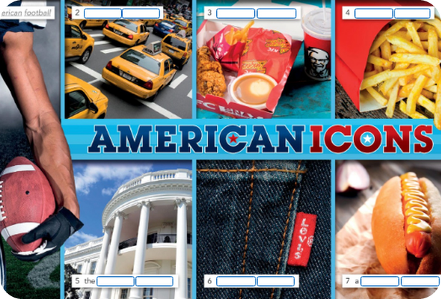
18
Extra: all the adjectives
🎧 LISTEN ASCOLTA
🙋 whole class
Click a speaker to play the book audio.
Clicca un altoparlante per l'audio del libro.
🎧 2.6 Colours – listen and repeat
🎧 2.7 Vocabulary Bank Adjectives – 21 opposites
🎧 2.11 Same-sound phrases
💡
Remember
2.7 = all 21 pairs of opposites (Vocabulary Bank p.152)
Click the speaker: play / pause
2B · Book audio · 2B
EXTRA · if there's time
Notes:
18. Book audio · 2B (0 min)
EXTRA. 2.7 has all 21 pairs from the Vocabulary Bank (too many for one A1/A2 lesson): use it for a fast class or as revision next time.

