Slide 1


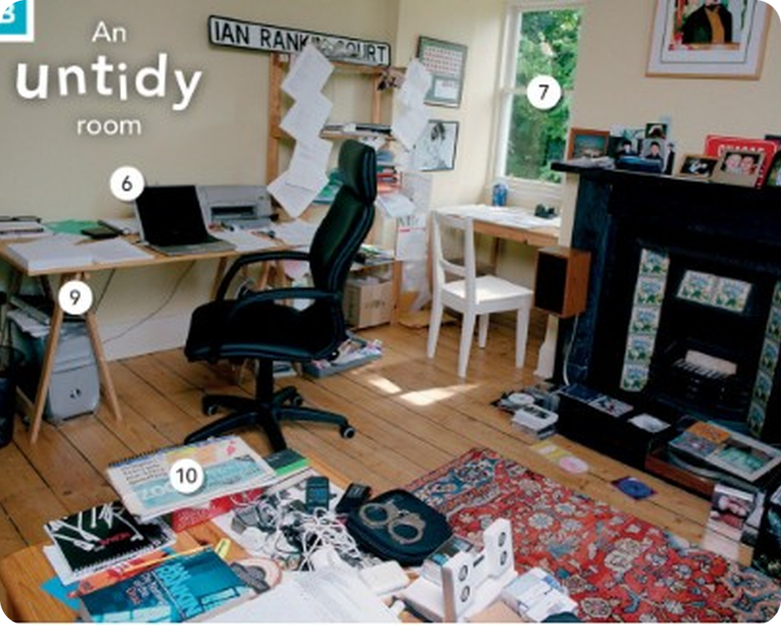


English File Elementary · SB pp.14–15
💡 THINK · PENSA
2A
Are you tidy or untidy?
Things, plurals, in/on/under
🎯
Today you're going to…
🔑 learn the names of everyday things
✏️ make plurals: a key → two keys
🔊 say -s and -es correctly
📍 say where things are: in, on, under
Is your desk at home tidy or untidy?
EXAMPLE My desk is very untidy! There are papers, cups and cables everywhere.
Notes:
1. OPENING (2 min)
Show the photo. Teach tidy / untidy with gestures (put your things in order / mess them up). Ask the question; students answer 'tidy' or 'untidy'. Click: the example. Read 'Today you're going to…' together.

Slide 2

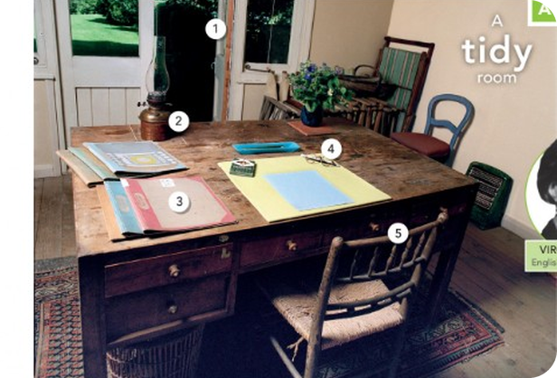
2
Remember last lesson?
💡 THINK PENSA
⏱ 3 min 🙋 whole class
Read the examples. Then say one more.
Leggi gli esempi. Poi dinne un altro.
be + questions
In the classroom
What's your name? My name's Anna.
Where are you from? I'm from Italy.
How do you spell it? A-N-N-A.
What's this? It's a chair.
What's that? It's a window.
Sorry I'm late. · What page is it?
📅
Last lesson…
File 1: be, questions, the alphabet
classroom language
🔤 KEY WORDS
board
chair
desk
door
window
table
2A · Revision · last lesson
Notes:
2. Revision · last lesson (3 min)
REVISION (3 min). Read the examples together. Point at things in the room: 'What's this?' – students answer 'It's a desk.' Then 'How do you spell desk?' (D-E-S-K). This leads straight into today: more THINGS.

Slide 3

3
Spell it!
🎲 PLAY GIOCA
⏱ 3 min 👥 pairs
Look at the word. Spell it to your partner!
Guarda la parola. Fai lo spelling al compagno!
🎲
How to play
ROUND 1 · A spells
ROUND 2 · B spells
A looks at the screen. B closes the book.
A spells the word: D-E-S-K.
B writes it and says it. Then swap.
window
door
chair
desk
board
picture
TEAM A ☆☆☆☆☆
TEAM B ☆☆☆☆☆
table
wall
2A · Warmer · alphabet + things
Notes:
3. Warmer · alphabet + things (3 min)
WARMER (3 min). Demo: spell C-H-A-I-R, a student writes it on the board. Click once per word. Watch the letters Italians mix up: E /iː/ vs I /aɪ/, A /eɪ/ vs E, G /dʒiː/ vs J /dʒeɪ/.

Slide 4
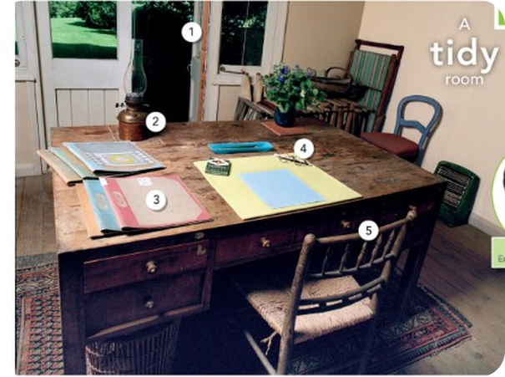
4
Room A and room B
👀 LOOK GUARDA
🔍 FIND TROVA
Look at rooms A and B. Find the PLURAL things.
⏱ 4 min 👥 pairs
Guarda le stanze A e B. Trova le cose al PLURALE.
⭐
Example
1
Room A (Virginia Woolf): tidy or untidy?
tidy
0 Room A: chairs (more than one chair)
2
Room B (Ian Rankin): tidy or untidy?
untidy!
3
Plural things in room A
chairs, doors, files, glasses
4
Plural things in room B
tables / desks, chairs, pieces of paper, photos, CDs
2A · Lead-in · two rooms · 📖 SB p.14 · 1a · 3c (answers: Teacher's Guide)
Notes:
4. Lead-in · two rooms (4 min)
LEAD-IN (4 min). Teach tidy (= everything in the right place) / untidy. Virginia Woolf = English writer (1882–1941); Ian Rankin = Scottish crime writer (Inspector Rebus). Pairs look at the two photos (slide 1 shows room B big) and list plural things. Click once per line. Answers from the Teacher's Guide (SB 3c).

Slide 5
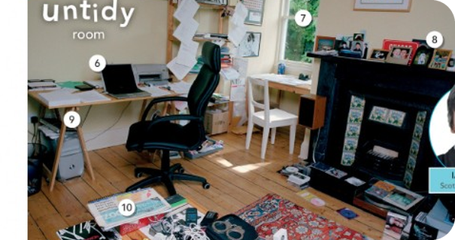

5
What's in your bag?
👀 LOOK GUARDA
✍️ WRITE SCRIVI
Name the things. Write a or an + the word.
⏱ 6 min 👥 pairs
Scrivi a o an + la parola.
⭐
Example
1
👓
glasses (always plural!)
0 🔑 → a key
2
👛 / 💼
a purse / a wallet
3
💳
a credit card
4
🪪
an identity card
5
🔌
a charger
6
🎧
headphones
7
☂️
an umbrella
🎧 2.1
8
📔
a diary
▶ normal · 🐢 slower
2A · Vocabulary · things · 📖 SB p.14 · 1b, 1c · Vocabulary Bank Things p.151
Notes:
5. Vocabulary · things (6 min)
ELICIT FIRST (5 min). Point to the emoji; pairs write a/an + word, then click once per line. Model and drill each word. Problem words for Italians: purse (borsellino) ≠ 'borsa' (= bag); wallet = portafoglio; diary = agenda (NOT diario, a personal diary – 'diary' in British English is mainly an agenda); glasses / headphones / scissors are ALWAYS plural. Next slide: Italian.

Slide 6

6
Things: English → Italian
✅ CHECK CONTROLLA
⏱ 3 min 🙋 whole class
Explain it in English. Then click for Italian.
Spiegalo in inglese. Poi clicca per l'italiano.
👛
a purse
💼
a wallet
📔
a diary
👓
glasses
a small bag for money (women)
for money and cards (men)
a book for dates and plans
you wear them to see
borsellino
portafoglio
agenda
occhiali
🔑
keys
🪙
coins
🤧
tissues
🔌
a charger
you open a door with them
small money (metal)
for your nose
for your phone
chiavi
monete
fazzoletti
caricabatterie
📁
a file
✂️
scissors
🎟️
a ticket
🧳
a bag
for papers
you cut paper with them
for the train or cinema
you carry things in it
cartellina
forbici
biglietto
borsa
⚠ Watch out! purse ≠ borsa (bag) · diary = agenda · glasses, scissors, headphones = always plural: My glasses ARE…
2A · Vocabulary · English, then Italian
Notes:
6. Vocabulary · English, then Italian (3 min)
CONSOLIDATION (3 min, owner rule 5). Students explain each word in simple English first (click 1 shows the English meaning), then click 2 shows the Italian.

Slide 7
7
One key, two keys
🔗 MATCH ABBINA
⏱ 4 min 👥 pairs
Add -s, -es or -ies? Match the colour.
Aggiungi -s, -es o -ies? Abbina il colore.
🏷️
Plurals
key → keys
+ s
watch → watches
+ es
+ s
+ es
diary → diaries
y → ies
y → ies
glass → glasses
+ es
photo → photos
+ s
city → cities
y → ies
box → boxes
+ es
ticket → tickets
+ s
2A · Grammar · plurals · 📖 SB p.15 · 2a · Workbook 2A 2b
Notes:
7. Grammar · plurals (4 min)
GUIDED DISCOVERY (4 min). Pairs decide, click once per word. Elicit the rules: + es after s, ss, sh, ch, x · consonant + y → ies (diary → diaries, but key → keys: vowel + y). Then ask: 'Why a pen but AN umbrella?' (an before a vowel SOUND: an umbrella, an identity card).

Slide 8
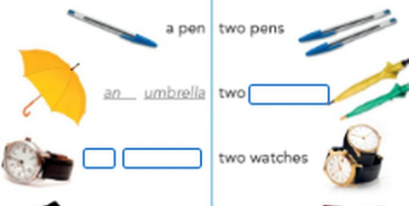
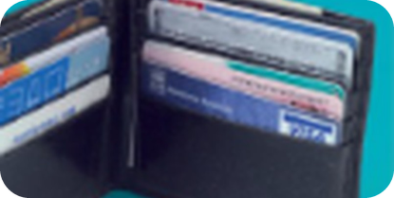
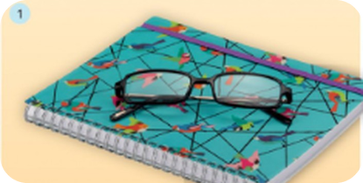
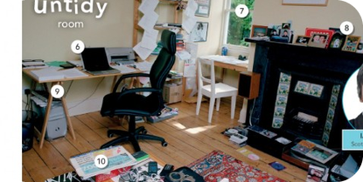
8
Singular and plural
👀 LOOK GUARDA
⏱ 4 min 🙋 whole class
Look at the coloured endings. What's the rule?
🎧 2.2
Guarda le desinenze colorate. Qual è la regola?
a / an
+ s / es
y → ies
irregular
one thing
most nouns
consonant + y
learn them!
a pen · a key
an umbrella · an ID card
two pens · three keys
two watches · glasses
diary → diaries
city → cities
man → men · woman → women
person → people · child → children
an + suono vocalico
-es dopo s, sh, ch, x
ma: key → keys
people = persone
⚠ No a/an with plurals: ✗ a glasses → ✓ glasses / a pair of glasses · ✗ peoples → ✓ people
▶ normal · 🐢 slower
2A · Grammar · singular and plural nouns · 📖 Grammar Bank 2A p.126
Notes:
8. Grammar · singular and plural nouns (4 min)
CLARIFY (4 min). Elicit each column before clicking. Italian learners: adjectives never take -s in English (two new pens, NOT news pens) – mention it here because it comes in 2B.

Slide 9
9
snake, zebra or /ɪz/?
🔊 SAY IT PRONUNCIA
⏱ 6 min 👥 pairs
Say the plural. Is it /s/, /z/ or /ɪz/?
Di' il plurale. È /s/, /z/ o /ɪz/?
🏷️
Rule: extra /ɪz/ only after s, ce, ge, sh, ch, x
classes
/ɪz/ glasses
lamps
/s/ books
/s/ books
/z/ keys
files
/z/ keys
/ɪz/ glasses
boxes
/ɪz/ glasses
tickets
/s/ books
🎧 2.3 + 2.4
phones
/z/ keys
pages
/ɪz/ glasses
pieces
/ɪz/ glasses
▶ normal · 🐢 slower
2A · Pronunciation · final -s and -es · 📖 SB p.15 · 3 Pronunciation · audio 2.3, 2.4
Notes:
9. Pronunciation · final -s and -es (6 min)
PRONUNCIATION (5 min). RULE first (owner rule 13): -es is an EXTRA syllable /ɪz/ only after the sounds s, z, sh, ch, j (ce, ge, se, sh, ch, x): glasses, purses, watches, boxes, pages, pieces. After p, t, k, f → /s/ (books, lamps, tickets). After other sounds → /z/ (keys, pens, phones, files). The /s/–/z/ difference is small; the /ɪz/ syllable matters. Italians often add /ɪz/ everywhere ('file-es', 'phone-es') – drill: files /faɪlz/ = ONE syllable. Book answers (2.4, -es = /ɪz/): classes, boxes, pages, pieces; NOT files, headphones, tissues, phones.

Slide 10
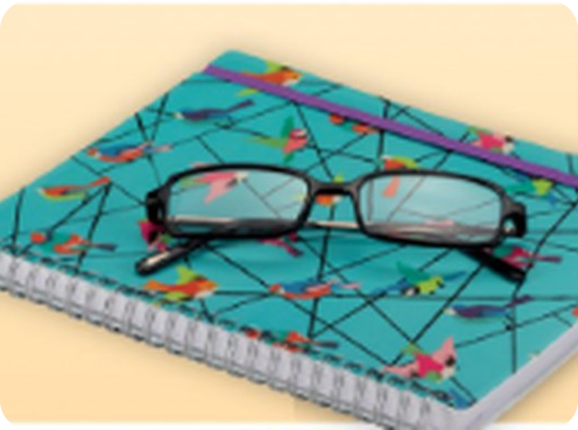
10
Where are the things?
✏️ FILL THE GAPS COMPLETA
⏱ 4 min 👤 alone
Look at photos 1–3. Complete with in, on or under.
Guarda le foto 1–3. Completa con in, on o under.
⭐
Example
1
1 The glasses are ___ the notebook.
on
0 The pen is ___ the desk. → on (sopra)
2
2 The credit cards are ___ the wallet.
in
3
3 The bag is ___ the desk.
under
4
4 My keys are ___ my bag.
in
5
5 The cat is ___ the table.
under (or on!)
2A · Vocabulary · in, on, under · 📖 SB p.15 · 4a
Notes:
10. Vocabulary · in, on, under (4 min)
PRESENT + PRACTISE (4 min). Show in / on / under with a pen and a bag first. Students write, click once per answer. Answers 1–3 from the book photos (glasses on the notebook, cards in the wallet, bag under the desk).

Slide 11
11
Where's my phone?
🎲 PLAY GIOCA
⏱ 5 min 👥 pairs
Hide it! Your partner asks: Is it in…? Is it on…?
Nascondilo! Il compagno chiede: Is it in…? Is it on…?
🎲
How to play
1
Is it on the table?
→ No, it isn't.
A: 'hide' your phone in the classroom (in your head!).
B asks yes/no questions: Is it on the desk?
Find it in 5 questions = 1 point.
Is it under the chair?
→ No, it isn't.
2
3
Is it in your bag?
→ Yes, it is!
4
Are my keys on the desk?
→ No, they aren't. They're in my pocket.
TEAM A ☆☆☆☆☆
TEAM B ☆☆☆☆☆
2A · Game · in, on, under
Notes:
11. Game · in, on, under (5 min)
GAME (5 min). Model with a strong student first (click to show the example exchange, one line per click). Then pairs play 3 rounds each. Extra challenge: plural things – 'Are my keys…? / Are my glasses…?' (They are…).

Slide 12
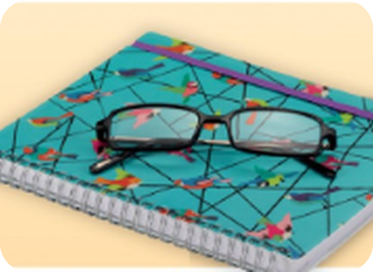
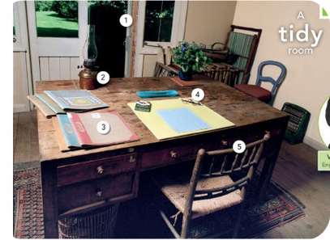
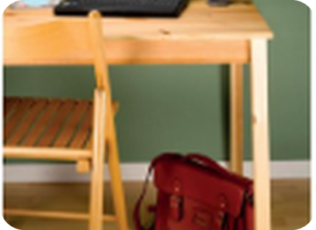
12
Where are their things?
🎧 LISTEN ASCOLTA
⏱ 3 min 👤 alone
Listen. Number the places 1–3.
Ascolta. Numera i luoghi 1–3.
🎧 2.5 · play once
↘ speaker bottom right
A
B
C
in her bag
3
on his desk
1
in her study
2
🎧
While you listen
Listen to three people.
Where are their things? Number the places 1–3.
▶ normal · 🐢 slower
2A · Listening · three people · 📖 SB p.15 · 5a · audio 2.5 (script SB p.118)
Notes:
12. Listening · three people (3 min)
GIST (3 min). A study = a room where you study, read or write. Play 2.5 once (🐢 slower copy for weak groups; the script is in the next slide's notes). Answers (TG): 1 on his desk · 2 in her study · 3 in her bag.

Slide 13
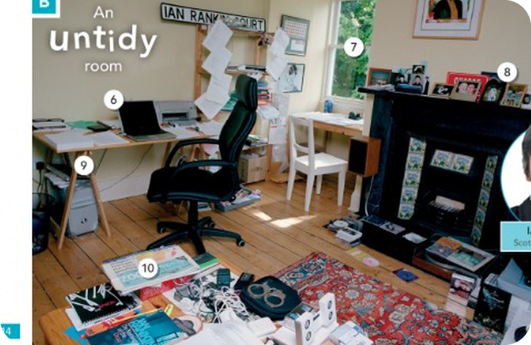
13
What do they have?
🎧 LISTEN ASCOLTA
✍️ WRITE SCRIVI
Listen again. Write the things each person has.
⏱ 4 min 👥 pairs
Riascolta. Scrivi le cose di ogni persona.
🎧 2.5 · play again
Speaker 1 – on his desk (6 things)
a computer, pens, pieces of paper, a lamp, a photo, a phone
Speaker 2 – in her study (6 things)
a desk, a table, two chairs, books, a dictionary, a map
Speaker 3 – in her bag (6 things)
a phone, a charger, sunglasses, tissues, keys, a purse
💡
Guess first, then listen!
▶ normal · 🐢 slower
2A · Listening · detail · 📖 SB p.15 · 5b · audio 2.5
Notes:
13. Listening · detail (4 min)
DETAIL (4 min). Example: speaker 1 – a computer. Play again (or read the script slowly for weaker students). Click once per speaker. SCRIPT (SB p.118): 1 'On my desk I have my computer. I have some pens and pieces of paper. I have a lamp, and a photo of my family. Oh, and a phone. It's very tidy.' 2 'In my study I have a desk, a table, and two chairs. I have a lot of books and a big dictionary on the desk – it isn't very tidy! And I have a map of Europe on the wall.' 3 'I have a lot of things in my bag. I have my phone. I have the charger for my phone. I have my sunglasses, tissues. And I have my house keys and my purse.'

Slide 14
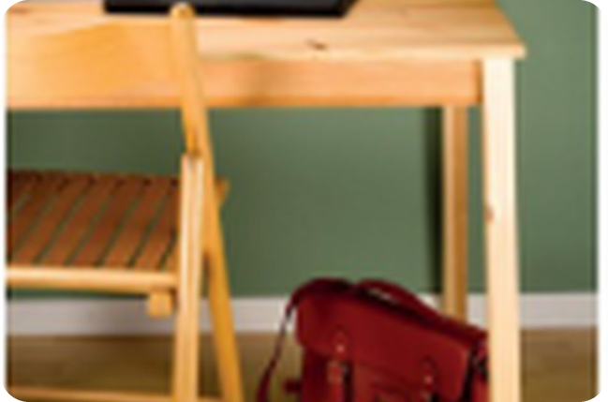
14
What's in your bag?
💬 TALK PARLA
⏱ 6 min 👥 pairs
Tell your partner what's in your bag. Use a/an + plurals.
Di' al compagno cosa c'è nella tua borsa.
1
What's in your bag? Name 5 things.
e.g. In my bag I have a purse, keys, my phone, tissues and a pen.
2
Where are your keys now?
e.g. They're in my pocket.
3
What's on your desk at home?
e.g. There's a laptop, some books and a lamp on my desk.
4
Is your desk tidy or untidy? Why?
e.g. It's untidy – there are papers everywhere!
💬
Useful phrases
In my bag I have a…, two…, some…
My … is / are in / on / under…
Really? Me too! · I don't have a…
5
Extension: what do you always lose?
e.g. I always lose my glasses! They're usually on my head.
2A · Speaking · your bag and desk · 📖 SB p.15 · 5c
Notes:
14. Speaking · your bag and desk (6 min)
FREER PRACTICE (6 min). Questions appear one per click; model each with your own answer. Monitor for a/an, plural -s and in/on/under. Delayed correction (2 min) at the end.

Slide 15
15
3 · 2 · 1
⏱ 3 min 👥 pairs
Books closed! What can you remember?
Libri chiusi! Cosa ricordi?
3
things in your bag: a/an or plural
📝
Homework · Compiti
Workbook 2A: 1a, 1b, 2a, 2b, 2c
Workbook 2A: 2e (where are the things?)
Write: 5 things in your bag and where they are
2
plurals with /ɪz/ (glasses…)
1
sentence with in, on or under
Next lesson: 2B · Made in America · colours and adjectives
2A · Exit · what can you remember?
Notes:
15. Exit · what can you remember? (3 min)
RETRIEVAL EXIT (2 min). Set homework (Workbook 2A, pages 12–13 of the Workbook).

