Slide 1


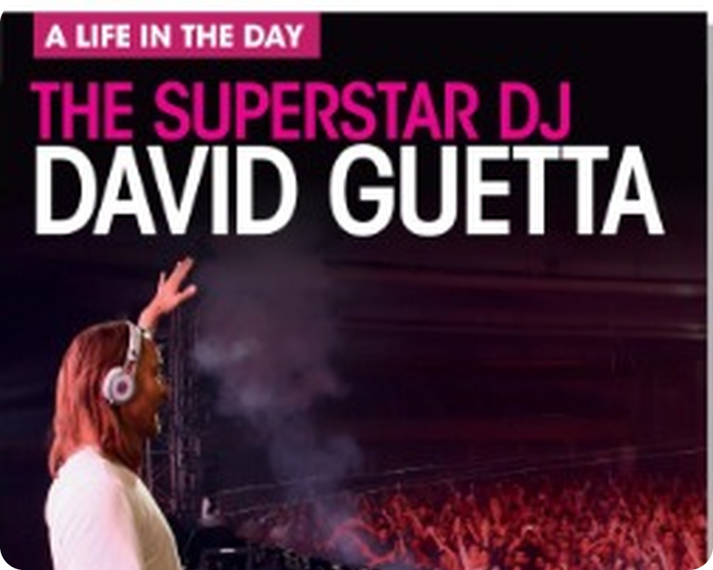


English File Elementary · SB pp.36–37
💡 THINK · PENSA
R3-4
Revise and Check 3&4
Files 3 and 4: test, games, David Guetta, interviews
🎯
Today you're going to…
📝 do a mini-test on Files 3 and 4
🔤 revise verb phrases, family and question words
🔊 practise sounds and word stress
📖 read about a superstar DJ's day
💬 check: can you say it in English?
Files 3 and 4: jobs, family, daily routine… What can you remember?
EXAMPLE I remember 'nephew', 'Whose is it?' and 'hardly ever'!
Notes:
1. OPENING (2 min)
OPENING (2 min). Revision lesson: page 1 = a mini-test (grammar 15, vocabulary, pronunciation). Students score themselves.

Slide 2

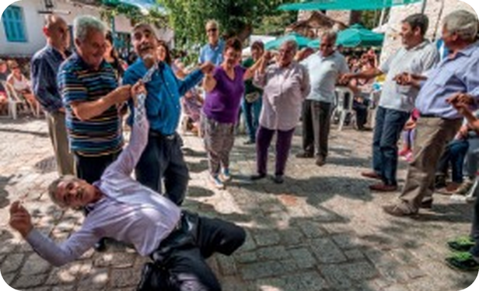
2
Remember?
💡 THINK → 💬 TALK
⏱ 3 min 👥 pairs
🎯 Revision · Retrieval
Can you remember? Say it – then use it in a sentence!
Ti ricordi? Dillo – poi usalo in una frase!
🔤 Can you remember these words? What do they mean?
a nurse
a lawyer
my nephew
my aunt
get dressed
have a shower
hardly ever
twice a week
⭐ What does it mean?
⭐⭐ Use it in a sentence.
⭐⭐⭐ Make it negative or a question!
📅
Last lesson…
Files 3 & 4
present simple · word order · 's · at / in / on · adverbs of frequency
R3-4 · Revision · Files 3 & 4
Notes:
2. Revision · Files 3 & 4 (3 min)
ACTIVE RECAP (3 min). ⭐ meaning ⭐⭐ sentence ⭐⭐⭐ question ('How often do you have a shower?').
HOW TO RUN IT (active recap): pairs. Words: A points at a word, B says what it means (⭐); then a sentence with it (⭐⭐); strong students make it negative or a question (⭐⭐⭐). Grammar: pairs make their own example for each use (offer, plan…) BEFORE you click – then click to show the model answers.

Slide 3

3
Grammar test (1)
✏️ FILL THE GAPS → ✅ CHECK
⏱ 5 min 👤 alone
🎯 Grammar · TPRS · reading
Mini-test! Choose a, b or c. Alone – 4 minutes.
Mini-test! Scegli a, b o c. Da soli – 4 minuti.
Circle a, b or c
1 I (1) ________ live near here. (a not · b don't · c doesn't)
1 I b don't live near here. (a not · b don't · c doesn't)
2 My sister (2) ________ three children. (a has · b have · c haves)
2 My sister a has three children. (a has · b have · c haves)
3 (3) ________ English? (a Are they speak · b Speak they · c Do they speak)
3 c Do they speak English? (a Are they speak · b Speak they · c Do they speak)
4 (4) ________ your sister work? (a Does · b Is · c Do)
4 a Does your sister work? (a Does · b Is · c Do)
5 A Do you work here? B Yes, I (5) ________ . (a work · b do · c am)
5 A Do you work here? B Yes, I b do. (a work · b do · c am)
6 A What (6) ________ ? B He's an engineer. (a he does · b does he · c does he do)
6 A What c does he do? B He's an engineer. (a he does · b does he · c does he do)
7 What languages (7) ________ ? (a speak you · b do you speak · c you speak)
💡
7 What languages b do you speak? (a speak you · b do you speak · c you speak)
Remember
8 Bill is (8) ________ . (a Carla's husband · b husband's Carla · c the Carla's husband)
8 Bill is a Carla's husband. (a Carla's husband · b husband's Carla · c the Carla's husband)
Alone · no talking
1 point each · ___ / 15
R3-4 · Grammar · SB p.36 · 1–8 · 📖 SB p.36 · Grammar 1–8 (SB key)
Notes:
3. Grammar · SB p.36 · 1–8 (5 min)
MINI-TEST 1 (5 min). Key: 1b 2a 3c 4a 5b 6c 7b 8a. Ask WHY after each one (6: QuASI – What does he do?).

Slide 4
4
Grammar test (2)
✏️ FILL THE GAPS → ✅ CHECK
⏱ 4 min 👤 alone
🎯 Grammar · TPRS · reading
Mini-test! Choose a, b or c. Then count your score.
Mini-test! Scegli a, b o c. Poi conta i punti.
Circle a, b or c
9 This is my (9) ________ house. (a parent's · b parents' · c parents)
9 This is my b parents' house. (a parent's · b parents' · c parents)
10 (10) ________ is this book? (a Who's · b Who · c Whose)
10 c Whose is this book? (a Who's · b Who · c Whose)
11 We usually have lunch (11) ________ two o'clock. (a in · b on · c at)
11 We usually have lunch c at two o'clock. (a in · b on · c at)
12 What time do you go (12) ________ bed? (a in · b to · c at)
12 What time do you go b to bed? (a in · b to · c at)
13 She (13) ________ late for class. (a never is · b is never · c isn't never)
13 She b is never late for class. (a never is · b is never · c isn't never)
14 I (14) ________ early. (a usually get up · b get usually up · c get up usually)
14 I a usually get up early. (a usually get up · b get usually up · c get up usually)
💡
Remember
15 I have an English class (15) ________ . (a one a week · b one the week · c once a week)
15 I have an English class c once a week. (a one a week · b one the week · c once a week)
Count your points: ___ / 15
13+ = excellent!
R3-4 · Grammar · SB p.36 · 9–15 · 📖 SB p.36 · Grammar 9–15 (SB key)
Notes:
4. Grammar · SB p.36 · 9–15 (4 min)
MINI-TEST 2 (4 min). Key: 9b 10c 11c 12b 13b 14a 15c. Italian traps: 13 (be + never) and 14 (adverb before the verb).

Slide 5
5
The rules
💡 THINK → 🔊 SAY IT
⏱ 4 min 🙋 whole class
🎯 Grammar · Communicative
Why is it right? Say the rule – then click!
Perché è giusto? Di' la regola – poi clicca!
I don't live · she doesn't live
present simple −
don't / doesn't + verb
My sister doesn't work. (✗ doesn't works)
What does he do?
question
QuASI
Where do you live? · Does she speak German?
my parents' house
possessive
's · plural s'
Carla's husband · my parents' car
Whose is it?
Whose / Who's
Whose = di chi
Whose book is it? · Who's that? (= Who is)
at two · in the morning · on Monday
time
at / in / on
go to bed · at home · go home
She is never late · I usually get up
adverbs
after be · before verb
I have class once a week. (end)
R3-4 · Grammar Banks 3A–4C · the rules · 📖 Grammar Banks 3A–4C
Notes:
5. Grammar Banks 3A–4C · the rules (4 min)
RULES (4 min). After the test: one row = one rule. Students say the rule, then click.

Slide 6

6
Grammar auction
🎲 PLAY · GIOCA
⏱ 6 min 🏆 teams
🎯 Grammar · Communicative game
You have €1,000. Buy the CORRECT sentences!
Avete 1.000 €. Comprate le frasi GIUSTE!
🎲
How to play
1
Where does your brother work?
→ ✓
Each team has €1,000.
Bid for the sentences you think are CORRECT.
Most correct sentences wins!
2
She don't like dogs.
→ ✗ She doesn't like dogs.
3
I go always to the gym.
→ ✗ I always go to the gym.
4
It's my cousin's car.
→ ✓
5
What kind of music you like?
→ ✗ What kind of music do you like?
TEAM A ☆☆☆☆☆
TEAM B ☆☆☆☆☆
6
I'm hardly ever tired.
→ ✓
7
We have lunch in Sunday.
→ ✗ on Sunday
8
Who's that man? – My uncle.
→ ✓
R3-4 · Game · grammar auction · 📖 Review of Grammar Banks 3A–4C
Notes:
6. Game · grammar auction (6 min)
AUCTION (6 min). Teams bid €50–€500; click to reveal. A wrong sentence loses the money.

Slide 7
7
Little words, big verbs
👀 READ → ✏️ FILL THE GAPS
⏱ 5 min 👥 pairs
🎯 Vocabulary · Controlled practice
Complete with at, in, on, to or up. Then the verbs.
Completa con at, in, on, to o up. Poi i verbi.
a · at, in, on, to, up
1 (1) ________ Saturday night I go to the cinema.
2 I'm a student. I'm (2) ________ university.
3 What time do you usually wake (3) ________ ?
4 My brother lives (4) ________ a flat.
5 What time do you go (5) ________ work?
a · at, in, on, to, up
1 (1) On Saturday night I go to the cinema.
2 I'm a student. I'm (2) ________ university.
3 What time do you usually wake (3) ________ ?
4 My brother lives (4) ________ a flat.
5 What time do you go (5) ________ work?
a · at, in, on, to, up
1 (1) On Saturday night I go to the cinema.
2 I'm a student. I'm (2) at university.
3 What time do you usually wake (3) ________ ?
4 My brother lives (4) ________ a flat.
5 What time do you go (5) ________ work?
a · at, in, on, to, up
1 (1) On Saturday night I go to the cinema.
2 I'm a student. I'm (2) at university.
3 What time do you usually wake (3) up ?
4 My brother lives (4) ________ a flat.
5 What time do you go (5) ________ work?
a · at, in, on, to, up
1 (1) On Saturday night I go to the cinema.
2 I'm a student. I'm (2) at university.
3 What time do you usually wake (3) up ?
4 My brother lives (4) in a flat.
5 What time do you go (5) ________ work?
a · at, in, on, to, up
1 (1) On Saturday night I go to the cinema.
2 I'm a student. I'm (2) at university.
3 What time do you usually wake (3) up ?
4 My brother lives (4) in a flat.
5 What time do you go (5) to work?
b · do, get, go, have, listen, play, read, see, take, wear
1 (6) ________ dressed · 2 (7) ________ the dog for a walk · 3 (8) ________ a shower · 4 (9) ________ your homework · 5 (10) ________ shopping
6 (11) ________ the guitar · 7 (12) ________ to music · 8 (13) ________ friends · 9 (14) ________ the newspaper · 10 (15) ________ glasses
b · do, get, go, have, listen, play, read, see, take, wear
1 (6) get dressed · 2 (7) ________ the dog for a walk · 3 (8) ________ a shower · 4 (9) ________ your homework · 5 (10) ________ shopping
6 (11) ________ the guitar · 7 (12) ________ to music · 8 (13) ________ friends · 9 (14) ________ the newspaper · 10 (15) ________ glasses
b · do, get, go, have, listen, play, read, see, take, wear
1 (6) get dressed · 2 (7) take the dog for a walk · 3 (8) ________ a shower · 4 (9) ________ your homework · 5 (10) ________ shopping
6 (11) ________ the guitar · 7 (12) ________ to music · 8 (13) ________ friends · 9 (14) ________ the newspaper · 10 (15) ________ glasses
b · do, get, go, have, listen, play, read, see, take, wear
1 (6) get dressed · 2 (7) take the dog for a walk · 3 (8) have a shower · 4 (9) ________ your homework · 5 (10) ________ shopping
6 (11) ________ the guitar · 7 (12) ________ to music · 8 (13) ________ friends · 9 (14) ________ the newspaper · 10 (15) ________ glasses
b · do, get, go, have, listen, play, read, see, take, wear
1 (6) get dressed · 2 (7) take the dog for a walk · 3 (8) have a shower · 4 (9) do your homework · 5 (10) ________ shopping
6 (11) ________ the guitar · 7 (12) ________ to music · 8 (13) ________ friends · 9 (14) ________ the newspaper · 10 (15) ________ glasses
b · do, get, go, have, listen, play, read, see, take, wear
1 (6) get dressed · 2 (7) take the dog for a walk · 3 (8) have a shower · 4 (9) do your homework · 5 (10) go shopping
6 (11) ________ the guitar · 7 (12) ________ to music · 8 (13) ________ friends · 9 (14) ________ the newspaper · 10 (15) ________ glasses
b · do, get, go, have, listen, play, read, see, take, wear
1 (6) get dressed · 2 (7) take the dog for a walk · 3 (8) have a shower · 4 (9) do your homework · 5 (10) go shopping
6 (11) play the guitar · 7 (12) ________ to music · 8 (13) ________ friends · 9 (14) ________ the newspaper · 10 (15) ________ glasses
b · do, get, go, have, listen, play, read, see, take, wear
1 (6) get dressed · 2 (7) take the dog for a walk · 3 (8) have a shower · 4 (9) do your homework · 5 (10) go shopping
6 (11) play the guitar · 7 (12) listen to music · 8 (13) ________ friends · 9 (14) ________ the newspaper · 10 (15) ________ glasses
b · do, get, go, have, listen, play, read, see, take, wear
1 (6) get dressed · 2 (7) take the dog for a walk · 3 (8) have a shower · 4 (9) do your homework · 5 (10) go shopping
6 (11) play the guitar · 7 (12) listen to music · 8 (13) see friends · 9 (14) ________ the newspaper · 10 (15) ________ glasses
b · do, get, go, have, listen, play, read, see, take, wear
1 (6) get dressed · 2 (7) take the dog for a walk · 3 (8) have a shower · 4 (9) do your homework · 5 (10) go shopping
6 (11) play the guitar · 7 (12) listen to music · 8 (13) see friends · 9 (14) read the newspaper · 10 (15) ________ glasses
b · do, get, go, have, listen, play, read, see, take, wear
1 (6) get dressed · 2 (7) take the dog for a walk · 3 (8) have a shower · 4 (9) do your homework · 5 (10) go shopping
6 (11) play the guitar · 7 (12) listen to music · 8 (13) see friends · 9 (14) read the newspaper · 10 (15) wear glasses
R3-4 · Vocabulary · SB p.36 a, b · 📖 SB p.36 · Vocabulary a, b (SB key)
Notes:
7. Vocabulary · SB p.36 a, b (5 min)
VOCAB (5 min). One click per gap. Key (SB): a 1 On 2 at 3 up 4 in 5 to · b 1 get 2 take 3 have 4 do 5 go 6 play 7 listen 8 see 9 read 10 wear.

Slide 8
8
Odd one out
🎲 PLAY · GIOCA
⏱ 4 min 🏆 teams
🎯 Vocabulary · Communicative game
Teams: which word is different? Say WHY!
Squadre: quale parola è diversa? Dite PERCHÉ!
🎲
How to play
brother · grandfather · niece · uncle
→ niece (the others are male relatives)
e.g.
Read the 4 words.
Find the different one = 1 point.
Say why = 1 more point!
aunt · husband · mother-in-law · stepsister
→ husband (the others are female relatives)
1
chef · cleaner · factory · pilot
→ factory (the others are jobs)
2
TEAM A ☆☆☆☆☆
TEAM B ☆☆☆☆☆
always · early · often · never
→ early (the others are adverbs of frequency)
3
April · August · July · Monday
→ Monday (the others are months)
4
R3-4 · Vocabulary · odd one out · 📖 SB p.36 · Vocabulary c (SB key)
Notes:
8. Vocabulary · odd one out (4 min)
ODD ONE OUT (4 min). Key (SB).

Slide 9
9
Question words
💡 THINK → 💬 TALK
⏱ 3 min 👥 pairs
🎯 Vocabulary · Controlled practice
Complete with How many, Who, Why, What or Where. Then ask a partner!
Completa con How many, Who, Why, What o Where. Poi chiedi!
⭐
Example
1
___ do you live?
Where
2
___ does your father do?
What
3
___ is your favourite family member?
Who
4
___ hours do you work?
How many
5
___ do you want to learn English?
Why
R3-4 · Vocabulary · question words · 📖 SB p.36 · Vocabulary d (SB key)
Notes:
9. Vocabulary · question words (3 min)
QUESTIONS (3 min). Key (SB): 1 Where 2 What 3 Who 4 How many 5 Why. Then pairs ask and answer all 5.

Slide 10
10
Which sound?
🔊 SAY IT → 🔗 MATCH
⏱ 3 min 👥 pairs
🎯 Pronunciation · Guided discovery
What sound do the pink letters have?
Che suono hanno le lettere rosa?
🏷️
The sounds
brother
⬆️ up /ʌ/
⬆️ up /ʌ/
🌸 flower /f/
nephew
🌸 flower /f/
💻 computer /ə/
🧙 witch /w/
teacher
💻 computer /ə/
🐦 bird /ɜː/
which
🧙 witch /w/
work
🐦 bird /ɜː/
R3-4 · Pronunciation · sounds · 📖 SB p.36 · Pronunciation a, c (SB key)
Notes:
10. Pronunciation · sounds (3 min)
SOUNDS (3 min). Drill the sound words in a first (bird, computer, up, clock · house, flower, chess, witch). Key (SB): brother /ʌ/ · nephew /f/ · teacher /ə/ · which /w/ · work /ɜː/.

Slide 11
11
Word stress
🔊 SAY IT → ✅ CHECK
⏱ 2 min 👥 pairs
🎯 Pronunciation · Controlled practice
Underline the stressed syllable. Say the word!
Sottolinea la sillaba accentata. Di' la parola!
⭐
Example
1
be|cause
beCAUSE
be|cause → beCAUSE
2
den|tist
DENtist
3
un|em|ployed
unemPLOYED
4
po|lice|man
poLICEman
5
grand|mo|ther
GRANDmother
R3-4 · Pronunciation · word stress · 📖 SB p.36 · Pronunciation d (SB key)
Notes:
11. Pronunciation · word stress (2 min)
STRESS (2 min). Key (SB).

Slide 12
12
The superstar DJ
👀 READ → ✅ CHECK
⏱ 7 min 👥 pairs
🎯 Reading · for detail
Read the article once. What is unusual about David Guetta's life? Then: true or false?
Leggi l'articolo. Cosa c'è di insolito? Poi: vero o falso?
1
a What is unusual about his life?
A life in the day: the superstar DJ David Guetta
I wake up at about 1.00 p.m., and the first thing I do is go outside. I live in Ibiza and I like having breakfast in the sun. I usually have fruit juice, eggs, fruit, and tea. I never drink coffee. After breakfast, I answer my emails for an hour, then I go to the gym.
I never listen to music in the house, or even in the car, because music is my job. On a typical day I spend two or three hours in my studio, then another four hours at a nightclub. My work starts in the evening. I usually have dinner in a restaurant, and then I go to the club. I try to have a normal life, but my job isn't normal. I arrive at a club like a secret agent – I go in through the back door and Security takes me to the stage.
I finish work at 4.00 in the morning. Security takes me out, and then I go home. After about four hours playing music I'm very excited. My manager says, 'Go home and sleep', but that's impossible. First I need to calm down. When I get home I have a cup of tea, brush my teeth and say, 'Thank you for this wonderful life'. I am 47 now, but I want to do this when I'm 60 or 80. I want to do this forever.
A life in the day: the superstar DJ David Guetta
I wake up at about 1.00 p.m., and the first thing I do is go outside. I live in Ibiza and I like having breakfast in the sun. I usually have fruit juice, eggs, fruit, and tea. I never drink coffee. After breakfast, I answer my emails for an hour, then I go to the gym.
I never listen to music in the house, or even in the car, because music is my job. On a typical day I spend two or three hours in my studio, then another four hours at a nightclub. My work starts in the evening. I usually have dinner in a restaurant, and then I go to the club. I try to have a normal life, but my job isn't normal. I arrive at a club like a secret agent – I go in through the back door and Security takes me to the stage.
I finish work at 4.00 in the morning. Security takes me out, and then I go home. After about four hours playing music I'm very excited. My manager says, 'Go home and sleep', but that's impossible. First I need to calm down. When I get home I have a cup of tea, brush my teeth and say, 'Thank you for this wonderful life'. I am 47 now, but I want to do this when I'm 60 or 80. I want to do this forever.
He wakes up at 1 p.m., his work starts in the evening, he arrives at the club in secret and finishes at 4 a.m.
2
1 He gets up in the afternoon.
T – 'at about 1.00 p.m.'
3
2 He only eats fruit for breakfast.
F – juice, eggs, fruit and tea
4
3 He does exercise every day.
T – 'then I go to the gym'
5
4 He works six to seven hours a day.
T – 2–3 hours in the studio + 4 at a club
6
5 He eats out in the evening.
T – 'dinner in a restaurant'
7
6 When he finishes work he goes home and sleeps.
F – 'that's impossible'
8
7 He doesn't want to change his life.
T – 'I want to do this forever'
R3-4 · Reading · A life in the day · 📖 SB p.37 · Can you understand this text? a, b (SB key)
Notes:
12. Reading · A life in the day (7 min)
READING (7 min). The T/F statements are as in the book; key from the SB answer key. Find the adverbs of frequency in the text (usually, never) – they're highlighted. Would you like his life?

Slide 13
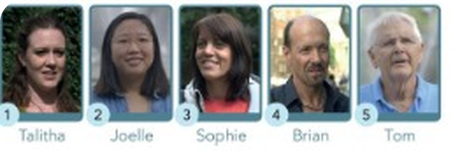
13
Street interviews
🎧 LISTEN → ✅ CHECK
⏱ 5 min 👤 alone
🎯 Listening · for detail
Watch or listen to 5 people. Choose a, b or c.
Guarda o ascolta 5 persone. Scegli a, b o c.
🎧 4.23 · play twice
1 Talitha works… a 27 hours a week b in a market c 37 hours a week
c 37 hours a week (she works in marketing)
2 Joelle has… a a 13-year-old sister b a 30-year-old sister c three sisters
a a 13-year-old sister
3 Sophie usually gets up at ___ at weekends. a 7.30 b 9.00 c 9.30
c 9.30 ('half past nine, ten o'clock')
4 Brian… a goes to the gym and does yoga b plays football and does yoga c goes to the gym and plays a team sport
a gym three times + yoga
5 Tom likes ___ in New York. a the taxis b the people c the food
b the people ('The variety. The people. Change.')
💡
Listen for numbers and times!
R3-4 · Listening · Can you understand these people? · 📖 SB p.37 · Can you understand these people? · audio 4.23 (SB key + script)
Notes:
13. Listening · Can you understand these people? (5 min)
LISTENING (5 min). Play 4.23 twice (audio to come – read the script if needed). Key (SB): 1c 2a 3c 4a 5b. Trap in 1: in Marketing ≠ in a market!

Slide 14
14
Can you…?
💬 TALK · PARLA
⏱ 5 min 👥 pairs
🎯 Speaking · Communicative
Can you say this in English? Do the tasks with a partner – then tick!
Sai dirlo in inglese? Fai i compiti con un compagno – poi spunta!
💬
Useful phrases
1
say where you live and what you do
e.g. I live in Bagheria. I'm a teacher.
I live in… I'm a…
I usually get up at…
On Monday mornings I…
What sports do you play?
What kind of music do you like?
2
say what time you usually get up and go to bed
e.g. I usually get up at seven and go to bed at eleven.
3
say what you do on a typical Monday morning
e.g. First I have a coffee, then I go to work.
4
ask: What sports…? What languages…? What kind of music…? What TV programmes…?
e.g. What kind of music do you like? – Rock!
R3-4 · Speaking · Can you say this in English? · 📖 SB p.37 · Can you say this in English? 1–4
Notes:
14. Speaking · Can you say this in English? (5 min)
CAN-DO (5 min). Pairs do all the tasks; tick only what they can do WELL.

Slide 15
15
3 · 2 · 1
⏱ 2 min 👥 pairs
🎯 Revision · Retrieval
Books closed! Tell your partner…
Libri chiusi! Di' al compagno…
3
Tell me 3 things David Guetta does every day.
📝
Homework · Compiti
Workbook: redo the Files 3–4 exercises you got wrong
Write about your typical day
2
Tell me 2 family words and 2 jobs.
Next lesson: 5A Vote for me! – can / can't (SB p.38)
1
Ask me 1 question with How often…?
R3-4 · Exit · what can you remember?
Notes:
15. Exit · what can you remember? (2 min)
EXIT (2 min). Pairs, books closed.

Slide 16
16
Today you…
💡 THINK · PENSA
⏱ 1 min 🙋 whole class
🎯 Revision · Reflection
Can you do it now? Thumbs up or thumbs down!
Ora sai farlo? Pollice su o pollice giù!
📝
Did a mini-test on Files 3 and 4
✅
👍 👌 👎
Can you do it now?
Ora sai farlo?
🔤
Revised verb phrases, family and question words
✅
🔊
Practised sounds and word stress
✅
📖
Read about a superstar DJ's day
✅
💬
Checked: can you say it in English?
✅
R3-4 · Review · what did you do today?
Notes:
16. Review · what did you do today? (1 min)
TODAY YOU… (1 min). Read each line (one per click: the tick appears). Students show thumbs up / middle / down: can they do it now? Note any thumbs down for the next lesson's recap.

