Slide 1


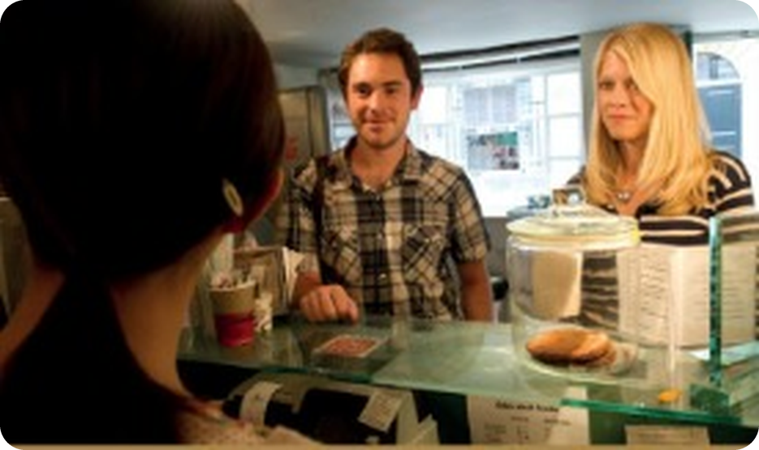


English File Elementary · SB pp.28–29 · VB p.157
💡 THINK · PENSA
PE2
Coffee to take away
Telling the time · buying a coffee
🎯
Today you're going to…
🕘 tell the time: quarter past six, twenty to nine
☕ order food and drink in a café
🤝 meet and introduce people
🎧 listen to Rob and Jenny: episode 2
What time is it now? What's your favourite coffee?
EXAMPLE It's half past seven. I love a cappuccino – but only in the morning!
Notes:
1. OPENING (2 min)
OPENING (2 min). TG lead-in: what do you remember about Episode 1? Who's Rob? Where does he work / live? Who's Jenny? Where is she from?

Slide 2

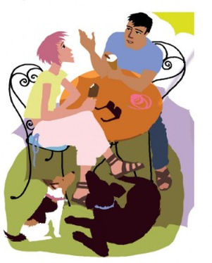
2
Remember last lesson?
💡 THINK → 💬 TALK
⏱ 3 min 👥 pairs
🎯 Revision · Retrieval
Can you remember? Say it – then use it in a sentence!
Ti ricordi? Dillo – poi usalo in una frase!
🔤 Can you remember these words? What do they mean?
How many
What kind of
Which
Who
Why
When
Where
How old
⭐ What does it mean?
⭐⭐ Use it in a sentence.
⭐⭐⭐ Make it negative or a question!
📅
Last lesson…
Your turn: QuASI
3C: Love me, love my dog
word order in questions · question words
Where do you live?
What kind of music do you like?
How old is Barry?
PE2 · Revision · last lesson
Notes:
2. Revision · last lesson (3 min)
ACTIVE RECAP (3 min). Each word: students ask a partner a real question with it before you click (Why do you study English?).
HOW TO RUN IT (active recap): pairs. Words: A points at a word, B says what it means (⭐); then a sentence with it (⭐⭐); strong students make it negative or a question (⭐⭐⭐). Grammar: pairs make their own example for each use (offer, plan…) BEFORE you click – then click to show the model answers.

Slide 3

3
What time is it?
🔊 SAY IT → ✅ CHECK
⏱ 5 min 🙋 whole class
🎯 Vocabulary · Controlled practice
Look at the clocks. Say the time, then click!
Guarda gli orologi. Di' l'ora, poi clicca!
⭐
Example
1
6.00
It's six o'clock.
2
6.10
It's ten past six.
9.00 → It's nine o'clock.
3
6.15
It's quarter past six.
4
6.20
It's twenty past six.
5
6.30
It's half past six.
6
6.35
It's twenty-five to seven.
7
6.45
It's quarter to seven.
8
6.55
It's five to seven.
🎧 3.26
9
6.03
It's three minutes past six.
▶ normal
🐢 slower
PE2 · Vocabulary Bank p.157 · telling the time · 📖 SB p.28 · 1a, 1b · VB p.157 Part 1 · audio 3.26 (TG script)
Notes:
3. Vocabulary Bank p.157 · telling the time (5 min)
TIME (5 min). TG notes: right side of the clock (12 → half past) = past; left side (half past → 12) = to. half /hɑːf/ (silent l), quarter /ˈkwɔːtə/. o'clock = 'of the clock'. British people often leave out a: It's (a) quarter to ten. Play 3.26 to check, then again to repeat. VB Time box: What time is it? / What's the time? · at 9.00 · in the morning / afternoon / evening · at night.

Slide 4

4
Clock race
🎲 PLAY → 💬 TALK
⏱ 4 min 👥 pairs
🎯 Speaking · Communicative game
What's the time? A draws a time on a clock. B says it. Swap!
Che ore sono? A disegna un orario. B lo dice. Scambiatevi!
🎲
How to play
7.25
→ It's twenty-five past seven.
1
Pairs, face to face. A draws 3 clocks (or writes 3 digital times).
B asks: What's the time? / What time is it? – A answers.
Then compare: are the clocks the same?
11.40
→ It's twenty to twelve.
2
2.45
→ It's quarter to three.
3
9.05
→ It's five past nine.
4
PE2 · Speaking · What's the time? · 📖 SB p.28 · 1c · Communication What's the time? A p.104 · B p.109
Notes:
4. Speaking · What's the time? (4 min)
CLOCKS (4 min). Zero-prep version of the Communication activity (or use pp.104 / 109). Drill What's the time? first. Click for 4 extra times to test the class.

Slide 5
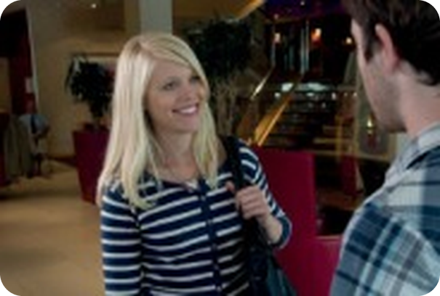
5
Rob and Jenny meet
🎧 LISTEN → ✅ CHECK
⏱ 6 min 👤 alone
🎯 Listening · Controlled practice
Listen. What do Rob and Jenny decide to do? Then listen again: why…?
Ascolta. Cosa decidono di fare Rob e Jenny? Poi ascolta di nuovo: perché…?
1
What do they decide to do?
They go for a coffee.
2
Why is Rob late?
Because the traffic is terrible.
3
Why doesn't Jenny like the hotel breakfast?
Because the hotel coffee isn't great.
4
Why is Jenny busy after 9.30?
Because she has a meeting with Daniel.
5
Why does Rob say 'Don't worry'?
Because they have lots of time – the office is very near.
🎧 3.27
▶ normal
🐢 slower
PE2 · Listening · Rob and Jenny meet · 📖 SB p.28 · 2a, 2b · audio 3.27 (TG key + script)
Notes:
5. Listening · Rob and Jenny meet (6 min)
MEET (5 min). Play 3.27 once: what do they decide? Then 2b – teach late first. Key (TG). Time from the script: 'What time is it?' – 'Nine fifteen.' (= quarter past nine).

Slide 6
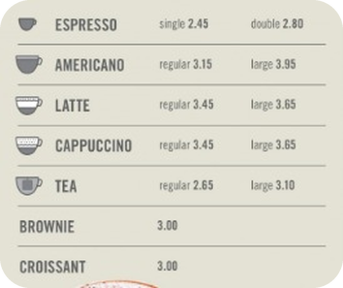
6
The menu
👀 LOOK → 💬 TALK
⏱ 3 min 👥 pairs
🎯 Speaking · Communicative
Look at the menu. Do you know all the things? Ask: How much is…?
Guarda il menu. Conosci tutto? Chiedi: How much is…?
1
How much is a large latte?
e.g. Three sixty-five.
2
How much is a regular tea?
e.g. Two sixty-five.
3
How much is a brownie?
e.g. Three pounds.
💬
Useful phrases
4
Coffee names in the UK are Italian! Which ones?
e.g. espresso, latte, cappuccino… and Americano
How much is a single espresso?
Two forty-five.
regular = normal size
large = big
£2.80 = two pounds eighty
PE2 · Buying a coffee · the menu · 📖 SB p.28 · 3a (TG notes)
Notes:
6. Buying a coffee · the menu (3 min)
MENU (3 min). TG: UK coffee shops use Italian words (latte, cappuccino). regular = normal size. Prices in pounds and pence (prices come in PE3). EXTRA IDEA (TG): A How much is a single espresso? B Two forty-five. How much is…?

Slide 7

7
What do they have?
🎧 LISTEN → ✅ CHECK
⏱ 3 min 👤 alone
🎯 Listening · Controlled practice
Listen to Rob and Jenny buying coffee. Answer the questions.
Ascolta Rob e Jenny che comprano il caffè. Rispondi.
1
What kinds of coffee do Jenny and Rob have?
Jenny: a double espresso. Rob: a large latte.
2
What do they have to eat?
Jenny: nothing. Rob: a brownie and a croissant.
3
How much is it?
£12.45 (twelve forty-five)
🎧 3.28
▶ normal
🐢 slower
PE2 · Listening · buying a coffee · 📖 SB p.29 · 3b · audio 3.28 (TG key)
Notes:
7. Listening · buying a coffee (3 min)
COFFEE (3 min). Books closed, questions on the slide. Play 3.28 once, again if needed. Key (TG).

Slide 8

8
Can I help you?
🎧 LISTEN → ✏️ FILL THE GAPS
⏱ 4 min 👤 alone
Listen again. Complete the You hear phrases.
Ascolta di nuovo. Completa le frasi del barista.
At the coffee shop
BARISTA Can I (1) ________ you?
ROB What would you like, Jenny? JENNY An espresso, please.
BARISTA (2) ________ or double? JENNY Double.
ROB Can I have a latte, please?
BARISTA (3) ________ or large? ROB Large.
BARISTA To have (4) ________ or take away? ROB To take away.
BARISTA Anything else? JENNY No, thanks.
ROB A brownie for me, please… and a croissant.
BARISTA OK. ROB How much is that?
BARISTA That's £12.45, please. ROB Sorry, how much?
BARISTA £12.45. Thank you. And your (5) ________ . ROB Thanks.
☕
Useful
At the coffee shop
BARISTA Can I (1) help you?
ROB What would you like, Jenny? JENNY An espresso, please.
BARISTA (2) ________ or double? JENNY Double.
ROB Can I have a latte, please?
BARISTA (3) ________ or large? ROB Large.
BARISTA To have (4) ________ or take away? ROB To take away.
BARISTA Anything else? JENNY No, thanks.
ROB A brownie for me, please… and a croissant.
BARISTA OK. ROB How much is that?
BARISTA That's £12.45, please. ROB Sorry, how much?
BARISTA £12.45. Thank you. And your (5) ________ . ROB Thanks.
At the coffee shop
BARISTA Can I (1) help you?
ROB What would you like, Jenny? JENNY An espresso, please.
BARISTA (2) Single or double? JENNY Double.
ROB Can I have a latte, please?
BARISTA (3) ________ or large? ROB Large.
BARISTA To have (4) ________ or take away? ROB To take away.
BARISTA Anything else? JENNY No, thanks.
ROB A brownie for me, please… and a croissant.
BARISTA OK. ROB How much is that?
BARISTA That's £12.45, please. ROB Sorry, how much?
BARISTA £12.45. Thank you. And your (5) ________ . ROB Thanks.
At the coffee shop
BARISTA Can I (1) help you?
ROB What would you like, Jenny? JENNY An espresso, please.
BARISTA (2) Single or double? JENNY Double.
ROB Can I have a latte, please?
BARISTA (3) Regular or large? ROB Large.
BARISTA To have (4) ________ or take away? ROB To take away.
BARISTA Anything else? JENNY No, thanks.
ROB A brownie for me, please… and a croissant.
BARISTA OK. ROB How much is that?
BARISTA That's £12.45, please. ROB Sorry, how much?
BARISTA £12.45. Thank you. And your (5) ________ . ROB Thanks.
At the coffee shop
BARISTA Can I (1) help you?
ROB What would you like, Jenny? JENNY An espresso, please.
BARISTA (2) Single or double? JENNY Double.
ROB Can I have a latte, please?
BARISTA (3) Regular or large? ROB Large.
BARISTA To have (4) here or take away? ROB To take away.
BARISTA Anything else? JENNY No, thanks.
ROB A brownie for me, please… and a croissant.
BARISTA OK. ROB How much is that?
BARISTA That's £12.45, please. ROB Sorry, how much?
BARISTA £12.45. Thank you. And your (5) ________ . ROB Thanks.
At the coffee shop
BARISTA Can I (1) help you?
ROB What would you like, Jenny? JENNY An espresso, please.
BARISTA (2) Single or double? JENNY Double.
ROB Can I have a latte, please?
BARISTA (3) Regular or large? ROB Large.
BARISTA To have (4) here or take away? ROB To take away.
BARISTA Anything else? JENNY No, thanks.
ROB A brownie for me, please… and a croissant.
BARISTA OK. ROB How much is that?
BARISTA That's £12.45, please. ROB Sorry, how much?
BARISTA £12.45. Thank you. And your (5) change . ROB Thanks.
What would you like? = offer
Can I have…? = ask
How much is it / that?
barista = a person who works in a coffee shop
Can I have a cappuccino, please?
PE2 · Buying a coffee · You hear · You say · 📖 SB p.29 · 3c · audio 3.28 (TG key)
Notes:
8. Buying a coffee · You hear · You say (4 min)
YOU HEAR (4 min). Students guess first, then play again. TG key 1 help 2 Single 3 Regular 4 here 5 change. Go through line by line: What would you like? = offering; Can I have…? = asking; How much is it? / How much is that? = the total price.

Slide 9
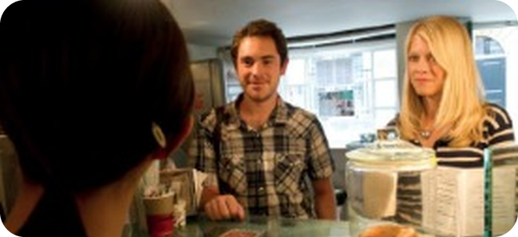
9
Copy the rhythm
🎧 LISTEN → 🔊 SAY IT
⏱ 4 min 👨‍👩‍👧 groups
🎯 Speaking · Communicative
Listen and repeat the You say phrases. Copy the rhythm. Then practise in threes.
Ascolta e ripeti le frasi del cliente. Poi esercitatevi in tre.
1
What would you like, Jenny?
e.g. An espresso, please.
2
Can I have a latte, please?
e.g. Large. / To take away.
3
How much is that?
e.g. Sorry, how much?
💬
Useful phrases
4
No, thanks. / Thanks.
e.g. Copy the rhythm!
A = the barista
B = Rob
C = Jenny
Then swap roles!
PE2 · Buying a coffee · You say · 📖 SB p.29 · 3d, 3e · audio 3.29 (repeat pauses)
Notes:
9. Buying a coffee · You say (4 min)
REPEAT (4 min). 3.29 = 3.28 with pauses: students repeat the You say phrases at the beep. 3e: threes read the conversation and swap roles.

Slide 10
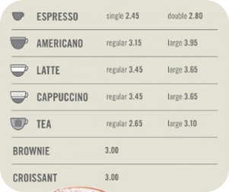
10
At the coffee shop
🎲 PLAY → 💬 TALK
⏱ 8 min 👨‍👩‍👧 groups
🎯 Speaking · Communicative game
Role-play! A is the barista (book open). B invites C for a drink. Use the menu!
Role-play! A è il barista. B offre da bere a C. Usate il menu!
🎲
How to play
Can I help you?
→ What would you like, Marco?
1
Groups of 3. A = barista, book open. B and C close their books.
A begins: Can I help you? · B asks C: What would you like?
Order 2 drinks + something to eat. Pay! Then change roles.
Single or double? · Regular or large?
→ A large cappuccino, please.
2
To have here or take away?
→ To have here.
3
Anything else? · That's £…, please.
→ Sorry, how much?
4
PE2 · Speaking · at the coffee shop · 📖 SB p.29 · 3f
Notes:
10. Speaking · at the coffee shop (8 min)
ROLE-PLAY (6 min). TG: A keeps the book open; B and C closed. Each group performs once; best group performs for the class. Real fun: change the café to a Bagheria bar – how do you order there?

Slide 11
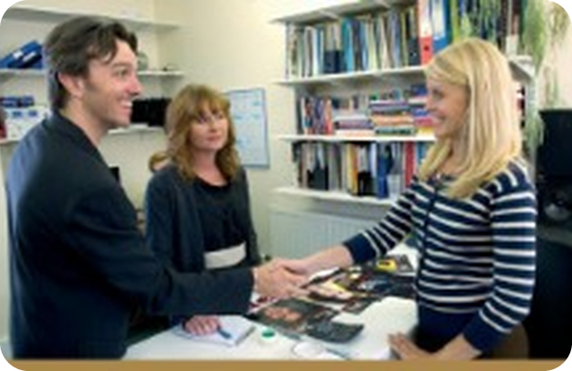
11
First day in the office
🎧 LISTEN → ✅ CHECK
⏱ 5 min 👤 alone
🎯 Listening · for detail
Listen. Jenny's first day in the office. Answer the questions.
Ascolta. Il primo giorno di Jenny in ufficio. Rispondi.
🎧 3.30 · play twice
What's Karen's job?
She's an administrator.
Where in Europe does Jenny have family?
In Poland.
Where does she live in New York?
In Manhattan.
Does Karen have family in New York?
Yes – a sister in Brooklyn.
What does Daniel offer Jenny to drink?
Tea, coffee, or water.
💡
Who are the people? Maybe… / I think…
What time is his next meeting?
At twelve o'clock.
▶ normal
🐢 slower
PE2 · Listening · first day in the office · 📖 SB p.29 · 4a · audio 3.30 (TG key + script)
Notes:
11. Listening · first day in the office (5 min)
OFFICE (5 min). Photo first: where is Jenny? Who are the others? (maybe / I think). Play once to listen, again pausing for answers. Key (TG).

Slide 12
12
Who says it?
💡 THINK → 🎧 LISTEN
⏱ 3 min 👥 pairs
Social English: who says it – Rob, Karen or Daniel? Then listen and repeat.
Social English: chi lo dice – Rob, Karen o Daniel? Poi ascolta e ripeti.
⭐
Example
1
Here we are.
R – Rob
2
Is this your first time in the UK?
K – Karen
3
Would you like something to drink?
D – Daniel
4
Talk to you later.
D – Daniel
🎧 3.31
▶ normal
🐢 slower
PE2 · Social English · 📖 SB p.29 · 4b, 4c · audio 3.31 (TG key)
Notes:
12. Social English (3 min)
SOCIAL ENGLISH (3 min). Pairs decide, play 3.31 to check (TG key 1 R 2 K 3 D 4 D). Play again to repeat. Italian? Eccoci. / È la prima volta…? / Vuoi qualcosa da bere? / Ci sentiamo dopo.

Slide 13
13
Say it!
💡 THINK → 💬 TALK
⏱ 3 min 👥 pairs
Complete the conversations with a Social English phrase. Then practise!
Completa i dialoghi con una frase. Poi esercitatevi!
⭐
Example
1
A Sit down. ___ – No, thanks, I'm fine.
Would you like something to drink?
Here we are. · Is this your first time in the UK? · Would you like something to drink? · Talk to you later.
2
B ___ Bye. – Bye.
Talk to you later.
3
C Nice to meet you. ___ – No, it isn't. I know London very well.
Is this your first time in the UK?
4
D OK. ___ This is your hotel. – Oh, it's very nice.
Here we are.
PE2 · Social English · practice · 📖 SB p.29 · 4d (TG key A3 B4 C2 D1)
Notes:
13. Social English · practice (3 min)
PRACTICE (3 min). TG key A 3 B 4 C 2 D 1. Pairs practise all four, then change the place: Bagheria, Palermo…

Slide 14
14
3 · 2 · 1
⏱ 2 min 👥 pairs
🎯 Revision · Retrieval
Books closed! Tell your partner…
Libri chiusi! Di' al compagno…
3
Tell me 3 times: 7.15, 8.30, 9.45.
📝
Homework · Compiti
Workbook Practical English 2 + Can you remember? 1–3
2
Tell me 2 Order 2 things in a café.
Next lesson: 4A Who's who? – possessive 's, family (SB p.30)
1
Tell me 1 Introduce your partner to someone: This is…
PE2 · Exit · Can you…?
Notes:
14. Exit · Can you…? (2 min)
EXIT (2 min). CAN YOU…? tell the time · order food and drink in a café · meet and introduce people. File 3 Quick Test / Test available in the TG resources.

Slide 15
15
Today you…
💡 THINK · PENSA
⏱ 1 min 🙋 whole class
🎯 Revision · Reflection
Can you do it now? Thumbs up or thumbs down!
Ora sai farlo? Pollice su o pollice giù!
🕘
Told the time: quarter past six, twenty to nine
✅
👍 👌 👎
Can you do it now?
Ora sai farlo?
☕
Practised order food and drink in a café
✅
🤝
Met and introduce people
✅
🎧
Listened to Rob and Jenny: episode 2
✅
PE2 · Review · what did you do today?
Notes:
15. Review · what did you do today? (1 min)
TODAY YOU… (1 min). Read each line (one per click: the tick appears). Students show thumbs up / middle / down: can they do it now? Note any thumbs down for the next lesson's recap.

