Slide 1


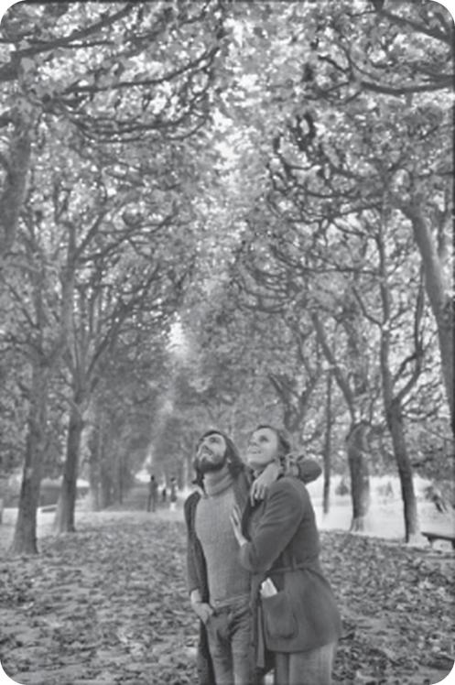


English File Pre-intermediate · SB pp.16–17 · VB p.153
💡 THINK · PENSA
2B
That's me in the picture!
Photos, stories and the past continuous
🎯
Today you're going to…
📷 read the true story behind a famous photo
📍 use at, in, on for time and place
⏸ past continuous: I was walking when…
📖 listen to a class story and answer questions
💬 talk about your favourite photo
Paris, a park, a couple… What are they looking at?
EXAMPLE Maybe they're looking at a bird in a tree!
Notes:
1. OPENING (2 min)
OPENING (2 min). TG lead-in: write PHOTO on the board – short for photograph; we TAKE a photo. Teach photographer / photography and the stress: PHOtograph, phoTOgrapher, phoTOgraphy. Show the photo (Henri Cartier-Bresson, famous French photographer, 1908–2004). Ask the THINK question; take 3–4 guesses. Click: the example. Don't say the answer – it's in the story.

Slide 2

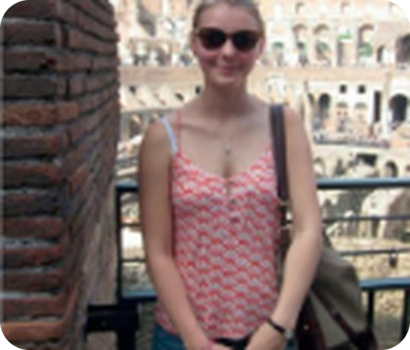
2
Remember last lesson?
💡 THINK → 💬 TALK
⏱ 3 min 👥 pairs
Can you remember? Say it – then use it in a sentence!
🎯 Revision · Retrieval
Ti ricordi? Dillo – poi usalo in una frase!
🔤 Can you remember these words? What do they mean?
went
stayed
took
lost
didn't
was
were
⭐ What does it mean?
⭐⭐ Use it in a sentence.
⭐⭐⭐ Make it negative or a question!
📅
Last lesson…
Your turn: Past simple
Your turn: Holidays
2A: holidays, past simple
-ed endings /t/ /d/ /ɪd/
I went to Rome. We stayed in a hotel.
I didn't take my passport!
Did you have a good time? – Yes, I did.
go abroad · go sightseeing
stay in a hotel · hire a car
was / were: The weather was amazing.
2B · Revision · last lesson
Notes:
2. Revision · last lesson (3 min)
REVISION (3 min). Pairs ask about their last holiday (3 questions each, past simple). 2 students tell the class. Today: the past simple's partner – the past continuous (what WAS happening).
HOW TO RUN IT (active recap): pairs. Words: A points at a word, B says what it means (⭐); then a sentence with it (⭐⭐); strong students make it negative or a question (⭐⭐⭐). Grammar: pairs make their own example for each use (offer, plan…) BEFORE you click – then click to show the model answers.

Slide 3
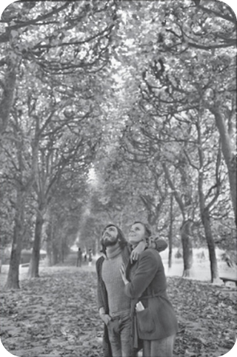
3
What's the story?
👀 LOOK → 🤔 GUESS
⏱ 3 min 👥 pairs
Look at the photo. Guess! Then read and check.
🎯 Reading · Controlled practice
Guarda la foto. Indovina! Poi leggi e controlla.
⭐
Example
1
What decade is it from?
the 1970s (1972)
Say why: I think it's the 1970s because of her coat.
2
What time of year is it?
autumn
3
What are they looking at?
an owl in a tree
4
What's in the woman's pocket?
bread for the animals in the zoo
2B · Reading · prediction · 📖 SB p.16 · 1a, 1b (answers: TG)
Notes:
3. Reading · prediction (3 min)
PREDICTION (3 min). Check: a decade = 10 years (the 1970s); time of year = season. Pairs guess and say why. DON'T click yet: students read the article on the next 2 slides, then come back – or click at the end of the reading. Answers (TG 1b): 1 the 1970s · 2 autumn · 3 an owl in a tree · 4 bread, to give the animals in the zoo.

Slide 4


4
That's me in the picture!
👀 READ → ✏️ FILL THE GAPS
⏱ 4 min 👥 pairs
Read Jane's story. Complete 1–3 with at, in or on.
🎯 Reading · TPRS · reading
Leggi la storia di Jane. Completa 1–3 con at, in o on.
📰 Jane's story (part 1)
📍 at · in · on (use them more than once!)
The Guardian newspaper has a weekly feature called That's me in the picture, where people describe famous photos they were in. This photo was sent in by Jane Rangeley.
at
in
on
(1) ________ 1972, I was living (1) ________ London. I was in my early twenties, and I was working for an advertising agency. That summer, I went on a camping holiday with my parents in the south of France. One night, I went to a nightclub on the beach and I met a young Frenchman, and we fell in love.
In 1972, I was living in London. I was in my early twenties, and I was working for an advertising agency. That summer, I went on a camping holiday with my parents in the south of France. One night, I went to a nightclub on the beach and I met a young Frenchman, and we fell in love.
When I got home, I immediately started looking for a job in Paris. He was (2) ________ university there – he was studying medicine. In the end, I found a job as a secretary with UNESCO, and I went to live there.
When I got home, I immediately started looking for a job in Paris. He was at university there – he was studying medicine. In the end, I found a job as a secretary with UNESCO, and I went to live there.
💡
Remember
We lived together for six years. (3) ________ Sundays, we often went for a walk, and one of our favourite places was the botanical gardens. It had a zoo, and I often put some bread in my pocket to give to the animals.
We lived together for six years. On Sundays, we often went for a walk, and one of our favourite places was the botanical gardens. It had a zoo, and I often put some bread in my pocket to give to the animals.
in my early twenties = 20–23 years old
fall in love = innamorarsi
2B · Reading · Jane's story 1/2 · 📖 SB p.16 · 1b, 2a · the full article
Notes:
4. Reading · Jane's story 1/2 (4 min)
READING 1/2 (4 min). The article is ON THE SLIDE (the book's text IN FULL, word for word). Students read and check their guesses, then complete the gaps with at / in / on (SB 2a sentences are inside the text). Click once per sentence. Answers (TG 2a): 1 In 1972, in London · 2 at university · 3 On Sundays. Pre-teach only: advertising agency (agenzia pubblicitaria), fall in love.

Slide 5
5
That's me in the picture!
👀 READ → ✏️ FILL THE GAPS
⏱ 4 min 👥 pairs
Read the rest of the story. Complete gap 4 (two words).
🎯 Reading · TPRS · reading
Leggi il resto della storia. Completa il 4 con at, in o on.
📰 Jane's story (part 2)
📍 at · in · on
We were walking (4) ________ the gardens one Sunday (4) ________ autumn when we stopped because a lot of noise was coming from one of the trees. There was an owl there, maybe escaped from the zoo, and some little birds were attacking it. I also noticed a man with a camera. When we started walking again, I said 'Why was that man taking photographs of us?'.
at
in
on
We were walking in the gardens one Sunday in autumn when we stopped because a lot of noise was coming from one of the trees. There was an owl there, maybe escaped from the zoo, and some little birds were attacking it. I also noticed a man with a camera. When we started walking again, I said 'Why was that man taking photographs of us?'.
I now know that Cartier-Bresson often waited in parks in Paris for the perfect photo opportunity. The following year, one of my boyfriend's friends saw the photo in a magazine. Before I returned to London, I phoned the magazine and I got Cartier-Bresson's phone number. I was very shy, but I called him. He was very friendly, and he sent me a copy. Years later I met him and he signed the photo for me.
💡
Remember
I love this picture. It was a happy time for me. And although my French boyfriend and I broke up in the end, we're still in touch.
an owl = un gufo
break up = lasciarsi · be in touch = sentirsi
2B · Reading · Jane's story 2/2 · 📖 SB p.16 · 1b, 2a · the full article
Notes:
5. Reading · Jane's story 2/2 (4 min)
READING 2/2 (4 min). Students finish reading and check their guesses on slide 3 (go back and click the answers). Gap 4 (TG 2a): We were walking in the gardens one Sunday in autumn. Then ask: Were your guesses right? Who guessed the owl?

Slide 6
6
Why is the photo special?
🔍 FIND TROVA
⏱ 4 min 👥 pairs
Read Jane's story again. Answer the questions.
🎯 Reading · Guided discovery
Rileggi la storia di Jane. Rispondi alle domande.
⭐
Example
1
Jane's life at the beginning?
in London, early twenties, advertising agency
Where was Jane living in 1972? → In London.
(The story is on slides 4 and 5.)
2
Where did she meet the Frenchman?
at a nightclub on a beach in France
3
What did they often do on Sundays?
They went for a walk.
4
Why did they stop in the gardens?
noise from a tree: birds attacking an owl
5
How did she get a copy?
She called Cartier-Bresson. He sent it.
6
Why is the photo important to her?
It was a happy time for her.
2B · Reading · detail · 📖 SB p.16 · 1c (answers: TG)
Notes:
6. Reading · detail (4 min)
DETAIL (4 min). SB 1c. Pairs answer from the text; click once per question. Answers (TG): 1 She was living in London, in her early twenties, working for an advertising agency. 2 At a nightclub on a beach in the south of France; she found a job in Paris to be with him. 3 They went for a walk. 4 They heard a lot of noise from a tree – some little birds were attacking an owl. 5 She called Cartier-Bresson and he sent her a copy. 6 Because it was a happy time for her. 1d (whole class): Is there a photo with YOU in it that you really love?

Slide 7


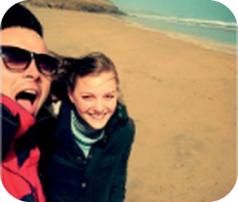
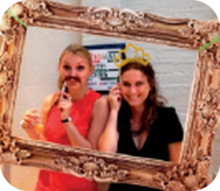

7
at, in, on
👀 LOOK GUARDA
⏱ 4 min 🙋 whole class
at, in or on? Look at the examples. What's the rule?
🎯 Vocabulary · Guided discovery
at, in o on? Guarda gli esempi. Qual è la regola?
in
on
at
big places · long time
days · surfaces · transport
points: places and times
in Rome · in the kitchen
in July · in autumn · in 1972
in the morning
on Sunday · on 1st March
on the beach · on the wall
on a bus · on a train
at home · at work · at a party
at 6 o'clock · at night
at the weekend · at Christmas
città, stanze, mesi, stagioni, anni
giorni, date, superfici, mezzi
luoghi precisi, orari, feste
⚠ in the morning / afternoon / evening BUT at night · at university (= studying there) · 2019 = twenty nineteen
🎧 2.10 ▶ normal
🐢 slower
2B · Vocabulary · prepositions · 📖 Vocabulary Bank Prepositions p.153 · audio 2.10
Notes:
7. Vocabulary · prepositions (4 min)
VOCABULARY (4 min). Elicit each column before clicking. 2.10 is long (the whole Vocabulary Bank) – play only part of it, or drill yourself. TG notes: at / in + shops and buildings are both OK at this level (at / in the supermarket); airport and station → at. Years from 2011 → twenty eleven. in the morning BUT at night.

Slide 8
8
at, in or on?
🎲 PLAY GIOCA
⏱ 3 min 🏆 teams
Teams: at, in or on? Be quick!
🎯 Vocabulary · Communicative game
Squadre: at, in o on? Veloci!
🎲
How to play
e.g.
___ Christmas
→ at Christmas
Read the word.
Leggi la parola.
Say the preposition + the word.
Di' la preposizione + la parola.
First right answer = 1 point.
Prima risposta giusta = 1 punto.
1
___ July
→ in July
2
___ Monday morning
→ on Monday morning
3
___ the airport
→ at the airport
4
___ a bus
→ on a bus
5
___ 2019
→ in 2019
6
___ the weekend
→ at the weekend
TEAM A ☆☆☆☆☆
TEAM B ☆☆☆☆☆
7
___ the kitchen
→ in the kitchen
2B · Vocabulary game · 📖 VB p.153 · Activation
Notes:
8. Vocabulary game (3 min)
GAME (3 min). TG Activation as a team race. Click once per line. Then 1 minute in pairs: A says a word (home, Friday, August…), B says the preposition (book closed).

Slide 9
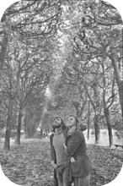
9
What was happening?
👀 READ → 🔗 MATCH
⏱ 3 min 👥 pairs
Read the sentences from the story. Which use?
🎯 Grammar · Guided discovery
Leggi le frasi della storia. Quale uso?
🏷️
Two uses
In 1972, I was living in London.
🎬 the scene
🎬 the scene
⏸ in progress
I was working for an advertising agency.
🎬 the scene
We were walking in the gardens when we stopped.
⏸ in progress
Some little birds were attacking an owl.
⏸ in progress
'Why was that man taking photos of us?'
⏸ in progress
2B · Grammar · past continuous · 📖 SB p.17 · 3a (answers: TG)
Notes:
9. Grammar · past continuous (3 min)
GUIDED DISCOVERY (3 min). SB 3a: look at the highlighted verbs – which describe 1) an action in progress at a specific moment in the past, 2) the situation at the beginning of the story? Click once per sentence. Answers (TG): 1 were looking (when Cartier-Bresson took the photo) · 2 was living, was working. Elicit the form: was / were + -ing – like the present continuous, but was / were.

Slide 10

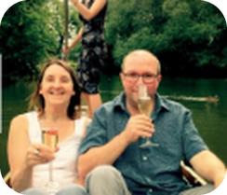
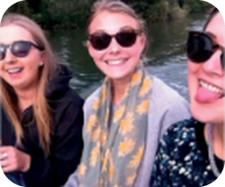
10
I was walking when…
👀 LOOK GUARDA
⏱ 4 min 🙋 whole class
How do we make it?
🎯 Grammar · Guided discovery
Come si forma?
+
−
?
when / while
was / were + -ing
wasn't / weren't + -ing
Was / Were + person + -ing?
long action + short action
I was living in London.
They were walking.
She wasn't working.
We weren't listening.
What were you doing?
Was it raining? – Yes, it was.
We were walking when we saw an owl.
While I was sleeping, the phone rang.
ero / stavo + -ando
non stavo…
Cosa stavi facendo?
azione lunga (continuous) + breve (simple)
⚠ ✗ When I was arriving, they were eating → ✓ When I arrived, they were eating (the short action = past simple)
2B · Grammar · past continuous · 📖 Grammar Bank 2B p.128 · audio 2.11, 2.12 (play from the book)
Notes:
10. Grammar · past continuous (4 min)
POP-UP GRAMMAR (4 min). Elicit each column before clicking. TG grammar notes: we use the past continuous at the beginning of a story to set the scene; very often the 'action in progress' is interrupted by a short, completed action (past simple). when + past simple, while / when + past continuous. Grammar Bank audio 2.11 and 2.12 (listen and repeat) are not in our audio folder – play them from the book, or model the examples yourself and get students to copy the rhythm.

Slide 11
11
Luca's terrible Sunday
👀 READ → 💬 TALK
⏱ 5 min 🙋 whole class
Listen to the story. Answer the questions!
🎯 Speaking · TPRS · story
Ascolta la storia. Rispondi alle domande!
🔑
Story phrases
1
Last Sunday at 8 o'clock, Luca was sleeping in bed.
❓ Was Luca sleeping or working? · Where was he sleeping?
was sleeping – stava dormendo
was running – stava correndo
were looking at – stavano guardando
was wearing – indossava
when + past simple – quando + passato
while + was / were -ing – mentre…
While he was sleeping, his phone rang. It was his boss!
❓ Was he sleeping when the phone rang? · Who was it?
2
3
Luca was running to the station when it started to rain.
❓ Was he walking or running? · What happened?
4
On the train, everybody was looking at him. He was wearing his pyjamas!
❓ What were people doing? · What was he wearing?
5
At work his boss was laughing: 'Luca… today is Sunday!'
❓ Was the boss angry or laughing? · What day was it?
6
And you? What were you doing last Sunday at 8 o'clock?
❓ Were you sleeping? · Were you working?
2B · Speaking · class story (TPRS)
Notes:
11. Speaking · class story (TPRS) (5 min)
TPRS CLASS STORY (5 min) – the past continuous + past simple, many times, before the practice. Click once per line. For each line: 1) say it, 2) ask the questions round the class (yes/no → either/or → what/where), 3) let the CLASS change details (accept their idea and use it in later lines): 'Was Luca wearing pyjamas? No? What was he wearing?' Students answer with one word or a short phrase – that's fine; repeat the full sentence yourself. Highlight the pattern: long action (was / were -ing) + short action (past simple). Finish: 'What happened next?'

Slide 12
12
Retell Luca's story!
💬 TALK PARLA
⏱ 4 min 👥 pairs
Retell Luca's story to your partner. Use the prompts!
🎯 Speaking · TPRS · retell
Racconta la storia di Luca al compagno. Usa gli spunti!
🔑
Story phrases
1
Sunday · 8 o'clock · sleep
💬 Last Sunday at 8 o'clock, Luca was sleeping…
was / were + -ing – the long action
when + past simple – the short action
while + was / were -ing – mentre…
phone · ring · boss
💬 While he was sleeping…
2
3
run · station · rain
💬 He was running to the station when…
4
train · people · look · pyjamas
💬 On the train…
5
boss · laugh · Sunday!
💬 At work…
6
Now YOU: change 2 things!
💬 Last Saturday at 10 o'clock, Maria was…
2B · Speaking · retell (TPRS)
Notes:
12. Speaking · retell (TPRS) (4 min)
STORY PROMPTS (4 min) – the story slide is gone; only key words remain. A retells lines 1–3, B lines 4–6, then swap. The grey line is a sentence starter for weaker students (cover it for strong pairs). Line 6: pairs change two details (person, day, place) and tell their new version to another pair. Listen for was / were + -ing + when + past simple.

Slide 13

13
Was it happening?
✏️ FILL THE GAPS → 💬 TALK
⏱ 4 min 👥 pairs
Past simple or past continuous? Say the sentence.
🎯 Grammar · Controlled practice
Past simple o past continuous? Di' la frase.
⭐
Example
1
He ___ his wife when he ___ in Japan. (meet · live)
met · was living
I ___ this photo when we ___ in Greece. (take · travel) → I took this photo when we were travelling in Greece.
2
___ she ___ a coat when she went out? (wear)
Was she wearing
3
The sun ___ when I went to work. (shine)
was shining
4
What ___ you ___ at 7.30 last night? (do)
were you doing
5
I ___ when you gave the instructions. (not listen)
wasn't listening
6
It started to rain when we ___ in the park. (run)
were running
2B · Grammar · practice · 📖 Grammar Bank 2B p.129 · a (answers: TG)
Notes:
13. Grammar · practice (4 min)
CONTROLLED PRACTICE (4 min). Grammar Bank 2B a (the book's sentences, answers from the TG). Pairs say the full sentence; click once per line. Remember: the short action = past simple (went, gave, started).

Slide 14
14
What was happening?
🎲 PLAY → 💬 TALK
⏱ 3 min 🏆 teams
Watch the mime. Say what was happening!
🎯 Grammar · Communicative game
Guarda il mimo. Di' cosa stava succedendo!
🎲
How to play
e.g.
play tennis · start to rain
→ They were playing tennis when it started to rain.
A student mimes both actions.
Uno studente mima le due azioni.
Teams say the sentence: …was / were -ing when…
Le squadre dicono la frase: …was / were -ing when…
Right sentence = 1 point.
Frase giusta = 1 punto.
drive · somebody phone
→ She was driving when somebody phoned her.
1
2
have a party · the police come
→ They were having a party when the police came.
3
have a shower · somebody knock
→ He was having a shower when somebody knocked at the door.
4
sleep · the baby start to cry
→ They were sleeping when the baby started to cry.
TEAM A ☆☆☆☆☆
TEAM B ☆☆☆☆☆
5
walk the dog · meet a friend
→ She was walking her dog when she met a friend.
2B · Grammar game · mime · 📖 SB p.17 · 3c (audio 2.13 = sound effects, play from the book)
Notes:
14. Grammar game · mime (3 min)
GAME (3 min). SB 3c uses sound effects (audio 2.13, not in our folder). Without the audio: a volunteer mimes BOTH actions (long, then short), teams say the sentence. With the book audio: play each sound effect, pairs write the sentence. Click once per line to show the book's answer (TG 2.13).

Slide 15

15
was /wəz/, were /wə/
🎧 LISTEN → 🔊 SAY IT
⏱ 3 min 👤 alone
Listen and complete. Is was / were strong or weak?
🎯 Pronunciation · Listening for detail
Ascolta e completa. Was / were sono forti o deboli?
🎧 2.14
1 ___ ___ my first term at university.
It was
2 I ___ ___ with him in the Easter holidays.
was staying
3 We ___ ___ a music course.
were doing
4 ___ ___ at school together.
We were
5 She took this when we ___ ___ the Colosseum.
were visiting
💡
Guess first, then listen!
6 We ___ all ___ champagne, and Roz ___ ___ the hard work!
were drinking · was doing
2B · Pronunciation · weak forms · 📖 SB p.17 · 4b, 4c · audio 2.14 (play from the book)
Notes:
15. Pronunciation · weak forms (3 min)
WEAK FORMS (3 min). Audio 2.14 is not in our folder: play it from the book, or read the sentences yourself at natural speed (was = /wəz/, were = /wə/ – unstressed). Answers (TG): 1 It was · 2 was staying · 3 were doing · 4 We were · 5 were visiting · 6 were…drinking, was doing. 4c: was and were are UNSTRESSED in positive sentences (strong /wɒz/ /wɜː/ only in short answers: Yes, I was). Drill: I was staying /aɪ wəz ˈsteɪɪŋ/.

Slide 16
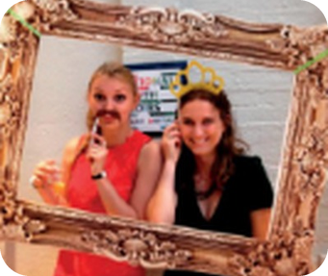



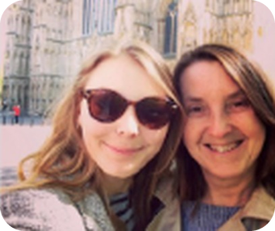
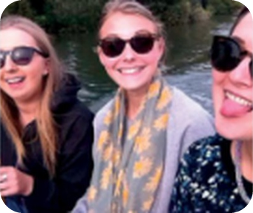
16
Anya's Instagram
🎧 LISTEN ASCOLTA
⏱ 5 min 👤 alone
Anya talks about her photos. Order them 1–6.
🎯 Listening · Controlled practice
Anya parla delle sue foto. Mettile in ordine 1–6.
A
B
C
e.g. Photo E
1 – York, with her mum
Photo A
3 – a party after a music course
Photo B
5 – Rome, the Colosseum
D
E
F
Photo C
2 – a windy beach in Cornwall
Photo D
6 – Oxford: punting on the river
Photo F
4 – a friend's house by the river
🎧 2.15
🎧 2.15
2B · Listening · Anya's photos · 📖 SB p.17 · 4d, 4e · audio 2.15 (play from the book · script SB p.120)
Notes:
16. Listening · Anya's photos (5 min)
LISTENING (5 min). Audio 2.15 is not in our folder: play it from the book, or read the script yourself (2 voices: Anya + friend). Script (TG): 1 This is me and my mum in York. It was my first term at university, and she came to visit me, and I took her on a tour round the city. – Is that the cathedral? – Yes, it's called York Minster. 2 This one's on the beach in Cornwall with my boyfriend, Ollie. I was staying with him in the Easter holidays, and we went for a walk. – It looks windy! – Yes, it was really windy and cold. 3 That's me and my friend Maisie. We were doing a music course, and this was at the party at the end of the course – the teachers made a corner with a big frame, hats and moustaches. 4 Me and two of my best friends – we were at school together. Libby has a house by the river, and we went there in September. 5 In Rome – I was there with my mum the summer before I went to university. She took this when we were visiting the Colosseum. 6 That's my mum, her partner and my sister Roz, on the river in Oxford. Every year we go punting. We were all drinking champagne, and Roz was doing the hard work! Answers: E 1 · C 2 · A 3 · F 4 · B 5 · D 6. Glossary: punt = a long flat boat (Oxford, Cambridge). 4e: what else do you remember about each photo?

Slide 17

17
My favourite photo
💬 TALK PARLA
⏱ 5 min 👥 pairs
Talk to a partner. Give more information!
🎯 Speaking · Communicative
Parla con un compagno. Dai più informazioni!
1
Do you post photos on Instagram or Facebook? What kind?
e.g. Yes, mostly food and my dog!
2
Do you have a photo as a background on your phone? What's the story?
e.g. My kids at the beach – we were having a picnic.
3
Do you have a photo you really like on your phone? Show your partner!
e.g. This is me in Rome – I was visiting my sister.
💬
Useful phrases
4
A favourite photo of you as a child? What were you wearing?
e.g. I was wearing a cowboy hat – I was 5!
I took it when I was… · We were…ing
It was a happy time for me.
Show me! Who took it?
2B · Speaking · your photos · 📖 SB p.17 · 5a
Notes:
17. Speaking · your photos (5 min)
SPEAKING (5 min). Questions one per click; model each with your own photo. Students SHOW real photos on their phones (great for the past continuous: What were you doing? Who were you with?). Note errors with was / were + -ing for 1 minute of correction.

Slide 18
18
3 · 2 · 1
⏱ 2 min 👥 pairs
🎯 Revision · Retrieval
Books closed! What can you remember?
Libri chiusi! Cosa ricordi?
3
Tell me 3 phrases with at, in, on (at night…)
📝
Homework · Compiti
Workbook 2B (past continuous, at / in / on)
Grammar Bank 2B p.129: exercise b
Write: your favourite photo (SB p.114) – 80–100 words
2
Tell me 2 facts about Jane's photo
1
Tell me 1 sentence: I was…ing when…
Next lesson: 2C · One dark October evening · time sequencers
2B · Exit · what can you remember?
Notes:
18. Exit · what can you remember? (2 min)
RETRIEVAL EXIT (2 min). Books closed. Set homework: Workbook 2B + Grammar Bank 2B exercise b (answers TG: 1 I broke my arm when I was playing football. 2 Were you driving fast when the police stopped you? 3 It was snowing when we left the pub. 4 I didn't see the match because I was working. 5 When you called me I was talking to my boss. 6 We were studying in Cambridge when we met. 7 Were they living in Rome when they had their first baby?) + Writing p.114 'Describing a photo' (use the questions from the speaking: Who took it? When? What was happening? Why do you like it?).

Slide 19
19
Today you…
💡 THINK PENSA
⏱ 1 min 🙋 whole class
Can you do it now? Thumbs up or thumbs down!
🎯 Revision · Reflection
Ora sai farlo? Pollice su o pollice giù!
📷
Read the true story behind a famous photo
✅
👍 👌 👎
Can you do it now?
Ora sai farlo?
📍
Used at, in, on for time and place
✅
⏸
Practised past continuous: I was walking when…
✅
📖
Listened to a class story and answered questions
✅
💬
Talked about your favourite photo
✅
2B · Review · what did you do today?
Notes:
19. Review · what did you do today? (1 min)
TODAY YOU… (1 min). Read each line (one per click: the tick appears). Students show thumbs up / middle / down: can they do it now? Note any thumbs down for the next lesson's recap.

Slide 20
⭐
Optional extensions
Only if there's time – the lesson is finished. · Solo se c'è tempo – la lezione è finita.
Notes:
20. OPTIONAL EXTENSIONS
The lesson ended on the previous slide ("Today you…"). Use the next slides only if there is time left, or keep them for a quick start next lesson.

Slide 21
21
Prepositions race
🎲 PLAY GIOCA
⏱ 5 min 🏆 teams
Teams: at, in or on? Say the whole phrase!
🎯 Vocabulary · Communicative game
Squadre: at, in o on? Di' la frase intera!
🎲
e.g.
the weekend
→ at the weekend – I sleep a lot at the weekend.
How to play
1
July
→ in July
Teacher says a word. Your team says at, in or on + the word.
Right = 1 point. A sentence about YOU = 1 more!
2
Monday morning
→ on Monday morning
3
night
→ at night
4
the 1990s
→ in the 1990s
5
my birthday
→ on my birthday
TEAM A ☆☆☆☆☆
TEAM B ☆☆☆☆☆
6
the station
→ at the station
7
a car
→ in a car
8
the bus
→ on the bus
⭐ OPTIONAL EXTENSION · only if there's time
2B · Vocabulary game · at / in / on · 📖 VB p.153 · audio 2.10
Notes:
21. Vocabulary game · at / in / on (5 min)
OPTIONAL EXTENSION – PREPOSITIONS RACE (5 min). Item 1 is the example. Say the word; the first team with the correct phrase scores 1; a true sentence about themselves scores 1 more. Click: the answer. Finish by playing 2.10 (the Vocabulary Bank list) – students tick the ones they got right.

