Slide 1


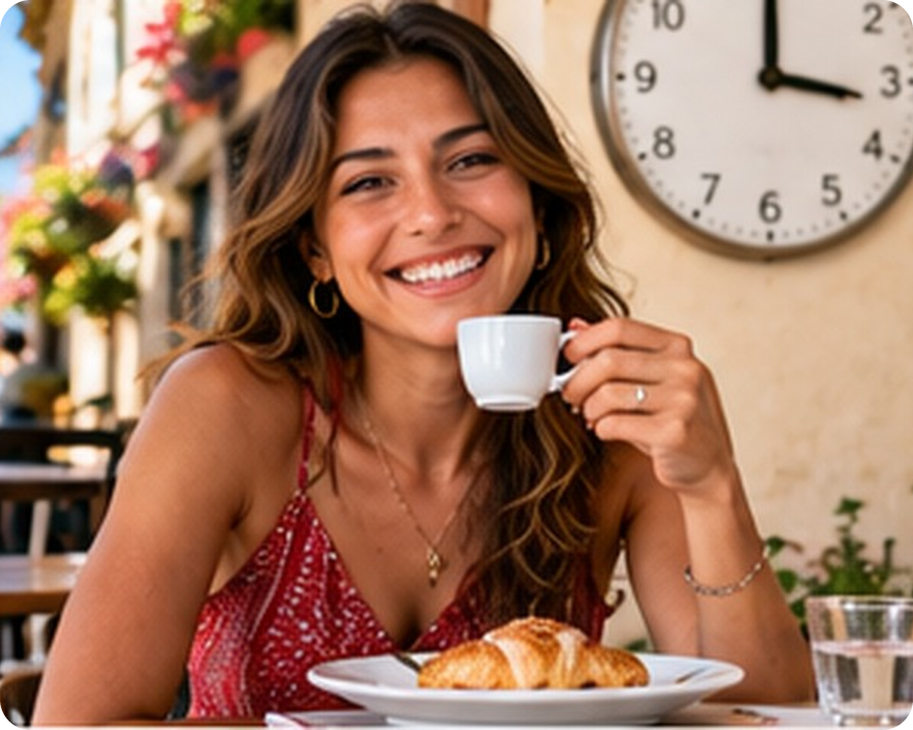


English File B1 · SB pp.6–7
💡 THINK · PENSA
1A-1
Eating in… and out
You are what you eat!
🎯
Today you're going to…
💬 get to know your new classmates
🍆 name food and ways to cook it
🔊 hear short and long vowel sounds
🎧 listen to people talking about food
👀 read about the best times to eat
When's the best time to drink coffee?
EXAMPLE I think the morning – I can't wake up without a coffee!
Notes:
1. OPENING (2 min)
FIRST LESSON OF THE COURSE (60 min). Show the photo. Ask the THINK question: 'When's the best time to drink coffee?' Take 3–4 guesses (7 a.m.? after lunch? never?). Don't give the answer: 'You'll find out at the end of the lesson – science has an answer!' (the article on p.7 says between 2.00 and 5.00 p.m.). Read the 'Today you're going to…' list together so students know where the lesson is going. No revision warmer today (first lesson).

Slide 2

2
Guess why!
💬 TALK PARLA
⏱ 5 min 👥 pairs
Write 6 answers. Your partner asks: Why?
Scrivi 6 risposte. Il compagno chiede: Perché?
1
the year you started learning English
e.g. "2015" → Why did you write 2015? – I started at primary school.
2
a food you LOVE
e.g. "arancine" → I think it's because you eat them every Sunday!
3
a food you can't stand
e.g. "broccoli" → Really? Why? – I hate the smell!
4
two things you like doing in your free time
e.g. "football, TikTok" → How often do you play football?
💬
Useful phrases
5
the best place to eat in Bagheria
e.g. "my nonna's house" → Why? – Her pasta is the best!
Why did you write…?
I think it's because…
Really? Tell me more!
How do you spell that?
6
the last film or TV series you watched
e.g. "Wednesday" → Did you like it? – Yes, it was really funny.
1A-1 · Warmer · getting to know you · 📖 Adapted from TG Communicative photocopiable 'Getting to know you' p.176–177
Notes:
2. Warmer · getting to know you (5 min)
GETTING TO KNOW YOU (5 min) – first lesson, so no revision. The six prompts appear ONE PER CLICK: students write only a short answer for each (a word, a name, a number) on a piece of paper, in circles around their name. MODEL FIRST (1 min): draw your own circles on the board with YOUR answers; the class guesses why, then asks 'Why did you write…?' and you answer. Then pairs swap papers: the partner GUESSES the reason first ('I think it's because…'), then asks and asks one follow-up question (3 min). Feedback (1 min): 3–4 students tell the class one surprising thing about their partner. Learn names now! Classroom language to teach on the way: How do you spell…? What does … mean? Can you say that again, please? PRIVACY: no questions about family, address or house numbers in a new group. ICQs: 'Do you write the question or the answer?' (the answer) · 'Who asks why – you or your partner?' (partner). Example answers on the slide are only models. Food prompts 2, 3 and 5 lead into today's topic (accept Italian food names: arancine, panelle, sfincione…).

Slide 3
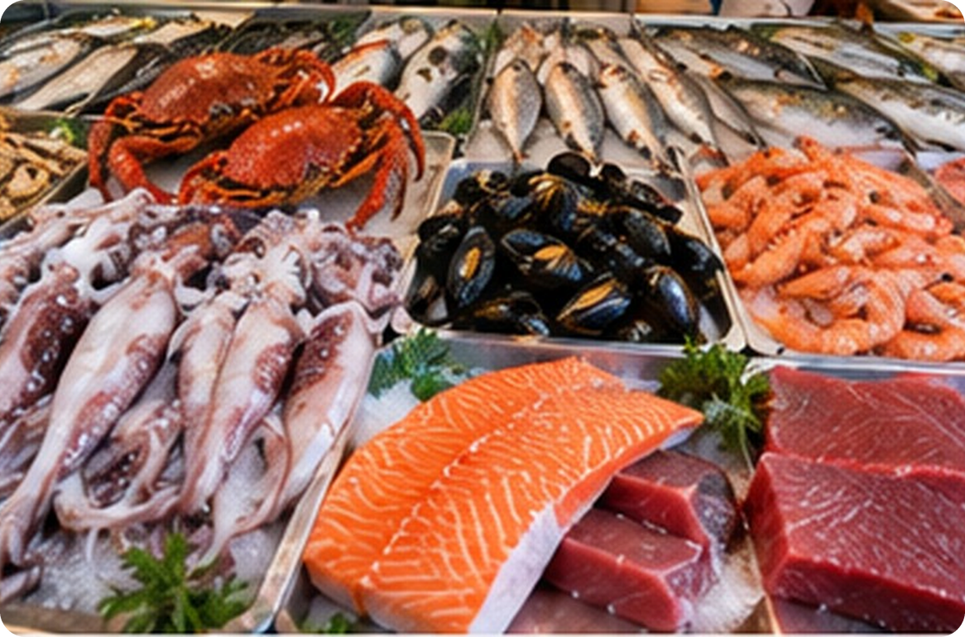
3
At the fish market
💬 TALK PARLA
⏱ 3 min 👥 pairs
What's 1–6 in English? Guess first!
Come si dice 1–6 in inglese? Prova!
1
Red, with eight legs.
crab
1
2
Black – in spaghetti allo scoglio!
mussels
2
3
3
Small, pink and curly.
prawns
4
4
In Sicily we fry it in rings.
5
squid /skwɪd/
6
5
Orange-pink fish from Norway.
salmon (silent l!) /ˈsæmən/
6
Big red fish – famous in Sicily!
tuna /ˈtjuːnə/
1A-1 · Vocabulary · fish and seafood · 📖 SB p.6 · 1c · Vocabulary Bank p.152 · 1 Food (audio 1.2)
Notes:
3. Vocabulary · fish and seafood (3 min)
ELICIT FIRST (3 min). Pairs look at the photo and the clues and say the English word for 1–6 (Italian is fine as a first step – then try English). Click once per number. Answers (Vocabulary Bank p.152, audio 1.2): 1 crab · 2 mussels · 3 prawns · 4 squid · 5 salmon · 6 tuna. Drill: squid /skwɪd/, salmon /ˈsæmən/ (silent l), tuna /ˈtjuːnə/ (not /ˈtuːnə/), mussels /ˈmʌslz/. Other words in the Vocabulary Bank: lobster (aragosta). ICQ: 'Are you writing or speaking?' (speaking). The Italian is on slide 6 for slower students.

Slide 4

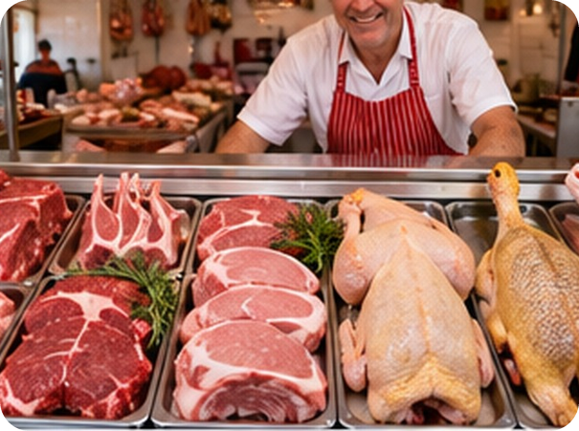
4
At the butcher's
💬 TALK PARLA
⏱ 2 min 👥 pairs
Which animal? Say the meat word.
Quale animale? Di' il nome della carne.
⭐
Example
1
meat from a pig
pork
0 a pig → pork (the animal is pig, the MEAT is pork)
2
meat from a cow
beef
3
meat from a young sheep
lamb (silent b!) /læm/
4
a bird that lays eggs
chicken
5
a bird that says "quack!"
duck
1A-1 · Vocabulary · meat · 📖 Vocabulary Bank p.152 · 1 Food (audio 1.2)
Notes:
4. Vocabulary · meat (2 min)
ELICIT (2 min). Do 0 with the class: pig = the animal, pork = the meat. Pairs say the meat words, then click once per line. Answers: 1 pork · 2 beef · 3 lamb · 4 chicken · 5 duck. Point out: we eat pork, beef and lamb – NOT 'pig', 'cow', 'sheep'. Drill lamb /læm/ (silent b). Italian on slide 6.

Slide 5
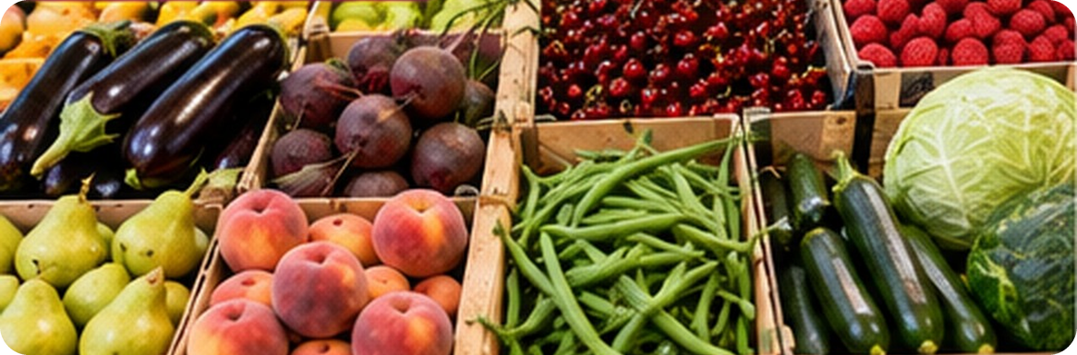
5
Fruit and veg
💬 TALK PARLA
⏱ 3 min 👥 pairs
What's 1–6 in English? Guess first!
Come si dice 1–6 in inglese? Prova!
3
1
Purple – the star of caponata!
aubergine /ˈəʊbəʒiːn/
1
2
2
Dark red. Great in salads.
5
beetroot
4
6
3
Small, red and soft.
raspberries
4
Orange-pink summer fruit.
💡
Remember
peaches (not pears!)
aubergine (US eggplant) · courgette (US zucchini)
a peach (pesca) ≠ a pear (pera) · a cherry (ciliegia)
One more: what's 'carciofo'? → artichoke!
5
Long, thin and green.
green beans
6
Long and green. Great in pasta!
courgettes /kɔːˈʒets/
1A-1 · Vocabulary · fruit and vegetables · 📖 Vocabulary Bank p.152 · 1 Food (audio 1.2)
Notes:
5. Vocabulary · fruit and vegetables (3 min)
ELICIT (3 min). Same procedure: pairs, then one click per number. Answers (VB p.152): 1 aubergine · 2 beetroot · 3 raspberries · 4 peaches · 5 green beans · 6 courgettes. Also in the photo: pears (bottom left), cherries (top middle), cabbage (right) – elicit if there's time. Drill aubergine /ˈəʊbəʒiːn/, courgette /kɔːˈʒet/, beetroot /ˈbiːtruːt/. TG tip: teach important local food that isn't in the book – artichokes, prickly pears (fichi d'India), pistachios, swordfish (pesce spada), sardines.

Slide 6

6
Food words in Italian
✅ CHECK CONTROLLA
⏱ 2 min 🙋 whole class
Say it in Italian. Then click!
Dillo in italiano. Poi clicca!
🦀
crab
🦐
prawns
🐚
mussels
🦑
squid
granchio
gamberi / gamberetti
cozze
calamari / totani
🐟
salmon · tuna
🐖
pork
🐄
beef
🐑
lamb
salmone · tonno
carne di maiale
carne di manzo
agnello
🍆
aubergine
🥒
courgette
🟣
beetroot
🍓
raspberries
melanzana
zucchina
barbabietola
lamponi
⚠ Watch out! pig / cow / sheep = the ANIMAL · pork / beef / lamb = the MEAT | silent letters: salmon, lamb
1A-1 · Vocabulary · in Italian
Notes:
6. Vocabulary · in Italian (2 min)
CONSOLIDATION for slower students (2 min). The class says the Italian for each word, then ONE click shows all the Italian. 20 seconds on the warning: we eat pork, not pig! Quick check: 'Spaghetti allo scoglio has… ?' (mussels, prawns, squid…). 'Is lamb from a cow?' (no – a young sheep).

Slide 7

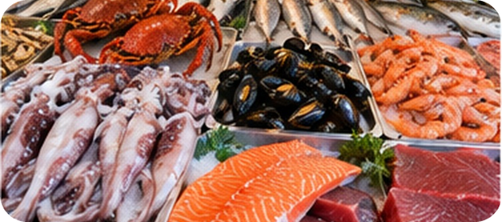
7
Describe it!
🎲 PLAY GIOCA
⏱ 3 min 👥 pairs
Explain the food. Don't say it!
Spiega il cibo. Non dirlo!
🎲
How to play
ROUND 1 · A explains
ROUND 2 · B explains
A looks at the screen. B turns around.
A explains the food. Don't say it!
B guesses. Then swap.
squid
beetroot
aubergine
prawns
mussels
courgette
lamb
duck
1A-1 · Vocabulary game
Notes:
7. Vocabulary game (3 min)
GAME 1 (3 min). Demo first with a strong student: 'It's meat from a cow' → beef (not in the game). Click to show each word: round 1 = 4 words for A, round 2 = 4 words for B (now B faces the screen). About 20 seconds per word. Useful language to model: It's a fish / a fruit / a vegetable / meat… It's red / long / small… You eat it in… ICQs: 'Can you say the word?' (no) · 'Can you use Italian?' (no!).

Slide 8
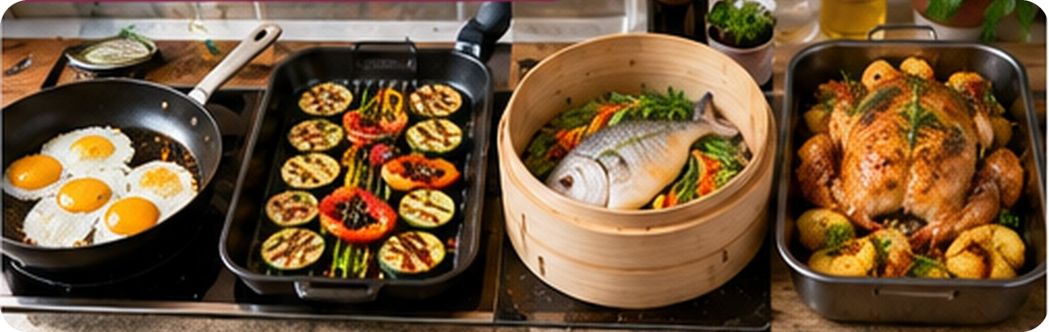
8
How is it cooked?
💬 TALK PARLA
⏱ 2 min 👥 pairs
How is it cooked? Say the word.
Come è cucinato? Di' la parola.
1
Cooked in hot oil in a pan
fried eggs
3
4
Cooked on very hot metal
2
2
1
grilled vegetables
3
Cooked over hot water
steamed fish
4
In the oven, with oil or fat
💡
Remember
roast chicken
boiled = cooked in hot water: boiled eggs, pasta
baked = in the oven: bread, cakes
How do you like your eggs? – Fried!
1A-1 · Vocabulary · cooking · 📖 Vocabulary Bank p.152 · 2 Cooking (audio 1.3)
Notes:
8. Vocabulary · cooking (2 min)
ELICIT (2 min). Pairs say the cooking word for 1–4; click once per number. Answers (VB p.152, 1.3): 1 fried · 2 grilled · 3 steamed · 4 roast. Then the Remember box: boiled and baked. TG note: baked and roast are both 'cooked in the oven' – baked for bread, cakes, sweet things, fruit or vegetables; roast always with fat, especially meat and potatoes. Quick personalisation: 'How do you like your eggs? Potatoes? Fish?' (2–3 students). Drill steamed /stiːmd/ (one syllable, not 'steam-ed').

Slide 9
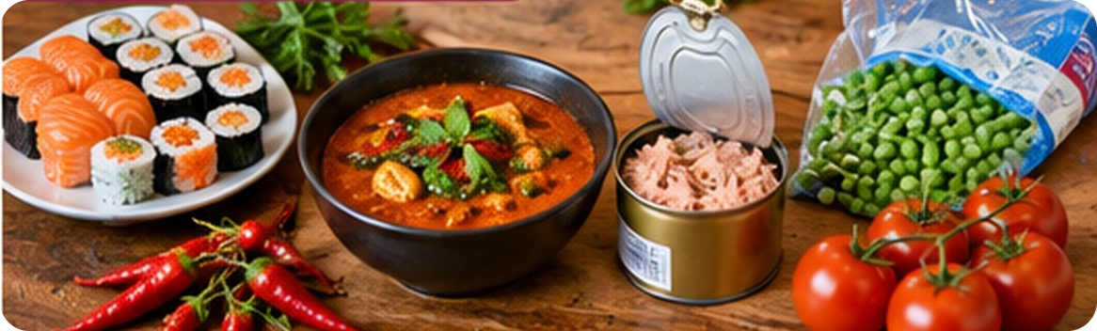
9
Raw, frozen or fresh?
💬 TALK PARLA
⏱ 2 min 👥 pairs
Which word? Raw, spicy, fresh…
Quale parola? Crudo, piccante, fresco…
1
Not cooked – like the fish in sushi
raw
1
4
2
Chillies are very…
3
spicy / hot
2
5
Fish in a metal can
3
tinned tuna
💡
Remember
4
Kept at –18°C
frozen peas
hot = spicy (piccante) – or warm (caldo)!
low-fat = with very little fat: low-fat yogurt, cheese
tinned (UK) = canned (US)
5
Just picked – not old
fresh tomatoes
1A-1 · Vocabulary · food adjectives · 📖 SB p.6 · 1d
Notes:
9. Vocabulary · food adjectives (2 min)
ELICIT (2 min). SB 1d: the adjectives fresh, frozen, hot / spicy, low-fat, raw, tinned. Pairs match 1–5; click once per number. Answers: 1 raw (sushi) · 2 spicy / hot (chillies) · 3 tinned (tuna) · 4 frozen (peas) · 5 fresh (tomatoes). Then low-fat from the Remember box. TG possible answers for other foods: fresh fish, vegetables · frozen peas, fish, pizza · hot / spicy sauce, chicken · low-fat yogurt, cheese · raw fish, vegetables · tinned tomatoes, tuna. Drill frozen /ˈfrəʊzn/, spicy /ˈspaɪsi/, raw /rɔː/.

Slide 10
10
Cooking words in Italian
✅ CHECK CONTROLLA
⏱ 2 min 🙋 whole class
Say it in Italian. Then click!
Dillo in italiano. Poi clicca!
🍳
fried
🔥
grilled
♨️
steamed
🍗
roast
fritto
alla griglia
al vapore
arrosto
🥚
boiled
🍞
baked
🍣
raw
🌶️
spicy / hot
bollito / lesso
al forno (pane, dolci)
crudo
piccante
🍅
fresh
🧊
frozen
🥫
tinned
🥛
low-fat
fresco
surgelato
in scatola
magro / light
🍽️
eat out
🍕
takeaway
✂️
cut down on
🚫
cut out
mangiare fuori
cibo da asporto
mangiare / bere meno
eliminare
1A-1 · Vocabulary · in Italian
Notes:
10. Vocabulary · in Italian (2 min)
CONSOLIDATION (2 min). Class says the Italian, then ONE click shows it all. The last row is new: the phrasal verbs from the Vocabulary Bank (audio 1.4) and 'takeaway'. Give the book's examples: 'I eat out a lot because I often don't have time to cook.' · 'I'm trying to cut down on coffee at the moment. I'm only having one cup at breakfast.' · 'The doctor told me that I should completely cut out all cheese and dairy products.' CCQ: 'I cut out sugar – do I eat a little sugar?' (no, none) · 'I cut down on sugar?' (yes, less).

Slide 11
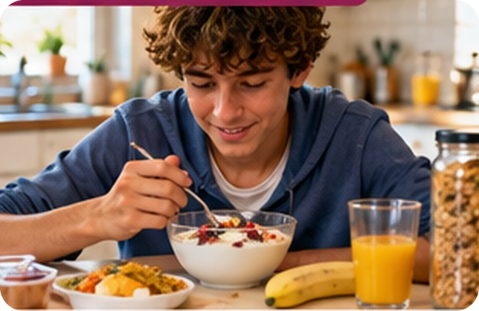
11
Six short conversations
🎧 LISTEN ASCOLTA
✏️ FILL THE GAPS COMPLETA
Guess the adjectives. Then listen.
⏱ 3 min 👥 pairs
Indovina gli aggettivi. Poi ascolta.
🎧 1.5 · pause after each one
0 You need ___ beetroot, not the cooked kind.
raw
⚠ Play it from the book audio
1 I'll have the ___ prawns. I love ___ food.
spicy · hot
2 How should I cook this ___ tuna?
fresh
3 Could you get me some ___ yogurts?
low-fat
4 We've got some ___ red peppers (peperoni).
tinned
💡
Guess first, then listen!
5 I never buy ___ raspberries.
frozen
1A-1 · Listening · food adjectives · 📖 SB p.6 · 1e · audio 1.5
Notes:
11. Listening · food adjectives (3 min)
LISTENING (3 min). 0 is the example (raw beetroot – done in the book). Pairs guess the adjectives first. Play 1.5, pausing after each conversation. Click once per sentence. Answers (TG + audio script): 0 raw beetroot · 1 spicy prawns, hot food · 2 fresh tuna · 3 low-fat yogurts · 4 tinned red peppers · 5 frozen raspberries. yogurt can also be spelled yoghurt. ICQ: 'Do you write the food or the adjective?' (the adjective).

Slide 12
12
Food race!
🎲 PLAY GIOCA
⏱ 3 min 🏆 teams
Teams: write the words. Fastest wins!
Squadre: scrivete le parole. Vince chi è più veloce!
🎲
How to play
1
TWO kinds of seafood
→ e.g. prawns · mussels · squid
Read the category.
Teams: write the words – 30 seconds!
Correct words = 1 point each.
THREE ways to cook potatoes
→ e.g. fried · roast · boiled · baked
2
3
TWO foods you can eat raw
→ e.g. salmon (sushi) · tomatoes
4
TWO foods people often buy frozen
→ e.g. peas · prawns
📷 1a1-food-race.jpg
5
TWO foods that often come in tins
→ e.g. tuna · red peppers
6
ONE red and ONE green fruit or vegetable
→ e.g. raspberries · courgette
1A-1 · Vocabulary game · race
Notes:
12. Vocabulary game · race (3 min)
GAME 2 (3 min). Teams of 3–4, one pen and paper per team. Show a category, 30 seconds, 'Go!' Then click to show EXAMPLE answers – accept any correct, correctly spelled word (the TG optional lead-in idea, adapted to today's words). 1 point per correct word; +1 bonus for a word nobody else has. Write the scores on the board. ICQ: 'How long do you have?' (30 seconds) · 'Does spelling count?' (yes).

Slide 13
13
Fish or tree?
🔊 SAY IT PRONUNCIA
🎧 LISTEN ASCOLTA
Say the phrase. Which sound picture?
⏱ 3 min 👥 pairs
Di' la frase. Quale immagine-suono?
🏷️
The colours
crab salad
🐱 cat /æ/
grilled squid
🐟 fish /ɪ/
🐟 fish /ɪ/
🌳 tree /iː/
a jar of raspberry jam
🚗 car /ɑː/
🐱 cat /æ/
🚗 car /ɑː/
⏰ clock /ɒ/
🐴 horse /ɔː/
steamed green beans
🌳 tree /iː/
🐂 bull /ʊ/
👢 boot /uː/
a good cook
🐂 bull /ʊ/
hot sausages
⏰ clock /ɒ/
raw pork
🐴 horse /ɔː/
🎧 1.6
tuna with beetroot
👢 boot /uː/
⚠ Play it from the book audio
1A-1 · Pronunciation · short and long vowels · 📖 SB p.7 · 2a, 2b · audio 1.6
Notes:
13. Pronunciation · short and long vowels (3 min)
PRONUNCIATION (3 min). 2a: introduce the sound pictures (one for each of the 44 sounds of English). Elicit and drill fish /ɪ/ and tree /iː/, then cat, car, clock, horse, bull, boot. Ask: 'How do you know a sound is long?' – the two dots /ː/. Each pair = a short and a long sound (left short, right long). 2b: pairs say the phrases aloud and match them (in the book the target letters are pink). Play 1.6 to check; click once per phrase. Answers (TG/audio script): crab salad cat /æ/ · grilled squid fish /ɪ/ · a jar of raspberry jam car /ɑː/ · steamed green beans tree /iː/ · a good cook bull /ʊ/ · hot sausages clock /ɒ/ · raw pork horse /ɔː/ · tuna with beetroot boot /uː/. Play again: listen and repeat. ITALIAN SPEAKERS: Italian has one 'i' and one 'u', so /ɪ/–/iː/ (ship / sheep, live / leave) and /ʊ/–/uː/ (full / fool) sound the same to them – exaggerate the long sounds. tuna = /ˈtjuːnə/.

Slide 14
14
Odd one out!
🎲 PLAY GIOCA
🔊 SAY IT PRONUNCIA
Find the different sound. Be quick!
⏱ 3 min 🏆 teams
Trova il suono diverso. Veloci!
🎲
How to play
1
beef · peach · squid · beans
→ squid /ɪ/ (others /iː/)
Say the four words aloud.
Find the word with a different vowel sound.
First team to say it = 1 point.
crab · lamb · jam · jar
→ jar /ɑː/ (others /æ/)
2
3
pork · prawns · raw · hot
→ hot /ɒ/ (others /ɔː/)
4
chicken · grilled · fish · steamed
→ steamed /iː/ (others /ɪ/)
5
tuna · fruit · boot · good
→ good /ʊ/ (others /uː/)
TEAM A ☆☆☆☆☆
TEAM B ☆☆☆☆☆
6
cook · cookie · bull · food
→ food /uː/ (others /ʊ/)
1A-1 · Pronunciation game
Notes:
14. Pronunciation game (3 min)
GAME 3 (3 min). Two teams. Teams say the four words aloud (quietly!), then the first team to call out the odd one out AND say its sound picture wins a point. Click once per line. Answers: 1 squid · 2 jar · 3 hot · 4 steamed · 5 good · 6 food. Drill each answer against the others (squid / beef). ICQ: 'Are we looking at the spelling or the sound?' (the sound!).

Slide 15
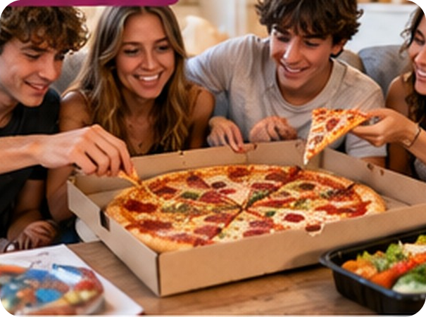
15
Key words first
💡 THINK PENSA
⏱ 2 min 👥 pairs
Guess the meaning. Then click.
Indovina il significato. Poi clicca.
⭐
Example
1
topping
on top of a pizza · il condimento
0 snack → a little food between meals · uno spuntino
2
filling
inside a sandwich · il ripieno
3
ready-made
already cooked – just heat it · pronto
4
takeaway
restaurant food you eat at home · da asporto
5
allergic (to)
your body reacts badly to a food · allergico
6
intolerant (to)
a food makes you feel ill · intollerante
7
cheer yourself up
make yourself happier · tirarsi su
8
miss
feel sad without it · sentire la mancanza
1A-1 · Listening · key words first · 📖 SB p.7 · 3a
Notes:
15. Listening · key words first (2 min)
ELICIT + CONSOLIDATE (2 min). SB 3a: the bold words in the questionnaire 'Your food profile'. Pairs guess the meaning; click once per word – each answer gives the meaning AND the Italian (consolidation for slower students on the same slide). Drill: allergic /əˈlɜːdʒɪk/ (stress on LER, not 'al-LER-gic' Italian-style), intolerant /ɪnˈtɒlərənt/, takeaway /ˈteɪkəweɪ/. FALSE FRIEND: miss here = sentire la mancanza (not 'perdere'): 'I miss my nonna's pasta.'

Slide 16
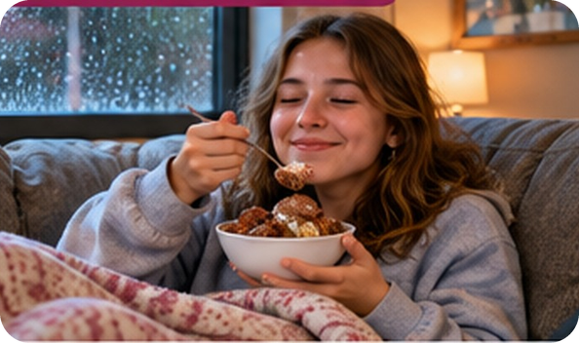
16
Your food profile
👀 READ LEGGI
✏️ FILL THE GAPS COMPLETA
Complete the questionnaire.
⏱ 2 min 👥 pairs
Completa il questionario.
Your food profile
1 What's your favourite… a snack b pizza (?) _____ c sandwich (?) _____ ?
1 What's your favourite… a snack b pizza topping c sandwich filling?
2 Do you ever have… a (?) _____ food b (?) _____ food c very hot / spicy food? Give examples.
2 Do you ever have… a ready-made food b takeaway food c very hot / spicy food? Give examples.
3 Are you (?) _____ or (?) _____ to any food?
3 Are you allergic or intolerant to any food?
4 What food do you usually eat… a to (?) _____ when you're feeling sad b when you're tired and don't want to cook?
4 What food do you usually eat… a to cheer yourself up when you're feeling sad b when you're tired and don't want to cook?
5 When you're away from home, is there any food or drink that you really (?) _____ ?
5 When you're away from home, is there any food or drink that you really miss?
💡
Remember
6 Is there any food or drink that you couldn't live without? How often do you eat / drink it?
8 words in 5 questions
No looking back!
1A-1 · Listening & speaking · the questionnaire · 📖 SB p.7 · 3a · Your food profile
Notes:
16. Listening & speaking · the questionnaire (2 min)
RECALL IN CONTEXT (2 min). The questionnaire from p.7 with the key words removed. Pairs say which word goes in each gap (from the last slide – no looking back!). Click once per question: the words appear highlighted in the text. Answers: 1 topping, filling · 2 ready-made, takeaway · 3 allergic, intolerant · 4 cheer yourself up · 5 miss. Check they understand every question (they need them for the listening). Book question 3 also asks 'How long have you had the problem?' – left out here.

Slide 17
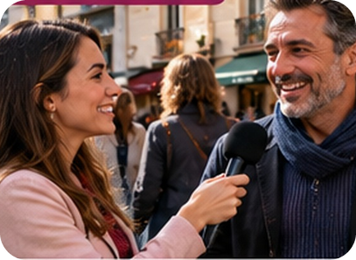
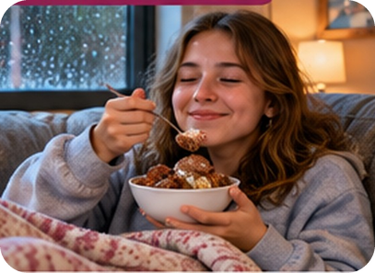
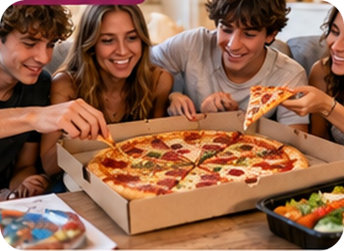
17
Six people, six answers
🎧 LISTEN ASCOLTA
⏱ 3 min 👤 alone
Listen. Which question are they answering?
Ascolta. A quale domanda rispondono?
🎧 1.7 · play once, then pause
⚠ Play it from the book audio
A
B
C
Emma (e.g.)
5 · food you miss
Sarah
6 · can't live without
John
2c · hot / spicy food
Rob
4a · cheer yourself up
🎧
While you listen
James
3 · allergic / intolerant
Before you listen: look at A–C. What are they eating?
Listen. Which question (1–6) is each person answering?
Sean
1b · pizza topping
1A-1 · Listening · gist · 📖 SB p.7 · 3b · audio 1.7
Notes:
17. Listening · gist (3 min)
GIST (3 min). Photo A = people answering in the street. Students look at the questionnaire again (previous slide). Play 1.7 once just to listen, then again pausing after each speaker: which question is he / she answering? Emma is the example (question 5). Pairs compare, then click once per speaker. Answers (TG/SB p.7): Emma 5 · Sarah 6 · John 2c · Rob 4a · James 3 · Sean 1b. Photo task: B = Rob (cheer yourself up – something sweet) · C = Sean (pizza toppings). ICQ: 'Do you write the food now?' (no – only the question number; food is next).

Slide 18
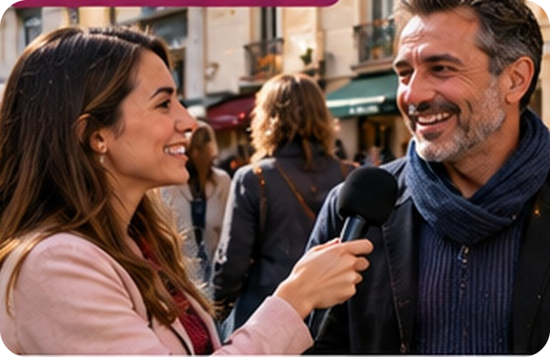
18
Listen again: what food?
🎧 LISTEN ASCOLTA
✏️ FILL THE GAPS COMPLETA
What food? Guess, then listen again.
⏱ 3 min 👥 pairs
Che cibo? Indovina, poi riascolta.
🎧 1.7 · pause after each speaker
Emma missed English breakfast ___.
tea
⚠ Play it from the book audio
Sarah: ___ and pesto – twice a week!
pasta
John loves hot food, like ___.
curries
Rob eats ___ or ice cream.
chocolate
James stopped drinking ___.
caffeine (coffee)
💡
Guess first, then listen!
Sean likes his pizza with ___.
pepperoni
1A-1 · Listening · detail · 📖 SB p.7 · 3c · audio 1.7
Notes:
18. Listening · detail (3 min)
DETAIL (3 min). Pairs guess the food first from what they remember. Play 1.7 again, pausing after each speaker. Click once per line. Answers (audio script 1.7): Emma tea (she missed English breakfast tea on holiday in Slovenia) · Sarah pasta (pasta and pesto at least twice a week) · John curries (his wife is from Indonesia; he also loves Thai green curry) · Rob chocolate or ice cream – 'definitely something sweet' · James caffeine – coffee gave him headaches · Sean pepperoni – spicy toppings with meat. Note: pepperoni in English = spicy salami (NOT peperoni = peppers!).

Slide 19
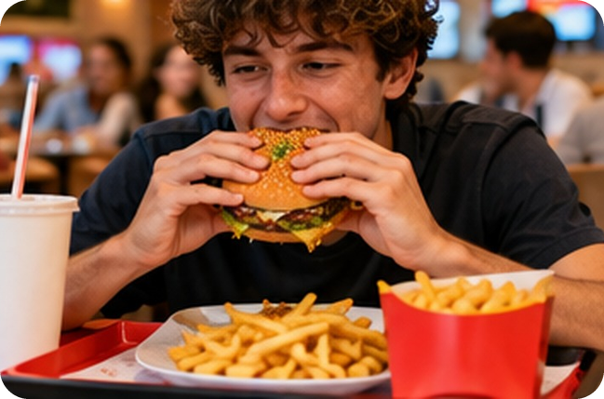
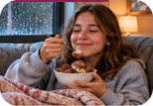
19
Your food profile
💬 TALK PARLA
⏱ 4 min 👥 pairs
Ask your partner. Find 3 things in common!
Chiedi al compagno. Trovate 3 cose in comune!
1
What's your favourite pizza topping? And sandwich filling?
e.g. Spicy salami! And tuna and tomato in a sandwich.
2
Do you ever have takeaway or ready-made food?
e.g. Yes – we get a pizza takeaway on Saturdays.
3
Are you allergic or intolerant to any food?
e.g. No, but my sister is allergic to prawns.
4
What do you eat to cheer yourself up?
e.g. Ice cream – or my mum's arancine!
💬
Useful phrases
5
When you're away from home, what food do you really miss?
e.g. Fresh fish! It's never the same abroad.
Really? Me too! / Not me!
What kind? How often?
Both of us love… / Neither of us likes…
6
Is there a food you couldn't live without? How often do you eat it?
e.g. Pasta! I eat it almost every day.
1A-1 · Speaking · your food profile · 📖 SB p.7 · 3d
Notes:
19. Speaking · your food profile (4 min)
SPEAKING (4 min). Demonstrate by answering one or two questions yourself first (TG extra support). New pairs. Questions appear ONE PER CLICK – about 30–40 seconds each. No one-word answers: give an example or a reason. Monitor and help with food words; note 4–5 errors for delayed correction. TG extra challenge: teach Both of us… (plural verb: Both of us like…) and Neither of us… (singular verb: Neither of us likes…). Feedback: 2–3 pairs say what they have in common. Then 1 minute of delayed error correction on the board. ICQ: 'Can you answer just yes or no?' (no – example or reason).

Slide 20
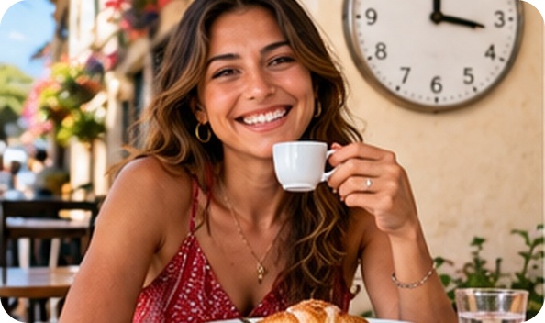
20
Eat at the right time!
👀 READ LEGGI
🤔 GUESS INDOVINA
Read the reasons. Guess the times!
⏱ 3 min 👥 pairs
Leggi i motivi. Indovina gli orari!
Eat and drink – but at the right time!
We usually do things whenever it suits us – but science shows that by doing things at the right time, we can be happier and healthier.
Have breakfast at (1) _____ It's good for our blood sugar levels. People who ate a regular breakfast as teenagers were 32% less likely to be at risk of heart disease as adults.
Have breakfast at 8.00 a.m. It's good for our blood sugar levels. People who ate a regular breakfast as teenagers were 32% less likely to be at risk of heart disease as adults.
Don't drink coffee in the morning: it stops the body producing cortisol, which helps us to wake up. Have one between (2) _____ , when it can make us more mentally alert.
Don't drink coffee in the morning: it stops the body producing cortisol, which helps us to wake up. Have one between 2.00 and 5.00 p.m., when it can make us more mentally alert.
Have lunch between (3) _____ . This is when our body digests food best. Blood glucose levels after an evening meal are much higher, and high glucose can cause diabetes.
Have lunch between 12.00 and 2.00. This is when our body digests food best. Blood glucose levels after an evening meal are much higher, and high glucose can cause diabetes.
💡
Remember
alert = awake · attento
digest = digerire
1A-1 · Reading · the morning and lunch · 📖 SB p.7 · 4a, 4b · article adapted
Notes:
20. Reading · the morning and lunch (3 min)
READING (3 min). 4a first (1 min): pairs tell each other what time they usually get up, have breakfast, have a coffee, have lunch, have dinner and go to bed. Pre-teach only the blocking words (Remember box + heart disease = malattie cardiache). Then: read the REASONS in the article and guess the best times for 1–3 (2 min). Click once per gap: the time appears highlighted in the text. Answers (SB p.7): 1 8.00 a.m. · 2 between 2.00 and 5.00 p.m. · 3 between 12.00 and 2.00. Back to the opening question: coffee is best between 2 and 5 p.m. – early morning is the WORST time! 'Would your Italian parents agree?!' The text is the book's article, shortened (the introduction and the research details are cut); facts unchanged. 4c question answers: 1 you're less likely to be at risk of heart disease as an adult · 2 it can make us more mentally alert · 3 lunch: we digest it better; dinner: our blood glucose levels are higher.

Slide 21
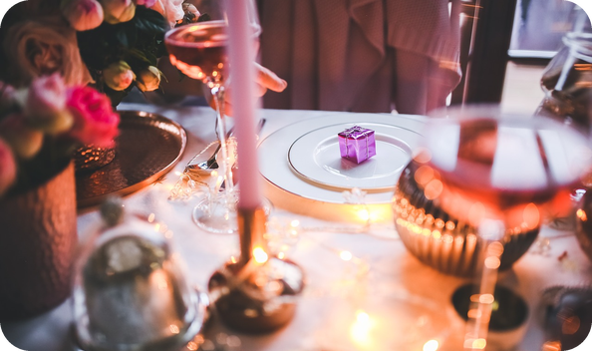
21
Eat at the right time!
👀 READ LEGGI
🤔 GUESS INDOVINA
Read the reasons. Guess the times!
⏱ 3 min 👥 pairs
Leggi i motivi. Indovina gli orari!
…and the rest of the day
Have dinner at (4) _____ It should be delicious – our sense of smell and taste are at their best at this time – but light.
Have dinner at 7.00 p.m. It should be delicious – our sense of smell and taste are at their best at this time – but light.
Do yoga or go for a walk before breakfast.
Do important tasks at (5) _____ , when your brain is working best.
Do important tasks at 11.00 a.m., when your brain is working best.
The best time to run or cycle is (6) _____ , when your lung capacity is at its greatest.
The best time to run or cycle is 5.00 p.m., when your lung capacity is at its greatest.
💡
Remember
Go to bed between (7) _____ This is when the brain begins producing melatonin, the sleep hormone.
Go to bed between 9.00 p.m. and 11.00 p.m. This is when the brain begins producing melatonin, the sleep hormone.
light = not heavy · leggero
lungs = polmoni
1A-1 · Reading · the evening and more · 📖 SB p.7 · 4b, 4c · article adapted
Notes:
21. Reading · the evening and more (3 min)
READING (3 min). Same procedure (melatonin = the sleep hormone): read the reasons, guess 4–7, click once per gap. Answers (SB p.7): 4 7.00 p.m. · 5 11.00 a.m. · 6 5.00 p.m. · 7 between 9.00 p.m. and 11.00 p.m. Then 4b: 'Do you or your partner do any of these things at the times the article recommends?' Expect a reaction to 'dinner at 7.00 p.m.' – most Sicilian families eat at 8.30–9! 4c answers: 4 our sense of smell and taste are at their best · 5 a yoga or going for a walk b running or cycling · 6 it helps us to go to sleep. Cut from the book's text: the glass of wine before dinner, getting up at sunrise, weightlifting at midday. If short of time: do this slide quickly as a whole class (1 min).

Slide 22
22
3 · 2 · 1
⏱ 2 min 👥 pairs
Books closed! What can you remember?
Libri chiusi! Cosa ricordi?
3
seafood or meat words (no looking!)
📝
Homework · Compiti
Workbook 1A: 1a–1g, 2a, 2c
Vocabulary Bank p.152: cover and test yourself
Homework sheet 1A-1 in the LLS app
2
ways to cook – and a food for each
1
best time for coffee – and why?
Next lesson: 1A part 2 · A chef's story · present simple & continuous
1A-1 · Exit · what can you remember?
Notes:
22. Exit · what can you remember? (2 min)
RETRIEVAL EXIT (2 min). Books closed. Pairs: 3 seafood or meat words, 2 cooking words with a food (e.g. grilled squid, roast potatoes), 1 best time for coffee and why (between 2 and 5 p.m. – it makes us more alert). A few students share. Set homework (on the slide and in the app): Workbook 1A vocabulary 1a–1g and pronunciation 2a, 2c (2b and 2d need audio – optional) + Vocabulary Bank p.152 (cover and test yourself) + the 1A-1 homework sheet (easier version available). Explain how homework works at LLS: photo of the sheet → LLS app → Homework.

Slide 23
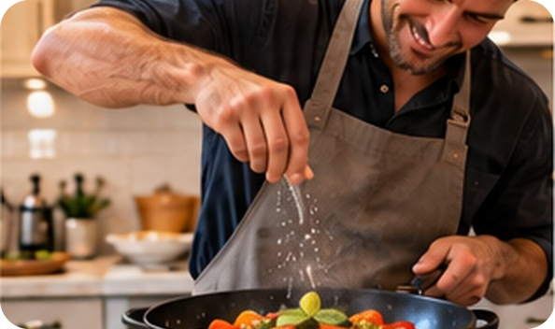
23
Food for thought
👀 READ LEGGI
✏️ FILL THE GAPS COMPLETA
Complete the quotes. Choose your favourite!
⏱ 3 min 👥 pairs
Completa le citazioni. Scegli la preferita!
Food quotes from Pinterest
There are only ten minutes in the life of a (1) _____ when it is perfect to eat. (R. W. Emerson)
There are only ten minutes in the life of a pear when it is perfect to eat. (R. W. Emerson)
Life is a combination of magic and (2) _____ . (Federico Fellini)
Life is a combination of magic and pasta. (Federico Fellini)
One day, I'm going to make the (3) _____ cry.
One day, I'm going to make the onions cry.
Knowledge is knowing that a (4) _____ is a fruit. Wisdom is not putting it in a (4) _____ . (Miles Kington)
Knowledge is knowing that a tomato is a fruit. Wisdom is not putting it in a fruit salad. (Miles Kington)
A party without (5) _____ is just a meeting. (Julia Child)
A party without cake is just a meeting. (Julia Child)
💡
Remember
A balanced diet is a (6) _____ in each hand. (Barbara Johnson)
A balanced diet is a cookie in each hand. (Barbara Johnson)
cake · cookie · fruit salad
onions · pasta · pear · tomato
1A-1 · Extra · food quotes · 📖 SB p.6 · 1a, 1b
EXTRA · if there's time
Notes:
23. Extra · food quotes (3 min)
EXTRA (3 min, if there's time – or as the warmer for 1A part 2). SB 1a: a quote = una citazione. Pairs complete the six quotes with the words in the Remember box. Click once per quote. Answers (TG): 1 pear · 2 pasta · 3 onions · 4 tomato, fruit salad · 5 cake · 6 cookie. Drill onions /ˈʌnjənz/; cookie (AmE) = biscuit (BrE). 1b: choose your favourite quote and tell a partner why. Forced choice: 'Only ONE quote can go on the fridge at LLS – which one?' Class vote.

Slide 24
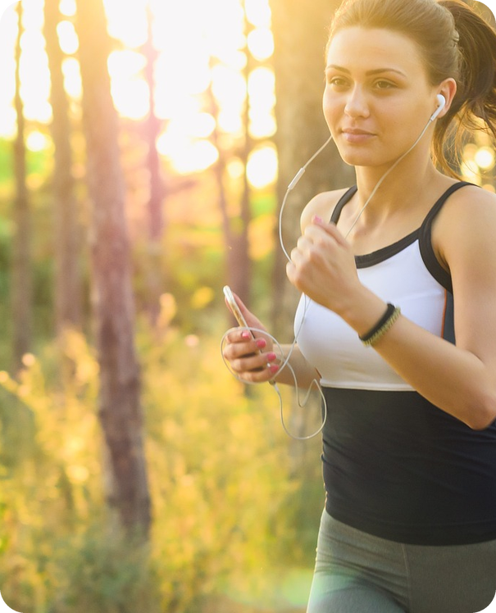
24
Why? Find it in the text
🔍 FIND TROVA
⏱ 3 min 👥 pairs
Answer the questions about the article.
Rispondi alle domande sull'articolo.
1
Why have breakfast as a teenager?
less risk of heart disease as an adult
2
Coffee at 2–5 p.m.: what effect?
it can make us more mentally alert
3
Steak and chips for lunch, not dinner. Why?
lunch: we digest it better · dinner: higher blood glucose
4
Why should dinner be delicious?
our sense of smell and taste are at their best
5
Best exercise: a) early morning b) afternoon?
a) yoga or a walk b) running or cycling
6
Why does the body produce melatonin?
it helps us to go to sleep
1A-1 · Extra · reading for detail · 📖 SB p.7 · 4c
EXTRA · if there's time
Notes:
24. Extra · reading for detail (3 min)
EXTRA (3 min, if there's time). SB 4c questions 1–6 (shortened). Pairs answer from the article; click once per question. Answers (TG): 1 Because you're less likely to be at risk of heart disease as an adult. 2 It can make us more mentally alert. 3 Having steak and chips for lunch means we digest it better; having it for dinner makes our blood glucose levels higher. 4 Because our sense of smell and taste are at their best at this time. 5 a yoga or going for a walk b running or cycling. 6 Because it helps us to go to sleep. 4e follow-up: 'Do you believe all the information in this article? Would you change any of your habits?'

