Slide 1


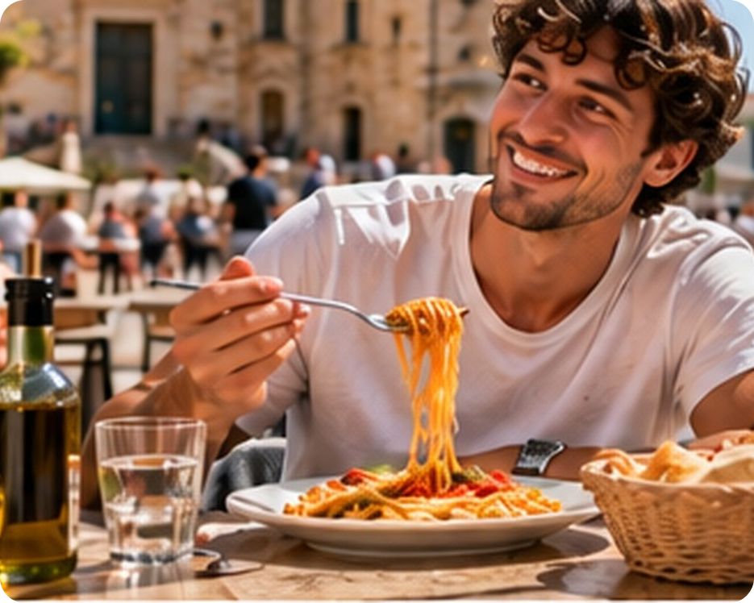


English File B1 · SB pp.8–9
💡 THINK · PENSA
1A-2
Eating in… and out
A chef's story
🎯
Today you're going to…
🎧 listen to a chef's story
🍳 say what you usually do – and what you're doing now
🧠 find the verbs that never take -ing
💬 interview a partner about your diet
🤝 agree and disagree about food
Who's the best cook you know?
EXAMPLE My nonna – her pasta alla Norma is amazing!
Notes:
1. OPENING (2 min)
1A PART 2 (60 min) · SB pp.8–9. Show the photo. Ask the THINK question: 'Who's the best cook you know?' Take 3–4 answers (my nonna, my dad, me!) and ask one follow-up: 'What does she / he make?' Don't correct yet – just listen for present simple. Read the 'Today you're going to…' list together. Link: 'Today we meet a real chef: who taught HER to cook?' (her family – the listening). PICTURE: 1a2-cover.jpg in the img folder shows a young man eating spaghetti in a piazza (the picture list asked for a lobster with lemon and olive oil) – the question works with either picture.

Slide 2

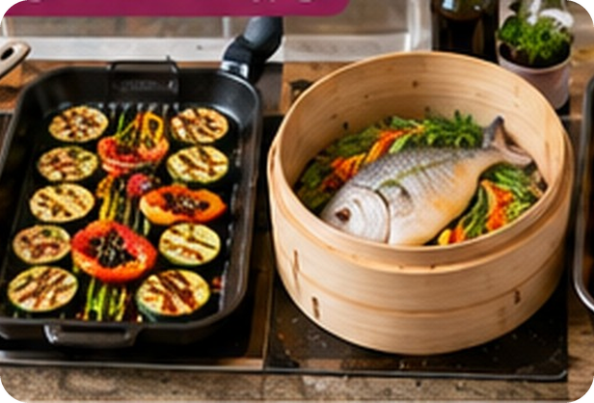
2
Remember last lesson?
💡 THINK PENSA
⏱ 2 min 🙋 whole class
What did we learn? Read the examples.
Cosa abbiamo imparato? Leggi gli esempi.
Food: fish, meat, fruit and veg
Cooking + vowel sounds
In Sicily we fry squid in rings.
Lamb is meat from a young sheep.
Aubergine is the star of caponata!
→ pig = the animal · pork = the meat
I like my eggs fried, not boiled.
Steamed fish is very healthy.
Sushi is raw fish.
→ fish /ɪ/ · tree /iː/ · car /ɑː/ · boot /uː/
📅
Last lesson…
1A: food and cooking words
short and long vowel sounds
🔤 KEY WORDS
squid
tuna
lamb
aubergine
steamed
raw
jar
cook
1A-2 · Revision · last lesson
Notes:
2. Revision · last lesson (2 min)
REVISION (2 min) before the warmer game. Read the examples with the class; elicit one more food word for each group (fish / meat / veg) and one more cooking word (grilled, roast…). Drill the 8 sound pictures quickly: fish, tree, cat, car, clock, horse, bull, boot – they are the answers in the game. Point at the silent letters (lamb, salmon). Then play 'Food clues + sounds' – every answer is a word from this slide or last lesson.

Slide 3

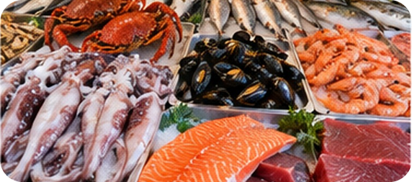
3
Food clues + sounds
🎲 PLAY GIOCA
🔊 SAY IT PRONUNCIA
Read the clue. Say the food and its sound!
⏱ 4 min 🏆 teams
Leggi l'indizio. Di' il cibo e il suo suono!
🎲
How to play
1
In Sicily we fry it in rings.
→ squid · 🐟 fish /ɪ/
Read the clue.
Teams: write the word AND its sound picture.
Word = 1 point. Sound = 1 point.
2
Cooked over hot water.
→ steamed · 🌳 tree /iː/
3
Meat from a young sheep.
→ lamb · 🐱 cat /æ/
4
Jam comes in a glass…
→ jar · 🚗 car /ɑː/
5
Not cooked – like the fish in sushi.
→ raw · 🐴 horse /ɔː/
6
Chillies are very… (not 'spicy'!)
→ hot · ⏰ clock /ɒ/
7
My nonna is a very good…
→ cook · 🐂 bull /ʊ/
8
Big red fish – famous in Sicily!
→ tuna · 👢 boot /uː/
1A-2 · Warmer · last lesson: food and vowel sounds · 📖 Revision of 1A-1 · Vocabulary Bank p.152 · Pronunciation 2a–b (audio 1.6)
Notes:
3. Warmer · last lesson: food and vowel sounds (4 min)
RETRIEVAL WARMER (5 min) – recycles 1A-1 (food and cooking words + the 8 vowel sound pictures). Different format from last lesson's 'Guess why!' speaking warmer: a team quiz. Two or three teams, one pen and paper each, books closed. Before you start, elicit the 8 sound pictures from last lesson onto the board: fish, tree, cat, car, clock, horse, bull, boot (they reappear in the answers). Show the clue (the clue rows are all visible), teams write the WORD and the SOUND PICTURE of its vowel (10–15 seconds each), then click to reveal. 1 point for the word (correct spelling), 1 point for the sound. Answers: 1 squid – fish /ɪ/ · 2 steamed – tree /iː/ · 3 lamb – cat /æ/ (silent b!) · 4 jar – car /ɑː/ · 5 raw – horse /ɔː/ · 6 hot – clock /ɒ/ · 7 cook – bull /ʊ/ · 8 tuna – boot /uː/ (/ˈtjuːnə/). Drill each answer chorally after the reveal. ICQs: 'Do you write one thing or two?' (two – the word and the sound) · 'Do you shout the answer?' (no – write it). If short of time: do items 1–6 only.

Slide 4

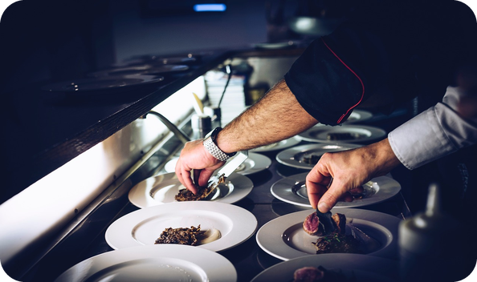
4
Meet Marianna
👀 READ LEGGI
🤔 GUESS INDOVINA
Read. Guess the missing words.
⏱ 2 min 👥 pairs
Leggi. Indovina le parole mancanti.
Marianna Leivaditaki
Marianna is the (1) _____ at Morito, a very popular restaurant on Hackney Road, in London.
Marianna is the head chef at Morito, a very popular restaurant on Hackney Road, in London.
She was born on the island of (2) _____ , in Greece.
She was born on the island of Crete, in Greece.
Her father was a Cretan (3) _____ and her mother was (4) _____ .
Her father was a Cretan fisherman and her mother was Scottish.
Together they ran a (5) _____ restaurant, which is where Marianna spent most of her childhood.
Together they ran a seafood restaurant, which is where Marianna spent most of her childhood.
💡
Remember
Word bank: Crete · fisherman · head chef · Scottish · seafood
caught = past of catch · pescare
1A-2 · Listening · lead-in · 📖 SB p.8 · 5a
Notes:
4. Listening · lead-in (2 min)
LEAD-IN (2 min). SB 5a: the introduction to Marianna, with five key words gapped. Pairs read and put the word-bank words in the gaps (30–60 seconds), then click once per gap: the word appears highlighted in the text. Answers (SB p.8): 1 head chef · 2 Crete · 3 fisherman · 4 Scottish · 5 seafood. Elicit that Cretan = from Crete, a Greek island (TG). TG EXTRA SUPPORT comprehension questions: Where is Marianna's mother from? (Scotland) · Who owned a seafood restaurant? (Marianna's parents) · Where does Marianna work now? (Morito, London). Pre-teach ONE blocking word for the listening (Remember box): caught = past of catch (pescare). The book uses a photo of the real Marianna; our picture is a generic chef (placeholder until supplied).

Slide 5
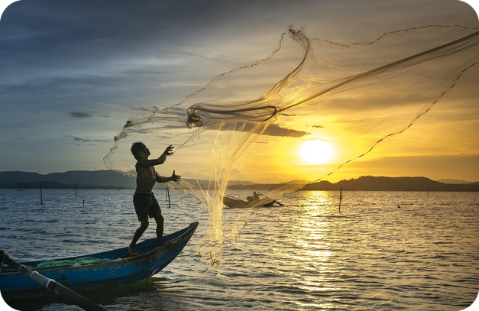

5
A chef's childhood
🎧 LISTEN ASCOLTA
🤔 GUESS INDOVINA
Guess the endings. Then listen.
⏱ 5 min 👥 pairs
Indovina come finiscono. Poi ascolta.
🎧 1.8 · play once, then again
1 We ate fish every day, which ___.
my dad caught
2 We boiled it and ate it with ___.
lemon and olive oil
3 I wrote down recipes which I wanted to cook for the family in ___.
a small blue notebook
4 My aunt, Thia Koula, had ___.
animals, a garden, olive trees and grapes
5 Occasionally, my mum used to buy me and my brother souvlaki for lunch, a sort of ___.
Greek sandwich with pitta bread
💡
Guess first, then listen!
🔈 click ▶
1A-2 · Listening · part 1 · prediction · 📖 SB p.8 · 5a, 5b · audio 1.8
Notes:
5. Listening · part 1 · prediction (5 min)
PREDICTION + LISTENING (5 min). SB 5a: in the book each extract goes with a photo (1 a box of fish · 2 a lobster · 3 a notebook · 4 grapes, sheep and olive trees · 5 souvlaki) – describe them or show the book page. Pairs say how they think each extract finishes (2 min). Get some ideas, but DON'T say if they're right (TG). 5b: play 1.8 once the whole way through; pairs compare; play again if necessary. Click once per extract. Answers (TG + audio script): 1 my dad caught · 2 lemon and olive oil · 3 a small blue notebook · 4 animals, a garden, olive trees and grapes · 5 Greek sandwich with pitta bread. 'used to' in 5 = she did it often in the past – receptive only today, no need to teach it. ICQ: 'Do you know the answers now?' (no – we guess first) · 'Do you write a whole sentence?' (no – just the end).

Slide 6
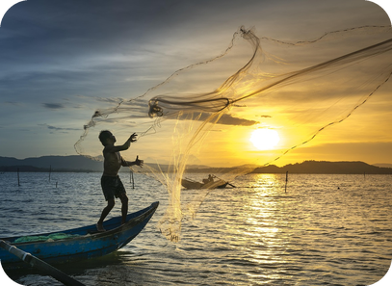
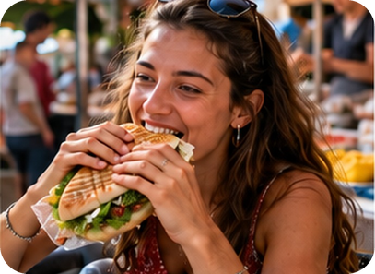
6
Listen again: what else?
🎧 LISTEN ASCOLTA
⏱ 3 min 👥 pairs
Listen again. What else does she say?
Riascolta. Cos'altro dice?
🎧 1.8 · pause after each photo
↘ speaker bottom right
A
B
C
📷 1a2-taverna.jpg
1 fish
Dad still goes fishing every night
2 lobster
never sold it – always for the family
3 notebook
helped in the kitchen – didn't play
🎧
While you listen
4 aunt
only ate food she grew, found or made
Listen again. One more fact about each extract.
Compare with your partner.
5 souvlaki
pork, tomato, red onion, thick yoghurt
🔈 click ▶
1A-2 · Listening · part 1 · detail · 📖 SB p.8 · 5c · audio 1.8
Notes:
6. Listening · part 1 · detail (3 min)
DETAIL (3 min). SB 5c: play 1.8 again, pausing after Marianna talks about each photo (TG extra support) so students can note ONE more fact. Pairs compare, then click once per line. Answers (audio script 1.8): 1 her dad still goes fishing every night (fish is expensive, even on an island) · 2 when he caught a lobster he never sold it – it was always for the family; that's how she cooks lobster today at Morito · 3 she spent every evening in the restaurant and helped in the kitchen instead of playing · 4 her aunt knew everything about wild food in Crete and only ate what she had grown, found or made herself · 5 souvlaki has pork, tomato, red onion and lots of thick yoghurt; they never ate out in the evening because the restaurant was open seven days a week. Photos: A = fishing family, B = family taverna, C = a wrap like souvlaki. Local link: 'Does this remind you of anyone in Porticello or Aspra?'

Slide 7
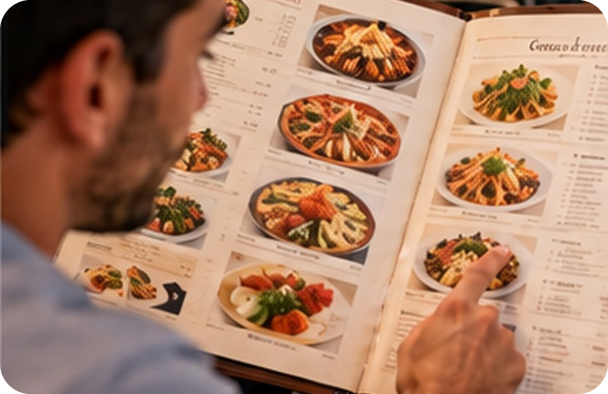
7
From psychology to chef
🎧 LISTEN ASCOLTA
⏱ 5 min 👥 pairs
Listen. Answer 0 first, then 1–5.
Ascolta. Rispondi prima alla 0, poi 1–5.
🎧 1.9 · play twice
0 Did she always want to be a chef?
No! a psychologist
1 What three things did she do before London?
studied psychology (Kent) · travelled · family restaurant
2 Moro: her first connection? Why go back?
saved money to eat there · wanted a job
3 What happened seven years later?
she became head chef
4 How is Morito different from Moro?
more Cretan dishes on the menu
💡
Guess first, then listen!
5 Crete: how often? Lunch with friends?
4–5 times a year · share it all, order too much
🔈 click ▶
1A-2 · Listening · part 2 · gist then detail · 📖 SB p.8 · 5d · audio 1.9
Notes:
7. Listening · part 2 · gist then detail (5 min)
GIST THEN DETAIL (5 min). Question 0 (our gist question): ask it before playing – most students say yes, so the answer is a surprise: no, she wanted to be a psychologist. Play 1.9 once for 0. Then go quickly through 1–5 (the book's questions, shortened) and play again, pausing after each answer if needed (TG). Pairs compare; click once per question. Answers (TG): 0 No – she wanted to be a psychologist · 1 She studied psychology at Kent University; she travelled round southern Europe and South America (Ecuador); she went back to Crete and worked in the family restaurant (for two years) · 2 When she was a student, she used to save money and go and eat there; she went back because she wanted to work there · 3 She became head chef · 4 It has more Cretan dishes on the menu · 5 Four or five times a year; they share all the food and always order too much. Listen for one sentence for the grammar: 'This week, for example, I'm making ntakos' (a Cretan salad). TG EXTRA SUPPORT: if there's time, listen again with the script (SB p.125).

Slide 8
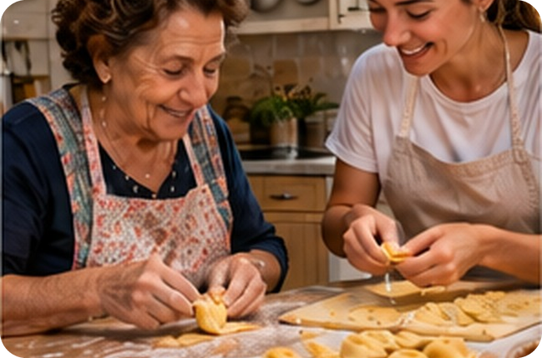
8
What about you?
💬 TALK PARLA
⏱ 3 min 👥 pairs
Ask and answer. Then choose ONE!
Chiedi e rispondi. Poi scegline UNA!
1
What was your favourite food when you were a child?
e.g. My nonna's pasta al forno – every Sunday!
2
What kind of things did your mother or father cook? Do you still eat them?
e.g. My dad made grilled fish. Yes – I still love it!
3
Do you have a favourite restaurant? What do you like most – the food, the atmosphere, the service or the price?
e.g. A pizzeria in Bagheria – the price and the atmosphere!
4
Choose ONE: your nonna's food or a famous chef's food?
e.g. My nonna's! Nobody cooks like her.
💬
Useful phrases
When I was a child, I loved…
My favourite was…
Really? Me too! / Not me!
What about you?
1A-2 · Speaking · what about you? · 📖 SB p.8 · 5e
Notes:
8. Speaking · what about you? (3 min)
SPEAKING (3 min). SB 5e questions 1–3 + one forced choice (our addition). Answer question 1 yourself first as a model (TG: you could also tell them about yourself). Questions appear ONE PER CLICK – about 40 seconds each. Forced choice: no 'both' or 'it depends' – choose and give a reason; quick show of hands at the end. PRIVACY: for question 2 'or another person in your family' is fine. Listen for present simple (I love…, I prefer…) – a bridge to the grammar. ICQ: 'Can you say both in the last one?' (no!).

Slide 9
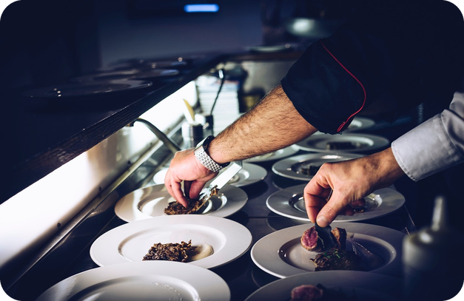
9
Which one did she say?
🎧 LISTEN ASCOLTA
✅ CHECK CONTROLLA
Choose the right form. Then listen.
⏱ 3 min 👥 pairs
Scegli la forma giusta. Poi ascolta.
🎧 1.10 · sentences 1–3
1 You (don't need / aren't needing) anything except lemon and olive oil…
don't need
2 This week, for example, (I make / I'm making) ntakos, a Cretan salad.
I'm making
3 (I go / I'm going) to Crete maybe four or five times a year.
I go
4 My dad still (goes / is going) fishing every night!
goes
5 We always (order / are ordering) too much.
order
💡
Guess first, then listen!
6 …the people I (miss / 'm missing) when I'm in London.
miss
🔈 click ▶
1A-2 · Grammar · what did she say? · 📖 SB p.9 · 6a, 6b · audio 1.10 (4–6 from audio scripts 1.8, 1.9)
Notes:
9. Grammar · what did she say? (3 min)
GUIDED DISCOVERY 1 (3 min). SB 6a: 1–3 are the book's sentences; 4–6 are more sentences from the same interview (audio scripts 1.8 and 1.9). Students choose alone, then compare. Play 1.10 to check 1–3 (it contains only those three); 4–6 are exactly what Marianna says in the interview. Click once per sentence. Answers: 1 don't need · 2 I'm making · 3 I go · 4 goes · 5 order · 6 miss. Don't explain WHY yet – that's the next slide. For 1 and 6 they may just 'feel' the answer (TG): good! ICQ: 'Do you choose one form or two?' (one).

Slide 10
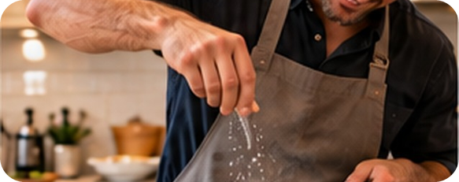
10
Why simple? Why -ing?
🔗 MATCH ABBINA
⏱ 3 min 👥 pairs
Why this form? Match the colour.
Perché questa forma? Abbina il colore.
🏷️
The colours
You don't need anything except lemon and olive oil.
🧠 no -ing verb
This week I'm making ntakos.
⏳ around now
🔁 habit
⏳ around now
I go to Crete four or five times a year.
🔁 habit
🧠 no -ing verb
My dad still goes fishing every night.
🔁 habit
We always order too much.
🔁 habit
…the people I miss when I'm in London.
🧠 no -ing verb
What are you cooking?
⏳ around now
It smells delicious!
🧠 no -ing verb
1A-2 · Grammar · why? · 📖 SB p.9 · 6b · audio 1.10, 1.13
Notes:
10. Grammar · why? (3 min)
GUIDED DISCOVERY 2 (3 min). SB 6b: 'say why you think she uses each form' (Italian is fine – TG). The colours: pink = something you do regularly (habit) · blue = happening now or only this week (temporary) · yellow = verbs like need, miss, like, smell that we don't use with -ing. Sentences 7–8 are from audio 1.13 (Grammar Bank): 'What are you cooking? It smells delicious.' Pairs decide, then click once per sentence. Answers: 1 yellow (need) · 2 blue (this week – temporary) · 3 pink (four or five times a year) · 4 pink (every night) · 5 pink (always) · 6 yellow (miss) · 7 blue (now) · 8 yellow (smell). CCQs: 'Is she making ntakos every week of the year?' (no – just this week) · 'Does she go to Crete once or many times?' (many – a habit). This is the moment to give the name: action and non-action verbs (TG).

Slide 11
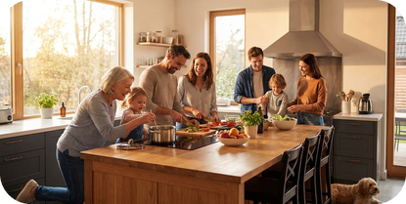
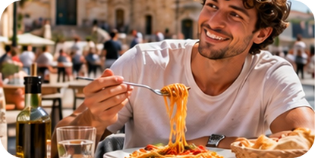
11
Simple or continuous?
👀 LOOK GUARDA
⏱ 4 min 🙋 whole class
Read the examples. Then click!
🎧 1.11
Leggi gli esempi. Poi clicca!
present simple
present continuous
non-action verbs
have / think
📷 1a2-cooking-now.jpg
📷 1a2-tasting-soup.jpg
habits · always true
now · around now · temporary
feelings, thoughts, senses: no -ing!
both – different meaning!
She works in a restaurant.
We only eat out about once a month.
The phone's ringing. Can you answer it?
House prices are going up at the moment.
It smells delicious.
Great! I love pasta.
But I need them now!
I have a big kitchen. / I'm having lunch.
I think it's good. / What are you thinking about?
abitudini, cose sempre vere
adesso, in questo periodo
verbi di stato: mai -ing
possedere / mangiare · opinione / riflettere
⚠ ✗ I'm needing a new phone → ✓ I need ✗ This soup is tasting good → ✓ It tastes good ✗ What do you do? (now) → ✓ What are you doing?
🔈 click ▶
1A-2 · Grammar · the rule · 📖 Grammar Bank 1A p.132 · audio 1.11, 1.12, 1.13
Notes:
11. Grammar · the rule (4 min)
RULE (4 min). Students open Grammar Bank 1A p.132. Click once per column: the examples appear (meaning first, then form). Optional: play 1.11, 1.12 and 1.13 (only 1.11 shows on the slide – play 1.12 and 1.13 from the book audio) for students to listen and repeat; copy the rhythm (TG). Columns 1–3 use sentences from those tracks; column 4 sentences are ours (the Grammar Bank box uses have and think as its examples – check the book's sentences). TG notes: present simple = things that are always true or happen regularly; remind them of 3rd person -s /s/ cooks, /z/ plays, /ɪz/ watches, and says /sez/, does /dʌz/. Present continuous = actions in progress now or around now, temporary actions, changing situations (+ future arrangements – in 1B). Non-action verbs (states, feelings, senses) are not normally used in the continuous. have: possession = non-action (I have a car); eat / drink = action (I'm having lunch). think: opinion = non-action (I think it's good); using your brain = action (What are you thinking about?). Last click = typical Italian-speaker mistakes. CCQs: 'I'm having lunch – do I own lunch?' (no – I'm eating it) · 'House prices are going up – always, or now, changing?' (now, changing).

Slide 12
12
No -ing verbs in Italian
✅ CHECK CONTROLLA
⏱ 2 min 🙋 whole class
Say it in Italian. Then click!
Dillo in italiano. Poi clicca!
❤️
love
👍
like
😖
hate
🙏
want
amare, adorare
piacere
odiare
volere
❗
need
🧠
know
💭
remember
💡
understand
aver bisogno di
sapere, conoscere
ricordare
capire
⭐
prefer
🥺
miss
👃
smell
👅
taste
preferire
sentire la mancanza
avere odore, profumare
avere sapore
⚠ Watch out! BUT: enjoy = action → Are you enjoying your dinner? ✓ · look (= seem): That looks delicious. / look at = action: We're looking at the menu. ✓
1A-2 · Grammar · non-action verbs in Italian
Notes:
12. Grammar · non-action verbs in Italian (2 min)
CONSOLIDATION for slower students (2 min). Class says the Italian for each verb, then ONE click shows it all (and the 'But' line). These are common non-action verbs (the full list is in Grammar Bank 1A p.132 – check it with the class). Quick check: 'I'm loving this pizza' – right or wrong? (wrong in the grammar book: I love this pizza; the ad slogan is a special case – mention only if a student asks). TG points: enjoy is NOT a non-action verb: Are you enjoying it? ✓; look (= seem) is non-action, but look at is an action verb. smell and taste: 'It smells / tastes delicious' (non-action).

Slide 13
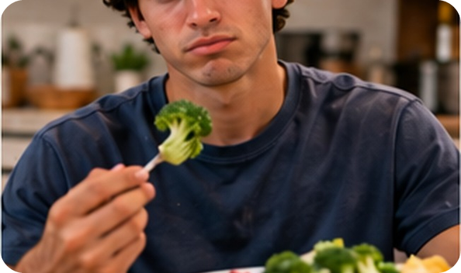
13
Grammar Bank practice
✏️ FILL THE GAPS COMPLETA
✍️ WRITE SCRIVI
Complete with the verb. Then click!
⏱ 3 min 👤 alone
Completa con il verbo. Poi clicca!
Simple or continuous?
I have high cholesterol, so I never (1) _____ fried food. (eat)
I have high cholesterol, so I never eat fried food. (eat)
(2) _____ any vitamins at the moment? (you / take)
Are you taking any vitamins at the moment? (you / take)
Don't eat the spinach if you (3) _____ it. (not like)
Don't eat the spinach if you don't like it. (not like)
(4) _____ how to cook fish? (your boyfriend / know)
Does your boyfriend know how to cook fish? (your boyfriend / know)
💡
Remember
We (5) _____ takeaway pizzas once a week. (order)
We order takeaway pizzas once a week. (order)
never, once a week → simple
at the moment → -ing (if it's an action!)
1A-2 · Grammar · controlled practice · 📖 Grammar Bank 1A p.132 · b 1–5 (6–10 = homework)
Notes:
13. Grammar · controlled practice (3 min)
CONTROLLED PRACTICE (3 min). The sentences are Grammar Bank 1A exercise b 1–5 (key sentences from the TG); the verb prompts in brackets are ours – check the book's exercise format. Students write alone (1.5 min), compare with a partner, then click once per sentence: the answer appears highlighted in the sentence. Answers (TG): 1 eat · 2 Are you taking · 3 don't like · 4 Does your boyfriend know · 5 order. Ask WHY for each (student as teacher): 1 habit (never) · 2 around now · 3 like = non-action · 4 know = non-action · 5 habit (once a week). Get students to read the full sentences aloud. Grammar Bank a 1–5 can be done in the book if there's time (answers: 1 is coming · 2 doesn't want · 3 isn't working · 4 seems · 5 aren't speaking). a 6–10 and b 6–10 = homework.

Slide 14
14
Right or wrong?
🎲 PLAY GIOCA
🔁 CHANGE THE WORD CAMBIA
Right or wrong? Fix the wrong ones!
⏱ 3 min 🏆 teams
Giusto o sbagliato? Correggi gli errori!
🎲
How to play
1
I'm needing a new phone.
→ ✗ I need a new phone. (need: no -ing)
Read the sentence.
Teams: right or wrong? Fix it!
Right answer = 1 point. Correct fix = +1.
My dad cooks every Sunday.
→ ✓ right! (habit)
2
3
Where's Marco? – He has lunch.
→ ✗ He's having lunch. (now)
4
This pizza is tasting amazing!
→ ✗ This pizza tastes amazing!
5
Are you enjoying the lesson?
→ ✓ right! (enjoy = action)
TEAM A ☆☆☆☆☆
TEAM B ☆☆☆☆☆
6
Shh! What do you cook? It smells great!
→ ✗ What are you cooking?
1A-2 · Grammar game
Notes:
14. Grammar game (3 min)
GAME 2 (3 min). Two or three teams. Show a sentence; teams have 10 seconds to decide RIGHT or WRONG (hands up / show a ✓ or ✗ card). Then the team must say the corrected sentence for the bonus point. Click once per sentence. Answers: 1 wrong → I need a new phone · 2 right (habit) · 3 wrong → He's having lunch (have = eat = action, now) · 4 wrong → tastes · 5 right (enjoy is an action verb!) · 6 wrong → What are you cooking? (now) – 'smells' is right. These are typical Italian-speaker mistakes. ICQs: 'If it's wrong, what do you do?' (correct it) · 'Is every sentence wrong?' (no!).

Slide 15
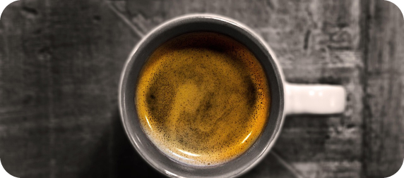
15
Make the question!
🎲 PLAY GIOCA
🔀 REORDER RIORDINA
Make the question. Fastest team wins!
⏱ 3 min 🏆 teams
Forma la domanda. Vince la squadra più veloce!
🎲
How to play
1
What / usually have for breakfast?
→ What do you usually have for breakfast?
Read the prompt.
Teams: say the full question.
Right question = 1 point.
/ ever cook? What / make?
→ Do you ever cook? What do you make?
2
3
/ prefer eating at home or eating out?
→ Do you prefer eating at home or eating out?
4
/ try to cut down on anything at the moment?
→ Are you trying to cut down on anything at the moment?
5
/ need to buy any food today?
→ Do you need to buy any food today?
6
/ want anything to eat right now?
→ Do you want anything to eat right now?
1A-2 · Grammar game · questions · 📖 SB p.9 · 6d
Notes:
15. Grammar game · questions (3 min)
GAME 3 (3 min). SB 6d prompts (6 of 11; the other 5 are on the next slide). First elicit diet = the food you eat and drink regularly, and drill /ˈdaɪət/ (TG). Elicit: 'On a typical day' prompts = habits → present simple + do you. 'At the moment / Nowadays' prompts → continuous if it's an action verb, simple if it's non-action (need, want) (TG). Teams race: the first team to say the full, correct question wins a point; click to reveal. Answers (TG): 1 What do you usually have for breakfast? · 2 Do you ever cook? What do you make? · 3 Do you prefer eating at home or eating out? · 4 Are you trying to cut down on anything at the moment? · 5 Do you need to buy any food today? (need = non-action) · 6 Do you want anything to eat right now? (want = non-action). After each one, drill the rhythm: stress the information words (TG extra support): What do you USUALLY HAVE for BREAKFAST? Teams should remember the questions – they ask them on the next slide.

Slide 16
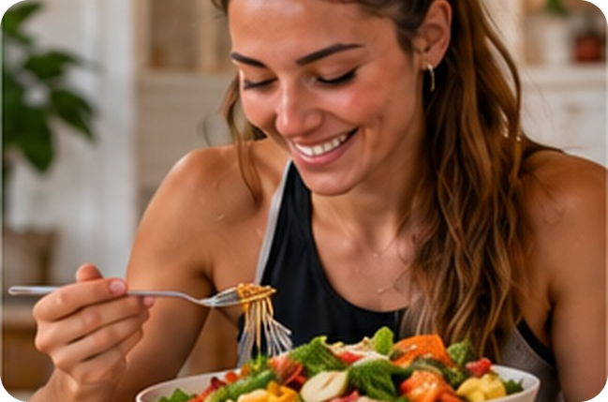
16
Interview: your diet
💬 TALK PARLA
⏱ 5 min 👥 pairs
Make the question. Ask it. Then ask 1 more!
Forma la domanda. Falla. Poi fanne 1 in più!
1
Where / normally have lunch?
e.g. Where do you normally have lunch? – At school, at about 1.30.
2
What / usually have for lunch during the week?
e.g. What do you usually have for lunch…? – A panino and some fruit.
3
/ drink fizzy drinks, e.g. Coke? How many glasses / drink a day?
e.g. Do you drink fizzy drinks? How many glasses do you drink a day? – One.
4
/ take vitamins or food supplements at the moment?
e.g. Are you taking vitamins at the moment? – Yes, vitamin C – it's winter!
💬
Useful phrases
What kind? How often? Why?
Really? Me too!
Is that healthy?!
5
/ the diet in your country / get better or worse?
e.g. Is the diet in your country getting better or worse? – Worse – too much fast food!
1A-2 · Speaking · your diet · 📖 SB p.9 · 6d
Notes:
16. Speaking · your diet (5 min)
SPEAKING – accurate practice (5 min). Pairs interview each other: first the 6 questions from the game, then these 5 prompts (they appear ONE PER CLICK; each example shows the correct question and a model answer – click when pairs have tried to make it). Always one follow-up question (How often? Why? What kind?). TG: the focus here is ACCURATE practice of the grammar – monitor and correct simple / continuous on the spot (gently: 'Now or every day?'). Answers (TG): Where do you normally have lunch? · What do you usually have for lunch during the week? · Do you drink fizzy drinks, e.g. Coke? How many glasses do you drink a day? · Are you taking vitamins or food supplements at the moment? · Is the diet in your country getting better or worse? Feedback: one surprising answer per pair. ICQ: 'How many questions after each answer?' (one more – a follow-up).

Slide 17
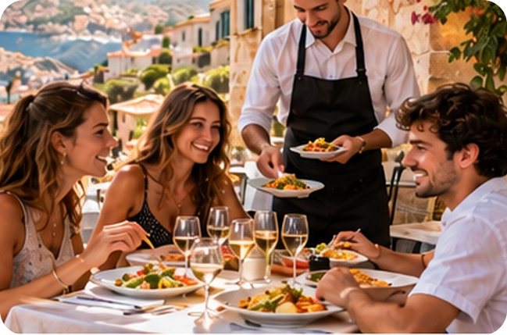
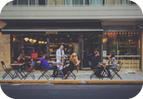
17
Do you agree?
💬 TALK PARLA
⏱ 5 min 👨‍👩‍👧 groups
Agree or disagree? Give reasons!
Sei d'accordo o no? Dai dei motivi!
1
Good service is more important than good food.
e.g. I disagree. If the food is bad, I never go back!
2
The best chefs are usually men.
e.g. I don't think that's true. My nonna is the best cook I know!
3
Everybody should learn to cook at school.
e.g. I agree with that. Then we don't need takeaways!
4
Cheap restaurants always serve bad food.
e.g. I don't agree – the best panelle in Bagheria are cheap!
💬
Useful phrases
5
Waiters should earn a good salary and tips should be banned.
e.g. I think it depends. A tip is a nice way to say thank you.
I agree / I don't agree / I disagree with that.
I think / I don't think that's true.
I think you're right.
I think it depends.
6
Italian food is the best in the world.
e.g. I agree with you! But Sicilian food is even better.
1A-2 · Speaking · agreeing and disagreeing · 📖 SB p.9 · 7a, 7b
Notes:
17. Speaking · agreeing and disagreeing (5 min)
SPEAKING – fluency (5 min). SB 7a–b: the book's six statements, ONE PER CLICK. Go through the 'Agreeing and disagreeing' box first (Useful phrases – the book's box). Groups of 3: for each statement, everyone says agree or disagree with ONE reason or example (about 45 seconds per statement; the TG suggests 2 minutes each – with less time, let groups choose 3 statements). TG EXTRA CHALLENGE: I completely / totally (dis)agree, I agree up to a point, I couldn't agree more! DON'T over-correct: note 4–5 errors (especially simple / continuous) for 1 minute of delayed correction on the board at the end. Feedback: 'Which statement caused the biggest argument?' Watch: 'I agree' – NOT 'I am agree' (Italian 'sono d'accordo'). ICQ: 'Is it OK to disagree with your partner?' (yes – but give a reason!).

Slide 18
18
3 · 2 · 1
⏱ 2 min 👥 pairs
Books closed! What can you remember?
Libri chiusi! Cosa ricordi?
3
facts about Marianna's life
📝
Homework · Compiti
Workbook 1A: 3a–3e
Grammar Bank 1A: a 6–10, b 6–10
Homework sheet 1A-2 in the LLS app
2
verbs that never take -ing
1
sentence: I usually… but this week I'm…
Next lesson: 1B part 1 · Modern families · future forms
1A-2 · Exit · what can you remember?
Notes:
18. Exit · what can you remember? (2 min)
RETRIEVAL EXIT (2 min). Books closed. Pairs: 3 facts about Marianna (e.g. her dad was a fisherman · she studied psychology · she's head chef at Morito · she goes to Crete 4–5 times a year), 2 non-action verbs (need, like, know, want, love, smell…), 1 sentence about themselves with both tenses (e.g. I usually have a cornetto for breakfast, but this week I'm trying to eat healthier food). 3–4 students share. Set homework (on the slide and in the app): Workbook 1A grammar 3a–3e + Grammar Bank 1A a 6–10, b 6–10 + the 1A-2 homework sheet (easier version available). Answers are in the teacher key.

Slide 19
19
Interview a chef
💬 TALK PARLA
⏱ 5 min 👥 pairs
A = journalist. B = famous chef. Swap!
A = giornalista. B = chef famoso. Scambiatevi!
📷 1a2-chef-interview.jpg
1
What's the name of your restaurant? Where is it?
e.g. It's called 'Il Pescatore'. It's in Aspra, by the sea.
2
Did you always want to be a chef?
e.g. No – I wanted to be a footballer!
3
What do you usually cook?
e.g. I usually cook fish – my dad catches it every morning.
4
What are you making this week?
e.g. This week I'm making a new pistachio pesto.
💬
Useful phrases
My restaurant is called… It's in…
I usually… / At the moment I'm…
Did you always want to be a chef?
5
How often do you go on holiday?
e.g. Once a year – and I always eat in other people's restaurants!
1A-2 · Extra · role play
EXTRA · if there's time
Notes:
19. Extra · role play (5 min)
EXTRA (5 min, if there's time). Role play based on the Marianna interview (1.8 / 1.9). B invents a restaurant (name, town, speciality) in 1 minute; A asks the questions (one per click; they're models – A can add more). Both tenses: What do you usually…? (habit) / What are you making this week? (temporary). Swap roles. Then 2–3 'chefs' are presented to the class by their journalist: 'Her restaurant is in… This week she's making…'.

