Slide 1


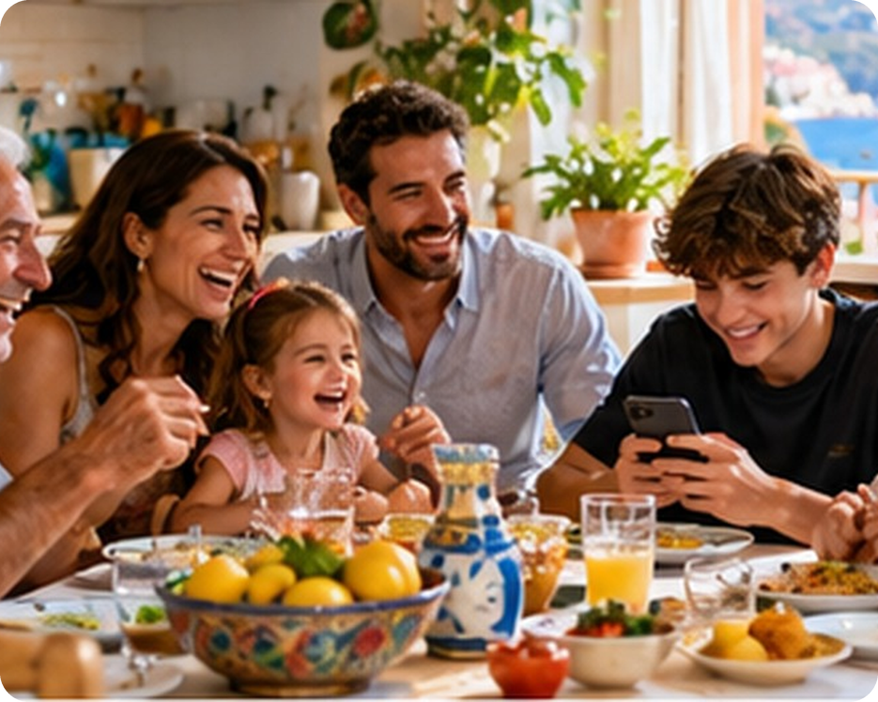


English File B1 · SB pp.10–11
💡 THINK · PENSA
1B-1
Modern families
Families, plans and the future
🎯
Today you're going to…
💬 talk about your family
👀 read a survey about British families
🎧 listen to three family conversations
✏️ talk about the future: plans, offers, promises
What makes a family "modern"?
EXAMPLE I think families are smaller now, and everyone is on their phone!
Notes:
1. OPENING (2 min)
Show the photo. Ask the THINK question; take 3–4 ideas (e.g. step-families, fewer children, everyone on their phones…). Read the 'Today you're going to…' list together: students know where the lesson is going. Don't teach words yet.

Slide 2

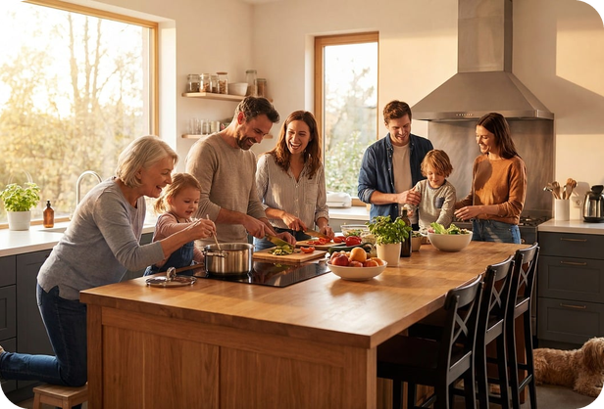
2
Remember last lesson?
💡 THINK PENSA
⏱ 2 min 🙋 whole class
What did we learn? Read the examples.
Cosa abbiamo imparato? Leggi gli esempi.
Present simple = habits
Present continuous = now / these days
I usually have pasta on Sundays.
How often do you eat out?
She doesn't like spicy food.
→ every day · usually · never
I'm cooking dinner right now.
We're trying to eat less sugar.
Are you watching TV?
→ now · at the moment · this week
📅
Last lesson…
1A: food, cooking and eating habits
present simple vs continuous
🔤 KEY WORDS
spicy
takeaway
eat out
raw
frozen
roast
cut down on
1B-1 · Revision · last lesson
Notes:
2. Revision · last lesson (2 min)
REVISION (2 min) before the warmer game. Read the examples with the class; elicit one more example for each column from students (e.g. 'What are you doing these days?'). Point at the time words: they tell you which tense. Then play 'Answers first!' – the answers in the game use exactly these two tenses and food words.

Slide 3

3
Answers first!
🎲 PLAY GIOCA
⏱ 3 min 🏆 teams
Read the answer. Write the question!
Leggi la risposta. Scrivi la domanda!
🎲
How to play
1
"Twice a week. I love it!"
→ How often do you eat pizza?
Read the ANSWER.
In teams, write the QUESTION.
Correct question = 1 point.
"No, I'm not. I'm doing my homework."
→ Are you watching TV?
2
3
"No, I don't. It's too spicy."
→ Do you like chilli?
4
"Because I'm trying to eat less sugar."
→ Why aren't you having dessert?
5
"At my nonna's, every Sunday."
→ Where do you have lunch on Sundays?
TEAM A ☆☆☆☆☆
TEAM B ☆☆☆☆☆
6
"Pasta with sardines!"
→ What are you cooking?
1B-1 · Warmer · last lesson · 📖 Recycles 30 Sept: present simple and continuous, food
Notes:
3. Warmer · last lesson (3 min)
RETRIEVAL WARMER (4 min). Two teams. Click once per line to show a possible question (accept any correct question in the right tense). Point for a correct question, +1 if the tense matches the answer (do/does vs am/is/are). ICQ: 'Are you writing answers or questions?' (questions).

Slide 4
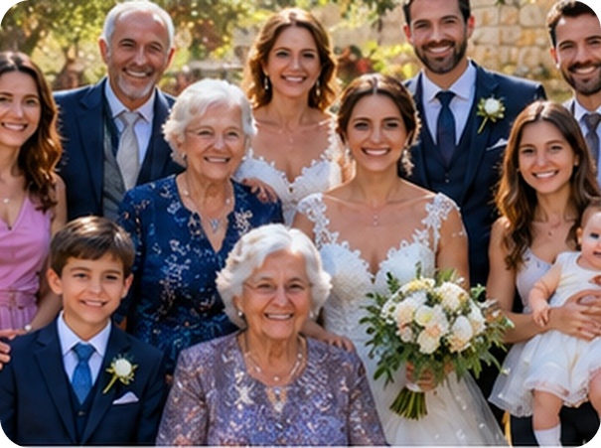
4
What's the difference?
💬 TALK PARLA
⏱ 5 min 👥 pairs
Explain the difference to your partner.
Spiega la differenza al compagno.
⭐
Example
1
father / parent
father = male parent · parent = mum or dad
0 mum / grandmother → your grandmother is your mum's or dad's mum
2
mother / stepmother
stepmother = your dad's wife, not your mum
3
brother / brother-in-law
your sister's husband or your partner's brother
4
stepsister / half-sister
step = no parent in common · half = one parent in common
5
grandfather / great-grandfather
great-grandfather = your grandparent's father
6
adopted child / only child
joined a new family / no brothers or sisters
7
brothers and sisters / siblings
same meaning · siblings is more formal
8
immediate / extended family
parents, children, siblings / uncles, cousins, grandparents…
1B-1 · Vocabulary · family · 📖 SB p.10 · 1a
Notes:
4. Vocabulary · family (5 min)
ELICIT FIRST (5 min). Demo item 0 with the class. Pairs explain each pair of words in English (Italian allowed only as a last resort). Click once per item to reveal. Monitor and note which words are new. ICQs: 'Are you writing?' (no, talking) · 'In English or Italian?' (English). Next slide gives the Italian for slower students.

Slide 5

5
Family words in Italian
✅ CHECK CONTROLLA
⏱ 2 min 🙋 whole class
Say it in Italian. Then click!
Dillo in italiano. Poi clicca!
👩
stepmother
👨
stepfather
👧
stepsister
👭
half-sister
matrigna
patrigno
sorellastra (nessun genitore in comune)
sorella da parte di padre / madre
🤵
brother-in-law
👰
sister-in-law
👴
great-grandfather
🧒
only child
cognato
cognata
bisnonno
figlio unico / figlia unica
🍼
adopted child
👫
siblings
👦
nephew / niece
👨‍👩‍👧‍👦
extended family
figlio adottivo
fratelli e sorelle
nipote (di zio/zia)
i parenti (zii, cugini, nonni)
⚠ Watch out! parents = genitori · relatives = parenti | nipote = nephew / niece OR grandson / granddaughter
1B-1 · Vocabulary · in Italian
Notes:
5. Vocabulary · in Italian (2 min)
CONSOLIDATION for slower students (2 min). Class says the Italian aloud for each word, then ONE click shows all the Italian. Spend 20 seconds on the warning: 'parents' is NOT 'parenti' (false friend), and English has two words for 'nipote'. Quick CCQ: 'My dad's new wife – is she my mum?' (no) 'So she's my…?' (stepmother).

Slide 6
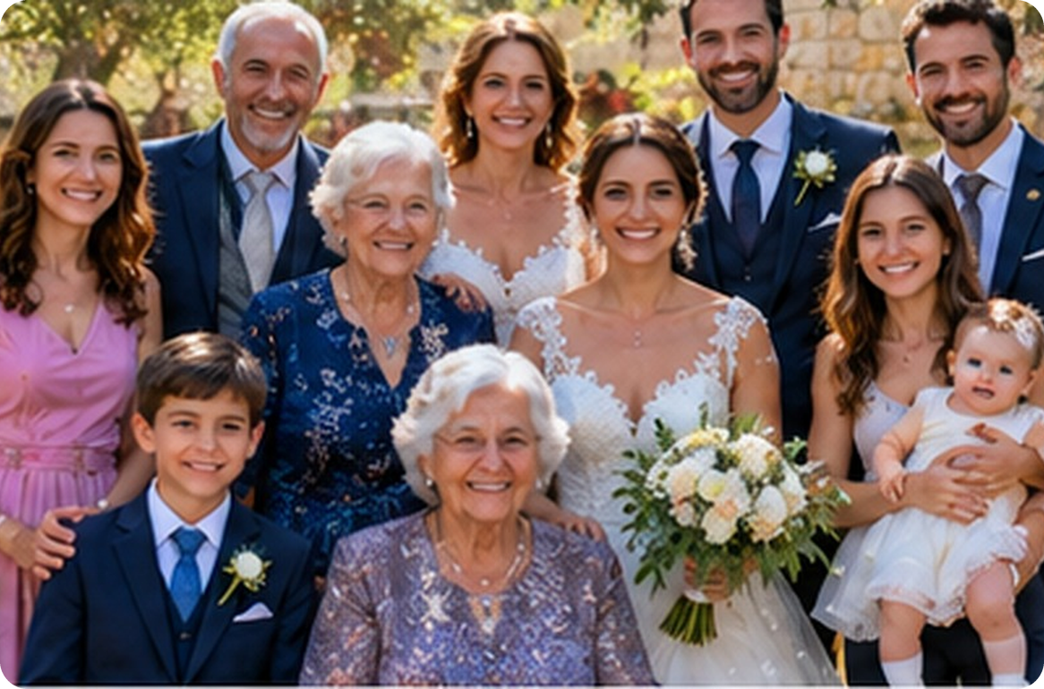
6
Who's who at Sara's wedding?
💬 TALK PARLA
⏱ 3 min 👥 pairs
Sara is the bride. Who are 1–6?
Sara è la sposa. Chi sono 1–6?
1
Her grandmother's mother
great-grandmother
2
Same dad, different mum
4
half-sister
3
Her dad's second wife
2
3
stepmother
4
Her husband's brother
★ Sara
5
brother-in-law
5
Her husband's sister
6
1
sister-in-law
6
Her brother's son
nephew
1B-1 · Vocabulary · practice · 📖 Practice of SB p.10 · 1a words
Notes:
6. Vocabulary · practice (3 min)
CONTROLLED PRACTICE (3 min). Pairs: 'Number 1 is her great-grandmother.' Click once per number. Fast finishers: invent the next relationship (e.g. 'the baby is her niece'). The people and relationships are invented for practice.

Slide 7
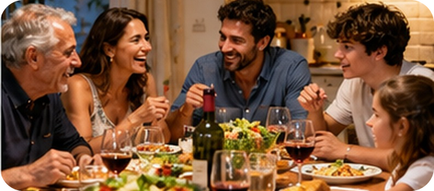
7
Describe it!
🎲 PLAY GIOCA
⏱ 3 min 👥 pairs
Explain the word. Don't say it!
Spiega la parola. Non dirla!
🎲
How to play
ROUND 1 · A explains
ROUND 2 · B explains
A looks at the screen. B turns around.
A explains the word. Don't say it!
B guesses. Then swap.
stepmother
half-sister
only child
great-grandfather
brother-in-law
adopted child
siblings
extended family
1B-1 · Vocabulary game
Notes:
7. Vocabulary game (3 min)
GAME 2 (3 min). Demo first with a strong student: 'It's your dad's wife, but not your mum' → stepmother. Click to show each word (round 1 = 4 words for A, round 2 = 4 words for B, B faces the screen). 20 seconds per word. ICQ: 'Can you say the word?' (no).

Slide 8
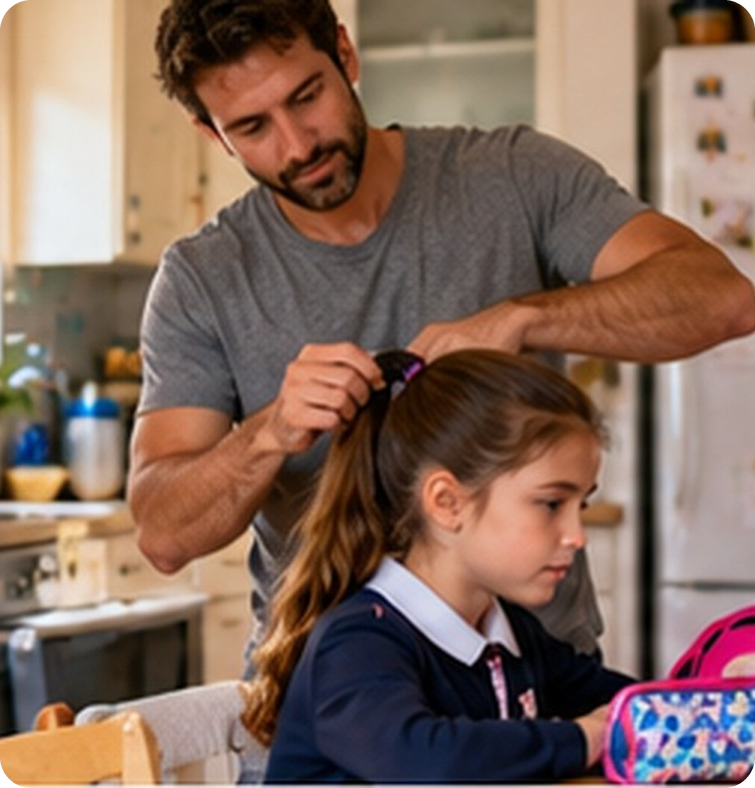
8
Guess the numbers
👀 READ LEGGI
🤔 GUESS INDOVINA
Read the intro. 8 numbers – 8 gaps next!
⏱ 2 min 👥 pairs
Leggi l'intro. 8 numeri – 8 spazi dopo!
The modern family
Family life is changing all over the world – not just the structure of the family, but also its habits. A recent survey of British family life showed some surprising statistics.
➡ NEXT The survey on the next 2 slides has 8 gaps. Write your guess for each gap, then listen and check.
🔢 NUMBER BANK · guess where they go!
2
10%
14%
17%
30
32
40%
45%
1B-1 · Reading · prediction · 📖 SB p.10 · 1b
Notes:
8. Reading · prediction (2 min)
PREDICTION (2 min). Read the introduction aloud. Check 'survey' (sondaggio) and 'statistics'. Pairs look at the number bank and commit to guesses on the next two slides — every pair must guess before checking. ICQ: 'Are you checking or guessing?' (guessing).

Slide 9
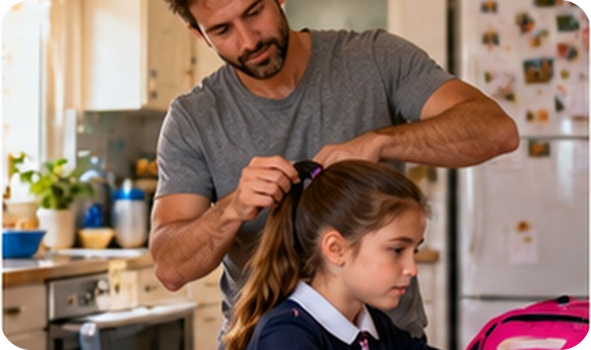

9
Read and check 1/2
👀 READ LEGGI
🎧 LISTEN ASCOLTA
Write a number in gaps 1–5. Then listen.
⏱ 3 min 👥 pairs
Scrivi un numero negli spazi 1–5. Poi ascolta.
Family structure
🎧 1.14
60% of families have married parents.
22% are single-parent families. Only (1) _____ of the single parents are men.
22% are single-parent families. Only 14% of the single parents are men.
(2) _____ of families have one child, (3) _____ have two, and 15% have three or more.
45% of families have one child, 40% have two, and 15% have three or more.
11% of families have stepchildren.
On average, women get married at (4) _____ and men at (5) _____ .
On average, women get married at 30 and men at 32.
🔈 click ▶
1B-1 · Reading · Family structure · 📖 SB p.10 · 1b, 1c · audio 1.14
Notes:
9. Reading · Family structure (3 min)
READ + CHECK (3 min). Pairs write their guesses for gaps 1–5. Play 1.14 (or read the text aloud if the audio isn't in the deck yet). Click once per gap: the answer appears highlighted IN the text. Answers (audio script): 1 14% · 2 45% · 3 40% · 4 30 · 5 32. Ask: 'Which number surprises you?'

Slide 10
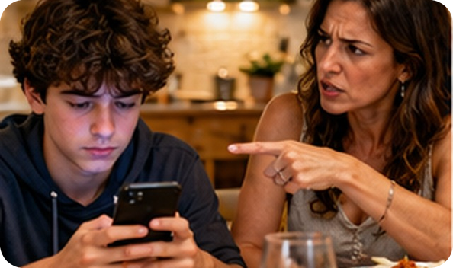
10
Read and check 2/2
👀 READ LEGGI
🎧 LISTEN ASCOLTA
Write a number in gaps 6–8. Then listen.
⏱ 3 min 👥 pairs
Scrivi un numero negli spazi 6–8. Poi ascolta.
Family habits
🎧 1.14
20% of families only eat together once or twice a week, and (6) _____ never eat at the same time.
20% of families only eat together once or twice a week, and 10% never eat at the same time.
They visit friends or extended family twice a month.
(7) _____ of people have family members who they never speak to or contact.
17% of people have family members who they never speak to or contact.
75% of people are happiest with their families, and 17% with their friends.
The average family has (8) _____ rows /raʊz/ each day. The most common cause: children or teenagers refusing to put down their phones or tablets.
The average family has 2 rows /raʊz/ each day. The most common cause: children or teenagers refusing to put down their phones or tablets.
🔈 click ▶
1B-1 · Reading · Family habits · 📖 SB p.10 · 1b, 1c · audio 1.14
Notes:
10. Reading · Family habits (3 min)
READ + CHECK (3 min). Same procedure. Answers: 6 10% · 7 17% · 8 2. Vocabulary from context: row /raʊ/ = argument (litigio) – NOT row /rəʊ/ (fila); refuse = say no. The photo is the clue for 'rows'. Extra slide (after the exit) = 'Find in the text' if there's time.

Slide 11
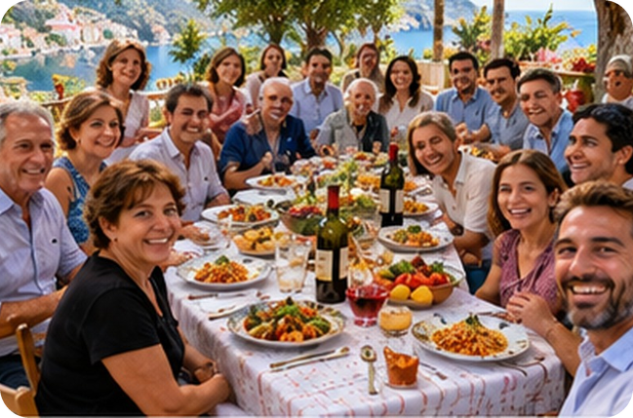


11
Sicily vs the UK
💬 TALK PARLA
⏱ 5 min 👨‍👩‍👧 groups
Answer with a reason. Then ask: Why?
Rispondi con un motivo. Poi chiedi: Perché?
1
In the UK, 20% of families rarely eat together. And in Sicily?
e.g. No! In Sicily most families eat together every day.
2
Who do you live with? Is your family big or small?
e.g. I live with my mum, my dad and my little brother.
3
How often do you see your extended family?
e.g. Every Sunday – we have lunch at my nonna's!
4
Free time: family or friends? Why?
e.g. Friends, because we like the same things.
💬
Useful phrases
5
Is there anyone in your family you don't get on with?
e.g. My cousin – he always takes my things!
I'm sorry, I'd rather not talk about that.
6
What do you argue about at home? Phones?
e.g. My mum says I'm always on my phone at dinner.
1B-1 · Speaking · Sicily vs the UK · 📖 SB p.10 · 1c, 1d
Notes:
11. Speaking · Sicily vs the UK (5 min)
SPEAKING (5 min). Questions appear ONE PER CLICK: give groups about 45 seconds per question, then click. Teach the polite refusal first (yellow box): anyone can use it — no one has to talk about their family. Monitor and note 4–5 errors for delayed correction (don't interrupt). Feedback on question 1: what's different in Sicily?

Slide 12
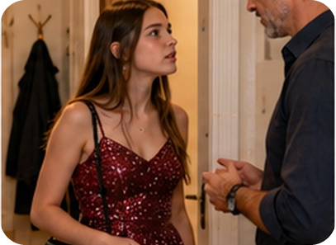
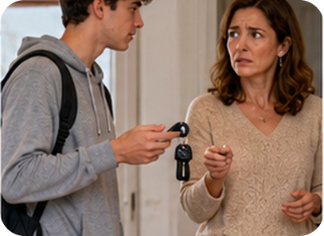
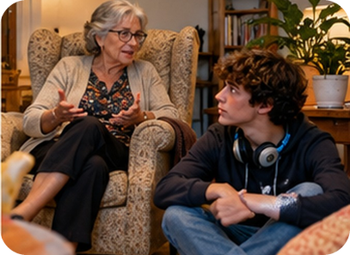
12
Three conversations
🎧 LISTEN ASCOLTA
⏱ 3 min 👤 alone
Listen. Match 1–3 to the photos A–C.
Ascolta. Abbina 1–3 alle foto A–C.
🎧 1.15 · play once
↘ speaker bottom right
A
B
C
Conversation 1
C · his plans for next year
Conversation 2
A · a party at Katie's
Conversation 3
B · borrowing the car
🎧
While you listen
Look at A, B and C. Who are they?
Listen. Match conversations 1–3 to A–C.
🔈 click ▶
1B-1 · Listening · gist · 📖 SB p.11 · 2a · audio 1.15
Notes:
12. Listening · gist (3 min)
GIST (3 min). Pictures (left to right) = A, B, C. Before listening: 'Who are the people? Where are they?' Play 1.15 ONCE. Pairs compare, then click once per conversation. Answers (TG): 1 C – what Adam's going to do next year · 2 A – a party she's going to · 3 B – whether he can borrow her car.

Slide 13
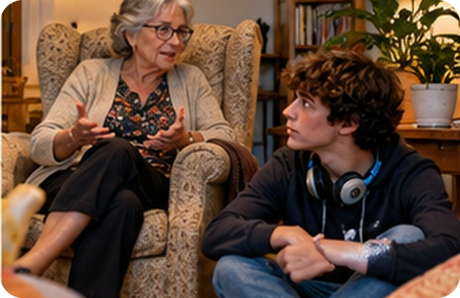
13
Listen again: complete
🎧 LISTEN ASCOLTA
✏️ FILL THE GAPS COMPLETA
Guess the words. Then listen again.
⏱ 4 min 👥 pairs
Indovina le parole. Poi riascolta.
🎧 1.15 · pause after each conversation
a I'm not ___ to university.
going to go
b ___ you a cup of tea?
Shall I make
c I ___ the night there.
'm staying
d It ___ cold tonight.
's going to be
e You ___ too fast.
'll drive
💡
Guess first, then listen!
f I ___ really careful.
'll be
🔈 click ▶
1B-1 · Listening · detail · 📖 SB p.11 · 2b · audio 1.15
Notes:
13. Listening · detail (4 min)
DETAIL (4 min). Pairs guess first (extra challenge from the TG). Play again, pausing after each conversation. Click once per sentence. Answers: a going to go · b Shall I make · c 'm staying · d 's going to be · e 'll drive · f 'll be.

Slide 14
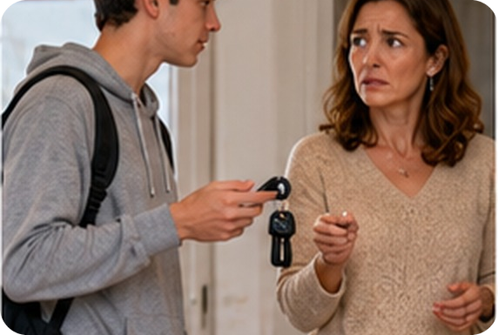
14
Find the future
🔍 FIND TROVA
⏱ 2 min 👥 pairs
Find the future forms in the lines.
Trova le forme del futuro.
So what are you going to do next year, dear?
1 · Gran
So what are you going to do next year, dear?
I'm not going to go to university. I'm going to look for a job.
1 · Adam
I'm not going to go to university. I'm going to look for a job.
Shall I make you a cup of tea?
1 · Adam
Shall I make you a cup of tea?
I'm going to a party at Katie's. I'm staying the night there.
2 · Girl
I'm going to a party at Katie's. I'm staying the night there.
Where's your coat? It's going to be cold tonight!
🔍
Find it!
2 · Dad
Where's your coat? It's going to be cold tonight!
going to
present continuous
will / won't
Shall I…?
You won't look after it. You'll drive too fast.
3 · Woman
You won't look after it. You'll drive too fast.
I won't, I promise. I'll be really careful.
3 · Man
I won't, I promise. I'll be really careful.
1B-1 · Noticing · the conversations · 📖 SB audio script 1.15 (p.124)
Notes:
14. Noticing · the conversations (2 min)
NOTICING (2 min). Text from the audio script. Pairs underline the future forms; click once per line to highlight them. This leads straight into the next slide (what does each form do?).

Slide 15
15
Plan, prediction or promise?
🔗 MATCH ABBINA
⏱ 3 min 👥 pairs
Plan, prediction, offer…? Match the colour.
Piano, previsione, offerta…? Abbina il colore.
🏷️
The colours
a I'm not going to go to university.
plan
plan
prediction
b Shall I make you a cup of tea?
offer
offer
arrangement
c I'm staying the night there.
arrangement
promise
d It's going to be cold tonight.
prediction
e You'll drive too fast.
prediction
f I'll be really careful.
promise
1B-1 · Grammar · future forms · 📖 SB p.11 · 2c
Notes:
15. Grammar · future forms (3 min)
GUIDED DISCOVERY (3 min). Pairs match a–f to the five uses. Click once per sentence. Answers (TG): plan a · prediction d, e · offer b · arrangement c · promise f. CCQ for c: 'Has she already organised it?' (yes – Katie knows) → arrangement.

Slide 16

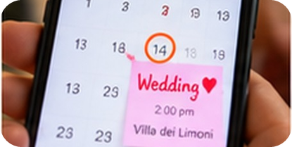

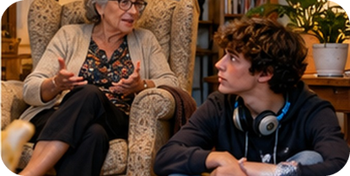
16
Talking about the future
👀 LOOK GUARDA
⏱ 3 min 🙋 whole class
Look at the examples. Which form?
🎧 1.16
Guarda gli esempi. Quale forma?
be going to
present continuous
will / won't
Shall I / we…?
plans · predictions you can SEE
arrangements (day, time, place fixed)
offers · promises · instant decisions · predictions
offers & suggestions (questions)
I'm going to look for a job.
Look at the clouds! It's going to rain.
I'm staying at Katie's tonight.
We're going to a wedding on Saturday.
I'll carry that for you!
I won't tell anybody.
I think you'll pass.
Shall I make you a cup of tea?
Shall we eat out tonight?
intenzione · sta per…
già organizzato
decisione sul momento, promessa
Vuoi che…? · Che ne dici se…?
⚠ Italian present ≠ English future: ✗ Tomorrow I go to Palermo → ✓ I'm going to Palermo tomorrow. ✗ I carry your bag → ✓ I'll carry it.
🔈 click ▶
1B-1 · Grammar · the rule · 📖 Grammar Bank 1B p.133 · audio 1.16
Notes:
16. Grammar · the rule (3 min)
RULE (3 min). Click once per column: the examples appear (meaning first, then form). Optional: play 1.16 (Grammar Bank listen and repeat). Last click = the Italian-speaker warning. CCQs: 'It's going to rain – can you see something?' (yes, clouds) · 'I'll carry it – did I decide before?' (no, now).

Slide 17
17
Quick! Say it!
🎲 PLAY GIOCA
⏱ 4 min 🏆 teams
Read the situation. Say the reply!
Leggi la situazione. Di' la risposta!
🎲
How to play
1
"It's really hot in here."
→ Shall I open the window? (offer)
Read the situation.
Teams: say the reply in 10 seconds.
Right future form = 1 point.
"Look at those black clouds!"
→ It's going to rain. (prediction)
2
3
"Don't tell anyone my secret!"
→ I won't tell anybody, I promise.
4
Waiter: "Pizza or pasta?"
→ I'll have the pizza, please.
5
"Free on Saturday?" (dinner with cousins – booked)
→ No, I'm having dinner with my cousins.
TEAM A ☆☆☆☆☆
TEAM B ☆☆☆☆☆
6
Your mum's bags are really heavy.
→ I'll carry them for you!
1B-1 · Grammar game
Notes:
17. Grammar game (4 min)
GAME 3 (4 min). Read each situation; teams have 10 seconds to say (or write) a reply with the right future form. Click to show a model answer. Accept any correct reply. Point only if the future form is right.

Slide 18
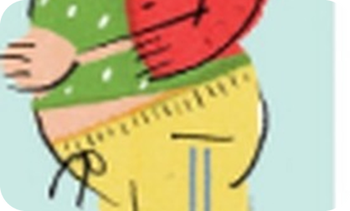
18
Hear the BIG words
🎧 LISTEN ASCOLTA
🔊 SAY IT PRONUNCIA
Listen. Write only the BIG words.
⏱ 3 min 👥 pairs
Ascolta. Scrivi solo le parole forti.
🎧 1.21 · pause after each sentence
1
sister's
having
baby
April
My sister's having a baby in April.
🔊
Big words = STRESSED
2
anyone
family
moving
house
soon
nouns, verbs, adjectives are strong
to, a, the, of are weak and fast
Is anyone in your family moving house soon?
3
see
parents
weekend
Are you going to see your parents at the weekend?
4
think
live
home
next
year
Do you think you'll live at home next year?
🔈 click ▶
1B-1 · Pronunciation · sentence stress · 📖 SB p.11 · 3b, 3c, 3d · audio 1.21
Notes:
18. Pronunciation · sentence stress (3 min)
PRONUNCIATION (3 min). Model first: 'I'm going to LOOK for a JOB' (audio 1.20) – the small words are fast and weak (going to = /ɡəʊɪŋ tə/). Play 1.21, pausing. Click 1 = the stressed words, click 2 = the full sentence (for each sentence). Then drill: chorally, then individually. Italian speakers give every word equal stress – exaggerate the big words.

Slide 19
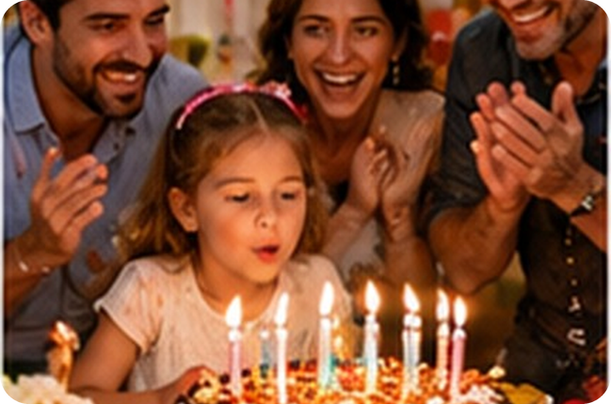
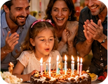
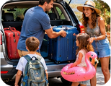

19
Is anyone in your family…?
💬 TALK PARLA
⏱ 4 min 🚶 mingle
Stand up! Ask 3 classmates.
Alzati! Chiedi a 3 compagni.
1
Is anyone in your family getting married soon?
e.g. Yes! My cousin is getting married in June.
2
Is anyone celebrating their birthday soon?
e.g. My dad is – he's going to be 50!
3
Are you going to do something with your family this week?
e.g. We're going to the beach on Sunday.
4
Are you going to go on holiday with your family this year?
e.g. I don't think so. Maybe next year.
💬
Useful phrases
Maybe · Probably · I don't think so · I have no idea… because…
5
Do you think you'll move away from Bagheria one day?
e.g. Maybe. I'd like to study in Milan.
1B-1 · Speaking · future plans · 📖 SB p.11 · 3e
Notes:
19. Speaking · future plans (4 min)
FREER PRACTICE (4 min). Mingle. Questions appear one per click (show all 5, then let them mingle). Model the rhythm first. Feedback: 2–3 students report one thing they found out. Then 2 minutes of delayed error correction (errors noted during both speaking tasks): write them on the board, students correct them.

Slide 20
20
3 · 2 · 1
⏱ 2 min 👥 pairs
Books closed! What can you remember?
Libri chiusi! Cosa ricordi?
3
family words from today (no looking!)
📝
Homework · Compiti
Workbook 1B: 1a, 2a, 2b
Grammar Bank 1B p.133: a 6–9, b 5–8
Homework sheet in the LLS app
2
sentences with two different future forms
1
plan for this weekend: "I'm going to…"
Next lesson: 1B part 2 · personality adjectives (audio 1.22) · birth order
1B-1 · Exit · what can you remember?
Notes:
20. Exit · what can you remember? (2 min)
RETRIEVAL EXIT (2 min). Books closed. Pairs: 3 family words, 2 future sentences, 1 weekend plan. A few students share. Set homework (on the slide and in the app).

Slide 21
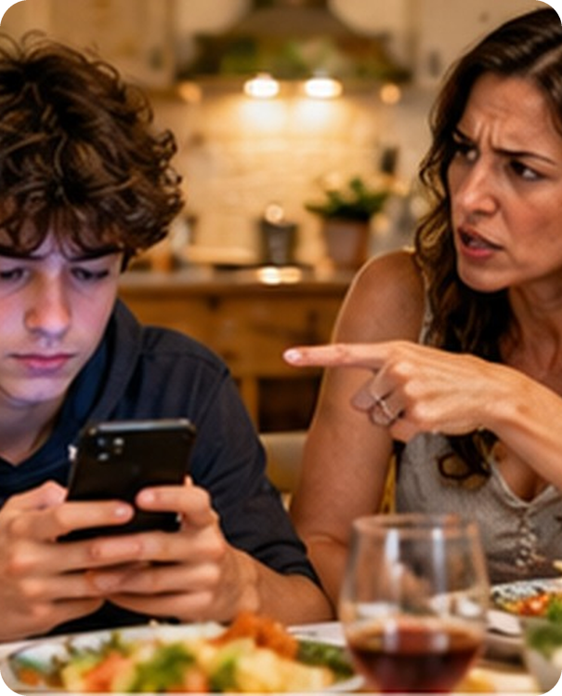
21
Find in the text
🔍 FIND TROVA
⏱ 2 min 👥 pairs
Find a word in the text that means…
Trova nel testo una parola che significa…
1
arguments
rows
2
a family with only a mum or only a dad
a single-parent family
3
your husband's or wife's children from before
stepchildren
4
usually · as a number
on average
5
say 'no' to doing something
refuse (refusing to)
6
have no contact with
never speak to
1B-1 · Reading · vocabulary from the text
EXTRA · if there's time
Notes:
21. Reading · vocabulary from the text (2 min)
EXTRA (2 min, if there's time). Vocabulary from context. Click once per item.

