Slide 1


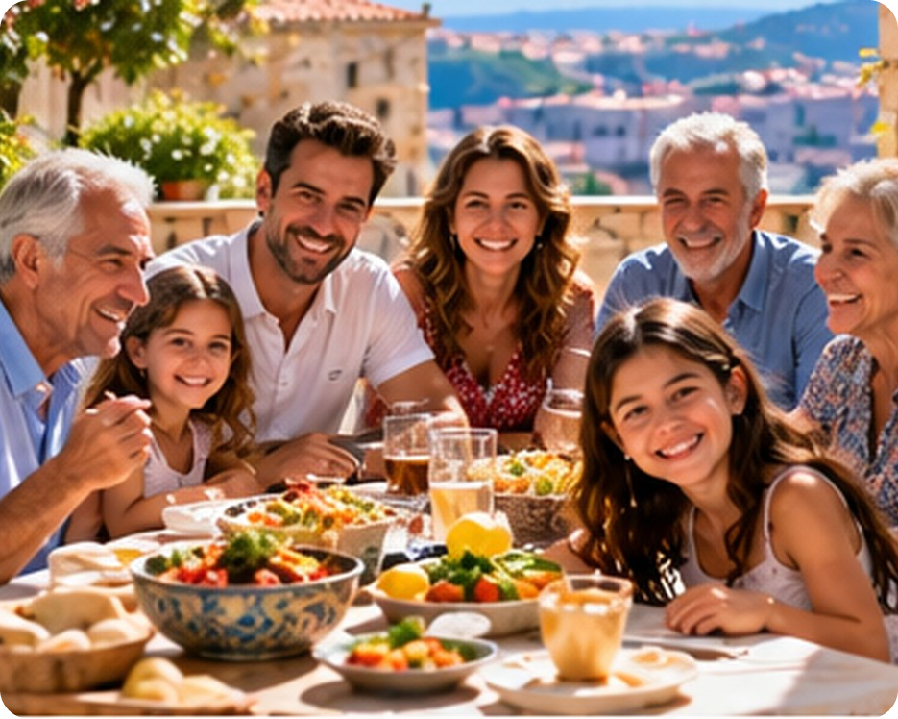


English File B1 · SB pp.12–13
💡 THINK · PENSA
1B-2
Modern families
Personality and birth order
🎯
Today you're going to…
💬 describe people's personality
🔤 make opposites: un-, dis-, im-…
👀 read about birth order and personality
🎧 listen to two stories about brothers and sisters
Oldest, youngest or only child – does it change you?
EXAMPLE Yes! I'm the oldest, so I think I'm more responsible.
Notes:
1. OPENING (2 min)
OPENING (2 min). Show the photo. Ask the THINK question: 'Are you the oldest, a middle child, the youngest or an only child? Does it change your personality?' Quick show of hands for each position (SB 6a – which is the most common in the class?). Take 2–3 opinions, don't teach words yet. Read the 'Today you're going to…' list together.

Slide 2

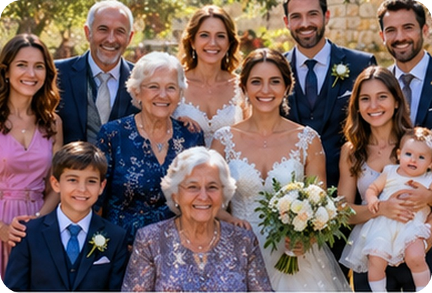
2
Remember last lesson?
💡 THINK PENSA
⏱ 2 min 🙋 whole class
What did we learn? Read the examples.
Cosa abbiamo imparato? Leggi gli esempi.
will / won't / Shall I…?
going to / present continuous
Your bags look heavy. I'll carry one!
Don't worry. I won't tell anybody.
Shall I make you a cup of tea?
→ offer · promise · instant decision
I'm going to look for a job.
We're seeing Nonna on Sunday.
Look at the clouds! It's going to rain.
→ plan · arrangement · prediction
📅
Last lesson…
1B: modern families
family words · future forms
🔤 KEY WORDS
brother-in-law
stepmother
half-sister
great-grandfather
only child
siblings
nephew / niece
1B-2 · Revision · last lesson
Notes:
2. Revision · last lesson (2 min)
REVISION (2 min) before the warmer game. Read the examples with the class; for each one ask 'Plan, arrangement, prediction, offer or promise?'. Elicit 2–3 family words with a definition (e.g. 'my sister's husband' → brother-in-law). Remind them: Italian present ≠ English future (✗ I carry your bag → ✓ I'll carry it). Then play 'Spot the mistake!' – the mistakes are exactly these family words and future forms.

Slide 3


3
Spot the mistake!
🎲 PLAY GIOCA
⏱ 3 min 🏆 teams
Find the mistake. Fix it!
Trova l'errore. Correggilo!
🎲
How to play
1
"My sister's husband is my stepbrother."
→ my brother-in-law
Read the sentence. Find the mistake.
Teams: say the correct sentence.
Correct fix = 1 point.
"My grandad's father is my grandfather too."
→ my great-grandfather
2
3
"I've got no brothers or sisters. I'm an adopted child."
→ I'm an only child.
4
"Your bags look heavy. I carry one for you!"
→ I'll carry one for you! (offer)
5
"I see my cousins on Saturday. We booked a table."
→ I'm seeing my cousins… (arrangement)
6
"Don't worry. I don't tell anybody, I promise."
→ I won't tell anybody. (promise)
1B-2 · Warmer · last lesson · 📖 Recycles 1B part 1: family words, future forms
Notes:
3. Warmer · last lesson (3 min)
RETRIEVAL WARMER (4 min) – different format from last lesson's 'Answers first!': this time teams CORRECT sentences. Two teams. Read each sentence aloud; teams have 10 seconds to say the correct version. Click once per line to show the answer. 1 point per correct fix. Items 1–3 = family words (1B-1 vocabulary), items 4–6 = future forms (offer, arrangement, promise). Accept any correct alternative (e.g. 4 'Shall I carry one?'; 5 'We're having dinner with my cousins'). DEMO: 'My mum's mum is my aunt.' → grandmother. ICQ: 'Do you say the mistake or the correct sentence?' (the correct sentence).

Slide 4
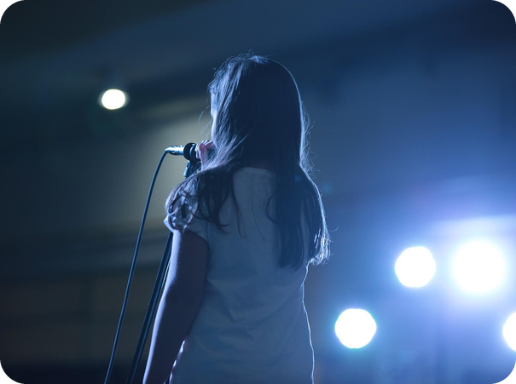
4
Opposites attract
💬 TALK PARLA
⏱ 2 min 👥 pairs
Complete the opposite adjective.
Completa l'aggettivo contrario.
⭐
Example
1
extroverted ≠ sh___
shy
0 tall ≠ sh___ → short
2
generous ≠ m___
mean (tirchio)
3
hard-working ≠ l___
lazy
4
talkative ≠ q___
quiet
5
funny ≠ se___
serious
1B-2 · Vocabulary · opposites · 📖 SB p.12 · 4a
Notes:
4. Vocabulary · opposites (2 min)
ELICIT (2 min). SB 4a 'Opposites attract': the missing adjectives are the OPPOSITES of the first adjectives. Do 0 with the class. Pairs complete 1–5 (book sentences: 'She's extroverted, but he's sh___.' etc. – shortened on the slide); click once per line. Answers (TG): 1 shy · 2 mean · 3 lazy · 4 quiet · 5 serious. Check meaning while revealing: extroverted (= outgoing – in the article later!) ↔ shy; generous ↔ mean (≠ 'mean' = significare). Drill. Quick question: 'Do opposites attract? Do you know a couple like this?' Placeholder picture: a shy boy and a sociable girl.

Slide 5
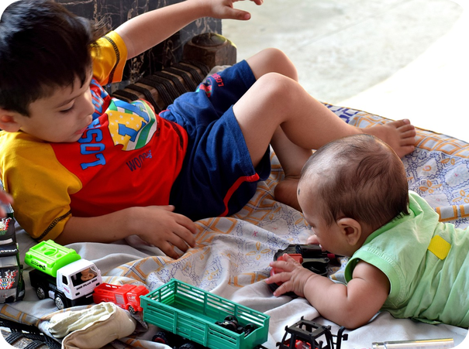
5
What are they like? (1)
💬 TALK PARLA
⏱ 3 min 👥 pairs
Read the clue. Say the adjective!
Leggi l'indizio. Di' l'aggettivo!
⭐
1
only thinks about himself
selfish
Example
2
gets everything he wants
spoilt
0 doesn't like obeying rules → rebellious
3
tells people what to do
bossy
4
never changes her opinion
stubborn
5
happy, then angry, then sad…
moody
6
always wants to win
competitive
7
often worried or stressed
anxious /ˈæŋkʃəs/
8
not confident about herself
insecure
9
easily hurt or offended
sensitive
10
wants to be successful in life
ambitious
1B-2 · Vocabulary · personality 1 · 📖 SB p.12 · 4b · Vocabulary Bank Personality p.153 (audio 1.22)
Notes:
5. Vocabulary · personality 1 (3 min)
ELICIT FIRST (3 min). Teach the question 'What are they like?' = what kind of personality do they have? (NOT 'What do they like?'). Do 0 with the class. Pairs say the adjective for each clue (guess in English; Italian only as a last resort). Click once per line. Answers (Vocabulary Bank p.153 / audio 1.22): 1 selfish · 2 spoilt · 3 bossy · 4 stubborn · 5 moody · 6 competitive · 7 anxious · 8 insecure · 9 sensitive · 10 ambitious (+ 0 rebellious). Drill as you go. The clues are the book's definitions, shortened. Audio 1.22 (all 22 definitions) is on the next slide. ICQ: 'Do you say the clue or the adjective?' (the adjective).

Slide 6

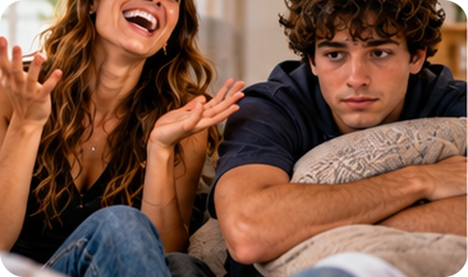

6
What are they like? (2)
🎧 LISTEN ASCOLTA
✏️ FILL THE GAPS COMPLETA
Guess the adjective. Then listen.
⏱ 3 min 👥 pairs
Indovina l'aggettivo. Poi ascolta.
Vocabulary Bank · What are they like?
🎧 1.22
(1) _____ people behave like adults.
Mature people behave like adults.
(2) _____ people always tell the truth and never steal or cheat.
Honest people always tell the truth and never steal or cheat.
(3) _____ people have an attractive personality.
Charming people have an attractive personality.
(4) _____ people have common sense and are practical.
Sensible people have common sense and are practical.
(5) _____ people are friendly and enjoy being with other people.
Sociable people are friendly and enjoy being with other people.
(6) _____ people have a good imagination.
Imaginative people have a good imagination.
(7) _____ people like doing things on their own, without help.
Independent people like doing things on their own, without help.
(8) _____ people can wait for a long time without getting angry.
💡
Patient people can wait for a long time without getting angry.
Remember
(9) _____ people are ones who you can trust or depend on.
Reliable people are ones who you can trust or depend on.
Positive or negative?
+ affectionate = shows love
(10) _____ people are sure of themselves and their abilities.
Self-confident people are sure of themselves and their abilities.
🔈 click ▶
1B-2 · Vocabulary · personality 2 · 📖 Vocabulary Bank Personality p.153 · audio 1.22
Notes:
6. Vocabulary · personality 2 (3 min)
GUESS, THEN LISTEN (3 min). Pairs guess the adjectives (all positive this time). Play 1.22 (embedded – click the speaker icon): it has all 22 definitions in the book's order, so it also checks slide 4 – pause as needed. Click once per gap: the adjective appears highlighted in the sentence. Definitions are from audio script 1.22 (8 shortened). Answers (audio script 1.22): 1 Mature · 2 Honest · 3 Charming · 4 Sensible · 5 Sociable · 6 Imaginative · 7 Independent · 8 Patient · 9 Reliable · 10 Self-confident. 1.22 also has 22 Affectionate (= show that they love or like other people very much) – teach it. Then play 1.22 again for listen and repeat, or drill yourself. ACTIVATION (TG): 'Which adjectives are positive?' (suggested: mature, honest, charming, sensible, sociable, imaginative, independent, patient, reliable, self-confident, affectionate).

Slide 7
7
Personality in Italian
✅ CHECK CONTROLLA
⏱ 2 min 🙋 whole class
Say it in Italian. Then click!
Dillo in italiano. Poi clicca!
🙋
selfish
🧸
spoilt
📢
bossy
🐂
stubborn
egoista
viziato
prepotente, autoritario
testardo
🌦️
moody
🤝
reliable
😊
charming
💪
self-confident
lunatico
affidabile
affascinante
sicuro di sé
🧠
sensible
💔
sensitive
🙈
shy
🪙
mean
assennato, con buon senso
sensibile, permaloso
timido
tirchio
⚠ Watch out! sensible = assennato ≠ sensibile (= sensitive) · sympathetic = comprensivo ≠ simpatico (= nice, friendly)
1B-2 · Vocabulary · in Italian
Notes:
7. Vocabulary · in Italian (2 min)
CONSOLIDATION for slower students (2 min). These are the adjectives that are DIFFERENT from Italian (TG extra idea: Latin-based languages – most others are similar: mature = maturo, honest = onesto, independent = indipendente…). Class says the Italian, then ONE click shows it all. 30 seconds on the false friends (book box, p.153): sensible / sensitive / sympathetic – 'sympathetic' is in the article later. CCQ: 'My friend cries when you criticise her. Is she sensible or sensitive?' (sensitive) · 'She's sympathetic – is she funny?' (no – she understands your problems).

Slide 8
8
What's he like?
🎲 PLAY GIOCA
⏱ 3 min 🏆 teams
Read the situation. Say the adjective!
Leggi la situazione. Di' l'aggettivo!
🎲
How to play
1
"My brother never says sorry, even when he's wrong."
→ stubborn
Read the situation.
Teams: say the adjective in 5 seconds.
Right adjective = 1 point.
"She always tells everyone what to do."
→ bossy
2
3
"He's happy one minute and angry the next."
→ moody
4
"She's got 40 toys and she still screams for more!"
→ spoilt
📷 1b2-stubborn.jpg
5
"He cries if he loses at Uno!"
→ competitive
6
"I lent her €10. She gave it back the next day."
→ reliable / honest
1B-2 · Vocabulary game
Notes:
8. Vocabulary game (3 min)
GAME (3 min). Two teams. Read each situation aloud; the first team to say the right adjective in 5 seconds wins the point. Click to show the answer. Accept any adjective that fits (e.g. 4 spoilt / selfish). Bonus round: 'Who in your family is like that?' (only if they want to say!). ICQ: 'How long do you have?' (5 seconds).

Slide 9
9
un-, dis-, im-, ir- or in-?
🔗 MATCH ABBINA
⏱ 3 min 👥 pairs
Which prefix makes the opposite?
Quale prefisso forma il contrario?
🏷️
The colours
friendly → ___friendly
un-
honest → ___honest
dis-
un-
dis-
mature → ___mature
im-
im-
ir-
in-
patient → ___patient
im-
responsible → ___responsible
ir-
sensitive → ___sensitive
in-
📷 1b2-untidy.jpg
🎧 1.23
organized → ___organized
dis-
⚠ Play it from the book audio
ambitious → ___ambitious
un-
1B-2 · Vocabulary · negative prefixes · 📖 Vocabulary Bank Personality p.153 · 2 Negative prefixes · audio 1.23
Notes:
9. Vocabulary · negative prefixes (3 min)
PREFIXES (3 min). Explain: some opposites are different words (generous / mean), others just add a prefix. Pairs match each adjective to a prefix colour; click once per line. Answers (audio 1.23): unfriendly · dishonest · immature · impatient · irresponsible · insensitive · disorganized · unambitious. Others in 1.23 (all un-): unimaginative, unkind, unreliable, unselfish, unsociable, untidy (see the picture: an untidy bedroom). Audio 1.23 is not in the deck yet – play it from the book audio. Elicit the rules (TG): un- is by far the most common · im- before p or m (impatient, immature) · ir- before r (irresponsible). Which one has a POSITIVE meaning? → unselfish. Italian helps: irresponsabile, immaturo, impaziente. These words are in the article later (immature, disorganized, unambitious, impatient).

Slide 10
10
Real or fake?
🎲 PLAY GIOCA
⏱ 3 min 🏆 teams
Real word or fake word? Be quick!
Parola vera o falsa? Veloci!
🎲
How to play
1
unpatient
→ FAKE → impatient
Read the word.
Teams: REAL or FAKE? Fix the fakes!
Right answer = 1 point. Fix = +1.
unkind
→ REAL ✓
2
3
inhonest
→ FAKE → dishonest
4
irresponsible
→ REAL ✓
5
disreliable
→ FAKE → unreliable
TEAM A ☆☆☆☆☆
TEAM B ☆☆☆☆☆
6
unselfish
→ REAL ✓ (a positive word!)
1B-2 · Vocabulary game · prefixes
Notes:
10. Vocabulary game · prefixes (3 min)
GAME (3 min). Two teams, one pen and paper each. Show the word, teams write REAL or FAKE and, for fakes, the correct word (10 seconds). Click to check. 1 point for real/fake, +1 for the correct fix. The fakes are typical Italian-speaker errors (✗ unpatient, ✗ inhonest – see the homework sheet). ICQ: 'If it's fake, do you just write FAKE?' (no – write the right word too).

Slide 11

11
Where's the stress?
🎧 LISTEN ASCOLTA
🔊 SAY IT PRONUNCIA
Guess the stress. Then listen.
⏱ 3 min 👥 pairs
Indovina l'accento. Poi ascolta.
🎧 1.24 · pause after each group
anxious · ambitious
ANxious · amBItious
generous · rebellious
GEnerous · reBELlious
sociable · reliable
SOciable · reLIable
responsible · sensible
resPONsible · SENsible
competitive · talkative
comPEtitive · TALKative
sensitive
SENsitive
unfriendly · insecure
unFRIENDly · inseCURE
💡
Guess first, then listen!
impatient · immature
imPAtient · immaTURE
🔈 click ▶
1B-2 · Pronunciation · word stress · 📖 SB p.12 · 5a, 5b · audio 1.24
Notes:
11. Pronunciation · word stress (3 min)
PRONUNCIATION (3 min). HEAR: model one word yourself (ANxious). Pairs say the words aloud and decide which syllable is stressed (they look like Italian words but the stress is often different: amBItious ≠ ambiZIOso). Play 1.24 (book audio – not in the deck yet), pausing after each group; click once per line. Answers (TG): ANxious, amBItious, GEnerous, reBELlious · SOciable, reLIable · resPONsible, SENsible · comPEtitive, TALKative, SENsitive · unFRIENDly, inseCURE, imPAtient, immaTURE. Ask: are the prefixes and suffixes stressed? → NO, never. -ous and -able/-ible = /ə/ (weak), -ive = /ɪv/. REPEAT: play again, choral then individual. PRODUCE: 'Tell your partner: I'm quite… but I'm not very…' (stress!). The picture shows an anxious teenager.

Slide 12
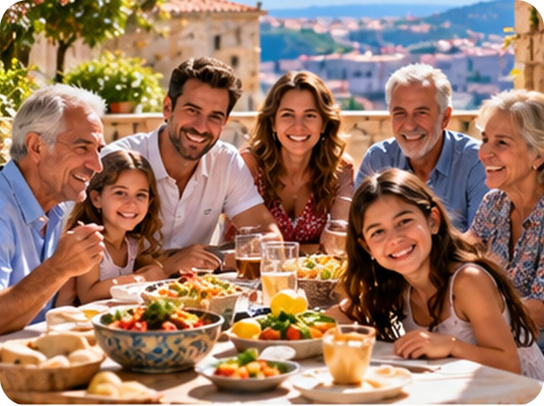
12
Which child?
🤔 GUESS INDOVINA
⏱ 2 min 👥 pairs
Which child? Guess!
Quale figlio? Indovina!
⭐
Example
1
outgoing, charming, disorganized
the youngest child
0 oldest · middle · youngest · only child
2
responsible, ambitious, anxious
the oldest child
3
self-confident, independent, spoilt
the only child
4
sociable, sensitive, unambitious
the middle child
5
They make good leaders.
the oldest child
6
They get on with everybody.
the middle child
7
They try to get attention.
the youngest child
8
They do very well at school.
the only child
1B-2 · Reading · prediction · 📖 SB p.12 · 6a, 6b, 6c
Notes:
12. Reading · prediction (2 min)
PREDICTION (2 min). 6a was in the opening (show of hands). 6b: pairs decide which group of adjectives goes with each position in the family (outgoing = extroverted). Elicit opinions but DON'T confirm yet. 6c: 'The article on the next slides will tell you!' – after the reading (slides 13–16) come back here, or click now for a quick check if short of time. Answers (TG): 1 the youngest child · 2 the oldest child · 3 the only child · 4 the middle child. Items 5–8 are sentences from the article (TG extra challenge phrases): 5 oldest · 6 middle · 7 youngest · 8 only. The article (slides 13–16) proves every answer.

Slide 13
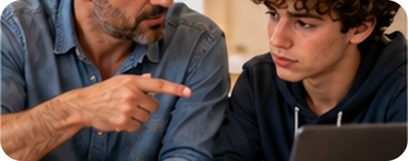
13
Because…
👀 READ LEGGI
🤔 GUESS INDOVINA
Read the reasons. Which child?
⏱ 2 min 👥 pairs
Leggi i motivi. Quale figlio?
🏷️
The colours
A they grew up between older and younger siblings
middle
B it's easier for them to break the rules
youngest
oldest
middle
C their parents were more relaxed with them
middle
youngest
only
D they are given everything they ask for
only
E they have always been the baby of the family
youngest
F they spend a lot of time with adults
only
G they've never sorted out problems with siblings
only
H they lost some of their parents' attention
oldest
1B-2 · Reading · reasons A–H · 📖 SB p.12 · 6d (reasons A–H)
Notes:
13. Reading · reasons A–H (2 min)
PRE-READING (2 min). Reasons A–H from SB 6d, shortened on the slide (the full book wording appears in the article on slides 13–16). Pairs read them and guess which child each one explains – this prepares them for the gap task in the article. Click once per reason (or click after the reading as the check). Answers (from the article / TG key 6d): A middle (gap 3) · B youngest (gap 4) · C middle (gap 2) · D only (gap 7) · E youngest (gap 5) · F only (gap 6) · G only (gap 8) · H oldest (gap 1, the example). Check: discipline = regole, disciplina · sort out = risolvere · rejected = rifiutato. ICQ: 'Are you reading the article now?' (no – only the reasons).

Slide 14
14
How birth order influences you
👀 READ LEGGI
⏱ 2 min 👥 pairs
Read. Which reason goes in gap 1?
Leggi. Quale motivo va nello spazio 1?
The oldest child
Nowadays, it is an accepted fact that our position in the family is possibly the strongest influence there is on our character and personality. So what influence does it have?
📷 1b2-oldest.jpg
Firstborn children often have to look after their younger brothers and sisters, so they're usually sensible and responsible as adults.
They also tend to be ambitious and they make good leaders.
On the negative side, oldest children can be insecure and anxious. This is because (1) _____ .
On the negative side, oldest children can be insecure and anxious. This is because H when the second child was born, they lost some of their parents' attention, and maybe they felt rejected.
💡
Remember
tend to = di solito
leaders = capi, guide
1B-2 · Reading · the oldest child · 📖 SB p.12 · 6c, 6d · article (intro shortened)
Notes:
14. Reading · the oldest child (2 min)
READING FOR DETAIL (2 min). The article from SB p.12, one paragraph per slide (slides 13–16). Read the introduction together (shortened: the book adds 'that is, whether we're an oldest child, a middle child, a youngest child, or an only child'). Students read the paragraph and decide which reason (A–H, slide 12) goes in the gap. Gap 1 is the book's example: click to show H highlighted IN the text. EVIDENCE: 'Why are oldest children responsible?' (they look after younger brothers and sisters) · 'Why are they insecure?' (they lost some attention – maybe they felt rejected = rifiutati). Check slide 11 item 5 (good leaders = oldest). Placeholder picture: an older sister helping her brother with homework.

Slide 15
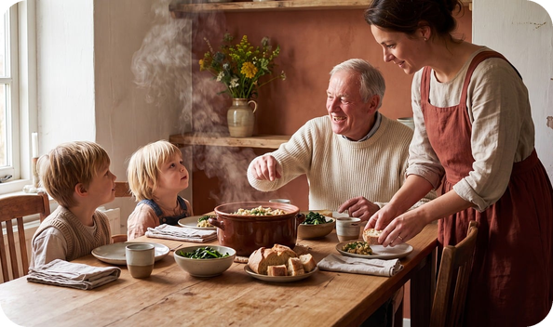
15
How birth order influences you
👀 READ LEGGI
⏱ 2 min 👥 pairs
Read. Which reasons go in gaps 2–3?
Leggi. Quali motivi vanno negli spazi 2–3?
The middle child
Middle children are more relaxed than the oldest children, probably because (2) _____ .
Middle children are more relaxed than the oldest children, probably because C their parents were more relaxed themselves by the time the second child arrived.
They're usually very sociable – the kind of people who get on with everybody.
They are also usually sensitive to what other people need, because (3) _____ .
They are also usually sensitive to what other people need, because A they grew up between older and younger brothers and sisters.
For the same reason, they're often quite good at sorting out arguments, and they're always sympathetic to the ones on the losing side, or in general, to people who are having problems.
💡
Remember
On the other hand, middle children can sometimes be unambitious, and they can lack direction in life.
sympathetic = comprensivo
sort out = risolvere
1B-2 · Reading · the middle child · 📖 SB p.12 · 6d · article
Notes:
15. Reading · the middle child (2 min)
READING FOR DETAIL (2 min). Pairs read and choose the reasons for gaps 2 and 3. Click once per gap: the reason appears highlighted in the text. Answers (TG): 2 C · 3 A. Vocabulary from context: get on with (= have a good relationship with) · sort out arguments (= solve) · sympathetic (= comprensivo, NOT simpatico!) · lack direction in life (= not know what they want to do). Placeholder picture: a middle child between two siblings at dinner.

Slide 16
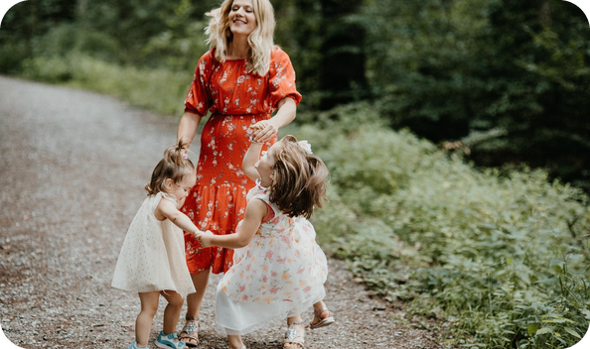
16
How birth order influences you
👀 READ LEGGI
⏱ 2 min 👥 pairs
Read. Which reasons go in gaps 4–5?
Leggi. Quali motivi vanno negli spazi 4–5?
The youngest child
Youngest children are often very outgoing and charming. This is the way they try to get the attention of both their parents and their older brothers and sisters.
They are often more rebellious, and this is probably because (4) _____ .
They are often more rebellious, and this is probably because B it's easier for them to break the rules – by the time they were born, their parents were more relaxed about discipline.
They can also be immature and disorganized, and they often depend too much on other people, because (5) _____ .
They can also be immature and disorganized, and they often depend too much on other people, because E they have always been the baby of the family.
💡
Remember
discipline = regole, disciplina
depend on = dipendere da
1B-2 · Reading · the youngest child · 📖 SB p.12 · 6d · article
Notes:
16. Reading · the youngest child (2 min)
READING FOR DETAIL (2 min). Same procedure. Answers (TG): 4 B · 5 E. Drill rebellious /rɪˈbeljəs/, immature /ˌɪməˈtʃʊə/, discipline /ˈdɪsəplɪn/. Ask: 'Are you the youngest? Do you agree?!' (quick reactions only – the discussion is on slide 17). Placeholder picture: the youngest child making the family laugh.

Slide 17
17
How birth order influences you
👀 READ LEGGI
⏱ 2 min 👥 pairs
Read. Which reasons go in gaps 6–8?
Leggi. Quali motivi vanno negli spazi 6–8?
The only child
Only children usually do very well at school, because they have a lot of contact with adults.
📷 1b2-only-child.jpg
They get a lot of love and attention from their parents, so they're typically self-confident.
They're also independent, as they spend so much time by themselves. And because (6) _____ , they're often very organized.
They're also independent, as they spend so much time by themselves. And because F they spend a lot of time with adults, they're often very organized.
Only children can sometimes be spoilt, because (7) _____ by their parents.
Only children can sometimes be spoilt, because D they are given everything they ask for by their parents.
💡
Remember
They can also be quite selfish and get impatient, especially when things go wrong. This is because (8) _____ .
They can also be quite selfish and get impatient, especially when things go wrong. This is because G they've never had to sort out problems with other brothers and sisters.
by themselves = da soli
things go wrong = vanno male
1B-2 · Reading · the only child · 📖 SB p.12 · 6d · article
Notes:
17. Reading · the only child (2 min)
READING FOR DETAIL (2 min). Same procedure. Answers (TG): 6 F · 7 D · 8 G. Now check slide 11 if you didn't (youngest = outgoing, charming, disorganized; only = self-confident, independent, spoilt). TG extra challenge: 'Who are these about? They get impatient when things go wrong (only) · They spend a lot of time by themselves (only) · They tend to be ambitious (oldest) · They can lack direction in life (middle).' Placeholder picture: an only child reading between two parents.

Slide 18
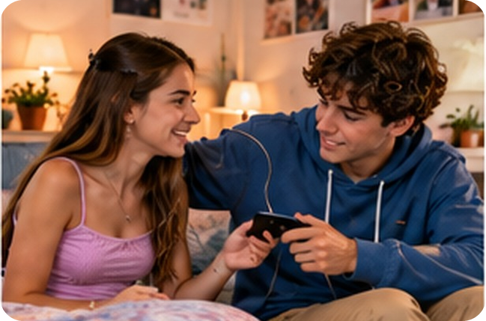

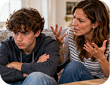
18
Is it true for you?
💬 TALK PARLA
⏱ 3 min 👥 pairs
Is it true for you? Say why.
È vero per te? Di' perché.
1
Read your paragraph again. Is it true for you?
e.g. Yes! I'm the oldest and I'm quite responsible.
2
Is it true for your brothers, sisters or friends?
e.g. My sister is the baby of the family – she's so charming!
3
Is birth order really the strongest influence? What else is important?
e.g. I don't think so. Friends and school are important too.
4
Which is the best position in a family? Why?
e.g. The only child – you get all the attention!
💬
Useful phrases
That's true for me because…
Not really – I'm quite…
My brother is a typical…
I'd rather not say.
5
Who's the most stubborn person in your family?
e.g. My nonno – he never changes his mind!
1B-2 · Speaking · birth order · 📖 SB p.12 · 6e
Notes:
18. Speaking · birth order (3 min)
SPEAKING (3 min). SB 6e. Questions appear ONE PER CLICK – about 35 seconds each. Only children: talk about a cousin or a friend. Q3 and Q5 are added (opinion + personal); 'I'd rather not say' is always OK. Monitor: listen for the new adjectives and their stress (amBItious, reBELlious); note 4–5 errors for delayed correction at the end of the lesson. Feedback: which position does the class think is best? TG: you could tell them about your own family position first.

Slide 19
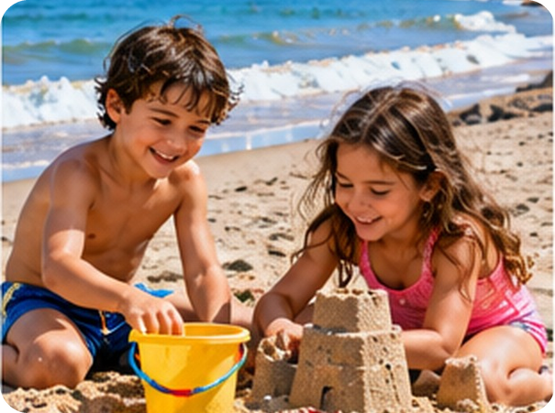
19
Key words first
💡 THINK PENSA
⏱ 2 min 👥 pairs
Guess the meaning. Then click.
Indovina il significato. Poi clicca.
⭐
Example
1
penknife
a small knife for your pocket · coltellino
0 twin → born on the same day as your brother or sister · gemello
2
stab (stabbed)
hurt someone with a knife · accoltellare
3
horrified
very shocked · inorridito
4
blood
red liquid in your body · sangue
5
cage
a bird lives in it · gabbia
6
let out
open the door so it can go out · far uscire
7
hide (hid, hidden)
put something where no one can find it · nascondere
8
cupboard /ˈkʌbəd/
furniture with doors for keeping things · armadio
1B-2 · Listening · key words first · 📖 SB p.13 · 7a (words from the stories)
Notes:
19. Listening · key words first (2 min)
PRE-TEACH + CONSOLIDATE (2 min). 'You're going to hear two people talking about a time when they or one of their brothers or sisters behaved badly.' Pairs guess the meaning of the key words from the stories; click once per word – each answer gives the meaning AND the Italian. Drill cupboard /ˈkʌbəd/ (silent p!), blood /blʌd/. THEN PREDICT (SB 7a): pairs use the words to guess what happened. The book's word clouds: JAMES – brother, teenagers, fighting, stabbed, finger, penknife, accident, horrified, blood, mum angry, hospital · MARILYN – sister, parrot, cage, let out, fly, bedroom, looked everywhere, cried, window, hidden, cupboard, frightened, horrible. Write the two clouds on the board. Take 2 predictions – don't confirm.

Slide 20
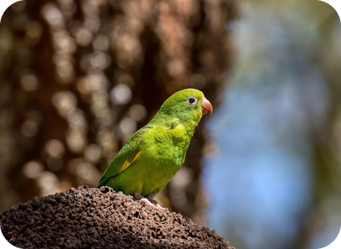
20
Brothers and sisters
🎧 LISTEN ASCOLTA
⏱ 3 min 👤 alone
Listen. Were your predictions right?
Ascolta. Le tue previsioni erano giuste?
🎧 1.25 · play once
⚠ Play it from the book audio
A
B
📷 1b2-twins-finger.jpg
A · James
a penknife accident with his twin
B · Marilyn
her sister hid her parrot
Who was horrified?
James
🎧
While you listen
Before you listen: predict the two stories.
Listen. What happened in each story?
Who cried and cried?
Marilyn
1B-2 · Listening · gist · 📖 SB p.13 · 7b · audio 1.25
Notes:
20. Listening · gist (3 min)
GIST (3 min). Photos: A = James's story, B = Marilyn's story. Play 1.25 ONCE (book audio – not in the deck yet): were your predictions right? Pairs compare, then click once per line (rows 3–4 = quick gist checks: James was horrified, Marilyn cried and cried). Elicit each story (TG): James accidentally stabbed his twin brother in the finger with a penknife when they were fighting · Marilyn's sister hid her parrot, Charlie, in a cupboard. Ask: 'Who behaved worse?' – just a first reaction, then listen again for detail. ICQ: 'Do you need to understand every word?' (no – just what happened).

Slide 21
21
James's story
🎧 LISTEN ASCOLTA
✏️ FILL THE GAPS COMPLETA
Answer for James. Then listen again.
⏱ 3 min 👥 pairs
Rispondi per James. Poi riascolta.
🎧 1.25 · stop after James
1 How old were they?
15
⚠ Play it from the book audio
2 Where were they?
in their bedroom (they shared it)
📷 1b2-twins-finger.jpg
3 What bad thing did he do?
stabbed his brother's finger with a penknife – by accident
4 What happened in the end?
Mum was very angry – but it was a very small cut
5 How does his brother show he hasn't forgotten?
he still tells people about it (30 years later!)
💡
Guess first, then listen!
1B-2 · Listening · detail · James · 📖 SB p.13 · 7c · audio 1.25
Notes:
21. Listening · detail · James (3 min)
DETAIL (3 min). Read questions 1–5 first. Pairs answer from memory, then play the first story again (stop after James). Click once per question. Answers (TG): 1 15 · 2 in their bedroom · 3 James accidentally stabbed his brother in the finger with a penknife · 4 their mother was very angry with James, but it was a very small cut (no hospital) · 5 James's brother still tells other people about when James stabbed him. Fun detail: the brother said 'I'm going to tell Mum!' – at 15! (a future form from last lesson).

Slide 22
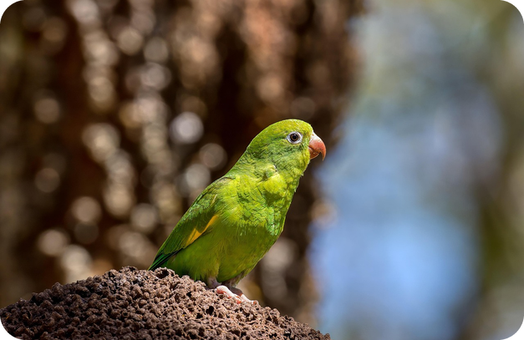
22
Marilyn's story
🎧 LISTEN ASCOLTA
✏️ FILL THE GAPS COMPLETA
Answer for Marilyn. Then listen again.
⏱ 3 min 👥 pairs
Rispondi per Marilyn. Poi riascolta.
🎧 1.25 · play the second story
1 How old was she?
about ten
⚠ Play it from the book audio
2 Where was she?
in her bedroom
3 What bad thing did her sister do?
hid her parrot, Charlie, in a cupboard
4 What happened in the end?
her sister opened the cupboard – Charlie was there
5 How does Marilyn show she hasn't forgotten?
she hides her sister's car keys or purse!
💡
Guess first, then listen!
1B-2 · Listening · detail · Marilyn · 📖 SB p.13 · 7c · audio 1.25
Notes:
22. Listening · detail · Marilyn (3 min)
DETAIL (3 min). Same questions for Marilyn. Play the second story. Click once per question. Answers (TG): 1 ten · 2 she was in her bedroom · 3 her sister hid her parrot in a cupboard; Marilyn and her parents looked everywhere and she was very upset · 4 her sister showed them where the parrot was, in the cupboard · 5 Marilyn sometimes hides her sister's things (car keys, purse) to remind her of the parrot incident. Finally (TG): 'Who behaved worse, James or Marilyn's sister?' Quick class vote. EXTRA SUPPORT: listen again with the script on SB p.125.

Slide 23
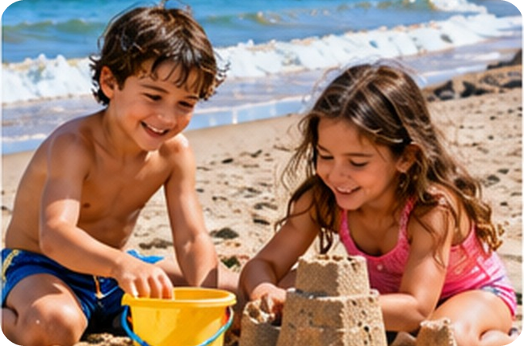
23
Now tell YOUR side!
💬 TALK PARLA
⏱ 4 min 👥 pairs
Tell the story from the other side!
Racconta la storia dall'altra parte!
1
A: You're James's twin brother. Tell your story.
e.g. I have a twin brother called James, and we used to fight a lot…
2
B: You're Marilyn's sister. Tell your story.
e.g. My little sister had a green parrot called Charlie. One day…
3
Who behaved worse? Why?
e.g. Marilyn's sister – she did it on purpose!
4
Did you (or a sibling or friend) ever behave badly as a child?
e.g. Once I hid my brother's phone in the fridge!
💬
Useful phrases
Why did you…?
How did you feel?
What happened next?
I was so angry / frightened!
1B-2 · Speaking · retell the story · 📖 SB p.13 · 7d, 7e
Notes:
23. Speaking · retell the story (4 min)
SPEAKING (4 min). Questions one per click. 7d (2 min): pairs A and B retell the story from the OTHER person's point of view (the first example is the book's model opening). Monitor and help with vocabulary; 1–2 students tell the class. 7e (2 min): a time when they or a sibling / friend behaved badly as a child – only if they want to; a funny story is perfect. If you have a story, tell it first (TG). Then 1–2 minutes of delayed error correction: write 4–5 errors from slides 17 and 22 on the board, pairs correct them.

Slide 24
24
3 · 2 · 1
⏱ 2 min 👥 pairs
Books closed! What can you remember?
Libri chiusi! Cosa ricordi?
3
personality adjectives – with their opposites
📝
Homework · Compiti
Workbook 1B: 1b, 1c, 1d, 1e
Writing p.115: your email (task e)
Vocabulary Bank p.153: test yourself
Homework sheet 1B-2 in the LLS app
2
facts about the oldest or the only child
1
what did Marilyn's sister do?
Next lesson: Practical English 1 · Meeting the parents
1B-2 · Exit · what can you remember?
Notes:
24. Exit · what can you remember? (2 min)
RETRIEVAL EXIT (2 min). Books closed. Pairs: 3 adjectives + their opposites (e.g. patient – impatient), 2 things the article says about the oldest or only child, 1 what Marilyn's sister did (hid her parrot in a cupboard). A few students share. Homework: Workbook 1B 1b, 1c, 1d, 1e (personality, prefixes, false friends) + Writing p.115 'A description of a person' task e (if possible go through the model emails in class – EXTRA slide 25 – or at the start of next lesson) + the 1B-2 homework sheet (easier version available).

Slide 25
25
Personality Taboo
🎲 PLAY GIOCA
⏱ 4 min 🏆 teams
Describe the personality. Don't say it!
Descrivi la personalità. Non dirla!
🎲
How to play
ROUND 1 · Team A
ROUND 2 · Team B
The describer faces the screen. Others turn round.
Describe a person like that. Don't say the ✗ word!
Your team guesses. Correct = 1 point.
STUBBORN ✗ opinion
SPOILT ✗ everything
BOSSY ✗ tell
COMPETITIVE ✗ win
RELIABLE ✗ trust
AFFECTIONATE ✗ love
📷 1b2-taboo.jpg
MOODY ✗ happy
SELFISH ✗ himself
1B-2 · Extra game · Personality Taboo
EXTRA · if there's time
Notes:
25. Extra game · Personality Taboo (4 min)
EXTRA GAME (4 min, if there's time – or as next lesson's warmer). Taboo: one describer per team faces the screen; the class must not see the screen. Click to show each card: describe a person like that without saying the adjective or the ✗ word. Encourage situations: 'If you lend her your car, she always brings it back on time' (reliable). 1 minute per card. Bonus point if the team also gives the OPPOSITE (reliable → unreliable).

Slide 26
26
Sofia's email
👀 READ LEGGI
⏱ 5 min 👥 pairs
Read the emails on p.115. Answer!
Leggi le email a p.115. Rispondi!
⭐
Example
1
Why did Angela write to Sofia?
she's looking for an au pair – Kasia told her about Sofia
0 au pair /əʊ ˈpeə/ → a young person who lives with a family and looks after the children
2
Correct Sofia's 5 spelling mistakes
interested · responsible · forgetful · photography · independent
3
Which positive adjectives does Sofia use?
intelligent, hard-working, mature, responsible, friendly, independent
📷 1b2-oldest.jpg
4
What are her negative points?
quite shy · a bit forgetful · her English isn't very good
5
Order: very positive → negative
incredibly → really → very → quite → a bit
1B-2 · Extra · Writing · a description of a person · 📖 SB p.13 · 8b · Writing p.115
EXTRA · if there's time
Notes:
26. Extra · Writing · a description of a person (5 min)
EXTRA / WRITING PREPARATION (5 min). Books open at p.115. Click once per question. Answers (TG): a1 Because she is looking for an au pair and Sofia's friend Kasia told Angela she might be interested in working in England as an au pair · a2 Yes, she does. b interrested → interested · responsable → responsible · forgetfull → forgetful · fotography → photography · independant → independent (Italian interference: responsabile, indipendente, fotografia!). c1 intelligent, hard-working, mature, responsible, friendly, independent · c2 going to the cinema, listening to music, taking photos · c3 quite shy, a bit forgetful, her English isn't very good · c4 Yes, she does. d incredibly, really, very, quite, a bit – we normally use 'a bit' only with negative adjectives. Task e (the email) = homework.

