Slide 1


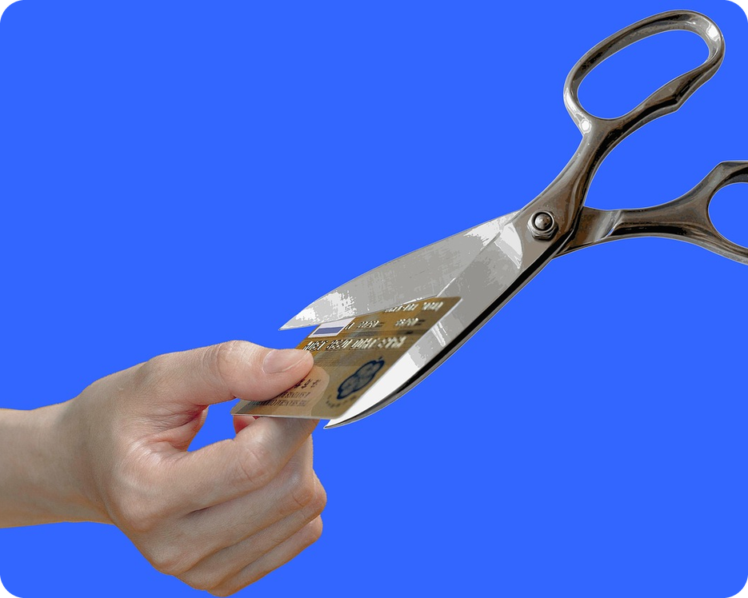


English File B1 · SB pp.16–17
💡 THINK · PENSA
2A-1
Spending money
Save it, spend it or waste it?
🎯
Today you're going to…
💬 talk about how you spend and save money
🔤 learn about 30 money words
🔊 say the letter o in five different ways
👀 read about a woman who spent nothing for a year
One year without spending money. Could YOU do it?
EXAMPLE No way! I love buying clothes – I couldn't stop for a year.
Notes:
1. OPENING (2 min)
Show the photo. Ask the THINK question; quick show of hands: yes / no / maybe for a month! Take 2–3 reasons (no coffee? no shopping? no pizza?). Read the 'Today you're going to…' list together. Optional lead-in from the TG (books closed): write SPEND on the board, elicit spend TIME + -ing (spend time doing) and spend MONEY ON something. Don't teach the money words yet.

Slide 2

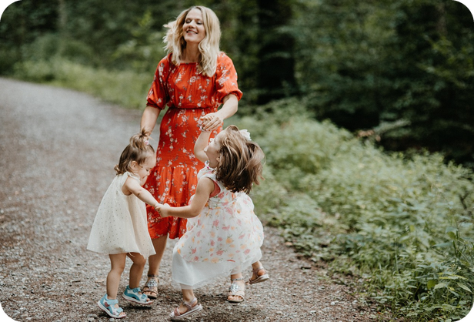
2
Remember last lesson?
💡 THINK PENSA
⏱ 2 min 🙋 whole class
What did we learn? Read the examples.
Cosa abbiamo imparato? Leggi gli esempi.
Birth order
Opposites: negative prefixes
The oldest child is often ambitious.
The middle child sorts out arguments.
The youngest is charming but disorganized.
→ oldest · middle · youngest · only child
He's so impatient! He can't wait.
She's unreliable – she's always late.
Telling lies is dishonest.
→ prefixes are never stressed: imPAtient
📅
Last lesson…
PE1: meeting the parents
1B: personality, birth order
🔤 KEY WORDS
responsible
anxious
sociable
independent
stubborn
charming
spoilt
2A-1 · Revision · last lesson
Notes:
2. Revision · last lesson (2 min)
REVISION (2 min) before the warmer game. Last lesson was the Practical English video; the warmer goes back to 1B part 2 (birth order article + personality adjectives), so revise those. Read the examples; ask 'Which child are YOU?' to one or two students. Drill the stress on the prefixes (imPAtient, unreLIable, disHONest). Then play 'Who am I?'.

Slide 3

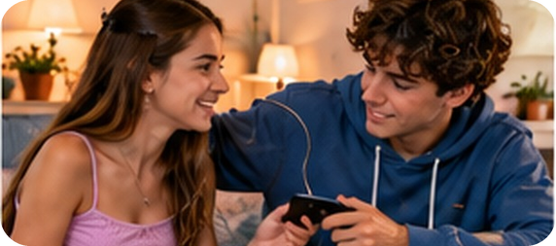
3
Who am I?
🎲 PLAY GIOCA
⏱ 3 min 🏆 teams
Read the clue. Who is it? What's the word?
Leggi l'indizio. Chi è? Qual è la parola?
🎲
How to play
1
"I'm responsible and ambitious, but a bit anxious."
→ the oldest child
Read the clue.
Teams: say the answer in 10 seconds.
Right = 1 point. Right stress = +1!
"I'm sociable. I sort out arguments."
→ the middle child
2
3
"I'm charming, but disorganized. I'm the baby!"
→ the youngest child
4
"I'm independent. I spend a lot of time with adults."
→ the only child
5
"She never changes her mind!"
→ She's STUBborn.
6
Opposites: patient · reliable · honest
→ imPAtient · unreLIable · disHONest
2A-1 · Warmer · last lesson · 📖 Recycles 1B part 2: birth order article, personality adjectives, negative prefixes
Notes:
3. Warmer · last lesson (3 min)
RETRIEVAL WARMER (4 min) · books closed · format: team clue quiz (different from the 1B-2 warmer). Two teams. Read each clue aloud; teams have 10 seconds to answer. Click once per line. Answers: 1 the oldest child · 2 the middle child · 3 the youngest child · 4 the only child (all from the birth order article, SB p.12) · 5 stubborn · 6 impatient, unreliable, dishonest. Bonus point for the right stress (prefixes are never stressed: imPAtient, unreLIable, disHONest). Fast extra: 'Which one are YOU? Give one adjective.' ICQ: 'Do you need to say the answer or write it?' (say it) · 'How long do you have?' (10 seconds).

Slide 4
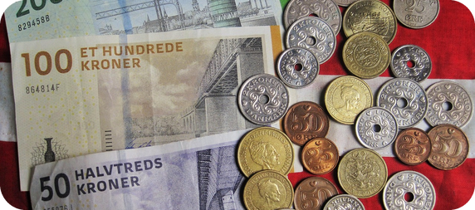
4
The money quiz
🎲 PLAY GIOCA
⏱ 3 min 🏆 teams
Which currency? True or false?
Quale valuta? Vero o falso?
🎲
How to play
1
Japan
→ the yen
Read the country or the sentence.
Teams: write the currency, or T / F.
Right = 1 point.
2
Mexico
→ the peso
3
Switzerland
→ the franc
4
Turkey
→ the lira
5
T or F? The Romans made the first coins.
→ F · the Lydians, about 600 BC (today's Turkey)
6
T or F? All EU countries use the euro.
→ F · e.g. Poland, Hungary, Czech Republic
7
T or F? The British pound is the oldest currency still in use.
→ T
2A-1 · Lead-in · the money quiz · 📖 SB p.16 · 1a The money quiz
Notes:
4. Lead-in · the money quiz (3 min)
LEAD-IN (3 min). Small teams (TG). Teams write their answers for all 7, then click once per line. Answers (TG key): Japan – the yen · Mexico – the peso · Switzerland – the franc · Turkey – the lira · F (the first coins were made around 600 BC by the Lydians of Asia Minor, present-day Turkey) · F (e.g. the Czech Republic, Hungary, Poland don't use the euro) · T. Show of hands: which team got everything right? If you have the book, the full quiz is on p.16 (coins 1–8: Russia rouble · China yuan · Japan yen · Poland zloty · Brazil real · Mexico peso · Switzerland franc · Hungary forint; France euro, Turkey lira; NB the TG's '2 China, lei' is a misprint — the coin says YI YUAN). Other true/false items in the book: b The largest English note is worth £50 (T) · c Bank notes are always made of paper (F – most UK notes are polymer, a plastic). ICQ: 'Do you shout or write?' (write).

Slide 5
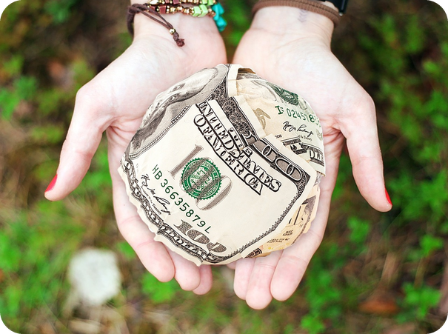
5
What's the difference?
💬 TALK PARLA
⏱ 4 min 👥 pairs
Explain the difference to your partner.
Spiega la differenza al compagno.
⭐
Example
1
earn / win
earn = from your job · win = in a game or the lottery
0 lend / borrow → lend = give · borrow = take
2
save / waste
save = keep for later · waste = spend badly, for nothing
3
cost / charge
It costs €200 (the price) · The mechanic charges me €100
4
owe / afford
owe = you must pay it back · can't afford = not enough money
5
inherit / invest
inherit = get money when someone dies · invest = put money in to make more
6
be worth / raise
My house is worth €200,000 · raise money for a hospital
2A-1 · Vocabulary · money verbs · 📖 Vocabulary Bank Money p.154 · 1 Verbs
Notes:
5. Vocabulary · money verbs (4 min)
ELICIT FIRST (4 min). Demo item 0 with the class: 'Can you lend me your pen? / Can I borrow your pen?' (TG). Pairs explain each pair of verbs in English, with an example if they can. Click once per item. Meanings follow the Vocabulary Bank / audio 2.1 sentences and the TG notes. Monitor: which verbs are new? ICQs: 'Are you writing?' (no, talking) · 'English or Italian?' (English). Next slide = Italian for slower students.

Slide 6

6
Money verbs in Italian
✅ CHECK CONTROLLA
⏱ 2 min 🙋 whole class
Say it in Italian. Then click!
Dillo in italiano. Poi clicca!
🤝
lend (to)
🙏
borrow (from)
💼
earn
🐷
save
prestare (a qualcuno)
prendere in prestito (da)
guadagnare (lavorando)
risparmiare
🗑️
waste
💳
can't afford
🧾
owe
🔧
charge
sprecare
non potersi permettere
dovere (soldi a qualcuno)
far pagare
📜
inherit
📈
invest (in)
🏠
be worth
❤️
raise money
ereditare
investire (in)
valere
raccogliere fondi
⚠ Watch out! prestare = lend OR borrow! · earn ≠ win (vincere) · charge ≠ caricare · spend ON
2A-1 · Vocabulary · in Italian
Notes:
6. Vocabulary · in Italian (2 min)
CONSOLIDATION for slower students (2 min). Class says the Italian aloud, then ONE click shows all the Italian. Spend 20 seconds on the warning box: Italian 'prestare' covers both lend and borrow; earn = guadagnare (work) ≠ win = vincere; charge = far pagare (not 'caricare' here). CCQ: 'I give you my book. Do I lend or borrow?' (lend) · 'You get €1,000 from your job. Do you earn or win it?' (earn).

Slide 7

7
Money verbs in action
🎧 LISTEN ASCOLTA
✏️ FILL THE GAPS COMPLETA
Guess the verb. Then listen and check.
⏱ 3 min 👥 pairs
Indovina il verbo. Poi ascolta e controlla.
🎧 2.1 · pause after each sentence
a I'm going to ___ £2,000.
inherit
b He has promised to ___ me €50.
lend
📷 2a1-inherit.jpg
c I need to ___ £20 from my mum.
borrow
d I can't ___ to buy that car.
afford
e The mechanic ___ me £100.
charges
f I ___ Jim £100.
owe
g I ___ £1,000 a month.
earn
💡
Guess first, then listen!
h My house is ___ about €200,000.
worth
🔈 click ▶
2A-1 · Vocabulary · practice · 📖 Vocabulary Bank Money p.154 · 1 Verbs · audio 2.1
Notes:
7. Vocabulary · practice (3 min)
CONTROLLED PRACTICE (3 min). Pairs guess the verbs first (books closed). Play 2.1 (13 sentences; the slide shows 8 of them), pausing after each one. Click once per sentence. Answers (audio script 2.1): a inherit · b lend · c borrow · d afford · e charges · f owe · g earn · h worth. The other 2.1 sentences: I save money every week · I often waste money · They cost $200 · I want to invest some money · We want to raise money for the new hospital. Drill with the audio (TG). EXTRA SUPPORT (TG): cover the answers and try to remember the sentences.

Slide 8
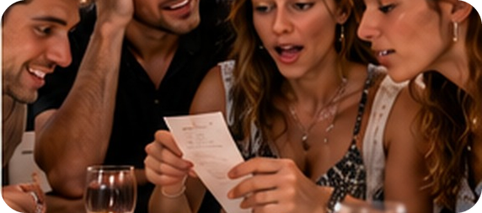
8
Preposition ping-pong
🎲 PLAY GIOCA
⏱ 4 min 👥 pairs
A reads. B says the preposition – fast!
A legge. B dice la preposizione – veloce!
🎲
How to play
1
Pay cash or ___ credit card?
→ by
A reads the sentence.
B says the preposition in 3 seconds!
Right = 1 point. Then swap.
2
I paid ___ the dinner.
→ for
3
I spent £50 ___ books.
→ on
4
He invested his money ___ property.
→ in
5
I don't lend money ___ friends.
→ to
6
I borrowed money ___ the bank.
→ from
7
I never get ___ debt /det/.
→ into
8
I took ___ €200 from a cash machine.
→ out
2A-1 · Vocabulary · prepositions · 📖 Vocabulary Bank Money p.154 · 2 Prepositions, 4 Phrasal verbs · audio 2.2, 2.4
Notes:
8. Vocabulary · prepositions (4 min)
GAME 2 (4 min). Pairs. Demo line 1 with a strong student. Round 1: A reads lines 1–4, B answers; round 2: swap for 5–8. Then click once per line to check. Sentences are shortened from audio 2.2 / 2.4. Answers: by · for · on · in · to · from · into · out. Silent b in debt /det/ (TG). Phrasal verbs (2.4, teach in 1 minute after the game): take out (money from a cash machine) · pay back (Can I pay you back next week?) — both separable: pay me the money back · live off = get your money from someone else (live off my parents at university) · live on = have enough for basic needs (difficult to live on one salary). Other 2.2 sentence: They charged us €60 FOR a bottle of wine. ICQ: 'How long does B have?' (3 seconds).

Slide 9
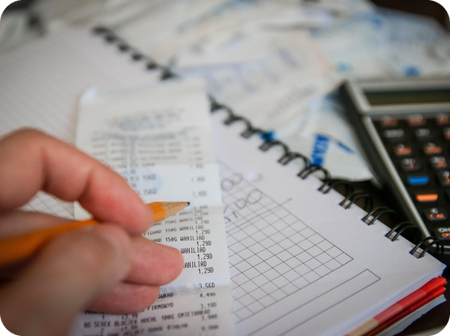
9
What's the word?
🤔 GUESS INDOVINA
⏱ 3 min 👥 pairs
Read the meaning. Say the word!
Leggi il significato. Di' la parola!
⭐
Example
1
you pay it for gas, phone…
a bill · bolletta / conto
0 money for the government → tax
2
money every month for your job
a salary · stipendio
3
money a bank or person lends you
a loan · prestito
4
a plan for how to spend money
a budget · budget, bilancio
5
a bank loan to buy a house
a mortgage /ˈmɔːɡɪdʒ/ · mutuo
6
pay by touching your card
contactless payment · pagamento contactless
7
it pays if you have an accident
insurance · assicurazione
2A-1 · Vocabulary · money nouns · 📖 Vocabulary Bank Money p.154 · 3 Nouns · audio 2.3
Notes:
9. Vocabulary · money nouns (3 min)
VOCABULARY (3 min). Pairs read each meaning and say the word (books closed; strong classes first, then the class). Click once per line: the word + the Italian. Answers = the eight nouns of Vocabulary Bank 3 (audio 2.3): bill · salary · tax · loan · budget · mortgage · contactless payment · insurance. TG: a loan = money lent by a person or a bank; a mortgage = only money from a bank to buy a house or flat. Pronunciation: mortgage /ˈmɔːɡɪdʒ/ – silent t. Personalised forced choice (no numbers needed): 'Which of these does your family pay every month?' Play 2.3 to drill if there's time.

Slide 10
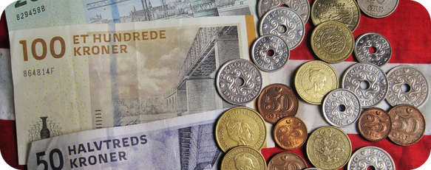
10
Five ways to say o
🔊 SAY IT PRONUNCIA
⏱ 4 min 👥 pairs
Say the word aloud. Which sound?
Di' la parola ad alta voce. Quale suono?
🏷️
The colours
money
up /ʌ/
borrow
clock /ɒ/
up /ʌ/
clock /ɒ/
clothes
phone /əʊ/
phone /əʊ/
or /ɔː/
work /ɜː/
worry
up /ʌ/
honest
clock /ɒ/
owe
phone /əʊ/
afford
or /ɔː/
worth
work /ɜː/
2A-1 · Pronunciation · o and or · 📖 SB p.16 · 2a–e · audio 2.5, 2.6
Notes:
10. Pronunciation · o and or (4 min)
PRONUNCIATION (4 min). 2a lead-in (30 sec): 'Three words that rhyme with money?' → sunny · funny · honey (TG). Elicit the sound pictures: up /ʌ/, clock /ɒ/, phone /əʊ/. Pairs say each word aloud and choose the colour; click once per word. Answers (audio 2.5 / 2.6): money /ʌ/ · borrow /ɒ/ · clothes /əʊ/ · worry /ʌ/ · honest /ɒ/ · owe /əʊ/ · afford /ɔː/ · worth /ɜː/. Full lists to drill (2.5): /ʌ/ done, money, nothing, some, won, worry · /ɒ/ borrow, cost, dollar, honest, promise, shopping · /əʊ/ clothes, loan, note, owe, sold. 2.6: afford, mortgage, order, organized, store = /ɔː/ (or is /ɔː/ when stressed); work, worth = /ɜː/ (most wor- + consonant: word, world, worse). Play 2.5 and 2.6: listen and repeat (chorally, then individually). Rules (TG): o between consonants often /ɒ/ (but worry) · o + consonant + e usually /əʊ/ (hope) but some, money = /ʌ/ · ol / oa = /əʊ/ (told, road). Italian speakers say every o the same — exaggerate the mouth shapes.

Slide 11
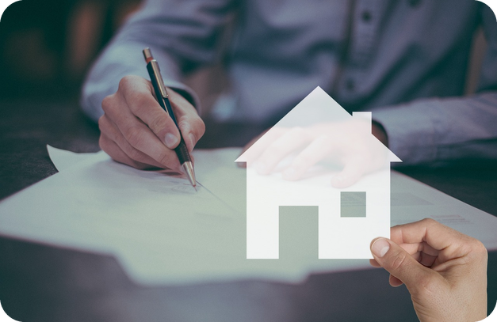
11
Listen and write
🎧 LISTEN ASCOLTA
✍️ WRITE SCRIVI
Listen. Write the missing words.
⏱ 3 min 👤 alone
Ascolta. Scrivi le parole mancanti.
🎧 2.7 · pause after each sentence
1 Let's go ___ for ___.
shopping · clothes
2 Can I ___ some ___?
borrow · money
3 He ___ a million ___.
won · dollars
4 I've ___ ___ wrong.
done · nothing
5 They can't ___ to pay the ___.
afford · mortgage
💡
Guess first, then listen!
6 I ___ in a ___.
work · store
🔈 click ▶
2A-1 · Pronunciation · dictation · 📖 SB p.16 · 2f · audio 2.7
Notes:
11. Pronunciation · dictation (3 min)
DICTATION (3 min). Students write only the missing o / or words (the book asks for full sentences – strong classes can write everything). Play 2.7, pausing after each sentence. Pairs compare; play again if needed. Click once per sentence. Answers (audio script 2.7): 1 Let's go shopping for clothes. · 2 Can I borrow some money? · 3 He won a million dollars. · 4 I've done nothing wrong. · 5 They can't afford to pay the mortgage. · 6 I work in a store. Then pairs practise saying them (EXTRA SUPPORT: model and drill first). Listen for won /wʌn/ (= one!), done /dʌn/, work /wɜːk/, afford /əˈfɔːd/. Micro-challenge: who can say sentence 5 three times fast?

Slide 12
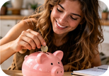
12
Money Q&A
💬 TALK PARLA
⏱ 5 min 👥 pairs
Ask and answer. Give details!
Chiedi e rispondi. Dai dettagli!
📷 2a1-cash-card.jpg
1
What do you usually spend your money on?
e.g. Clothes, and pizza with my friends at the weekend.
2
Do you prefer to pay cash or by card?
e.g. By card – contactless is so easy!
3
Do you ever lend money to friends? Do they pay you back?
e.g. Sometimes. My best friend always pays me back.
4
Are you saving for something at the moment?
e.g. Yes, I'm saving for a new phone.
💬
Useful phrases
5
What's the last thing you wasted money on?
e.g. A T-shirt – I never wear it!
It depends…
Not really, because…
I'd rather not say.
6
What's something you really want but can't afford?
e.g. A scooter! They're so expensive.
2A-1 · Speaking · money and you · 📖 SB p.16 · 2g (in the book: Communication Money Q&A pp.106 / 111)
Notes:
12. Speaking · money and you (5 min)
SPEAKING (5 min). Replaces the book's Communication Money Q&A (pp.106 / 111 are not in our files – if you prefer the book's questions, use them instead). Questions appear ONE PER CLICK: about 45 seconds each, then click. Follow-up rule: after every answer, ask one more question (Why? How much? What happened?). Nobody has to talk about how much they or their family earn or have: teach 'I'd rather not say' first. Monitor for the target words and prepositions (spend ON, pay BY card, lend TO, borrow FROM) and note 4–5 errors for delayed correction. Feedback: the most surprising answer from each pair. ICQ: 'One question or many at once?' (one).

Slide 13
13
Guess the numbers
👀 READ LEGGI
🤔 GUESS INDOVINA
Read. What are the numbers about?
⏱ 2 min 👥 pairs
Leggi. Di cosa parlano i numeri?
📷 2a1-cycle-holiday.jpg
A no-spend year
One woman's 'no-spend year', and how she survived. She cycled 120 miles to a wedding, and her lunch budget was just 51p a day.
🔢 NUMBER BANK · guess where they go!
£230k
£1,570
£30
60
£1.95
6,500
£23k
2A-1 · Reading · prediction · 📖 SB p.17 · 3a
Notes:
13. Reading · prediction (2 min)
PREDICTION (2 min). 3a (whole class): 'Why do you think someone might decide to have a no-spend year?' Take 2–3 ideas (to save for a house, to pay a loan…). Then pairs look at the number bank and guess what each number is (any sensible guess – wild guesses are fun). They check on the next four slides: the numbers are gaps 1–7 in the article (£230k = £230,000, £23k = £23,000). Pre-teach only 'cycle' and 'budget' if needed (budget was taught on slide 8). ICQ: 'Are you reading the article now?' (no – just guessing).

Slide 14
14
Read and check
👀 READ LEGGI
⏱ 3 min 👥 pairs
Read. Which number goes in each gap?
Leggi. Quale numero va in ogni spazio?
A · The plan
A Michelle McGagh, a 34-year-old journalist, had a mortgage of (1) _____ which she wanted to reduce.
A Michelle McGagh, a 34-year-old journalist, had a mortgage of £230,000 which she wanted to reduce.
📷 2a1-budget.jpg
Last November, she looked at her finances and she discovered that every year she spent a lot of money unnecessarily –
for example, (2) _____ in the pub, £1,110 in restaurants, and £400 on coffees. So she made a radical plan – to stop spending money for a year.
for example, £1,570 in the pub, £1,110 in restaurants, and £400 on coffees. So she made a radical plan – to stop spending money for a year.
She continued to pay her broadband, gas, and electricity bills, and allowed herself (3) _____ a week to buy food and household essentials.
She continued to pay her broadband, gas, and electricity bills, and allowed herself £30 a week to buy food and household essentials.
💡
Remember
But she couldn't spend money on anything else – no clothes, no buses or flights, no meals out, no drinks, and no cosmetics.
reduce = ridurre
household essentials = cose di casa
2A-1 · Reading · paragraph A · 📖 SB p.17 · article paragraph A
Notes:
14. Reading · paragraph A (3 min)
READ FOR SPECIFIC INFORMATION (3 min). Pairs read paragraph A and decide which number from the bank goes in gaps 1–3. Click once per gap: the number appears highlighted IN the text. Answers (SB article): 1 £230,000 (her mortgage – the bank showed it as £230k) · 2 £1,570 (in the pub) · 3 £30 (a week for food and household essentials). Ask: 'Was your guess right?' Check: finances, unnecessarily, radical. 'What couldn't she spend money on?' (clothes, buses or flights, meals out, drinks, cosmetics).

Slide 15
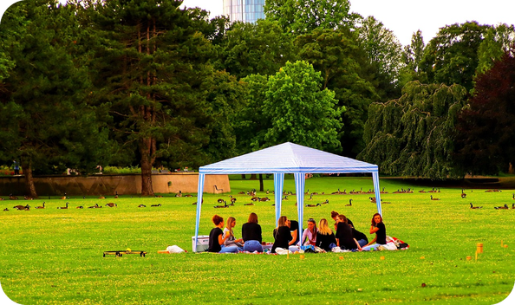
15
Read and check
👀 READ LEGGI
⏱ 2 min 👥 pairs
Read. Which number goes in the gap?
Leggi. Quale numero va nello spazio?
B · At home C · Friends
B She cooked large quantities of curry and bolognese sauce, which lasted her a week, and which she ate with rice or pasta. It was cheap and healthy, but also 'really boring'.
She also experimented with home-made cleaning products and beauty treatments, like using vinegar for cleaning or olive oil as moisturiser, but she decided that most of them didn't really work.
C At first, she tried to see her friends as often as before. She cycled 120 miles to be at a friend's wedding, and camped in their garden to avoid paying for accommodation.
The following weekend, she rode (4) _____ miles to Brighton to meet friends. But she couldn't join them for dinner in a restaurant, and when they went to the pub, she drank tap water.
The following weekend, she rode 60 miles to Brighton to meet friends. But she couldn't join them for dinner in a restaurant, and when they went to the pub, she drank tap water.
💡
Remember
In the end, she simply went out less, which made her feel more isolated.
camp = dormire in tenda
isolated = isolata
2A-1 · Reading · paragraphs B–C · 📖 SB p.17 · article paragraphs B–C
Notes:
15. Reading · paragraphs B–C (2 min)
READ FOR SPECIFIC INFORMATION (2 min). Same procedure: gap 4, one click. Answer (SB article): 4 60 (miles to Brighton). Quick questions: 'Was her food good?' (cheap and healthy, but 'really boring') · 'How did she feel when she went out less?' (more isolated) · 'Would you drink tap water in a pub with your friends?'

Slide 16
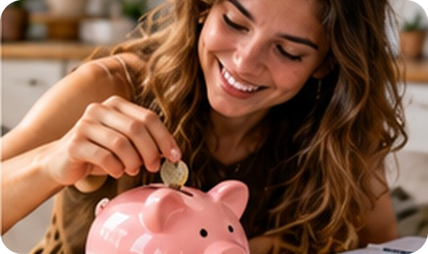
16
Read and check
👀 READ LEGGI
⏱ 2 min 👥 pairs
Read. Which number goes in each gap?
Leggi. Quale numero va in ogni spazio?
D · Holidays E · The result
D Of course, she couldn't afford to go abroad, so she missed a trip to Ibiza with friends. Her only holiday was a cycling trip to East Anglia, where again she camped.
Here, for the first and only time in the year, she bought food that she had not cooked herself – a bag of chips for (5) _____ .
Here, for the first and only time in the year, she bought food that she had not cooked herself – a bag of chips for £1.95.
E At the end of the year, she had saved (6) _____ .
E At the end of the year, she had saved £23,000.
She was much slimmer and fitter – over the year, she had cycled (7) _____ miles. She says she now feels freer and happier, because she appreciates the simple things in life.
She was much slimmer and fitter – over the year, she had cycled 6,500 miles. She says she now feels freer and happier, because she appreciates the simple things in life.
💡
Remember
She also gained confidence and a sense of adventure.
slimmer and fitter = più magra e in forma
gain confidence = acquistare sicurezza
2A-1 · Reading · paragraphs D–E · 📖 SB p.17 · article paragraphs D–E
Notes:
16. Reading · paragraphs D–E (2 min)
READ FOR SPECIFIC INFORMATION (2 min). Gaps 5–7, click once per gap. Answers (SB article): 5 £1.95 (a bag of chips) · 6 £23,000 (she saved – the bank showed it as £23k) · 7 6,500 (miles she cycled). Quick question: 'What were the good things about the year?' (£23,000, slimmer and fitter, freer and happier, confidence, a sense of adventure).

Slide 17
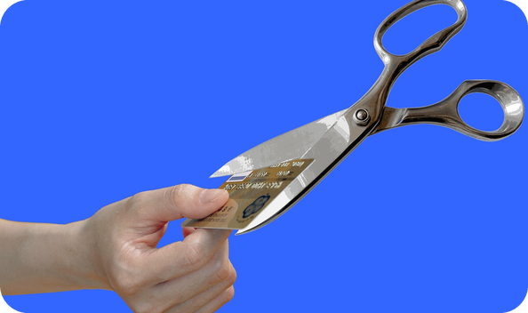
17
Michelle's key tip
👀 READ LEGGI
🤔 GUESS INDOVINA
Read. Guess a–c: need or want?
⏱ 2 min 👥 pairs
Leggi. Indovina a–c: need o want?
F · After the year G · Her key tip
F But she learned the hard way that you can't really socialize if you don't want to spend money.
The evening after her year-long challenge ended, she bought all her friends a drink in the pub.
But she has not gone back to her past spending habits. She occasionally pays to socialize and go on holiday. She has even taken a taxi.
But after buying a few new clothes and some perfume, she insists, 'I have absolutely no interest in buying anything else.'
G So what's her key tip for those who want to save?
'Whenever you open your wallet, think about whether what you are buying is something you (a) _____ or something you (b) _____ .
'Whenever you open your wallet, think about whether what you are buying is something you need or something you want.
💡
Remember
We all say, "I need to buy this." Most of the time, we (c) _____ to buy it.
We all say, "I need to buy this." Most of the time, we want to buy it.
Maybe we don't know the difference between needing something and wanting something any more.'
the hard way = a sue spese
need = avere bisogno · want = volere
2A-1 · Reading · paragraphs F–G · 📖 SB p.17 · article paragraphs F–G
Notes:
17. Reading · paragraphs F–G (2 min)
READ AND GUESS (2 min). Pairs read F and G and guess need or want for a–c (the meaning makes it clear). Click 1 = a + b together, click 2 = c. Answers (SB article): a need · b want · c want. Quick questions on F: 'What did she do on the first evening after the year?' (bought all her friends a drink) · 'Is she spending a lot again now?' (no – a few clothes, some perfume, a taxi). Her key tip leads into the final speaking task (slide 19).

Slide 18
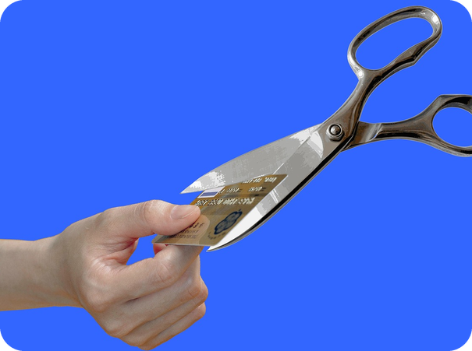
18
True or false?
👀 READ LEGGI
✅ CHECK CONTROLLA
Read again. True or false? Why?
⏱ 3 min 👥 pairs
Rileggi. Vero o falso? Perché?
⭐
Example
1
She could use public transport.
F · 'no buses or flights' (A)
0 She was a teacher. → F · 'a 34-year-old journalist' (A)
2
She was often hungry.
F · cheap and healthy, but 'really boring' (B)
3
At the wedding, she slept in a tent.
T · 'camped in their garden' (C)
4
She never had ready-made food.
F · a bag of chips for £1.95 (D)
5
She didn't lose any weight.
F · 'much slimmer and fitter' (E)
6
Now she spends less than she used to.
T · 'not gone back to her past spending habits' (F)
7
When we buy, we should ask ourselves why.
T · need or want? (G)
2A-1 · Reading · detail · 📖 SB p.17 · 3c, 3d
Notes:
18. Reading · detail (3 min)
READ FOR DETAIL (3 min). The 7 sentences are the book's 3c, slightly shortened (one per paragraph – TG). Pairs decide T or F and find the words that prove it (go back to slides 13–16 if needed). Correct the false ones. Click once per sentence: the evidence from the text appears. Answers (TG key): 1 F (She couldn't use buses or flights) · 2 F (She had plenty of cheap food, but it was boring) · 3 T · 4 F (She had a bag of chips in East Anglia) · 5 F (She is much slimmer and fitter) · 6 T · 7 T. 3d (30 sec, whole class): 'Do you agree with her key tip? Why (not)?'

Slide 19
19
Two nouns together
🔍 FIND TROVA
⏱ 2 min 👥 pairs
Find the second word in the text.
Trova la seconda parola nel testo.
⭐
Example
1
olive…
olive oil (B) · olio d'oliva
0 cash + ? → cash machine (say: CASH machine)
2
electricity…
electricity bill (A) · bolletta della luce
3
cleaning…
cleaning products (B) · detersivi
📷 2a1-budget.jpg
4
cycling…
cycling trip (D) · viaggio in bici
5
beauty…
beauty treatments (B) · trattamenti di bellezza
6
tap…
tap water (C) · acqua del rubinetto
2A-1 · Reading · compound nouns · 📖 SB p.17 · 3e Compound nouns
Notes:
19. Reading · compound nouns (2 min)
VOCABULARY FROM THE TEXT (2 min). Compound nouns box (SB): two nouns together, the first describes the second (e.g. cash machine); the stress is usually on the FIRST noun. Pairs find the six compound nouns in the article (slides 13–15). Click once per word. Answers (TG): olive oil · electricity bill · cleaning products · cycling trip · beauty treatments · tap water. Drill with first-word stress: OLive oil, eLECtricity bill, CLEANing products. Italian puts the words the other way round (olio d'oliva) – English: describing word FIRST.

Slide 20
20
Could YOU do it?
💬 TALK PARLA
⏱ 5 min 👨‍👩‍👧 groups
Imagine! Answer with I'd… or I wouldn't…
Immagina! Rispondi con I'd… o I wouldn't…
📷 2a1-need-want.jpg
1
What would you spend less on?
e.g. I'd spend less on clothes and coffee.
2
What would you eat?
e.g. I'd cook pasta at home every day!
3
How would you get around?
e.g. I'd walk or cycle everywhere.
4
How would you socialize cheaply?
e.g. I'd invite my friends home for a pizza.
💬
Useful phrases
5
Your phone, coffee, new trainers: need it or want it?
e.g. I need my phone, but I just want new trainers.
To save money, I'd (= I would)…
I wouldn't…
I'd find it hard to…
6
Could you really do a no-spend year? Why (not)?
e.g. No way! I'd miss going out with my friends.
2A-1 · Speaking · could you do it? · 📖 SB p.17 · 3f · would for imaginary situations
Notes:
20. Speaking · could you do it? (5 min)
FREER PRACTICE (5 min). First (1 min) go through the SB box 'would for imaginary situations': We use would to talk about imaginary situations, e.g. To save money, I'd spend less on clothes and I'd cook for myself at home. CCQ: 'Am I doing a no-spend year now?' (no – I'm imagining it). Groups of 3. Questions appear ONE PER CLICK (questions 1–4 are the book's 3f; 5–6 added): about 45 seconds each. You could tell the class whether YOU could do what Michelle did (TG). Monitor; then 1–2 minutes of delayed error correction on the board (errors from both speaking tasks: spend for → spend ON, I would to… → I'd…, lend/borrow).

Slide 21
21
3 · 2 · 1
⏱ 2 min 👥 pairs
Books closed! What can you remember?
Libri chiusi! Cosa ricordi?
3
money verbs + their preposition (spend… ON)
📝
Homework · Compiti
Workbook 2A: 1a–1f, 2a, 2b (audio: Online Practice), 2c
Vocabulary Bank Money p.154: cover and test yourself
Homework sheet in the LLS app
2
words where o sounds different (money / borrow)
1
sentence: "To save money, I'd…"
Next lesson: 2A part 2 · present perfect or past simple? · scams
2A-1 · Exit · what can you remember?
Notes:
21. Exit · what can you remember? (2 min)
RETRIEVAL EXIT (2 min). Books closed. Pairs: 3 money verbs with their preposition (e.g. spend ON, borrow FROM, lend TO, pay BY card, invest IN), 2 words with a different o sound, 1 sentence with I'd. A few students share. Set homework (on the slide and in the app; easier sheet available). Answers to the Workbook are in the teacher key.

Slide 22
22
Which paragraph?
🔗 MATCH ABBINA
⏱ 3 min 👥 pairs
Read the article. Match A–G to the topics.
Leggi l'articolo. Abbina A–G agli argomenti.
⭐
Example
1
why she decided to save money
A
0 where she went on holiday → D
2
how often she saw her friends
C
3
what she achieved
E
📷 2a1-cycle-holiday.jpg
4
her advice for other people
G
5
how she saved money at home
B
6
what she discovered
F
2A-1 · Reading · paragraphs · 📖 SB p.17 · 3b
EXTRA · if there's time
Notes:
22. Reading · paragraphs (3 min)
EXTRA (3 min, if there's time – or use it as the gist task BEFORE the gap slides with a strong class). Book 3b: match paragraphs A–G to topics 1–7 (the topic words in bold in the book: on holiday, why, friends, achieved, advice, at home, discovered). Click once per topic. Answers (TG key A 2 · B 6 · C 3 · D 1 · E 4 · F 7 · G 5): 1 where she went on holiday D · 2 why she decided to save money A · 3 how often she saw her friends C · 4 what she achieved E · 5 her advice G · 6 how she saved money at home B · 7 what she discovered F.

Slide 23
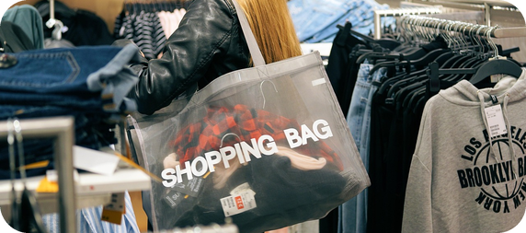
23
Describe it!
🎲 PLAY GIOCA
⏱ 4 min 👥 pairs
Explain the word. Don't say it!
Spiega la parola. Non dirla!
🎲
How to play
ROUND 1 · A explains
ROUND 2 · B explains
A looks at the screen. B turns around.
A explains the word. Don't say 'money'!
B guesses. Then swap.
mortgage
bill
salary
waste
inherit
insurance
borrow
can't afford
2A-1 · Vocabulary game
EXTRA · if there's time
Notes:
23. Vocabulary game (4 min)
EXTRA GAME (4 min) – or a warmer for 2A part 2. Demo first: 'You get it every month from your job' → salary. Click to show each word (round 1 = A explains to B, round 2 = B explains, A turns around). 20 seconds per word. Rule: the word 'money' is banned! ICQ: 'Can you say the word?' (no) · 'Can you say money?' (no).

