Slide 1




English File B1 · SB pp.18–19
💡 THINK · PENSA
2A-2
Spending money
📷 2a2-cover.jpg
Money experiences and scams
🎯
Today you're going to…
💬 ask and answer about money experiences
✏️ choose: present perfect or past simple?
👀 find the mistakes in a scam email
🎧 listen to three true scam stories
New shoes again! A good idea or a waste of money?
EXAMPLE A waste of money – I've already got five pairs!
Notes:
1. OPENING (2 min)
OPENING (2 min). Show the photo: a woman showing her partner her new shoes. Ask the THINK question (it recycles 'waste' from last lesson): take 3–4 quick opinions (show of hands: good idea / waste of money). Ask: 'What is HE thinking?' (e.g. How much did they cost?!) – accept anything, don't correct tenses yet. Read the 'Today you're going to…' list together. Don't teach the grammar yet.

Slide 2

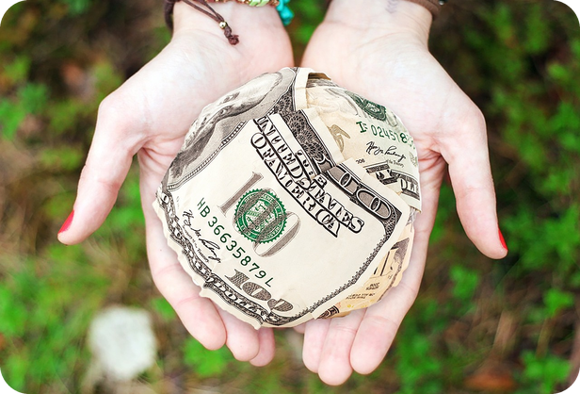
2
Remember last lesson?
💡 THINK PENSA
⏱ 2 min 🙋 whole class
What did we learn? Read the examples.
Cosa abbiamo imparato? Leggi gli esempi.
Money verbs
Prepositions + would
Can you lend me €10, please?
Can I borrow €10 from you?
She earns €1,500 a month.
→ earn = from work · win = the lottery
I spent €50 on books last month.
Can I pay by credit card?
To save money, I'd cook at home.
→ spend ON · pay BY · be worth €…
📅
Last lesson…
2A: spending money
money verbs · prepositions · would
🔤 KEY WORDS
lend
borrow
earn
win
owe
afford
be worth
waste
2A-2 · Revision · last lesson
Notes:
2. Revision · last lesson (2 min)
REVISION (2 min) before the warmer game. Read the examples with the class; CCQ: 'lend – give or take?' (give) · 'borrow?' (take). Point at the prepositions (spend ON, pay BY) and 'My house is worth…' (no verb 'values'). Remind them: would = imaginary situations ('I'd cook at home'). Then play 'Fix it!' – every mistake in the game is one of these points.

Slide 3


3
Fix it!
🎲 PLAY GIOCA
🔁 CHANGE THE WORD CAMBIA
Find the mistake. Say it correctly!
⏱ 4 min 🏆 teams
Trova l'errore. Dillo correttamente!
🎲
How to play
1
"Can you borrow me €10, please?"
→ Can you LEND me €10, please?
Read the sentence. There's ONE mistake.
Teams: say it correctly – 15 seconds!
Correct sentence = 1 point.
"I spent €50 for books last month."
→ I spent €50 ON books last month.
2
3
"She wins €1,500 a month as a nurse."
→ She EARNS €1,500 a month as a nurse.
4
"Can I pay with credit card?"
→ Can I pay BY credit card?
5
"My house values about €200,000."
→ My house IS WORTH about €200,000.
6
"To save money, I will cook at home." (imaginary)
→ I'D (would) cook at home.
2A-2 · Warmer · last lesson · 📖 Recycles 2A part 1: money verbs, prepositions, would (Vocabulary Bank Money p.154)
Notes:
3. Warmer · last lesson (4 min)
RETRIEVAL WARMER (5 min) – a different format from last lesson's warmer: correct the mistake. Books closed. Two teams. Show one sentence at a time (read it aloud), teams have 15 seconds to say it correctly; click to show the answer. 1 point for the correct sentence, +1 bonus if they can say WHY (e.g. lend = give, borrow = take). Answers: 1 lend (lend = prestare a qualcuno; borrow = prendere in prestito) · 2 spend money ON something (audio 2.2) · 3 earn = from work, win = lottery · 4 pay BY credit card, pay cash (audio 2.2) · 5 be worth (audio 2.1: 'My house is worth…') · 6 would for imaginary situations (3f box: 'To save money, I'd spend less on clothes and I'd cook for myself at home'). Drill worth /wɜːθ/ and won /wʌn/ (o and or from last lesson). ICQ: 'How many mistakes in each sentence?' (one).

Slide 4
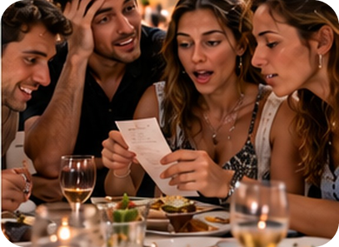

4
New shoes!
🎧 LISTEN ASCOLTA
⏱ 2 min 👤 alone
Listen. What are they arguing about?
Ascolta. Su cosa litigano?
🎧 2.8 · books closed · play once
↘ speaker bottom right
A
B
C
📷 2a2-cover.jpg
📷 2a2-receipt.jpg
Arguing about…?
money!
Kate bought…
new shoes
David bought…
a new iPad
🎧
While you listen
Look at A–C. What are they thinking?
Listen. What are they arguing about?
This morning?
the phone bill arrived
🔈 click ▶
2A-2 · Grammar · the conversation · gist · 📖 SB p.18 · 4a · audio 2.8
Notes:
4. Grammar · the conversation · gist (2 min)
GIST (2 min). Books closed. Look at the photos: husband and wife or boyfriend and girlfriend (TG). The SB thought bubbles: 'More new shoes?' (him) / 'He'll never notice my new shoes.' (her). Play 2.8 ONCE. Pairs compare. Click once per line. Photo C (a shocked look at a bill) = the phone bill that arrived this morning. Answers (audio script 2.8): they're arguing about money – Kate's new shoes (£99.99) and the iPad David bought last week. Quick vote: 'Who's right, David or Kate?' (show of hands – no right answer!). ICQ: 'Do you need every word?' (no – just the topic).

Slide 5

5
Have you seen this?
👀 READ LEGGI
✏️ FILL THE GAPS COMPLETA
Complete the verbs. Then listen and check.
⏱ 4 min 👥 pairs
Completa i verbi. Poi ascolta e controlla.
David and Kate
🎧 2.8
D: I haven't seen (see) those shoes before. Are they new?
K: Yes. I (2) _____ (just buy) them. Do you like them?
K: Yes. I 've just bought (just buy) them. Do you like them?
📷 2a2-receipt.jpg
D: They're OK. How much (3) _____ (cost)?
D: They're OK. How much did they cost (cost)?
K: Oh, not much. They (4) _____ (be) a bargain. Under £100.
K: Oh, not much. They were (be) a bargain. Under £100.
D: You mean £99.99! … (5) _____ (see) this?
D: You mean £99.99! … Have you seen (see) this?
D: Our phone bill. It (6) _____ (arrive) this morning.
D: Our phone bill. It arrived (arrive) this morning.
D: And we (7) _____ (not pay) the house insurance yet.
D: And we haven't paid (not pay) the house insurance yet.
K: Well, what about the iPad you (8) _____ (buy) last week?
K: Well, what about the iPad you bought (buy) last week?
K: You (9) _____ (not need) a new one.
K: You didn't need (not need) a new one.
💡
Remember
K: The old one (10) _____ (work) perfectly well.
K: The old one worked (work) perfectly well.
D: But I (11) _____ (need) the new model.
D: But I needed (need) the new model.
bargain = affare
phone bill = bolletta
K: Well, I (12) _____ (need) some new shoes.
K: Well, I needed (need) some new shoes.
🔈 click ▶
2A-2 · Grammar · the conversation · detail · 📖 SB p.18 · 4b · audio 2.8 (conversation shortened)
Notes:
5. Grammar · the conversation · detail (4 min)
DETAIL + NOTICING (4 min). Line 1 is the example (haven't seen). Pairs complete the verbs in the present perfect or past simple (in the book or on paper) – 2 minutes. Play 2.8 again to check. Click once per line: the answers appear highlighted IN the conversation. Answers (TG key 4b): 2 've just bought · 3 did … cost · 4 were · 5 Have … seen · 6 arrived · 7 haven't paid · 8 bought · 9 didn't need · 10 worked · 11 needed · 12 needed. Click once per gap (11 clicks). The conversation on the slide is slightly shortened (cut: 'That isn't cheap for a pair of shoes. Anyway, we can't afford to buy new clothes at the moment.' / 'Why not?' / 'No. What is it?' / 'What about it?'); answers unchanged. Then pairs read the conversation aloud (one is David, one is Kate). Don't explain the rule yet – that's the next slide.

Slide 6
6
When? Or no time?
🔗 MATCH ABBINA
⏱ 3 min 👥 pairs
Why this tense? Match the colour.
Perché questo tempo? Abbina il colore.
🏷️
The colours
a I've just bought them.
PP · just / yet
PS · when?
PP · no time
b How much did they cost?
PS · when?
PP · just / yet
c I haven't seen those shoes before.
PP · no time
d It arrived this morning.
PS · when?
e We haven't paid the insurance yet.
PP · just / yet
📷 2a2-cover.jpg
f …the iPad you bought last week.
PS · when?
2A-2 · Grammar · guided discovery · 📖 SB p.18 · 4c
Notes:
6. Grammar · guided discovery (3 min)
GUIDED DISCOVERY (3 min). Explain the colours first: PINK = past simple, we know WHEN (a finished time); BLUE = present perfect, no time is said; GREEN = present perfect with just, yet or already. Pairs decide for a–f. Click once per sentence. Answers: a green (just) · b pink (she bought them today – we know when) · c blue (no time – 'in my life until now') · d pink (this morning) · e green (yet) · f pink (last week). Then ask the SB 4c questions (answers TG): 'Which tense for a completed action in the past?' (PS) · 'For recent actions when we don't say exactly when?' (PP) · 'In sentences with just, yet and already?' (PP). CCQ for b: 'Do we know when she bought the shoes?' (yes – today) → past simple.

Slide 7
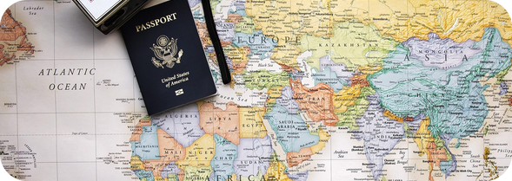
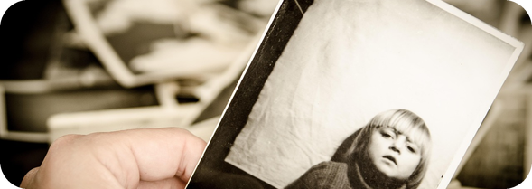
7
Ever? Or when?
👀 LOOK GUARDA
⏱ 4 min 🙋 whole class
Read. Which tense? Why?
Leggi. Quale tempo? Perché?
present perfect
present perfect
past simple
📷 2a2-cover.jpg
your life until now · NO time (ever / never)
news · just / yet / already
WHEN? a finished time
Have you ever lost your credit card?
Sally has never met Bill's ex-wife.
Too late! Our train has just left!
I've already seen this film twice.
Have you finished your homework yet?
They got married last year.
I've been to Madrid twice. I went there in 1998.
esperienze · senza dire quando
appena · già · non ancora
ieri · fa · lo scorso… · When…?
⚠ ✗ I've bought them yesterday → ✓ I bought them yesterday · ✗ When have you arrived? → ✓ When did you arrive?
2A-2 · Grammar · the rule · 📖 Grammar Bank 2A p.134 · audio 2.9, 2.10, 2.11
Notes:
7. Grammar · the rule (4 min)
RULE (4 min). Click once per column: the examples appear (meaning first). All examples are from audio 2.9, 2.10 and 2.11 (🎧 play them from the book audio – Grammar Bank 2A) – play them for students to listen and repeat (copy the rhythm). Rules (TG): present perfect = a past action when NO specific time is mentioned or understood (experiences: ever / never); very recent actions, often with just, to give news; yet (questions and negatives, at the end), already (positive, before the main verb). Past simple = a specific time is mentioned or understood – so When…? and What time…? questions are past simple. Column 3, last example (2.11): we start with the present perfect (experience), then change to the past simple when we say WHEN. Last click = the Italian-speaker warning: the passato prossimo is NOT the present perfect ('Ho comprato le scarpe ieri' = I bought the shoes yesterday). Also on the slide: What time did you wake up this morning? (2.10) can be added orally. CCQs: 'Have you ever lost your credit card? – Do I want to know when?' (no – in your life) · 'They got married last year – finished time?' (yes) → past simple. Irregular verbs list p.165.

Slide 8
8
Right or wrong?
🔁 CHANGE THE WORD CAMBIA
✅ CHECK CONTROLLA
Right or wrong? Correct the mistakes.
⏱ 3 min 👥 pairs
Giusto o sbagliato? Correggi gli errori.
⭐
Example
1
Did you ever book a flight online?
✗ Have you ever booked a flight online?
0 I've seen that film yesterday. → ✗ I saw that film yesterday. (yesterday = finished time)
2
We just won the lottery!
✗ We've just won the lottery!
3
When have you bought that jacket?
✗ When did you buy that jacket?
📷 2a2-booking.jpg
4
They finished paying back the loan last month.
✓ last month = finished time
5
I haven't borrowed money from you last week.
✗ I didn't borrow any money from you last week.
6
Has your sister paid you back yet?
✓ yet → present perfect
2A-2 · Grammar · controlled practice · 📖 Grammar Bank 2A p.134 · a and b (adapted)
Notes:
8. Grammar · controlled practice (3 min)
CONTROLLED PRACTICE (3 min). Do 0 with the class. Pairs say right or wrong and correct the wrong ones – say WHY (the time word!). Click once per sentence. Answers: 1 ✗ Have you ever booked a flight online? · 2 ✗ We've just won the lottery! · 3 ✗ When did you buy that (leather) jacket? · 4 ✓ · 5 ✗ I didn't borrow any money from you last week · 6 ✓. The CORRECT sentences are from the Grammar Bank 2A key (a 1, a 6, b 2, b 4, b 5, b 8); the wrong versions are written for this slide, so the exercise is not the book's wording – the book's Grammar Bank exercises a 5–8 and b 6–10 are homework. ICQ: 'Do you only say right or wrong?' (no – correct it and say why).

Slide 9

9
Build it fast!
🎲 PLAY GIOCA
⏱ 3 min 🏆 teams
Make the sentence. Right tense = point!
Fai la frase. Tempo giusto = punto!
🎲
How to play
1
I / lose / my phone / yesterday
→ I lost my phone yesterday.
Read the words.
Teams: make a sentence – 15 seconds!
Right tense = 1 point.
I / just / lose / my phone!
→ I've just lost my phone!
2
3
you / pay / the bill / yet?
→ Have you paid the bill yet?
4
you / ever / win / a prize?
→ Have you ever won a prize?
5
when / you / buy / those shoes?
→ When did you buy those shoes?
6
I / never / borrow / money from a bank
→ I've never borrowed money from a bank.
2A-2 · Grammar game
Notes:
9. Grammar game (3 min)
GAME 2 (3 min). Two teams, mini-whiteboards or paper. Show the words, 15 seconds, then 'Show me!' Click to show the model answer. 1 point for the right tense, +1 for a perfect sentence (spelling of the participle!). Teaching point: lines 1 and 2 – same verb, different tense (yesterday vs just). Drill won /wʌn/ and bought /bɔːt/. ICQ: 'Can you change the order of the words?' (yes – make a correct sentence).

Slide 10
10
Verb ping-pong
🎲 PLAY GIOCA
🔊 SAY IT PRONUNCIA
Say the past simple and the participle!
⏱ 3 min 🏆 teams
Di' il past simple e il participio!
🎲
How to play
1
save
→ saved · saved /seɪvd/
Team A says the verb.
Team B says the past simple AND the participle.
Right = 1 point. Then swap.
2
lend
→ lent · lent
3
waste
→ wasted · wasted /ˈweɪstɪd/
4
buy
→ bought · bought /bɔːt/
5
lose
→ lost · lost
6
win
→ won · won /wʌn/
TEAM A ☆☆☆☆☆
TEAM B ☆☆☆☆☆
7
forget
→ forgot · forgotten
8
take out · sell
→ took out · taken out · sold · sold
2A-2 · Speaking prep · irregular verbs · 📖 SB p.18 · 5a verbs · Irregular verbs p.165
Notes:
10. Speaking prep · irregular verbs (3 min)
GAME 3 (3 min). These are the bold verbs in the SB 5a questionnaire. Teams take turns: the teacher (or Team A) says the verb, the other team says past simple + past participle. Click to check each one. Answers (TG 5a + Irregular verbs p.165): saved · lent · wasted · bought · inherited (regular) · lost · won · forgotten · taken out · bought, sold. Pronunciation (TG): saved /seɪvd/ (one syllable), wasted /ˈweɪstɪd/ and inherited /ɪnˈherɪtɪd/ (extra syllable after t and d) – ITALIAN SPEAKERS often say 'sav-ed'. won /wʌn/ = one (o and or, last lesson!). This prepares the questionnaire on the next slide.

Slide 11

11
Have you ever…? One lie!
💬 TALK PARLA
⏱ 7 min 👥 pairs
Ask Have you ever…? One 'yes' is a lie!
Chiedi Have you ever…? Un 'sì' è una bugia!
📷 2a2-found-money.jpg
1
Have you ever saved for something for a long time?
e.g. Yes, I saved for six months to pay the deposit on my car. – How much was it?
2
Have you ever lent money to somebody who didn't pay you back?
e.g. No, I haven't. But my brother lent me some money last week…
3
Have you ever wasted money on something you've never used?
e.g. Yes! I bought a guitar two years ago. I've never played it!
4
Have you ever lost your wallet or purse?
e.g. Yes, I have. I lost it on the bus last summer.
💬
Useful phrases
5
Have you ever won any money (e.g. in a lottery)?
e.g. Yes – I won €20 in a school raffle!
When did you…? Where…?
How much was it? What happened?
I'd rather not say.
6
Have you ever bought or sold something on eBay or a similar site?
e.g. Yes, I sold my old phone on Vinted last month.
2A-2 · Speaking · the money questionnaire · 📖 SB p.18 · 5a, 5b
Notes:
11. Speaking · the money questionnaire (7 min)
SPEAKING (7 min). Questions 1, 2, 3, 6, 7, 9 and 11 of the SB questionnaire (the book has 11 – the others: immediately regretted buying · inherited from a relative · lost your card in a cash machine · forgotten your PIN · taken out a loan from the bank). Questions appear ONE PER CLICK – show all six, then start. MODEL FIRST (1 min): students ask YOU 2 questions; one of your answers is a lie – they ask follow-ups and guess. Then pairs: each student secretly chooses ONE question to answer 'Yes' falsely and invents details. The partner asks Have you ever…? (present perfect) and, if the answer is yes, 2 follow-up questions in the past simple (When did you…? How much was it?), then guesses the lie. Example answers 1 and 2 are the SB 5b models; the others are examples. Monitor: note 4–5 tense mistakes for delayed correction (e.g. 'When have you lost it?'). Feedback (TG): how many people have sold something on the internet? PRIVACY: nobody has to talk about real amounts of money – 'I'd rather not say' is fine.

Slide 12

12
Is it a scam?
💡 THINK PENSA
⏱ 2 min 👥 pairs
Guess the meaning. Then click.
Indovina il significato. Poi clicca.
⭐
Example
1
a scammer
a person who does scams · un truffatore
0 a scam /skæm/ → a dishonest way of making money · una truffa
2
a victim
a person a scam happens to · una vittima
3
suspicious
you think something is wrong · sospettoso
4
your bank / card details
account number, PIN… · i dati bancari
5
transfer money
move money to another account · trasferire
6
hang up
end a phone call · riattaccare
2A-2 · Reading & listening · key words first · 📖 SB p.19 · 6a · words from the email and audio 2.12
Notes:
12. Reading & listening · key words first (2 min)
ELICIT + CONSOLIDATE (2 min). SB 6a: read the definition of a scam (n.): 'a dishonest and illegal way of making money by tricking people, e.g. selling a product online that doesn't exist'. Ask: 'What kind of scams have you heard of?' (TG – take 2–3 ideas: fake messages, fake shops online…). Then pairs guess the meaning of the 6 words; click once per word – each answer gives the meaning AND the Italian (consolidation on the same slide). These are the words that block the email and the listening; don't teach more. Drill scam /skæm/, suspicious /səˈspɪʃəs/. FALSE FRIEND: details = dati (not just 'dettagli').

Slide 13

13
A strange email
👀 READ LEGGI
🔁 CHANGE THE WORD CAMBIA
Read. Would you reply? Why?
⏱ 3 min 👥 pairs
Leggi. Risponderesti? Perché?
✉ From: Naomi Cooper
Subject: (Businness) _____ opportunity
Subject: Business opportunity
Dear Friend,
I know this message will be a surprise. I am Naomi Cooper and I work at the International Bank in Lagos, Nigeria.
My parents (have died) _____ last month and left 4.6 million US dollars in (there) _____ account.
My parents died last month and left 4.6 million US dollars in their account.
I would like to transfer this money out of Nigeria and (I am needing) _____ your help.
I would like to transfer this money out of Nigeria and I need your help.
💡
Remember
I (can to transfer) _____ all the money to you in the UK, and you can then keep 20% of the money for yourself…
I can transfer all the money to you in the UK, and you can then keep 20% of the money for yourself…
Mistakes = a sign of a scam!
Find and correct ten.
2A-2 · Reading · a scam email · part 1 · 📖 SB p.19 · 6b, 6c
Notes:
13. Reading · a scam email · part 1 (3 min)
READING part 1 (3 min). 6b (1 min): pairs read the email: 'What would you do if you got an email like this? Why?' (delete it – it's a scam!). Elicit the clues: a stranger, lots of money, 'reply fast', and the mistakes. 6c – race: 'Emails like this often have lots of mistakes, especially grammar and spelling. Correct the ten highlighted mistakes.' The mistakes are in brackets, in green; pairs correct them. Click once per line: the correction appears highlighted IN the email. Answers (TG key 6c), part 1: Businness → Business · have died → died · there → their · I am needing → I need · can to transfer → can transfer. Highlight 'have died last month → died': last month = finished time → past simple (today's grammar!).

Slide 14
14
A strange email
👀 READ LEGGI
🔁 CHANGE THE WORD CAMBIA
Correct mistakes 6–10. First pair wins!
⏱ 2 min 👥 pairs
Correggi gli errori 6–10. Vince la prima coppia!
✉ …the email continues
…(920,000 US (dolars) _____ ) and transfer the rest to an (acount) _____ in Switzerland.
…(920,000 US dollars) and transfer the rest to an account in Switzerland.
It will be very quick and easy.
I would be very grateful if you can do this for me – it's my parents' money and I want to keep (him) _____ safe for my family.
I would be very grateful if you can do this for me – it's my parents' money and I want to keep it safe for my family.
Please reply to this email as fast as you can – (I want organize) _____ everything in the next two days.
Please reply to this email as fast as you can – I want to organize everything in the next two days.
Thank you in advance for (you) _____ help.
Thank you in advance for your help.
💡
Remember
Naomi Cooper
What's the scam? She wants your bank details!
2A-2 · Reading · a scam email · part 2 · 📖 SB p.19 · 6c
Notes:
14. Reading · a scam email · part 2 (2 min)
READING part 2 (2 min). Same procedure – the race continues: first pair with all ten corrections wins. Click once per line. Answers (TG key 6c), part 2: dolars → dollars · acount → account · him → it (the money) · I want organize → I want to organize · you → your. Ask: 'What does Naomi really want?' (your bank account details – to steal your money). This leads into the listening: three people who believed scams.

Slide 15

15
Three scam stories
🎧 LISTEN ASCOLTA
⏱ 4 min 👤 alone
Listen. How much did each person lose?
Ascolta. Quanto ha perso ognuno?
🎧 2.12 · play once
↘ speaker bottom right
A
B
C
📷 2a2-friend-abroad.jpg
📷 2a2-lottery-letter.jpg
A · Heather
over £2,000
B · Carl
about £200
C · Paul
£20,000
🎧
While you listen
Look at A, B and C. Which scam cost the most? Guess!
Listen. How much did they lose? The best advice?
Best advice?
never give your bank or card details
🔈 click ▶
2A-2 · Listening · Five-Minute Money · gist · 📖 SB p.19 · 6d · audio 2.12
Notes:
15. Listening · Five-Minute Money · gist (4 min)
GIST (4 min). Before listening (1 min): A = an email from a friend abroad · B = a lottery win · C = a phone call from 'your bank'. Pairs guess which scam cost the most money – rank them. Play 2.12 ONCE: students write how much each person lost and the most important advice. Pairs compare; play again if needed. Click once per line. Answers (TG / audio script 2.12): Heather (Edinburgh) over £2,000 · Carl (Hastings) about £200 · Paul (Bristol) £20,000 · never give your bank account or credit card details to anybody, either in an email or on the phone, unless you are 100% sure who they really are. Facts from the script: over 3,000,000 people a year are victims of scams in the UK; average loss £1,200. ICQ: 'Do you write the whole story?' (no – just the money).

Slide 16
16
Listen again: complete
🎧 LISTEN ASCOLTA
✏️ FILL THE GAPS COMPLETA
Guess the words. Then listen again.
⏱ 4 min 👥 pairs
Indovina le parole. Poi riascolta.
🎧 2.12 · pause after each story
H: an ___ from a friend in Berlin
1 email
H: he'd lost his ___
2 wallet
📷 2a2-lottery-letter.jpg
H: send him her ___ details
3 credit card
C: he'd won a lot of ___ · He ___ it.
4 money · 5 believed
C: send his ___ details
6 bank account
P: a ___ from 'his ___'
7 phone call · 8 bank
P: a problem with his ___
9 account
💡
Guess first, then listen!
P: move his money into a ___
10 new account
🔈 click ▶
2A-2 · Listening · detail · 📖 SB p.19 · 6e · audio 2.12
Notes:
16. Listening · detail (4 min)
DETAIL (4 min). The SB summaries (H = Heather, C = Carl, P = Paul), shortened to fit. Extra challenge (TG): pairs try to complete the gaps BEFORE the second listening. Play 2.12 again, pausing after each story. Click once per line. Answers (TG key 6e): 1 email · 2 wallet · 3 credit card · 4 money · 5 believed · 6 bank account · 7 phone call · 8 bank · 9 account · 10 new account. Presenter's advice for Paul's scam: your bank will never ask you on the phone to transfer money to another account – hang up, wait ten minutes, then phone your bank.

Slide 17
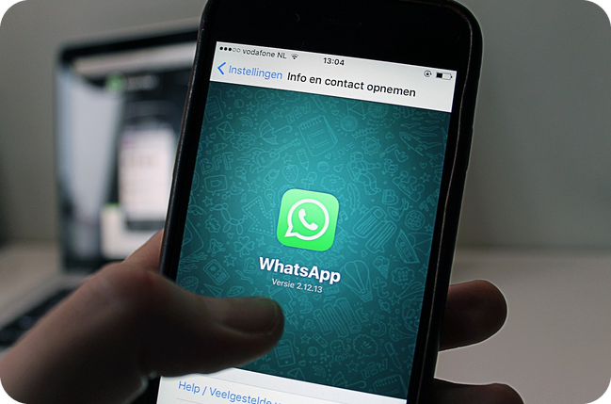

17
Scam or real?
💬 TALK PARLA
⏱ 5 min 👥 pairs
Scam or real? Decide – and say why!
Truffa o vero? Decidete – e dite perché!
1
A text: "Your parcel is waiting. Pay €1.99 here." + a link
e.g. Scam! I'd never click on the link.
2
Your 'bank' phones: "Move all your money to a new account now!"
e.g. Scam – like Paul! I'd hang up and phone my bank.
3
An email: "You've won the lottery in Spain! Send your bank details."
e.g. Scam – like Carl. I've never bought a Spanish ticket!
4
Your friend: "I've lost my wallet abroad. Send me your card number!"
e.g. Scam – like Heather. I'd phone my friend first.
💬
Useful phrases
It must be a scam because…
I'd hang up / delete it.
I'd never click on the link.
5
Have you, or has anybody you know, ever been the victim of a scam?
e.g. Yes, my uncle has. He got a strange text last year and he clicked on the link…
2A-2 · Speaking · scam or real? · 📖 SB p.19 · 6f + follow-up
Notes:
17. Speaking · scam or real? (5 min)
SPEAKING (5 min). Questions appear ONE PER CLICK – about 45 seconds each. Forced choice: SCAM or REAL, no 'maybe', and a reason. Messages 2–4 are the three scams from 2.12; message 1 is a common text-message scam (not in the book – the picture shows it). Model answer for each: SCAM. Uses 'would' from last lesson (I'd hang up). Question 5 = SB 6f: 'Have you, or has anybody you know, ever been the victim of a scam? Explain what happened.' – present perfect question, past simple story. No names needed; 'I'd rather not talk about that' is fine. Then 1–2 minutes of delayed error correction: write 4–5 tense mistakes from today's speaking on the board; students correct them.

Slide 18
18
3 · 2 · 1
⏱ 2 min 👥 pairs
Books closed! What can you remember?
Libri chiusi! Cosa ricordi?
3
Have you ever…? questions with money verbs
📝
Homework · Compiti
Workbook 2A: 3a–3d
Grammar Bank 2A: a 5–8, b 6–10
Homework sheet 2A-2 in the LLS app
2
sentences: one with just, one with yesterday
1
golden rule to avoid a scam
Next lesson: 2B part 1 · Changing lives · How long have you been…?
2A-2 · Exit · what can you remember?
Notes:
18. Exit · what can you remember? (2 min)
RETRIEVAL EXIT (2 min). Books closed. Pairs: 3 Have you ever…? questions (lend, waste, win…), 2 sentences – one present perfect with just, one past simple with yesterday – and 1 golden rule (never give your bank or card details to anybody). A few students share. Set homework (on the slide and in the app): Workbook 2A 3a–3d + Grammar Bank 2A a 5–8, b 6–10 + the 2A-2 homework sheet (easier version available).

Slide 19
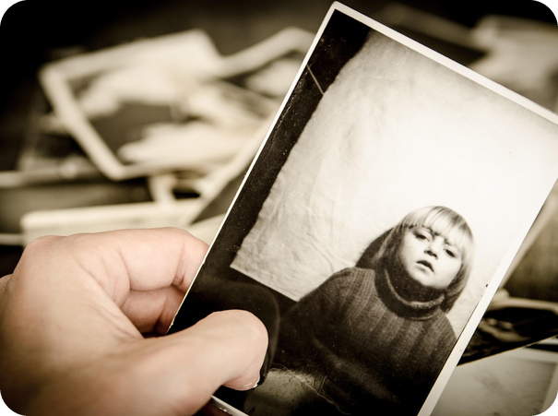
19
Been there, did that
✅ CHECK CONTROLLA
⏱ 8 min 👤 alone
Check the photocopiable answers.
Controlla le risposte della fotocopia.
⭐
Example
1
a Mike & Gina 2–4
I've been · did you go · finished
0 a 1 = been · b1 1 = have you been (examples on the sheet)
2
a Mike & Gina 5–7
I've been · did you go · went
3
b1 Paul & James 2–5
had · did you meet · was · went
4
b1 Paul & James 6–9
've known · got · were you · 've just met
5
b2 Sophia & Jacob 1–4
did you go · didn't leave · came · Have you finished
6
b2 Sophia & Jacob 5–7
sent · 've just made · 've already had
2A-2 · Extra · Grammar PCM · 📖 📄 B1_2A_Photocopiables.pdf p.1 (TG p.151)
EXTRA · if there's time
Notes:
19. Extra · Grammar PCM (8 min)
EXTRA (8 min, if there's time – or extra homework). Grammar photocopiable 2A (one copy per student). a: circle the correct verb in Mike and Gina's conversation. b: complete conversations 1 and 2 with the past simple or present perfect (contractions where possible). Click once per line. Official answers (TG PCM): a 2 I've been · 3 did you go · 4 finished · 5 I've been · 6 did you go · 7 went. b1 2 had · 3 did you meet · 4 was · 5 went · 6 've known · 7 got · 8 were you · 9 've just met. b2 1 did you go · 2 didn't leave · 3 came · 4 Have you finished · 5 sent · 6 've just made · 7 've already had. Then pairs practise the conversations aloud. Student as teacher: for each answer, say the clue (finished time → past simple; ever / just / already / yet → present perfect).

Slide 20
20
Saver or spender?
💬 TALK PARLA
⏱ 8 min 👥 pairs
Ask and answer. Saver or spender?
Chiedi e rispondi. Risparmiatore o spendaccione?
📷 2a2-saver-spender.jpg
1
Have you ever borrowed money from friends or family?
e.g. Yes, once. I borrowed €20 from my brother – and I paid him back!
2
Do you usually have cash in your wallet?
e.g. Not really. I usually pay by card.
3
What would you do with money you won?
e.g. I'd save half and spend half on a holiday.
4
So – are you a saver or a spender?
e.g. A spender! I've already spent my birthday money.
💬
Useful phrases
mostly a = a SPENDER
mostly b = in the middle
mostly c = a SAVER
2A-2 · Extra · Communicative PCM · 📖 📄 B1_2A_Photocopiables.pdf p.2 (TG p.180)
EXTRA · if there's time
Notes:
20. Extra · Communicative PCM (8 min)
EXTRA (8 min, if there's time). Communicative photocopiable 2A 'Are you a saver or a spender?' (one copy per student or pair). Language: present simple and present perfect questions, money vocabulary. Procedure (TG): read out question 1 and the three options and demonstrate by choosing one and explaining why. Pairs ask and answer, noting their partner's answers; about 5 minutes. Then they count a, b and c answers: mostly a = a SPENDER · mostly b = somewhere in the middle · mostly c = a SAVER – partners read the paragraph. The quiz's 9 topics: cash in your wallet · something expensive you love in a shop · what you'd do with money you won or inherited · your money situation in the future · saving · borrowing from friends or family · lending · credit cards · bank loans. The questions on the slide are short warm-up examples (not the photocopiable's wording); the example answers are models. Nobody has to give real amounts or talk about family money.

