Slide 1


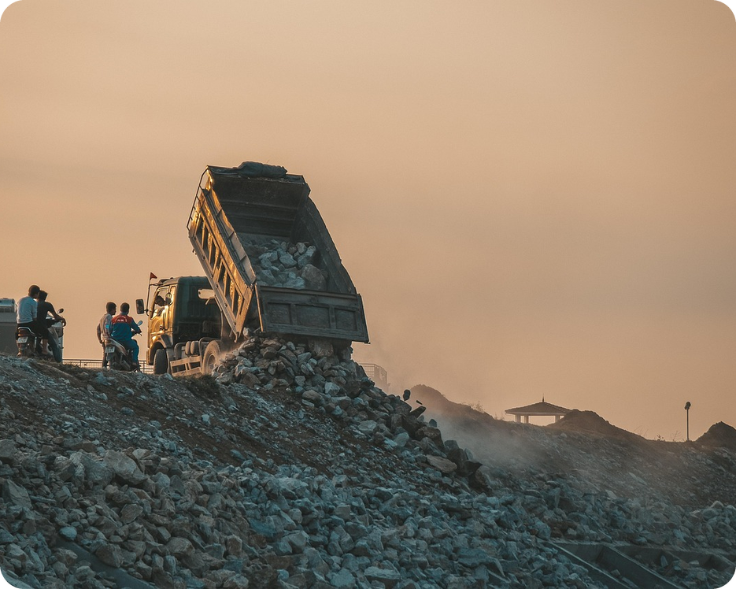


English File B1 · SB pp.20–21
💡 THINK · PENSA
2B-1
Changing lives
A charity, a school and How long…?
🎯
Today you're going to…
🎧 listen to the true story of a charity
💬 talk about helping other people
✏️ ask How long…? with for and since
🔊 say How long…? questions with the right stress
Your lorry breaks down in a tiny village in Uganda. What happens next?
EXAMPLE I think I'd ask the people in the village for help.
Notes:
1. OPENING (2 min)
OPENING (2 min). Show the photo: a safari lorry broken down on a red dirt road. Ask the THINK question; take 3–4 ideas (they wait for a mechanic… they meet the villagers… they go home…). Don't give the answer: 'In this story, the tourists built a SCHOOL!' comes out in the listening. Read the 'Today you're going to…' list together. lorry = camion (UK; US truck) – teach it now if nobody knows it.

Slide 2


2
Remember last lesson?
💡 THINK PENSA
⏱ 2 min 🙋 whole class
What did we learn? Read the examples.
Cosa abbiamo imparato? Leggi gli esempi.
Present perfect = no time
Past simple = when?
Have you ever lost your wallet?
I've just paid the bill.
We haven't paid the insurance yet.
→ ever · never · just · already · yet
I bought these shoes yesterday.
When did you get the email?
He lost €2,000 last year.
→ yesterday · last week · in 2020 · ago
📅
Last lesson…
2A: money experiences and scams
present perfect or past simple?
🔤 KEY WORDS
a scam
a scammer
a victim
suspicious
hang up
bank details
go – went – gone
2B-1 · Revision · last lesson
Notes:
2. Revision · last lesson (2 min)
REVISION (2 min) before the warmer game. Read the examples with the class; ask 'Is there a time?' for each one – time = past simple, no time / just / yet = present perfect. Check one irregular verb: go – went – gone. Recall the scam stories: 'What should you do?' (hang up, delete it). Then play 'Odd one out!' – it uses these time words, participles and scam words.

Slide 3


3
Odd one out!
🎲 PLAY GIOCA
💡 THINK PENSA
Find the odd one out. Say why!
⏱ 3 min 🏆 teams
Trova l'intruso. Di' perché!
🎲
How to play
1
just · already · yesterday · yet
→ yesterday → past simple (the others: present perfect)
Read the four words.
Teams: find the odd one out – 20 seconds!
Odd one out + the reason = 1 point.
When did…? · Have you ever…? · What time did…? · How much did…?
→ Have you ever…? → present perfect
2
3
won · lost · went · forgotten
→ went → past simple (participle = gone)
4
Heather · Carl · Paul · Naomi
→ Naomi → the scammer (the others were victims)
5
hang up · delete it · ignore it · click on the link
→ click on the link → the dangerous one!
6
a friend abroad · a lottery win · a call from 'the bank' · a birthday present
→ a birthday present → not a scam in the stories
2B-1 · Warmer · last lesson · 📖 Recycles 2A part 2: present perfect or past simple, scams (audio 2.12, the scam email)
Notes:
3. Warmer · last lesson (3 min)
RETRIEVAL WARMER (4 min) · books closed · format: odd one out with a reason (different from 2A-1's 'Who am I?' and 2A-2's 'Fix it!'). Two teams. Read the four items; 20 seconds; a team calls out the odd one out AND the reason – the reason wins the point (accept other logical reasons). Click once per line. Answers: 1 yesterday (finished time → past simple; just / already / yet → present perfect) · 2 Have you ever…? (present perfect; When / What time / How much did…? = past simple) · 3 went is past simple, not a participle (go – went – gone) · 4 Naomi Cooper wrote the scam email; Heather, Carl and Paul lost money in the scams in 2.12 · 5 click on the link (the others are what you should do – 'I'd hang up / delete it') · 6 the three scams in 2.12: an email from a friend abroad (Heather), a lottery win (Carl), a phone call from 'the bank' (Paul). Quick follow-up: 'Have you ever got a strange email?' – 'When did you get it?' ICQ: 'Is the answer enough?' (no – say why).

Slide 4
4
Key words first
💡 THINK PENSA
⏱ 3 min 👥 pairs
Guess the meaning. Then click.
Indovina il significato. Poi clicca.
⭐
Example
1
a charity
helps people in need · un ente benefico
0 an orphan → a child without a mother or father · un orfano / un'orfana
2
a lorry
a big truck · un camion
3
break down
stop working (a car…) · guastarsi
📷 2b1-schoolchildren.jpg
4
take shelter
go inside to be safe · ripararsi
5
raise money
collect money for a good cause · raccogliere fondi
6
set up
start (a charity, a business) · fondare
7
seeds
a new plant grows from them · i semi
8
malnutrition
not having enough (good) food · la malnutrizione
2B-1 · Listening · key words first · 📖 SB pp.20–21 · glossary + TG pre-teaching (charity, orphan, lorry, take shelter)
Notes:
4. Listening · key words first (3 min)
ELICIT + CONSOLIDATE (3 min). Only the words that block the two listenings (TG: remind them what a charity is, pre-teach orphan; book glossary: orphan, malnutrition, seeds, FAL, AIDS). Do 0 with the class. Pairs guess the meaning; click once per word – each chip gives the meaning AND the Italian (consolidation for slower students on the same slide). Also tell them (no slide): FAL = Functional Adult Literacy (classes where adults learn to read and write) · AIDS = an illness which attacks the body's immune system. Drill: orphan /ˈɔːfn/, charity /ˈtʃærəti/, malnutrition /ˌmælnjuˈtrɪʃn/, lorry /ˈlɒri/. CCQ: 'My car broke down – can I drive it?' (no). 'We raise money – do we spend it or collect it?' (collect it). SENSITIVE CONTENT (orphans, illness): keep it factual and positive.

Slide 5

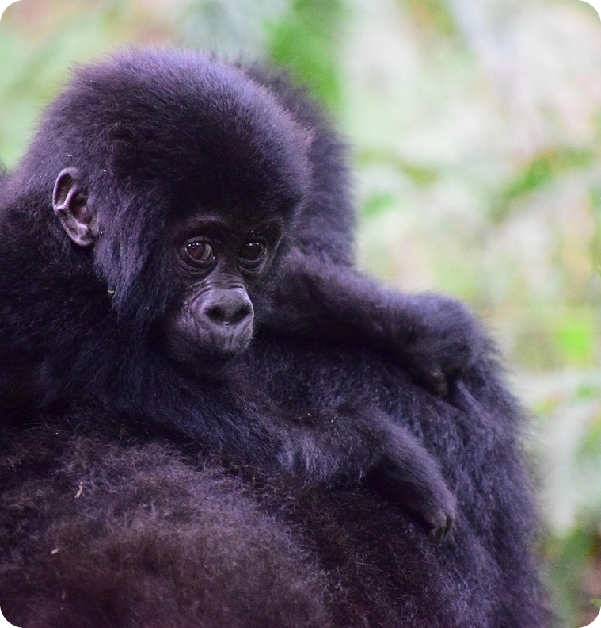
5
Guess the numbers
🎧 LISTEN ASCOLTA
🤔 GUESS INDOVINA
Guess: what are the numbers about?
⏱ 2 min 👥 pairs
Indovina: di cosa parlano i numeri?
Adelante Africa
A group of tourists on holiday in Uganda. A broken lorry. A school with no desks. This is how a small charity started – and it's still changing lives today.
🔢 NUMBER BANK · guess where they go!
2008
75
2010
2012
57
11
2B-1 · Listening · prediction · 📖 SB p.20 · 1 · numbers from audio 2.13 and 2.14
Notes:
5. Listening · prediction (2 min)
PREDICTION (2 min). The introduction is written for this slide (it summarises audio 2.13 – no new facts). Pairs guess what each number is about: a year? a number of children? groups? e.g. 'I think 75 is the number of children in the school.' Every pair must guess before listening. Answers come in the two listenings (don't confirm now): 2008 = the charity started · 75 = children at the new school · 2010 = the new school opened (14 March) · 2012 = the children's home started · 57 = children in the children's home now · 11 = more FAL groups (adult classes). ICQ: 'Do you know or are you guessing?' (guessing!).

Slide 6
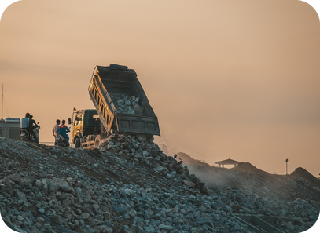
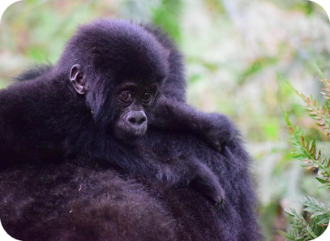

6
The lorry broke down…
🎧 LISTEN ASCOLTA
⏱ 3 min 👤 alone
Listen to Part 1. Answer the questions.
Ascolta la Parte 1. Rispondi alle domande.
🎧 2.13 · play once
↘ speaker bottom right
A
B
C
📷 2b1-schoolchildren.jpg
Started when?
in 2008
Why in Uganda?
to see the mountain gorillas
The lorry…?
broke down (in Igayaza)
🎧
While you listen
The building?
a school for orphans
Look at A–C. Tell the story in 3 sentences!
Listen. Answer the questions on the right.
New school opened?
14 March 2010 · 75 children
🔈 click ▶
2B-1 · Listening · Part 1 · the story · 📖 SB p.20 · 1a · audio 2.13
Notes:
6. Listening · Part 1 · the story (3 min)
LISTENING PART 1 (3 min). Before listening: pairs look at A–C and guess the story (30 seconds). Play 2.13 ONCE (again if needed). Pairs compare, then click once per question. Answers (TG key 1a / audio script 2.13), book questions 1–4 and 9: 1 in 2008 · 2 on safari to see the mountain gorillas · 3 it broke down (in a small village called Igayaza) · 4 a primary school for orphans · 9 on 14 March 2010, with 75 children. Check the predictions: 2008, 2010, 75 ✓. Questions 5–8 are on the next slide. ICQ: 'Do you need every word?' (no – just the answers).

Slide 7
7
Listen again: complete
🎧 LISTEN ASCOLTA
✏️ FILL THE GAPS COMPLETA
Guess the words. Then listen again.
⏱ 3 min 👥 pairs
Indovina le parole. Poi riascolta.
🎧 2.13 · play again
The walls were ___ down.
falling
The blackboards were ___.
broken
📷 2b1-schoolchildren.jpg
One tourist taught them English ___.
songs
"What we need is a new ___!"
school
They set up a ___ to raise money.
charity
💡
Guess first, then listen!
Since then Adelante Africa hasn't ___.
stopped
🔈 click ▶
2B-1 · Listening · Part 1 · detail · 📖 SB p.20 · 1a questions 5–8 · audio 2.13
Notes:
7. Listening · Part 1 · detail (3 min)
DETAIL (3 min). These gaps cover the book's questions 5–8 (5 What condition was the building in? 6 What did one of the tourists do with the children? 7 What did the head teacher tell them they needed? 8 What did the tourists decide to do when they got home?). Pairs guess first, then play 2.13 again. Click once per line. Answers (audio script 2.13): falling · broken · songs · school · charity · stopped. TG key: 5 terrible condition: the walls were falling down, the blackboards were broken, there weren't many desks · 6 she started teaching them English songs · 7 a new school · 8 to set up a charity to raise money to rebuild the school. Point at the last line: 'hasn't stopped' – since then – from 2010 until NOW (today's grammar is coming!).

Slide 8
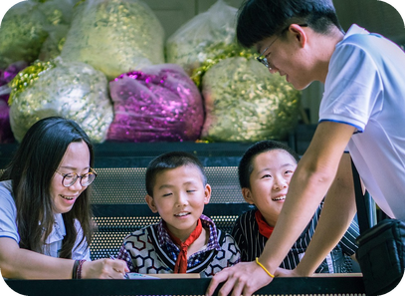
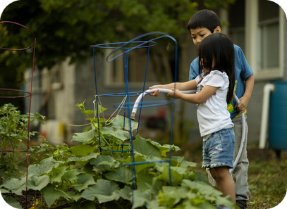
8
What has Jane done?
🎧 LISTEN ASCOLTA
⏱ 3 min 👤 alone
Listen to Part 2. Number the projects.
Ascolta la Parte 2. Numera i progetti.
🎧 2.14 · play once
↘ speaker bottom right
A
B
C
📷 2b1-building-school.jpg
water tanks
3
a children's home
1
a secondary school
6
vegetable seeds
2
🎧
While you listen
classes for adults
5
Read the six projects on the right.
Listen. Number them 1–6 in order.
a sunflower oil factory
4
🔈 click ▶
2B-1 · Listening · Part 2 · the interview · gist · 📖 SB p.20 · 1b · audio 2.14
Notes:
8. Listening · Part 2 · the interview · gist (3 min)
GIST (3 min). Jane Cadwallader is the secretary of Adelante Africa – the teacher who sang songs with the children in 2008 (photo A). Students read the six projects (jumbled), then listen and number them in the order Jane mentions them. Play 2.14 ONCE. Pairs compare. Click once per project. Order (audio script 2.14): 1 a children's home (since 2012, 57 children) · 2 vegetable seeds (to improve their diet) · 3 water tanks (to collect rainwater) · 4 a sunflower oil factory · 5 FAL groups – classes for adults (since 2011, 11 more groups) · 6 a secondary school (just built, not finished). Check the predictions: 2012, 57, 11 ✓. This replaces SB 1b (numbering photos A–H, which we don't have on the slide); TG key for 1b if students use the book: B (example), 2 A · 3 E · 4 D · 5 H · 6 F · 7 C · 8 G. Then Jane also talks about two children: John and Rose (next slide).

Slide 9
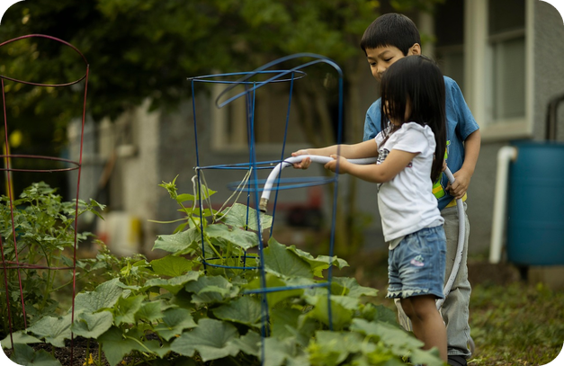
9
Correct the information
🎧 LISTEN ASCOLTA
🔁 CHANGE THE WORD CAMBIA
Every sentence is wrong. Correct it!
⏱ 4 min 👥 pairs
Ogni frase è sbagliata. Correggila!
🎧 2.14 · pause after each part
47 children live in the home.
57
People eat a lot of vegetables.
they DON'T eat many
Tanks to store petrol.
to collect rainwater
The factory makes palm oil.
sunflower oil
FAL: children learn to read.
adults (mainly women)
They've just built a primary school.
a secondary school
Most volunteers are from Europe.
from Uganda
John is studying to be a teacher.
a nurse
💡
Guess first, then listen!
Rose never spoke.
she never smiled
🔈 click ▶
2B-1 · Listening · Part 2 · detail · 📖 SB p.20 · 1c · audio 2.14 (sentences shortened)
Notes:
9. Listening · Part 2 · detail (4 min)
DETAIL (4 min). The nine SB 1c sentences, shortened to fit. Pairs first correct what they remember (1 min), then play 2.14 again, pausing after each project. Click once per sentence. Answers (TG key 1c / audio script): 1 there are 57 children in the children's home · 2 people in rural Uganda don't eat (a lot of) fruit and vegetables · 3 tanks to collect rainwater · 4 sunflower oil (healthier than palm oil) · 5 adults, mainly women, learn to read and write (and speak English) · 6 they have just built a secondary school · 7 the Ugandan volunteers make it all possible · 8 John Muzzei is studying to be a nurse · 9 when Rose arrived she never smiled – now she's running around, laughing. Sensitive content (orphans, AIDS, malnutrition): keep it factual and focus on what the charity has achieved.

Slide 10
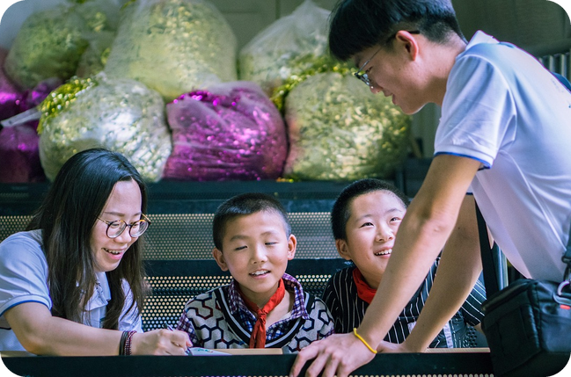
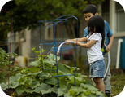
10
Could you help?
💬 TALK PARLA
⏱ 3 min 👥 pairs
Answer with a reason. Ask: Why?
Rispondi con un motivo. Chiedi: Perché?
1
Do you know anybody like Jane who does voluntary work? What do they do?
e.g. My aunt helps at a food bank in Palermo every Saturday.
2
Which Adelante Africa project is the most important? Why?
e.g. The water tanks – clean water is the first thing you need.
3
Would you like to volunteer abroad one day? Where?
e.g. Yes! I'd love to teach English songs to children, like Jane.
4
Should every student do voluntary work at school?
e.g. No – it should be your choice, not homework!
💬
Useful phrases
I'd love to… because…
I don't think I could…
In my opinion, the most important…
2B-1 · Speaking · helping people · 📖 SB p.20 · 1d + follow-up
Notes:
10. Speaking · helping people (3 min)
RESPONSE TO THE LISTENING (3 min). Question 1 = SB 1d. Questions appear ONE PER CLICK – about 40 seconds each. Question 4 is the provocative one: get a quick show of hands (yes / no) before pairs argue. Uses 'would' from 2A part 1 (I'd love to…). Feedback: one or two interesting answers. Don't correct now – note errors for later. Voluntary work = volontariato (TG: a volunteer = someone who works without being paid).

Slide 11
11
What has Jane been doing?
👀 READ LEGGI
✏️ FILL THE GAPS COMPLETA
Complete with the words. Then listen.
⏱ 3 min 👥 pairs
Completa con le parole. Poi ascolta.
From the interview with Jane
🎧 2.15
1 Jane, how long have you been working with Adelante Africa?
📷 2b1-building-school.jpg
2 Tell us what Adelante Africa has been (2) _____ since 2010.
2 Tell us what Adelante Africa has been doing since 2010.
3 The children's home has been (3) _____ since 2012.
3 The children's home has been running since 2012.
4 We've also been (4) _____ water tanks to collect rainwater.
4 We've also been building water tanks to collect rainwater.
5 Since then we've (5) _____ 11 more FAL groups.
5 Since then we've started 11 more FAL groups.
💡
Remember
6 Since she came here she's (6) _____ completely.
6 Since she came here she's changed completely.
building · changed · doing
running · started
🔈 click ▶
2B-1 · Grammar · from the interview · 📖 SB p.21 · 2a, 2b · audio 2.15
Notes:
11. Grammar · from the interview (3 min)
NOTICING (3 min). Sentence 1 is the example (have been working). Pairs complete 2–6 with a past participle or -ing form from the box (Remember card). Play 2.15 to check. Click once per gap: the word appears highlighted IN the sentence. Answers (TG key / audio script 2.15): 2 doing · 3 running · 4 building · 5 started · 6 changed. Then CCQs: 'Is Jane still working with Adelante Africa?' (yes) · 'Is the children's home still running?' (yes) · 'When did it start?' (2012). So these sentences are about a period from the PAST until NOW (SB 2b question 1: answer b).

Slide 12
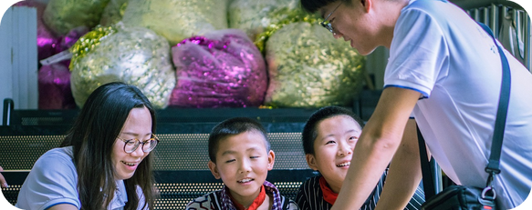
12
been + -ing or participle?
🔗 MATCH ABBINA
⏱ 2 min 👥 pairs
Which form? Match the colour.
Quale forma? Abbina il colore.
🏷️
The colours
1 How long have you been working…?
been + -ing
been + -ing
+ participle
2 …what Adelante Africa has been doing
been + -ing
3 The home has been running since 2012.
been + -ing
4 We've also been building water tanks.
been + -ing
5 Since then we've started 11 more groups.
+ participle
6 Since she came here she's changed.
+ participle
2B-1 · Grammar · guided discovery · 📖 SB p.21 · 2b
Notes:
12. Grammar · guided discovery (2 min)
GUIDED DISCOVERY (2 min). SB 2b question 2: 'What's the difference in form between the verbs in 1–4 and in 5 and 6?' Pairs match each sentence to a colour; click once per sentence. Answers (TG key 2b): 1–4 present perfect continuous = have / has + been + -ing (BLUE) · 5–6 present perfect simple = have / has + past participle (GREEN). Question 1 answer: b – a period of time from the past until now. Ask: 'Can you see a word that comes again and again?' (since). Don't explain action / non-action yet – that's the next slide.

Slide 13


13
How long have you…?
👀 LOOK GUARDA
⏱ 4 min 🙋 whole class
Read. Which form? Why?
🎧 2.16 + 2.17
Leggi. Quale forma? Perché?
⚠ Play it from the book audio
PP simple + for / since
PP continuous · How long?
PP continuous · just now
📷 2b1-painting.jpg
be · have · know · like (no action)
action verbs: learn · work · go · wait
a long action that has just stopped
They've known each other for ten years.
Julia's had that bag since she was at university.
How long have you been learning English?
Nick has been working here since April.
Your eyes are red. Have you been crying?
No, I've been chopping onions.
conosco… da · ho… da
studio… da (ancora adesso)
ho appena… (si vede!)
⚠ for ten years · since April ✗ I study English for 3 years → ✓ I've been studying… ✗ been knowing → ✓ known
2B-1 · Grammar · the rule · 📖 Grammar Bank 2B p.135 · audio 2.16, 2.17
Notes:
13. Grammar · the rule (4 min)
RULE (4 min). Click once per column: the examples appear (meaning first, then form). All examples are from audio 2.16 and 2.17 (🎧 play them from the book audio – Grammar Bank 2B): students listen and repeat, copying the rhythm. Rules (TG grammar notes): How long…? + for / since uses the PRESENT PERFECT, not the present (✗ How long do you live in this town?). With ACTION verbs (learn, go, play, do, wait) we normally use the continuous; with NON-ACTION verbs (be, have, know, like, love) the simple. live and work can be both (live and work box). The continuous is also for a continuous action that has just stopped or is still going on (You look tired. – I've been cleaning the house all afternoon). Column 3 picture: paint on his face → 'He's been painting!' Last click = the Italian-speaker warning: 'Studio inglese da tre anni' = I've been studying English for three years (✗ I study / I am studying… for). Other typical mistakes: forgetting been (✗ How long have you learning…?). CCQs: 'They've known each other for ten years – do they know each other now?' (yes) · 'Your eyes are red – are you crying now?' (no, just before) · 'for or since… April?' (since – a point).

Slide 14

14
for or since?
🎲 PLAY GIOCA
⏱ 2 min 🏆 teams
for or since? Shout it out!
for o since? Dillo ad alta voce!
🎲
How to play
1
___ 2012
→ since (a point)
Read the time.
Teams: shout FOR or SINCE!
First right team = 1 point.
___ ten years
→ for (a period)
2
3
___ lunchtime
→ since
4
___ ages
→ for
5
___ I was a child
→ since
6
___ about three years
→ for
2B-1 · Grammar game · for or since? · 📖 Grammar Bank 2B p.135 · for / since (audio 2.16, 2.17)
Notes:
14. Grammar game · for or since? (2 min)
GAME (2 min). Fast and noisy. Read each time expression; the first team to shout the right word wins a point. Click once per line. Answers: 1 since 2012 (audio 2.15) · 2 for ten years (2.16) · 3 since lunchtime (2.18) · 4 for ages · 5 since I was a child · 6 for about three years (2.17). Rule to repeat: for + a PERIOD (how long), since + a POINT (when it started). Bonus point: make a true sentence about you with the expression ('I've lived in Bagheria since I was a child').

Slide 15
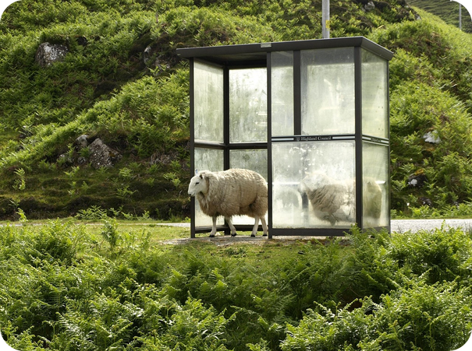
15
Make the sentence
✍️ WRITE SCRIVI
✅ CHECK CONTROLLA
Make the sentence. for or since?
⏱ 3 min 👥 pairs
Fai la frase. for o since?
⭐
Example
1
She / study English / three years
She's been studying English for three years.
0 I / learn English / six years → I've been learning English for six years.
2
How long / they / watch TV?
How long have they been watching TV?
3
It / rain / lunchtime
It's been raining since lunchtime.
4
I / not live here / very long
I haven't been living here for very long.
5
How long / you / learn to drive?
How long have you been learning to drive?
6
Julia / have that bag / she was at university
Julia's had that bag since she was at university. (have = no action)
2B-1 · Grammar · controlled practice · 📖 Grammar Bank 2B p.135 · a 1–5 (prompts written for the slide) · audio 2.16
Notes:
15. Grammar · controlled practice (3 min)
CONTROLLED PRACTICE (3 min). Do 0 with the class. Pairs say (or write) the full sentence: present perfect continuous or simple, for or since. Click once per line. Answers: 1–5 = Grammar Bank 2B a 1–5 (TG key): She's been studying English for three years · How long have they been watching TV? · It's been raining since lunchtime · I haven't been living here for very long · How long have you been learning to drive? · 6 = audio 2.16 (have = non-action → simple). The prompts are written for this slide from the key answers – the book's exercise layout may differ (Grammar Bank b 1–5 can be done in the book if there's time; c 1–10 is homework). Student as teacher: say WHY (action or non-action? period or point?).

Slide 16

16
Hear the BIG words
🎧 LISTEN ASCOLTA
🔊 SAY IT PRONUNCIA
Listen. Write only the BIG words.
⏱ 3 min 👥 pairs
Ascolta. Scrivi solo le parole forti.
🎧 2.18 · pause after each sentence
1
How
long
learning
French
How long have you been learning French?
🔊
Big words = STRESSED
2
learning
French
three
years
nouns, verbs, adjectives are strong
to, a, the, of are weak and fast
I've been learning French for three years.
3
How
long
raining
How long has it been raining?
4
raining
lunchtime
It's been raining since lunchtime.
🔈 click ▶
2B-1 · Pronunciation · sentence stress · 📖 SB p.21 · 3a, 3b, 3c · audio 2.18
Notes:
16. Pronunciation · sentence stress (3 min)
PRONUNCIATION (3 min). 3a: play 2.18, pausing; students write only the stressed words (the pink boxes in the book). Click 1 = the stressed words, click 2 = the full sentence (for each sentence). Answers (TG key 3a): 1 learning, French (book: How long is given) · 2 learning, French, three, years · 3 How, long, raining · 4 raining, lunchtime. 3b: pairs rebuild the unstressed words; listen again to check. 3c: drill chorally, then individually – stressed words strong and slow, the small words fast and weak: been /bɪn/, for /fə/, has /həz/, have /həv/. Italian speakers give every word the same stress – exaggerate the big words.

Slide 17
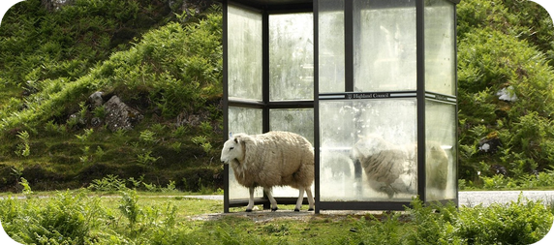
17
How long…? Quick!
🎲 PLAY GIOCA
🔊 SAY IT PRONUNCIA
Hear the news. Ask How long…? fast!
⏱ 3 min 🏆 teams
Ascolta la notizia. Chiedi How long…? veloce!
🎲
How to play
1
"It's snowing."
→ How long has it been snowing?
Read (or hear) the news.
Teams: ask How long…? – 10 seconds!
Right question + rhythm = 1 point.
"I'm learning Russian."
→ How long have you been learning Russian?
2
3
"Susan is working in Italy."
→ How long has Susan been working in Italy?
4
"John is looking for a job."
→ How long has John been looking for a job?
5
"They're living with Mary's parents."
→ How long have they been living with Mary's parents?
6
"John is going out with Emily."
→ How long has John been going out with Emily?
2B-1 · Pronunciation game · make questions · 📖 SB p.21 · 3d · audio 2.19
Notes:
17. Pronunciation game · make questions (3 min)
GAME (3 min). SB 3d as a team game. Play 2.19 (🎧 from the book audio), pausing after each sentence – or read the sentence yourself. Teams have 10 seconds to say the How long…? question with the right stress; click to show the answer (audio script 2.19 – items 1, 2, 3, 4, 5 and 8; also 6 'I'm going to salsa classes' → How long have you been going to salsa classes? and 7 'It's raining' → How long has it been raining?). 1 point for the right question, +1 if the rhythm is good (HOW LONG has it been SNOWing?). Extra support (TG): write HOW LONG HAS … BEEN + -ing…? / HOW LONG HAVE … BEEN + -ing…? on the board. ICQ: 'Do you repeat the sentence?' (no – you ask a question).

Slide 18



18
Guess my square!
💬 TALK PARLA
⏱ 6 min 👥 pairs
Write 6 short answers. Partner asks How long…?
Scrivi 6 risposte brevi. Il compagno chiede How long…?
1
a friend you know very well
e.g. "Irina" → How long have you known Irina? – Since primary school.
2
a sport or exercise you do regularly
e.g. "volleyball" → How long have you been playing volleyball? – For three years.
3
a social media site you use regularly
e.g. "TikTok" → How long have you been using TikTok? – Since 2022.
4
the bike, motorbike or car you have
e.g. "Vespa" → How long have you had your Vespa? – For a year.
💬
Useful phrases
5
something you're learning (to do)
e.g. "guitar" → How long have you been learning the guitar?
Is WWF a charity you support?
How long have you been + -ing…?
How long have you had / known…?
6
the place where you live
e.g. "Bagheria" → How long have you lived / been living there?
2B-1 · Speaking · How long…? · 📖 SB p.21 · 4a, 4b
Notes:
18. Speaking · How long…? (6 min)
SPEAKING (6 min). Squares appear ONE PER CLICK – go through all six first and elicit for each: action or non-action? → the question form (TG extra support): know, have → simple (How long have you known…? NOT been knowing); play, use, learn → continuous; live → both. 4a (1 min): students write ONE word or name for at least 6 squares (book p.21 has 10 squares; the others: a charity you support · a bar or restaurant you often go to · a possession which is very important for you · an organization, club or gym you are a member of). 4b: swap. The partner GUESSES what each word means ('Is Irina your sister?'), then the first question MUST be How long…?, then 2 more questions in any tense (book models: How long have you been supporting Adelante Africa? – Have you ever been to Uganda? / How long have you known Irina? – How often do you see her?). Demonstrate with two squares of your own on the board. Monitor: note 4–5 errors (been knowing, I study… since) for delayed correction at the end. Students choose which squares to fill (privacy).

Slide 19
19
Why are you so…?
🎲 PLAY GIOCA
💬 TALK PARLA
Mime the RESULT. Team: Have you been…?
⏱ 4 min 🏆 teams
Mima il RISULTATO. Squadra: Have you been…?
🎲
How to play
TEAM A · mime
TEAM B · mime
The mimer looks at the screen. The team doesn't!
Mime how you look NOW. No words!
Team asks: Have you been…-ing?
RUNNING
EATING CHOCOLATE
CHOPPING ONIONS
WAITING FOR A BUS
SWIMMING
STUDYING ALL NIGHT
📷 2b1-out-of-breath.jpg
PAINTING
SHOPPING
2B-1 · Grammar game · recent actions · 📖 Grammar Bank 2B · present perfect continuous for recent actions (audio 2.17)
Notes:
19. Grammar game · recent actions (4 min)
GAME (4 min). Like 2.17: 'Your eyes are red. Have you been crying? – No, I've been chopping onions.' A new mimer for each word stands with their back to the class, facing the screen; everyone else closes their eyes / turns round while you click. The mimer acts the RESULT (out of breath, red eyes, wet hair, paint on hands, chocolate on the mouth, bored, yawning, heavy bags) – no words. The team asks full questions: 'Have you been running?' The mimer nods or shakes their head. Point only for a correct question with been + -ing. When they guess, everybody says the answer together: 'He's been running!' Round 1 = Team A mimers, round 2 = Team B. ICQ: 'Do you mime the action or how you look after?' (how you look after).

Slide 20
20
3 · 2 · 1
⏱ 2 min 👥 pairs
Books closed! What can you remember?
Libri chiusi! Cosa ricordi?
3
Adelante Africa projects (no looking!)
📝
Homework · Compiti
Workbook 2B: 1a–1e, 2a
Grammar Bank 2B: c 1–10
Writing p.116: an informal email
Homework sheet 2B-1 in the LLS app
2
How long…? questions: one been + -ing, one known / had
1
true sentence about you with for or since
Next lesson: 2B part 2 · The polar challenge · strong adjectives
2B-1 · Exit · what can you remember?
Notes:
20. Exit · what can you remember? (2 min)
RETRIEVAL EXIT (2 min). Books closed. Pairs: 3 Adelante Africa projects (children's home, water tanks, sunflower oil, FAL groups, secondary school, seeds), 2 How long…? questions (e.g. How long have you been learning English? / How long have you known your best friend?), 1 true for / since sentence. A few students share. Then 1 minute of delayed error correction from the speaking (4–5 errors on the board, students correct). Set homework (on the slide and in the app): Workbook 2B 1a–1e and 2a (2b uses the audio – Online Practice) + Grammar Bank 2B c 1–10 + Writing An informal email p.116 (TG: go through a and b in class if there's time; the email in c as homework – they stayed with British friends for a week last month and write to say thank you; d = check for mistakes; answers to a and b in the teacher key) + the 2B-1 homework sheet (easier version available).

Slide 21
21
What has been happening?
✅ CHECK CONTROLLA
⏱ 8 min 👤 alone
Check the photocopiable answers.
Controlla le risposte della fotocopia.
⭐
Example
1
a pictures 2–3
2 She's been playing the violin for two hours. · 3 She hasn't been feeling well since last week.
0 a 1 and b 1 = the examples on the sheet
2
a pictures 4–5
4 They've been waiting for the bus for a long time. · 5 It's been raining all day.
3
a picture 6
They've been watching TV since they got home.
📷 2b1-painting.jpg
b 2–3
2 have the children been doing / 've been doing, for · 3 have you been going out / 've been going out since
4
5
b 4–5
4 has Penny been / 's been single since · 5 have you had / 've had, for
6
b 6–7
6 has Pete been trying / 's been trying since · 7 has your sister wanted / 's wanted, since
7
b 8
have you known / 've known, for
2B-1 · Extra · Grammar PCM · 📖 📄 B1_2B_Photocopiables.pdf p.1 (TG p.152)
EXTRA · if there's time
Notes:
21. Extra · Grammar PCM (8 min)
EXTRA (8 min, if there's time – or extra homework). Grammar photocopiable 2B (one copy per student). a: look at the pictures – what has been happening? Use the present perfect continuous (contractions). b: complete the questions and answers with the present perfect simple or continuous and for or since. Click once per line. Official answers (TG PCM): a 2 She's been playing the violin for two hours. 3 She hasn't been feeling well since last week. 4 They've been waiting for the bus for a long time. 5 It's been raining all day. 6 They've been watching TV since they got home. b 2 A have the children been doing B 've been doing, for · 3 A have you been going out B 've been going out since · 4 A has Penny been B 's been single since · 5 A have you had B 've had, for · 6 A has Pete been trying B 's been trying since · 7 A has your sister wanted B 's wanted, since · 8 A have you known B 've known, for. Student as teacher: action or non-action? for or since?

Slide 22
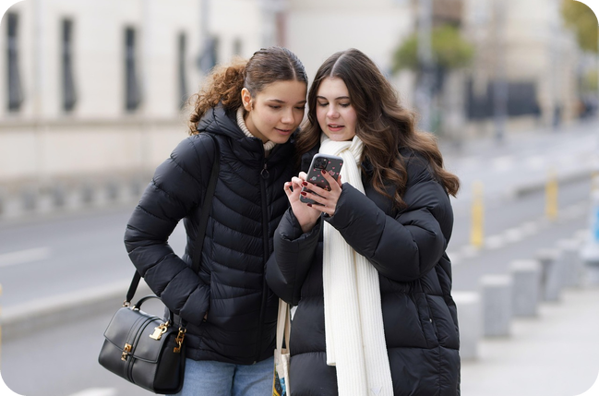
22
Find someone who…
💬 TALK PARLA
⏱ 6 min 🚶 mingle
Stand up! Find someone who… Ask How long?
Alzati! Trova qualcuno che… Chiedi How long?
1
…is learning another language
e.g. Are you learning another language? – Yes, Spanish. – How long have you been learning it?
2
…has had the same phone for 3+ years
e.g. How long have you had your phone? – Since 2021!
3
…has known their best friend since primary school
e.g. How long have you known Giulia? – Since we were six.
4
…does a sport (5+ years)
e.g. How long have you been playing tennis? – For six years.
💬
Useful phrases
5
…has lived in the same house all their life
e.g. How long have you lived here? – Since I was born.
Are you learning…?
Have you had…?
How long have you…?
6
…is reading a good book at the moment
e.g. How long have you been reading it? – For a week.
2B-1 · Extra · find someone who… · 📖 Communicative PCM 2B 'How long have you been…?' (TG p.181) – adapted
EXTRA · if there's time
Notes:
22. Extra · find someone who… (6 min)
EXTRA (6 min, if there's time). Mingle. The prompts appear ONE PER CLICK – show all six, then students copy them and stand up. They ask a yes / no question first; when someone says yes, they write the name and ask How long…? + one more question. First to complete 4 names wins. Checks action vs non-action (been learning / had / known / lived). The official activity is the Communicative photocopiable 2B 'How long have you been…?' (card game, B1_2B_Photocopiables.pdf p.2): questions in bold, e.g. Occupation – How long have you been working or studying there? · House – How long have you been living there? · Social media – How long have you been using it?

