Slide 1


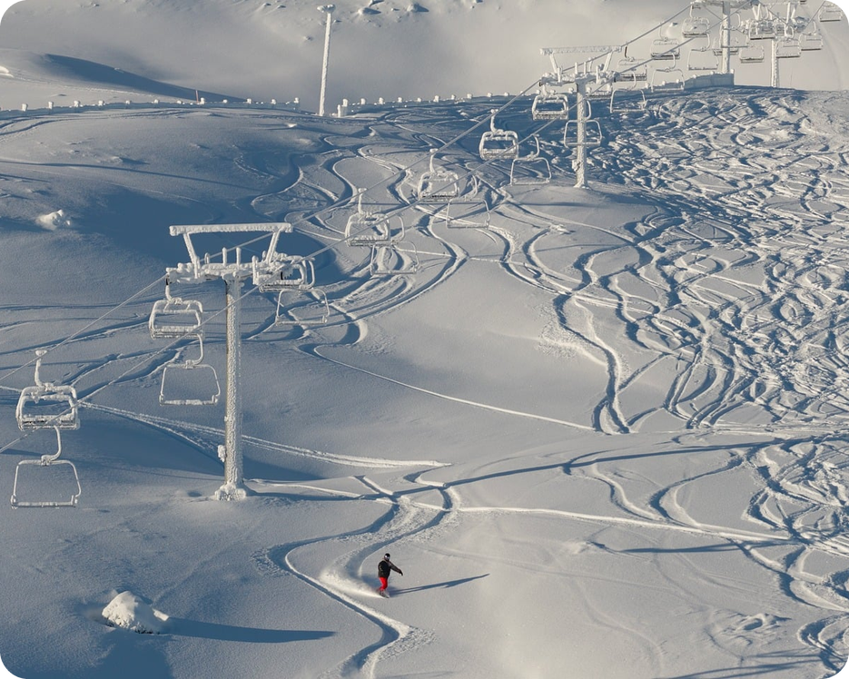


English File B1 · SB pp.22–23
💡 THINK · PENSA
2B-2
Changing lives
Charity challenges · strong adjectives
🎯
Today you're going to…
💬 talk about charity challenges
👀 read a blog from Antarctica
🔥 use strong adjectives: I'm starving!
🎬 watch a video about a charity bake sale
500 miles to the South Pole. Would you do it?
EXAMPLE No, I wouldn't – I hate the cold!
Notes:
1. OPENING (2 min)
OPENING (2 min). Show the photo: a person pulling a sledge across the snow. Ask the THINK question: 'Would you ski 500 miles to the South Pole – for charity?' Take 3–4 quick answers (Yes! / No way – it's too cold!). Tell them: 'It's –15°C, the wind is 70 miles per hour… how would you feel?' Accept 'very cold, very tired' – today they'll learn stronger words. Read the 'Today you're going to…' list together. The photo is a generic image (the book's blog is by TV presenter Helen Skelton).

Slide 2

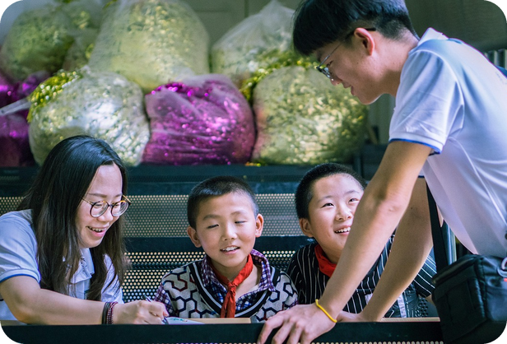
2
Remember last lesson?
💡 THINK PENSA
⏱ 2 min 🙋 whole class
What did we learn? Read the examples.
Cosa abbiamo imparato? Leggi gli esempi.
PP continuous + for / since
PP simple (no -ing verbs)
How long have you been learning English?
It's been raining since lunchtime.
The home has been running since 2012.
→ for + a period · since + a start point
They've known each other for years.
I've had this bag since 2019.
They've started 11 groups since 2011.
→ ✗ been knowing → ✓ known
📅
Last lesson…
2B: Adelante Africa
How long…? + for / since
🔤 KEY WORDS
a charity
an orphan
raise money
set up
a volunteer
How long…?
2B-2 · Revision · last lesson
Notes:
2. Revision · last lesson (2 min)
REVISION (2 min) before the warmer game. Read the examples with the class; ask 'for or since + 2012?' (since) · '+ ten years?' (for). Point out: action verbs → been + -ing; know / have / be → simple. Recall the charity quickly: 'Where is Adelante Africa? What have they built?'. Then play 'Number game!' – students make for / since sentences about Adelante Africa.

Slide 3

3
Number game!
🎲 PLAY GIOCA
⏱ 4 min 🏆 teams
Read the number. What is it? Use for or since!
Leggi il numero. Cos'è? Usa for o since!
🎲
How to play
1
2008
→ Adelante Africa started. It's been helping since 2008.
Read the number.
Teams: what is it? Make a sentence with for or since.
Fact = 1 point. Correct sentence = +1.
75
→ children at the new school when it opened in 2010
2
3
2012
→ The children's home has been running since 2012.
4
57
→ children live in the children's home now
5
11
→ They've started 11 more FAL groups since 2011.
TEAM A ☆☆☆☆☆
TEAM B ☆☆☆☆☆
6
10+
→ Jane has been working with them for over ten years.
2B-2 · Warmer · last lesson: Adelante Africa · 📖 Recycles 2B part 1 · audio 2.13, 2.14 · present perfect + for / since
Notes:
3. Warmer · last lesson: Adelante Africa (4 min)
RETRIEVAL WARMER (5 min) – recycles 2B part 1. Books closed. Format: a number-memory quiz (different from last lesson's 'Odd one out!' warmer) – the same numbers students predicted and heard in 2B-1, now recalled from memory. Two teams, one pen and paper each. Read each number aloud; teams have 30 seconds to write what it refers to AND a sentence with the present perfect (simple or continuous) + for or since. Click once per number for a model answer (facts from audio scripts 2.13 / 2.14). 1 point for the fact, +1 for a correct for / since sentence (accept any correct sentence, e.g. 'The new school has been open since 2010'). Watch for: ✗ The home is running since 2012 → ✓ has been running · ✗ since ten years → ✓ for ten years · ✗ I've been knowing → ✓ I've known. Bonus number if fast: 5 (kilos – Baby Rose's weight when she arrived). ICQs: 'Do you write only the fact?' (no – the fact AND a sentence) · 'for or since + 2012?' (since).

Slide 4
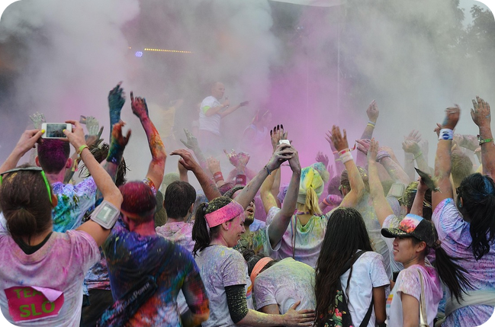

4
Charity events
💬 TALK PARLA
⏱ 3 min 👥 pairs
Answer. Then ask: What did you do?
Rispondi. Poi chiedi: Cosa hai fatto?
1
Are there charity events in Bagheria or Palermo? What kind?
e.g. Yes, I think there are charity runs and concerts.
2
Have you ever taken part in one? What did you do?
e.g. Yes – I did a 5 km fun run with my school.
3
How much money did you raise? For what good cause?
e.g. We raised about €300 for a children's hospital.
4
Would you do a challenge for charity? Which one?
e.g. Maybe a marathon – but not in the snow!
💬
Useful phrases
raise money for a good cause = raccogliere fondi
take part in = partecipare a
a charity = un ente benefico
2B-2 · Lead-in · charity events · 📖 SB p.22 · 6a
Notes:
4. Lead-in · charity events (3 min)
LEAD-IN (3 min). SB 6a. First check the phrases in the purple box (TG): raise money for a good cause, take part in a charity event. Link to last lesson: Adelante Africa raises money for a school in Uganda. Questions appear ONE PER CLICK – about 40 seconds each. Example answers are only models. Feedback: 2–3 pairs. ICQ: 'Can you just say yes or no?' (no – give an example).

Slide 5
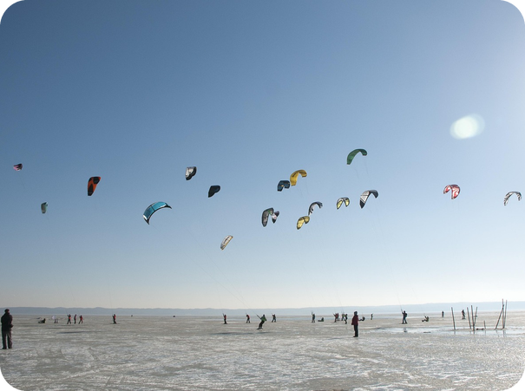
5
Polar words
💡 THINK PENSA
⏱ 2 min 👥 pairs
Guess the meaning. Then click.
Indovina il significato. Poi clicca.
⭐
Example
1
a sledge
you pull it on the snow with your things · una slitta
0 a blog → a website where someone writes about their life, with photos · un blog
2
a trek
a long, hard journey · una lunga traversata
3
kite-skiing
skiing pulled by a big kite · sci con l'aquilone
4
set off
start a journey · partire
5
the halfway checkpoint
the stop in the middle of the journey · la tappa a metà
2B-2 · Reading · key words first · 📖 SB p.22 · 6b, 6c (TG extra support: pre-teach)
Notes:
5. Reading · key words first (2 min)
PRE-TEACH BLOCKING WORDS ONLY (2 min). TG: make sure students know what a blog is (example 0). Pairs guess the meaning; click once per word – each answer gives the meaning AND the Italian (consolidation on the same slide). Use the photo for kite-skiing. Drill: sledge /sledʒ/, trek /trek/. Don't teach other words from the blog now – the strong adjectives come later (they are the gaps in the text).

Slide 6

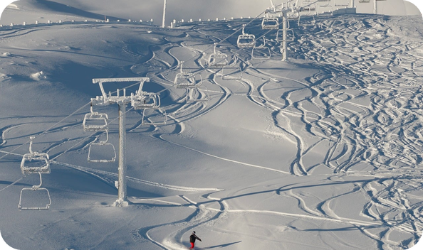
6
Who is Helen Skelton?
👀 READ LEGGI
✏️ FILL THE GAPS COMPLETA
Read. Put the words in gaps 1–4.
⏱ 3 min 👥 pairs
Leggi. Metti le parole negli spazi 1–4.
The polar challenge
TV presenter Helen Skelton has never been afraid of a charity challenge.
She has run the (1) _____ Ultra Marathon in Namibia, and she has kayaked (2) _____ kilometres down the Amazon for the charity Sport Relief.
She has run the 78-mile Ultra Marathon in Namibia, and she has kayaked 3,200 kilometres down the Amazon for the charity Sport Relief.
Now she has decided to leave the (3) _____ of Africa and South America to take part in a polar challenge:
Now she has decided to leave the heat of Africa and South America to take part in a polar challenge:
a (4) _____ ski, kite-ski and bike journey to the South Pole, the bottom of the world.
a 500-mile ski, kite-ski and bike journey to the South Pole, the bottom of the world.
💡
Remember
During the challenge, Helen is writing a blog.
78 · 3,200 · 500 · heat
What has she done before? What's different now?
2B-2 · Reading · the introduction · 📖 SB p.22 · 6b · article adapted
Notes:
6. Reading · the introduction (3 min)
READING · INTRODUCTION (3 min). SB 6b, adapted: pairs put the words from the yellow box into gaps 1–4 (1 min), then click once per line – the answer appears highlighted IN the text. Answers (SB p.22): 1 78(-mile) · 2 3,200 · 3 heat · 4 500(-mile). Then the book's two questions (in the yellow box). TG key: 1 She's run an ultra marathon in Namibia and she's kayaked down the Amazon. 2 A polar challenge – a 500-mile journey to the South Pole; it's different because the cold, rather than the heat, might be a problem. Notice the present perfect from last lesson: She has run… she has kayaked… (experiences, no time). TG extra support: 'How is Helen going to get there?' (skiing, kite-skiing and cycling). Text slightly shortened (Nauta–Almeirim route cut).

Slide 7
7
Put the blog in order
👀 READ LEGGI
🔀 REORDER RIORDINA
Use the time clues. Number the entries.
⏱ 4 min 👥 pairs
Usa gli indizi di tempo. Numera i post.
⭐
Example
1
A · over a month since we arrived
8th · "reach the South Pole late tonight"
0 B · "My first night in Antarctica" → 1st
2
C · first day of the trek is over
4th · the trek starts
3
D · in Antarctica for four days
2nd · only four days!
📷 2b2-antarctic-tent.jpg
4
E · the second day of our trek
5th · after the first day
5
F · 150 miles from our destination
7th · nearly there
6
G · completed our journey in 18 days
9th · the end!
7
H · on our way to the halfway checkpoint
6th · halfway
8
I · training is over · starting today
3rd · training, then the trek
2B-2 · Reading · order of events · 📖 SB p.22 · 6c (the highlighted phrases)
Notes:
7. Reading · order of events (4 min)
READING · ORDER (4 min). SB 6c: the blog entries A–I are mixed up; B (My first night in Antarctica) is number 1. Students use the highlighted time clues (the book's yellow phrases, shortened on the slide) to number the others 2–9. Tip: underline the time words first (four days, first day, second day, halfway, 150 miles from…, over a month, completed). Pairs compare, then click once per entry (rows are in letter order – the coloured row numbers are NOT the answers). Answers (TG): 2 D · 3 I · 4 C · 5 E · 6 H · 7 F · 8 A · 9 G. ICQ: 'Which entry is number 1?' (B) · 'Do you read everything now?' (no – only the first lines). The next three slides show the blog in the right order.

Slide 8
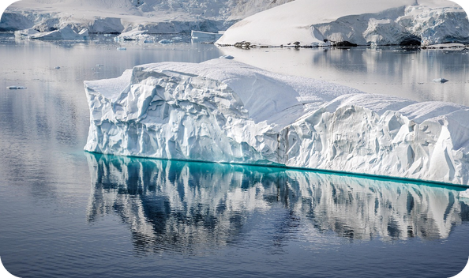
8
The polar challenge 1
👀 READ LEGGI
🤔 GUESS INDOVINA
Read entries 1–3. Guess the missing word.
⏱ 2 min 👥 pairs
Leggi i post 1–3. Indovina la parola mancante.
Entries 1–3 · B · D · I
1 · B My first night in Antarctica. It's summer here, and the 24-hour daylight is weird. Today was my first full day on cross-country skis, pulling a sledge.
It was a nightmare! Still, the scenery was incredible. Now I'm going to try out the ice bike, and we're also going to practise kite-skiing.
2 · D We've only been in Antarctica for four days, but there's been a huge snowstorm for the past 48 hours.
It's (1) _____ outside, so we can't train – we've had to stay in the tent. The winds are 70 miles per hour, with –15°C and lots of snow.
It's freezing outside, so we can't train – we've had to stay in the tent. The winds are 70 miles per hour, with –15°C and lots of snow.
3 · I The training is over and we're starting our 500-mile journey today! We've been cycling, walking and kiting for ten days.
💡
Remember
I washed and changed my clothes. I'm not going to get clean clothes again for three weeks!
weird = strange · strano
a nightmare = un incubo
2B-2 · Reading · the blog (1) · 📖 SB p.22 · blog entries B, D, I · 7a
Notes:
8. Reading · the blog (1) (2 min)
READING (2 min). The blog in the RIGHT order, entries 1–3 (shortened; facts unchanged). Students read silently (90 seconds) and guess gap 1 – a word that means 'very cold' (SB 7a, sentence 2). Click: the answer appears in the text. Answer: freezing (= very cold). Ask: 'Why can't they train?' (a huge snowstorm – they had to stay in the tent). Don't teach strong adjectives yet – just 'What do you think it means?'

Slide 9
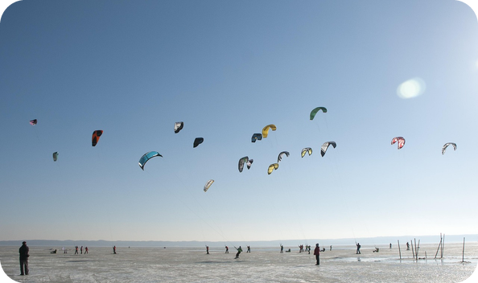
9
The polar challenge 2
👀 READ LEGGI
🤔 GUESS INDOVINA
Read entries 4–6. Guess the missing words.
⏱ 2 min 👥 pairs
Leggi i post 4–6. Indovina le parole mancanti.
Entries 4–6 · C · E · H
4 · C The first day of the trek is over! We managed to make the bikes work! But we need to do 25 miles a day, and we only managed 15 miles today.
After nine hours of cycling (and a lot of pushing), we had to stop, because I was completely (2) _____ .
After nine hours of cycling (and a lot of pushing), we had to stop, because I was completely exhausted.
5 · E This morning, the second day of our trek, we set off on the kite-skis, and straight away we were travelling fast.
In the first hour, we'd gone eight miles! Late this afternoon the wind dropped, but we'd travelled 41 miles – I'm very proud of that.
6 · H We're on our way to the halfway checkpoint today, where we can have a rest… and lots of hot water, so I can have a good wash.
💡
Remember
It's my second one since arriving in Antarctica. I have to admit it, I smell awful… and my hair is absolutely (3) _____ .
It's my second one since arriving in Antarctica. I have to admit it, I smell awful… and my hair is absolutely filthy.
managed to = riuscire a
awful = terrible · terribile
2B-2 · Reading · the blog (2) · 📖 SB p.22 · blog entries C, E, H · 7a
Notes:
9. Reading · the blog (2) (2 min)
READING (2 min). Entries 4–6. Students read and guess gaps 2 and 3 (SB 7a, sentences 1 and 3): 2 = very tired, 3 = very dirty. Click once per gap. Answers: 2 exhausted (= very tired) · 3 filthy (= very dirty). Point at the words before them: completely exhausted, absolutely filthy – NOT 'very exhausted' (the Strong adjectives box – taught on slide 11). Quick question: 'How far did they go on the kite-skis?' (41 miles).

Slide 10
10
The polar challenge 3
👀 READ LEGGI
🤔 GUESS INDOVINA
Read entries 7–9. Guess the missing words.
⏱ 2 min 👥 pairs
Leggi i post 7–9. Indovina le parole mancanti.
Entries 7–9 · F · A · G
7 · F We're now only 150 miles from our destination. For the last few days, we've only been using bikes and cross-country skis, not kite-skis.
📷 2b2-antarctic-tent.jpg
Yesterday the morning went well, but then we hit some soft snow and ended up pushing the bikes for six miles. Today we used skis, but progress has been slow.
8 · A It's over a month since we arrived in Antarctica, and if everything goes to plan, we should reach the South Pole late tonight.
I'm wearing a face mask because of the wind and sun. I may look like (4) _____ , but it will help me get there.
I'm wearing a face mask because of the wind and sun. I may look like Darth Vader, but it will help me get there.
9 · G We've completed our 500-mile journey in 18 days!
💡
Remember
When I talked to Dad on the phone, saying we've done it, I (5) _____ . This is the biggest thing I have ever been part of.
When I talked to Dad on the phone, saying we've done it, I cried. This is the biggest thing I have ever been part of.
progress = progressi
ended up pushing = alla fine abbiamo spinto
2B-2 · Reading · the blog (3) · 📖 SB p.22 · blog entries F, A, G
Notes:
10. Reading · the blog (3) (2 min)
READING (2 min). Entries 7–9. Gap 4: a science-fiction character with a black mask (students love guessing!) → Darth Vader. Gap 5: what do you do when you're very emotional? → cried. Click once per gap. Ask: 'How long did the journey take?' (18 days) · 'Who did she phone?' (her dad). React: 'Would YOU cry?'

Slide 11
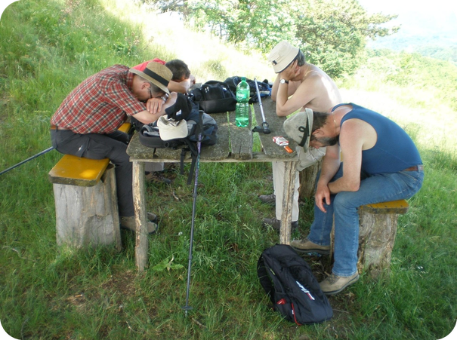
11
Which entry?
🔍 FIND TROVA
⏱ 3 min 👥 pairs
In which entry does Helen talk about…?
In quale post Helen parla di…?
⭐
Example
1
feeling very emotional
G · "I cried"
0 looking forward to a wash → H · "hot water… a good wash"
2
how beautiful Antarctica is
B · "the scenery was incredible"
3
the same clothes every day
I · "no clean clothes for three weeks"
4
travelling fast for the first time
E · "straight away… travelling fast"
5
looking like a sci-fi character
A · "I may look like Darth Vader"
6
not able to go outside
D · "we've had to stay in the tent"
7
stopping cycling: very tired
C · "I was completely exhausted"
8
stopping one kind of transport
F · "not kite-skis"
2B-2 · Reading · detail · 📖 SB p.22 · 6d, 6e
Notes:
11. Reading · detail (3 min)
READING FOR DETAIL (3 min). SB 6d: in which entry does Helen mention…? Pairs answer from memory first (a challenge!), then go back to slides 7–9 to check if they disagree. Click once per item: the entry letter AND the evidence. Answers (TG): feeling very emotional G (I cried) · how beautiful Antarctica is B (the scenery was incredible) · looking forward to a wash H (example) · having to wear the same clothes every day I (I'm not going to get clean clothes again for three weeks!) · travelling quickly for the first time E (straight away we were travelling fast) · looking like a science fiction character A (Darth Vader) · not being able to go outside D (we've had to stay in the tent) · stopping cycling because she was very tired C (completely exhausted) · stopping using one method of transport F (only bikes and cross-country skis, not kite-skis). Then 6e (if time, 1 min): 'Which day would be the worst for YOU?'

Slide 12

12
Not just cold – freezing!
🎧 LISTEN ASCOLTA
✏️ FILL THE GAPS COMPLETA
Write the normal adjective. Then listen.
⏱ 3 min 👥 pairs
Scrivi l'aggettivo normale. Poi ascolta.
🎧 2.20 · pause after each one
1 Was Lisa's father ___ about the car accident? – Yes, he was furious!
angry
2 Is Oliver's flat ___? – Yes, it's really tiny.
small
📷 2b2-furious.jpg
3 Are you ___ of flying? – Yes, I'm terrified!
afraid
4 There was an ___ documentary on TV. – Yes, it was fascinating.
interesting
5 Are you very ___? – I'm starving! I haven't eaten all day.
hungry
💡
Guess first, then listen!
6 Is your parents' house ___? – It's huge. It has seven bedrooms.
big
🔈 click ▶
2B-2 · Vocabulary · strong adjectives (1) · 📖 SB p.23 · 7a, 7b, 7c · audio 2.20
Notes:
12. Vocabulary · strong adjectives (1) (3 min)
VOCABULARY (3 min). First the Strong adjectives box (SB p.22): 'exhausted, freezing and filthy are STRONG adjectives = very tired, very cold, very dirty. With strong adjectives you can use absolutely, completely, really or totally – but NOT very (✗ very exhausted).' Then SB 7b: pairs read B's answer and write the normal adjective in A's question (1 = the book's example). Play 2.20 (1–6) to check; click once per line. Answers (TG): 1 angry · 2 small · 3 afraid · 4 interesting · 5 hungry · 6 big (huge OR enormous). Play again, pausing: students repeat B's answer and copy the STRONG stress (I'm STARving!). TG: strong adjectives are not literal – starving = very hungry, not dying of hunger. Drill: furious /ˈfjʊəriəs/, huge /hjuːdʒ/, terrified /ˈterɪfaɪd/.

Slide 13
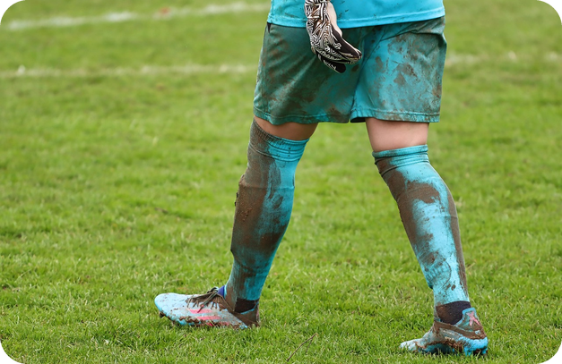
13
Not just funny – hilarious!
🎧 LISTEN ASCOLTA
✏️ FILL THE GAPS COMPLETA
Write the normal adjective. Then listen.
⏱ 3 min 👥 pairs
Scrivi l'aggettivo normale. Poi ascolta.
🎧 2.20 · pause after each one
7 Was it ___ in Dubai? – It was boiling! 45 degrees.
hot
8 Was Jack's kitchen ___? – It was filthy. It took us three hours to clean it.
dirty
9 Are your parents ___ about the wedding? – They're delighted!
pleased
10 Was the film ___? – It was hilarious. We laughed the whole way through.
funny
11 Are you ___ you locked the door? – I'm positive.
sure
💡
Guess first, then listen!
12 Were you ___ to hear that Ted and Sonia have broken up? – I was absolutely amazed!
surprised
🔈 click ▶
2B-2 · Vocabulary · strong adjectives (2) · 📖 SB p.23 · 7b, 7c · audio 2.20
Notes:
13. Vocabulary · strong adjectives (2) (3 min)
VOCABULARY (3 min). Same procedure for 7–12. Play 2.20 (7–12); click once per line. Answers (TG): 7 hot · 8 dirty · 9 pleased · 10 funny · 11 sure · 12 surprised. TG notes: amazed = very surprised, but amazing = very surprising OR very good (an amazing film) · delighted can also mean very happy · positive here = very sure. Then pairs read all 12 mini-dialogues aloud (A / B, then swap), stressing the strong adjective. 2–3 pairs perform. Drill filthy /ˈfɪlθi/ (th!), hilarious /hɪˈleəriəs/, delighted /dɪˈlaɪtɪd/ (-ed = /ɪd/ after t).

Slide 14
14
Strong adjectives in Italian
✅ CHECK CONTROLLA
⏱ 2 min 🙋 whole class
Say it in Italian. Then click!
Dillo in italiano. Poi clicca!
😡
furious
🐜
tiny
😱
terrified
🤩
fascinating
furioso
minuscolo
terrorizzato
affascinante
🍽️
starving
🐘
huge / enormous
🔥
boiling
🧽
filthy
affamato · muoio di fame!
enorme
si muore di caldo!
sudicio · lurido
🥳
delighted
😂
hilarious
👍
positive
😲
amazed
felicissimo
esilarante
sicurissimo
sbalordito
⚠ Watch out! exhausted = very tired · freezing = very cold | ✗ very exhausted → ✓ absolutely / really / completely exhausted | STRESS it: I'm STARving!
2B-2 · Vocabulary · in Italian
Notes:
14. Vocabulary · in Italian (2 min)
CONSOLIDATION for slower students (2 min). The class says the Italian for each word, then ONE click shows all the Italian (and the warning line). 20 seconds on the warning: never 'very' + a strong adjective. CCQs: 'I'm starving – am I going to die?' (no – I'm very hungry) · 'The film was hilarious – did we laugh a little?' (no – a lot) · 'Can I say very furious?' (no – absolutely furious). FALSE FRIEND note: positive = very sure here (not 'ottimista').

Slide 15
15
Upgrade it!
🎲 PLAY GIOCA
🔊 SAY IT PRONUNCIA
Answer with a STRONG adjective!
⏱ 4 min 🏆 teams
Rispondi con un aggettivo FORTE!
🎲
How to play
1
Is the sea cold in January?
→ Cold? It's absolutely freezing!
Listen to the question.
Teams: answer with a STRONG adjective – 5 seconds!
Big stress = 1 point. 'very' = 0!
Are you hungry? It's 2 o'clock!
→ Hungry? I'm starving!
2
3
Was Palermo hot in August?
→ Hot? It was boiling!
4
Is your brother's bedroom dirty?
→ Dirty? It's absolutely filthy!
📷 2b2-starving.jpg
5
Was the comedy funny?
→ Funny? It was hilarious!
6
Are you tired after the match?
→ Tired? I'm completely exhausted!
2B-2 · Vocabulary game · 📖 SB p.23 · 7d (Communication Are you hungry? A p.106, B p.111 – adapted)
Notes:
15. Vocabulary game (4 min)
GAME 2 (4 min). Replaces / prepares SB 7d (Communication 'Are you hungry?', A p.106, B p.111 – the same idea: answer a normal question with a strong adjective). Read each question aloud with a 'normal' voice; the first team to answer with the right strong adjective AND strong stress wins the point ('very' = no point). Click to show a model answer. Then pairs do the book activity (pp.106 / 111) or ask each other the six questions – SECOND ROUND FASTER (TG). TG extra support questions: Is an elephant big? Are you frightened of snakes? Was the book good? ICQ: 'Can you say very freezing?' (no!).

Slide 16
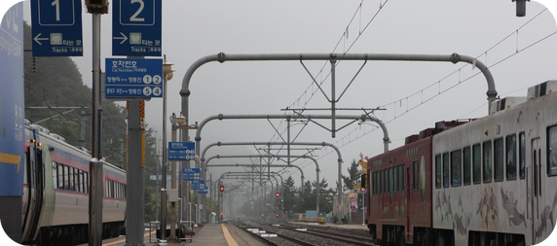
16
The worst trip ever!
🎲 PLAY GIOCA
💬 TALK PARLA
Finish the story with a strong adjective!
⏱ 4 min 🏆 teams
Finisci la storia con un aggettivo forte!
🎲
How to play
1
We got to the hotel. The room was…
→ e.g. tiny – and absolutely filthy!
Read the start of the sentence.
Teams: finish it with a strong adjective. No repeats!
Funniest correct ending = 1 point.
We went to the beach. The sea was…
→ e.g. freezing! It was April!
2
3
All the restaurants were closed. We were…
→ e.g. starving!
4
Then we got lost in the mountains. I was…
→ e.g. terrified!
5
We walked for six hours. At the end we were…
→ e.g. completely exhausted.
6
Mum saw our clothes. She was…
→ e.g. furious! But the photos were hilarious.
2B-2 · Speaking game · story chain · 📖 Strong adjectives · SB p.22 6e (an exciting experience)
Notes:
16. Speaking game · story chain (4 min)
GAME 3 (4 min). A chain story about a school trip where EVERYTHING went wrong (like Helen's snowstorm, soft snow and filthy hair). Show each sentence start; teams have 20 seconds to finish it with a strong adjective they haven't used yet. Click to show an example ending. Point for the funniest correct ending (the class votes with a show of hands). No adjective, a repeated adjective, or 'very + strong adjective' = no point. FAST FINISHERS / extra minute: groups of 3 invent their own 'worst trip' – each person adds one sentence with a different strong adjective; one group tells its story to the class. ICQ: 'Can you use starving twice?' (no).

Slide 17
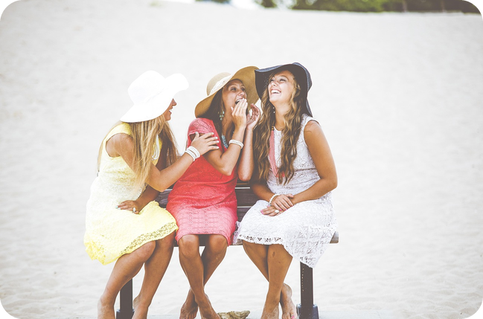


17
Absolutely!
💬 TALK PARLA
⏱ 4 min 👥 pairs
Ask and answer. Use a strong adjective!
Chiedi e rispondi. Usa un aggettivo forte!
1
Have you ever been swimming where the water was very cold?
e.g. Yes! Mondello in March – it was absolutely freezing!
2
Does anything make you angry about drivers or cyclists here?
e.g. Yes! People who park on the pavement make me furious.
3
Are you afraid of any animals or insects?
e.g. Spiders! I'm absolutely terrified of them.
4
What's the hottest place you've been to?
e.g. Seville in July. It was boiling – 44 degrees!
💬
Useful phrases
Really? What happened?
How did you feel?
It was absolutely / really…
5
Is there a TV comedy series you think is really funny?
e.g. Yes! My favourite sitcom is hilarious – I cry with laughter.
2B-2 · Speaking · strong adjectives · 📖 SB p.23 · 7e
Notes:
17. Speaking · strong adjectives (4 min)
SPEAKING (4 min). SB 7e (question 2 adapted: 'in your country' → here). TG extra support: answer one question yourself first, giving lots of detail. Questions appear ONE PER CLICK – about 45 seconds each. Each answer needs a strong adjective (freezing, furious, terrified, boiling, hilarious) and a detail; the partner asks one follow-up question. Monitor; note 4–5 errors (especially 'very + strong adjective' and flat stress) for 1 minute of delayed correction at the end. Feedback: 2–3 students tell the class their partner's best answer.

Slide 18
18
The Great OUP Bake Sale
👀 LOOK GUARDA
🎧 LISTEN ASCOLTA
Watch. Why are these mentioned?
⏱ 9 min 👤 alone
Guarda. Perché vengono nominati?
⭐
Example
1
Which cake (1–5) wins?
2 · the Neapolitan cake
0 Daisy Watt → a chef – one of the judges
2
the New York Marathon
raises about $40 million every year
3
The Great British Bake Off
TV show – made bake sales very popular
📷 2b2-bake-sale.jpg
4
Macmillan · Adelante Africa
the two charities the sale is for
5
Viennese Whirls
Emma's biscuits (buttercream and jam)
6
a stress-reliever
what baking is for Emma
7
a sponge cake with blueberries
James's cake
8
£270
the sale raised over £270
2B-2 · Video listening · The Great OUP Bake Sale · 📖 SB p.23 · 8a, 8b · Video 2B (7'27")
Notes:
18. Video listening · The Great OUP Bake Sale (9 min)
VIDEO LISTENING (9 min). ⚠ The video is NOT inside this deck: play EF_INT_2B_THE_GREAT_OUP_BAKE_SALE.mp4 (LLS course folder b1/video/) or Online Practice 2B. BEFORE watching (1 min): look at the five cakes in the book (SB p.23) and read the list on the slide – the questions are on screen before they watch. TG extra support – pre-teach if needed: buttercream (butter + sugar), a sponge cake, blueberries, cookies, a loaf cake, icing. Watch ONCE all the way through (7.5 min) and do 8a + 8b together. TG EXTRA IDEA: pause at 05:27 ('And then to choose the winner') – pairs predict the winner. Click once per line. Answers (TG): 8a the winning cake is number 2, the Neapolitan cake (Laura's) – does it look the best? 8b 1 New York Marathon: an example of raising money – about $40 million every year · 2 The Great British Bake Off: TV programme that made baking and bake sales very popular · 3 Macmillan Cancer Support and Adelante Africa: the two charities · 4 Daisy Watt: a chef, one of the judges (example) · 5 Viennese Whirls: the biscuits Emma is making · 6 Emma: baking is a stress-reliever for her · 7 James: a sponge cake with blueberries · 8 baking with kids: when James bakes, it's usually with his kids, something easy like cookies · 9 the decoration: what Daisy is looking for (real effort) · 10 £270: the sale raised over £270. Link: Adelante Africa = last lesson's charity! If short of time: set the video for homework on Online Practice and do the exit now.

Slide 19
19
3 · 2 · 1
⏱ 2 min 👥 pairs
Books closed! What can you remember?
Libri chiusi! Cosa ricordi?
3
strong adjectives – and their normal adjective
📝
Homework · Compiti
Workbook 2B: 3a–3d
SB p.22: Strong adjectives – cover and test yourself
Video 2B on Online Practice (if not watched)
Homework sheet 2B-2 in the LLS app
2
things that happened to Helen in Antarctica
1
time you were absolutely exhausted or starving
Next lesson: Revise and Check 1&2 · review games
2B-2 · Exit · what can you remember?
Notes:
19. Exit · what can you remember? (2 min)
RETRIEVAL EXIT (2 min). Books closed. Pairs: 3 strong adjectives with the normal one (starving = very hungry), 2 things that happened to Helen (snowstorm, exhausted after nine hours of cycling, filthy hair, she cried…), 1 true sentence: 'I was absolutely exhausted after…'. A few students share – check the stress. Set homework (on the slide and in the app): Workbook 2B 3a–3d + learn the strong adjectives (cover one column and test yourself) + the 2B-2 homework sheet (easier version available). If the video wasn't watched in class: Online Practice 2B Video Listening.

Slide 20
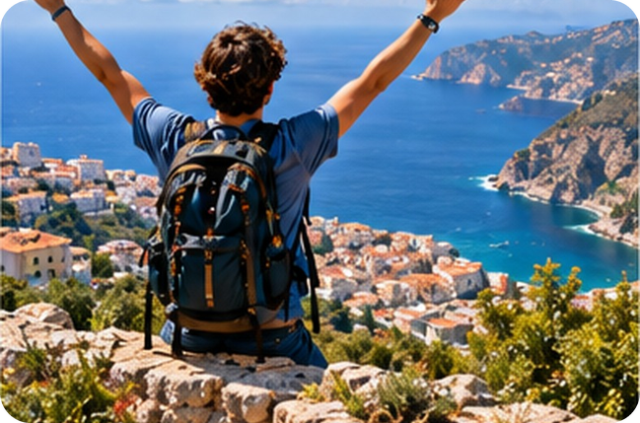
20
An exciting experience
💬 TALK PARLA
⏱ 4 min 👥 pairs
Tell your partner. Then ask: How did you feel?
Racconta al compagno. Poi chiedi: Come ti sei sentito?
1
Have you ever done an adventure sport? What?
e.g. Yes – I went rafting in Calabria. It was amazing!
2
Tell me about an exciting experience.
e.g. I climbed Etna with my cousins. We started at 5 a.m.
3
Was it a positive experience? Why (not)?
e.g. Yes, but I was exhausted and starving at the top!
4
How did you feel?
e.g. Absolutely delighted – and a bit terrified!
💬
Useful phrases
It was absolutely amazing / terrifying…
I was exhausted / delighted…
Would you do it again?
2B-2 · Extra · an exciting experience · 📖 SB p.22 · 6e
EXTRA · if there's time
Notes:
20. Extra · an exciting experience (4 min)
EXTRA (4 min, if there's time). SB 6e: tell your partner about an adventure sport you've done or an exciting experience you've had. Was it a positive experience? Why (not)? How did you feel? TG: tell the class about your own experience first. Questions appear one per click. Answers can be invented. Strong adjectives with -ing / -ed (terrifying / terrified, amazing / amazed) – accept both, and note that -ed / -ing adjectives come later in the course.

Slide 21
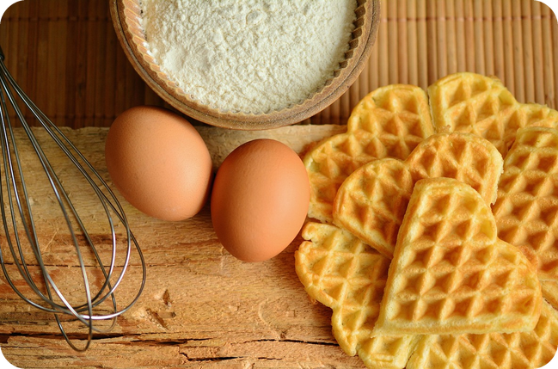
21
Plan a bake sale!
💬 TALK PARLA
⏱ 6 min 👨‍👩‍👧 groups
Plan a bake sale for a local charity!
Organizzate una vendita di dolci per beneficenza!
1
Which charity? Why this one?
e.g. A local animal shelter – the dogs are starving!
2
When and where? Who bakes what?
e.g. On Saturday at school. I'll make cannoli!
3
How much will you charge? How much do you want to raise?
e.g. €2 a slice. We want to raise €200.
4
Write a poster slogan with a strong adjective.
e.g. Our cannoli are absolutely fantastic – only €2!
💬
Useful phrases
We're going to… · We'll…
It'll be absolutely delicious!
How much will you charge?
2B-2 · Extra · project · 📖 TG extra idea (Video Listening 2B): a class bake sale
EXTRA · if there's time
Notes:
21. Extra · project (6 min)
EXTRA (6 min). TG EXTRA IDEA: the class could organize a real bake sale for a local charity. Recycles future forms from 1B (going to, will) and money words from 2A (charge, raise). Questions one per click. Keep the charity choice neutral and local. Each group presents in 1 minute; class vote.

