Slide 1


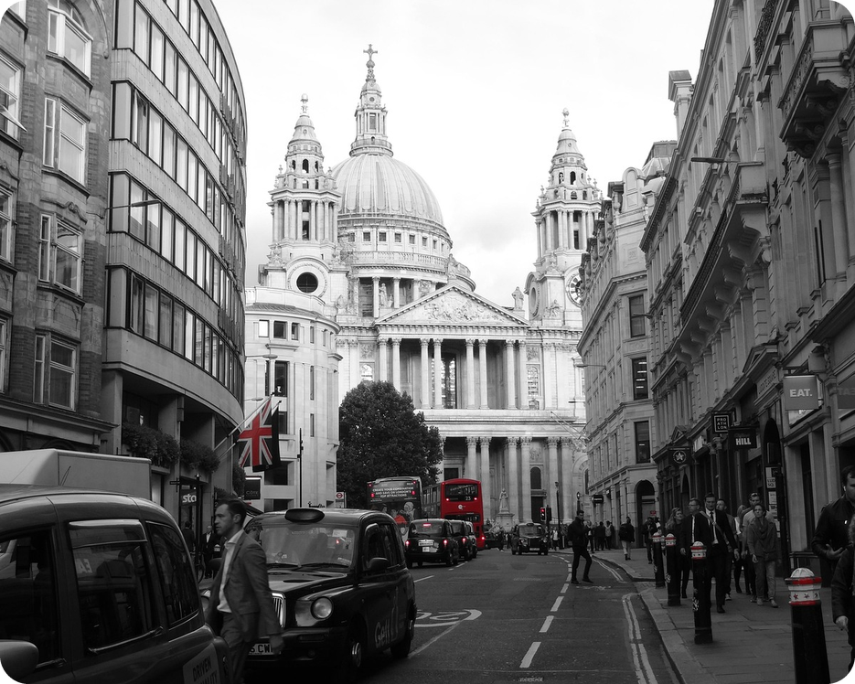


English File B1 · SB pp.26–27
💡 THINK · PENSA
3A-1
Survive the drive
Transport · a race across London
🎯
Today you're going to…
🚦 learn 25 transport and road words
🔊 say /ʃ/ /dʒ/ /tʃ/: shower, jazz, chess
👀 read about a crazy race across London
🎧 listen: who won the race?
💬 plan a race from Bagheria to Palermo
Bike, car, boat or bus: what's the fastest way across London?
EXAMPLE I think the bike is the fastest – London is full of cars and buses!
Notes:
1. OPENING (2 min)
OPENING (2 min). Show the photo (a London street with black cabs and a red bus). Ask the THINK question; click 1 shows the example answer. Get a quick show of hands for each option (bike / car / boat / bus) and WRITE THE VOTES ON THE BOARD – you check them after the listening (slide 20). Read the 'Today you're going to…' list together. Don't teach the vocabulary yet.

Slide 2

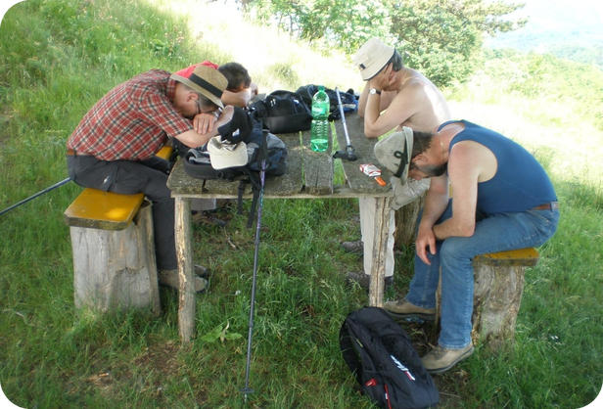
2
Remember last lesson?
💡 THINK PENSA
⏱ 2 min 🙋 whole class
What did we revise? Read the examples.
Cosa abbiamo ripassato? Leggi gli esempi.
Strong adjectives
Say WHY: Files 1–2 tenses
I ran 10 km. I'm exhausted!
It's –30°C. It's freezing!
That comedy is hilarious!
→ absolutely / really – NOT very
I'm starving – I haven't eaten all day.
I'm exhausted – I've been walking since 6!
It's freezing – I'm going to buy a coat.
→ present perfect · been + -ing · going to
📅
Last lesson…
Revise and Check 1&2: games, test, targets
strong adjectives + Files 1–2 tenses
🔤 KEY WORDS
exhausted
freezing
starving
furious
filthy
hilarious
terrified
3A-1 · Revision · last lesson
Notes:
2. Revision · last lesson (2 min)
REVISION (2 min) before the warmer game. Left: the strong adjectives from last lesson's warmer ('Make it stronger!'). Ask 'Can you say very exhausted?' (no – absolutely / really exhausted). Right: a strong adjective + a reason in a Files 1–2 tense (the four grammar points of the R1-2 test). Elicit one more example from a student (e.g. 'I'm furious – my brother has taken my phone!'). Ask: 'What was your revision target from last lesson?' (2–3 students). Then play 'Travel nightmares!' – the answers use exactly this language.

Slide 3

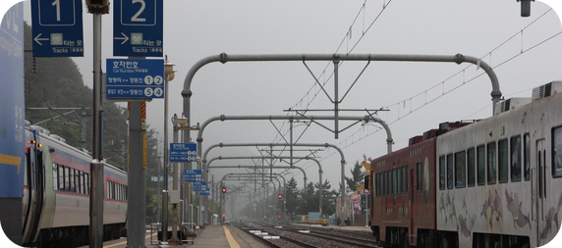
3
Travel nightmares!
🎲 PLAY GIOCA
⏱ 3 min 🏆 teams
React with a strong adjective. Say why!
Reagisci con un aggettivo forte. Di' perché!
🎲
How to play
1
You walked 15 km to the station.
→ I'm exhausted! I've been walking for hours.
Read the travel nightmare.
React: a strong adjective + WHY.
Strong adjective = 1 point. Good reason = +1.
The bus has no heating. It's –2°C.
→ It's freezing! I'm going to wear two coats.
2
3
Your train is 3 hours late. No food!
→ I'm starving! I haven't eaten all day.
4
Your brother took your bike – without asking!
→ I'm furious! He's done it again!
5
The seats on the old bus are really dirty.
→ They're filthy! I'm not going to sit down.
6
Your friend fell asleep on the bus and woke up in Catania!
→ That's hilarious! / He was terrified!
3A-1 · Warmer · last lesson: strong adjectives · 📖 Recycles R1-2 (strong adjectives, 2B audio 2.20) + Files 1–2 tenses
Notes:
3. Warmer · last lesson: strong adjectives (3 min)
RETRIEVAL WARMER (3 min) · books closed. Format: situation → reaction (different from R1-2's 'Make it stronger!', where students only changed 'very + adjective'). Two teams. Read each travel nightmare aloud dramatically; the first team to react with a strong adjective AND a reason gets the points (1 for the strong adjective with good stress – EXhausted, FREEzing; +1 for a correct reason in a Files 1–2 tense). Click once per line for a model answer; accept any correct reaction. Watch for ✗ very starving. ICQs: 'Is one word enough?' (no – say why too) · 'Can you say very exhausted?' (no). The situations bridge to today's topic: transport and journeys (only known words: bus, train, bike, station).

Slide 4
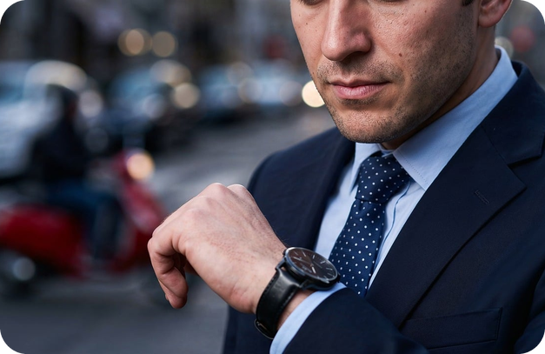

4
What can you hear?
🎧 LISTEN ASCOLTA
🤔 GUESS INDOVINA
Close your eyes. Listen. What is it?
⏱ 3 min 👥 pairs
Chiudi gli occhi. Ascolta. Cos'è?
🎧 3.1 · play once
🔊 1 ___
train
🔊 2 ___
car
🔊 3 ___
bike
🔊 4 ___
motorbike
🔊 5 ___
lorry
🔊 6 ___
the Underground
🔊 7 ___
scooter
💡
Guess first, then listen!
🔊 8 ___
bus
🔈 click ▶
3A-1 · Vocabulary · lead-in · sounds · 📖 SB p.26 · 1a · audio 3.1
Notes:
4. Vocabulary · lead-in · sounds (3 min)
LEAD-IN (3 min). First, 30 seconds books closed: pairs write as many kinds of transport as they can (the longest list reads it out). Then play 3.1 (sound effects) ONCE: students close their eyes and write the transport in order. Pairs compare. Click once per sound. Answers (TG / audio script): 1 train · 2 car · 3 bike · 4 motorbike · 5 lorry · 6 the Underground · 7 scooter · 8 bus. Drill lorry /ˈlɒri/ and scooter /ˈskuːtə/. Show of hands (TG): who uses public transport to get to school / work? ICQ: 'Eyes open or closed?' (closed).

Slide 5
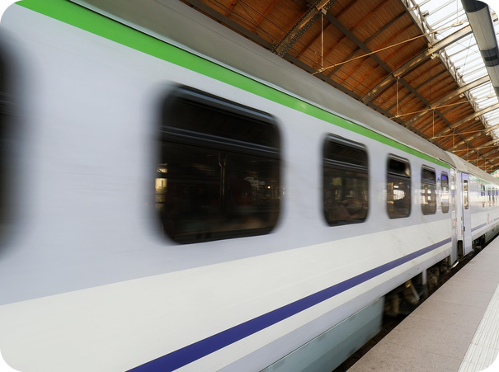
5
Vehicles: what's the word?
💡 THINK PENSA
💬 TALK PARLA
Read the clue. Say the word!
⏱ 3 min 👥 pairs
Leggi l'indizio. Di' la parola!
⭐
Example
1
a bus between cities
a coach
2
a very big vehicle for things
a lorry
0 something that carries people or things → a vehicle /ˈviːəkl/
3
a small lorry for deliveries
a van
4
a small motorbike
a scooter
5
a boat for people and cars
a ferry
6
a train in city streets
a tram
7
trains under London
the Underground (the Tube)
8
a big, fast road
a motorway
9
a bike with an engine
a motorbike
3A-1 · Vocabulary · vehicles · 📖 Vocabulary Bank Transport p.155 · 1 Public transport and vehicles · audio 3.2
Notes:
5. Vocabulary · vehicles (3 min)
ELICIT FIRST (3 min). Demo item 0: drill vehicle /ˈviːəkl/ (silent h). Pairs read each clue and say the word; click once per item. Then (optional) Vocabulary Bank p.155 1a – match words and photos, play 3.2 to check: van 1 · coach 2 · lorry 3 · scooter 4 · tram 5 · motorway 6 · the Underground 7 · ferry 8 · motorbike 9. TG notes: a bus is usually in a town; a coach goes between cities. The London Underground is often called the Tube. Ask: 'Which of these can you take from Bagheria?' (bus, coach to the airport, the ferry from Palermo…). ICQ: 'Do you say the clue or the word?' (the word).

Slide 6
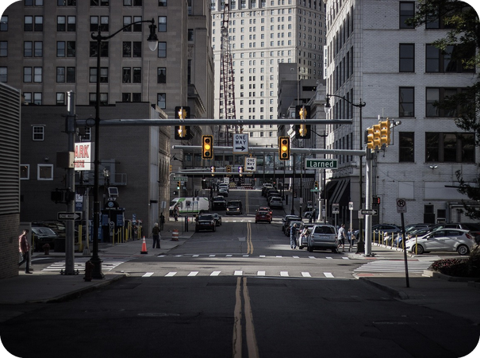
6
On the road: the other half
🔗 MATCH ABBINA
💬 TALK PARLA
Say the first word. Find the other half!
⏱ 4 min 👥 pairs
Di' la prima parola. Trova l'altra metà!
⭐
Example
1
car ___
car crash
0 traffic ___ → traffic jam · traffic lights
2
cycle ___
cycle lane
3
parking ___
parking fine
4
pedestrian ___
pedestrian zone
5
petrol ___
petrol station
6
rush ___
rush hour
7
seat ___
seat belt
8
speed ___ (2!)
speed camera · speed limit
3A-1 · Vocabulary · on the road · 📖 Vocabulary Bank Transport p.155 · 2 On the road · audio 3.3
Notes:
6. Vocabulary · on the road (4 min)
COMPOUND NOUNS (4 min). TG: compound nouns = two nouns together; the first describes the second. Demo 0 with the photo (traffic lights at the junction). Pairs say the first word and find the second; click once per item. Then add the other 5 from the Vocabulary Bank (write on the board): roadworks (ONE word, always plural), taxi rank, zebra crossing (+ traffic jam, traffic lights from item 0). Audio 3.3 (14 items): car crash · cycle lane · parking fine · pedestrian zone · petrol station · roadworks · rush hour · seat belt · speed camera · speed limit · taxi rank · traffic lights · traffic jam · zebra crossing. Drill: the STRONG stress is on the FIRST word – SEAT belt, RUSH hour, TRAFfic jam (Italian speakers stress the second). ICQ: 'One word or two?' (two – except roadworks).

Slide 7

7
Transport words in Italian
✅ CHECK CONTROLLA
⏱ 2 min 🙋 whole class
Say it in Italian. Then click!
Dillo in italiano. Poi clicca!
🚌
coach
🚛
lorry
🚐
van
⛴️
ferry
pullman (tra città)
camion
furgone
traghetto
🛣️
motorway
🚇
the Underground
🚗
traffic jam
🚦
traffic lights
autostrada
la metropolitana
ingorgo, traffico
semaforo
🦓
zebra crossing
🚧
roadworks
🚕
taxi rank
📷
speed camera
strisce pedonali
lavori stradali
posteggio dei taxi
autovelox
⚠ Watch out! coach ≠ bus in town · roadworks = always plural · stress the FIRST word: TRAFfic jam, SEAT belt
3A-1 · Vocabulary · in Italian
Notes:
7. Vocabulary · in Italian (2 min)
CONSOLIDATION for slower students (2 min). The class says the Italian aloud for each tile, then ONE click shows all the Italian. 20 seconds on the warning line: coach is between cities (pullman), a bus is in town; roadworks has no singular; compound nouns are stressed on the first word. Quick CCQ: 'There are 100 cars and nobody can move – it's a…?' (traffic jam) · 'It takes a photo if you drive too fast' (speed camera).

Slide 8
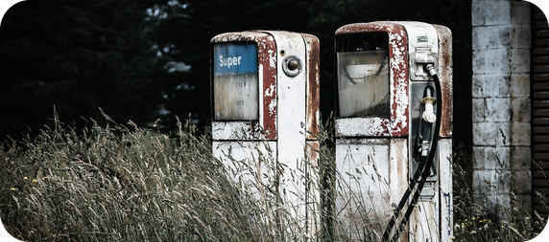
8
Describe it… or mime it!
🎲 PLAY GIOCA
⏱ 3 min 👥 pairs
Explain or mime it. Don't say it!
Spiegalo o mimalo. Non dirlo!
🎲
How to play
ROUND 1 · A explains
ROUND 2 · B explains
A looks at the screen. B turns around.
A explains, mimes or makes the sound. No part of the word!
B guesses. Then swap.
traffic jam
speed camera
seat belt
scooter
ferry
petrol station
zebra crossing
rush hour
3A-1 · Vocabulary game
Notes:
8. Vocabulary game (3 min)
GAME 2 (3 min) · variation of 'Describe it!' (worked well in 1B-1): this time A can also MIME or make a SOUND (great for ferry, scooter, seat belt) – but can't say any part of the word (for 'traffic jam', no 'traffic' and no 'jam'!). Demo with a strong student: mime putting on a seat belt + 'click!' → seat belt. Click to show each word (round 1 = 4 words for A, round 2 = 4 words for B, B faces the screen). 20 seconds per word. ICQs: 'Can you say traffic for traffic jam?' (no) · 'Can you mime?' (yes).

Slide 9
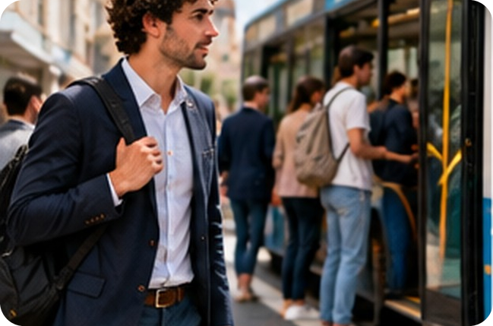
9
How long does it take?
💬 TALK PARLA
⏱ 3 min 👥 pairs
Ask and answer. Use: It takes me…
Chiedi e rispondi. Usa: It takes me…
1
How do you get to school or work? How long does it take?
e.g. I go by scooter. It takes me about ten minutes.
2
How long does it take to get to Palermo – by train? By car in the rush hour?
e.g. By train it's quick, but by car in the rush hour it can take an hour!
3
Have you ever been in a terrible traffic jam? Where?
e.g. Yes, on the motorway to Catania. I was furious!
4
Do you always wear a seat belt? And a helmet on a scooter?
e.g. Always! My dad's really strict about it.
💬
Useful phrases
How long does it take you?
It takes me about 20 minutes.
by bus · by car · on foot
5
Are there cycle lanes in Bagheria? Would you use one?
e.g. Not many. I'd use one to go to the beach in summer.
3A-1 · Speaking · How long does it take? · 📖 Vocabulary Bank p.155 · 3 How long does it take? · SB p.26 · 1c
Notes:
9. Speaking · How long does it take? (3 min)
SPEAKING (3 min). First go through the 'It takes…' box (Vocabulary Bank 3): It takes (me) + time = ci metto / ci vuole. ✗ I take 20 minutes · ✗ It wants 20 minutes. Questions appear ONE PER CLICK (about 35 seconds each). Monitor for the new words and 'It takes…'. Extra idea (TG): show of hands – who has the shortest / longest journey to school or work? The SB 1c information gap (Communication p.106 / p.111, 'I'm a tourist – can you help me?') can replace questions 3–5 if you have the book pages ready (the questions are not in our files). ICQ: 'Do you say I take 20 minutes?' (no – It takes me…).

Slide 10
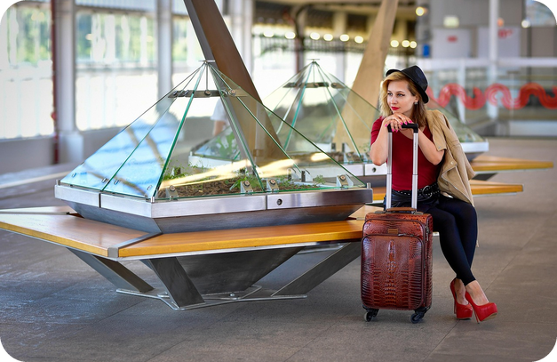
10
Set off, pick up, look out!
✏️ FILL THE GAPS COMPLETA
🎧 LISTEN ASCOLTA
Complete with ONE small word. Then listen.
⏱ 3 min 👥 pairs
Completa con UNA parolina. Poi ascolta.
🎧 3.4 · pause after each one
1 We set ___ at 7.00 to avoid the traffic.
off
2 Could you pick me ___ at the station?
up
3 Check your satnav or you may end ___ in the wrong place.
up
4 We're going to run ___ ___ petrol soon.
out of
5 Look ___! You're going to crash!
out
💡
Guess first, then listen!
🔈 click ▶
3A-1 · Vocabulary · phrasal verbs · 📖 Vocabulary Bank Transport p.155 · 4 Phrasal verbs · audio 3.4
Notes:
10. Vocabulary · phrasal verbs (3 min)
PHRASAL VERBS (3 min). Pairs guess the particles; play 3.4, pausing; click once per sentence. Answers (audio script 3.4; sentences 1 and 3 shortened on the slide): 1 off · 2 up · 3 up · 4 out of · 5 out. Meaning check (CCQs): set off = start a journey (partire) · pick sb up = collect sb in a car (passare a prendere) – the pronoun goes in the middle: pick ME up · end up = arrive where you didn't plan (finire) · run out of = have no more (rimanere senza) · Look out! = be careful (attento!). satnav = navigatore. ICQ: 'How many words in gap 4?' (two).

Slide 11
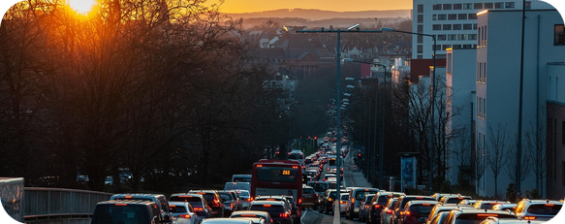
11
Shower, jazz or chess?
🔊 SAY IT PRONUNCIA
🔗 MATCH ABBINA
Say the word. Shower, jazz or chess?
⏱ 3 min 👥 pairs
Di' la parola. Shower, jazz o chess?
🏷️
The colours
crash
🚿 shower /ʃ/
bridge
🎷 jazz /dʒ/
🚿 shower /ʃ/
🎷 jazz /dʒ/
catch
♟️ chess /tʃ/
♟️ chess /tʃ/
rush
🚿 shower /ʃ/
journey
🎷 jazz /dʒ/
coach
♟️ chess /tʃ/
station
🚿 shower /ʃ/
traffic jam
🎷 jazz /dʒ/
adventure
♟️ chess /tʃ/
3A-1 · Pronunciation · /ʃ/ /dʒ/ /tʃ/ · 📖 SB p.26 · 2a, 2b, 2c · audio 3.5, 3.6
Notes:
11. Pronunciation · /ʃ/ /dʒ/ /tʃ/ (3 min)
PRONUNCIATION 1 · HEAR + SORT (3 min). 2a: play 3.5 – shower /ʃ/, jazz /dʒ/, chess /tʃ/ – students repeat. Pairs say each word aloud and match it to a sound (TG: saying the words aloud makes it easier). Play 3.6 and click once per word. Answers (audio script 3.6): /ʃ/ crash, rush, station · /dʒ/ bridge, journey, traffic jam · /tʃ/ adventure, catch, coach. Spelling rules (TG): sh and -tion = /ʃ/ · j (and -dge) = /dʒ/ · ch is usually /tʃ/, but /ʃ/ in French words (chef, machine) and /k/ in chemist's, technology. Italian has all three sounds (sci, gi, ci) – the problem is the English SPELLING. Play 3.6 again: listen and repeat.

Slide 12
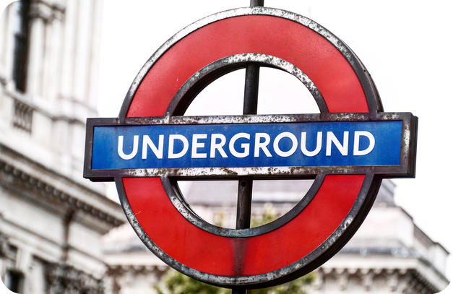
12
Cheap or jeep?
🎧 LISTEN ASCOLTA
🔊 SAY IT PRONUNCIA
Listen. Which word do you hear?
⏱ 2 min 👤 alone
Ascolta. Quale parola senti?
🎧 3.8 · play once
1 cheap / jeep
jeep
2 chain / Jane
chain
3 choke / joke
joke
4 ship / chip
chip
5 shoes / choose
shoes
💡
Guess first, then listen!
6 wash / watch
watch
🔈 click ▶
3A-1 · Pronunciation · which word? · 📖 SB p.26 · 2d, 2e · audio 3.7, 3.8
Notes:
12. Pronunciation · which word? (2 min)
PRONUNCIATION 2 · DISCRIMINATE + REPEAT + PRODUCE (2 min). 2d: make sure students know the meanings (choke = soffocare, chain = catena). Play 3.7 once to listen, then again pausing for students to repeat. 2e: play 3.8 – students write the word they hear; click once per pair. Answers (TG): 1 jeep · 2 chain · 3 joke · 4 chip · 5 shoes · 6 watch. Then PRODUCE in pairs: A says one word from a pair, B points to it in the book (or says 'one' / 'two'); swap. TG extra support: show the mouth position (Sound Bank videos). The 3.9 dictation is an EXTRA slide after the exit.

Slide 13
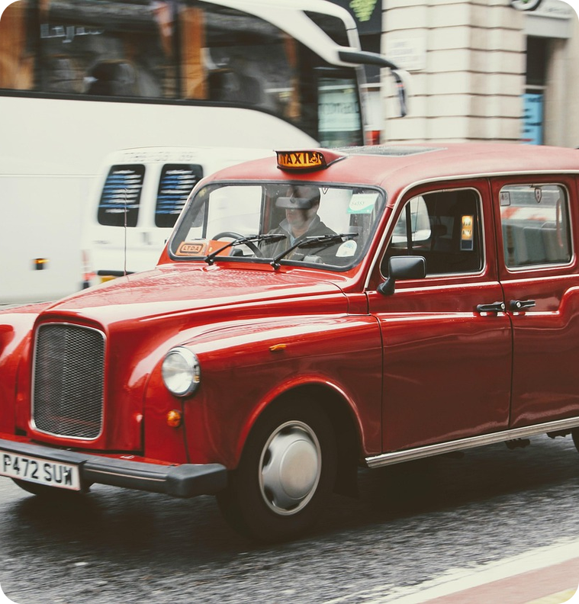
13
Who will win the race?
👀 READ LEGGI
🤔 GUESS INDOVINA
Read. Who will win? Put them 1st–4th!
⏱ 3 min 👥 pairs
Leggi. Chi vincerà? Mettili dal 1° al 4°!
Top Gear challenge
A race across London on a Monday morning in the rush hour: from Kew Bridge (south-west) to the check-in desk at London City Airport (east) – about 15 miles. Jeremy: a motorboat · James: a car · Richard: a bike · The Stig: public transport.
➡ NEXT The next 3 slides: the boat, the bike and the car. 7 gaps – guess today's words and numbers!
🔢 NUMBER BANK · guess where they go!
1st
2nd
3rd
4th
3A-1 · Reading · prediction · 📖 SB p.26 · 3a, 3b
Notes:
13. Reading · prediction (3 min)
PREDICTION (3 min). Ask: 'Do you know Top Gear?' (a BBC TV programme about cars; the presenters do funny, adventurous and sometimes dangerous things). Teach race (gara). Students read the introduction in the book (p.26, the slide shows a summary) + the glossary: 1 mile = 1.6 km (15 miles ≈ 25 km) · The Stig = the nickname of one of the Top Gear team · Oyster card = a London travel card. TG answers to 3a: from Kew Bridge, in the south-west of London, to the check-in desk at London City Airport, in the east · a bike, a car, a motorboat and public transport. Show the map in the book. 3b: pairs predict the order (1st–4th) with a reason ('The bike, because there's a lot of traffic in the rush hour'). Write 2–3 predictions on the board. Don't give the answer – it comes in audio 3.11 (slide 20). ICQ: 'Are you guessing or checking?' (guessing).

Slide 14
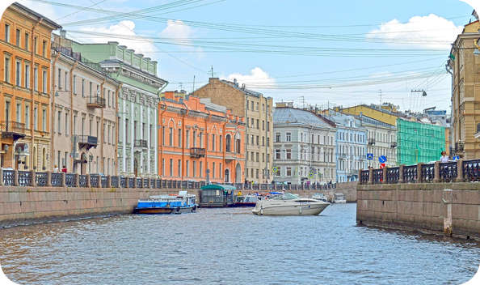
14
The race 1/3: the boat
👀 READ LEGGI
⏱ 2 min 👥 pairs
Read. Guess gaps 1–2. Still agree?
Leggi. Indovina gli spazi 1–2. Sei ancora d'accordo?
Jeremy in the motorboat
His journey was along the River Thames. For the first few miles, there was a (1) _____ of nine miles an hour, because there are so many ducks and other birds in that part of the river.
His journey was along the River Thames. For the first few miles, there was a speed limit of nine miles an hour, because there are so many ducks and other birds in that part of the river.
The river was confusing, and at one point, he realized that he was going in the wrong direction. But he turned round and got back onto the right route.
Soon, he was going past Fulham Football Club. He phoned Richard and asked him where he was. Good news for Jeremy! He was ahead of the bike!
He got to Wandsworth Bridge. The speed limit finished there and he could now go as fast as he liked. Jeremy felt like the fastest-moving man in all of London.
He was flying, coming close to 50 miles an hour! How could he lose now? He could see Tower Bridge ahead.
💡
Remember
His journey was seven miles longer than the others', but he was now going at (2) _____ miles an hour. Not far to the airport now!
His journey was seven miles longer than the others', but he was now going at 70 miles an hour. Not far to the airport now!
1 mile = 1.6 km
9 → 50 → 70 miles an hour!
3A-1 · Reading · the race 1/3 · 📖 SB p.26 · 3c · text: Jeremy in the motorboat
Notes:
14. Reading · the race 1/3 (2 min)
READ FOR GIST (2 min). Pairs read and guess the gaps (gapped-text technique: today's vocabulary and numbers), then click once per gap: the answer appears highlighted IN the text. Answers (SB text): 1 speed limit · 2 70. Gist question (SB 3c): 'Do you still agree with your prediction?' Don't explain the highlighted 3e verb phrases yet (turned round, was ahead of) – they come in the Phrase race game.

Slide 15
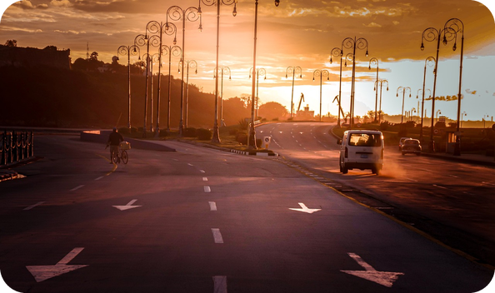
15
The race 2/3: the bike
👀 READ LEGGI
⏱ 2 min 👥 pairs
Read. Guess gaps 3–6. Still agree?
Leggi. Indovina gli spazi 3–6. Sei ancora d'accordo?
Richard on the bike
Richard could use (3) _____ , which was great, but of course he had to be careful not to crash into the buses. He hated buses! Horrible things!
Richard could use bus lanes, which was great, but of course he had to be careful not to crash into the buses. He hated buses! Horrible things!
When the (4) _____ turned red, he thought of cycling through them, but then he remembered that he was on TV, so he had to stop!
When the traffic lights turned red, he thought of cycling through them, but then he remembered that he was on TV, so he had to stop!
When he got to Piccadilly, he was delighted to see that there was a terrible (5) _____ – he could go through the traffic, but James, in his Mercedes, would get stuck.
When he got to Piccadilly, he was delighted to see that there was a terrible traffic jam – he could go through the traffic, but James, in his Mercedes, would get stuck.
He got to Trafalgar Square and then went into a (6) _____ . From now on, it was going to be easier…
He got to Trafalgar Square and then went into a cycle lane. From now on, it was going to be easier…
💡
Remember
Clue for 3: like a cycle lane, but for buses!
3A-1 · Reading · the race 2/3 · 📖 SB p.27 · 3c · text: Richard on the bike
Notes:
15. Reading · the race 2/3 (2 min)
READ FOR GIST (2 min). Same procedure: pairs guess the gaps from context (all compound nouns from slide 6), click once per gap. Answers (SB text): 3 bus lanes · 4 traffic lights · 5 traffic jam · 6 cycle lane. Ask: 'Why was Richard delighted about the traffic jam?' (a bike can go through it, but the car gets stuck). Still agree with your prediction?

Slide 16
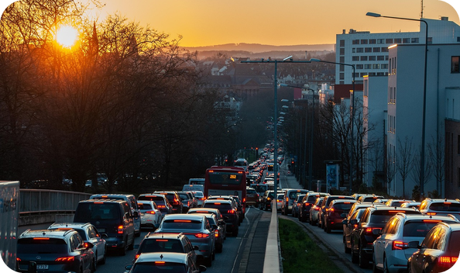
16
The race 3/3: the car
👀 READ LEGGI
⏱ 2 min 👥 pairs
Read. Guess gap 7. Who's winning?
Leggi. Indovina lo spazio 7. Chi sta vincendo?
James in the car
He started off OK. He wasn't going fast, but at a steady speed – until he was stopped by the police!
They only wanted to check the permit for the cameraman in the back of the car,
but it meant that he lost three or four valuable minutes!
The traffic was getting worse. Now he was going really slowly.
💡
Remember
25 miles an hour, 23…, 20…, (7) _____ … It was so frustrating!
25 miles an hour, 23…, 20…, 18… It was so frustrating!
steady = not fast, not slow
permit = a paper that says you can
3A-1 · Reading · the race 3/3 · 📖 SB p.27 · 3c · text: James in the car
Notes:
16. Reading · the race 3/3 (2 min)
READ FOR GIST (2 min). Pairs guess the number (pattern: 25, 23, 20…), click to check. Answer (SB text): 7 18. Teach steady and permit (yellow card) if needed. Then: 'Who's winning now? Has anyone changed their prediction?' (show of hands – SB 3c: tell a partner). Note: the article stops before the end – nobody knows who won yet (the curiosity gap for slide 20).

Slide 17
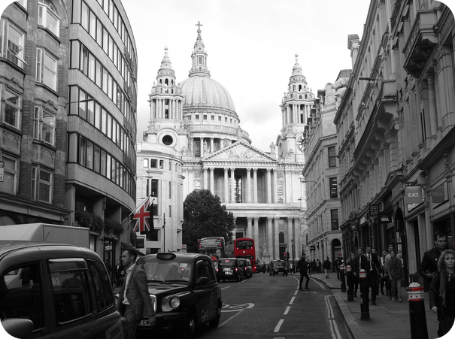
17
Who…? Je, R or Ja?
👀 READ LEGGI
🔍 FIND TROVA
3 minutes! Jeremy, Richard or James?
⏱ 4 min 👥 pairs
3 minuti! Jeremy, Richard o James?
⭐
Example
1
had to show a paper?
Ja · the police checked the permit
0 Who went by bike? → R (Richard)
2
went much faster later on?
Je · no speed limit after Wandsworth Bridge
3
didn't break the law?
R · he didn't cycle through the red lights
4
went more slowly later on?
Ja · 25, 23, 20, 18 miles an hour
5
was happy to see traffic?
R · delighted to see a terrible traffic jam
6
got slightly lost?
Je · he was going in the wrong direction
7
had the most exciting trip?
Je · 'the fastest-moving man in all of London'
3A-1 · Reading · detail · speed challenge · 📖 SB p.27 · 3d (TG key)
Notes:
17. Reading · detail · speed challenge (4 min)
READ FOR DETAIL (4 min) · speed challenge. Books open at pp.26–27 (or go back through slides 14–16). Three minutes: pairs answer Je, R or Ja for each question. Pair check, then click once per item: the answer AND the evidence from the text appear. TG key: 1 Ja · 2 Je · 3 R · 4 Ja · 5 R · 6 Je · 7 Je. Ask for the line in the text each time ('Show me!'). The questions on the slide are shortened from the book (book: 1 was asked to show a piece of paper · 2/4 … in the later part of his journey · 5 was happy to see that there was a lot of traffic · 7 had the most exciting journey). ICQ: 'How many minutes?' (three) · 'Do you write the name or J / R?' (Je, R or Ja).

Slide 18
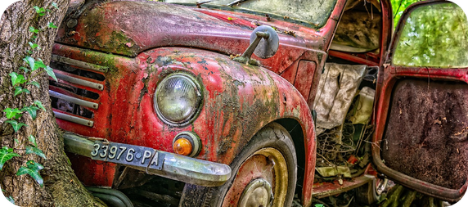
18
Phrase race!
🎲 PLAY GIOCA
🔍 FIND TROVA
Read the meaning. Find the phrase!
⏱ 3 min 🏆 teams
Leggi il significato. Trova l'espressione!
🎲
How to play
1
changed direction (Jeremy)
→ turned round
Read the meaning.
Find the phrase in the text. Shout it!
First team = 1 point.
was in front of (Jeremy)
→ was ahead of
2
3
hit another vehicle (Richard)
→ crash into
4
changed to red (Richard)
→ turned red
5
be unable to move (Richard)
→ get stuck
6
becoming more and more busy (James)
→ getting worse
3A-1 · Game · words from the text · 📖 SB p.27 · 3e (TG key)
Notes:
18. Game · words from the text (3 min)
GAME 3 (3 min) · scan race. Teams look at the three texts (book pp.26–27). Read the meaning aloud; the first team to shout the correct phrase from the text gets the point. Click once per item. TG key: turned round /tɜːnd raʊnd/ = changed direction · was ahead of /wəz əˈhed əv/ = was in front of sb · crash into /kræʃ ˈɪntə/ = hit an object or another vehicle · turned red = changed to red · get stuck /get stʌk/ = be unable to move · getting worse /ˈgetɪŋ wɜːs/ = becoming more and more busy. Drill the phrases. Italian: get stuck = rimanere bloccato (✗ get blocked).

Slide 19
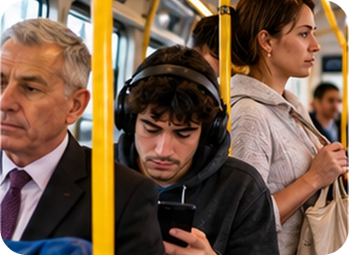
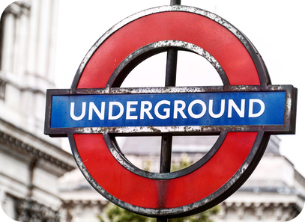
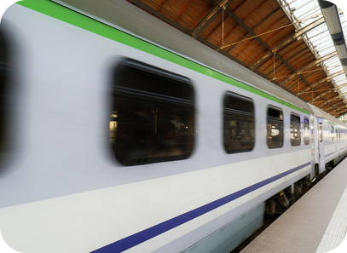
19
The Stig's journey
🎧 LISTEN ASCOLTA
⏱ 3 min 👤 alone
Listen. How did The Stig travel?
Ascolta. Come ha viaggiato The Stig?
🎧 3.10 · play once or twice
↘ speaker bottom right
A
B
C
1st
a bus · Kew Bridge → Acton Town
2nd
the Tube · District line · 18 stops
3rd
Docklands Light Railway · 10 stops
🎧
While you listen
Which 3 kinds of public transport? In what order?
What did he do on the Tube?
On the Tube?
he read a free newspaper
🔈 click ▶
3A-1 · Listening · The Stig · 📖 SB p.27 · 3f · audio 3.10
Notes:
19. Listening · The Stig (3 min)
LISTENING (3 min). Focus on the map in the book (p.27). Pre-teach warning (an announcement that tells you something bad may happen) and the gap (between the train and the platform). Play 3.10 once (twice if needed): students follow The Stig's route on the map. Pictures A–C: a bus, the Underground, a train platform. Click once per answer (audio script 3.10): he took a bus from Kew Bridge to Acton Town (paid with his Oyster card), the Underground (District line, 18 stops) to Monument, then the Docklands Light Railway (10 stops) to London City Airport; everyone was reading a newspaper, so he picked up a free one. Tube announcements (TG): 'The train now approaching is…' · 'Please mind the gap between the train and the platform' (= the warning) · 'The next station is Monument. Change here for…'. ICQ: 'Are you listening for the order?' (yes).

Slide 20
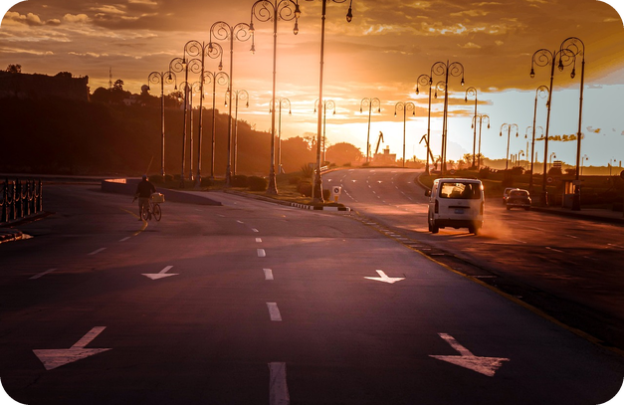
20
Who won the race?
🤔 GUESS INDOVINA
🎧 LISTEN ASCOLTA
Number them 1–4. Then listen!
⏱ 2 min 👥 pairs
Numerali da 1 a 4. Poi ascolta!
🎧 3.11 · play once
1st
Richard (bike) 🏆
2nd
Jeremy (boat)
3rd
The Stig (public transport)
4th – 15 minutes later!
James (car)
Why was Jeremy annoyed?
Top Gear is about cars – and the car came last!
💡
Guess first, then listen!
🔈 click ▶
3A-1 · Listening · the result · 📖 SB p.27 · 3g · audio 3.11
Notes:
20. Listening · the result (2 min)
LISTENING · RESULT (2 min). Write JEREMY – BOAT, JAMES – CAR, RICHARD – BIKE, THE STIG – PUBLIC TRANSPORT on the board; pairs number them again (TG). Teach annoyed (= slightly angry). Play 3.11 once. Click once per line. Answers (TG / audio script): 1 Richard (bike) · 2 Jeremy (boat) · 3 The Stig (public transport) · 4 James (car), fifteen minutes after The Stig. Jeremy was annoyed because Top Gear is a programme about cars and the car came last ('Disaster! Public transport had beaten the car!'). Show of hands: who predicted correctly? Check the votes from slide 1 too.

Slide 21
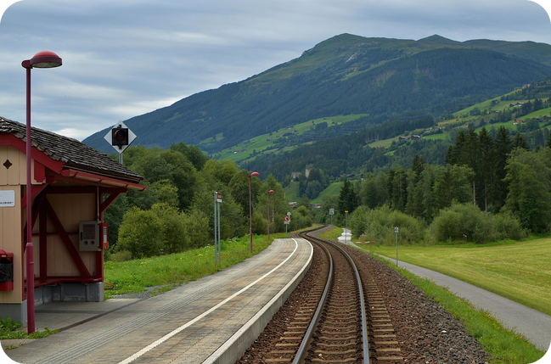
21
The Bagheria race!
💬 TALK PARLA
⏱ 4 min 👨‍👩‍👧 groups
Same race here! Who wins? Say why.
Stessa gara qui! Chi vince? Di' perché.
1
Bagheria → Teatro Massimo, Monday 8 a.m.: car, scooter, bike or train?
e.g. The scooter – it doesn't get stuck in traffic jams!
2
What problems will the car have?
e.g. The rush hour, roadworks – and no parking spaces!
3
And the train? How long does it take?
e.g. It's quick, but then you have to walk from the station.
4
Is the bike a good idea? Why / why not?
e.g. Not really – there aren't many cycle lanes.
💬
Useful phrases
I think the … will win.
It'll get stuck in traffic.
I don't agree – the roadworks!
5
Now agree as a group: 1st, 2nd, 3rd, 4th!
e.g. 1 the scooter · 2 the train · 3 the bike · 4 the car!
3A-1 · Speaking · our own race · 📖 SB p.27 · 3h
Notes:
21. Speaking · our own race (4 min)
SPEAKING (4 min) · personalisation (SB 3h). Questions appear ONE PER CLICK (about 45 seconds each). Groups of 3 decide on an order and give reasons with today's words (traffic jam, rush hour, roadworks, speed camera, get stuck…). Change the start / finish if your students live elsewhere (Aspra, Ficarazzi, Santa Flavia). Feedback: one group gives its order; others agree or disagree. Students will probably use comparatives (faster, the quickest) – don't correct them now: that's next lesson's grammar (3A part 2); note good examples. Note 4–5 errors for delayed correction at the exit. The example answers are only models (we don't know the real result!).

Slide 22
22
3 · 2 · 1
⏱ 2 min 👥 pairs
Books closed! What can you remember?
Libri chiusi! Cosa ricordi?
3
words for problems on the road (no looking!)
📝
Homework · Compiti
Workbook 3A: 1a–1e, 2a
Vocabulary Bank p.155: cover and test yourself
Homework sheet 3A-1 in the LLS app
2
phrasal verbs in a sentence about YOUR journey
1
who won the race – and why was Jeremy annoyed?
Next lesson: 3A part 2 · comparatives and superlatives · why do car accidents happen?
3A-1 · Exit · what can you remember?
Notes:
22. Exit · what can you remember? (2 min)
RETRIEVAL EXIT (2 min). Books closed. Pairs: 3 road-problem words (e.g. traffic jam, roadworks, parking fine, car crash, rush hour), 2 phrasal-verb sentences ('I set off at 7.30.' · 'My mum picks me up after school.'), 1 race fact (Richard / the bike won; the car came last and Top Gear is a car programme). Write 2–3 errors from the speaking on the board for students to correct. Set homework: Workbook 3A 1a–1e (vocabulary) and 2a (pronunciation; 2b is audio – optional), Vocabulary Bank p.155, homework sheet 3A-1 (easier version available).

Slide 23
23
Sound dictation
🎧 LISTEN ASCOLTA
✍️ WRITE SCRIVI
Listen. Write the sentence. Then check!
⏱ 3 min 👤 alone
Ascolta. Scrivi la frase. Poi controlla!
⭐
Example
1
Sentence 1
Do you like chips?
0 Listen carefully: /ʃ/ /dʒ/ or /tʃ/? ship or chip?
2
Sentence 2
I'm going to wash it.
3
Sentence 3
You choose.
4
Sentence 4
Don't joke about it.
5
Sentence 5
Is it cheap?
3A-1 · Extra · pronunciation · dictation · 📖 SB p.26 · 2f · audio 3.9
EXTRA · if there's time
Notes:
23. Extra · pronunciation · dictation (3 min)
EXTRA (3 min). SB 2f: play 3.9 once just to listen, then again pausing after each sentence for students to write. Click once per sentence (audio script 3.9). Then pairs dictate the sentences to each other, changing ONE sound (wash → watch, chips → ships): the partner says which word they heard. ⚠ Audio 3.9 is not in the deck folder: play it from the book audio.

Slide 24
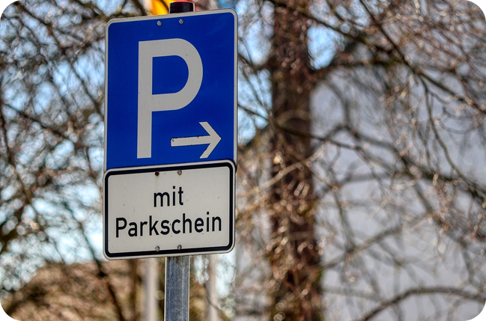
24
The worst journey ever!
💬 TALK PARLA
🎲 PLAY GIOCA
Invent the worst journey. Use 6 words!
⏱ 5 min 👥 pairs
Inventate il viaggio peggiore. Usate 6 parole!
1
Invent the WORST journey to school or work ever (pairs, 2 minutes).
e.g. We set off late, ran out of petrol on the motorway…
2
Use at least 6 words from today.
e.g. …got stuck in a traffic jam, got a parking fine…
3
Tell another pair in 1 minute. They count your words!
e.g. …and ended up in Catania! I was furious!
4
Vote: whose journey was the worst?
e.g. Theirs! They got a speed camera fine AND a car crash!
💬
Useful phrases
First… then… in the end…
set off · run out of · end up · get stuck
It was a nightmare! I was furious!
3A-1 · Extra · speaking · the worst journey
EXTRA · if there's time
Notes:
24. Extra · speaking · the worst journey (5 min)
EXTRA (5 min). Light-hearted personalisation + recycling (strong adjectives from last lesson welcome). Click once per step. The listening pair counts the words from today's lesson; the class votes for the worst journey. Alternative extra: Vocabulary photocopiable 3A Transport (TG p.207): 2 cycle lane · 3 platform · 4 car crash · 5 tram · 6 seat belt · 7 ferry · 8 zebra crossing · 9 taxi rank · 10 scooter · 11 petrol station · 12 coach · 13 speed camera · 14 parking fine · 15 van · 16 speed limit · 17 lorry · 18 roadworks · 19 motorway · 20 the Underground.

