Slide 1


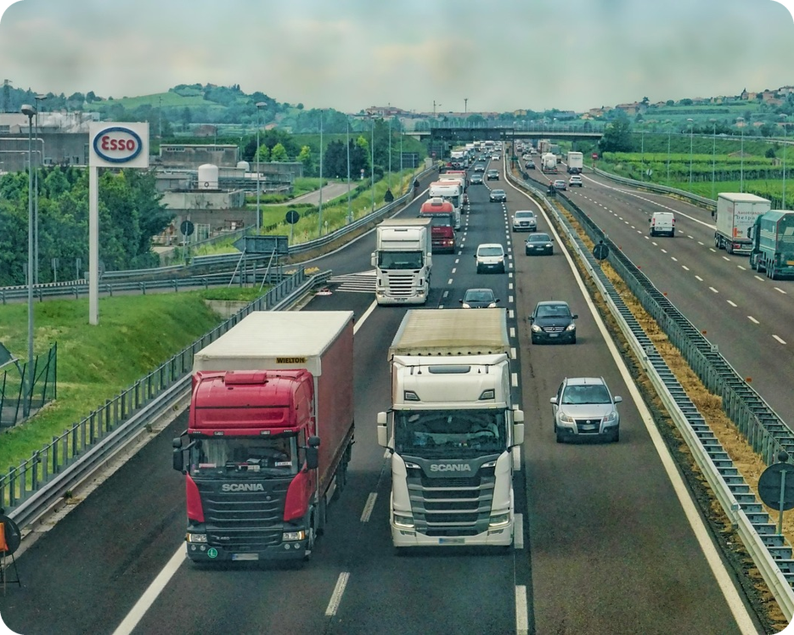


English File B1 · SB pp.28–29
💡 THINK · PENSA
3A-2
Survive the drive
Which is the most dangerous?
🎯
Today you're going to…
💬 compare ways to travel
✏️ use the most…, more… than, as… as
👀 read about research on 3,500 drivers
🎧 listen to an expert: the top 8 dangers
What's the most dangerous thing you can do while you're driving?
EXAMPLE I think using your phone is the most dangerous thing!
Notes:
1. OPENING (2 min)
Show the photo (a motorway). Ask the THINK question; take 3–4 ideas and WRITE THEM ON THE BOARD (check them after audio 3.16). Click 1 = the example answer. Twist for later: the expert does NOT talk about alcohol, drugs or a phone in your hand – 'everyone knows you must never do that' – and his number 1 is a surprise. Read the 'Today you're going to…' list together. Don't teach the grammar yet.

Slide 2

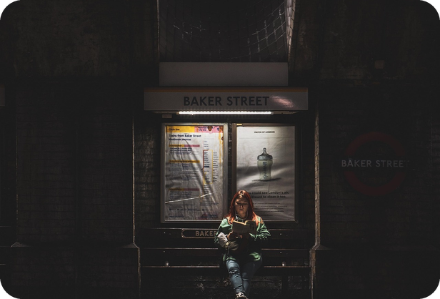
2
Remember last lesson?
💡 THINK PENSA
⏱ 2 min 🙋 whole class
What did we learn? Read the examples.
Cosa abbiamo imparato? Leggi gli esempi.
On the road
Phrasal verbs
We got stuck in a traffic jam.
Always wear your seat belt!
Slow down! There's a speed camera.
→ rush hour · cycle lane · zebra crossing · petrol station
We set off at 7 a.m.
Could you pick me up at the station?
We're going to run out of petrol!
→ end up · look out!
📅
Last lesson…
3A: transport and problems on the road
the Top Gear race across London
🔤 KEY WORDS
van
coach
lorry
scooter
tram
ferry
the Underground
roadworks
3A-2 · Revision · last lesson
Notes:
2. Revision · last lesson (2 min)
REVISION (2 min) before the warmer game. Language from 3A part 1 (Vocabulary Bank Transport p.155 and the Top Gear article). Read the examples with the class; elicit one more compound noun (traffic lights, taxi rank, parking fine) and the meaning of each phrasal verb: set off = start a journey · pick sb up = collect sb in a car · run out of = have no more · end up = arrive somewhere you didn't plan · look out = be careful. The photo: The Stig took the Underground. Then play 'Odd one out!' – it uses exactly these words.

Slide 3

3
Odd one out!
🎲 PLAY GIOCA
⏱ 4 min 🏆 teams
Find the odd one out. Say WHY!
Trova l'intruso. Di' PERCHÉ!
🎲
How to play
1
bus · tram · van · the Underground
→ van – it isn't public transport
Read the 4 words.
Find the odd one out.
Right word = 1 point. Good reason = +1!
traffic ___ : jam · lights · rank
→ rank – it's a taxi rank
2
3
coach · lorry · scooter · ferry
→ ferry – it goes on water
4
set off · pick up · run out of · speed limit
→ speed limit – not a phrasal verb
5
cycle lane · zebra crossing · pedestrian zone · petrol station
→ petrol station – it's for cars
TEAM A ☆☆☆☆☆
TEAM B ☆☆☆☆☆
6
BONUS Richard · Jeremy · The Stig · James: who came LAST?
→ James – the car came last!
3A-2 · Warmer · last lesson · 📖 Recycles 3A part 1: Vocabulary Bank Transport p.155 · audio 3.11
Notes:
3. Warmer · last lesson (4 min)
RETRIEVAL WARMER (4 min). Two teams. 30 seconds per line, then click to show a possible answer. 1 point for the word, +1 for a correct reason in English. Accept any good, logical reason (e.g. 3 'scooter – it has two wheels'; 1 'tram – it runs on rails' = bonus point for creativity). Line 6 is from audio 3.11: 1 Richard (bike) · 2 Jeremy (boat) · 3 The Stig (public transport) · 4 James (car). ICQs: 'One word or two?' (one) · 'Do you need a reason?' (yes).

Slide 4
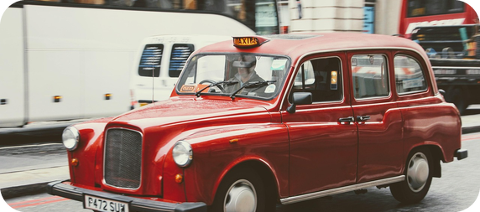
4
Right or wrong? Bet!
🎲 PLAY GIOCA
⏱ 4 min 🏆 teams
Right or wrong? Bet 1–3 points!
Giusta o sbagliata? Scommetti 1–3 punti!
🎲
How to play
1
What's the quicker way to get across London?
→ ✗ the quickest way
Each team starts with 10 points.
Read: right ✓ or wrong ✗? Bet 1, 2 or 3.
Wrong? Correct it to win the bet!
2
Driving is more boring than going by train.
→ ✓ right
3
The boat was nearly as fast than the bike.
→ ✗ as fast as
4
Oxford is about the same distance from London as Brighton.
→ ✓ right
5
There aren't as much trains as there were before.
→ ✗ as many trains as
6
It was the more exciting journey I've ever had.
→ ✗ the most exciting journey
7
The worst time of day to travel in London is between 7.30 and 9.30 a.m.
→ ✓ right
8
Women drive more careful than men.
→ ✗ more carefully than
3A-2 · Grammar · test first · 📖 SB p.28 · 4a
Notes:
4. Grammar · test first (4 min)
TEST FIRST (4 min) – SB 4a as a betting game (TTT: they met this at A2; the game shows what they still get wrong). Books closed. Teams write their bet (1–3) and ✓/✗ for each sentence; if ✗ they must write the correction. Click once per sentence. Right + correct correction = win the bet; wrong = lose it. Answers (TG): 1 ✗ the quickest way · 2 ✓ · 3 ✗ as fast as · 4 ✓ · 5 ✗ as many trains as · 6 ✗ the most exciting journey · 7 ✓ · 8 ✗ more carefully than. Ask WHY for each wrong one: superlative needs 'the … -est'; as … AS (not than); many + countable nouns (trains); drive how? → adverb (carefully). In the book the key phrases are highlighted: the quicker way · more boring than · as fast than · the same distance … as · as much trains as · the more exciting journey · The worst time of day · more careful than. Note which items most teams got wrong: spend time on those on the next slide. ICQs: 'Can you lose points?' (yes) · 'What must you do if it's wrong?' (correct it).

Slide 5
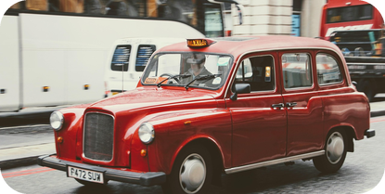
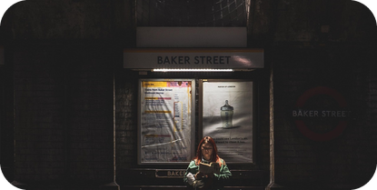
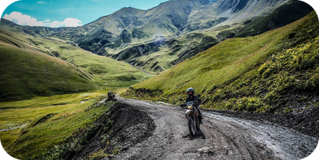
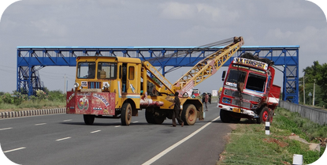

5
Comparing things
🎧 LISTEN ASCOLTA
👀 LOOK GUARDA
Listen and repeat!
🎧 3.12 + 3.13 + 3.14
⏱ 5 min 🙋 whole class
Ascolta e ripeti!
comparatives
(not) as … as
superlatives
irregular
-er / more / less + than
the same / not the same
the -est / the most / the least
learn them by heart!
My car is a bit older than yours.
London is more expensive than Edinburgh.
My father drives faster than me.
The new sofa isn't as comfortable as the old one.
Max doesn't speak English as well as his wife.
Kevin is the tallest player in the team.
Oslo is the most expensive capital city in Europe.
That's the worst we've ever played.
good → better → the best
bad → worse → the worst
far → further → the furthest
più / meno … di → than
(non) così … come → as … AS (not than!)
il più … di → the most … IN (not of!)
buono, migliore, il migliore…
🔈 click ▶
3A-2 · Grammar · the rule · 📖 Grammar Bank 3A p.136 · audio 3.12, 3.13, 3.14
Notes:
5. Grammar · the rule (5 min)
RULE (5 min). Play 3.12, 3.13 and 3.14 (Grammar Bank 3A p.136): students listen and repeat, copying the rhythm (than = weak /ðən/, as = weak /əz/). Click once per column: the examples appear (all from the audio). Form: one syllable + -er / the -est (older, the tallest); two or more syllables more / the most (more expensive, the most expensive); less / the least = the opposite of more / the most; adverbs work the same way (faster, more slowly). (not) as + adjective/adverb + as; as many / as much + noun. Superlative + in + place/group (in the team, NOT of) and often + present perfect + ever (the worst we've ever played). After than / as: object pronoun (than me) or subject + auxiliary (than I do). CCQs: 'Kevin is the tallest player in the team – is anyone taller?' (no) · 'The new sofa isn't as comfortable as the old one – which is more comfortable?' (the old one). The grey Italian line under each column shows the typical Italian-speaker trap (as … than; the best OF the class). Other typical mistakes to point out: ✗ He's best player → ✓ the best player · ✗ drive more careful → ✓ more carefully · ✗ more better → ✓ better. Go through the two information boxes in the Grammar Bank.

Slide 6
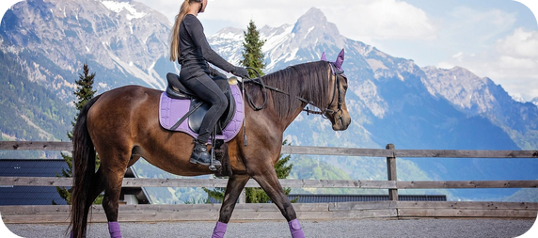
6
Beat the clock!
🎲 PLAY GIOCA
✏️ FILL THE GAPS COMPLETA
Write the missing words. 2 minutes!
⏱ 4 min 🏆 teams
Scrivi le parole mancanti. 2 minuti!
🎲
How to play
1
I think skiing is ___ horse-riding. (easy)
→ easier than
Teams: 2 minutes. Complete 1–7.
Swap papers with another team.
Check: 1 point per correct answer.
2
This is ___ train I've ever been on. (hot)
→ the hottest
3
A motorbike is ___ a scooter. (powerful)
→ more powerful than
4
I drive ___ my partner. (slowly)
→ more slowly than
5
___ time to travel is on holiday weekends. (bad)
→ The worst
6
The Stig wasn't ___ Richard. (quick)
→ as quick as
7
James was ___ driver in the race. (slow)
→ the slowest
3A-2 · Grammar · practice · 📖 Grammar Bank 3A p.136 · a 1–5 (+ 2 from last lesson's race)
Notes:
6. Grammar · practice (4 min)
CONTROLLED PRACTICE (4 min). Teams write the answers on paper (2 minutes), swap with another team and check as you click (one answer per click). Items 1–5 = Grammar Bank 3A a 1–5 (TG key: 1 I think skiing is easier than horse-riding · 2 This is the hottest train I've ever been on · 3 A motorbike is more powerful than a scooter · 4 I drive more slowly than my partner · 5 The worst time to travel is on holiday weekends). ⚠ The exact Grammar Bank prompts are in the book: the slide gives the word in brackets. Items 6–7 recycle the Top Gear race (Richard 1st, The Stig 3rd, James last). Students then read the full sentences aloud. Grammar Bank a 6–9 and b 6–10 are homework (b 1–5 in class if there's time: as · the · than · ever · him). ICQ: 'One word or more?' (sometimes more: 'more powerful than').

Slide 7
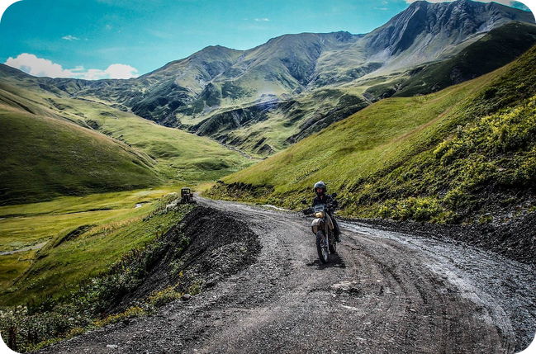
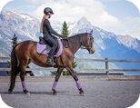
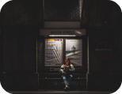
7
Most, more, less!
💬 TALK PARLA
⏱ 4 min 👥 pairs
Say the MOST… Then compare the other two.
Di' il PIÙ… Poi confronta gli altri due.
1
Dangerous: cycling, driving or riding a motorbike?
e.g. I think riding a motorbike is the most dangerous. Cycling is more dangerous than driving.
2
Easy: learning to drive, to ride a bike or to ride a horse?
e.g. Riding a bike is the easiest. Driving is more difficult than riding a horse.
3
Relaxing: driving, flying or travelling by train?
e.g. Travelling by train is the most relaxing. Flying isn't as relaxing as driving.
4
Difficult: sleeping on a coach, on a plane or on a train?
e.g. Sleeping on a coach is the most difficult. A train is more comfortable than a plane.
💬
Useful phrases
the most… / the least…
more… than / …-er than
…isn't as… as…
because…
5
Boring: a traffic jam, waiting at an airport or waiting for a bus?
e.g. Being stuck in a traffic jam is the most boring!
3A-2 · Speaking · superlative + comparative · 📖 SB p.28 · 4c
Notes:
7. Speaking · superlative + comparative (4 min)
FREER PRACTICE (4 min). SB 4c: for each group, first say which is the MOST (superlative), then compare the other two (comparative or not as … as) and say why. Questions appear ONE PER CLICK; about 45 seconds each. Book example: 'I think cycling is the most dangerous because sometimes drivers don't see cyclists. Riding a motorbike is more dangerous than driving.' EXTRA CHALLENGE (TG): two pairs compare answers and defend their choices. Monitor: the most / the least, more … than, not as … as – note 3–4 errors for correction at the end of the task.

Slide 8

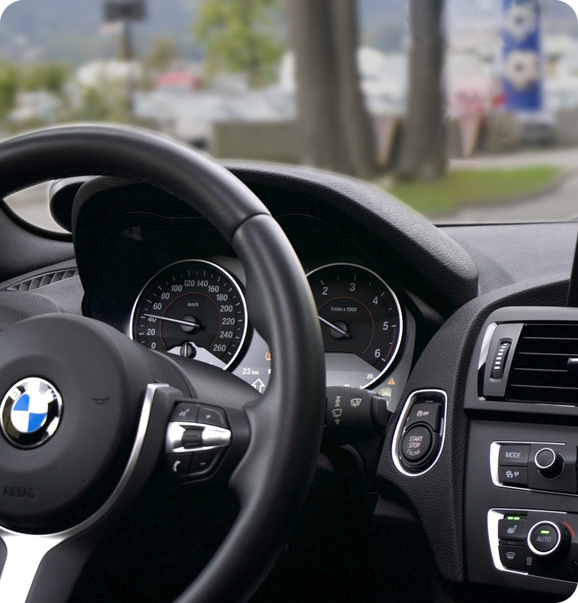
8
Guess the numbers
👀 READ LEGGI
🤔 GUESS INDOVINA
Guess the 5 numbers in the text.
⏱ 2 min 👥 pairs
Indovina i 5 numeri nel testo.
Survive the Drive!
Two scientists at Virginia State University, in the USA, have published a book called Survive the Drive. In it, they describe their research into the most distracting things you can do when you are driving.
➡ NEXT The text on the next slide has 5 number gaps. Guess them first, then read and check.
🔢 NUMBER BANK · guess where they go!
3
16
30
98
900
3,500
9,000
3A-2 · Reading · prediction · 📖 SB p.28 · 5a
Notes:
8. Reading · prediction (2 min)
PREDICTION (2 min). Books closed. Read the introduction aloud (from the book text). Teach distracting = it takes your attention away from something (che distrae). Pairs look at the number bank (5 numbers + 2 extra ones) and guess where they go on the next slide: how many drivers? how old? how many years? how many accidents? Every pair must commit to a guess. ICQ: 'Are you checking or guessing?' (guessing) · 'Do you use all the numbers?' (no – 2 are extra).

Slide 9
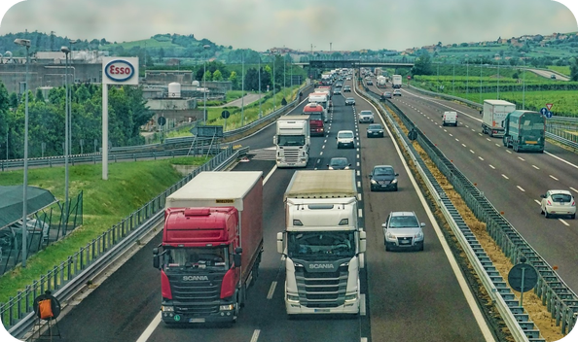
9
Read and check
👀 READ LEGGI
⏱ 3 min 👥 pairs
Guess the numbers. Then read p.28 and check.
Indovina i numeri. Poi leggi p.28 e controlla.
Survive the Drive
Two scientists at Virginia State University, in the USA, have published a book called Survive the Drive.
They fitted video cameras and other devices to the cars of more than (1) _____ drivers
They fitted video cameras and other devices to the cars of more than 3,500 drivers
who were aged between (2) _____ and (3) _____ .
who were aged between 16 and 98.
They then recorded their driving for (4) _____ years and they got millions of hours of video.
They then recorded their driving for three years and they got millions of hours of video.
During this time, the drivers had more than (5) _____ accidents,
During this time, the drivers had more than 900 accidents,
💡
Remember
and the researchers used the video to analyse exactly why they happened.
fit = install (montare)
device = gadget
3A-2 · Reading · the research · 📖 SB p.28 · 5a (the text)
Notes:
9. Reading · the research (3 min)
READ + CHECK (3 min). Pairs say their guesses for gaps 1–5; then books open at p.28 – they read the text (1 minute) to check. Click once per gap: the answer appears highlighted IN the text. Answers (SB text): 1 3,500 · 2 16 · 3 98 · 4 three · 5 900. (30 and 9,000 were extra.) Then SB 5a question 1 (whole class, 30 seconds): 'Do you think the research process was reliable? Why (not)?' – e.g. yes: lots of drivers, all ages, three years, real video. The two other 5a questions come on slide 12, after the vocabulary.

Slide 10
10
8 dangers in Italian
✅ CHECK CONTROLLA
⏱ 2 min 🙋 whole class
Look at p.28. Say it in Italian!
Guarda p.28. Dillo in italiano!
😢
feeling emotional
🎒
reaching for something
👀
looking at something by the road
🗺️
adjusting the satnav
triste, arrabbiato, stressato
allungarsi a prendere
guardare a bordo strada
regolare il navigatore
😴
feeling tired
📻
adjusting the radio
🥪
eating or drinking
🗣️
talking to a passenger
essere stanco
regolare la radio
mangiare o bere
parlare col passeggero
📵
distracting
🎯
concentrate
🎲
more likely
🤚
the wheel
che distrae
concentrarsi
più probabile
il volante
⚠ Watch out! likely = probabile (NOT 'likes') · passenger = passeggero ≠ pedestrian = pedone
3A-2 · Vocabulary · in Italian · 📖 SB p.28 · 5a (photos) · 5c 'likely' box
Notes:
10. Vocabulary · in Italian (2 min)
ELICIT, THEN CONSOLIDATE (2 min). Books open at p.28: students point to the photo for each phrase as you say it (adjust, reach for = mime them). Then the class says the Italian aloud and ONE click shows all the Italian (for slower students). Go through the 'likely' box (SB p.29): likely is an adjective = probable – 'you're more likely to have an accident'. CCQ: 'If you're nine times more likely to have an accident, is an accident more probable or less probable?' (more).

Slide 11

11
Mime it!
🎲 PLAY GIOCA
⏱ 3 min 👥 pairs
Mime the danger. Don't speak!
Mima il pericolo. Non parlare!
🎲
How to play
ROUND 1 · A mimes
ROUND 2 · B mimes
A looks at the screen. B turns around.
A mimes the danger. No words!
B says it in English. Then swap.
adjusting the satnav
feeling emotional
eating or drinking
adjusting the radio
feeling tired
talking to a passenger
reaching for something
looking at something by the road
3A-2 · Vocabulary game
Notes:
11. Vocabulary game (3 min)
GAME (3 min) – a variation of 'Describe it!' (owner: it works very well). Demo first: sit like a driver, mime pressing buttons on a satnav → 'adjusting the satnav'. Click to show each phrase (round 1 = 4 for A; then B faces the screen for round 2). 20 seconds per phrase. B must say the WHOLE phrase (-ing form). ICQ: 'Can A speak?' (no) · 'Who guesses?' (B).

Slide 12
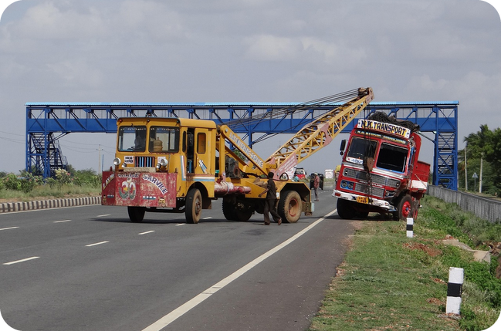
12
Your top 3?
💬 TALK PARLA
🤔 GUESS INDOVINA
Rank them. 1 = the most dangerous.
⏱ 2 min 👥 pairs
Mettili in ordine. 1 = il più pericoloso.
1
Which 3 are the MOST dangerous? Number them 1–3.
e.g. I think feeling tired is number 1 – you can fall asleep!
2
Which one is the LEAST dangerous?
e.g. Talking to a passenger is the least dangerous, I think.
3
Do you agree with your partner? Why (not)?
e.g. No! I think eating is more dangerous than talking.
💬
Useful phrases
I think… is the most dangerous.
…is more dangerous than…
…isn't as dangerous as…
3A-2 · Listening · prediction · 📖 SB p.28 · 5a questions 2–3
Notes:
12. Listening · prediction (2 min)
PREDICTION (2 min). SB 5a questions 2 and 3. Pairs agree on their top 3 (write 1, 2, 3 next to the photos in the book) and the least dangerous. Questions appear one per click. Take a quick vote: which one is number 1? Write the class top 3 on the board next to the cover ideas. DON'T confirm – the interview (3.16) gives the answer.

Slide 13
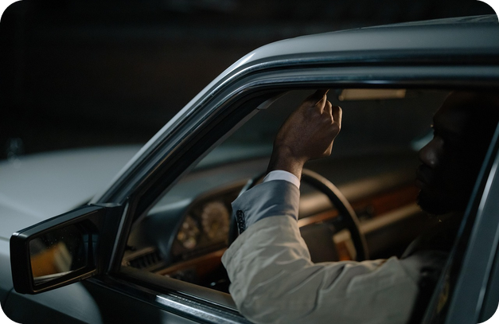
13
Words that run together
🎧 LISTEN ASCOLTA
✏️ FILL THE GAPS COMPLETA
Listen. Complete with the linked words.
⏱ 4 min 👤 alone
Ascolta. Completa con le parole collegate.
🎧 3.15 · pause after each one
1 What's the ___ ___ thing you can do…?
most_dangerous
2 …you'll probably make ___ ___…
bad_decisions
3 …slow down to ___ ___ ___ ___…
look_at_an_accident
4 …a really common ___ ___ ___ ___ motorways.
cause_of_accidents_on
5 …makes you ___ ___ likely to ___ ___ ___.
twice_as · have_an_accident
6 ___ ___ you find ___ ___?
What_did · most_interesting
💡
Guess first, then listen!
7 …always ___ ___ ___ ___ the road!
keep_your_eyes_on
🔈 click ▶
3A-2 · Pronunciation · linking · 📖 SB p.29 · 5b · audio 3.15
Notes:
13. Pronunciation · linking (4 min)
LINKING (4 min). Go through the Linking box (SB p.29): we link words 1 consonant sound + vowel sound (the most_interesting) · 2 the same consonant sound (the worst_time) · 3 /t/ or /d/ + /t/ or /d/ (the biggest_danger). The aim is to UNDERSTAND fast speech (Italian is syllable-timed, so students expect to hear every word separately). Play 3.15, pausing after each extract; students write the missing words in the book. Click once per sentence. Answers (TG / audio script): 1 most dangerous · 2 bad decisions · 3 look at an accident · 4 cause of accidents on · 5 twice as, have an accident · 6 What did, most interesting · 7 keep your eyes on. Play again: students repeat, linking the words. Micro-challenge: who can say 3 fastest and still clearly?

Slide 14
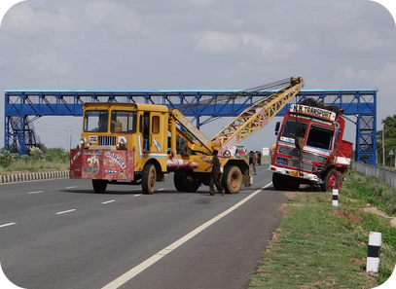
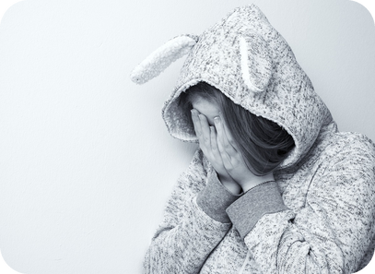
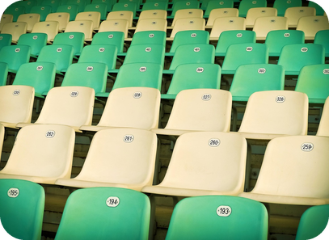
14
The top 8 dangers 1/2
🎧 LISTEN ASCOLTA
⏱ 3 min 👤 alone
Listen. Which photo is 1, 2 and 3?
Ascolta. Quale foto è 1, 2 e 3?
🎧 3.16 · play once
↘ speaker bottom right
A
B
C
Number 1
B · feeling emotional
Number 2
C · reaching for something
Number 3
A · looking at something by the road
🎧
While you listen
Listen. Number the 8 dangers 1–8 in your book.
Which photo is 1, 2, 3? Were you right?
Number 4
adjusting the satnav
🔈 click ▶
3A-2 · Listening · gist · 📖 SB p.29 · 5c · audio 3.16
Notes:
14. Listening · gist (3 min)
GIST (3 min). Photos A–C (left to right): A looking at something by the road · B feeling emotional · C reaching for something. Play 3.16 ONCE: students number all 8 activities 1–8 in the book (p.28). Pairs compare, then click once per number. Answers (TG / audio script): 1 feeling emotional · 2 reaching for something in the car · 3 looking at something by the road · 4 adjusting the satnav. Show of hands: who had the right number 1? Check the class guesses on the board. Next slide = numbers 5–8 (same listening, no need to play again).

Slide 15
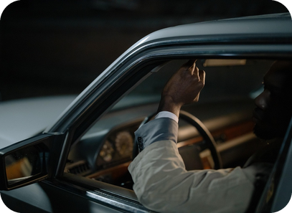
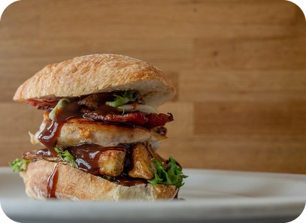
15
The top 8 dangers 2/2
✅ CHECK CONTROLLA
⏱ 2 min 👥 pairs
Check numbers 5–8.
Controlla i numeri 5–8.
🎧 3.16 · play again if needed
↘ speaker bottom right
A
B
Number 5
A · feeling tired
Number 6
adjusting the radio
Number 7
B · eating or drinking
🎧
While you listen
Compare numbers 5–8 with a partner.
Were your top 3 right? Surprised?
Number 8
talking to a passenger
🔈 click ▶
3A-2 · Listening · gist · 📖 SB p.29 · 5c · audio 3.16
Notes:
15. Listening · gist (2 min)
CHECK (2 min). Photos (left to right): A feeling tired · B eating or drinking. Click once per number. Answers (TG / audio script): 5 feeling tired · 6 adjusting the radio or music system · 7 eating or drinking · 8 talking to a passenger. Quick reaction: 'Is anything surprising?' (most classes expect tiredness or eating higher and emotions lower).

Slide 16
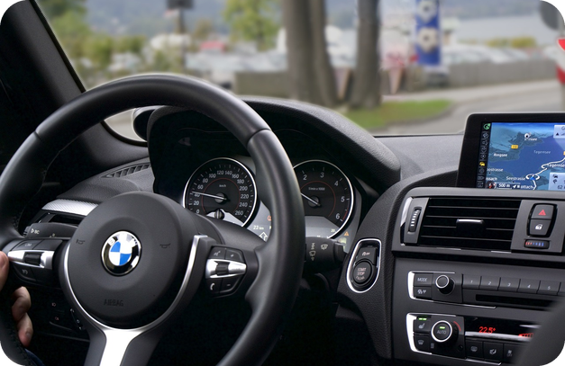
16
Listen again: the facts
🎧 LISTEN ASCOLTA
✏️ FILL THE GAPS COMPLETA
Listen again. Write the number or reason.
⏱ 5 min 👥 pairs
Riascolta. Scrivi il numero o il motivo.
🎧 3.16 · play again
1 Emotional: ___ more likely to have an accident
nearly 10 times
2 Reaching for something: ___ more likely
9 times
3 Looking by the road: the chance goes up ___
over 7 times
4 Adjusting the satnav: ___ more likely
nearly 5 times
5 Tired: ___ of drivers drove tired last year
60%
6 Adjusting the radio: ___ likely
twice as
7 Eating or drinking: why is it dangerous?
one hand off the wheel
💡
Guess first, then listen!
8 Talking to a passenger: why?
the driver turns to look
🔈 click ▶
3A-2 · Listening · detail · 📖 SB p.29 · 5d · audio 3.16
Notes:
16. Listening · detail (5 min)
DETAIL (5 min). SB 5d: pairs guess first, then listen again and note a number or fact for each activity (book example: 1 feeling emotional – ten times more likely to have an accident). Click once per item. Answers (TG / audio script): 1 nearly ten times more likely (if you're very sad, angry or stressed) · 2 nine times · 3 over seven times · 4 nearly five times · 5 60% of drivers say they've driven when tired in the last year – you can lose control of the car · 6 twice as likely (distraction + only one hand on the wheel) · 7 you normally take one hand off the wheel · 8 the driver often turns to look at the passenger. Also in the script: at speed you can travel over 100 metres in less than three seconds. EXTRA SUPPORT: play again with the audio script (SB p.126).

Slide 17
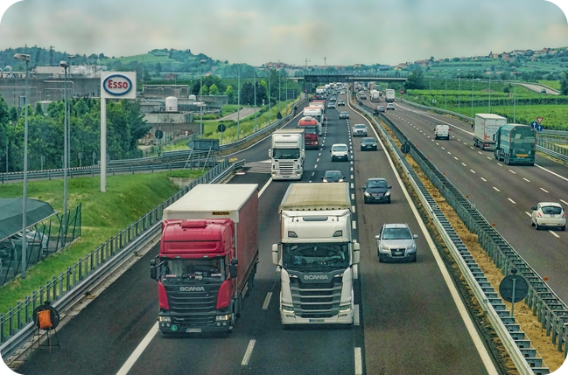
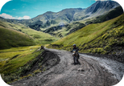
17
What do YOU think?
💬 TALK PARLA
⏱ 5 min 👨‍👩‍👧 groups
Agree or disagree? Say why.
D'accordo o no? Di' perché.
1
Number 1 is feeling emotional. Are you surprised?
e.g. Yes! I thought eating was more dangerous.
2
Slow drivers cause more accidents than fast drivers.
e.g. I don't agree. Fast drivers are more dangerous.
3
Speed cameras don't stop accidents, they just make money for the government.
e.g. I disagree. People drive more slowly near a speed camera.
4
It should be illegal to eat or drink when you're driving.
e.g. Personally, I don't think it should be illegal to drink water.
💬
Useful phrases
5
The minimum age for riding a motorbike should be 25.
e.g. In my opinion, 18 is old enough.
Personally, I (don't) think…
In my opinion, … should…
I (don't) agree, because…
6
People who drink and drive should lose their driving licence for life.
e.g. I agree – it's the most dangerous thing you can do.
3A-2 · Speaking · giving your opinion · 📖 SB p.29 · 5e, 6a, 6b
Notes:
17. Speaking · giving your opinion (5 min)
SPEAKING (5 min). Q1 = SB 5e (are you surprised by the research? which things do you or drivers you know do?). Q2–6 = statements from SB 6a (the book has 8; the other three: drivers over 70 are as dangerous as young drivers · cyclists in cities should only be allowed in cycle lanes · the speed limit on motorways should be lower). Go through the 'Giving your opinion' box: we often use should + verb to say what we think is the right thing to do. Groups of 3–4: one student reads the statement, gives an opinion and asks the others; the listener must ask one follow-up question ('Why?', 'What about older people?'). Statements appear ONE PER CLICK (about 50 seconds each). Feedback: a quick vote on 2–3 statements. Then delayed correction: 4–5 errors (comparatives, should) on the board.

Slide 18
18
3 · 2 · 1
⏱ 3 min 👥 pairs
Books closed! What can you remember?
Libri chiusi! Cosa ricordi?
3
dangerous things to do when you're driving
📝
Homework · Compiti
Workbook 3A: 3a, 3b, 3c, 4a
Grammar Bank 3A p.136: a 6–9, b 6–10
Writing p.117: an article about transport in your town
Homework sheet 3A-2 in the LLS app
2
sentences: one comparative + one superlative
1
sentence with (not) as … as
Next lesson: 3B part 1 · Men, women, and children · articles
3A-2 · Exit · what can you remember?
Notes:
18. Exit · what can you remember? (3 min)
RETRIEVAL EXIT (3 min). Books closed. Pairs: 3 dangers (in English, -ing form), 2 sentences (e.g. 'Feeling emotional is the most dangerous.' 'A train is more relaxing than a car.'), 1 sentence with (not) as … as. A few pairs share. Set homework (on the slide and in the app): Workbook 3A 3a–3c (grammar) and 4a (linking; 4b audio optional), Grammar Bank a 6–9, b 6–10, the article about transport in their town (Writing p.117, 120–150 words ⚠ suggested length – check the book) and the 3A-2 homework sheet (easier version available). If slide 19 was skipped, tell students to read the model article on p.117 first.

Slide 19
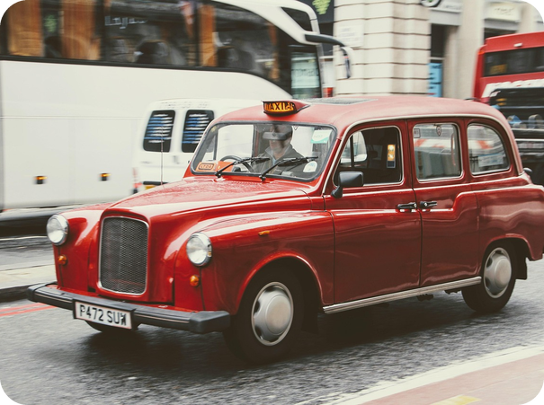
19
Getting around London
🤔 GUESS INDOVINA
👀 READ LEGGI
Guess. Then read p.117 and check.
⏱ 5 min 👥 pairs
Indovina. Poi leggi p.117 e controlla.
⭐
Example
1
the most expensive?
a black cab / taxi
0 In London, the cheapest way to travel? → walking!
2
the healthiest?
cycling
3
the best for sightseeing?
a (double-decker) bus
4
the safest late at night?
a taxi / minicab
5
Oyster card: for…?
the Underground and buses
6
Black cab vs minicab?
cab = more expensive · minicab = book it, cheaper
7
7c prepositions 2–7
on · off · on · with · in · at
3A-2 · Writing · an article for a website · 📖 Writing p.117 · 7a, 7b, 7c, 7d
EXTRA · if there's time
Notes:
19. Writing · an article for a website (5 min)
WRITING PREP (5 min, if there's time – otherwise it's homework). 7a: pairs guess the four answers about London. 7b: they read the article on p.117 to check (ignore the gaps) and answer 1–3. Click once per item. Answers (TG): most expensive – black cab / taxi · healthiest – cycling · best for sightseeing – (double-decker) bus · safest late at night – taxi / minicab. 1 An Oyster card is used to travel on the Underground and on buses · 2 bike hire: £2 a day for short journeys up to 30 minutes, £2 for each additional 30 minutes · 3 a black cab is more expensive, but the drivers know London very well; a minicab is a normal car which works for a company – you have to book it, but it's much cheaper. 7c: 2 on · 3 off · 4 on · 5 with · 6 in · 7 at. 7d: go through the 'Transport in your town' box; students plan their article about Bagheria / Palermo (headings as in the model). Example 0 is only a model for the guessing (not in the book). VARIATION: write it for a tourist who has never been to Sicily.

Slide 20
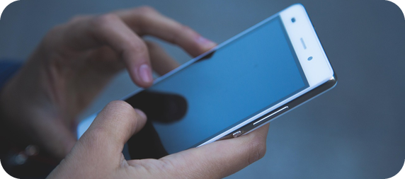
20
Class records
🎲 PLAY GIOCA
⏱ 6 min 🚶 mingle
Stand up! Find the class records.
In piedi! Trova i record della classe.
🎲
How to play
1
the longest journey here
→ How long does it take you to get here?
Choose ONE record. Make the question.
Stand up and ask EVERYONE.
Report: "Marco has the longest journey!"
the oldest phone
→ How old is your phone?
2
3
the earliest alarm
→ What time does your alarm go off?
4
the most cousins
→ How many cousins have you got?
5
the furthest place you've ever been
→ What's the furthest place you've ever been to?
3A-2 · Extra game · class records
EXTRA · if there's time
Notes:
20. Extra game · class records (6 min)
EXTRA GAME (6 min). Mingle. Each student takes one record (or invents one). Click once per row to show the question to ask. Students ask everyone, note the answers, then report with a superlative + a comparative: 'Giulia gets up the earliest – at 6 a.m.! That's an hour earlier than me.' Keep it neutral: no records about weight, money or age.

