Slide 1


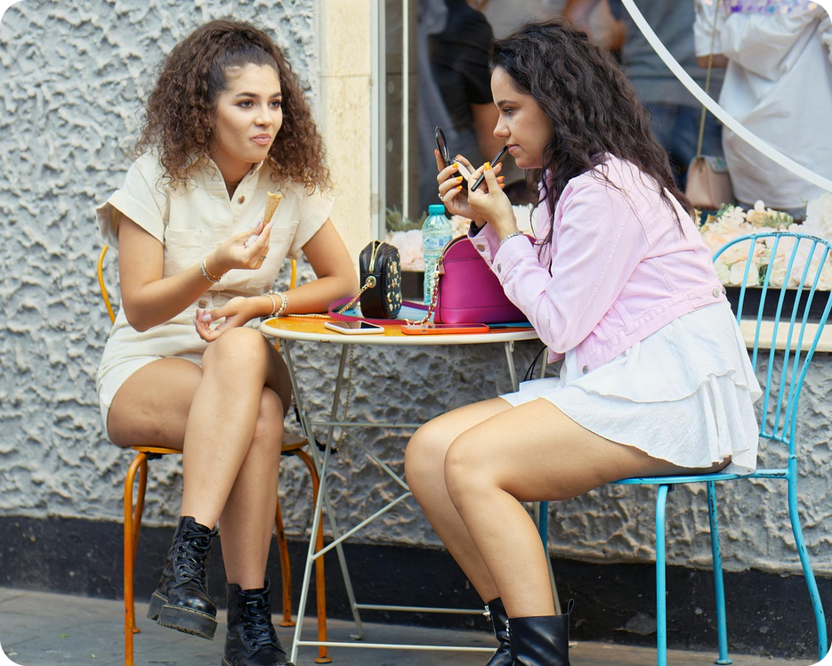


English File B1 · SB pp.30–31
💡 THINK · PENSA
3B-1
Men, women, and children
Stereotypes: true or not?
🎯
Today you're going to…
💬 say what you think about men and women
👀 read what scientists discovered
✏️ use a / an, the or no article
🔊 say "the" in two different ways
Women talk more than men. True or a myth?
EXAMPLE I think it's partly true. My sister never stops talking – but my dad talks a lot too!
Notes:
1. OPENING (2 min)
OPENING (2 min). Show the photo (two friends chatting at a café). Ask the THINK question; quick show of hands: true / myth? Click 1 = the example answer – students use it as a model: 2–3 students answer. Don't confirm – the article will tell us (paragraph 2). TG lead-in (optional, 30 sec): write 'A fixed idea about a type of person, which is often not true' and elicit STEREOTYPE /ˈsteriətaɪp/ (stereotipo). Read the 'Today you're going to…' list together. Keep the topic light: research and generalizations, never comments about a student in the room.

Slide 2

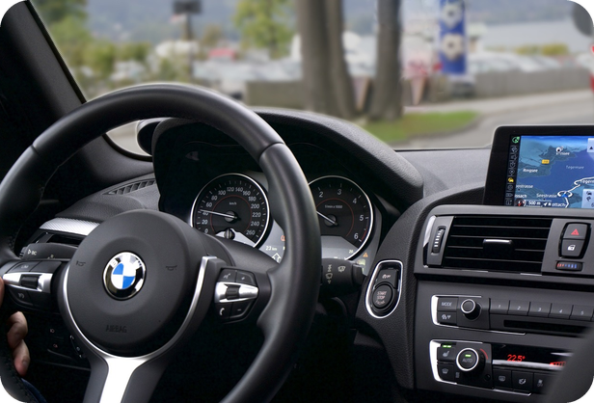
2
Remember last lesson?
💡 THINK PENSA
⏱ 2 min 🙋 whole class
What did we learn? Read the examples.
Cosa abbiamo imparato? Leggi gli esempi.
Comparing two things
The most / the least
Feeling emotional is more dangerous than feeling tired.
Talking to a passenger isn't as dangerous as adjusting the radio.
My mum drives more carefully than my dad.
→ -er / more / less … than · (not) as … as
Feeling emotional is the most dangerous thing.
Talking to a passenger is the least dangerous.
Rush hour is the worst time to drive.
→ the -est · the most · the least · ever
📅
Last lesson…
3A: Survive the drive
comparing things: more, the most, as … as
🔤 KEY WORDS
dangerous
likely
twice as likely
satnav
passenger
reach for
adjust
distracting
3B-1 · Revision · last lesson
Notes:
2. Revision · last lesson (2 min)
REVISION (2 min) before the warmer game. Read the examples with the class. Ask: 'Two things or all the group?' → comparative or superlative. Point at the arrows: than / as … as / the. Elicit one more example from a student (e.g. 'A scooter is cheaper than a car'). Then play 'Remember the research!' – the answers use exactly these forms and the facts from audio 3.16 (1 feeling emotional … 6 adjusting the radio … 8 talking to a passenger).

Slide 3

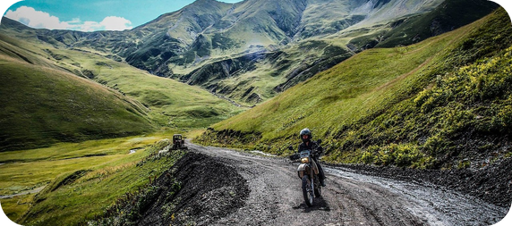
3
Remember the research!
🎲 PLAY GIOCA
⏱ 3 min 🏆 teams
Make the sentence. Use the right form!
Fai la frase. Usa la forma giusta!
🎲
How to play
1
feeling emotional ↔ feeling tired (dangerous)
→ Feeling emotional is more dangerous than feeling tired.
Read the clue.
Teams: say the full sentence in 15 seconds.
Right fact + right form = 2 points.
a passenger ↔ the radio (not as … as)
→ Talking to a passenger isn't as dangerous as adjusting the radio.
2
3
Number 1 of all 8? (the most…)
→ Feeling emotional is the most dangerous thing.
4
Number 8 of all 8? (the least…)
→ Talking to a passenger is the least dangerous.
5
Adjusting the radio: how likely?
→ It makes you twice as likely to have an accident.
6
Who drives more carefully: your mum or your dad?
→ My mum drives more carefully than my dad.
3B-1 · Warmer · last lesson · 📖 Recycles 3A part 2: comparatives, superlatives · audio 3.16
Notes:
3. Warmer · last lesson (3 min)
RETRIEVAL WARMER (3 min). Two teams, books closed. Read each clue; teams have 15 seconds to say the full sentence. 1 point for the right fact (from audio 3.16: 1 feeling emotional · 2 reaching for something · 3 looking at something by the road · 4 adjusting the satnav · 5 feeling tired · 6 adjusting the radio · 7 eating or drinking · 8 talking to a passenger) + 1 point for a correct form (than / as … as / the most). Click once per clue to show a model. Item 6 is personal: any correct comparative adverb wins (more carefully, faster, more slowly). ICQ: 'One word or a full sentence?' (full sentence).

Slide 4
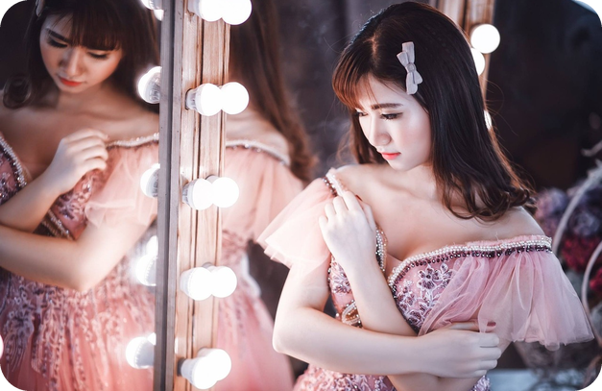

4
Generally speaking…
🎧 LISTEN ASCOLTA
✏️ FILL THE GAPS COMPLETA
Guess the words. Then listen and check.
⏱ 4 min 👥 pairs
Indovina le parole. Poi ascolta e controlla.
🎧 3.17 · pause after each speaker
1 Generally ___, I think it's true that women worry more about their appearance than men.
speaking
2 However, ___ the whole, I think…
on
…women ___ to have fewer opportunities to do sport.
tend
3 I think that in ___, men worry about their health more than women.
general
Hypochondriacs are ___ men, not women.
usually
💡
Guess first, then listen!
🔈 click ▶
3B-1 · Speaking · generalizing · 📖 SB p.30 · 1a · Generalizing box · audio 3.17
Notes:
4. Speaking · generalizing (4 min)
GENERALIZING (4 min). These phrases help us talk about groups of people without sounding rude. Pairs guess the missing words first (30 sec). Play 3.17, pausing after each speaker. Click once per gap. Answers (TG / audio script): 1 speaking · 2 on (the whole) · tend (to have) · 3 (in) general · usually. Check: hypochondriac /haɪpəˈkɒndriæk/ = someone who always thinks they're ill (ipocondriaco); appearance = how you look. Quick vote after each speaker: agree or disagree? NOTICE (don't teach yet): 'women worry…', 'men worry…' – no 'the'! Speaker 2 says 'participate in sport' – the slide says 'do sport' to keep it short.

Slide 5
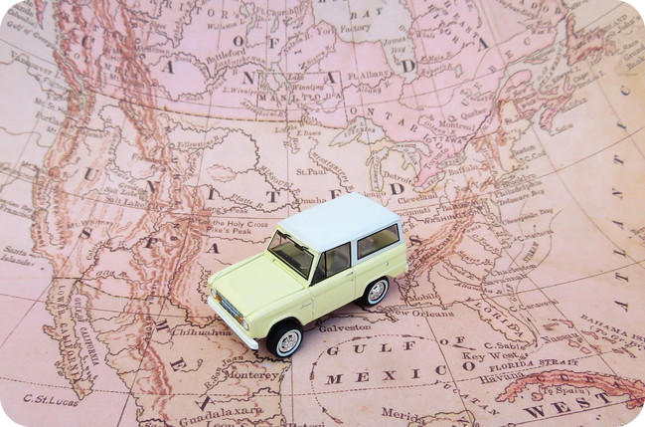
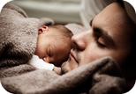

5
True or a myth?
💬 TALK PARLA
⏱ 5 min 👨‍👩‍👧 groups
True, partly true or untrue? Say why.
Vero, in parte vero o falso? Spiega perché.
1
Men are better at navigating than women.
e.g. Generally speaking, I think it's true – my dad never gets lost!
2
Women talk more than men.
e.g. On the whole, I think it's partly true. My sister talks all the time!
3
Women are more caring than men.
e.g. I think it's completely untrue. My dad is very caring.
4
Women can multitask better than men.
e.g. In general, women tend to do more things at the same time.
💬
Useful phrases
5
Men are better at telling jokes than women.
e.g. Completely untrue! My mum's jokes are the funniest.
Generally speaking, … · On the whole, …
I think … tend to …
completely true · partly true · completely untrue
6
Men make better bosses than women.
e.g. I don't think it's true. My mum is a great boss!
3B-1 · Speaking · do you think it's true? · 📖 SB p.30 · 1b (6 of the 10 statements – the other 4 are on slide 10)
Notes:
5. Speaking · do you think it's true? (5 min)
SPEAKING (5 min). Pre-teach with gestures / the photo: navigate (= find the way: orientarsi), multitask (= do many things at the same time), caring (= kind, looks after people: premuroso). Groups of 3. Statements appear ONE PER CLICK: about 45 seconds each, then click. Every group must decide a), b) or c) and give a reason – no 'it depends' on the first turn! They MUST start with a phrase from the box. Monitor: correct 'The men…' / 'The women…' → 'Men…' / 'Women…' (preview of today's grammar – just echo the right form). DON'T give the answers: statements 1–5 are the headings of the article on the next slides. Feedback: quick vote on 2 statements. Sensitive: keep it general and light.

Slide 6

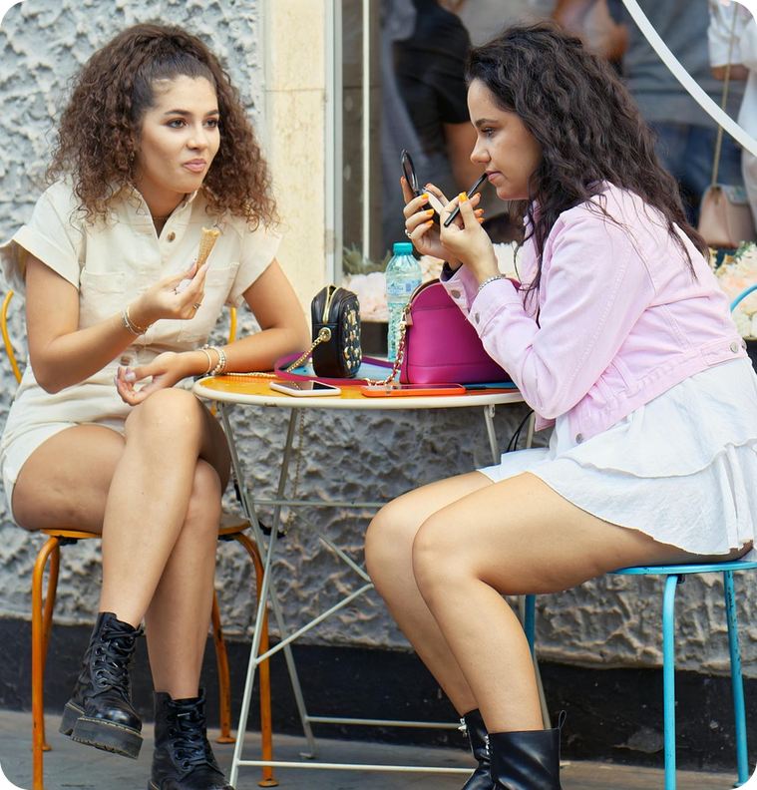
6
Are they really true?
👀 READ LEGGI
🤔 GUESS INDOVINA
Read the intro. Then guess the results!
⏱ 2 min 👥 pairs
Leggi l'intro. Poi indovina i risultati!
Men and women
Common stereotypes – but are they really true? Scientists say that there are certain gender stereotypes which they have proved are true, for example, a recent study found that men are better at assembling IKEA furniture than women! Here are five more…
➡ NEXT The article on the next 3 slides has 5 paragraphs. Find the sentence from slide 5 that goes with each one. Then find these numbers!
🔢 NUMBER BANK · guess where they go!
18
50%
30%
20,000
8
50
3B-1 · Reading · prediction · 📖 SB p.30 · 1c (introduction)
Notes:
6. Reading · prediction (2 min)
PREDICTION (2 min). Read the introduction aloud (the slide shortens it slightly; full text SB p.30: '…But can we really believe the results of these studies? Here are five more stereotypes which researchers claim are true.'). Check: prove = show that something is true (dimostrare) · assemble IKEA furniture = put it together (montare i mobili) · claim = say something is true (sostenere). Ask: 'So, which five stereotypes do the researchers say are TRUE?' Pairs look back at slide 5 and guess. Point at the number bank: 'These numbers are in the article – you'll find them later (slide 11).' ICQ: 'Are you reading the article now?' (no, only the introduction).

Slide 7
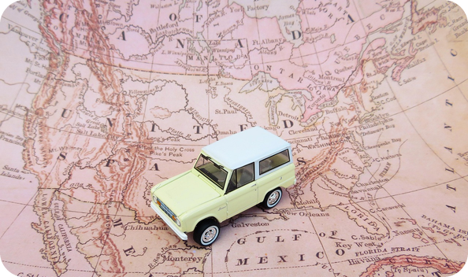
7
The article 1/3
👀 READ LEGGI
⏱ 3 min 👤 alone
Read. Which sentence from slide 5?
Leggi. Quale frase della slide 5?
Common stereotypes – are they true?
(1) _____ Scientists in Norway asked 18 men and 18 women to find their way through a virtual maze, completing various tasks along the way.
Men are better at navigating than women. Scientists in Norway asked 18 men and 18 women to find their way through a virtual maze, completing various tasks along the way.
Men were able to solve 50% more of the problems than women in the same time. 'Men's sense of direction was more effective. They simply got to their destination faster,'
said Dr Carl Pintzka of the Norwegian University of Science and Technology.
(2) _____ Researchers from the University of Maryland separated baby rats from their mothers and discovered that baby rats with more Foxp2,
Women talk more than men. Researchers from the University of Maryland separated baby rats from their mothers and discovered that baby rats with more Foxp2,
💡
Remember
a kind of protein necessary for the development of speech and language, made more noise and called to their mothers more often. Moving on to humans, scientists then discovered that women have 30% more Foxp2 than men.
Headings = the sentences on slide 5
maze = labirinto
3B-1 · Reading · paragraphs 1–2 · 📖 SB pp.30–31 · 1c · paragraphs 1–2
Notes:
7. Reading · paragraphs 1–2 (3 min)
GIST READING (3 min for slides 7–9 together: give 4 minutes' reading time in total, then check). Students read alone and choose the heading for each paragraph from the statements on slide 5 (show it again if needed). Pairs compare. Click once per paragraph: the heading appears IN the text. Answers (TG): 1 Men are better at navigating than women. 2 Women talk more than men. Vocabulary: virtual maze = labirinto virtuale · sense of direction = senso dell'orientamento · protein /ˈprəʊtiːn/. ICQ: 'Do you need to understand every word?' (no – just find the heading).

Slide 8
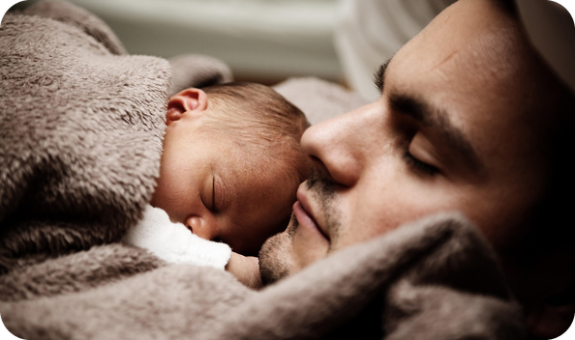
8
The article 2/3
👀 READ LEGGI
⏱ 2 min 👤 alone
Read. Which sentence from slide 5?
Leggi. Quale frase della slide 5?
Common stereotypes – are they true?
(3) _____ Australian researchers gave 20,000 men and women a list of questions to answer, to discover how they feel if their partner has a problem.
Women are more caring than men. Australian researchers gave 20,000 men and women a list of questions to answer, to discover how they feel if their partner has a problem.
Women said they were very affected, but men showed no change. 'It is not that men are unemotional, but they simply are not very emotional when it comes to the feelings of their partner,' said the study's author, Dr Cindy Mervin.
(4) _____ Psychologists at the University of Herefordshire gave 50 male and 50 female students eight minutes to perform three tasks at the same time:
Women can multitask better than men. Psychologists at the University of Herefordshire gave 50 male and 50 female students eight minutes to perform three tasks at the same time:
maths problems, finding restaurants on a map, and drawing a plan for finding a lost key in a field. To make it more difficult, they were asked some general knowledge questions while they worked.
💡
Remember
The women, it turned out, easily did all four things at once, but not the men – so it seems that this old cliché is true.
affected = colpito, toccato
cliché /ˈkliːʃeɪ/ = luogo comune
3B-1 · Reading · paragraphs 3–4 · 📖 SB p.31 · 1c · paragraphs 3–4
Notes:
8. Reading · paragraphs 3–4 (2 min)
GIST READING (continued). Same procedure; click once per paragraph. Answers (TG): 3 Women are more caring than men. 4 Women can multitask better than men. Note the photo: a dad caring for his baby – the research is about feelings for a PARTNER. 'it turned out' (paragraph 4) comes back on slide 11.

Slide 9
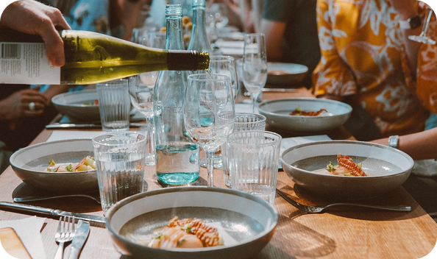
9
The article 3/3
👀 READ LEGGI
⏱ 2 min 👤 alone
Read. Which sentence from slide 5?
Leggi. Quale frase della slide 5?
Common stereotypes – are they true?
(5) _____ Professor Laura Mickes and a team of psychologists from the University of California asked men and women to write captions for cartoons in The New Yorker magazine.
Men are better at telling jokes than women. Professor Laura Mickes and a team of psychologists from the University of California asked men and women to write captions for cartoons in The New Yorker magazine.
Without knowing the author, a group of male and female judges preferred the men's jokes. The psychologists argued that men use humour to attract women, who in turn are attracted to men with a good sense of humour.
AND SOME THAT AREN'T TRUE… For every stereotype verified by science, many others turn out not to be true. Recent research shows, for example, that women are just as competitive and aggressive as men,
better at driving, and no worse at mathematics. Men, on the other hand, are more insecure in relationships, make worse bosses, and are more likely to panic in stressful conditions.
💡
Remember
caption = the words under a cartoon
judge = giudice
3B-1 · Reading · paragraph 5 · 📖 SB p.31 · 1c · paragraph 5 + 'And some that aren't true…' · adapted from The Daily Telegraph
Notes:
9. Reading · paragraph 5 (2 min)
GIST READING (end). Click 1 = heading 5. Answer (TG): 5 Men are better at telling jokes than women. Then read the last paragraph together: 'Which of OUR statements are NOT true?' – the next slide checks this. Back to the opening question: women DO talk more, according to this research (paragraph 2). Picture = placeholder until the owner supplies 3b1-jokes.jpg.

Slide 10
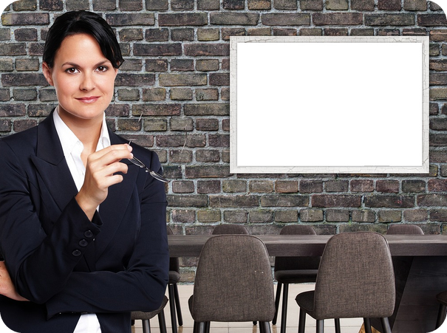
10
What does the research say?
👀 READ LEGGI
✅ CHECK CONTROLLA
Read again. True or not true? Why?
⏱ 3 min 👥 pairs
Rileggi. Vero o no? Perché?
⭐
Example
1
Men make better bosses.
✗ NOT TRUE – men make worse bosses
0 Men are better at assembling IKEA furniture. → TRUE: 'a recent academic study found…' (intro)
2
Women are worse at maths.
✗ NOT TRUE – no worse at mathematics
3
Men are more competitive.
✗ NOT TRUE – women are just as competitive
4
Women panic more in stressful situations.
✗ NOT TRUE – men are more likely to panic
5
Which research used animals?
paragraph 2 – baby rats
6
Which research used a list of questions?
paragraph 3 – 20,000 men and women
7
Which research used practical experiments?
paragraphs 1, 4, 5 – maze, 3 tasks, cartoons
3B-1 · Reading · detail · 📖 SB p.30 · 1b (statements 6–10) · 1d
Notes:
10. Reading · detail (3 min)
DETAIL (3 min). Pairs answer from the article (slides 7–9 – go back if they ask). Demo 0 with the class. Click once per item. Answers: items 1–4 from 'And some that aren't true…': men make worse bosses · women are no worse at mathematics · women are just as competitive and aggressive as men · men are more likely to panic in stressful conditions. Items 5–7 = SB 1d (TG): a with animals → 2 · b questionnaires → 3 · c practical experiments → 1, 4, 5 (virtual maze; three tasks in eight minutes; captions for New Yorker cartoons). Insist on 'why': students quote the words in the text.

Slide 11
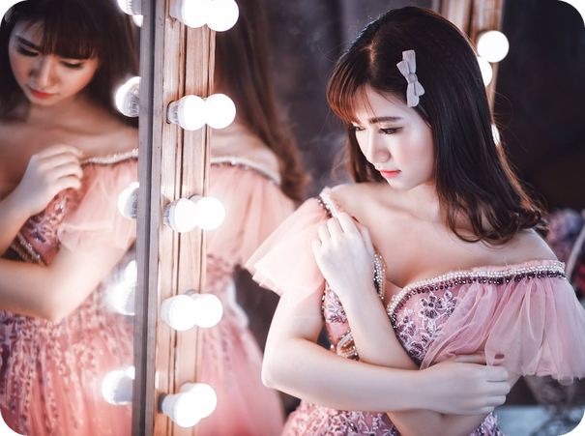
11
Find the word!
🔍 FIND TROVA
⏱ 2 min 👥 pairs
Scan race! Find the word in the text.
Gara! Trova la parola nel testo.
⭐
Example
1
= prove (a verb)
show (Recent research shows…)
0 a fixed idea about a type of person → stereotype
2
= find (a verb)
discover (discovered that…)
3
give reasons why you think sth is true
argue (The psychologists argued…)
4
become clear that…
turn out (it turned out)
5
knowing where you are and the way to go
sense of direction
6
18 men and 18 women in a maze: which country?
Norway
3B-1 · Reading · words from the article · 📖 SB p.31 · 1e
Notes:
11. Reading · words from the article (2 min)
SCAN RACE (2 min). Pairs race: the first pair to shout the right word wins the point. Click once per item. Answers (TG 1e): 1 show · 2 discover · 3 argue · 4 turn out. Items 5–6 = scan for detail. WARNING: argue here = sostenere (give reasons), not only 'litigare'. Next slide = the Italian for slower students.

Slide 12
12
Today's words in Italian
✅ CHECK CONTROLLA
⏱ 2 min 🙋 whole class
Say it in Italian. Then click!
Dillo in italiano. Poi clicca!
🧠
stereotype
💬
generally speaking
⚖️
on the whole
↗️
tend to
stereotipo
in generale
nel complesso
tendere a
🔬
prove / show
🔎
discover
🗣️
argue (that)
💡
it turned out
dimostrare
scoprire
sostenere (che)
si è scoperto che
🧭
sense of direction
🤹
multitask
🤗
caring
🏆
competitive
senso dell'orientamento
fare più cose insieme
premuroso
competitivo
⚠ Watch out! argue = litigare OR sostenere (in an article) · tend + to + verb: Men tend to…
3B-1 · Vocabulary · in Italian
Notes:
12. Vocabulary · in Italian (2 min)
CONSOLIDATION for slower students (2 min). Class says the Italian aloud for each word, then ONE click shows all the Italian. Spend 20 seconds on the warning line. Quick check: 'Generally speaking = in generale or nel complesso?' (both are close – fine!). 'Men tend to ___ (talk) less' → to talk.

Slide 13
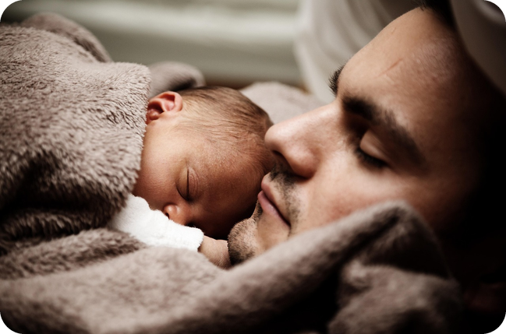
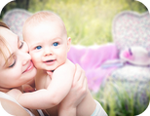
13
Are you surprised?
💬 TALK PARLA
⏱ 3 min 👥 pairs
Answer the question. Give an example!
Rispondi alla domanda. Fai un esempio!
1
Men solved 50% more problems in the maze. Are you surprised?
e.g. Not really. My dad never uses the satnav!
2
Women have 30% more Foxp2 – the 'language protein'. Who talks most in your family?
e.g. My sister! She never stops talking.
3
Women did 4 things at once in 8 minutes. Can you multitask?
e.g. Yes – I do my homework and listen to music at the same time!
4
The judges preferred the men's jokes. Who's the funniest person you know?
e.g. My grandmother. Her jokes are the best!
💬
Useful phrases
I'm (not) surprised because…
In my family, …
I'm sorry, I'd rather not say.
5
Think of one more stereotype about men or women. Is it true?
e.g. People say men can't cook. Not true – my dad is a great cook!
3B-1 · Speaking · react to the article · 📖 SB p.30 · 1f
Notes:
13. Speaking · react to the article (3 min)
SPEAKING · RESPONSE (3 min). Questions appear ONE PER CLICK (about 35 seconds each). Pairs answer with an example, then ask 'And you?'. Q5 = SB 1f (think of more stereotypes). Monitor: collect 3–4 article mistakes ('the men', 'is engineer') for the grammar that follows – write them on the side of the board. Feedback: one funny answer for Q4.

Slide 14
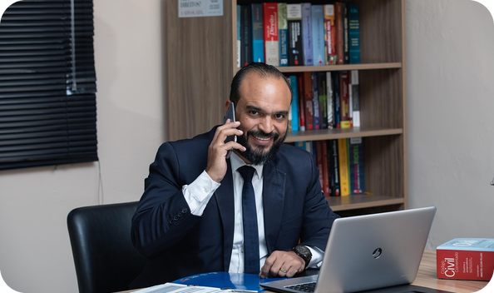
14
Four jokes 1/2
✏️ FILL THE GAPS COMPLETA
🎧 LISTEN ASCOLTA
a, an, the or – ? Then listen.
⏱ 2 min 👥 pairs
a, an, the o – ? Poi ascolta.
Joke 1 · Joke 2
🎧 3.18
Girl: Daddy, did you know that (1) _____ girls are cleverer than (2) _____ boys?
Girl: Daddy, did you know that – girls are cleverer than – boys?
Father: No, I didn't know that. Girl: You see!
(3) _____ man goes to see (4) _____ lawyer.
A man goes to see a lawyer.
Man: Excuse me. What do you charge? Lawyer: $1,000 for three questions.
Man: Wow! Isn't that (5) _____ bit expensive?
Man: Wow! Isn't that a bit expensive?
Lawyer: Yes. What's your third question?
🔈 click ▶
3B-1 · Grammar · four jokes · 📖 SB p.31 · 2a, 2b · audio 3.18 (jokes 1–2)
Notes:
14. Grammar · four jokes (2 min)
GRAMMAR · TEST FIRST (2 min, with the next slide 4 min). Pairs write a, an, the or – (no article) in gaps 1–5. Don't explain the rules yet. Play 3.18 (jokes 1–2), then click once per line: the answer appears highlighted IN the joke. Answers (TG): 1 – · 2 – · 3 A · 4 a · 5 a. Check: – = no article · charge = far pagare. Check the jokes are understood: 'Why is the lawyer's answer funny?' (the man's question WAS his second question!). ICQ: 'What does – mean?' (no article).

Slide 15
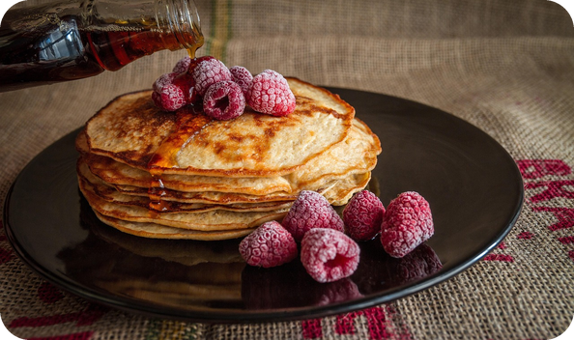
15
Four jokes 2/2
✏️ FILL THE GAPS COMPLETA
🎧 LISTEN ASCOLTA
a, an, the or – ? Then listen.
⏱ 2 min 👥 pairs
a, an, the o – ? Poi ascolta.
Joke 3 · Joke 4
🎧 3.18
Doctor: Hello, did you come to see me with (6) _____ eye problem?
Doctor: Hello, did you come to see me with an eye problem?
Patient: Yes! How did you know?
Doctor: Because you came in through (7) _____ window instead of (8) _____ door.
Doctor: Because you came in through the window instead of the door.
Mother: What did you do at (9) _____ school today, Patrick?
Mother: What did you do at – school today, Patrick?
Patrick: It was (10) _____ great day! We made explosives!
Patrick: It was a great day! We made explosives!
Mother: And what are you going to do at (11) _____ school tomorrow?
Mother: And what are you going to do at – school tomorrow?
Patrick: What school?
🔈 click ▶
3B-1 · Grammar · four jokes · 📖 SB p.31 · 2a, 2b · audio 3.18 (jokes 3–4)
Notes:
15. Grammar · four jokes (2 min)
GRAMMAR · TEST FIRST (2 min). Same procedure, gaps 6–11. Play 3.18 (jokes 3–4). Click once per line. Answers (TG): 6 an · 7 the · 8 the · 9 – · 10 a · 11 –. Ask: 'Which joke is the funniest?' (SB 2b). explosives = esplosivi. Volunteers can act out a joke (fun, and they produce the articles). Picture = placeholder until the owner supplies 3b1-girl-dad.jpg (a child telling a parent something).

Slide 16
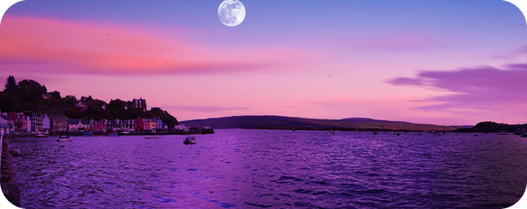
16
Why this article?
🔗 MATCH ABBINA
⏱ 3 min 👥 pairs
Why a, the or nothing? Match the colour.
Perché a, the o niente? Abbina il colore.
🏷️
The colours
a A man goes to see a lawyer.
a/an: one, new
a/an: one, new
the: we know
b Girls are cleverer than boys.
–: in general
the: only one
–: in general
c You came in through the window.
the: we know
–: school, home
d What did you do at school today?
–: school, home
e The moon goes round the Earth.
the: only one
f It was a great day!
a/an: one, new
3B-1 · Grammar · why? · 📖 SB p.31 · 2a jokes + Grammar Bank 3B p.137 (audio 3.20)
Notes:
16. Grammar · why? (3 min)
GUIDED DISCOVERY (3 min). Pairs match a–f to the five colours. Click once per sentence. Answers: a a/an – one man, one lawyer, we mention them for the first time · b no article – girls and boys IN GENERAL · c the – we know which window (the doctor's window) · d no article – at school / at home / at work · e the – there is only one moon · f a/an – one (great) day. CCQs: 'Girls are cleverer – which girls? Our class?' (no, all girls in general) · 'the window – any window?' (no, the window of this room). Sentence e is from Grammar Bank audio 3.20.

Slide 17

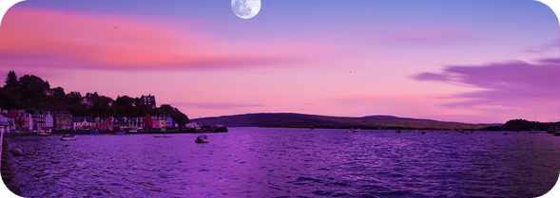
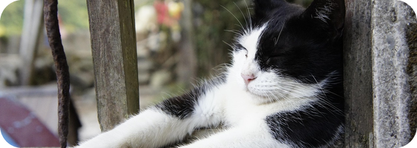
17
a / an, the or no article
👀 LOOK GUARDA
⏱ 3 min 🙋 whole class
Read the examples. Then click!
🎧 3.20
Leggi gli esempi. Poi clicca!
a / an
the
no article
one thing, first time · jobs · What a…! · twice a week
we know which one · only one · the cinema · the best
things in general · home, work, school · meals, days
I saw an old man with a dog.
She's a nurse.
What an awful day!
I saw a dog. The dog was barking.
The moon goes round the Earth.
It's the best restaurant in town.
Love is more important than money.
She's not at home today.
I never have breakfast.
un / una (anche con i lavori!)
il / la… quando sappiamo quale
in generale: NIENTE articolo!
⚠ ✗ The men love the football → ✓ Men love football · ✗ She's lawyer → ✓ She's a lawyer · an eye, an hour
🔈 click ▶
3B-1 · Grammar · the rule · 📖 Grammar Bank 3B p.137 · audio 3.19, 3.20, 3.21
Notes:
17. Grammar · the rule (3 min)
RULE (3 min). Click once per column: the examples and the Italian appear. Optional: play 3.20 (embedded) and 3.19, 3.21 from the book audio (Grammar Bank: listen and repeat, copy the rhythm). an + vowel SOUND: an eye, an hour (silent h) – but a university. Rules (GB): a / an = singular countable noun mentioned for the first time, jobs, What a…!, frequency (three times a week). the = it's clear which one (mentioned before, or only one: the moon, the Earth), places in town (the cinema, the theatre), superlatives (the best). No article = plural / uncountable nouns in general (love, money, men, cats), home / work / school / bed, meals, days, next / last week. Last click = the Italian-speaker warning – the BIG one: Gli uomini amano il calcio → Men love football. CCQ: 'I love ___ pizza' (– general) vs '___ pizza in this restaurant is great' (the – this one).

Slide 18
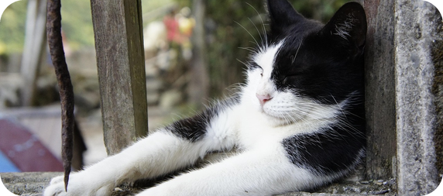
18
Fix the article!
🎲 PLAY GIOCA
⏱ 4 min 🏆 teams
Find the mistake. Fix it!
Trova l'errore. Correggilo!
🎲
How to play
1
The cats are more independent than the dogs.
→ Cats are more independent than dogs.
Read the sentence.
Teams: find the article mistake.
Say it correctly = 1 point.
My brother is nurse.
→ My brother is a nurse.
2
3
Look at moon! It's beautiful.
→ Look at the moon!
4
She's not at the home today.
→ She's not at home today.
5
What amazing joke!
→ What an amazing joke!
6
We go to cinema once the month.
→ We go to the cinema once a month.
3B-1 · Grammar game
Notes:
18. Grammar game (4 min)
GAME (4 min). Two teams. Read each sentence; teams have 15 seconds to find and fix the article mistake (every sentence has one; 6 has two). Click to show the correct sentence. Bonus point if they say WHY (general / job / only one / home / What a…! / places in town + frequency). ICQ: 'Is every sentence wrong?' (yes). Typical Italian errors – exaggerate the correction on item 1.

Slide 19
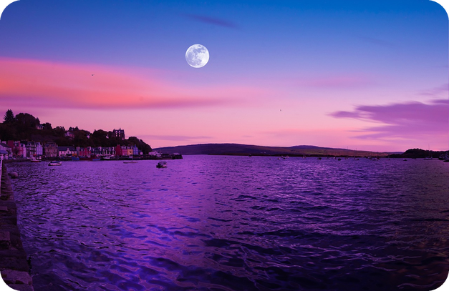
19
/ðə/ or /ðiː/?
🎧 LISTEN ASCOLTA
🔊 SAY IT PRONUNCIA
Guess: /ðə/ or /ðiː/? Then listen.
⏱ 3 min 👥 pairs
Indovina: /ðə/ o /ðiː/? Poi ascolta.
🎧 3.23 · pause after each phrase
the cinema
/ðə/
the office
/ðiː/ – vowel sound
the Underground
/ðiː/ – vowel sound
the universe
/ðə/ – /juː/!
the moon
/ðə/
the internet
/ðiː/ – vowel sound
the sea
/ðə/
the accident
/ðiː/ – vowel sound
💡
Guess first, then listen!
the evening
/ðiː/ – vowel sound
the dark
/ðə/
🔈 click ▶
3B-1 · Pronunciation · the · 📖 SB p.31 · 3a, 3b, 3c · audio 3.22, 3.23
Notes:
19. Pronunciation · the (3 min)
PRONUNCIATION (3 min). First, 30 seconds of /ə/ (SB 3a, audio 3.22): computer – the o and the er are /ə/; listen and repeat: a, about, accident, future, internet, important, person, question. /ə/ is the most common sound in English (unstressed). Then 3b: model /ðə/ (the cinema) and /ðiː/ (the office). Pairs guess for each phrase. Play 3.23, pausing. Click once per phrase. Answers (TG): /ðiː/ = the office, the Underground, the internet, the accident, the evening (the noun starts with a VOWEL SOUND). Exception: the universe = /ðə/ because it starts with the sound /j/. Same rule as a / an: an office, an evening, but a university. 3c drill: the other day · the only way · the end of the world (= not a disaster) · the average person · the important thing – all /ðiː/.

Slide 20

20
Noughts and crosses
🎲 PLAY GIOCA
⏱ 4 min 🏆 teams
Choose a square. Make a sentence!
Scegli una casella. Fai una frase!
🎲
1
1 · moon
→ the moon (only one)
How to play
2
2 · Tuesday
→ on – Tuesday (days)
Team O or X: choose a square 1–9.
Make a correct sentence with the word.
Correct article = win the square!
3
3 · honest man
→ an honest man (h is silent!)
4
4 · breakfast
→ have – breakfast (meals)
5
5 · best pizza
→ the best pizza in town
6
6 · home
→ at – home / go – home
7
7 · university
→ a university /juː/ · go to – university
8
8 · cats (in general)
→ I like – cats.
9
9 · hour
→ an hour (h is silent!)
3B-1 · Grammar game · noughts and crosses
Notes:
20. Grammar game · noughts and crosses (4 min)
GAME (4 min). Draw a 3×3 grid with the numbers 1–9 on the board. Team O and team X take turns: choose a square and make a sentence with that word in 20 seconds (the team can help). The square is won only if the WHOLE sentence is correct, including the article. Three in a row wins; play 2 rounds if there's time. Click the number to show the expected article (any correct sentence wins). Traps: 3 and 9 (silent h → an), 7 (university = /juː/ → a, and /ðə/!) – they link to the pronunciation slide.

Slide 21
21
3 · 2 · 1
⏱ 2 min 👥 pairs
Books closed! What can you remember?
Libri chiusi! Cosa ricordi?
3
results from the article: true or not true?
📝
Homework · Compiti
Workbook 3B: 1a, 1b, 1c, 2a
Grammar Bank 3B p.137: a 6–10, b 5–9
Homework sheet in the LLS app
2
phrases for generalizing: Generally speaking…
1
sentence about men or women – with NO 'the'!
Next lesson: 3B part 2 · Pink and blue · dependent prepositions (audio 3.24)
3B-1 · Exit · what can you remember?
Notes:
21. Exit · what can you remember? (2 min)
RETRIEVAL EXIT (2 min). Books closed. Pairs: 3 research results (e.g. men are better at navigating; men make worse bosses), 2 generalizing phrases, 1 sentence like 'Generally speaking, men…' (no 'the'!). A few students share. Set homework (on the slide and in the app; an easier version of the sheet is available).

Slide 22

22
Describe it!
🎲 PLAY GIOCA
⏱ 3 min 👥 pairs
Explain the word. Don't say it!
Spiega la parola. Non dirla!
🎲
How to play
ROUND 1 · A explains
ROUND 2 · B explains
A looks at the screen. B turns around.
A explains: It's a… / It's the… Don't say it!
B guesses. Then swap.
a lawyer
a nurse
the moon
the internet
a stereotype
a joke
breakfast
sense of direction
3B-1 · Vocabulary game
EXTRA · if there's time
Notes:
22. Vocabulary game (3 min)
EXTRA GAME (3 min, if there's time). Variation of 'Describe it!' that practises articles: A must say 'It's a person who…', 'It's the thing that…', 'It's something you…'. Demo: 'There's only one. It's in the sky at night.' → the moon. Click to show each word. 20 seconds per word. ICQ: 'Can you say the word?' (no).

Slide 23
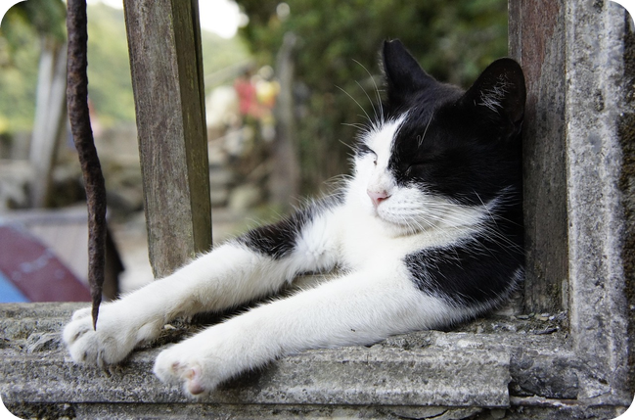
23
Generally speaking…
💬 TALK PARLA
⏱ 5 min 👨‍👩‍👧 groups
Agree or disagree? Give a reason!
D'accordo o no? Dai un motivo!
1
Cats make the best pets.
e.g. I don't agree. Generally speaking, dogs are friendlier than cats.
2
Designer clothes are a waste of money.
e.g. On the whole, I agree – they're too expensive.
3
Young people today have easier lives than their parents.
e.g. I think it's partly true. We have phones, but school is harder!
4
Food that tastes good is usually bad for you.
e.g. Not always – pasta with sardines is good AND healthy!
💬
Useful phrases
Generally speaking, … · On the whole, …
I agree / I don't agree because…
Personally, I think…
5
School friends are for life.
e.g. I agree. My dad still sees his school friends every week.
3B-1 · Speaking · Generally speaking… · 📖 Communicative photocopiable 3B 'Generally speaking' (5 of the 12 cards) · B1_3B_Photocopiables.pdf p.3
EXTRA · if there's time
Notes:
23. Speaking · Generally speaking… (5 min)
EXTRA SPEAKING (5 min, if there's time). Statements from the Communicative photocopiable 3B (cards). One per click; groups give their opinion, then the others react. Monitor and correct 'the' with general nouns (✗ The cats make… → ✓ Cats make…). Feedback: generally speaking, does the class agree? If you have printed the photocopiable (p.3, 12 cards), groups can use the cards instead.

