Slide 1


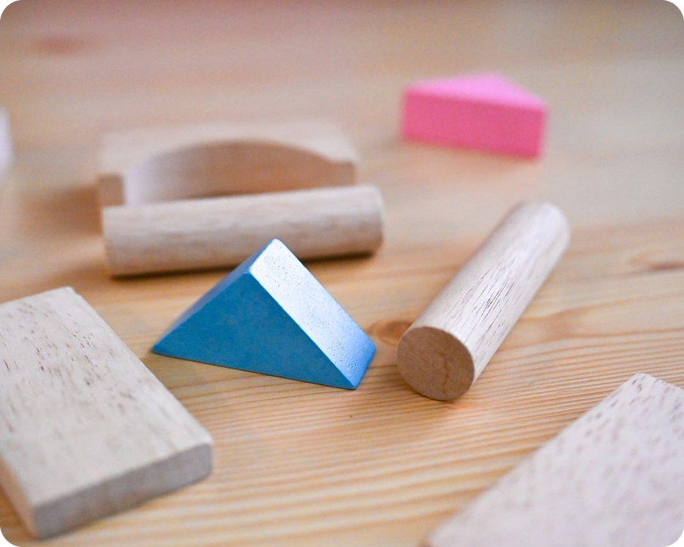


English File B1 · SB pp.32–33
💡 THINK · PENSA
3B-2
Men, women, and children
Pink and blue · toys · prepositions
🎯
Today you're going to…
💬 talk about toys and your childhood
🎧 listen to a radio programme: pink and blue
✏️ use prepositions: afraid of, good at…
🎲 play "Just a minute!"
Pink for girls, blue for boys. Always?
EXAMPLE No! My little brother loves pink, and my sister's favourite colour is blue.
Notes:
1. OPENING (2 min)
Show the photo. Ask the THINK question: 'Pink for girls, blue for boys – is it always like this?' Take 3–4 ideas, then click for the example answer. Don't confirm anything: the radio programme will surprise them (100 years ago it was the opposite!). Read the 'Today you're going to…' list together. (Book: SB pp.32–33 · 4 Listening & Speaking, 5 Vocabulary.)

Slide 2

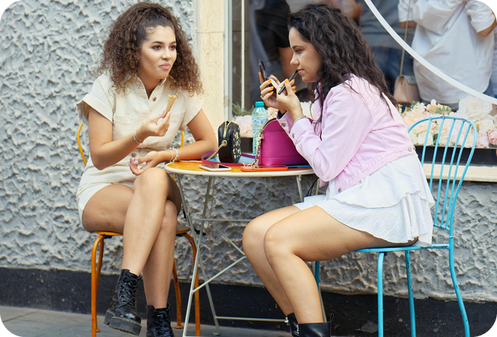
2
Remember last lesson?
💡 THINK PENSA
⏱ 2 min 🙋 whole class
What did we learn? Read the examples.
Cosa abbiamo imparato? Leggi gli esempi.
a / an · the
No article = in general
I saw an old man with a dog. The dog was barking.
She's a lawyer.
The moon goes round the Earth.
→ a / an = first time, jobs · the = we know which one, only one
Men usually love football.
Love is more important than money.
I'm at home. I'm going to school.
→ things in general · home, work, school · next week
📅
Last lesson…
3B: men, women and stereotypes
articles: a / an, the, no article
🔤 KEY WORDS
generally speaking
on the whole
tend to
a stereotype
an hour
the cinema
3B-2 · Revision · last lesson
Notes:
2. Revision · last lesson (2 min)
REVISION (2 min) before the warmer game. Read the examples with the class. Quick checks: 'I love ___ pizza' (no article – in general) vs '___ pizza in this restaurant is great' (the – a specific pizza). 'She's ___ engineer' (an – job + vowel sound). Remind them of the big Italian trap: 'Gli uomini amano il calcio' → Men love football (NO the). Then play 'Bet on it!' – every sentence in the game tests exactly these article rules.

Slide 3

3
Bet on it!
🎲 PLAY GIOCA
⏱ 4 min 🏆 teams
Right or wrong? Bet 1, 2 or 3 points!
Giusta o sbagliata? Scommetti 1, 2 o 3 punti!
🎲
How to play
1
Hurry up! You're going to be late for the school.
→ ✗ late for school
Read the sentence. Right or wrong?
Bet 1, 2 or 3 points.
Wrong? Correct it to win!
I have a friend who is an electrician.
→ ✓ correct
2
3
I don't like the people who talk about the football all the time.
→ ✗ people … football
4
Luckily, the people who work in my office don't talk about sport.
→ ✓ correct (specific people)
5
That's a easy question. I think I know the answer.
→ ✗ an easy question
TEAM A ☆☆☆☆☆
TEAM B ☆☆☆☆☆
6
I think the good health is more important than money.
→ ✗ good health
3B-2 · Warmer · last lesson: articles · 📖 Recycles 3B part 1 · Grammar Bank 3B · Grammar photocopiable 3B
Notes:
3. Warmer · last lesson: articles (4 min)
RETRIEVAL WARMER (4 min) – recycles 3B part 1 (articles). Format: betting game (different from 3B-1's warmer). Two teams start with 10 points. For each sentence, teams decide RIGHT or WRONG and bet 1, 2 or 3 points – write the bets on the board BEFORE you click. Correct = win the bet; wrong = lose it. A WRONG sentence wins only if the team also corrects it. Click once per sentence. Sentences adapted from Grammar photocopiable 3B items 11, 12, 14, 15, 18, 20 (official key: 11 – · 12 an · 14 –, – · 15 the, – · 18 an, the · 20 –, –). Why: 1 school as an institution = no article · 2 an + job ✓ · 3 people / football in general = no article · 4 the people = specific people (in my office) ✓ · 5 an + vowel sound · 6 health in general = no article. Sentences 3 and 4 make a nice contrast. ICQs: 'Do you bet before or after I click?' (before) · 'Is a wrong sentence enough?' (no – correct it).

Slide 4
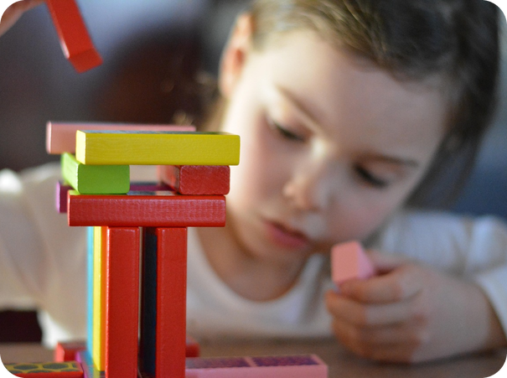
4
Name the toy!
💡 THINK PENSA
⏱ 3 min 👥 pairs
Read the clue. Name the toy!
Leggi l'indizio. Come si chiama il giocattolo?
⭐
Example
1
You build towers and houses with them
construction toys (Lego, bricks)
0 You kick it in the garden → a football
2
Little people: you dress them and brush their hair
dolls
3
Costumes: a pirate, a princess…
dressing-up clothes
4
A picture in 500 pieces
a jigsaw
5
A teddy bear is one
soft toys
6
Little cars, trains and lorries
toy vehicles
7
Swords and water pistols
toy weapons
3B-2 · Vocabulary · toys · 📖 SB p.32 · 4a (the book's list of toys)
Notes:
4. Vocabulary · toys (3 min)
ELICIT FIRST (3 min). Demo item 0 with the class. Pairs read each clue and name the toy (in English if they can). Click once per item. The seven answers are exactly the book's list in 4a: construction toys · dolls · dressing-up clothes · jigsaws · soft toys · toy vehicles · toy weapons. Drill the words (jigsaw /ˈdʒɪɡsɔː/, vehicle /ˈviːəkl/ – the h is silent, weapon /ˈwepən/). ICQ: 'Are you guessing the toy or the colour?' (the toy). Next slide = Italian + the key words for the listening.

Slide 5

5
Toy words in Italian
✅ CHECK CONTROLLA
⏱ 2 min 🙋 whole class
Say it in Italian. Then click!
Dillo in italiano. Poi clicca!
🧱
construction toys
🪆
dolls
🦸
dressing-up clothes
🧩
a jigsaw
giochi di costruzione
bambole
costumi (per travestirsi)
un puzzle
🧸
soft toys
🚂
toy vehicles
🗡️
toy weapons
🛒
an aisle /aɪl/
peluche
macchinine, trenini…
armi giocattolo
una corsia (del negozio)
📦
package (v)
🧬
genetically
📺
advertisers
⚖️
equal to men
confezionare, impacchettare
geneticamente
i pubblicitari
uguali agli uomini (parità)
⚠ Watch out! jigsaw = un puzzle · dressing-up clothes ≠ vestiti eleganti · aisle /aɪl/: the s is silent!
3B-2 · Vocabulary · in Italian
Notes:
5. Vocabulary · in Italian (2 min)
CONSOLIDATION for slower students (2 min). Class says the Italian aloud, then ONE click shows all the Italian. The last five words (aisle, package, genetically, advertisers, equal to men) are the blocking words for the radio programme (TG extra support: pre-teach aisle, package, construction toys). CCQ: 'Where do you find aisles? In a park or a supermarket?' (supermarket). 'If you package a toy, what do you put it in?' (a box).

Slide 6
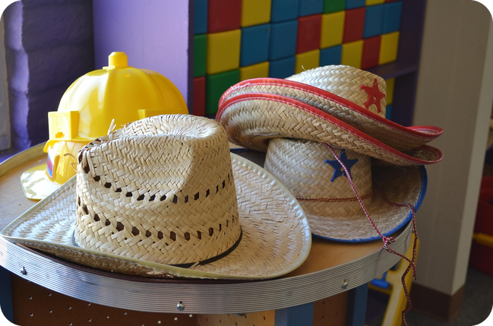
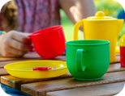
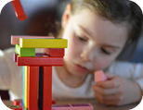
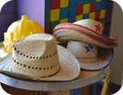
6
Girls, boys or both?
💬 TALK PARLA
⏱ 3 min 👥 pairs
Girls, boys or both? Say why.
Bambine, bambini o entrambi? Spiega perché.
1
Dolls and soft toys: girls more, boys more, or both?
e.g. Generally speaking, girls play with dolls more, but everyone loves soft toys.
2
Construction toys and jigsaws: girls, boys, or both?
e.g. Both! My sister loved Lego.
3
Toy vehicles and toy weapons: girls, boys, or both?
e.g. On the whole, boys – my brother had 50 toy cars!
4
Dressing-up clothes: girls, boys, or both?
e.g. Both – at Carnevale everybody dresses up!
💬
Useful phrases
Generally speaking, girls / boys play with… more
Both equally!
On the whole, I think…
5
Which of these toys did you have?
e.g. I had lots of jigsaws and a big box of Lego.
3B-2 · Speaking · toys · 📖 SB p.32 · 4a
Notes:
6. Speaking · toys (3 min)
SPEAKING (3 min). SB 4a: which toys do a) girls play with more than boys, b) boys more than girls, c) boys and girls equally? Questions appear ONE PER CLICK (about 30 seconds each). Recycle 3B-1: push them to use 'Generally speaking… / On the whole…' (purple box) – and no article when they generalize (✗ The girls play with the dolls → ✓ Girls play with dolls). Quick class vote on question 3. Don't give your opinion yet – the radio programme comes next. Personalisation with boundaries: no one has to say why they had a toy.

Slide 7
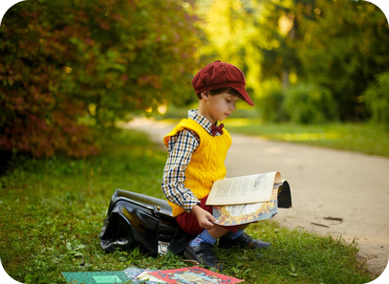
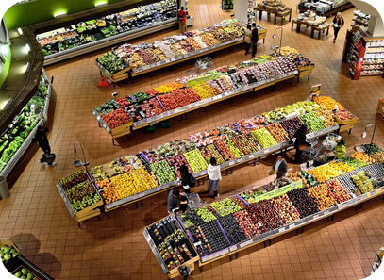
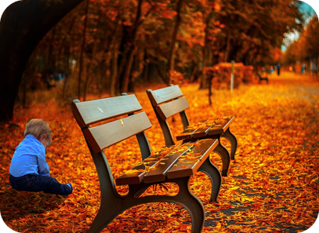

7
The Pink and Blue Project
🎧 LISTEN ASCOLTA
⏱ 4 min 👤 alone
Listen once. Answer questions 1–3.
Ascolta una volta. Rispondi alle domande 1–3.
🎧 3.24 · play once
↘ speaker bottom right
A
B
C
1 · 100 years ago?
pink = BOYS! blue = girls
2 · Born to love pink?
No – it seems not
3 · Alison & Natasha agree?
No, they don't
🎧
While you listen
1 100 years ago: what colour was for boys?
2 Are girls genetically attracted to pink?
3 Do Alison and Natasha agree about toy colours?
🔈 click ▶
3B-2 · Listening · gist · 📖 SB p.32 · 4b, 4c · audio 3.24
Notes:
7. Listening · gist (4 min)
GIST (4 min). 4b first (1 min): show the two photos on SB p.32 (The Pink and Blue Project by South Korean photographer JeongMee Yoon: Tess with all her pink things, Jimin with all his blue things). 'What is the artist saying with these images?' Take 2–3 ideas. Then look at A–C on the slide and predict. Play 3.24 ONCE. Pairs compare, then click once per question. Answers (audio script + TG): 1 100 years ago it was the exact opposite – 'pink for boys and blue for girls' (pink = a stronger colour, blue = more delicate) · 2 'It seems not.' · 3 No – Alison Carr thinks toys should be the same colours for all children; Natasha Crookes thinks we should package science and engineering toys in a pink box. ICQ: 'How many times do we listen now?' (once).

Slide 8
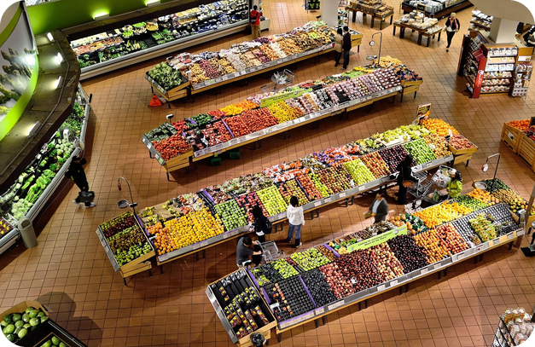
8
Listen again: a, b or c?
🎧 LISTEN ASCOLTA
✅ CHECK CONTROLLA
Listen again. Choose a, b or c.
⏱ 5 min 👥 pairs
Ascolta di nuovo. Scegli a, b o c.
🎧 3.24 · play again
1 100 years ago pink was ___ than blue. a more attractive · b more delicate · c stronger
c stronger
2 Girls in pink after 1945 because of… a equality · b advertisers · c it suited them
a gender equality
3 Girls' toys today are ___ boys' toys. a similar to · b very different from · c more similar to
b very different from
4 Alison: toys influence children's future… a education · b relationships · c personalities
a education
5 Natasha: girls choose science toys if… a parents say so · b they choose · c they're in a pink box
c a pink box
💡
Guess first, then listen!
🔈 click ▶
3B-2 · Listening · detail · 📖 SB p.32 · 4d · audio 3.24
Notes:
8. Listening · detail (5 min)
DETAIL (5 min). Pairs read the five sentences BEFORE listening and guess (book 4d, shortened on the slide). Play 3.24 again. Pairs compare; click once per answer. Answers (TG): 1 c · 2 a · 3 b · 4 a · 5 c. Evidence in the audio script: 1 'pink, being a stronger colour, is more suitable for a boy' · 2 'The idea of women being equal to men emerged and, as a result, people started dressing little girls in pink' (advertisers came AFTER – that's the trap in b) · 3 'Most girls' toys are still based on dolls and dressing up, while boys' toys are more likely to be related to building and cars' · 4 'the toys we play with influence our interests, and even the jobs… they'll be less likely to choose to study it at school' · 5 'we should package science and engineering toys in a pink box'. EXTRA SUPPORT: play a third time with the audio script (SB p.127).

Slide 9
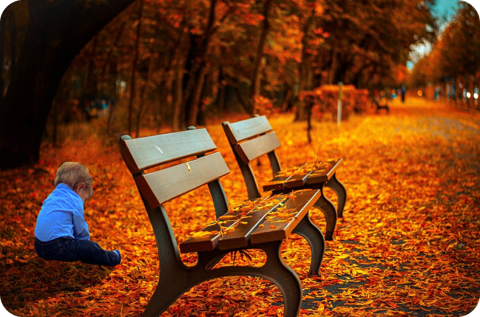
9
Pink box or no pink box?
💬 TALK PARLA
⏱ 4 min 👥 pairs
Answer. Then ask your partner: Why?
Rispondi. Poi chiedi al compagno: Perché?
1
89% of girls' toys are pink. Is that a problem?
e.g. Yes – girls think science isn't for them.
2
Same colours for all toys (Alison) or a pink box (Natasha)?
e.g. Natasha! A pink box is a clever idea.
3
What toys did you play with? 'Girls' toys' or 'boys' toys'?
e.g. Both – I had dolls and lots of toy cars.
4
Would you buy a pink toy for a little boy?
e.g. Why not? Colours are for everyone.
💬
Useful phrases
I agree with Alison / Natasha because…
In my opinion… · Generally speaking…
Really? Why?
5
Did your parents ever make you wear clothes you didn't like?
e.g. Yes! A horrible yellow jumper from my nonna.
3B-2 · Speaking · your opinion · 📖 SB p.32 · 4e
Notes:
9. Speaking · your opinion (4 min)
SPEAKING (4 min). SB 4e questions 1–3 (slide 2, 3, 5) + two concrete questions from the programme (1, 4). Questions appear ONE PER CLICK, about 45 seconds each. The listener must ask at least one follow-up question ('Why?' 'Really?'). Monitor and note 4–5 errors for delayed correction. Feedback: show of hands – Alison or Natasha? Tell them your own answer to one question (TG). EXTRA IDEA (TG): students with young children can say what toys / clothes their children have.

Slide 10
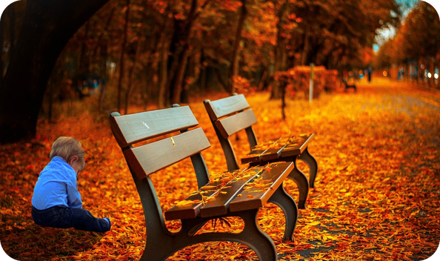
10
Remember the prepositions?
🔍 FIND TROVA
🎧 LISTEN ASCOLTA
Which preposition? Then listen and check.
⏱ 3 min 👥 pairs
Quale preposizione? Poi ascolta e controlla.
From the radio programme
🎧 3.24
Are little girls genetically attracted (1) _____ pink?
Are little girls genetically attracted to pink?
But is this something we really need to worry (2) _____ ?
But is this something we really need to worry about?
When we're choosing (3) _____ one toy or another…
When we're choosing between one toy or another…
Most girls' toys are still based (4) _____ dolls and dressing up.
Most girls' toys are still based on dolls and dressing up.
If we want girls to get interested (5) _____ maths and science…
If we want girls to get interested in maths and science…
…parents need to forget (6) _____ the stereotypes.
…parents need to forget about the stereotypes.
🔈 click ▶
3B-2 · Vocabulary · prepositions in the programme · 📖 SB p.33 · 5a · audio script 3.24 (p.127)
Notes:
10. Vocabulary · prepositions in the programme (3 min)
NOTICING (3 min). SB 5a has lines 2, 3 and 5 (answers TG: about · between · in); lines 1, 4 and 6 are extra lines from the audio script 3.24. Pairs guess the preposition from memory. Click once per gap: the answer appears highlighted IN the text. Answers: 1 to · 2 about · 3 between · 4 on · 5 in · 6 about. If they're unsure, play the beginning of 3.24 again (or read the lines aloud). Point out: worry ABOUT, interested IN – some verbs and adjectives are always followed by the same preposition ('dependent prepositions'). That leads into the Vocabulary Bank.

Slide 11
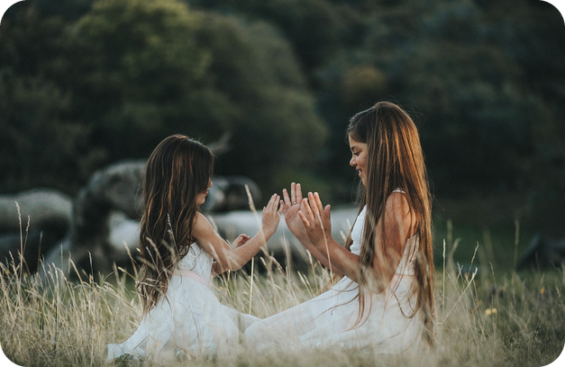
11
Verb + preposition
✏️ FILL THE GAPS COMPLETA
🎧 LISTEN ASCOLTA
Write the prepositions. Then listen.
⏱ 4 min 👥 pairs
Scrivi le preposizioni. Poi ascolta.
🎧 3.25 · pause after each one
1 He apologized ___ the police officer ___ driving fast.
to · for
2 I never argue ___ my husband ___ money.
with · about
3 We might go out. It depends ___ the weather.
on
4 Don't laugh ___ me! I'm doing my best!
at
5 I'm really looking forward ___ the party.
to
💡
Guess first, then listen!
6 This music reminds me ___ our honeymoon in Italy.
of
🔈 click ▶
3B-2 · Vocabulary · verb + preposition · 📖 Vocabulary Bank Dependent prepositions p.156 · 1 After verbs · audio 3.25
Notes:
11. Vocabulary · verb + preposition (4 min)
VOCABULARY (4 min). Sentences from Vocabulary Bank p.156, 1 After verbs (audio 3.25). Do sentence 1 together as the worked example (apologize TO a person FOR something). Pairs guess the prepositions first; then play 3.25 (pause after each one) and click once per sentence. Answers (key / audio script 3.25 items 1, 2, 9, 11, 12, 14): 1 to, for · 2 with, about · 3 on · 4 at · 5 to · 6 of. Then students do the whole Vocabulary Bank section (or for homework): arrive in Milan / at the airport · ask for the bill · believe in · belong to · choose between · dream about · pay for · spend money on · talk to sb about sth (spend money on comes back on the Italian slide and in 'Finish it!'). Point out: argue = litigare (false friend: argomento = topic). ICQ: 'Are you writing a word or a whole sentence?' (one word – the preposition).

Slide 12

12
Adjective + preposition
🔗 MATCH ABBINA
⏱ 4 min 👥 pairs
Which preposition? Match the colour.
Quale preposizione? Abbina il colore.
🏷️
The colours
a My brother is afraid ___ bats.
of
b I've never been good ___ sport.
at
of
at
c I'm fed up ___ sitting in this traffic jam.
with
with
in
on
about
d My sister is very interested ___ astrology.
in
e She's very keen ___ cycling.
on
f My dad was very proud ___ learning to ski.
of
g Rachel is worried ___ losing her job.
about
h I'm tired ___ walking. Let's stop.
of
3B-2 · Vocabulary · adjective + preposition · 📖 Vocabulary Bank p.156 · 2 After adjectives · audio 3.26
Notes:
12. Vocabulary · adjective + preposition (4 min)
VOCABULARY (4 min). Sentences from Vocabulary Bank p.156, 2 After adjectives (audio 3.26). Pairs choose the preposition (colour) for a–h; play 3.26 to check (or read the sentences); click once per sentence. Answers: a of · b at · c with · d in · e on · f of · g about · h of. Box 'Gerunds after prepositions' (TG): after a preposition we use verb + -ing – I'm tired of walking, She's worried about losing her job, proud of learning (c, f, g, h). Notes (TG): good at = you're an expert / good for = beneficial; 'fed up of' is informal – teach fed up with. Other book items for homework: angry with sb about sth · close to · different from · excited about · famous for · fond of · kind to · married to · pleased with · rude to. CCQ: 'I'm interested ___ music – of or in?' (in!).

Slide 13
13
Prepositions in Italian
✅ CHECK CONTROLLA
⏱ 2 min 🙋 whole class
Say it in Italian. Then click!
Dillo in italiano. Poi clicca!
🌦️
depend on
🎉
look forward to
🎵
remind sb of
😂
laugh at
dipendere da
non vedere l'ora di
far pensare a, ricordare
ridere di, prendere in giro
🙏
apologize to sb for
💸
spend money on
🦇
afraid of
⚽
good at
scusarsi con qn per
spendere soldi in / per
aver paura di
bravo in
🔭
interested in
🚴
keen on
😩
fed up with
🏛️
famous for
interessato a
appassionato di
stufo di
famoso per
⚠ Watch out! ✗ depend from → depend ON · ✗ interested of → interested IN · ✗ married with → married TO · + -ing: I'm tired of walking
3B-2 · Vocabulary · in Italian
Notes:
13. Vocabulary · in Italian (2 min)
CONSOLIDATION for slower students (2 min). Class says the Italian aloud, then ONE click shows all the Italian. Spend 30 seconds on the warning line: these are the mistakes Italian speakers make because the Italian preposition is different (dipendere DA, sposato CON). famous for: Bagheria is famous for its villas! Quick CCQ: 'I can't wait for the holidays – I'm looking forward ___ the holidays' (to).

Slide 14
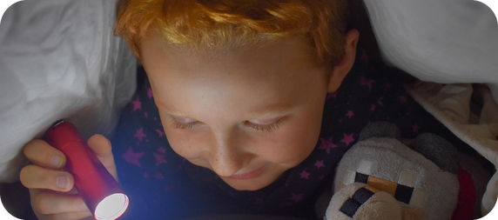
14
Mime it!
🎲 PLAY GIOCA
⏱ 3 min 👥 pairs
Mime it! Your partner says the sentence.
Mimalo! Il compagno dice la frase.
🎲
How to play
ROUND 1 · A mimes
ROUND 2 · B mimes
A looks at the screen. B turns around.
A mimes it. No words!
B says: "You're afraid of…!" Then swap.
afraid of (spiders)
fed up with (homework)
laugh at (a joke)
apologize for (being late)
argue with (your brother)
keen on (football)
proud of (your exam)
looking forward to (holidays)
3B-2 · Vocabulary game
Notes:
14. Vocabulary game (3 min)
GAME 2 (3 min) – a variation of 'Describe it!'. Demo first: mime being terrified of a spider → class says 'You're afraid of spiders!'. Click to show each phrase (round 1 = A mimes 4 phrases while B faces away; round 2 = swap, B mimes). B must say a FULL sentence with the right preposition: 'You're laughing at a joke!' 'You're apologizing for being late!' 20 seconds per phrase. ICQs: 'Can you speak when you mime?' (no) · 'Is one word enough?' (no – a sentence with the preposition).

Slide 15
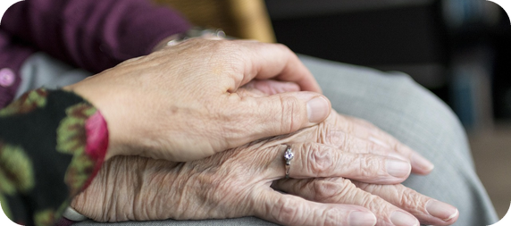
15
Finish it!
🎲 PLAY GIOCA
💬 TALK PARLA
Finish it: preposition + a true ending!
⏱ 3 min 🏆 teams
Finiscila: preposizione + un finale vero!
🎲
How to play
1
When I was a child, I was afraid…
→ …of the dark / of dogs
Read the beginning.
Teams: finish it in 10 seconds.
Right preposition = 1 point.
I've never been very good…
→ …at maths / at singing
2
3
I'm really fed up…
→ …with homework / with the rain
4
My grandparents are very proud…
→ …of me / of my cousin
5
I'd like to spend more money…
→ …on clothes / on video games
6
This song reminds me…
→ …of last summer
3B-2 · Speaking game
Notes:
15. Speaking game (3 min)
GAME 3 (3 min). Read each beginning; teams have 10 seconds to say an ending with the right preposition (and a TRUE or funny ending). Click to show a model answer – accept any correct ending. 1 point for the right preposition, +1 if a gerund is needed and correct (e.g. 'afraid of swimming'). Monitor the -ing after prepositions.

Slide 16
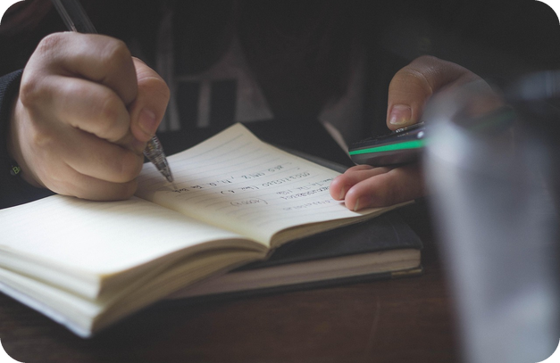
16
Complete the questions
✏️ FILL THE GAPS COMPLETA
🎧 LISTEN ASCOLTA
Complete the questions. Then listen.
⏱ 4 min 👥 pairs
Completa le domande. Poi ascolta.
🎧 3.27 · pause, then repeat
1 With friends of the same sex, what do you usually talk ___?
about
2 Are there any sports or games that you're good ___?
at
3 Is there anything you're really looking forward ___?
to
6 Are there any animals or insects that you're afraid ___?
of
7 What's your town or region famous ___?
for
💡
Guess first, then listen!
12 What do you think success in an exam depends ___?
on
🔈 click ▶
3B-2 · Vocabulary · questions · 📖 SB p.33 · 5c, 5d · audio 3.27
Notes:
16. Vocabulary · questions (4 min)
VOCABULARY + PRONUNCIATION (4 min). SB 5c: pairs complete all 12 questions in the book; the slide shows the 6 used in 'Just a minute!' (book numbers 1, 2, 3, 6, 7, 12). Play 3.27 to check; click once per question. Answers on the slide: 1 about · 2 at · 3 to · 6 of · 7 for · 12 on. Other book answers (TG): 4 to (closest to) · 5 on (keen on) · 8 in (believe in) · 9 of (tired of) · 10 with, about · 11 with (pleased with). PRONUNCIATION (TG): play again for repetition. At the END of a question the preposition is stressed and NOT weak: What are you afraid OF? (/ɒv/, not /əv/). Italian speakers often drop the final preposition – insist on it.

Slide 17
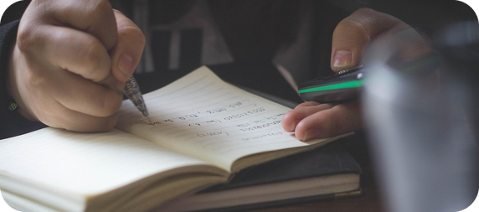
17
Just a minute!
🎲 PLAY GIOCA
💬 TALK PARLA
Talk for 30 seconds. Don't stop!
⏱ 5 min 👨‍👩‍👧 groups
Parla per 30 secondi. Non fermarti!
🎲
How to play
1
What do you usually talk about with your friends?
→ We usually talk about football and…
Groups of 3: A answers a question for 30 seconds.
B times it. C counts the prepositions.
30 seconds = 2 points + 1 per preposition. Swap!
Is there anything you're looking forward to?
→ I'm really looking forward to the summer, because…
2
3
What's Bagheria famous for?
→ Bagheria is famous for its villas and…
4
Are you good at any sports or games?
→ I'm quite good at volleyball, but I'm not keen on…
5
What are you afraid of?
→ I'm afraid of spiders! When I was a child…
6
What does success in an exam depend on?
→ I think it depends on how much you study…
3B-2 · Speaking game · fluency · 📖 SB p.33 · 5d (speaking)
Notes:
17. Speaking game · fluency (5 min)
GAME 4 / FREER PRACTICE (5 min). Inspired by the radio game 'Just a Minute'. Groups of 3, so everyone has a job: A speaks for 30 seconds (no long pauses, no Italian), B times it, C counts correct verb / adjective + preposition phrases. A 3-second pause or an Italian word = stop. Click to show each question with an example start (A can also choose any question from SB p.33 5c). Swap roles after each turn. At the end the top scorer in each group answers one question for the class. Personal questions: students can always choose another question. Then 1–2 minutes delayed error correction from the speaking tasks (board, students correct).

Slide 18
18
3 · 2 · 1
⏱ 2 min 👥 pairs
Books closed! What can you remember?
Libri chiusi! Cosa ricordi?
3
toys from today (no looking!)
📝
Homework · Compiti
Workbook 3B: 3a, 3b, 4a (audio: Online Practice)
Vocabulary Bank p.156: cover the prepositions and test yourself
Homework sheet in the LLS app
2
verbs + preposition: depend on…
1
true sentence: "I'm afraid of…"
Next lesson: Practical English 2 · A difficult celebrity
3B-2 · Exit · what can you remember?
Notes:
18. Exit · what can you remember? (2 min)
RETRIEVAL EXIT (2 min). Books closed. Pairs: 3 toys, 2 verbs with their prepositions, 1 true sentence with an adjective + preposition. A few students share. Set homework (on the slide and in the app; easier version of the sheet available). Answers in the teacher key.

Slide 19
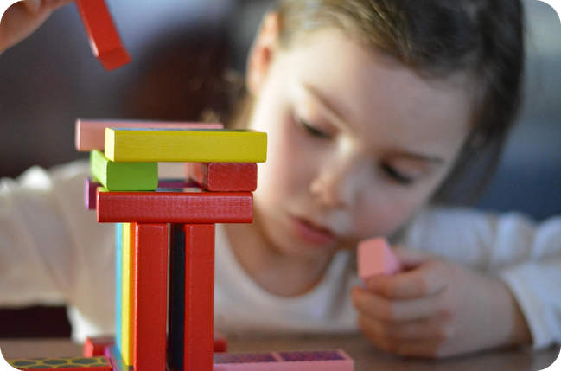
19
A toy for everyone
💬 TALK PARLA
⏱ 6 min 👨‍👩‍👧 groups
Design a toy for ALL children!
Inventate un giocattolo per TUTTI i bambini!
1
What's it called? How old are the children?
e.g. It's called 'Robo-Builder', for children aged 6–10.
2
What colour is the box: pink, blue or another colour?
e.g. Green and yellow – for boys AND girls!
3
What do children learn from it?
e.g. It's good for children who are interested in science.
4
How much does it cost?
e.g. €29.99 – cheaper than a video game!
💬
Useful phrases
It's good for children who are interested in…
Kids who are keen on… will love it!
3B-2 · Extra · design task
EXTRA · if there's time
Notes:
19. Extra · design task (6 min)
EXTRA (6 min, if there's time). Groups invent a toy that boys AND girls will love, then present it in a 1-minute 'advert'. They must use 3 preposition phrases (good for, interested in, keen on…). Questions appear one per click to guide the planning. Links Alison's and Natasha's ideas: will their toy be in a pink box, a blue box, or another colour? The class votes for the toy they would buy.

