Slide 1


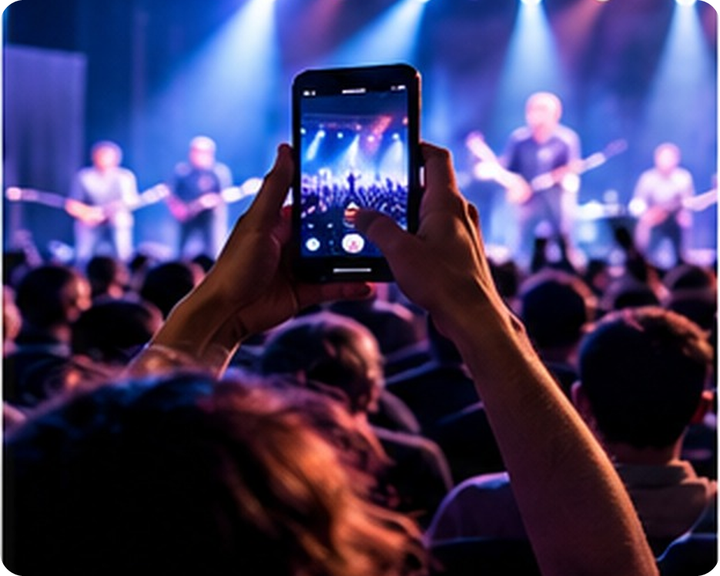


English File B1 · SB pp.36–37
💡 THINK · PENSA
4A-1
Bad manners?
Phones, rules and good manners
🎯
Today you're going to…
📱 talk about phones: hang up, on hold…
👀 read about a phone in a concert
✏️ make rules: have to, must, should
🎲 play "Describe it!" and "Where am I?"
Is it OK to film a whole concert on your phone?
EXAMPLE No! It's annoying for other people. Just watch the concert and enjoy it!
Notes:
1. OPENING (2 min)
Show the photo (someone filming a concert). Ask the THINK question; take 3–4 opinions – encourage last lesson's phrases (Personally, I think… / To be honest…). Click 1 = the example answer. Read the 'Today you're going to…' list together. Don't teach must / should yet – if students use them, just accept.

Slide 2

2
Remember last lesson?
💡 THINK PENSA
⏱ 2 min 🙋 whole class
What did we learn? Read the examples.
Cosa abbiamo imparato? Leggi gli esempi.
📷 pe2-lunch.jpg
Giving your opinion
Agreeing & disagreeing
Personally, I think London is more easy-going.
In my opinion, New York is the greatest city.
To be honest, I prefer London.
→ If you ask me… · Don't you agree?
OK, I agree.
I don't think that's right.
You can't be serious!
→ What do you think? · Oh sure… (ironic)
📅
Last lesson…
Practical English 2: A difficult celebrity
giving opinions · agreeing · disagreeing
🔤 KEY WORDS
Personally
In my opinion
To be honest
If you ask me
I agree
I don't think that's right
Hang on a minute!
4A-1 · Revision · last lesson
Notes:
2. Revision · last lesson (2 min)
REVISION (2 min) before the warmer game. The lines are from PE2 (audio 3.29–3.31: Kerri, Don and Jenny at lunch – London v New York). Read the examples with the class; drill the intonation of 'Don't you agree?' and 'I don't think that's right'. Elicit: which phrases are polite, which are strong? ('You can't be serious!' = strong, for friends). Point at the key words: students need them for the game. Picture pe2-lunch.jpg = PE2 picture list (placeholder until the owner supplies it).

Slide 3

3
Opinion ping-pong
🎲 PLAY GIOCA
⏱ 4 min 🏆 teams
Read the opinion. Agree or disagree!
Leggi l'opinione. D'accordo o no?
🎲
How to play
1
"Bagheria is better than Palermo."
→ If you ask me, Palermo is more exciting.
Read the opinion.
Team A: agree or disagree with a phrase.
Team B answers back. New phrase = 1 point.
"Teenagers spend too much time on their phones."
→ To be honest, I agree. I'm on mine all day!
2
3
"Phones at dinner are OK."
→ I don't think that's right. Dinner is family time.
4
"Concerts are better on TV."
→ You can't be serious! Live music is much better.
5
"Messages are better than phone calls."
→ Personally, I think calls are friendlier.
TEAM A ☆☆☆☆☆
TEAM B ☆☆☆☆☆
6
"Everybody needs a smartphone."
→ In my opinion, my grandad doesn't need one!
4A-1 · Warmer · last lesson · 📖 Recycles PE2: giving opinions, agreeing and disagreeing (SB p.35)
Notes:
3. Warmer · last lesson (4 min)
RETRIEVAL WARMER (4 min) – a different format from PE2's warmer. Two teams. Show opinion 1; Team A has 10 seconds to agree or disagree, starting with a phrase from the recap; Team B must answer back with a DIFFERENT phrase (ping-pong, 2–3 hits). 1 point for each new, correct phrase; same phrase twice = no point. Click once per opinion to show a model reply (accept any good reply). ICQs: 'Can you use the same phrase twice?' (no) · 'Do you have to agree?' (no – agree or disagree). The opinions are about phones on purpose: they lead into today's topic.

Slide 4
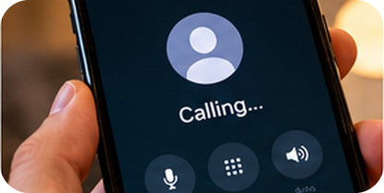
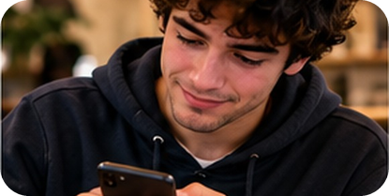
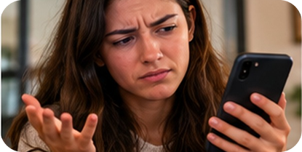
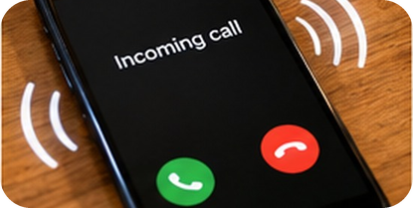
4
What's happening? 1/2
👀 LOOK GUARDA
🤔 GUESS INDOVINA
Look at the photo. Say the phone phrase!
⏱ 2 min 👥 pairs
Guarda la foto. Di' l'espressione!
1
2
3
4
He's d________ a number.
He's t______ a friend.
Somebody h___ u_ on her!
Listen! What a cool r_______!
He's dialling a number.
He's texting (messaging) a friend.
Somebody hung up on her!
(hang up → hung up)
What a cool ringtone!
(the sound your phone makes)
4A-1 · Vocabulary · phone language · 📖 SB p.36 · 1a (meaning first, with pictures)
Notes:
4. Vocabulary · phone language (2 min)
ELICIT FIRST (2 min). Books closed. Pairs look at each photo and the first-letter clue and say the phrase. Click once per photo: the answer appears. Concept checks: 'He's dialling – is he talking yet?' (no, he's pressing the numbers) · 'Somebody hung up on her – did they say goodbye?' (no, they just ended the call – that's rude!) · Text = message (verb): 'I'll text you.' Model and drill each phrase. The Italian comes on slide 8 for slower students.

Slide 5
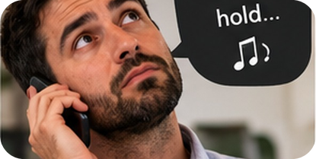
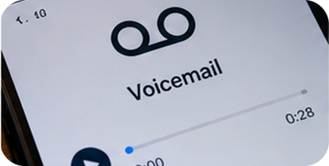
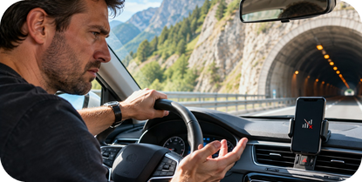
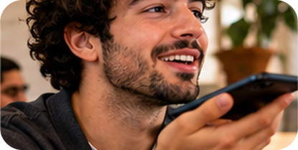
5
What's happening? 2/2
👀 LOOK GUARDA
🤔 GUESS INDOVINA
Look at the photo. Say the phone phrase!
⏱ 2 min 👥 pairs
Guarda la foto. Di' l'espressione!
5
6
7
8
They've put him o_ h___.
Leave a message on my v________.
He was c__ o___ in the tunnel.
He's talking on s___________.
They've put him on hold.
(he has to wait…)
Leave a message on my voicemail.
He was cut off in the tunnel.
(the call suddenly stopped)
He's talking on speakerphone.
(everyone can hear!)
4A-1 · Vocabulary · phone language · 📖 SB p.36 · 1a (meaning first, with pictures)
Notes:
5. Vocabulary · phone language (2 min)
ELICIT (2 min). Same procedure. CCQs: 'They've put him on hold – is he talking to someone?' (no, he's waiting, listening to music) · 'He was cut off – did he hang up?' (no, he lost the signal) · voicemail = where people leave messages when you don't answer. 'Speakerphone' is not in the book but very common – it comes back in the speaking. Drill: put sb on HOLD, cut OFF (stress on the particle).

Slide 6
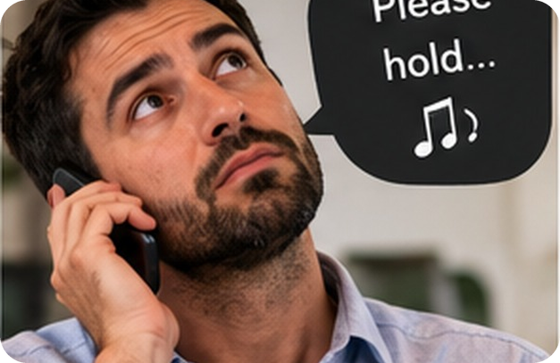
6
What can you hear? 1/2
🎧 LISTEN ASCOLTA
✏️ FILL THE GAPS COMPLETA
Listen to sounds 1–6. Complete!
⏱ 3 min 👥 pairs
Ascolta i suoni 1–6. Completa!
🎧 4.1 · pause after each sound
1 He's just h___ u_.
hung up
⚠ Play it from the book audio
2 His phone w___ o__ in a meeting.
went off
3 The line's e_______ (busy).
engaged
4 The helpline put her o_ h___.
on hold
5 She's left a message on his v________.
voicemail
💡
Guess first, then listen!
6 She's choosing a new r_______.
ringtone
4A-1 · Listening · phone sounds · 📖 SB p.36 · 1a, 1b · audio 4.1, 4.2
Notes:
6. Listening · phone sounds (3 min)
LISTENING (3 min). The sentences are in the order of the sounds in 4.1 (book: A–K; here 1–11 = the sound numbers). Pairs read 1–6 and guess (1 min). Play 4.1 sounds 1–6, pausing after each. Click once per sound. Answers (audio script 4.1 / 4.2): 1 hung up (C) · 2 went off (I) · 3 engaged (G) · 4 on hold (J) · 5 voicemail (F) · 6 ringtone (D). New: go off = ring / make a noise suddenly; engaged (BrE) = busy (AmE). TG: we still say hang up, although we don't physically hang up the phone any more. ICQ: 'Do you write a word or a number?' (a word).

Slide 7
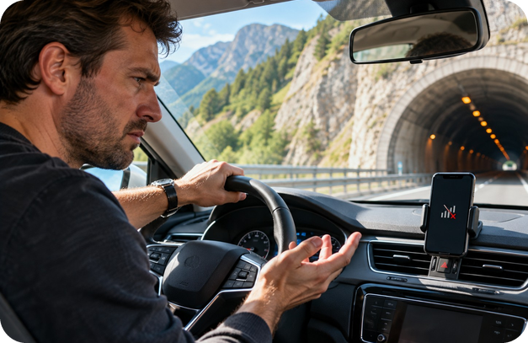
7
What can you hear? 2/2
🎧 LISTEN ASCOLTA
✏️ FILL THE GAPS COMPLETA
Listen to sounds 7–11. Complete!
⏱ 3 min 👥 pairs
Ascolta i suoni 7–11. Completa!
🎧 4.1 + 4.2 · 4.2 = repeat
7 He's d________ a number.
dialling
⚠ Play it from the book audio
8 He was c__ o___ during the call.
cut off
9 He's c______ b___ (again).
calling back
10 She's t______ a friend.
texting (messaging)
11 She's s_______ through photos.
swiping
💡
Guess first, then listen!
4A-1 · Listening · phone sounds · 📖 SB p.36 · 1a, 1b · audio 4.1, 4.2
Notes:
7. Listening · phone sounds (3 min)
LISTENING (3 min). Play 4.1 sounds 7–11, pausing after each. Click once per sound. Answers: 7 dialling (A) · 8 cut off (K) · 9 calling back (E – 'I phoned half an hour ago, but Ann wasn't in') · 10 texting (B) · 11 swiping (H – 'Here, have a look… the next one'). Then play 4.2 (the 11 sentences): students repeat each one. Books closed: play 4.2 again, pause after each NUMBER – students say the sentence from memory (TG).

Slide 8

8
Phone words in Italian
✅ CHECK CONTROLLA
⏱ 2 min 🙋 whole class
Say it in Italian. Then click!
Dillo in italiano. Poi clicca!
📞
dial a number
💬
text / message
📵
hang up
🎵
ringtone
comporre il numero
mandare un messaggio
riattaccare
suoneria
🔁
call back
📼
voicemail
⛔
engaged / busy
👆
swipe
richiamare
segreteria telefonica
occupato
scorrere (col dito)
🔔
go off
⏳
put sb on hold
✂️
be cut off
🔊
speakerphone
suonare (all'improvviso)
mettere in attesa
cade la linea
vivavoce
⚠ Watch out! go off ≠ andare via · engaged = occupato, but also fidanzato! · hang up → hung up
4A-1 · Vocabulary · in Italian
Notes:
8. Vocabulary · in Italian (2 min)
CONSOLIDATION for slower students (2 min). Class says the Italian for each phrase, then ONE click shows all the Italian. 20 seconds on the warnings: go off is NOT 'go away'; engaged also means fidanzato (context!). Quick CCQ: 'The call stopped in the tunnel. Did you hang up?' (no – I was cut off).

Slide 9
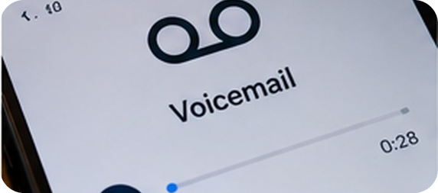
9
Describe it!
🎲 PLAY GIOCA
⏱ 3 min 👥 pairs
Explain the phrase. Don't say it!
Spiega l'espressione. Non dirla!
🎲
How to play
ROUND 1 · A explains
ROUND 2 · B explains
A looks at the screen. B turns around.
A explains the phrase. Don't say it!
B guesses. Then swap.
hang up
call back
ringtone
be cut off
voicemail
swipe
put on hold
speakerphone
4A-1 · Vocabulary game
Notes:
9. Vocabulary game (3 min)
GAME 2 (3 min). Demo first with a strong student: 'You finish the call, you press the red button' → hang up. Mime is allowed as a last resort! Click to show each phrase (round 1 = 4 phrases for A, round 2 = 4 phrases for B; B faces the screen). 20 seconds per phrase. ICQ: 'Can you say the word?' (no) · 'Who looks at the screen in round 2?' (B).

Slide 10
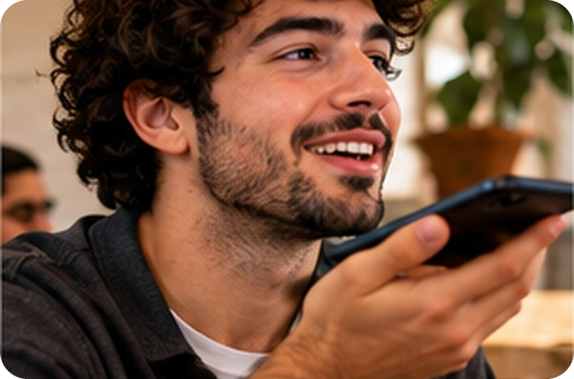


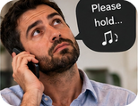
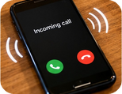
10
You and your phone
💬 TALK PARLA
⏱ 3 min 👥 pairs
Ask a partner. Give details!
Chiedi a un compagno. Dai dettagli!
1
Do you prefer calling or messaging? Why?
e.g. Messaging – it's quicker and I can answer later.
2
Have you ever sent a message to the wrong person?
e.g. Yes! A message about my teacher… to my teacher!
3
Have you ever hung up on someone? Why?
e.g. Yes, on a call centre – they called during dinner!
4
What do you do if they put you on hold for 20 minutes?
e.g. I put it on speakerphone and do my homework.
💬
Useful phrases
Yes, once… · No, never!
It depends. · What about you?
5
Has your phone ever gone off at a bad moment?
e.g. Yes, in a test! The teacher wasn't happy.
4A-1 · Speaking · you and your phone · 📖 SB p.36 · 1c
Notes:
10. Speaking · you and your phone (3 min)
SPEAKING (3 min). From SB 1c (5 of the 7 book questions; 'phone network' and 'monthly contract / pay as you go' left out – the words aren't taught). Questions appear ONE PER CLICK: about 35 seconds each. The listener must ask one follow-up question (What happened? Why?). TG idea: students ask YOU two questions first. Monitor for the phone phrases; note 3–4 errors for later.

Slide 11
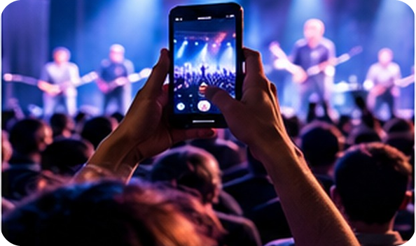
11
Out!
👀 READ LEGGI
⏱ 3 min 👥 pairs
Read. Guess the missing words.
Leggi. Indovina le parole mancanti.
Conductor throws out audience member
At the National Music Auditorium in Madrid, a performance of Handel's Messiah
was interrupted by a mobile phone (1) _____ in a row close to the stage.
was interrupted by a mobile phone going off in a row close to the stage.
Conductor William Christie (2) _____ the performance, turned, (3) _____ at the phone owner, and shouted:
Conductor William Christie stopped the performance, turned, pointed at the phone owner, and shouted:
'Out! You have just (4) _____ one of the most beautiful passages of one of the most beautiful works ever written.'
'Out! You have just ruined one of the most beautiful passages of one of the most beautiful works ever written.'
💡
Remember
The phone owner got up and quickly (5) _____ the hall.
The phone owner got up and quickly left the hall.
conductor /kənˈdʌktə/ = direttore d'orchestra
row = fila (of seats)
4A-1 · Reading · the article · 📖 SB p.36 · 2b (article, slightly shortened)
Notes:
11. Reading · the article (3 min)
READING (3 min). OPTIONAL lead-in (SB 2a, TG): play 4.3 from the book audio – viola player Lukáš Kmit stops and plays the phone's ringtone on his viola (a joke!). Then: 'What would a strict conductor do?' Show the headline; pairs predict, then read and guess gaps 1–5 (gap 1 = a phrase from today). Click once per gap: the word appears IN the text. Answers (SB text): 1 going off · 2 stopped · 3 pointed · 4 ruined · 5 left. Gist: what did the conductor do? (stopped, pointed and shouted 'Out!') What did the phone owner do? (got up and quickly left the hall). Quick vote: right or too rude? Then the comments.

Slide 12

12
Read the comments
👀 READ LEGGI
🔍 FIND TROVA
Read. Who do you agree with?
⏱ 3 min 👥 pairs
Leggi. Con chi sei d'accordo?
If people can't live without their phones for two hours, ¹ they shouldn't go to concerts.
danny
If people can't live without their phones for two hours, ¹ they shouldn't go to concerts.
We need a new rule: ² you have to leave your phone in the cloakroom.
danny
We need a new rule: ² you have to leave your phone in the cloakroom.
If you are caught with a phone in the auditorium, ³ you must immediately pay a fine!
cassie
If you are caught with a phone in the auditorium, ³ you must immediately pay a fine!
People have work phones. Their companies tell them ⁴ they mustn't give their phones to anyone.
anton
People have work phones. Their companies tell them ⁴ they mustn't give their phones to anyone.
I think all concert halls ⁵ should block mobile phone reception.
🔍
Find it!
kasia
I think all concert halls ⁵ should block mobile phone reception.
should / shouldn't
have to / don't have to
must / mustn't
Often it's an alarm, which ⁶ doesn't have to have reception to go off.
marcel
Often it's an alarm, which ⁶ doesn't have to have reception to go off.
4A-1 · Reading · the comments · 📖 SB p.36 · 2b comments (shortened)
Notes:
12. Reading · the comments (3 min)
READING + NOTICING (3 min). Pairs read the comments (shortened from the book) and decide who they agree with: quick show of hands for each person. Teach: cloakroom = guardaroba (photo); a fine = una multa; block reception = no signal. Then click once per line: the highlighted phrase (1–6, as in the book) lights up. These are the phrases for the next slide – don't explain the rules yet.

Slide 13
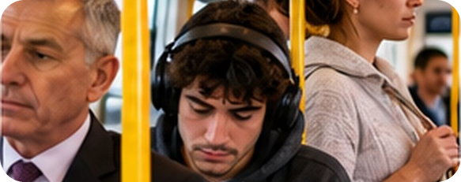
13
What do they mean?
🔗 MATCH ABBINA
⏱ 3 min 👥 pairs
What do 1–6 mean? Match the colour.
Cosa significano 1–6? Abbina il colore.
🏷️
Meanings
1 they shouldn't go to concerts
a bad idea
not necessary
not allowed
2 you have to leave your phone
necessary
necessary
a good idea
3 you must immediately pay a fine
necessary
a bad idea
4 they mustn't give their phones to anyone
not allowed
5 (they) should block phone reception
a good idea
6 (it) doesn't have to have reception
not necessary
4A-1 · Grammar · discovery · 📖 SB p.36 · 2c
Notes:
13. Grammar · discovery (3 min)
GUIDED DISCOVERY (3 min). Book meanings: A This isn't necessary · B Don't do this. It isn't allowed / permitted · C It's necessary or compulsory to do this · D It's a good idea to do this · E It's a bad idea to do this. Pairs match; click once per phrase. Answers (TG): A 6 · B 4 · C 2, 3 · D 5 · E 1. CCQs: 'Phrase 4 – can they give their phone to a friend?' (no, it isn't allowed) · 'Phrase 6 – does an alarm need reception?' (no, it isn't necessary). Highlight 4 vs 6: mustn't ≠ doesn't have to – the most important point of the lesson.

Slide 14


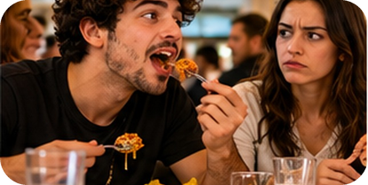
14
have to, must, should
👀 LOOK GUARDA
⏱ 4 min 🙋 whole class
Read. What's the rule?
🎧 4.4 + 4.5 + 4.6 + 4.7
Leggi. Qual è la regola?
⚠ Play it from the book audio
have to / must
mustn't
don't have to
should / shouldn't
it's necessary · a rule
it isn't allowed · don't do it!
it isn't necessary · you can choose
a good / bad idea · advice
You have to switch off your phone during take-off.
You must be on time – there's a test.
You mustn't park here.
Shh! You mustn't talk in the library.
You don't have to pay – this museum is free.
You don't have to answer – they can leave a message.
You should take warm clothes to Dublin.
You shouldn't talk with your mouth full!
è obbligatorio · bisogna
è vietato
non è necessario
dovresti / non dovresti
⚠ 'non devi' = mustn't (vietato) OR don't have to (non serve)! ✗ I must to go ✗ I must study yesterday → ✓ I had to
4A-1 · Grammar · the rule · 📖 Grammar Bank 4A p.138 · audio 4.4–4.7
Notes:
14. Grammar · the rule (4 min)
RULE (4 min). Click once per column: examples + Italian (meaning first, then form). Most examples are from audio 4.4–4.7 (Grammar Bank listen and repeat – play them from the book audio, students copy the rhythm). Rules (TG / Grammar Bank): have to and must = obligation; have to is more common for rules and external obligations; must often = the speaker's own feeling or a strong recommendation ('You must see this film!'). must is present only: past = had to, future = will have to, -ing = having to. don't have to = not necessary; mustn't = prohibited – NOT the same. should = advice, weaker than must (ought to = should, less common). No 'to' after must / should. Last click = the Italian-speaker warning. CCQs: 'You don't have to pay – can you pay if you want?' (yes) · 'You mustn't park here – can you?' (no) · 'You should take warm clothes – is it a rule?' (no, advice).

Slide 15
15
Rules race!
🎲 PLAY GIOCA
⏱ 4 min 🏆 teams
Read. Say the missing words. Quick!
Leggi. Di' le parole mancanti. Veloce!
🎲
How to play
1
Shh! The baby's sleeping. You ___ shout.
→ mustn't (not allowed)
Read the sentence.
Teams: say the missing words in 10 seconds.
Right + say WHY = 2 points.
The concert is free. You ___ buy a ticket.
→ don't have to (not necessary)
2
3
On a plane, you ___ switch off your phone.
→ have to / must (a rule)
4
You look really tired. You ___ go to bed earlier.
→ should (good idea)
5
Yesterday I ___ wait on hold for 30 minutes!
→ had to (past!)
TEAM A ☆☆☆☆☆
TEAM B ☆☆☆☆☆
6
You ___ play games on your phone all night.
→ shouldn't (bad idea)
4A-1 · Grammar game
Notes:
15. Grammar game (4 min)
GAME 3 (4 min). Two teams take turns. Show the sentence; 10 seconds to say the missing words. 1 point for the right form, +1 if they say why (not allowed / not necessary / a rule / advice / past). If a team says 'don't have to' for 1, the other team can steal the point by explaining the difference. Click to show the answer. Accept must or have to in 3; should or ought to in 4.

Slide 16
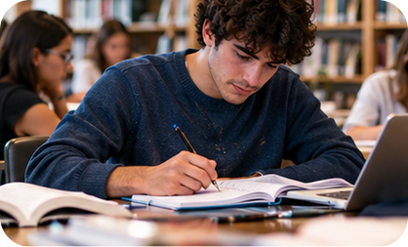
16
Ghost letters
🎧 LISTEN ASCOLTA
🔊 SAY IT PRONUNCIA
Find the silent letters. Say the sentences.
⏱ 4 min 👥 pairs
Trova le lettere mute. Di' le frasi.
🎧 4.8 · then say the sentences
1
wa(l)ked
(w)hole
i(s)land
⚠ Play it from the book audio
We walked round the whole island.
🔊
👻 Which letter is silent?
2
mus(t)n't
ta(l)k
lis(t)en
calm · design · dishonest · doubt · foreign · half
hour · island · knowledge · listen · mustn't · ought
rhythm · should · talk · walk · whole · wrong
You mustn't talk – just listen.
3
shou(l)d
forei(g)n
Everyone should learn a foreign language.
4
ou(gh)t
ha(l)f
(h)our
The taxi ought to be here in half an hour.
4A-1 · Pronunciation · silent consonants · 📖 SB p.37 · 3a, 3b, 3c · audio 4.8
Notes:
16. Pronunciation · silent consonants (4 min)
PRONUNCIATION (4 min). 3a: pairs say the 18 words (purple card) and cross out the silent consonant(s) (1 min). 3b: play 4.8 to check. Answers (TG): calm, half, should, talk, walk (l) · dishonest, hour, rhythm (h) · whole, wrong (w) · design, foreign (g) · ought (gh) · doubt (b) · knowledge (k) · island (s) · listen (t) · mustn't (the first t). 3c: for each sentence, click 1 = the words with the silent letter in ( ), click 2 = the full sentence. Model, then drill chorally and individually. Italian speakers often say the l in calm / walk / should and the w in wrong – exaggerate. EXTRA CHALLENGE (TG): thumb, castle, science, knee, answer, sign, climb, scissors, exhausted.

Slide 17
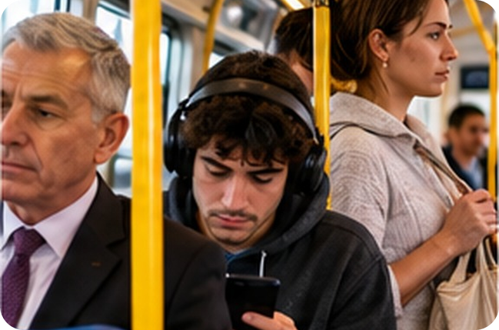



17
Does it annoy you?
💬 TALK PARLA
⏱ 5 min 👨‍👩‍👧 groups
Does it annoy you? Say why!
Ti dà fastidio? Di' perché!
1
People film every minute of a concert.
e.g. It annoys me! They should watch the band, not the screen.
2
People listen to music so loud that everyone can hear it.
e.g. On the bus every day! They should turn it down.
3
People text while they're walking in the street.
e.g. To be honest, I sometimes do it… but I know I shouldn't!
4
People take selfies all the time and post them online.
e.g. It's OK – but not 20 a day!
💬
Useful phrases
5
People put their phones on the table in a restaurant.
e.g. My uncle does it. I think it's rude – you shouldn't!
It really annoys me when people…
They should / shouldn't…
To be honest, I sometimes…
6
Your friend sends messages during a film at the cinema.
e.g. That's really annoying. You mustn't do that!
4A-1 · Speaking · annoying phone habits · 📖 SB p.37 · 4 Speaking (6 of the 13 annoying things)
Notes:
17. Speaking · annoying phone habits (5 min)
FREER PRACTICE (5 min). Check annoy (dare fastidio). Groups of 3–4. Habits appear ONE PER CLICK (about 45 seconds each). For each one the book asks: 1 Do you know people who do this? Do you ever do it? 2 Does it annoy you, or is it OK? 3 What should / shouldn't these people do? OUTCOME: each group agrees on its TOP 3 most annoying habits and makes one rule with mustn't or shouldn't. 'To be honest, I sometimes…' recycles last lesson – everyone admits one thing they do (no pressure). Monitor; then 2 minutes of delayed error correction (errors from both speaking tasks; watch for must to / mustn't vs don't have to). The other 7 book habits (for fast groups): play noisy games · tweet about everything · keep posting photos of their babies · video every event and every minute of their holiday · post on your birthday but never get in touch · swipe through all their photos when showing you one.

Slide 18
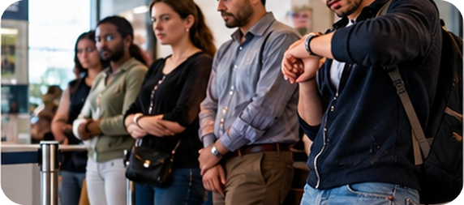
18
Where am I?
🎲 PLAY GIOCA
⏱ 4 min 👥 pairs
Give rules for a place. Don't say it!
Dai le regole di un posto. Non dirlo!
🎲
How to play
ROUND 1 · A gives rules
ROUND 2 · B gives rules
A looks at the screen. B turns around.
A gives rules: You have to… You mustn't…
B guesses the place. Then swap.
LIBRARY
HOSPITAL
CINEMA
MUSEUM
AIRPORT
PLANE
SWIMMING POOL
CLASSROOM
4A-1 · Grammar game · 📖 Practice of Grammar Bank 4A: have to, must, should
Notes:
18. Grammar game (4 min)
GAME 4 (4 min) – a 'Describe it!' variation. Model with 'a classroom' first: 'You have to listen to the teacher. You mustn't eat. You don't have to wear a uniform.' → classroom. Only rules with have to / don't have to / must / mustn't / should count – no other clues, never say the place. Click to show each place (round 1 = 4 places for A, round 2 = 4 for B). Guessed after 1–2 rules = 2 points, after 3+ = 1 point. Listen for mustn't vs don't have to: 'You don't have to talk' in a library is wrong (→ mustn't). ICQ: 'Can you say what you see there?' (no – only rules).

Slide 19
19
3 · 2 · 1
⏱ 2 min 👥 pairs
Books closed! What can you remember?
Libri chiusi! Cosa ricordi?
3
phone phrases from today (no looking!)
📝
Homework · Compiti
Workbook 4A: 1a, 1b, 2a, 2b, 3a
Grammar Bank 4A p.138: a 5–8, b 5–7
Homework sheet in the LLS app
2
rules for our class: "You have to… / You mustn't…"
1
piece of advice for a friend: "You should…"
Next lesson: 4A part 2 · modern manners · rude relatives?
4A-1 · Exit · what can you remember?
Notes:
19. Exit · what can you remember? (2 min)
RETRIEVAL EXIT (2 min). Books closed. Pairs: 3 phone phrases, 2 class rules (one with have to or must, one with mustn't), 1 piece of advice with should. A few students share – check mustn't vs don't have to one last time. Set homework (on the slide and in the app): Workbook 4A 1a, 1b, 2a, 2b, 3a + Grammar Bank 4A a 5–8, b 5–7 + the 4A-1 homework sheet (easier version available). Workbook 2c and 2d are part 2 homework.

Slide 20
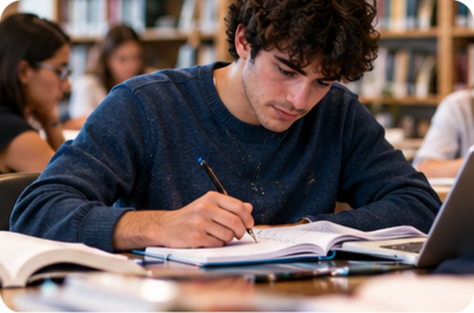
20
Can you think of a situation?
💬 TALK PARLA
⏱ 3 min 👥 pairs
Think of a situation. Tell a partner.
Pensa a una situazione. Dillo al compagno.
1
When do you have to switch off your phone?
e.g. On a plane, during take-off and landing.
2
When shouldn't you use your phone?
e.g. At dinner with your family – it's rude.
3
Where mustn't you use your phone, but you don't have to switch it off?
e.g. In the cinema – you can put it on silent.
💬
Useful phrases
You have to… when…
You shouldn't… because…
4A-1 · Speaking · situations · 📖 SB p.36 · 2e
EXTRA · if there's time
Notes:
20. Speaking · situations (3 min)
EXTRA (3 min, if there's time) – SB 2e. Questions one per click. Get students to say full sentences. Accept any logical situation (the e.g. answers are only models).

Slide 21
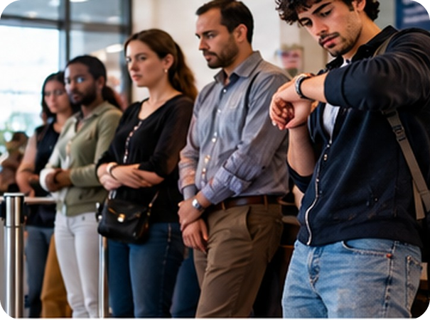
21
Grammar Bank 4A
✏️ FILL THE GAPS COMPLETA
⏱ 4 min 👤 alone
Do Grammar Bank 4A. Then check!
Fai il Grammar Bank 4A. Poi controlla!
⭐
Example
1
a 1–4 (in the book)
1 ✓ · 2 mustn't · 3 ✓ · 4 ✓
0 a: ✓ or correct it · b: complete with have to / must / should
2
b1 Did you ___ do a lot of homework at school?
have to
3
b2 ___ I take my tablet out of my bag at Security?
Must
4
b3 My sister's a nurse, so some weeks she ___ work nights.
has to
5
b4 Have you ever ___ have an operation?
had to
4A-1 · Grammar · Grammar Bank practice · 📖 Grammar Bank 4A p.138 · a 1–4, b 1–4 (a 5–8, b 5–7 = homework)
EXTRA · if there's time
Notes:
21. Grammar · Grammar Bank practice (4 min)
EXTRA (4 min) – or start of the homework. Answers (TG key): a 1 ✓ · 2 mustn't · 3 ✓ (has to would be more common – external obligation) · 4 ✓. b 1 Did you have to do… · 2 Must I take… · 3 …she has to work nights · 4 Have you ever had to have an operation? ⚠ The Grammar Bank a 1–4 prompts are not in our photos – students work from the book. Click once per item.

