Slide 1


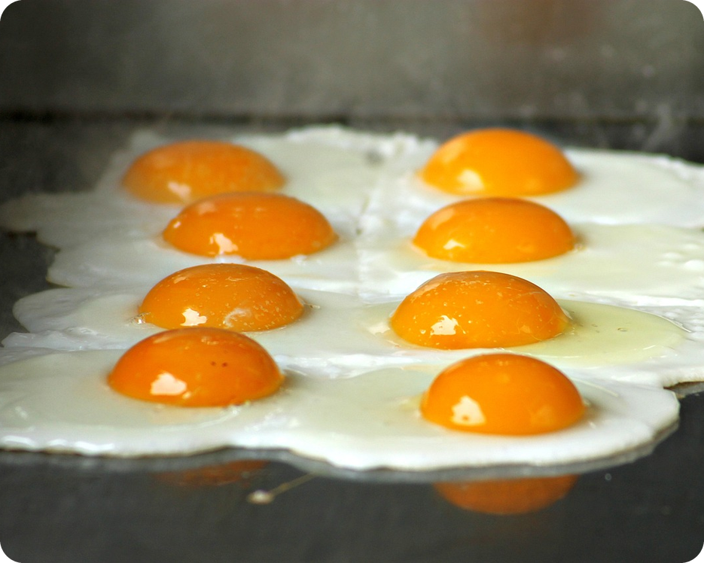


English File B1 · SB pp.38–39
💡 THINK · PENSA
4A-2
Bad manners?
Modern manners · rude relatives
🎯
Today you're going to…
👀 read a guide to modern manners
🎧 listen to a radio show about rude relatives
💬 give advice: should, mustn't, don't have to
🎲 decide: good manners or bad manners?
Is it rude to start eating before everyone is served?
EXAMPLE Yes! In my family we always wait. My nonna gets angry if you start first!
Notes:
1. OPENING (2 min)
Show the photo. Ask the THINK question: 'Is it rude to start eating before everyone is served?' Quick vote: hands up for rude / not rude. Take 2–3 reasons, then click for the example answer. Don't give the 'right' answer: a famous British book answers it later in the lesson (it says YES, it's rude – unless the host says it's OK). Read the 'Today you're going to…' list together. (Picture: the 4a2-cover picture is still to come; until then the deck shows 4a1-table-manners.jpg.)

Slide 2

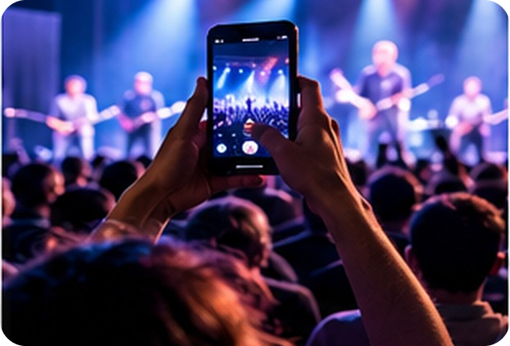
2
Remember last lesson?
💡 THINK PENSA
⏱ 2 min 🙋 whole class
What did we learn? Read the examples.
Cosa abbiamo imparato? Leggi gli esempi.
must / have to · mustn't
should / ought to · don't have to
You have to switch off your phone on a plane.
You must be on time tomorrow – there's a test.
You mustn't text while you're driving.
→ must / have to = necessary · mustn't = NOT allowed
You should take warm clothes to Dublin.
You shouldn't drink so much coffee.
You don't have to pay – the museum is free.
→ should / ought to = a good idea · don't have to = not necessary
📅
Last lesson…
4A part 1: phone language
have to, must, should
silent letters: calm, hour
🔤 KEY WORDS
hang up
call back
voicemail
put on hold
be cut off
go off
ringtone
calm · hour · wrong
4A-2 · Revision · last lesson
Notes:
2. Revision · last lesson (2 min)
REVISION (2 min) before the warmer game. Read the examples with the class (they are from the Grammar Bank 4A examples, audio 4.4–4.7). Point at the arrows: the meaning tells you which verb. Key check: 'non devi' in Italian can be mustn't OR don't have to – ask 'Is it NOT allowed or just NOT necessary?' Remind them: ought to = should. Then quickly say the last chip aloud: calm (no l), hour (no h), wrong (no w). The warmer game 'Odd one out' uses exactly this language.

Slide 3

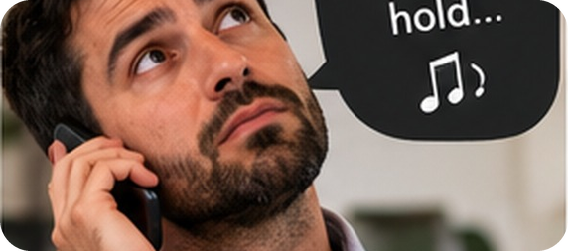
3
Odd one out
🎲 PLAY GIOCA
⏱ 4 min 🏆 teams
Find the odd one out. Say WHY!
Trova l'intruso. Spiega PERCHÉ!
🎲
How to play
1
hang up · be cut off · call back
→ call back – you START a call; the others end it
Read the words or sentences.
Find the odd one out.
Say WHY = 1 point.
calm · half · talk · wrong
→ wrong – silent w (the others: silent l)
2
3
hour · whole · dishonest · rhythm
→ whole – silent w (the others: silent h)
4
mustn't park · can't park · don't have to park
→ don't have to = not necessary (the others = not allowed)
5
should · ought to · must
→ must = necessary (the others = a good idea)
4A-2 · Warmer · last lesson: phones, modals, silent letters · 📖 Recycles 4A part 1 · SB pp.36–37 · audio 4.8 · Grammar Bank 4A
Notes:
3. Warmer · last lesson: phones, modals, silent letters (4 min)
RETRIEVAL WARMER (4 min) – recycles 4A part 1 (phone language, modals, silent letters). Format: odd one out in two teams (different from 4A-1's warmer). Teams have 30 seconds per line; they must say the odd one out AND why (the 'why' is the real revision). Click once per line. Answers: 1 call back starts a call; hang up / be cut off end it · 2 wrong (silent w) – calm, half, talk = silent l (audio 4.8) · 3 whole (silent w) – hour, dishonest, rhythm = silent h · 4 You don't have to park here = not necessary; You mustn't / can't park here = not allowed · 5 must = very important / necessary; should and ought to = advice. Quick follow-up for item 4: each team says a true sentence about our school with don't have to (e.g. We don't have to wear a uniform). ICQ: 'Is the answer enough?' (no – say why).

Slide 4
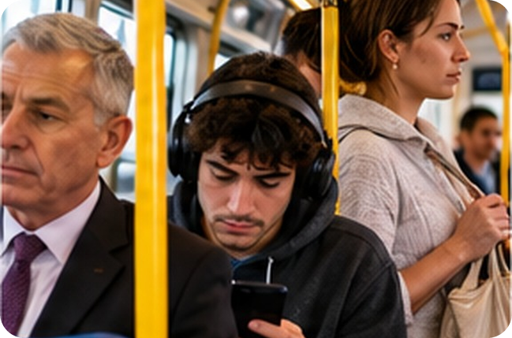
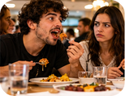
4
What do YOU think?
💬 TALK PARLA
⏱ 3 min 👥 pairs
Answer with your opinion. Give a reason!
Rispondi con la tua opinione. Spiega perché!
1
When shouldn't you greet someone with a kiss?
e.g. Maybe at a job interview?
2
What shouldn't you do on public transport?
e.g. You shouldn't talk loudly on your phone!
3
Should you recline your seat on a plane?
e.g. Yes, on a long flight. It's normal!
4
When should you give up your seat on the bus?
e.g. When an old person gets on.
💬
Useful phrases
I think you should / shouldn't…
It's rude to…
It depends…
5
Should you ever start eating before everyone is served?
e.g. No! My nonna says we have to wait.
4A-2 · Reading · lead-in: modern dilemmas · 📖 SB p.38 · 5a
Notes:
4. Reading · lead-in: modern dilemmas (3 min)
LEAD-IN / PREDICTION (3 min). Book 5a questions, ONE PER CLICK; about 30 seconds per question in pairs. Teach dilemma /dɪˈlemə/ (= a situation in which you have to make a difficult choice – un dilemma) and drill it. Don't correct their opinions: on the next slides they find out what a very traditional British book says. Feedback: one or two pairs per question; ask 'Is it the same in Sicily?' (e.g. two kisses are normal here). ICQ: 'Are you giving YOUR opinion or the book's?' (mine).

Slide 5

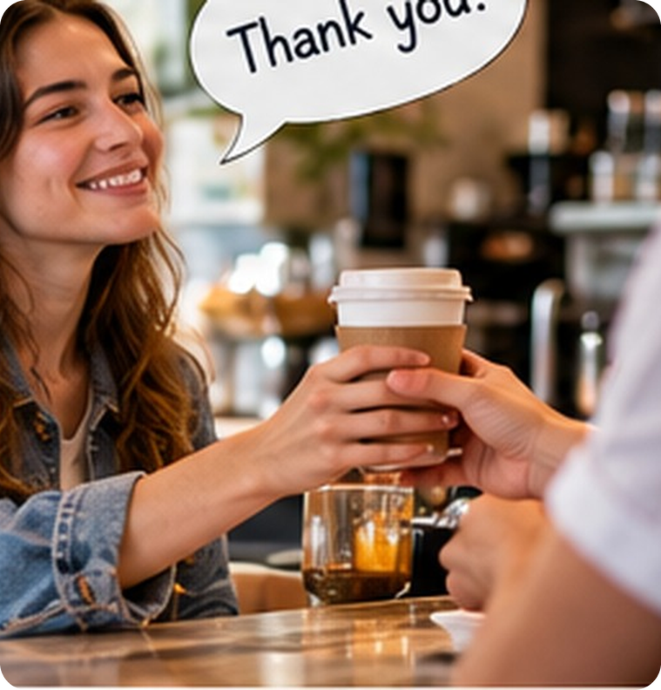
5
Debrett's
👀 READ LEGGI
🤔 GUESS INDOVINA
Read. Guess where the 5 numbers go!
⏱ 2 min 👥 pairs
Leggi. Indovina dove vanno i 5 numeri!
Debrett's Guide
…to Modern Dilemmas. Debrett's is a British publisher of books about modern manners. For nearly ___ years, its Handbook has advised the British public on social etiquette: how to behave in social situations.
➡ NEXT The text on the next 2 slides has 5 number gaps (a–e) and 5 advice gaps (Q1–Q5). Guess first, then click to check.
🔢 NUMBER BANK · guess where they go!
100
10,000
1994
2004
20%
4A-2 · Reading · prediction · 📖 SB p.38 · 5b · Debrett's introduction
Notes:
5. Reading · prediction (2 min)
PREDICTION (2 min). Read the introduction aloud. Teach etiquette /ˈetɪket/ (= galateo) and manners (buone maniere). Pairs look at the number bank and guess what each number is about (years? questions per year? a year? a percentage?) – every pair commits to a guess before the next slide. Hint if needed: one year was a question about the Queen, the other about wedding presents. ICQ: 'Are you checking or guessing?' (guessing). (Curiosity from the article: the editor, Jo Bryant, says 'The key is to always consider those around you.')

Slide 6
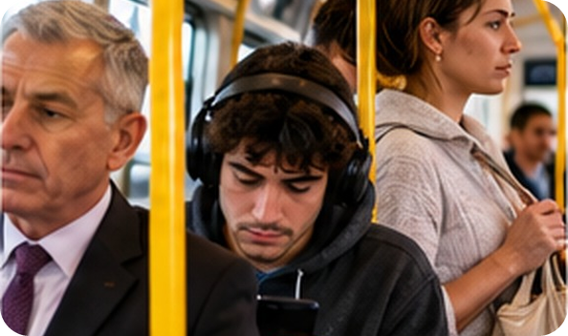
6
Modern dilemmas 1/2
👀 READ LEGGI
🤔 GUESS INDOVINA
Guess the gaps. Then click to check.
⏱ 3 min 👥 pairs
Indovina gli spazi. Poi clicca per controllare.
The Handbook · Kissing · Public transport
For nearly (a) _____ years, Debrett's Handbook has advised the British public. It receives more than (b) _____ enquiries a year.
For nearly 100 years, Debrett's Handbook has advised the British public. It receives more than 10,000 enquiries a year.
In (c) _____ people asked: 'What should you do if you meet the Queen?' In (d) _____ : 'Is it acceptable to ask for money as a wedding present?'
In 1994 people asked: 'What should you do if you meet the Queen?' In 2004: 'Is it acceptable to ask for money as a wedding present?'
KISSING · Debrett's advice is that kissing is not appropriate in many (Q1) _____ .
KISSING · Debrett's advice is that kissing is not appropriate in many professional situations.
It should only be used among friends, but not on a (Q1) _____ .
It should only be used among friends, but not on a first meeting.
💡
Remember
PUBLIC TRANSPORT · It's inconsiderate to eat (Q2) _____ in a closed environment, and putting on (Q2) _____ makes you appear disorganized.
PUBLIC TRANSPORT · It's inconsiderate to eat smelly food in a closed environment, and putting on make-up makes you appear disorganized.
Were your answers the same as Debrett's?
4A-2 · Reading · Debrett's 1/2 · 📖 SB p.38 · 5b (text adapted from the article)
Notes:
6. Reading · Debrett's 1/2 (3 min)
READ + CHECK (3 min). Pairs write their guesses for a–d (numbers) and Q1–Q2 (Debrett's advice: the gaps answer questions 1–2 from slide 4). Then click once per line: the answer appears highlighted IN the text. Answers (article): a 100 · b 10,000 · c 1994 (the Queen) · d 2004 (money as a wedding present) · Q1 professional situations / a first meeting – TG: at work or when meeting someone socially for the first time · Q2 smelly food / make-up – TG: you shouldn't eat smelly food or put on make-up. Ask after each click: 'Were your answers the same as Debrett's?' (5b). Don't explain the highlighted words yet (appropriate, inconsiderate): slide 8 does that. (The book article also says: an air kiss, without contact, may seem rude, so very slight contact is best, but no sound effects!) Picture: 4a2-office-kiss.jpg is still to come; the deck shows 4a1-public-transport.jpg until then.

Slide 7
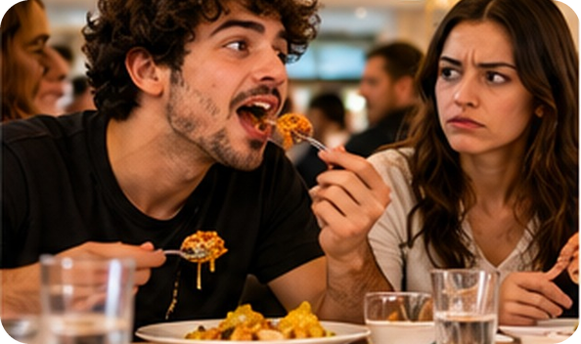
7
Modern dilemmas 2/2
👀 READ LEGGI
🤔 GUESS INDOVINA
Guess the gaps. Then click to check.
⏱ 3 min 👥 pairs
Indovina gli spazi. Poi clicca per controllare.
Aeroplanes · Seats · Eating
AEROPLANES · It's selfish to recline your seat during (Q3) _____ . Stay in your own space and don't monopolize the armrest.
AEROPLANES · It's selfish to recline your seat during short daytime flights. Stay in your own space and don't monopolize the armrest.
SEATS · In an experiment, only (e) _____ of London Tube passengers gave up their seat to a visibly pregnant woman.
SEATS · In an experiment, only 20% of London Tube passengers gave up their seat to a visibly pregnant woman.
Always offer your seat to anyone who is (Q4) _____ . But it's also rude to aggressively decline the offer of a seat.
Always offer your seat to anyone who is pregnant, elderly, or clearly in need. But it's also rude to aggressively decline the offer of a seat.
EATING · Is it rude to start eating before everyone is served? Yes, (Q5) _____ .
EATING · Is it rude to start eating before everyone is served? Yes, unless the host or hostess gives permission.
💡
Remember
Only 20%! Would YOU give up your seat?
4A-2 · Reading · Debrett's 2/2 · 📖 SB p.38 · 5b (text adapted from the article)
Notes:
7. Reading · Debrett's 2/2 (3 min)
READ + CHECK (3 min). Same procedure. Answers (article / TG): Q3 not on short (daytime) flights · e 20% · Q4 when someone is pregnant, elderly / old, or clearly in need · Q5 only if you have permission: unless the host or hostess (or, in a restaurant, the other diners) gives permission. React: 'Only 20%! Is it the same on the bus in Palermo?' Back to the opening question: Debrett's says YES, it's rude. (The article also says: avoid kicking the seat in front of you, or using it to help you stand up.) Picture: 4a2-recline.jpg is still to come; the deck shows 4a1-table-manners.jpg until then.

Slide 8
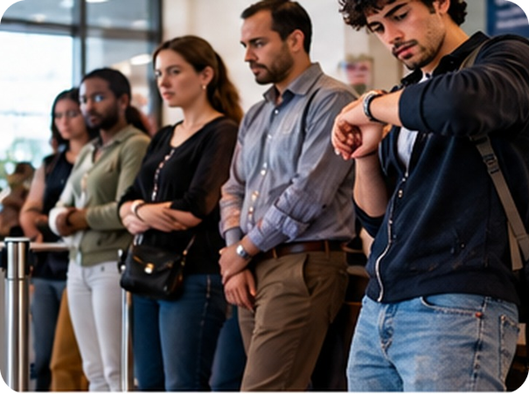
8
Say it more simply
💬 TALK PARLA
⏱ 4 min 👥 pairs
Say it more simply to your partner.
Dillo in modo più semplice al compagno.
⭐
Example
1
not appropriate in many professional situations
don't kiss people you meet at work
0 It's selfish → you're only thinking about yourself
2
it's inconsiderate to eat smelly food
it isn't nice for other people (trains, offices…)
3
don't monopolize the armrest
share the armrest – don't use it all yourself
4
it's rude to aggressively decline the offer of a seat
if you don't want the seat, say no politely
5
unless the host gives permission
only start if the person who invited you says it's OK
4A-2 · Reading · vocabulary from the text · 📖 SB p.38 · 5c (highlighted phrases)
Notes:
8. Reading · vocabulary from the text (4 min)
ELICIT FIRST (4 min). Book 5c: the highlighted phrases. Demo item 0 with the class. Pairs explain each phrase in simple English, looking at the context on slides 6–7 (Italian only as a last resort). Click once per item: the TG's possible answers (accept any similar paraphrase). Drill: inconsiderate /ˌɪnkənˈsɪdərət/, monopolize /məˈnɒpəlaɪz/, decline /dɪˈklaɪn/, permission /pəˈmɪʃn/. ICQs: 'Are you translating into Italian?' (no – simple English) · 'Alone or in pairs?' (pairs). Next slide gives the Italian for slower students. 5d (30 seconds, whole class): 'Do you agree with Debrett's advice? Are the reasons good ones?' Picture: 4a2-smelly-food.jpg is still to come; the deck shows 4a1-queue.jpg until then.

Slide 9
9
Manners words in Italian
✅ CHECK CONTROLLA
⏱ 2 min 🙋 whole class
Say it in Italian. Then click!
Dillo in italiano. Poi clicca!
😠
rude
😊
polite
🙄
inconsiderate
🤳
selfish
maleducato, scortese
educato, gentile
che non pensa agli altri
egoista
👔
appropriate
🙅
decline (an offer)
💺
recline your seat
💪
monopolize the armrest
adatto, opportuno
rifiutare (un'offerta)
reclinare il sedile
occupare tutto il bracciolo
🏠
the host / hostess
👍
permission
🤰
pregnant · elderly
🤔
a dilemma
il padrone / la padrona di casa
il permesso
incinta · anziano
un dilemma (una scelta difficile)
⚠ Watch out! polite = educato · educated = istruito (false friend!) | manners = buone maniere · etiquette = galateo
4A-2 · Vocabulary · in Italian
Notes:
9. Vocabulary · in Italian (2 min)
CONSOLIDATION for slower students (2 min). Class says the Italian aloud for each word, then ONE click shows all the Italian. 20 seconds on the warning: 'educato' is polite, NOT educated (educated = istruito, who studied a lot). Quick CCQs: 'He takes all the armrest. Is he thinking about other people?' (no) 'So he's…?' (selfish / inconsiderate) · 'You say no to a seat: you…?' (decline it) · 'The person who invites you to dinner is the…?' (host).

Slide 10
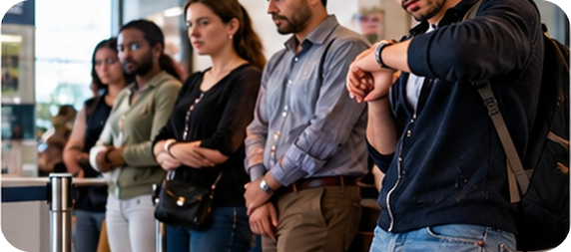
10
Describe it!
🎲 PLAY GIOCA
⏱ 3 min 👥 pairs
Explain the word. Don't say it!
Spiega la parola. Non dirla!
🎲
How to play
ROUND 1 · A explains
ROUND 2 · B explains
A looks at the screen. B turns around.
A explains the word. Don't say it!
B guesses. Then swap.
selfish
inconsiderate
the host
permission
decline
recline your seat
polite
rude
4A-2 · Vocabulary game
Notes:
10. Vocabulary game (3 min)
GAME 2 (3 min). Variation of 'Describe it!' – A must use a SITUATION, not a definition: 'Someone eats all the pizza and doesn't share. He's…' → selfish. Demo first with a strong student. Click to show each word (round 1 = 4 words for A; round 2 = B faces the screen, 4 more words). 20 seconds per word. ICQ: 'Can you say the word?' (no) · 'Definition or situation?' (situation).

Slide 11

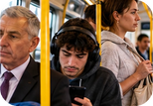
11
Manners: Sicily vs Britain
💬 TALK PARLA
⏱ 4 min 👥 pairs
Answer. Then ask: And you? Why?
Rispondi. Poi chiedi: E tu? Perché?
1
Debrett's: no kissing at work. How do you greet a friend in Sicily?
e.g. Two kisses for friends – a handshake for my teacher!
2
What else shouldn't people do on the bus or train?
e.g. They shouldn't play music without headphones!
3
Only 20% of Tube passengers gave up their seat to a pregnant woman. Would you?
e.g. Yes, of course! You should always offer your seat.
4
What else should you ask the host's permission to do?
e.g. You should ask before you open their fridge!
💬
Useful phrases
5
Be honest: are you ever rude to anyone in your family?
e.g. Sometimes… I'm on my phone at dinner!
In Sicily we usually…
I think it's rude / polite to…
You shouldn't… because…
6
Do you think manners are important? Why (not)?
e.g. Yes – good manners make life easier for everyone.
4A-2 · Speaking · Sicily vs Britain · 📖 SB p.38 · 5e
Notes:
11. Speaking · Sicily vs Britain (4 min)
SPEAKING (4 min). Book 5e (adapted, made concrete). Questions appear ONE PER CLICK: about 40 seconds per question, then click. Q5 is personal: anyone can say 'I'd rather not say'. Monitor and note 4–5 errors (e.g. ✗ 'Is rude to…' → It's rude to…; ✗ 'You must to…') for delayed correction after the listening. Feedback on Q1: is Sicily more 'kissy' than Britain? Keep it light – no stereotypes. Other book questions if there's time: 'What do you think passengers ought not to do on planes?' · 'How else is it appropriate to help elderly people?'

Slide 12

12
Help! My relatives…
🎧 LISTEN ASCOLTA
⏱ 3 min 👤 alone
Listen. Who is the problem? What do they do?
Ascolta. Chi è il problema? Cosa fa?
🎧 4.9 · play once, pause after each caller
↘ speaker bottom right
A
B
C
📷 4a2-mother-in-law.jpg
📷 4a2-puppy.jpg
📷 4a2-radio-advice.jpg
1 Belinda
A · mother-in-law: criticizes her cooking
2 Damien
B · brother: brings his new puppy
3 Miranda
nephew (8): writes on the walls!
🎧
While you listen
Look at A and B. Guess the problems.
Listen. Who is the problem for each caller?
What does he / she do? Make notes.
🔈 click ▶
4A-2 · Listening · rude relatives (gist) · 📖 SB p.39 · 6a · audio 4.9
Notes:
12. Listening · rude relatives (gist) (3 min)
GIST (3 min). Set the scene with picture C: a radio phone-in about modern manners; today's subject: rude relatives (parenti maleducati). Check mother-in-law (suocera), nephew (nipote, son of your brother / sister), puppy (cucciolo). Play 4.9 ONCE, pausing after each caller for notes; play again if necessary. Pairs compare, then click once per caller (chips: picture letter · who · the problem). Answers (TG / audio script): 1 Belinda's mother-in-law criticizes her cooking whenever she comes for a meal · 2 Damien's brother is coming next month with his new dog, a puppy – Damien and his girlfriend aren't very into dogs, and they've just redecorated the house and done a lot of work on the garden · 3 Miranda's nephew (her sister's son) is 8; his parents don't give him any rules: he shouts, jumps on the furniture, makes a mess in the kitchen, even writes on the walls; her sister is very sensitive about criticism, so Miranda doesn't say anything. ICQ: 'Are you writing every word?' (no – just the problem). Pictures A–C are still to come (placeholders).

Slide 13
13
What should they do?
🎧 LISTEN ASCOLTA
✏️ FILL THE GAPS COMPLETA
Your advice first! Then listen and complete.
⏱ 4 min 👥 pairs
Prima il tuo consiglio! Poi ascolta e completa.
🎧 4.10 · pause after each piece of advice
1 You ought to be the one who ___.
behaves well
2 You shouldn't ___ – she won't change her opinion.
argue with her
📷 4a2-radio-advice.jpg
3 You should politely but directly ___.
say how you feel
4 To be honest, you don't really have to ___.
give a reason
5 You must ___ before their next visit.
speak to his parents
6 He has to ___ a bit when he's visiting.
calm down
💡
Guess first, then listen!
7 'You mustn't ___ .'
write on the walls
🔈 click ▶
4A-2 · Listening · the expert's advice (detail) · 📖 SB p.39 · 6b, 6c · audio 4.10
Notes:
13. Listening · the expert's advice (detail) (4 min)
DETAIL (4 min). 6b (1 min): pairs give ONE piece of advice for each caller, using should / ought to / must / mustn't / don't have to (no 'it depends'!). Take one idea per caller. 6c: play 4.10 (Sarah, the etiquette expert), pausing after each piece of advice; students guess first, then complete. Callers: 1–2 Belinda · 3–4 Damien · 5–7 Miranda. Click once per sentence. Answers (TG): 1 behaves well · 2 argue with her · 3 say how you feel · 4 give a reason · 5 speak to his parents · 6 calm down · 7 write on the walls. Full sentences (4.10): I think you ought to be the one who behaves well. · You shouldn't argue with her, because she won't change her opinion. · I think you should politely but directly say how you feel. · To be honest, you don't really have to give a reason. · You must speak to his parents before their next visit. · Explain that he has to calm down a bit when he's visiting. · 'You mustn't write on the walls.' Ask: 'Was your advice similar?'

Slide 14
14
What else does Sarah say?
🎧 LISTEN ASCOLTA
⏱ 3 min 👥 pairs
Listen to the whole show. Answer.
Ascolta tutto il programma. Rispondi.
🎧 4.11 · play once
Belinda: what 3 things should she do?
stay calm · thank her politely · change the subject
Who should praise Belinda's cooking?
her husband (or another relative)
📷 4a2-puppy.jpg
Is it rude to bring a dog to someone's house?
yes – it's bad manners to bring an uninvited pet
Miranda: what should she say to his parents first?
how great it is that he has so much energy
What should she do at the start of the next visit?
welcome him, then give him some house rules
💡
Guess first, then listen!
🔈 click ▶
4A-2 · Listening · the whole programme · 📖 SB p.39 · 6d · audio 4.11 (script p.127)
Notes:
14. Listening · the whole programme (3 min)
WHOLE PROGRAMME (3 min). 6d: students read the questions first, then listen to 4.11 once. Pairs compare; click once per question. Answers (audio script 4.11): 1 stay calm, thank her as politely as possible for her advice, and change the subject · 2 her husband or another relative – in front of her mother-in-law (then she'll either stop criticizing or start paying compliments) · 3 yes: it's bad manners for a guest to bring an uninvited pet, even to a relative's home · 4 say how great it is that their son has so much energy and how much she loves him – then explain that he has to calm down · 5 welcome him, but give him some house rules (no jumping on the furniture; draw on paper – you mustn't write on the walls). Then 6d: 'Do you agree with Sarah's advice? Anything else you would suggest?' EXTRA SUPPORT: script on SB p.127 (also homework). Picture: 4a2-puppy.jpg (placeholder).

Slide 15
15
Sarah's advice
🔗 MATCH ABBINA
⏱ 3 min 👥 pairs
Good idea or necessary? Match the colour.
Buona idea o necessario? Abbina il colore.
🏷️
What does it mean?
1 You ought to be the one who behaves well.
good idea
good idea
bad idea
2 You shouldn't argue with her.
bad idea
necessary
not allowed
3 You should politely but directly say how you feel.
good idea
not necessary
4 You don't really have to give a reason.
not necessary
5 You must speak to his parents.
necessary
🎧 4.10 · listen again
6 He has to calm down a bit.
necessary
7 You mustn't write on the walls.
not allowed
🔈 click ▶
4A-2 · Grammar · advice in the programme · 📖 Recycles Grammar Bank 4A p.138 · audio 4.10
Notes:
15. Grammar · advice in the programme (3 min)
MEANING CHECK (3 min) – the 4A-1 grammar in a new context. Pairs match sentences 1–7 to the five meanings (the same meanings as 4A-1's comments task: good idea / bad idea / necessary / not allowed / not necessary). Click once per sentence. Answers: 1 good idea (ought to = should) · 2 bad idea · 3 good idea · 4 not necessary · 5 necessary · 6 necessary · 7 not allowed. CCQs: 'You don't have to give a reason – can Damien give one?' (yes, if he wants) · 'You mustn't write on the walls – can he?' (no!). Drill ought to /ˈɔːt tə/ – remember the silent gh! Then 2 minutes of delayed error correction from the speaking (slide 11).

Slide 16
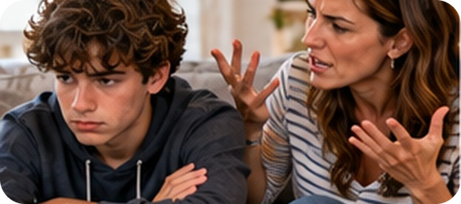
16
Ask Sarah!
🎲 PLAY GIOCA
⏱ 3 min 🏆 teams
Read the problem. Give advice – fast!
Leggi il problema. Dai un consiglio – veloce!
🎲
How to play
1
"My friend is always on her phone when we meet for pizza."
→ You should tell her politely how you feel.
Read the problem.
Teams: give advice in 10 seconds.
should / mustn't / don't have to… = 1 point.
"My uncle always asks: 'When are you getting married?'"
→ You don't have to answer! Just change the subject.
2
3
"My little cousin jumps on my bed with his shoes on."
→ Tell him: 'You mustn't jump on the bed!'
4
"The man behind me on the plane keeps kicking my seat."
→ You should politely ask him to stop.
5
"I'm invited for dinner and it's fish. I hate fish!"
→ You shouldn't criticize the food. Try a little!
6
"A pregnant woman gets on the full bus. I'm sitting down."
→ You ought to offer her your seat!
4A-2 · Speaking game · giving advice
Notes:
16. Speaking game · giving advice (3 min)
GAME 3 (3 min). Two teams; the class is now the radio expert. Read each problem; teams have 10 seconds to give advice with should / shouldn't / ought to / must / mustn't / don't have to. Click to show a model answer – accept ANY correct, sensible advice. 1 point if the modal verb is right (✗ 'You must to…' = no point), +1 for the funniest polite advice. The problems are our own (model answers are examples, not from the book).

Slide 17
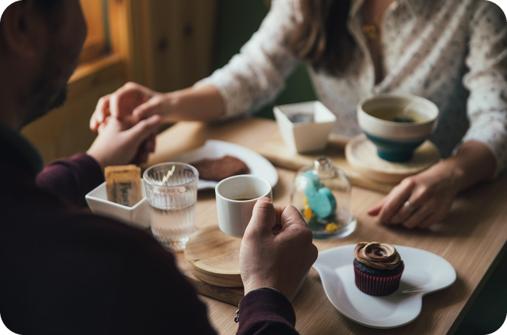
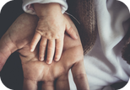
17
Good or bad manners? 1/2
💬 TALK PARLA
⏱ 4 min 👨‍👩‍👧 groups
GM, BM or NI? Then say why!
GM, BM o NI? Poi spiega perché!
1
GREETING: use more formal language with an older person
e.g. GM – I always say 'buongiorno' to my friend's grandma.
2
GREETING: kiss somebody on both cheeks the first time you meet them
e.g. NI – in Sicily it's normal!
3
GREETING: use your partner's parents' first names
e.g. BM – I don't think people should do it at first.
4
A MAN SHOULD… pay for the meal on a first date
e.g. NI – I think it's fine to share the bill.
💬
Useful phrases
5
A MAN SHOULD… hold the door open for a woman
e.g. GM – but women can do it for men too!
GM good · BM bad · NI not important
I think it's rude / selfish / inappropriate to…
I don't think people should… · It really annoys me when…
6
A MAN SHOULD… accompany a woman home
e.g. It depends – late at night, I think it's polite.
4A-2 · Speaking · good or bad manners? 1/2 · 📖 SB p.39 · 7a, 7b · Saying what you think is right
Notes:
17. Speaking · good or bad manners? 1/2 (4 min)
SPEAKING (4 min). 7a + 7b. Go through the 'Saying what you think is right' box first (useful phrases card): I don't think people should… · I think it's rude / selfish / inappropriate / bad manners to… · I don't think it's important to… / you have to… · I hate it / I don't mind it / It really annoys me when… Statements appear ONE PER CLICK; students mark GM / BM / NI alone (10 seconds), then groups of 3–4 compare and say why. EXTRA SUPPORT (TG): do the first statement with the whole class. Mild controversy for the 'A man should…' section: let the groups disagree; feedback = 'Which one caused the biggest disagreement?' Book items not on the slide: none from these two sections (all 6 shown).

Slide 18
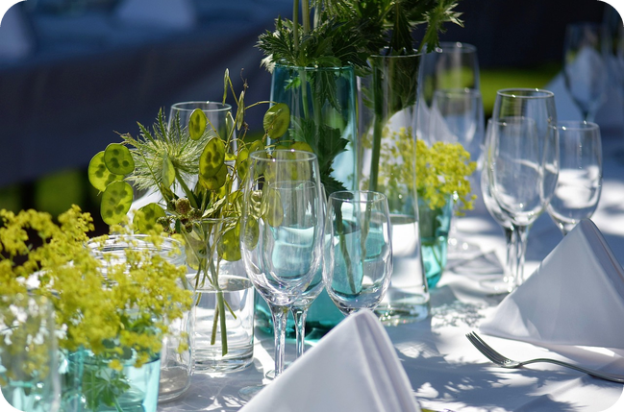

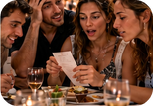
18
Good or bad manners? 2/2
💬 TALK PARLA
⏱ 4 min 👨‍👩‍👧 groups
GM, BM or NI? Then say why!
GM, BM o NI? Poi spiega perché!
1
INVITED FOR A MEAL: take a present
e.g. GM – flowers, or cannoli from the pasticceria!
2
INVITED FOR A MEAL: criticize the food (it's too cold, too salty…)
e.g. BM – remember Belinda's mother-in-law!
3
INVITED FOR A MEAL: send a message the next day to say thank you
e.g. GM – it's polite, and it only takes a minute.
4
RESTAURANT: insist on only paying for what you ate when the bill is divided
e.g. It really annoys me when people do that!
💬
Useful phrases
5
SOCIAL NETWORKING: post a photo of a friend without asking their permission
e.g. BM – I hate it when people do that!
I think it's rude / bad manners to…
I don't mind it. · It really annoys me when…
In Sicily… but in Britain…
6
OUR EXTRA: arrive 20 minutes late for dinner
e.g. NI in Sicily! But in Britain I think it's rude.
4A-2 · Speaking · good or bad manners? 2/2 · 📖 SB p.39 · 7a, 7b
Notes:
18. Speaking · good or bad manners? 2/2 (4 min)
SPEAKING (4 min). Same procedure, one statement per click. The last one is NOT in the book (our extra, Sicily vs Britain): 20 minutes late is normal for many Sicilians, not for many British people – ask 'Would a British person agree with you?' Book items not on the slide (use them if a group finishes early): take your shoes off when you arrive · complain that the food isn't very good (restaurant) · be very affectionate with your partner · make a negative comment about somebody's photo · post a private message or conversation. Feedback: each group says the thing they ALL think is bad manners. Then delayed error correction: 3–4 errors from the speaking on the board; students correct them. Picture: 4a2-late-guest.jpg / 4a2-dinner-guest.jpg are still to come; the deck shows spare/1a1-supper.jpg until then.

Slide 19
19
3 · 2 · 1
⏱ 2 min 👥 pairs
Books closed! What can you remember?
Libri chiusi! Cosa ricordi?
3
manners words from today (no looking!)
📝
Homework · Compiti
Workbook 4A: 2c, 2d
SB p.127: script 4.11 – underline have to, must, should, ought to
Homework sheet in the LLS app
2
pieces of advice for Damien or Miranda
1
thing that is really bad manners for you: "I think it's rude to…"
Next lesson: 4B part 1 · Yes, I can! · can, could, be able to
4A-2 · Exit · what can you remember?
Notes:
19. Exit · what can you remember? (2 min)
RETRIEVAL EXIT (2 min). Books closed. Pairs: 3 manners words (rude, polite, selfish, inconsiderate, host, decline…), 2 pieces of advice with should / must / mustn't / don't have to, 1 personal opinion with I think it's rude to… A few students share. Set homework (on the slide and in the app): Workbook 4A 2c (grammar: past and present obligation) and 2d (personal writing) + read the script of 4.11 on SB p.127 and underline the modal verbs + the 4A-2 homework sheet (easier version available).

Slide 20
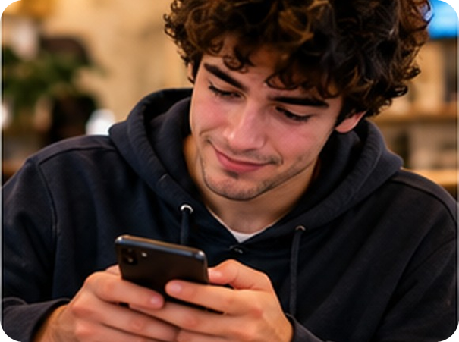
20
Dear Debrett's…
✍️ WRITE SCRIVI
⏱ 6 min 👥 pairs
Write a question. Another pair answers!
Scrivete una domanda. Un'altra coppia risponde!
⭐
Example
1
Is it rude to send a 5-minute voice message?
Yes! You should keep it short – or just call.
0 Is it rude to wear headphones at Sunday lunch? → Yes. You shouldn't…
2
Should I answer my phone at Sunday lunch?
You shouldn't, unless it's urgent.
3
Do I have to reply in the family WhatsApp group?
You don't have to – but say happy birthday!
4
Can I leave a party without saying goodbye?
You should always thank the host first.
4A-2 · Extra · writing: Dear Debrett's…
EXTRA · if there's time
Notes:
20. Extra · writing: Dear Debrett's… (6 min)
EXTRA (6 min, if there's time). From the TG EXTRA IDEA for 5e. First show the 4 model questions and replies (one per click – our own models, not from the book). Then pairs write their own modern, local dilemma (WhatsApp groups, voice messages, family lunches, school…), pass it on, and write a 2–3 sentence Debrett's-style reply with should / mustn't / don't have to. Read aloud; the class votes for the best advice. Correct the modal verbs as they read.

