Slide 1





1B
ENGLISH FILE PRE-INT (A2) · 1B · Part 1 · SB pp.8–9 · VB p.150
THE PERFECT DATE?
GRAMMAR · present simple
VOCABULARY · describing people
PRONUNCIATION · final -s and -es
Would you let your children choose a partner for you?
Never! …or maybe? 😄
Teacher: timings, answers and tips are in the slide notes.
1B · Part 1
Notes:
1B (60 min). ⚠ Built without the Student's Book page images: it follows the SB 1B syllabus (present simple; describing people – appearance and personality, Vocabulary Bank p.150; final -s/-es) and uses the REAL SB p.8 reading 'Please date my dad' on the slides, so you don't need the book. If you have the SB audio, the reading is also recorded — otherwise read it aloud yourself. Aims: describe appearance and personality; use the present simple (he/she +s, doesn't, does…?) accurately; pronounce -s/-es (/s/ /z/ /ɪz/). Timing: cover 2 · opinions 5 · appearance 5 · personality 5 · predict 2 · reading 1 6 · reading 2 5 · notice 4 · rule 3 · -s sounds 5 · error hunt 4 · matchmaker 9 · exit 3 = 58 min. Click 1: question; 2–3 quick answers BEFORE click 2. RETRIEVAL from 1A first (1 min): 'Ask your partner two questions from last lesson – correct word order!'

Slide 2

LEAD-IN · Love in 2026
⏱ 5 min
Agree or no way?
SPEAK! PARLA!
"Parents know who is right for their children."
AGREE
NO WAY
Read. Agree or no way? Tell your partner WHY.
Leggi. D'accordo o no? Spiega PERCHÉ al compagno.
"Online dating is better than meeting people in a bar."
AGREE
NO WAY
"On a first date, looks are more important than personality."
AGREE
NO WAY
"You can't know a person from their profile photo."
AGREE
NO WAY
"The man should always pay on a first date."
AGREE
NO WAY
I agree because… · I don't agree. I think… · It depends. For me…
1B · Part 1
Notes:
LEAD-IN (5 min). Adults have opinions about this! Pairs discuss (3 min), then a quick class vote on each (hands up: agree / no way). Push for a reason: 'Why?' 'Has it happened to you or a friend?' Statement 5 is a nice light debate (and comes up in the text). Feed in 'It depends' — very useful. Don't correct grammar yet; note present simple errors (he think, she don't…) for later.

Slide 3
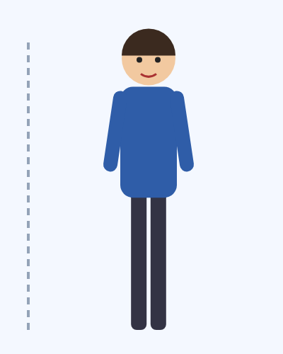
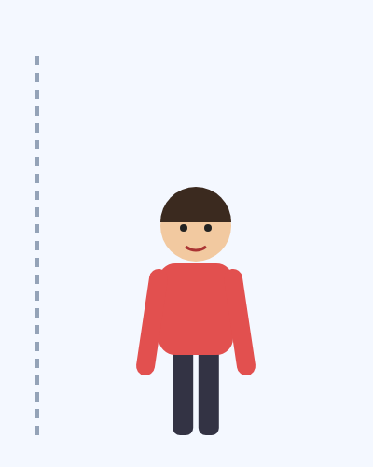
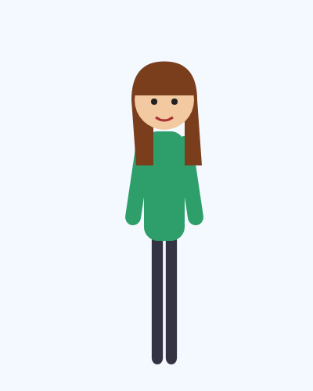
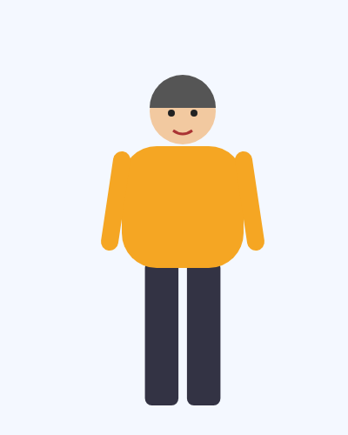
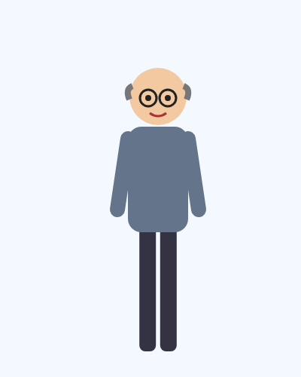
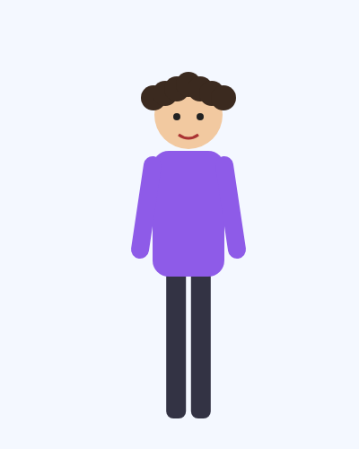
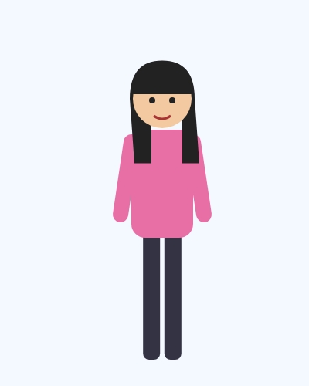
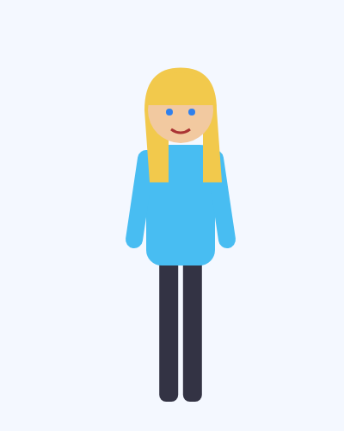
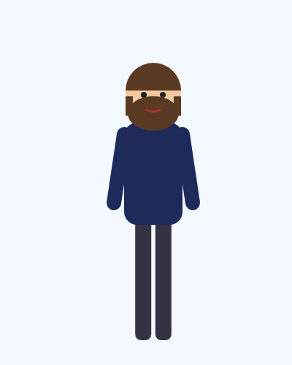
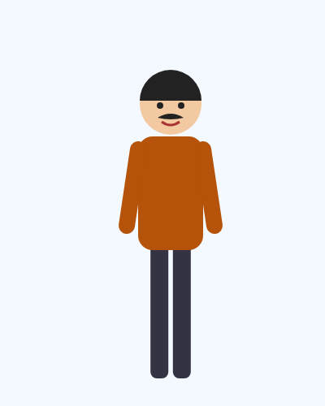
VOCABULARY · What do they look like?
⏱ 4 min
Describe the people
LOOK! GUARDA!
1
2
3
4
5
What do they look like? Say it in English. Then click.
Com'è fisicamente? Dillo in inglese. Poi clicca.
He's tall.
alto
She's short.
bassa
She's slim.
snella
He's a bit overweight.
un po' sovrappeso
He's bald (+ glasses).
calvo
6
7
8
9
10
She has curly hair.
capelli ricci
She has long straight hair.
capelli lunghi e lisci
She has blonde hair and blue eyes.
bionda, occhi azzurri
He has a beard.
barba
He has a moustache.
baffi
1B · Part 1
Notes:
PRESENT (4 min). Picture first: point to each person – students say what they can, then click 1 for all the sentences. Highlight the two patterns: He's / She's + tall, short, slim, bald · He / She HAS + hair, eyes, a beard. Polite: 'a bit overweight' (fat is rude about people).

Slide 4

PRACTICE · Appearance
⏱ 4 min
Italian → English: do you remember?
WRITE! SCRIVI!
Example 0 occhi azzurri → blue eyes
1 capelli ricci
curly hair
2 capelli lisci
straight hair
Write the English words. Then compare. Don't look back at the pictures!
Scrivi le parole in inglese senza guardare le immagini. Poi confronta.
3 calvo
bald
4 barba · baffi
a beard · a moustache
5 snello / magro
slim / thin
6 sovrappeso
overweight (polite) · fat (rude!)
hair = singular! Her hair IS long. (not hairs)
7 di media statura
medium height
8 biondo · occhi azzurri
blonde · blue eyes
1B · Part 1
Notes:
PRACTICE (4 min). Retrieval with L1 prompts, straight after the pictures (most students know some of these). Pairs write, then click 1 for all answers. Pronounce: beard /bɪəd/, moustache /məˈstɑːʃ/, height /haɪt/, bald /bɔːld/, straight /streɪt/. Italian traps: 'capelli' is plural but HAIR is singular and uncountable (her hair is long — NOT hairs); He HAS (got) blue eyes (not 'He is blue eyes'); adjective BEFORE the noun: long straight hair. Quick practice: describe the teacher! Then: 'Describe a famous person in 2 sentences — your partner guesses.' Polite vs rude: 'fat' is rude about people → 'a bit overweight'.

Slide 5

VOCABULARY · Personality
⏱ 5 min
What kind of person?
WRITE! SCRIVI!
Example 0 A person who is nice to everybody. → kind
1 A person who talks a lot.
talkative
2 A person who likes giving people things.
generous
Read the description. Write the adjective (personality). Then click.
Leggi la descrizione e scrivi l'aggettivo (carattere). Poi clicca.
3 A person who doesn't want to work.
lazy
4 A person who makes you laugh.
funny
5 She finds it hard to talk to people she doesn't know.
shy
6 He's quick at learning and understanding things.
clever
False friend: sympathetic ≠ simpatico → friendly / nice
7 She never stops working.
hard-working
8 He never pays for anything. (UK)
mean
1B · Part 1
Notes:
PERSONALITY (5 min). Pairs write (2 min), click 1 = all answers. Opposites quickly (say, don't show): talkative ↔ quiet, generous ↔ mean, lazy ↔ hard-working, shy ↔ extrovert, friendly ↔ unfriendly, kind ↔ unkind, funny ↔ serious. KEY Italian false friend: 'sympathetic' = comprensivo, NOT simpatico → say 'nice / friendly / fun'. 'Mean' in British English = tirchio (also 'cattivo'). Quick personalisation (1 min): 'Which adjective is you? Which is your partner (be kind!)?'

Slide 6

READING · Predict
⏱ 2 min
Please date my dad
THINK! PENSA!
1 How old is her dad? What's his job?
A 26-year-old woman is looking for a partner for her dad. Guess!
Una ragazza di 26 anni cerca una compagna per suo padre. Indovina!
2 Why does she want to help him?
3 What kind of woman does he want?
1B · Part 1
Notes:
PREDICT (2 min). Students write a guess for each question — committing to a guess makes them read with a purpose. Take 2–3 guesses for each, no answers yet. Click shows 'read and check'.

Slide 7
READING · Part 1 · SB p.8
⏱ 6 min
Please date my dad (1)
READ! LEGGI! Read. Check your guesses. Answer the questions. Leggi. Controlla le tue ipotesi. Rispondi.
Please date my dad
'So, how was the date?' You probably think this is a parent asking the question to their child. But many children are now helping their single parents find love, too.
Clint Bouchez, a 52-year-old businessman from Reigate, Surrey, got divorced ten years ago. His daughter, 26-year-old Charlotte, doesn't want her dad to end up alone – her mum remarried five years ago, and Charlotte has a boyfriend. Charlotte and Clint are very close. They often go out together in the evening, they're planning a trip to India for later in the year, and they're both Bruce Springsteen fans. But Charlotte thinks that Clint needs a new partner, and he agrees.
1 Who is Clint? (age, job, family)
52, businessman, divorced 10 years ago
2 Who is helping him?
his daughter Charlotte (26)
3 What do they do together? (3 things)
go out in the evening · plan a trip to India · Springsteen fans
4 Why does Charlotte want to help?
she doesn't want him to end up alone
📖 SB p.8 · Reading (the text is from the Student's Book)
1B · Part 1
Notes:
READING 1 (6 min). Students read alone (2–3 min) — first: were their guesses right? Then the questions in pairs. Click 1: answers. Vocabulary in passing: got divorced (ha divorziato), remarried, end up alone (finire da solo), very close (molto legati). Point to the present simple without explaining yet: 'They often go out', 'Charlotte thinks', 'he agrees' — 'we'll come back to these'.

Slide 8
READING · Part 2 · SB p.8
⏱ 5 min
Please date my dad (2)
READ! LEGGI! Read the rest. Answer. Q5: what do YOU think? Leggi il resto. Rispondi. Domanda 5: tu cosa pensi?
Please date my dad (continued)
'My dad is the perfect man,' she says. 'He's warm, he's generous, he knows how to look after a woman. He's a gentleman. He's always the one who pays on dates. He's romantic and he's fun.'
Dating in the 21st century is very different from when Clint was young. Internet dating has changed everything. 'Before, when you met people face to face, there was sometimes a spark – you don't get that from someone's profile picture.'
Charlotte wrote Clint's dating profile. Clint would like to meet a woman who works, preferably a businesswoman. Someone who's independent, but funny and clever. 'I'm always hopeful,' he says.
1 How does Charlotte describe her dad?
warm, generous, a gentleman, romantic, fun
2 What has changed dating?
the internet
3 What does Clint miss?
the 'spark' of meeting face to face
4 What kind of woman does he want?
a businesswoman: independent, funny, clever
5 Will he find 'the one'? Why?
open – 'I'm always hopeful'
📖 SB p.8 · Reading (abridged from the Student's Book text)
1B · Part 1
Notes:
READING 2 (5 min). Shortened from the SB text (same story). Read alone, pairs answer, click 1. Q5 = opinion/inference: no right answer. Link back to the lead-in: 'He's always the one who pays' — remember statement 5? Is Charlotte right that her dad is 'the perfect man'? Would YOU write a profile for your dad/mum/friend? Then: underline all the verbs with -s in the text (knows, pays, thinks, agrees, needs, says) — that's the next slide.

Slide 9

GRAMMAR · Notice
⏱ 4 min
Why the -s? Why doesn't?
THINK! PENSA!
1 Charlotte THINKS that Clint NEEDS a new partner.
he / she / it → verb + s
Look at the verbs in CAPITALS. What's the rule? Decide BEFORE the click.
Guarda i verbi in MAIUSCOLO. Qual è la regola? Decidi PRIMA del clic.
2 They often GO out together.
I / you / we / they → no s
3 She DOESN'T WANT her dad to end up alone.
doesn't + verb (no s!)
4 DOES Clint LIKE internet dating?
does + subject + verb (no s!)
5 He's ALWAYS the one who pays.
always / often / never: after be, before other verbs
1B · Part 1
Notes:
NOTICE (4 min). One click per line. Before each click ask the class: 'Why THINKS with s?' 'Why no s in doesn't WANT?' Students hypothesise first. The key idea: the -s appears ONCE — on the verb OR on does/doesn't, never both ('She doesn't wants' ✗). Adverbs of frequency: before the main verb (They often go out) but after be (He's always…).

Slide 10
GRAMMAR · Present simple
⏱ 3 min
Present simple: the rules
+ positive
− negative
? question
how often?
I / you / we / they live
he / she / it lives
watch → watches
study → studies · have → has
+s solo con he / she / it
I / you / we / they don't live
he / she / it doesn't live
don't = do not · doesn't = does not
doesn't + verbo SENZA s
Do you live…?
Does she live…?
Yes, she does. / No, she doesn't.
Does + soggetto + verbo SENZA s
always · usually · often
sometimes · hardly ever · never
He often goes out.
He's never late.
prima del verbo · dopo be
Watch out! She doesn't wants ✗ → She doesn't want ✓ · Does he works? ✗ → Does he work? ✓ · He go ✗ → He goes ✓
1B · Part 1
Notes:
RULE (3 min). Quick — students have seen most of this before; the problem is ACCURACY, not knowledge. Concept check: 'Where's the s in a negative? (on doesn't)' 'In a question? (on does)'. Spelling: -es after ch/sh/s/x/o (watches, goes); consonant + y → ies (studies); have → has. 10-second Italian note: in Italian every person has its own ending — in English only he/she/it changes, so it's easy to forget!

Slide 11

PRONUNCIATION · -s and -es
⏱ 5 min
/s/, /z/ or /ɪz/?
LISTEN! ASCOLTA!
Example Listen: he watch-ES = 2 syllables /ɪz/ · he think-S = 1 syllable /s/ · he know-S = 1 syllable /z/
1 /s/ as in snake 🐍
thinks · wants · likes · gets
Listen and repeat each group. Then say which group the last 4 verbs go in.
Ascolta e ripeti ogni gruppo. Poi di' in quale gruppo vanno gli ultimi 4 verbi.
2 /z/ as in zebra 🦓
agrees · pays · knows · lives
3 /ɪz/ an extra syllable!
watches · chooses · finishes · kisses
No extra vowel! thinks ✓ thinks-e ✗
4 Which group? goes · works · relaxes · dances
/z/ · /s/ · /ɪz/ · /ɪz/
1B · Part 1
Notes:
PRONUNCIATION (5 min). Say each verb; students guess the group BEFORE each click. Rule of thumb: /ɪz/ (extra syllable) only after s, z, sh, ch, ge, x sounds; /s/ after voiceless sounds (p t k f); /z/ after the rest. Most important for Italians: 1) don't add a vowel at the end (thinks-e, likes-e); 2) DO say the -s — Italians often drop it in speech ('he think'), and that sounds like a grammar mistake. Drill: 'He thinks… She watches… It goes…' fast, round the class.

Slide 12

PRACTICE · Error hunt
⏱ 4 min
Correct the mistakes
THINK! PENSA!
Example 0 He live in Palermo. → He lives in Palermo. (he/she/it + s)
1 She have long curly hair.
She has long curly hair.
2 My brother don't like dancing.
My brother doesn't like dancing.
Each sentence has ONE mistake. Correct it in pairs.
Ogni frase ha UN errore. Correggetelo in coppia.
3 Does she works in Palermo?
Does she work in Palermo?
4 I have the hairs long.
I have long hair.
5 My boss is very sympathetic.
…very nice / friendly.
6 She goes always to the gym.
She always goes to the gym.
1B · Part 1
Notes:
ERROR HUNT (4 min). Real Italian-speaker errors. Pairs correct, one click per answer (ask a pair first). Team points if energy is low. Number 5 is meaning, not grammar — accept nice/friendly/kind/fun.

Slide 13
SPEAKING · The matchmaker
⏱ 9 min
Find a perfect date!
SPEAK! PARLA!
1
Think of a single person you know – or invent one! 2 minutes: name, age, job, appearance, personality, free time.
Describe a single friend (real or invented). Find them a partner in the class!
Descrivi un amico single (vero o inventato). Trovagli un partner nella classe!
2
Walk around. Describe your friend to a classmate. They describe theirs.
3
Ask questions: Does he like…? What does she do at the weekend? Is he tidy?
4
Decide: a perfect match? Yes / maybe / no way! Then find a new partner.
5
Tell the class your best match – and WHY: 'They both love… / She's quiet but he's talkative…'
My friend Marta is 38. She's tall with long dark hair. She's funny but a bit lazy. She never cooks!
1B · Part 1
Notes:
SPEAKING (9 min). Mingle — real, adult and fun, and it recycles everything: appearance, personality and the present simple (he/she +s, doesn't, does…?). Give 2 min to plan (notes, NOT full sentences). Mingle 5 min (2–3 partners). Monitor for -s and doesn't; correct at the end. Support: the example on the slide; the adjectives slide. Challenge: 'Say one thing your friend DOESN'T do and one thing they NEVER do.' Feedback (2 min): best matches + 2 errors on the board.

Slide 14
Look what you can do!
Guarda cosa sai fare adesso!
HOMEWORK · COMPITI
• Homework sheet 1B (normal / easier)
• Workbook 1B (teacher's choice)
📷 Hand it in on the LLS app · Consegna nell'app LLS
✓ I can describe what people look like and what they're like.
😀 🙂 😐
✓ I can use the present simple (she works / doesn't work / does she work?).
😀 🙂 😐
✓ I can say -s and -es: /s/ /z/ /ɪz/.
😀 🙂 😐
Next lesson: 1C · The Remake Project (clothes · present continuous)
1B · Part 1
Notes:
EXIT (3 min). Self-rating. Homework: the dating profile in exercise 3 is the most useful bit — tell students you'll read the best ones (anonymously) next lesson. Hand in on the LLS app.

Slide 15
EXTRA · Who is it?
EXTRA
⏱ 6 min
Describe the famous person
PLAY! GIOCA!
1
The DESCRIBER stands with their back to the class, facing the screen.
One student describes. Their team guesses. Don't say the red words!
Uno descrive, la squadra indovina. Non dire le parole rosse!
2
Everybody else: you must NOT see the screen – turn round!
3
Teacher: click → a famous person appears. 1 minute: describe appearance and personality.
4
Correct guess = 1 point. A red word = 0.
5
Next slide = next person and a new describer from the other team.
1B · Part 1
Notes:
EXTRA (6 min) if you have time. Describers must use appearance + personality + present simple ('He doesn't speak much. He's got short dark hair…'). You can replace the people with local celebrities your students know. IMPORTANT: guessers must not see the screen. Check they have turned round BEFORE you click each card. Every card is on its own slide.

Slide 16
EXTRA · Who is it? · card 1 of 6
EXTRA
👀 Guessers: don't look! · Non guardate!
Rowan Atkinson (Mr Bean)
Don't say:
Bean · funny · English
1B · Part 1
Notes:
Card 1. Check the guessers can't see the screen, THEN click to show it.

Slide 17
EXTRA · Who is it? · card 2 of 6
EXTRA
👀 Guessers: don't look! · Non guardate!
Sophia Loren
Don't say:
actress · Italian · Naples
1B · Part 1
Notes:
Card 2. Check the guessers can't see the screen, THEN click to show it.

Slide 18
EXTRA · Who is it? · card 3 of 6
EXTRA
👀 Guessers: don't look! · Non guardate!
Lionel Messi
Don't say:
football · Argentina · Barcelona
1B · Part 1
Notes:
Card 3. Check the guessers can't see the screen, THEN click to show it.

Slide 19
EXTRA · Who is it? · card 4 of 6
EXTRA
👀 Guessers: don't look! · Non guardate!
Andrea Bocelli
Don't say:
singer · opera · blind
1B · Part 1
Notes:
Card 4. Check the guessers can't see the screen, THEN click to show it.

Slide 20
EXTRA · Who is it? · card 5 of 6
EXTRA
👀 Guessers: don't look! · Non guardate!
Albert Einstein
Don't say:
scientist · E = mc²
1B · Part 1
Notes:
Card 5. Check the guessers can't see the screen, THEN click to show it.

Slide 21
EXTRA · Who is it? · card 6 of 6
EXTRA
👀 Guessers: don't look! · Non guardate!
Queen Elizabeth II
Don't say:
queen · England · king
1B · Part 1
Notes:
Card 6. Check the guessers can't see the screen, THEN click to show it.

