Slide 1





PE1
ENGLISH FILE PRE-INT (A2) · PE1 · Part 2 · SB pp.12–13 functions
HOTEL PROBLEMS
PRACTICAL ENGLISH · calling reception: problems
SOCIAL ENGLISH · small talk
REVISION · File 1
What's the worst hotel problem you've ever had?
No hot water… in January! 🥶
Teacher: timings, answers and tips are in the slide notes.
PE1 · Part 2
Notes:
PRACTICAL ENGLISH 1 + FILE 1 REVISION (60 min). ⚠ Built without the SB pages and the PE video (Episode 1 'Hotel problems' — Jenny arrives in London and has problems in her hotel room, then meets Rob). It teaches the same functions (calling reception about a problem; social English for meeting people) with our own model dialogue and role cards. If you have the video, play it after the 'Model call' slide as extra listening. The lesson starts with spaced RETRIEVAL of File 1 (1A–1C) and ends with a team quiz. Timing: cover 2 · retrieval 7 · worst hotel 4 · phone phrases 5 · model call 5 · polite intonation 4 · role play 10 · social English 5 · small talk 6 · team quiz 8 · exit 3 = 59 min.

Slide 2


RETRIEVAL · File 1
⏱ 7 min
Do you remember? No notes!
THINK! PENSA!
Example 0 Correct it: She have a dog. → She has a dog.
1 Correct it: Where you live?
Where do you live?
2 Correct it: What means 'shy'?
What does 'shy' mean?
Write your answers alone. NO notes, NO book. Then compare.
Rispondi da solo. NIENTE appunti né libro. Poi confronta.
3 She ___ (not like) football.
doesn't like
4 Look! He ___ (wear) a new jacket.
's / is wearing
5 riccio = ___ hair
curly
6 pantaloni = ___
trousers
7 A person who talks a lot is ___.
talkative
8 accanto a = ___
next to
PE1 · Part 2
Notes:
RETRIEVAL (7 min). Spaced retrieval of the whole of File 1 — don't show the old slides first! Students write alone (3 min), compare in pairs (1 min), then one click per answer (ask a student first). Ask: 'Which ones did you get wrong? Which do you need to review?' This also tells YOU what to recycle in File 2.

Slide 3
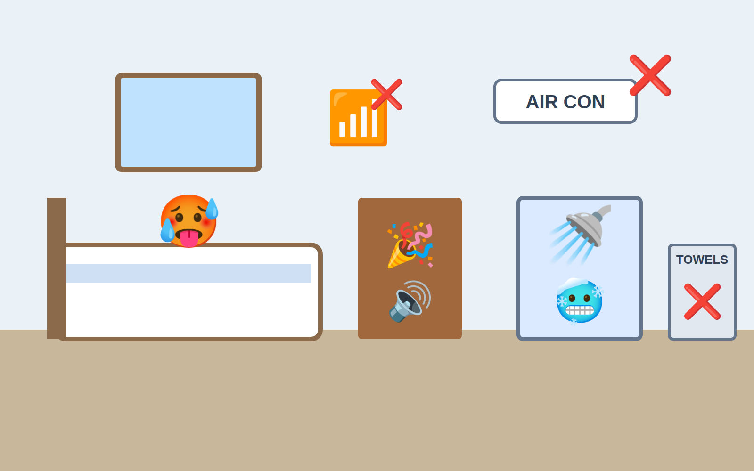
LEAD-IN · Hotel problems
⏱ 5 min
What's wrong with this room?
LOOK! GUARDA! Look at the hotel room. What's wrong? Tell your partner, then click. Guarda la camera d'albergo. Cosa non va? Dillo al compagno, poi clicca.
1 the Wi-Fi?
The Wi-Fi doesn't work.
2 the air conditioning?
It doesn't work. It's really hot!
3 the shower?
There's no hot water.
4 next door?
The people next door are very noisy.
5 towels?
There aren't any towels.
6 Has it happened to you?
open – Yes, in… / No, never.
PE1 · Part 2
Notes:
LEAD-IN + PRESENT (5 min). Picture first: pairs say what's wrong (1–2 min), then click one by one. These are the three patterns for the whole lesson: It DOESN'T WORK · There's NO… · There AREN'T ANY… – write them on the board. Last question: real stories ('Last year in…') – bad experiences give adults lots to say.

Slide 4
PRACTICAL ENGLISH · On the phone
⏱ 5 min
Calling reception: what do they say?
SPEAK! PARLA!
Example 0 G: Pronto, sono la camera 12. → Hello, this is room 12.
1 R: Buonasera, come posso aiutarla?
Good evening, reception. How can I help you?
R = receptionist, G = guest. Say it in English with your partner. Then click.
R = receptionist, G = ospite. Ditelo in inglese in coppia. Poi cliccate.
2 G: Mi scusi se la disturbo, ma…
I'm sorry to bother you, but…
3 G: C'è un problema con l'aria condizionata.
There's a problem with the air conditioning.
4 G: Non funziona.
It doesn't work. (NOT It doesn't function)
5 G: Non ci sono asciugamani.
There aren't any towels.
6 R: Mando subito qualcuno.
I'll send someone up right away.
7 R: Le passo il reparto IT.
I'll put you through to IT.
PE1 · Part 2
Notes:
PHRASES (5 min). One click per line; students guess first (in pairs, whispering). Italian traps: 'It doesn't work' (not 'function' / 'go'); 'There aren't any towels' (not 'There are not towels'); 'I'm sorry to bother you' (polite opener — English speakers soften complaints). Drill each guest phrase in chorus with a polite, rising-falling tone (next slide).

Slide 5
PRACTICAL ENGLISH · Model call
⏱ 5 min
Room 314 has a problem
LISTEN! ASCOLTA!
Receptionist: Good evening, reception. How can I help you?
Useful phrases
How can I help you?
I'm sorry to bother you, but…
There's a problem with…
It doesn't work.
There aren't any…
I'll send someone up.
That's very kind of you.
Teacher and a student read it. Then: what's the problem? What will they do?
L'insegnante e uno studente leggono. Qual è il problema? Cosa faranno?
Guest: Hello, this is room 314. I'm sorry to bother you, but there's a problem with the air conditioning.
Receptionist: Oh, I'm sorry. What's the problem exactly?
Guest: It doesn't work. It's really hot in here! And there aren't any towels in the bathroom.
Receptionist: I'm very sorry. I'll send someone up right away, and I'll bring you some towels in five minutes.
Guest: Thank you so much. That's very kind of you.
PE1 · Part 2
Notes:
MODEL (5 min). Each click reveals the next line — read it with a strong student (you = receptionist). Before revealing the rest, ask: 'What's the problem? What do you think the receptionist will do?' Then pairs read it twice, swapping roles. Second time: cover the dialogue and use only the phrases box. If you have the SB Practical English video (Episode 1), play the hotel scene now: what problems does Jenny have?

Slide 6

PRONUNCIATION · Sound polite
⏱ 4 min
Polite or rude?
LISTEN! ASCOLTA!
1 I'm sorry to bother you, but there's a problem.
polite = voice goes UP and DOWN, not flat
Your teacher says each sentence twice. Which one is polite: 1 or 2?
L'insegnante dice ogni frase due volte. Quale è gentile: 1 o 2?
2 The shower doesn't work.
polite = stress SHOWer and WORK
3 Could you send someone up, please?
polite = 'please' + rising voice
4 Thank you so much.
polite = big stress on SO
PE1 · Part 2
Notes:
INTONATION (4 min). Say each sentence twice: once flat and bored (rude), once with a wide, friendly voice range. Students vote 1 or 2, then click. English uses intonation to sound polite: a flat voice sounds angry or rude, even with polite words. Italians often have good range — but in a foreign language they go flat. Students repeat the polite version. Fun: ask a student to say 'Thank you so much' as rudely as possible, then as nicely as possible.

Slide 7
SPEAKING · Role play
⏱ 10 min
Call reception!
SPEAK! PARLA!
1
Sit back to back – it's a phone call, you can't see each other!
A = guest with problems. B = receptionist with solutions. Then swap!
A = cliente con problemi. B = receptionist con soluzioni. Poi scambiatevi i ruoli!
2
Guest: call reception. Explain your problems politely.
3
Receptionist: listen, say sorry, offer a solution from your card.
4
Guest: are you happy with the solutions? If not, ask for something else!
5
Swap roles with the second card.
A: Hello, this is room 208. I'm sorry to bother you, but the Wi-Fi doesn't work.
PE1 · Part 2
Notes:
ROLE PLAY (10 min). Back to back = real phone conditions (no gestures!). Print the role cards (A2_PE1_Role_cards.pdf) or show each card while the other student looks away. 4 min per call, then swap (B is the guest with new problems on the card). Challenge: the guest is NOT happy with the first solution ('30 minutes? I can't wait 30 minutes!') and the receptionist must offer another. Monitor: It doesn't work / There's no / There aren't any / I'll… Feedback: best polite phrases + 2 errors. ROLE CARDS: the next slides show each role on its own slide, hidden until you click. Show A's card while B students turn round, then B's while A turn round — or use the printable role cards (out/…_Role_cards.pdf) if they exist.

Slide 8
SPEAKING · Role play · Student A · Guest (room 208)
👀 STUDENT A · GUEST ONLY · B · Receptionist: look away! · Gli altri non guardano!
Student A · Guest (room 208) · Your problems
The Wi-Fi doesn't work – you need it for work tonight.
The people in room 210 are having a party. It's midnight!
There's no hot water in the shower.
Be polite: I'm sorry to bother you, but… · There's a problem with… · It doesn't work.
Second call (swap): you're the receptionist – use Student B's solutions.
PE1 · Part 2
Notes:
Student A · Guest (room 208)'s card. Check the others have turned round BEFORE you click.

Slide 9
SPEAKING · Role play · Student B · Receptionist
👀 STUDENT B · RECEPTIONIST ONLY · A · Guest: look away! · Gli altri non guardano!
Student B · Receptionist · Your solutions
Wi-Fi: 'I'll put you through to IT.' (or: give the new password: SUN2026)
Noise: 'I'll call room 210 now.' (or: offer a different room on the 5th floor)
Hot water: 'I'll send someone up right away.' (it takes 30 minutes)
Say sorry first: I'm very sorry… · How can I help you?
Second call (swap): you're the guest in room 117 – your problems: no towels, the TV doesn't work, the key card doesn't open the door.
PE1 · Part 2
Notes:
Student B · Receptionist's card. Check the others have turned round BEFORE you click.

Slide 10

SOCIAL ENGLISH · Meeting people
⏱ 5 min
What do you say?
THINK! PENSA!
Example 0 You meet your friend. → It's so nice to see you!
1 You arrive in a new city. You're very happy.
It's great to be here!
2 Your friend had a 10-hour flight.
You must be really tired.
What do you say in English? Guess, then click.
Cosa dici in inglese? Indovina, poi clicca.
3 Ask about your friend's hotel room.
What's your room like?
4 Change the topic.
By the way, …
5 Your friend says something true. You agree (not 100%).
I guess you're right.
6 After dinner in a restaurant.
That was a great meal!
PE1 · Part 2
Notes:
SOCIAL ENGLISH (5 min). These are the File 1 Social English phrases from the SB. Students guess in pairs first (meaning is clear from the situation); one click per answer. Notice: 'What's your room LIKE?' = com'è (NOT 'How is your room' — that's about health/feelings!). 'You must be tired' = sarai stanco — must for a logical guess.

Slide 11

SPEAKING · Small talk
⏱ 6 min
A friend arrives in Bagheria
SPEAK! PARLA!
1
B meets A at Palermo airport: say hello, ask about the flight.
A = an English friend arriving. B = meets them. Use 4 phrases from the last slide!
A = un amico inglese che arriva. B = lo accoglie. Usate 4 frasi della slide precedente!
2
In the car: ask about the hotel or the room.
3
Change the topic (By the way…): recommend a restaurant or a place in Bagheria.
4
After dinner: say something about the meal!
5
Swap roles. Then: which pair used the most phrases?
B: Welcome to Sicily! You must be really tired. A: Yes, but it's great to be here!
PE1 · Part 2
Notes:
SMALL TALK (6 min). Personal + local: they are the experts on Bagheria. A tick on the board for each Social English phrase pairs use naturally. Push for follow-up questions (1A skill). Optional: a confident pair performs.

Slide 12

GAME · File 1 team quiz
⏱ 8 min
Class vs teacher!
PLAY! GIOCA!
1 Spell 'WEDNESDAY' – letters only!
W-E-D-N-E-S-D-A-Y
2 Make a question: you / born / where / were
Where were you born?
Teams: 30 seconds per question. Write the answer. 1 point each!
Squadre: 30 secondi per domanda. Scrivete la risposta. 1 punto!
3 Opposite of 'hard-working'?
lazy
4 /s/ /z/ or /ɪz/? → watches
/ɪz/
5 Correct it: I'm wanting a coffee.
I want a coffee.
6 'Portare' an umbrella in your hand = ?
carry
7 Correct it: There are not towels.
There aren't any towels.
8 'Com'è la tua camera?' in English?
What's your room like?
PE1 · Part 2
Notes:
QUIZ (8 min). Teams write each answer on paper / a mini whiteboard in 30 seconds; reveal one answer per click. Class vs teacher option: if a team is wrong, the TEACHER gets the point — the class wants to beat you! Mixes all of File 1 + today (interleaving).

Slide 13
Look what you can do!
Guarda cosa sai fare adesso!
HOMEWORK · COMPITI
• Homework sheet PE1 (normal / easier)
• Workbook Practical English 1 (teacher's choice)
📷 Hand it in on the LLS app · Consegna nell'app LLS
✓ I can call reception and explain a problem politely.
😀 🙂 😐
✓ I can use social English when I meet people.
😀 🙂 😐
✓ I can remember the main language of File 1.
😀 🙂 😐
Next: File 2 · 2A OMG! Where's my passport? (past simple – holidays)
PE1 · Part 2
Notes:
EXIT (3 min). Self-rating. Tell students next lesson starts File 2 (holidays, past simple). Ask them to think of a holiday that went WRONG — it's the topic of 2A.

