Slide 1





10A
ENGLISH FILE B1 · 10A · Part 1 · SB pp.96–97
IDOLS AND ICONS
READING · The year our heroes died
GRAMMAR · relative clauses
WRITING · a biography (p.124)
Who's the actor who played Severus Snape?
Alan Rickman – a real icon!
Teacher: timings, answers and tips are in the slide notes.
10A · Part 1
Notes:
10A PART 1 (60 min) · SB pp.96–97 + Writing p.124. Aims: read short texts about nine icons who died in 2016; relative clauses, defining and non-defining (Grammar Bank 10A); a relative-clauses quiz (Communicative photocopiable p.196); add extra information to a biography of Umberto Eco. Timing: cover 2 · revision 5 · lead-in 4 · reading 8 · extracts 4 · rule 6 · practice 6 · mini quiz 3 · photocopiable quiz 9 · Umberto Eco 6 · exit 3 = 56 min. Click 1: the question (it's already a relative clause!) — who knows? Click 2. (2 min)

Slide 2


REVISION · Practical English 5
⏱ 5 min
Who said it?
REMEMBER! RICORDA!
1 "It's not like you want to marry her."
Paul
Rob, Jenny, Paul or Don? Then say it like them!
Rob, Jenny, Paul o Don? Poi dillo come loro!
2 "I'll even buy the ticket."
Rob
3 "I don't know if this is going to work out."
Jenny
4 "Can you tell me what you decided at the last meeting?"
Don
5 "Well, that's a start, I guess."
Jenny
6 "What if I proposed to you?"
Rob
📖 Teacher: revision of Practical English 5 pp.94–95 · audio 9.21–9.26
10A · Part 1
Notes:
REVISION of Practical English 5 (5 min). VARIATION: memory + change the energy — pairs decide who said each line (all quotes from the audio scripts 9.21, 9.22, 9.25); click once per line. Bonus point if a student says the line with the right emotion (Paul: mocking; Jenny: upset; Rob: nervous / romantic; Don: busy boss). Final 1-minute challenge: make Don's question direct (What did you decide at the last meeting?) and make two more indirect questions to Rob (Could you tell me why…? Do you know if…?).

Slide 3






READING · Lead-in
⏱ 4 min
2016: who were they?
THINK! PENSA!
rock star · album Blackstar
actor · Severus Snape
writer · To Kill a Mockingbird
Who are these icons? Guess – then click!
Chi sono queste icone? Indovina – poi clicca!
David Bowie
Alan Rickman
Harper Lee
footballer · Ajax & Barcelona
architect · born in Iraq
child prodigy · Purple Rain
Johan Cruyff
Zaha Hadid
Prince
boxer · 'The Greatest'
singer-songwriter · Hallelujah
actress · Princess Leia
Muhammad Ali
Leonard Cohen
Carrie Fisher
📖 Teacher: Student's Book p.96 · 1a · Communication 'The year our heroes died' p.110
10A · Part 1
Notes:
LEAD-IN (4 min). 1a: read the introduction; teach icon (= a famous person that people see as a symbol of an idea, a way of life, etc.). Pairs look at the photos on p.96 and say who they recognize; then go to Communication p.110 to check, and write the names in the gaps in the text headings. This slide is a clue version (clues from the texts): pairs guess, click 1 shows all nine names. VARIATION: curiosity gap. Ask: Which of them did you know? Who had you never heard of? (1b). Nobody has to know them all — the point is the stories.

Slide 4
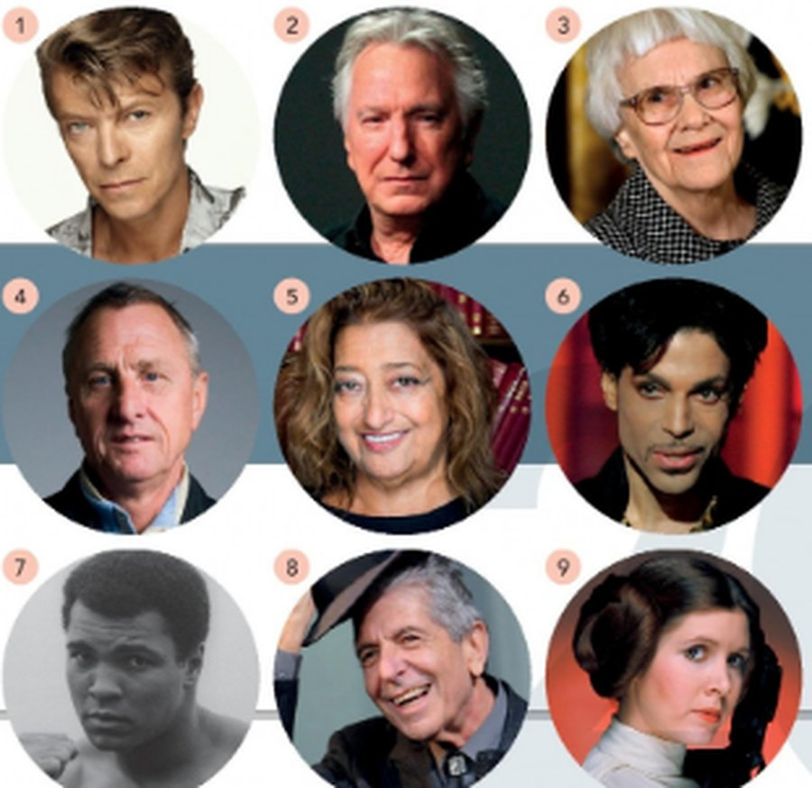
READING · The year our heroes died · 1c
⏱ 8 min
According to the texts, who…?
READ! LEGGI!
1 was the youngest when he / she died
P
2 changed jobs but did equally well in both
JC
Read the texts on pp.96–97. Who…? Answer with the initials!
Leggi i testi a pp.96–97. Chi…? Rispondi con le iniziali!
3 was child, friend, and partner of famous singers
CF
4 had a connection with the Olympic Games
ZH
5 changed his / her name completely, and had a famous nickname
MA
6 became famous for the first time when he / she was middle-aged
AR
7 did not want any publicity or recognition in later life
HL
8 spent time following a particular religion
LC
9 was awarded prizes for something he / she did shortly before dying
DB
📖 Teacher: Student's Book pp.96–97 · 1b, 1c, 1d
10A · Part 1
Notes:
READING (8 min). 1b (3 min): students read the nine texts; which people did they already know most about? 1c (4 min): students read questions 1–9 (the book's, on the slide) and find the answers in the texts – write the initials of the person. Click 1 for answers (TG): 1 P (Prince, aged 57) · 2 JC (Johan Cruyff – player, then coach) · 3 CF (Carrie Fisher – daughter of Debbie Reynolds and Eddie Fisher, dated Paul Simon, friend of James Blunt) · 4 ZH (Zaha Hadid – the Aquatic Centre, London 2012) · 5 MA (Muhammad Ali, born Cassius Clay, 'The Greatest') · 6 AR (Alan Rickman – 41 in Die Hard) · 7 HL (Harper Lee – retreated from public life) · 8 LC (Leonard Cohen – Buddhist monk for five years) · 9 DB (David Bowie – Blackstar, released two days before he died, won five Grammys). Ask for the evidence in the text each time. 1d (whole class, 1 min): Do you particularly admire any of these people? What other famous people do you admire? VARIATION: forced choice – which ONE would you most like to have met?

Slide 5
GRAMMAR · Presentation
⏱ 4 min
Who, which, where, whose
THINK! PENSA!
1 She wrote To Kill a Mockingbird, ___ is considered a classic of modern literature.
which · HL
Cover the texts! Complete with a relative pronoun. Who is it about?
Copri i testi! Completa con un pronome relativo. Di chi si parla?
2 At 60, he moved to California, ___ he lived as a Buddhist monk… the Norwegian woman ___ he lived with on the Greek island of Hydra.
where, who · LC
3 It was the role of Princess Leia in the first Star Wars film ___ made her famous.
which · CF
4 He also became a prominent civil rights figure, ___ campaigned for black equality.
who · MA
5 She was a world-famous architect, ___ Aquatic Centre at the 2012 London Olympics was probably her best-known work in the UK.
whose · ZH
📖 Teacher: Student's Book p.97 · 2a
10A · Part 1
Notes:
GRAMMAR PRESENTATION (4 min). 2a: students cover the texts and complete extracts 1–5 with a relative pronoun from the list; then say who each extract is about. Click 1 for answers (TG): 1 which (Harper Lee) · 2 where, who (Leonard Cohen) · 3 which (Carrie Fisher) · 4 who (Muhammad Ali) · 5 whose (Zaha Hadid). The extracts on the slide are the book's (2 slightly shortened). EXTRA CHALLENGE (TG): Which two clauses give ESSENTIAL information? → 2 (who he lived with on the Greek island of Hydra) and 3 (which made her famous). In which clause is the pronoun not necessary? → 2: the Norwegian woman (who) he lived with on Hydra. Point out the commas round the extra-information clauses. VARIATION: memory challenge (texts covered).

Slide 6
GRAMMAR · Grammar Bank 10A p.150
⏱ 6 min
Relative clauses
Defining
Non-defining
Pronouns
Harper Lee is the woman who wrote To Kill a Mockingbird.
That's the house where I was born.
Is Frank the man whose brother plays for Man United?
This is the phone (that) I bought yesterday.
informazione essenziale · that ✓ · niente virgole
This painting, which was painted in 1860, is worth millions.
Last week I visited my aunt Jane, who's nearly 90.
My neighbour, whose son goes to my son's school, has just remarried.
informazione in più · tra virgole · that ✗
who = people
which = things
where = places
whose = possession
leave out who / which / that when it's the OBJECT: the girl (who) I met
Watch out! ✗ a friend which lives near me → ✓ who ✗ the man who he works with my father → ✓ who works ✗ The film, that won an Oscar, … → ✓ which
📖 Teacher: Grammar Bank 10A p.150 · audio 10.1, 10.2
10A · Part 1
Notes:
GRAMMAR (6 min). Grammar Bank 10A p.150: play 10.1 (defining) and 10.2 (non-defining); students listen and repeat. All examples on the slide are from these audio tracks. Rules (TG grammar notes): defining clauses give essential information (Alan Rickman is the actor who played Snape); non-defining clauses give extra information which can be left out and the sentence still makes sense (Alan Rickman, who died in 2016, is…); in writing non-defining clauses go between commas. That is a common alternative to who / which in defining clauses but is NOT possible in non-defining clauses. In defining clauses we can leave out who / which / that when it is the object of the verb (the girl I met on the flight to Paris). Whom = formal object form (the man to whom I spoke) — recognise only. Typical mistakes (TG): who / which confusion; adding a personal pronoun (✗ the man who he works…); that in non-defining clauses. Italian: che = who / which / that, cui = which / who after a preposition, il cui = whose. Quick check: point at things / people in the class: 'Who's the student who…?'

Slide 7

GRAMMAR · Grammar Bank 10A · practice
⏱ 6 min
Complete and check
WRITE! SCRIVI!
1 Rob and Corinna, ___ have twins, often need a babysitter.
who
Grammar Bank 10A: a 1–6. Then b: where can you use that?
Grammar Bank 10A: a 1–6. Poi b: dove puoi usare that?
2 Downing Street, ___ the British Prime Minister lives, is in central London.
where
3 The sandwich ___ you made me for lunch was delicious.
which (that / –)
4 The woman ___ lived here before us was a writer.
who (that)
5 David Bowie, ___ songs inspired us for nearly 50 years, died in 2016.
whose
6 My computer is a lot faster than the one ___ I used to have.
which (that / –)
📖 Teacher: Grammar Bank 10A p.150 · a 1–6, b (a 7–12, c = homework)
10A · Part 1
Notes:
PRACTICE (6 min). Students do Grammar Bank 10A a 1–6 in the book; the slide shows the key sentences (TG) with the relative pronoun gapped — click 1 for answers. ⚠ The exact instruction for a (complete / join the sentences) is only in the Student's Book; students can use the slide version if they don't have the book open. Then b (TG key): the sentences in a where you can use that are 3, 4, 6 and 11; the pronoun can be left out in 3 (which), 6 (which) and 11 (who) — because it's the object. (⚠ b's instruction is inferred from the key — check p.150.) Homework: a 7–12 and c. VARIATION: student as teacher — the fastest pair explains WHY 2 and 5 have commas. EXTRA SUPPORT: Grammar photocopiable 10A p.167 = the EXTRA slide 'Join the sentences' after the exit (📄 B1_10A_Photocopiables.pdf, page 1).

Slide 8
SPEAKING · Quiz · revision vocabulary
⏱ 3 min
What do you call…?
THINK! PENSA!
1 a person who appears in crowd scenes in films
an extra
Answer the quiz. Every answer is a word from the course!
Rispondi al quiz. Ogni risposta è una parola del corso!
2 the place with black and white stripes where you cross the road
a zebra crossing
3 the part of the body you use to taste
your tongue
4 the thing which covers the top of a house
the roof
5 a man who a woman is going to marry
her fiancé
📖 Teacher: Student's Book p.97 · 3a
10A · Part 1
Notes:
QUIZ (3 min). 3a: students answer the five quiz questions individually, then compare. Click 1 for answers (TG): 1 an extra · 2 a zebra crossing · 3 your tongue · 4 the roof · 5 her fiancé. The definitions on the slide are the book's quiz 'What do you call…?' (p.97). Drill fiancé /fiˈɒnseɪ/. Show of hands: who got all five? Now they write their own questions (next slide).

Slide 9

GAME · Communicative photocopiable 10A
⏱ 9 min
Relative clauses quiz
PLAY! GIOCA!
1
Get your half of the sheet (A or B). Don't show it to your partner!
A and B: complete your questions. Then quiz your partner!
A e B: completate le domande. Poi fate il quiz al compagno!
2
Complete each question with who, which, where or whose.
3
Ask: Can you tell me the sport which is played at Wimbledon?
4
Correct answer with no help = 3 points. Wrong? Give the three options: correct now = 1 point.
5
Swap: B asks A. Who wins?
Can you tell me the name of the artist whose most famous work was the Mona Lisa?
📖 📄 Print: B1_10A_Photocopiables.pdf, page 2 · Teacher: Communicative photocopiable 10A p.196
10A · Part 1
Notes:
GAME (9 min) = Communicative photocopiable 10A 'Relative clauses quiz' (TG p.196, notes p.175). 📄 Print: B1_10A_Photocopiables.pdf, page 2 – one copy per pair, cut into A and B (page 3 = the editable version with blank options – print it only if you want to write your own questions). It has the same aim as SB 3b (Communication 'Relative clauses quiz' A p.110, B p.114 — use the book instead if you have no copies). Official procedure (TG): put Sts in pairs, A and B, and give out the worksheets. a: Sts complete the questions with a relative pronoun; check answers orally or by writing the pronouns on the board. Official answers (TG): A · Sport 1 which, 2 which · Art and literature 1 who, 2 whose · Film and TV 1 who, 2 where · Geography 1 which, 2 where · Technology 1 whose, 2 where. B · Sport 1 where, 2 whose · Art and literature 1 whose, 2 who · Film and TV 1 where, 2 who · Geography 1 where, 2 which · Technology 1 where, 2 which (that is also possible for who / which in these defining clauses). b: Sts sit face to face; they ask their partner the question (Can you tell me…?) WITHOUT giving the three alternatives – correct = 3 points; if wrong, they give the three alternatives – correct option = 1 point. The correct option is in bold on the sheet (A: tennis, puck, Bob Dylan, Leonardo da Vinci, Mark Hamill, Los Angeles, Asia, Rome, Apple, Harvard; B: Rio de Janeiro, Nike, Andy Warhol, Ian Fleming, Krypton, Penélope Cruz, Amsterdam, Germany and Belgium, South Korea, batteries and solar panels) – partners must not see each other's half. At the end, ask each pair who got more points. Nice link to PE5: every question starts with Can you tell me…? (indirect question). VARIATION: constraint challenge + competition.

Slide 10

WRITING · A biography · p.124
⏱ 6 min
Umberto Eco: add the info
WRITE! SCRIVI!
1 After he graduated, he worked for RAI, …
where he became friends with artists, painters, musicians, and writers
Read the biography on p.124. Add the extra information (2–7).
Leggi la biografia a p.124. Aggiungi le informazioni (2–7).
2 In September 1962, he married Renate Ramge, …
who was a German art teacher
3 They lived in an apartment in Milan, …
where Eco had a library of 30,000 books
4 Eco is best known for his novel The Name of the Rose, …
which was published in 1980 and made into a film six years later
5 The book, …, is a murder mystery set in a 14th-century monastery.
which sold 15 million copies and made him a literary star
6 Eco, …, died in Milan in 2016.
who had been diagnosed with cancer
📖 Teacher: Student's Book p.124 · Writing A biography · 4a, 4b (4c = homework)
10A · Part 1
Notes:
WRITING (6 min). Students go to Writing A biography p.124. 4a: who is Umberto Eco? (Italian students will know more than the book!) Read the biography. 4b: rewrite it adding the extra information in sentences 2–7 as non-defining relative clauses (in order; they may need to change or delete some words). Click 1 for answers (TG): 2 After he graduated, he worked for Radiotelevisione Italiana, where he became friends with artists, painters, musicians, and writers. 3 In September 1962, he married Renate Ramge, who was a German art teacher. 4 They lived in an apartment in Milan, where Eco had a library of 30,000 books. 5 Eco is best known for his novel The Name of the Rose, which was published in 1980 and made into a film six years later. 6 The book, which sold 15 million copies and made him an international literary star, is a murder mystery set in a 14th-century Italian monastery. 7 Eco, who had been diagnosed with cancer, died in Milan in 2016. Remind them: commas! 4c (homework): a 3–5 paragraph biography of an interesting or successful person they know enough about, using relative clauses. VARIATION: perspective change — an Italian icon seen through English eyes.

Slide 11
Look what you can do!
Guarda cosa sai fare adesso!
HOMEWORK · COMPITI
• Workbook 10A: 1a, 1b, 1c, 1d
• Grammar Bank 10A: a 7–12, c
• Writing p.124: a biography
• Homework sheet 10A-1
📷 Hand it in on the LLS app · Consegna nell'app LLS
✓ I can understand short biographies of famous people.
😀 🙂 😐
✓ I can use defining and non-defining relative clauses.
😀 🙂 😐
✓ I can add extra information to a biography.
😀 🙂 😐
Next lesson: 10A part 2 · Design icons · Compound nouns
10A · Part 1
Notes:
EXIT (3 min). Homework: Workbook 10A 1a–1d (relative clauses) + Grammar Bank 10A a 7–12 and c + Writing p.124 4c–d (a biography, 3–5 paragraphs, with relative clauses; check for mistakes before handing in) + the 10A-1 homework sheet (easier version available). Workbook 10A 2 and 3 (compound nouns) go with part 2.

Slide 12
EXTRA · Game · Define it!
EXTRA
⏱ 6 min
Define it – who, which, where
PLAY! GIOCA!
1
The DEFINER stands facing the screen, back to the class.
Define the word: who, which, where!
Definisci la parola: who, which, where!
2
Everybody else: you must NOT see the screen – turn round or close your eyes!
3
Teacher clicks → a secret word. Define it with a relative clause: It's a place where…
4
The definer's team guesses. Correct = 1 point. A red word = 0.
5
Next card = the other team.
10A · Part 1
Notes:
EXTRA GAME (6 min). VARIATION: constraint challenge — the definition MUST contain who, which, where or whose (It's a person who… / It's a thing which… / It's a place where…). Recycles vocabulary from Files 9–10 (devices; crime words are pre-taught for 10B). IMPORTANT: guessers must not see the screen. Check they have turned round BEFORE you click each card. Every card is on its own slide.

Slide 13
EXTRA · Game · Define it! · card 1 of 6
EXTRA
👀 Guessers: don't look! · Non guardate!
A DENTIST
Don't say:
teeth · doctor · mouth
10A · Part 1
Notes:
Card 1. Check the guessers can't see the screen, THEN click to show it.

Slide 14
EXTRA · Game · Define it! · card 2 of 6
EXTRA
👀 Guessers: don't look! · Non guardate!
A LIBRARY
Don't say:
books · read · borrow
10A · Part 1
Notes:
Card 2. Check the guessers can't see the screen, THEN click to show it.

Slide 15
EXTRA · Game · Define it! · card 3 of 6
EXTRA
👀 Guessers: don't look! · Non guardate!
A REMOTE CONTROL
Don't say:
TV · channel · change
10A · Part 1
Notes:
Card 3. Check the guessers can't see the screen, THEN click to show it.

Slide 16
EXTRA · Game · Define it! · card 4 of 6
EXTRA
👀 Guessers: don't look! · Non guardate!
AN AIRPORT
Don't say:
plane · fly · travel
10A · Part 1
Notes:
Card 4. Check the guessers can't see the screen, THEN click to show it.

Slide 17
EXTRA · Game · Define it! · card 5 of 6
EXTRA
👀 Guessers: don't look! · Non guardate!
A WITNESS
Don't say:
see · crime · police
10A · Part 1
Notes:
Card 5. Check the guessers can't see the screen, THEN click to show it.

Slide 18
EXTRA · Game · Define it! · card 6 of 6
EXTRA
👀 Guessers: don't look! · Non guardate!
A CHARGER
Don't say:
phone · battery · plug
10A · Part 1
Notes:
Card 6. Check the guessers can't see the screen, THEN click to show it.

Slide 19
EXTRA · Grammar photocopiable 10A
EXTRA
⏱ 7 min
Join the sentences
WRITE! SCRIVI!
1 Sydney, …, is well known for its Opera House and Harbour Bridge. (Many people think it's the capital of Australia.)
which many people think is the capital of Australia
Handout: a – who, which, where, whose? · c – join the sentences.
Scheda: a – who, which, where, whose? · c – unisci le frasi.
2 Our local post office, …, has closed down. (My grandmother used to work there.)
where my grandmother used to work
3 Pablo Picasso, …, was one of the world's most famous artists. (His best-known painting is Guernica.)
whose best-known painting is Guernica
4 The hurricane, …, was the worst storm for over a century. (It hit the city of New Orleans.)
which hit the city of New Orleans
5 Mozart, …, was an extremely talented composer. (He died when he was 35.)
who died when he was 35
📖 📄 Print: B1_10A_Photocopiables.pdf, page 1 · Teacher: Grammar photocopiable 10A p.167
10A · Part 1
Notes:
EXTRA (7 min) or HOMEWORK = Grammar photocopiable 10A 'relative clauses: defining and non-defining' (TG p.167). 📄 Print: B1_10A_Photocopiables.pdf, page 1 – one copy per student. a: complete the article (Elena's favourite things) with who, which, where or whose (1 where is the example). b: in which sentences could you also use that? In which could you leave out who or which? c: combine the two sentences with a non-defining relative clause (1 is the example) – the slide shows c 2–6, one answer per click. Official answers (TG PCM key): a 2 which · 3 which · 4 which · 5 which · 6 who · 7 which · 8 whose · 9 who · 10 which · 11 where · 12 which. b that: 2, 3, 4, 5, 7, 9, 10, 12 · leave out who / which: 2, 3, 4, 5, 10. c 2 which many people think is the capital of Australia · 3 where my grandmother used to work · 4 whose best known painting is Guernica · 5 which hit the city of New Orleans · 6 who died when he was 35. ACTIVATION (on the sheet): read the article again and write a paragraph about your favourite things in life (good homework). VARIATION: student-generated content (the Activation).

Slide 20
EXTRA · Speaking · Memory
EXTRA
⏱ 6 min
What do you remember?
SPEAK! PARLA!
Pairs. A covers the texts and looks only at the photos on pp.96–97.
1
A: texts covered. B: texts open. A says everything about 1–5!
A: testi coperti. B: testi aperti. A dice tutto su 1–5!
A says one sentence with a relative clause about person 1: Bowie was the singer who…
2
B (texts open) helps and adds information.
3
Do people 1–5, then swap roles for 6–9.
4
Zaha Hadid was the architect whose Aquatic Centre was built for the 2012 Olympics.
📖 Teacher: Student's Book p.97 · 2c + TG Extra idea
10A · Part 1
Notes:
EXTRA (6 min) = SB 2c / TG EXTRA IDEA. VARIATION: memory disruption + peer support.

