Slide 1





10B
ENGLISH FILE B1 · 10B · Part 1 · SB pp.100–101
AND THE MURDERER IS…
VOCABULARY · crime
READING & LISTENING · Jack the Ripper
GRAMMAR · question tags
London, 1888. Five murders. No arrest. Who was he?
PRONUNCIATION · intonation in tags
Nobody knows… do they?
Teacher: timings, answers and tips are in the slide notes.
10B · Part 1
Notes:
10B PART 1 (60 min) · SB pp.100–101. Aims: crime vocabulary; read about Jack the Ripper; listen to a retired detective on three theories about his identity; question tags (Grammar Bank 10B) with falling intonation to check information; 'Just checking' (Communication p.110 / p.114). Timing: cover 2 · revision 5 · vocabulary 6 · reading 6 · listening 10 · tags presentation 3 · rule 5 · practice 5 · pronunciation 5 · Communication 7 · exit 3 = 57 min. TG optional lead-in: write MURDER /ˈmɜːdə/ on the board; pairs brainstorm related words for 1 minute (murderer, kill, victim, detective, police, suspect, witness…). Click 1: the question — click 2 (the answer already has a question tag!). (2 min) Sensitivity: the topic is a historical crime; keep the focus on the mystery and the detective work, not on violence.

Slide 2


REVISION · 10A part 2 · Compound nouns
⏱ 5 min
The missing half
PLAY! GIOCA!
1 traffic ______
jam
2 seat ______
belt
Beat the clock: 10 seconds! Say it with the right STRESS.
Batti il tempo: 10 secondi! Dillo con l'ACCENTO giusto.
3 ______ lamp
desk
4 rush ______
hour
5 child ______
prodigy
6 ______ box
phone
7 science ______
fiction
8 ______ court
tennis
📖 Teacher: revision of 10A pp.98–99 · audio 10.5 · SB 7c
10B · Part 1
Notes:
REVISION of 10A part 2 (5 min). VARIATION: beat the clock (+ word stress). Two teams take turns; 10 seconds per item; click once per item (one answer per click). 1 point for the missing word + 1 bonus point for saying the whole compound with stress on the FIRST word (TRAFfic jam, SEAT belt, DESK lamp, RUSH hour, CHILD prodigy, PHONE box, SCIence fiction, TENnis court). Final 30 seconds: which design icon was inspired by the human arm? (the Anglepoise lamp).

Slide 3







VOCABULARY · Crime · audio 10.6
⏱ 6 min
Crime words
THINK! PENSA!
detectives
witnesses
victims
Match the words and the definitions in the book. Say them!
Abbina le parole alle definizioni nel libro. Dille!
investigatori
testimoni
vittime
a murderer /ˈmɜːdərə/
(a) murder
evidence (uncountable!)
un assassino
un omicidio
prove, indizi
suspects /ˈsʌspekts/
solve (a crime)
prove (that…)
sospettati
risolvere
dimostrare
📖 Teacher: Student's Book p.100 · 1a, 1b, 1c · audio 10.6
10B · Part 1
Notes:
VOCABULARY (6 min). 1a: what do they know about Jack the Ripper? Write their ideas on the board but don't say if they're right (they'll find out). 1b: students match definitions 1–9 to the words in the list; compare. (Book definitions: 1 noun police officers who investigate crimes · 2 noun people who see something which has happened and then tell others (e.g. the police) about it · 3 noun people who are hurt or killed by somebody in a crime · 4 noun a person who kills another person deliberately · 5 noun the crime of killing a person illegally and deliberately · 6 noun the facts, signs, etc. which tell you who committed a crime · 7 noun people who are thought to be guilty of a crime · 8 (a mystery) verb to find the correct answer to why something happened · 9 (sth) verb to use facts and evidence to show something is true.) Fast pairs: the teacher reads a definition, pairs shout the word. 1c: play 10.6 to check (TG): 1 detectives · 2 witnesses · 3 victims · 4 murderer · 5 murder · 6 evidence · 7 suspects · 8 solve · 9 prove. The slide shows the same nine words in the audio order; click 1 for the Italian. Pronunciation: murder /ˈmɜːdə/; suspect is a noun stressed on the 1st syllable /ˈsʌspekt/, but the verb is stressed on the 2nd /səˈspekt/ (TG). False friend: evidence = prove / indizi (uncountable: ✗ an evidence, ✗ evidences); prove (verb) ≠ le prove. VARIATION: vocabulary branching — pairs make the 'family': murder – murderer; witness – to witness; suspect – to suspect; solve – solution.

Slide 4
READING · The greatest unsolved crime
⏱ 6 min
Jack the Ripper
READ! LEGGI! Complete gaps 2–9 with words from 1b. Then answer. Completa i buchi 2–9 con le parole dell'1b. Poi rispondi.
The greatest unsolved crime (adapted)
In the autumn of 1888, a brutal (2) ______ walked the dark, foggy streets of Whitechapel, in east London. The (3) ______ were all women and the police seemed powerless to stop the murders. There were no (4) ______ to the crimes. A letter to Scotland Yard finished 'Yours truly, Jack the Ripper'. The murders continued – five in total. But in November, they suddenly stopped, three months after they had first begun. For more than a century, historians, writers, and (5) ______ have examined the (6) ______ and tried to discover and (7) ______ his identity. There have been plenty of (8) ______, … and all sorts of people have tried to (9) ______ this real-life mystery.
1 Where and when did the murders take place?
London (Whitechapel), autumn 1888
2 How many murders were there?
five
3 How long did the murders go on for?
three months
4 What kind of people have been suspects?
doctor · businessman · painter · sailor · singer · royal
📖 Teacher: Student's Book p.100 · 1d, 1e
10B · Part 1
Notes:
READING (6 min). 1d: students read the article on p.100 and complete gaps 2–9 with words from 1b (the slide text is a shortened version of the book's text with the same gaps; the four questions are the book's 1e). Gap answers are NOT on the slide (read them out / write them on the board after pairs compare) (TG): 2 murderer · 3 victims · 4 witnesses · 5 detectives · 6 evidence · 7 prove · 8 suspects · 9 solve. 1e: set a time limit; click 1 for the answers (TG): 1 in London in the autumn of 1888 · 2 five · 3 three months · 4 a doctor, a businessman, a painter, a sailor, a singer, and a member of the royal family. Were their ideas on the board right? VARIATION: curiosity gap — before the listening, quick vote: which of the suspects do they think it was?

Slide 5
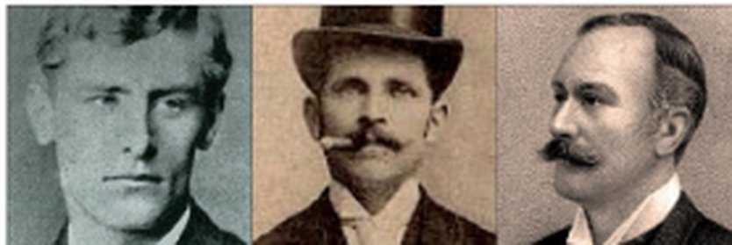
LISTENING · Making notes · audio 10.7, 10.8, 10.9
⏱ 10 min
Three theories
LISTEN! ASCOLTA!
🎧 10.7
🎧 10.8
🎧 10.9
Who's the suspect? What's the evidence? Make notes!
Chi è il sospettato? Quali sono le prove? Prendi appunti!
1 Bondeson's suspect?
Hendrik de Jong, a Dutch sailor
2 Evidence?
killed 4 women · in London then · matches descriptions
3 Robinson's suspect?
Michael Maybrick, a singer & composer
4 Evidence?
letters like his songs · posted from towns on his tour
5 Cornwell's suspect?
Walter Sickert, a painter
Sickert · de Jong · Maybrick
6 Evidence?
DNA · same unusual paper · violent paintings
📖 Teacher: Student's Book pp.100–101 · 2a, 2b, 2c, 2d · audio 10.7–10.9
10B · Part 1
Notes:
LISTENING (10 min). Inspector Morton, a retired Scotland Yard detective, talks about three recent theories. Part 1 (10.7): 2a — write 1 next to the person Jan Bondeson suspects and complete the occupation → Hendrik de Jong, a sailor. 2b — listen again, complete the first column of the chart: evidence = he had a history of violence against women, was in London when the murders took place, and matches the descriptions; Morton thinks he could be the murderer, but there isn't enough evidence. Part 2 (10.8): Michael Maybrick, a musician (singer and composer); evidence = the Ripper's letters are similar in style to his songs and were posted from different parts of the UK while he was on tour; Morton doesn't believe this theory (the police were incompetent, not corrupt). Read the Glossary (Freemasons, Isle of Wight) before the second listening. Part 3 (10.9): Walter Sickert, a painter; evidence = DNA from his paintings matches DNA from the Ripper's letters; letters by both on the same unusual paper; his paintings are violent and frightening; Morton thinks it might be correct, but he doesn't know for sure. (All TG / audio script.) Play each part twice — the slide answers come up together on click 1 at the end. 2d (whole class, 1 min; the book's questions: Which of the three suspects do you think is the most / least credible? Do you know of any famous unsolved crimes in your country?): teach credible /ˈkredəbl/; which theory is the most credible? VARIATION: prediction (vote before) + mini debate (vote after) — did anyone change their mind?

Slide 6
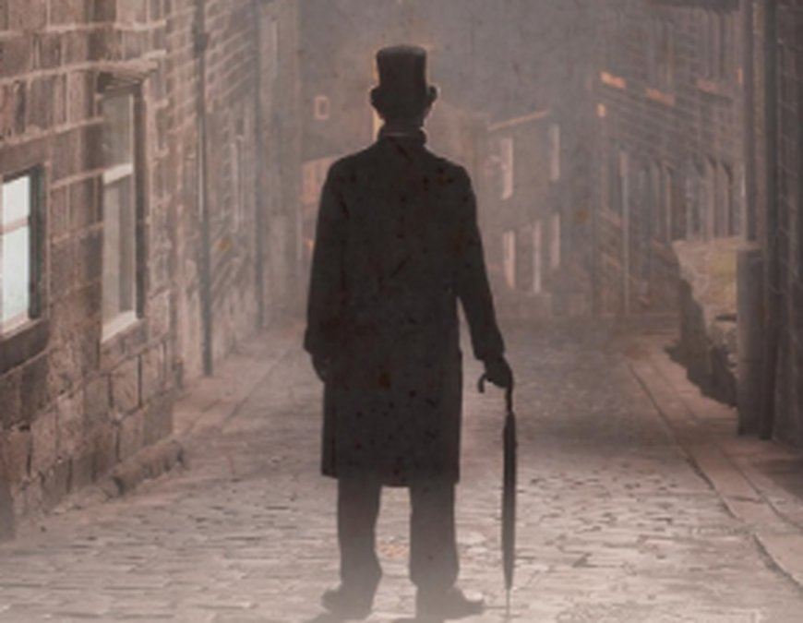
GRAMMAR · Presentation · audio 10.10
⏱ 3 min
…isn't it?
LISTEN! ASCOLTA!
1 You were a detective with Scotland Yard, ___ ___?
weren't you
Complete the questions from the interview. Listen and check.
Completa le domande dell'intervista. Ascolta e controlla.
2 It's incredible, ___ ___?
isn't it
3 But he was never arrested, ___ ___?
was he
4 But you don't think she's right, ___ ___?
do you
📖 Teacher: Student's Book p.101 · 3a, 3b · audio 10.10
10B · Part 1
Notes:
GRAMMAR PRESENTATION (3 min). 3a: students complete 1–4 (EXTRA CHALLENGE: elicit ideas for the two missing words first). 3b: play 10.10; click 1 for answers (TG): 1 weren't you · 2 isn't it · 3 was he · 4 do you. Then change them into direct questions: Were you a detective with Scotland Yard? · Is it incredible? · Was he ever arrested? · Do you think she's right? What's the difference? → question tags are used to CHECK that a statement is correct (TG). Note 3: never makes the sentence negative, so the tag is positive (was he).

Slide 7
GRAMMAR · Grammar Bank 10B p.151
⏱ 5 min
Question tags
+ verb → – tag
– verb → + tag
How?
It's cold today, isn't it?
They live in London, don't they?
Your sister worked in the USA, didn't she?
We've met before, haven't we?
You'll be OK, won't you?
She isn't here today, is she?
Lucy doesn't drive, does she?
You didn't like the film, did you?
Mike hasn't been to Rome before, has he?
You won't tell anyone, will you?
Same auxiliary as the verb: be, do / does / did, have, will, would, can…
No auxiliary? → do / does / did
Tag pronoun = subject: Lucy → she
= vero? / no? / giusto?
Watch out! ↘ Falling intonation = I'm checking (I think I know). ✗ You're Polish, isn't it? → ✓ aren't you?
📖 Teacher: Grammar Bank 10B p.151 · audio 10.11
10B · Part 1
Notes:
GRAMMAR (5 min). Grammar Bank 10B p.151: play 10.11; students listen and repeat, copying the rhythm. All examples on the slide are from 10.11. Rules: a positive verb normally takes a negative tag and a negative verb a positive tag; the tag uses the same auxiliary / modal as the main verb (be, have, will, would, can…); with present / past simple use do / does / did; the pronoun in the tag refers to the subject. Grammar notes (TG): tags are difficult because the auxiliary changes with the tense — and the intonation; this lesson focuses on the most common use: checking information, with falling intonation. Not covered: I'm late, aren't I? (irregular). Italian learners translate 'vero?' / 'no?' with isn't it for everything (✗ You're Polish, isn't it?).

Slide 8

GRAMMAR · Grammar Bank 10B · practice
⏱ 5 min
Add the tag
WRITE! SCRIVI!
a 1–5 (match in your book, p.151)
1 I · 2 E · 3 A · 4 F · 5 C
Grammar Bank 10B: a 1–5, b 1–5. Then check!
Grammar Bank 10B: a 1–5, b 1–5. Poi controlla!
b1 Your brother works at the police station, ___?
doesn't he
b2 They don't have any proof, ___?
do they
b3 That man isn't the murderer, ___?
is he
b4 You were a witness to the crime, ___?
weren't you
b5 The police have arrested someone, ___?
haven't they
📖 Teacher: Grammar Bank 10B p.151 · a 1–5, b 1–5 (a 6–10, b 6–10 = homework)
10B · Part 1
Notes:
PRACTICE (5 min). Students do Grammar Bank 10B a 1–5 and b 1–5 in the book. Click 1 for answers (TG): a 1 I · 2 E · 3 A · 4 F · 5 C; b 1 doesn't he · 2 do they · 3 is he · 4 weren't you · 5 haven't they (the slide shows the TG key sentences with the tag gapped). Students read the full sentences aloud with FALLING intonation. Homework: a 6–10, b 6–10. VARIATION: student as teacher — pairs explain to each other why b1 is doesn't (present simple → does) and b5 is haven't. EXTRA SUPPORT: Grammar photocopiable 10B p.168 = the EXTRA slide 'Complete the conversations' after the exit (📄 B1_10B_Photocopiables.pdf, page 1).

Slide 9

PRONUNCIATION · Intonation · audio 10.12, 10.13
⏱ 5 min
The interview room
LISTEN! ASCOLTA!
🎧 10.12
🎧 10.13
Complete the inspector's tags. Does the voice go up ↗ or down ↘?
Completa le tag dell'ispettore. La voce sale ↗ o scende ↘?
1 Your surname's Jones, ___?
isn't it ↘
2 And you're 27, ___?
aren't you ↘
3 You weren't at home last night at 8.00, ___?
were you ↘
4 But you don't have any witnesses, ___?
do you ↘
5 Your wife wasn't with you, ___?
was she ↘
6 How does the inspector KNOW?
she was with him – arrested!
📖 Teacher: Student's Book p.101 · 4a, 4b · audio 10.12, 10.13
10B · Part 1
Notes:
PRONUNCIATION (5 min). 4a: the policeman probably already has the information and is just checking. Play 10.12 once just to listen; students complete the tags; play again to check. Click 1 for answers (TG): 1 isn't it · 2 aren't you · 3 were you · 4 do you · 5 was she. The punchline (audio script): 'Because she was with me. At the police station. We arrested her yesterday.' 4b: ask if the intonation goes up or down (demonstrate both) → DOWN, because he's checking, not asking a new question (TG pronunciation notes; rising tags = real questions / surprise — not focused on here). Play 10.13: students repeat the policeman's questions; then individuals. EXTRA SUPPORT: pairs read the whole conversation, the 'suspect' looking guilty. VARIATION: change the energy — the inspector gets more and more threatening!

Slide 10
SPEAKING · Communication p.110 / p.114
⏱ 7 min
Just checking
SPEAK! PARLA!
1
Sit face to face. A = police inspector (p.110). B = suspect (p.114).
A = p.110, B = p.114. Interview, remember, then CHECK with tags!
A = p.110, B = p.114. Intervista, ricorda, poi CONTROLLA con le tag!
2
A asks B the questions and tries to REMEMBER the answers – no writing!
3
Then A checks with question tags: You live in…, don't you? You didn't…, did you?
4
B answers: Yes, that's right. / No, actually I…
5
Swap roles. Which inspector had the best memory?
You were born in Palermo, weren't you? – Yes, that's right.
📖 Teacher: Student's Book Communication 'Just checking' A p.110, B p.114
10B · Part 1
Notes:
COMMUNICATION (7 min). TG: Sts A (police inspector) ask Sts B some questions and try to remember the answers; then they check them with question tags. Then swap roles. Demonstrate by taking A's role with one student first. Monitor and help with the tags (and falling intonation). If there's an odd number of students, the teacher takes part. Feedback: which 'police inspectors' had the best memory? ⚠ The Communication pages are not in our files — check them before the lesson. 4d (if time, whole class): Which TV detective series or murder mystery films are popular in your country at the moment? Do you enjoy watching these kinds of programmes? (Montalbano, Rocco Schiavone…) VARIATION: memory challenge + role play.

Slide 11
Look what you can do!
Guarda cosa sai fare adesso!
HOMEWORK · COMPITI
• Workbook 10B: 1a, 1b, 2a
• Grammar Bank 10B: a 6–10, b 6–10
• Homework sheet 10B-1
📷 Hand it in on the LLS app · Consegna nell'app LLS
✓ I can use crime words: witness, suspect, evidence…
😀 🙂 😐
✓ I can understand a detective talking about theories.
😀 🙂 😐
✓ I can check information with question tags ↘.
😀 🙂 😐
Next lesson: 10B part 2 · May and June · a short story
10B · Part 1
Notes:
EXIT (3 min). Homework: Workbook 10B 1a, 1b (crime vocabulary) and 2a (question tags) + Grammar Bank 10B a 6–10, b 6–10 + the 10B-1 homework sheet (easier version available). Workbook 10B 2b, 2c and 3 go with part 2.

Slide 12
EXTRA · Grammar photocopiable 10B
EXTRA
⏱ 7 min
Complete the conversations
WRITE! SCRIVI!
1 You really don't remember me, ___? · We were at school together, ___?
2 do you · 3 weren't we
Handout: complete the five conversations with question tags.
Scheda: completa le cinque conversazioni con le question tag.
2 It wasn't your ex-boyfriend, ___? · He isn't still calling you, ___? · Ex-boyfriends don't just ring for a chat, ___?
4 was it · 5 is he · 6 do they
3 You haven't forgotten about your doctor's appointment, ___? · Tomorrow's Tuesday, ___? · You'll ring me tomorrow, ___?
7 have you · 8 isn't it · 9 won't you
4 Mrs Jones is really strict, ___? · She never lets anyone talk in class, ___? · We got loads yesterday, ___?
10 isn't she · 11 does she · 12 didn't we
5 You aren't having problems at school, ___? · You haven't had an argument, ___? · You'd tell me if there was a problem, ___?
13 are you · 14 have you · 15 wouldn't you
📖 📄 Print: B1_10B_Photocopiables.pdf, page 1 · Teacher: Grammar photocopiable 10B p.168
10B · Part 1
Notes:
EXTRA (7 min) or HOMEWORK = Grammar photocopiable 10B 'question tags' (TG p.168). 📄 Print: B1_10B_Photocopiables.pdf, page 1 – one copy per student. Students complete the five conversations with question tags (1 isn't it is the example); compare; click once per conversation (the slide gives shortened lines). Official answers (TG PCM key): 2 do you · 3 weren't we · 4 was it · 5 is he · 6 do they · 7 have you · 8 isn't it · 9 won't you · 10 isn't she · 11 does she · 12 didn't we · 13 are you · 14 have you · 15 wouldn't you. Point out 11: never is negative, so the tag is positive (does she). ACTIVATION (on the sheet): pairs practise the conversations – falling intonation when you're checking, rising when you're really asking (conversation 5: the worried parent!). VARIATION: change the energy (act it out).

Slide 13
EXTRA · Game · Alibi
EXTRA
⏱ 10 min
Alibi!
PLAY! GIOCA!
1
Story: last night someone took the teacher's chocolate cake from the staff room!
Two suspects. One story. Can the detectives find a difference?
Due sospettati. Una storia. I detective trovano una differenza?
2
Two 'suspects' go outside for 3 minutes and agree their alibi: where were they from 7 to 10 p.m.?
3
The class = detectives: prepare questions (Where did you eat? What did you wear?).
4
Suspect 1 comes in alone and answers. Then suspect 2.
5
Detectives check with tags: You had pizza, didn't you? Any difference = guilty!
You went to the cinema, didn't you? – Yes. – But your friend said you went bowling!
10B · Part 1
Notes:
EXTRA GAME (10 min). VARIATION: role play + spot the difference (a classic 'alibi' game with a harmless 'crime'). Recycles crime words (suspect, witness, evidence, prove, solve) and question tags.

Slide 14

EXTRA · Speaking · About you
EXTRA
⏱ 6 min
I think I know you…
SPEAK! PARLA!
1 You have ___ brothers and sisters, ___?
Complete for your partner. Then CHECK with a tag!
Completa per il tuo compagno. Poi CONTROLLA con una tag!
2 You're from ___, ___?
3 You don't like ___, ___?
4 You'd like to go to ___, ___?
5 You can't ___, ___?
6 You went to ___ last weekend, ___?
10B · Part 1
Notes:
EXTRA (6 min) = TG EXTRA IDEA. Pairs complete the sentences about each other with what they THINK is true and add the correct tag (haven't you / aren't you / do you / wouldn't you / can you / didn't you), then read them to each other and check. Falling intonation! Personalisation with boundaries: keep topics light (food, places, hobbies). The Communicative photocopiable 'Four little mysteries' p.197 is an EXTRA in 10B part 2 (📄 B1_10B_Photocopiables.pdf, page 2).

